Slide 1
18CSC204J
DESIGN AND ANALYSIS OF ALGORITHMS
REVIEW 1

Slide 2
Problem statement
To make a “Car Management System”.

Slide 3
OBJECTIVE
This system is named as Car Management System. This system is designed to help the customers to take access information about a particular car’s records; update or view it. When we go on any trip outside the town or country, we want to be free of time so instead of going through metros and taxis, we prefer to have our own vehicle for rent.
This system has only one admin account and cannot have more than one admin account. Admin can verify and register the user who is registering. If the admin does not verify, the user cannot register. All other features are explained further in detail.

Slide 4

APPROACH
IT IS A SIMPLE “TOUCH-AND-GO ” PROJECT THEREFORE THE APPROACH IS “NAIVE” OR “BRUTE FORCE”.
WE HAVE DECIDED TO FOLLOW THE “KIS” PRINCIPLE (KEEP IT SIMPLE).

Slide 5
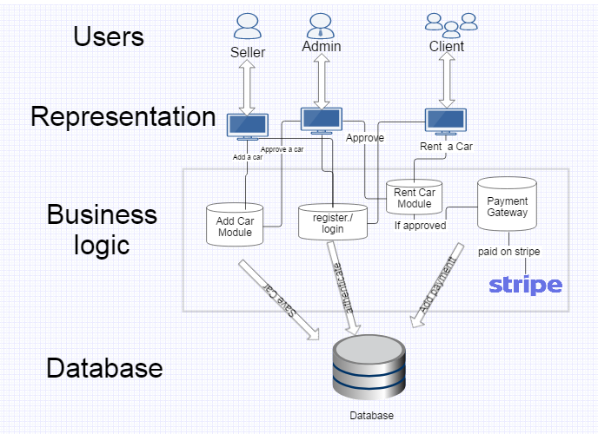
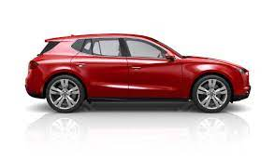
ARCHITECTURE DIAGRAM

Slide 6
TEAM MEMBERS
HARSHIT SHARMA (RA2011030010224)
SOORAJ TOMAR (RA2011030010224)
PANKAJ BHATTARAI (RA2011030010230)

Slide 7
THANK YOU

