Slide 1
18CSC204J
DESIGN AND ANALYSIS OF ALGORITHMS
REVIEW 2

Slide 2
Algorithm
Step 1: Start
Step 2: Give appropriate input (1/2/3/4/5/6)
Step 3: Give appropriate sub-input (information etc.)
Step 4: Display appropriate output
Step 5: Stop

Slide 3
DRY RUN AND CODE
https://docs.google.com/document/d/1MiPU6XxYcqSYo_T3CQAUwVQKVC6uNWhP/edit?usp=sharing&ouid=114159191075515505619&rtpof=true&sd=true

Slide 4
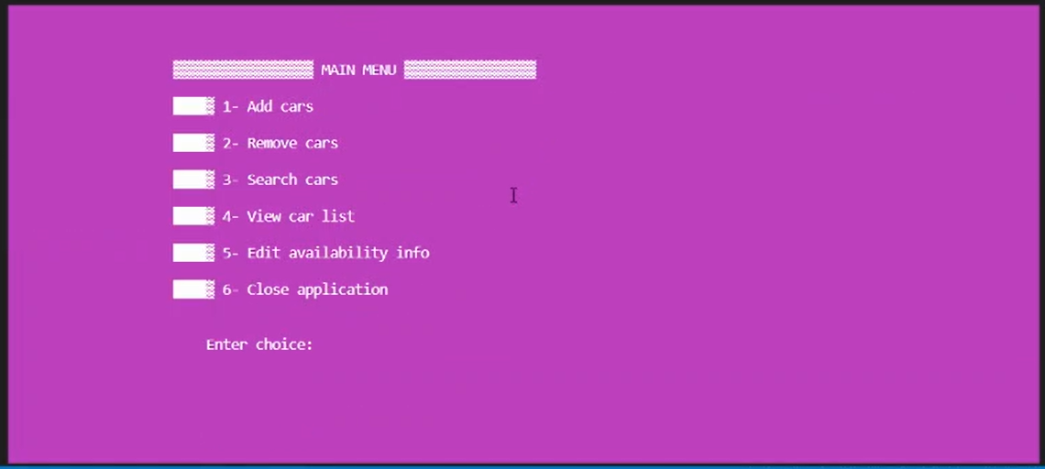
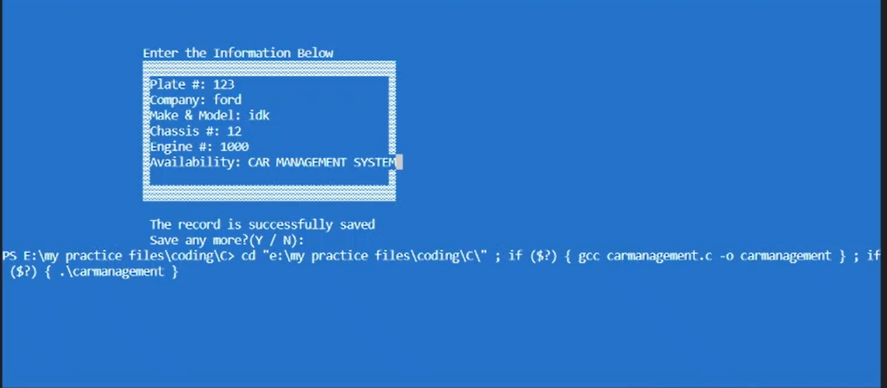

Slide 5
Time and Space Complexity
Time Complexity: O (N²)
Space Complexity: O (N)
* Due to nested loops.

Slide 6
Result
Thus, an effective and efficient algorithm and code was designed for the mentioned problem statement.
(CAR MANAGEMENT SYSTEM)

Slide 7
SUBMITTED BY
HARSHIT SHARMA (RA2011030010206)
SOORAJ TOMAR (RA2011030010224)
PANKAJ BHATTARAI (RA2011030010230)

Slide 8
THANK YOU

