Slide 1
18PDH103T Social Engineering
Project Presentation

Slide 2
Problem Statement
As we know that there is something called QUOTA (Also called as Reservation System) due to which many aspiring students lose their seats to a political idea where some minorities get some predefined number of seats and as a result there are very few general quota seats as per the demand.
This quota is getting misused and therefore we are proposing that this quota system shall be removed and instead some financial or material help be provided to those who actually need it.
We propose a social business idea that promotes and works towards the same while providing a well-functioning digital learning platform for the same. We shall focus upon reservation for educational seats only, i.e., for university seats and enrollment.

Slide 3
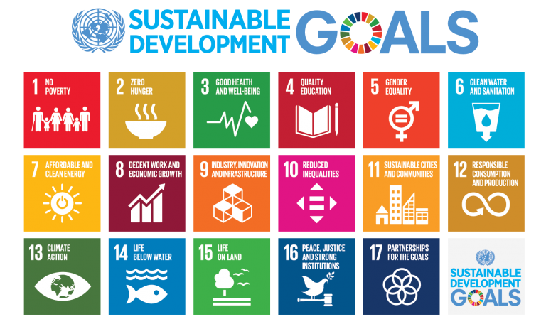
Sustainability Goals Fulfilled
We are trying to fulfil the goals number 4 and 10 by providing quality education through the digital learning platform and reduced inequality by providing proper help to those who actually need it.

Slide 4
NEED FOR RESERVATION
Based on provisions in the Indian Constitution, it allows the Union Government and also the States and Territories of India to set reserved quotas or seats, which lower the qualifications needed in exams, job openings etc. for "socially and educationally backward citizens."

Slide 5
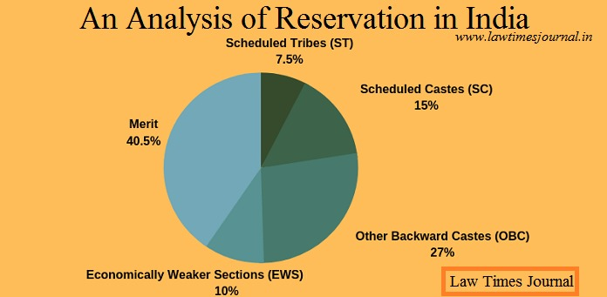
Statistics

Slide 6
PROBLEMS WITH RESERVATION
Encouraging casteism: It’s propagating the notion of caste-based society instead of eliminating it.
Chances of creating more castes in the society: Poor people from the forward castes still don’t have any social or economic advantage over the rich people from the backward castes. If this situation persists, it may result in the formation of a separate backward caste of people belonging from the poorer section of the forward castes.
The benefit of the privileged only: Beneficiaries of reservation are primarily from the creamy layer or the dominant class in backward castes. Hence, the marginalized section still remains marginalized.
Opposing meritocracy: It’s resulting in the degradation of the quality of students and employees enrolled in different institutions if the undeserving candidates get the opportunities.
Short-term relief: A reservation only provides a limited and short-term solution to the historical injustice issues.
The privileged getting more privileged: As the reservation grows more prominent, it becomes a mechanism of exclusion rather than inclusion. As we can see nowadays, the previously advantaged communities have becoming disadvantaged to a large extent due to the reservation problem. Many deserving people from the upper castes are still affected by poverty and illiteracy.
A barrier between ethnicities: It is a form of ethnic discrimination. It works as a barrier for removing casteism and racism and promoting harmony between castes and religions.
Social unrest: Reservation agitations may cause social unrest, such as during the Mandal Commission (1990).
This reservation is being misused as just a political get-out-of-jail-free card where whoever offers more “freebies” in terms of his “QUOTA” gets the vote.
A lot of people belonging to minorities actually are financially capable enough to reach their goals without this quota system but they still utilize this and thus taking this opportunity away from those who actually need it. (Corruption)

Slide 7
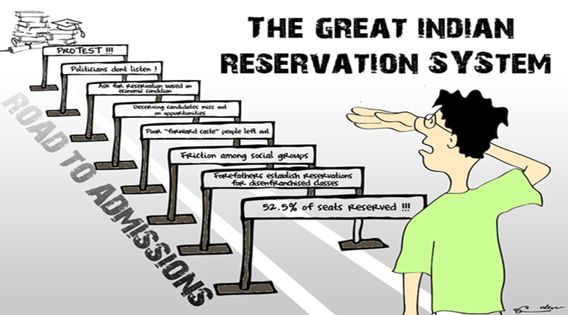

Slide 8
Our Solution
We aim to show that by providing the means of getting to where you deserve to be is a better way of improving diversity. No one should be looked down upon as a result of “Quota Category” and actually earn their keep.
Quota system was started with a basic idea of uplifting minorities who had very little resources as compared to the “Giants” and therefore had no means of getting to the top (Eg: Like an IIT for other prestige institutions). We want to provide them with the means: Financial, Material, Digital Learning or otherwise; so that there is fairness amongst competitors while keeping the doors for diversity wide open. Stringent background checks will be done before supporting the talent so that this helping hand is not misused. A proper Digital Learning platform shall also be started so that these talents get the preparation they deserve.

Slide 9
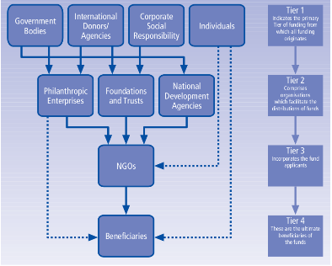

SIMILAR TO THIS FOR FINANCIAL AIDS
This is where we come into play.

Slide 10
Team Details
VIGHNESH PRADHAN(RA2011030010180)
HEMACHANDU B V(RA2011030010200)
PURAB SINGH THAKUR(RA2011030010204)
HARSHIT SHARMA(RA2011030010206)
KARAN PANDITA(RA2011030010216)
SOORAJ TOMAR(RA2011030010224)

Slide 11
THANK YOU

