Slide 1
A Dynamic DNA Cryptography Using RSA Algorithm and Stronger OTP
PRAKHRANSHU SINGH [RA2011030010217]
SOORAJ TOMAR [RA2011030010224]
MUSTYALA NANDA KISHOR [RA2011030010225]
SUSHANT KUMAR SINGH[RA2011030010228]
SIVE VISHWA T E[RA2011030010231]

Slide 2
Abstract
A Dynamic DNA Cryptography Using RSA Algorithm and Stronger OTP is a combination of algorithm like RSA and a strong One Time Pad key generation that are getting used for Encryption and Decryption of plain text, image, audio and video that are converted from binary numbers into a DNA sequence.
MAC Address is unique identification which helps to connect one or more nodes and from which the information is transmitted from one node to another node in secured fashion.
If the key used in the OTP is randomly generated and not used extra than once, then the algorithms are considered to be completely unbreakable.
This technique ensures the CIA Triad for Information Security.

Slide 3
Introduction
The principal objectives of this had been to more concentrate on the confidentiality phase & it helps to discover the approach (ciphers) to make certain privacy via the use of DNA. DNA Cryptography is one of the most essential & promising disciplines in information security.
The RSA algorithm is regarded as a robust asymmetric encryption algorithm. Asymmetric cryptography, also known as public-key cryptography, is a process that uses a pair of related keys -- one public key and one private key -- to encrypt and decrypt a message and protect it from unauthorized access or use. RSA has the more security; thus, the algorithm is proved to be cryptographically secure and it is suitable for applications where more than one layer of security is required.
OTP is used for key generation purpose which offers the total privacy for the ciphertext then it helps the user to encryption scheme which has proved to be unbreakable.
The transferring information from one node to another node by using the MAC address it is very safe and secure as every device has its unique address in its DNA Cryptography Encryption.
Keywords: DNA Cryptography, Encryption, Decryption, Cryptography, One Time Pad.

Slide 4
Literature Survey
S. No. | Title of Paper | Author and Journal Name | Objectives of the Paper | Methodologies Used | Results Obtained | Limitations
1. | “A Dynamic DNA Cryptography Using RSA Algorithm and OTP” | Poojashree Kamble,Firoz Nagarchi,Akshata Akkole,Vanishree Khanapur,Bahubali Akiwate, International Journal of Scientific Research in Computer Science and Engineering | In this approach, the encryption and the decryption take place through RSA Algorithm and the OTP. The use of a combination of DNA with RSA ensures twofold protections in a cloud environment where there are greater probabilities of breaches. | RSA Algorithm DNA Encoding Algorithm One Time Pad Key Generation | A robust Cryptography Technique using DNA Encryption and OTP System | In future the network can be connected with a greater number of nodes with both IP Address and MAC address with improvement in performance. Proposed File size only up to 100MB. Only 4-digit OTP, can be guessed easily by a fast-computing machine.
2. | “A Research Paper on Cryptography” | Gurdeep Singh, Prateek Kumar, International Journal for Technological Research in Engineering | Abstract Data Types, Data Encryption, Data Compression, Asymmetric Key Cryptography | Symmetric and Asymmetric Encryption and Decryption | Cryptography is used to ensure that the contents of a message are confidentiality transmitted and would not be altered. | If the attacker will get the key and sender and receiver is not aware about it, it may harm the CIA triad. So, proper method should be used to Encrypt and Decrypt the data.

Slide 5
Literature Survey (Contd..)
S. No. | Title of Paper | Author and Journal Name | Objectives of the Paper | Methodologies Used | Results Obtained | Limitations
3. | “Research Paper on Cyber Security” | Mrs. Ashwini Sheth, Mr. Sachin Bhosale & Mr. Farish Kurupkar, Contemporary Research in India | In the current world of technology, it is crucial to know what Cyber Security is and how to use it effectively. How to Secure Systems, important files, data and other important virtual things. | 1)Symmetric and Asymmetric Encryption 2) Types of Phishing: -Ransomware, Malware. 3)Goals of Cyber Security: Confidentiality, Integrity, Availability. 4)Attacks on IOT | Awareness on Online Attacks, Types of Viruses, Goals of Cyber Security, Advantages and Disadvantages of Cyber Security | Increasing Threats targeting user devices, devices used by employees who are working from home aren't protected well enough from attacks and preventing hackers.
4. | “A Study on Cryptographic Techniques” | Anjali Krishna A, Dr. L C Manikandan, International Journal of Scientific Research in Computer Science, Engineering and Information Technology | Data security using Symmetric and Asymmetric Key Encryption. | Symmetric and Asymmetric Key Encryption | There are different techniques and algorithms researched, and various types of work have been performed. In this paper briefly discussed cryptography and its form of symmetric key cryptography and algorithms for asymmetric key cryptography. | Key leakage, software bugs, holes in operating systems, side-channel attacks, phishing attacks, and social engineering. So, it is important to understand and acknowledge that cryptography ≠ security. Nevertheless, when cryptography fails, the consequences can be very severe.

Slide 6
Literature Survey (Contd..)

Slide 7
Literature Survey(Contd..)
This paper discusses about the Limitations of Paper [1] in the table(prev. slide).
The OTP generated is of only 4 digits which can be easily guessed by a fast computing machine in a matter of mere seconds (even milli seconds).
The data to be encrypted (and also condensed) can only be of 100MB which is Trivial in most cases.
We shall attempt to successfully rectify these limitations and provide for a stronger encryption built on the base of this journal.([1])

Slide 8
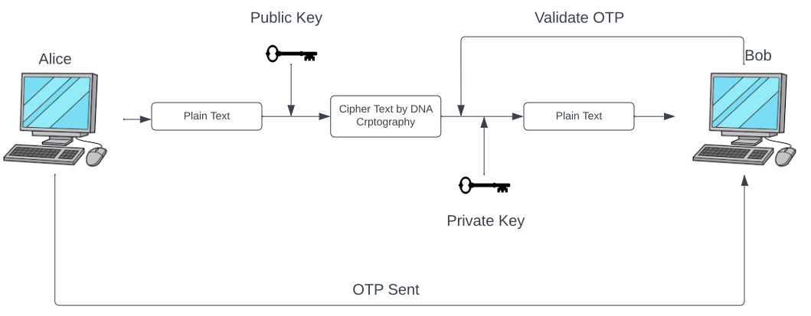
Architecture Diagram

Slide 9
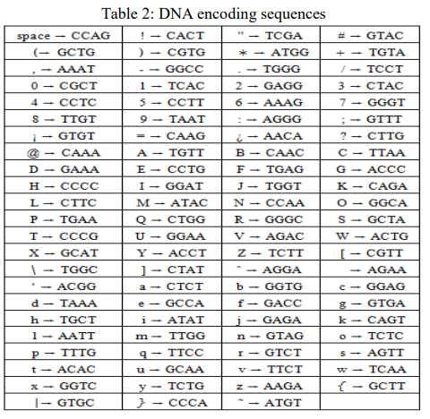
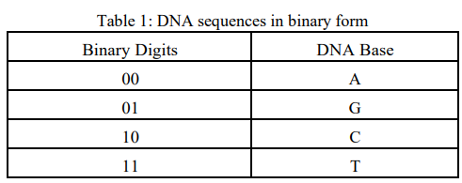
Working of the Algorithm

Slide 10
References
[1] Poojashree Kamble,Firoz Nagarchi,Akshata Akkole,Vanishree Khanapur,Bahubali Akiwate, “A Dynamic DNA Cryptography Using RSA Algorithm and OTP”, International Journal of Scientific Research in Computer Science and Engineering Vol.8, Issue.4, pp.78-82, August (2020).
[2] Mahbuba Begum, Jannatul Ferdush, Md. Golam Moazzam, “A Hybrid Cryptosystem using DNA, OTP and RSA,” International Journal of Computer Applications (0975 – 8887), Volume 172 – No.8, August 2017.
[3] Anjali Krishna A, Dr. L C Manikandan, “A Study on Cryptographic Techniques”, International Journal of Scientific Research in Computer Science, Engineering and Information Technology, Volume 6, Issue 4, pg. 321-327, July-August 2020.
[4] Gurdeep Singh, Prateek Kumar, “A Research paper on cryptography”, International Journal for Technological Research in Engineering, Volume 7, Issue 4, December-2019.
[5] Hamza Hammami, Hanen Brahmi, Sadok Ben Yahia, “Secured Outsourcing Towards a Cloud Computing Environment Based on DNA Cryptography,” IEEE, pp. 31-36, 2018.

