Slide 1
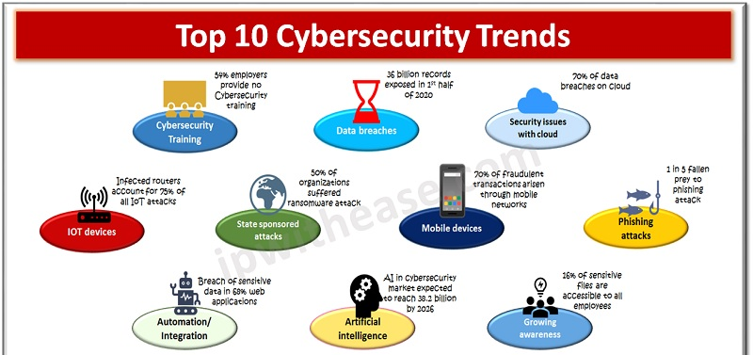
18CSE383T Information Assurance and Security
Seminar Presented by :
Sooraj Tomar
RA2011030010224

Slide 2
Current Trends In Cyber Security
Computer security, cybersecurity, or information technology security is the protection of computer systems and networks from information disclosure, theft of, or damage to their hardware, software, or electronic data, as well as from the disruption or misdirection of the services they provide.
Cybersecurity has always been a never-ending race, but the rate of change is accelerating. Companies are continuing to invest in technology to run their businesses. Now, they are layering more systems into their IT networks to support remote work, enhance the customer experience, and generate value, all of which creates potential new vulnerabilities.

Slide 3
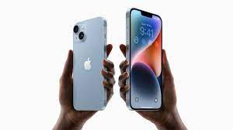
Mobile cybersecurity becoming front and center
The trend towards remote working is also accelerating the growth of mobile. For remote workers, it’s normal to switch between a range of mobile devices, such as tablets and phones, using public Wi-Fi networks and remote collaboration tools. As a result, mobile threats continue to grow and evolve. The ongoing rollout of 5G technology also creates potential security vulnerabilities which, as they become known, will need to be patched.

Slide 4
Mobile Cyber Security
Mobile cybersecurity is a broad topic that covers other elements such as back-end/cloud security, network security, and also a network of more and more connected objects (i.e., the Internet of Things), such as wearables and automotive devices.
There is no single method to protect apps in insecure environments – instead, it’s about ensuring additional layers of security to increase the overall level of security. Security specialists are combining mobile software security with hardware-based security solutions to reinforce sensitive data storage.

Slide 5
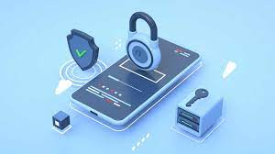
Mobile threats include
Specialized spyware designed to spy on encrypted messaging applications.
Criminals exploiting critical security vulnerabilities within Android devices.
Mobile malware with various possible application scenarios, ranging from Distributed Denial of Service (DDoS) attacks to SMS spam and data theft.

Slide 6
How does Mobile Device Security work?
Establish, share, and enforce clear policies and processes
Mobile device rules are only as effective as a company’s ability to properly communicate those policies to employees. Mobile device security should include clear rules about:
What devices can be used
Allowed OS levels
What the company can and cannot access on a personal phone
Whether IT can remote wipe a device
Password requirements and frequency for updating passwords
Password protection
One of the most basic ways to prevent unauthorized access to a mobile device is to create a strong password, and yet weak passwords are still a persistent problem that contributes to the majority of data hacks. Another common security problem is workers using the same password for their mobile device, email, and every work-related account. It is critical that employees create strong, unique passwords (of at least eight characters) and create different passwords for different accounts.

Slide 7
How does Mobile Device Security work? (Contd..)
Leverage biometrics
Instead of relying on traditional methods of mobile access security, such as passwords, some companies are looking to biometrics as a safer alternative. Biometric authentication is when a computer uses measurable biological characteristics, such as face, fingerprint, voice, or iris recognition for identification and access. Multiple biometric authentication methods are now available on smartphones and are easy for workers to set up and use.
Avoid public Wi-Fi
A mobile device is only as secure as the network through which it transmits data. Companies need to educate employees about the dangers of using public Wi-Fi networks, which are vulnerable to attacks from hackers who can easily breach a device, access the network, and steal data. The best defense is to encourage smart user behavior and prohibit the use of open Wi-Fi networks, no matter the convenience.

Slide 8
How does Mobile Device Security work? (Contd..)
Beware of apps
Malicious apps are some of the fastest growing threats to mobile devices. When an employee unknowingly downloads one, either for work or personal reasons, it provides unauthorized access to the company’s network and data. To combat this rising threat, companies have two options: instruct employees about the dangers of downloading unapproved apps, or ban employees from downloading certain apps on their phones altogether.
Mobile device encryption:
Most mobile devices are bundled with a built-in encryption feature. Users need to locate this feature on their device and enter a password to encrypt their device. With this method, data is converted into a code that can only be accessed by authorized users. This is important in case of theft, and it prevents unauthorized access.

Slide 9
Different types of Mobile Device Security
Enterprise Mobile Management platform: In addition to setting up internal device policies that protect against unauthorized access, it’s equally important to have an Enterprise Mobile Management (EMM) platform that enables IT to gather real-time insights to catch potential threats.
Email security: Email is the most popular way for hackers to spread ransomware and other malware. To combat such attacks, it’s critical for businesses to be armed with advanced email security that can detect, block, and address threats faster; prevent any data loss; and protect important information in transit with end-to-end encryption.
Endpoint protection: This approach protects enterprise networks that are remotely accessed by mobile devices. Endpoint security protects companies by ensuring that portable devices follow security standards and by quickly alerting security teams of detected threats before they can do damage. Endpoint protection also allows IT administrators to monitor operation functions and data backup strategies.

Slide 10
Different types of Mobile Device Security (Contd…)
VPN: A virtual private network, or VPN, extends a private network across a public network. This enables users to send and receive data across shared or public networks as if their computing devices were directly connected to the private network. VPNs’ encryption technology allows remote users and branch offices to securely access corporate applications and resources.
Secure web gateway: A secure web gateway protects against online security threats by enforcing company security policies and defending against phishing and malware in real-time. This is especially important for cloud security as this type of protection can identify an attack on one location and immediately stop it at other branches.
Cloud access security broker: A cloud access security broker (CASB) is a tool that sits between cloud service consumers and cloud service providers to enforce security, compliance, and governance policies for cloud applications. CASBs help organizations extend the security controls of their on-premises infrastructure to the cloud.

Slide 11
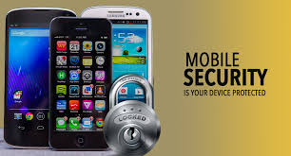
Making mobile devices secure is not a simple task, but it should be a high priority for any enterprise. To combat the growing threat of cyber-attacks, companies must continually audit their mobile security solutions and consider new security measures as they become available.

Slide 12
Thank You

