Slide 1
Workspace Analysis
Torso mechanism

Slide 2
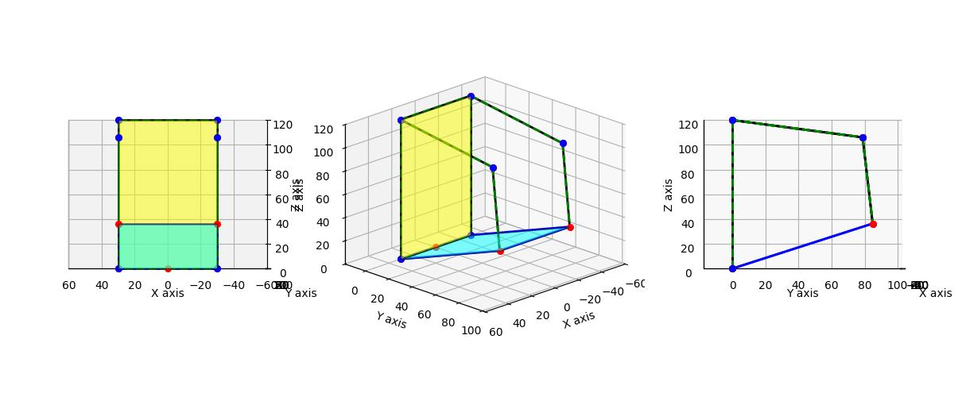
Mechanism Depiction

Slide 3
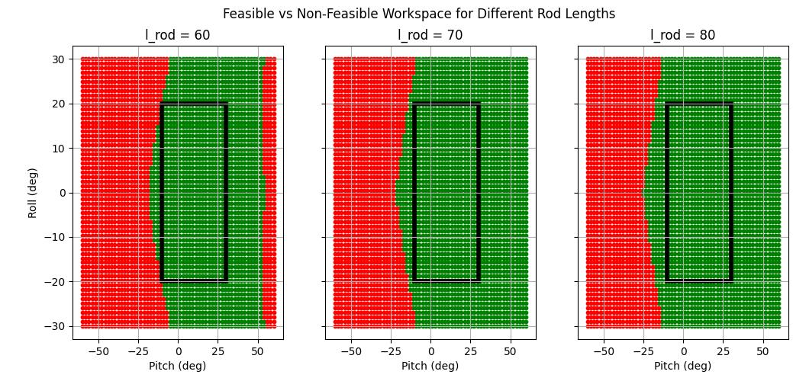
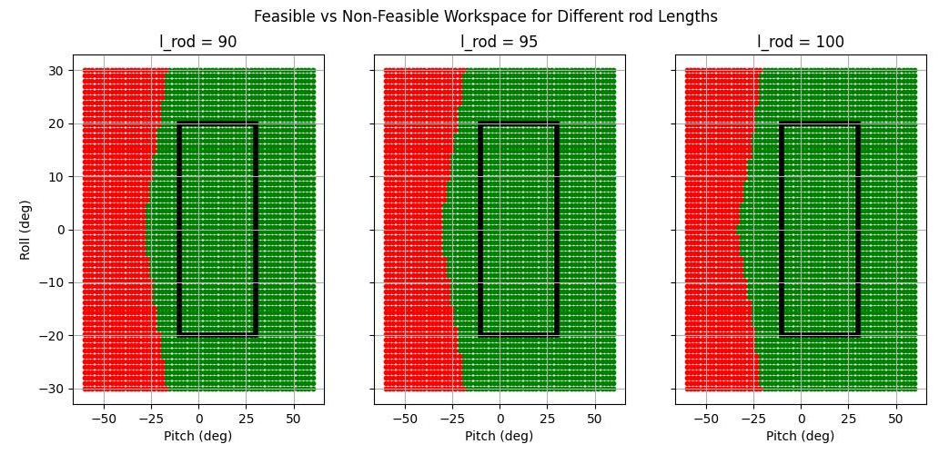
Effect of rod length on the workspace
For l_crank = 85 mm
l_torso = 120 mm
l_spacing = 60 mm and
Varying l_rod

Slide 4
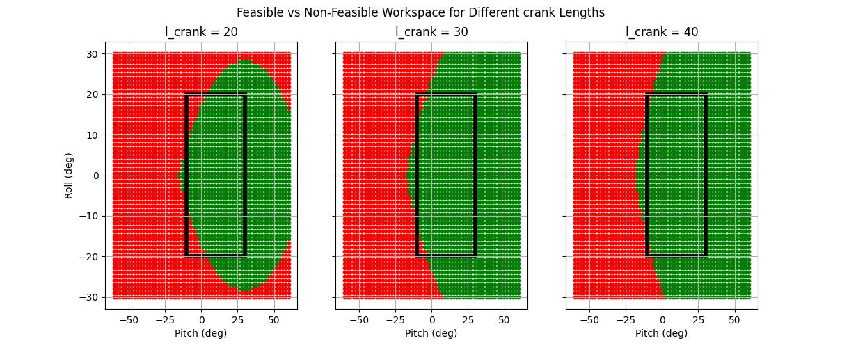
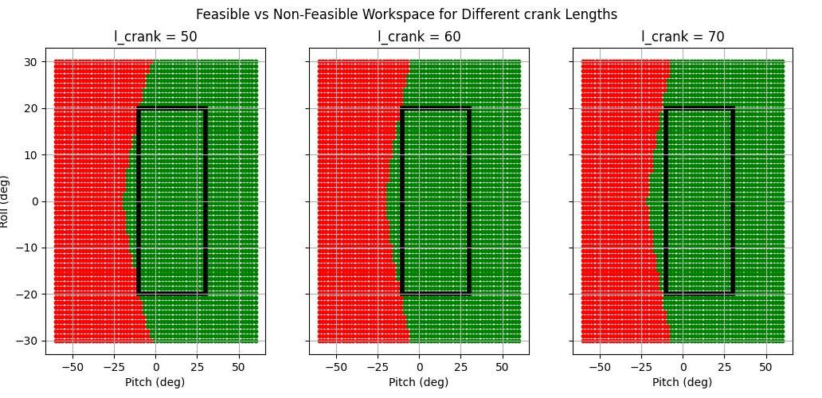
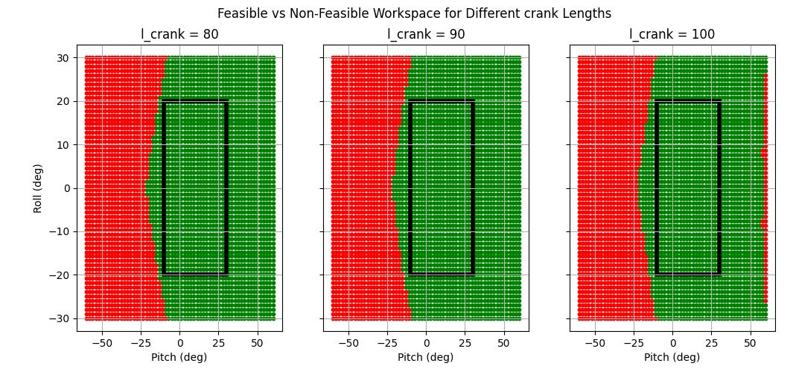
Effect of crank length on the workspace
For l_rod = 70 mm
l_torso = 120 mm
l_spacing = 60 mm and
Varying l_crank

Slide 5
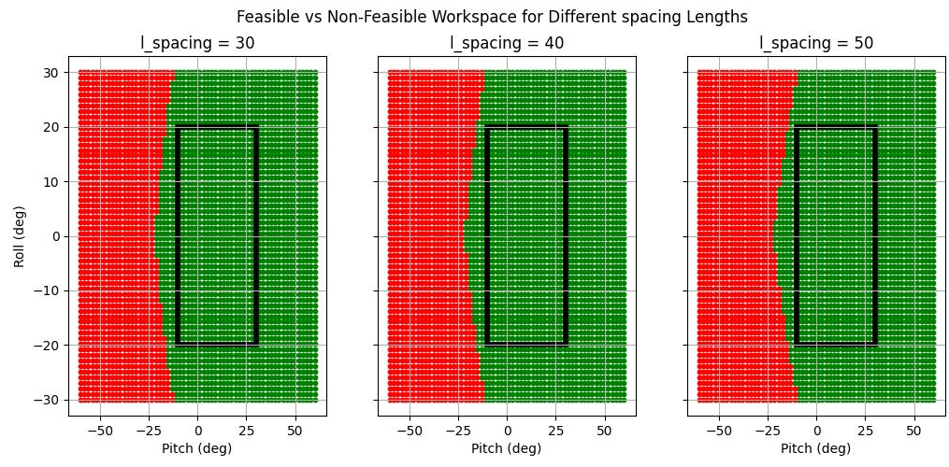

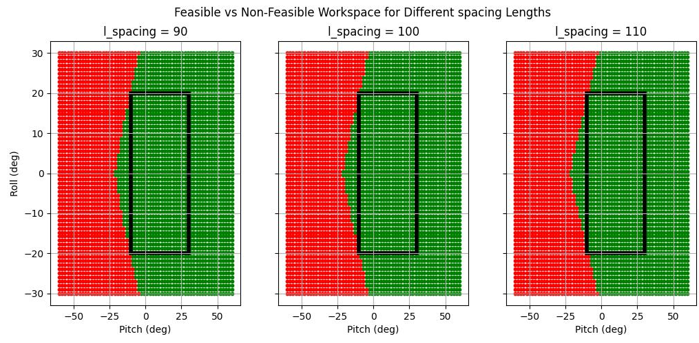
Effect of link spacing on the workspace
For l_rod = 70 mm
l_torso = 120 mm
l_crank = 80 mm and
Varying l_crank

Slide 6
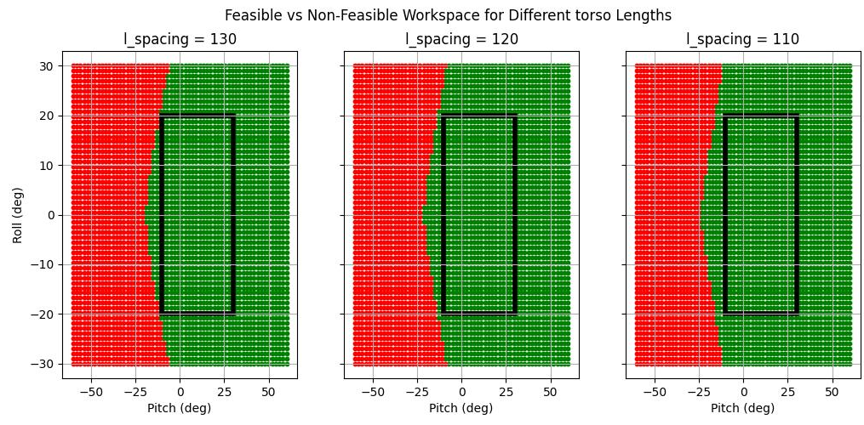
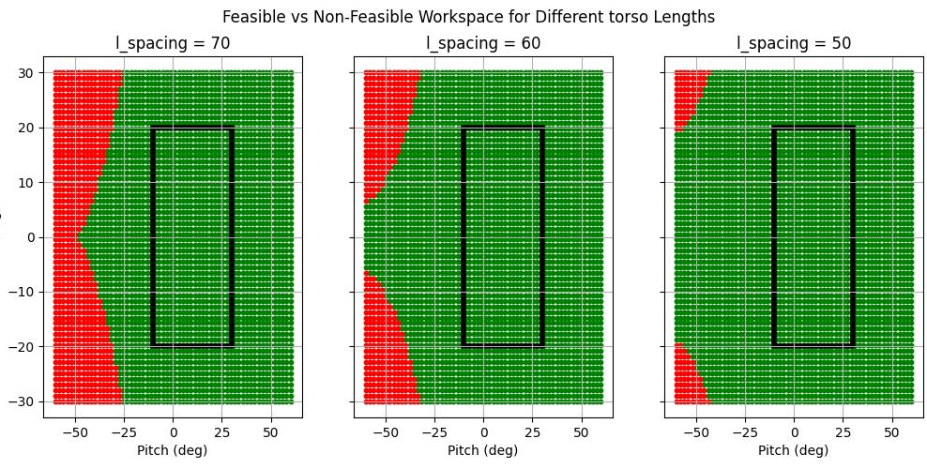
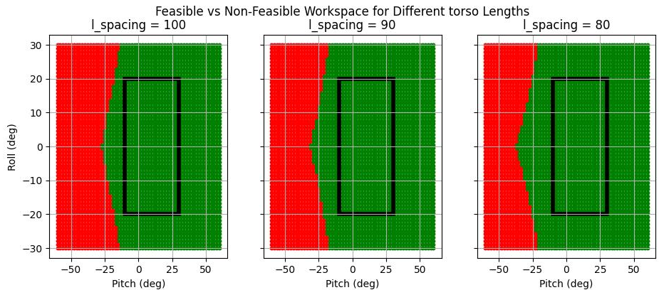
Effect of l_torso on the workspace
For l_rod = 70 mm
l_spacing = 60 mm
l_crank = 80 mm and
Varying l_torso

Slide 7
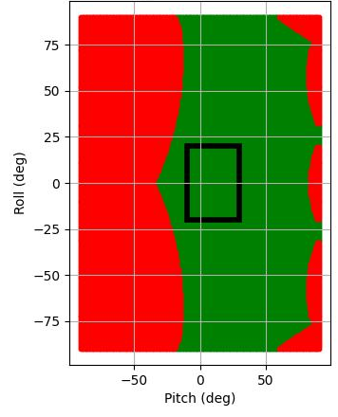
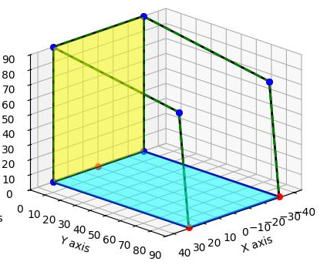
Initial optimized values for workspace
l_rod > 70
l_spacing < 60
l_crank > 80
90 < l_torso < 110

Slide 8
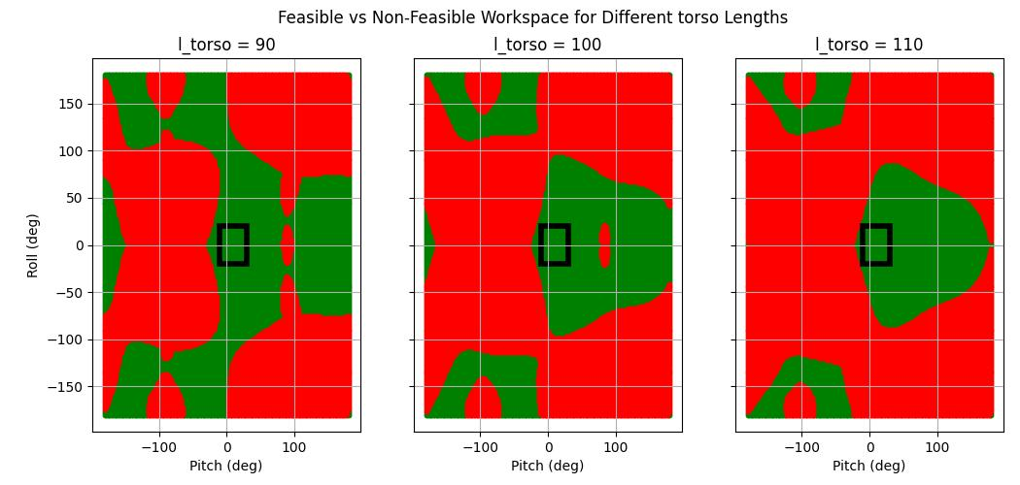

Slide 9
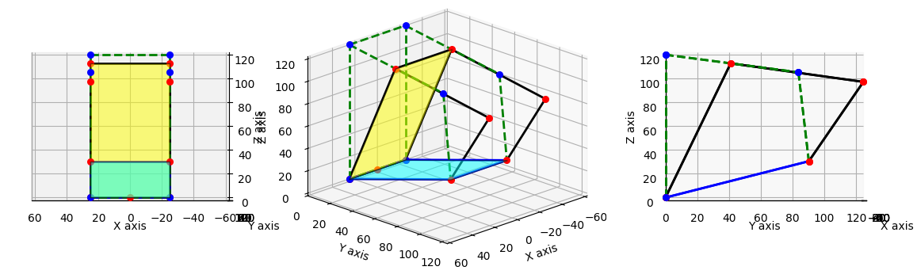
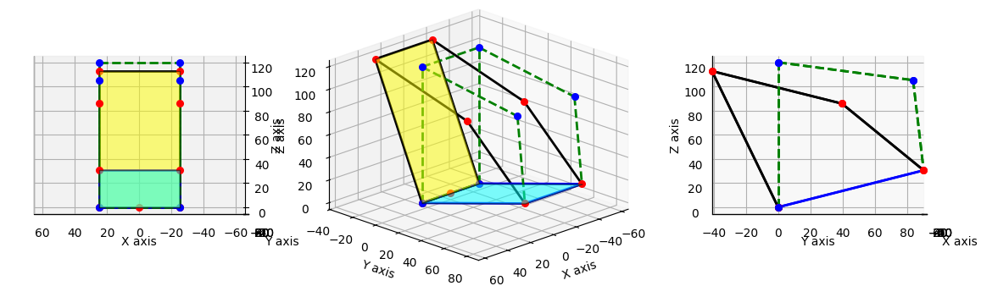
Pitch – 20 degree
Pitch – -20 degree

Slide 10
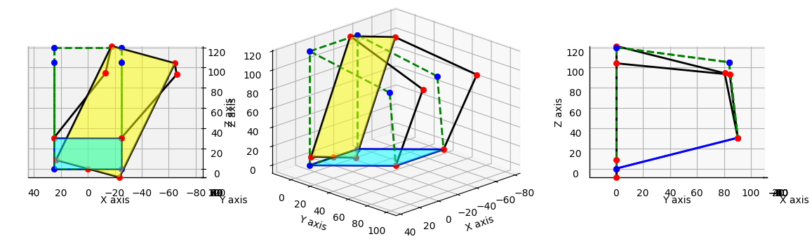
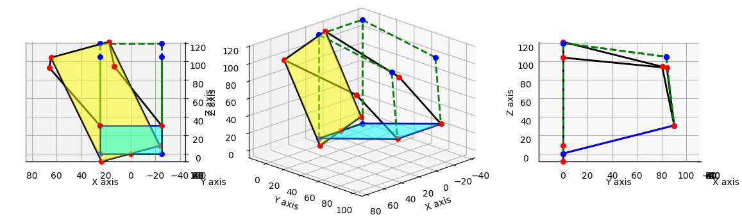
Roll – 20 degree
Roll – -20 degree

