Slide 1

MEC 324A
Microprocessors and Microcontrollers
Localising the faults in Power Grid transmission lines
Group 26

Slide 2
Abstract
This project aims to detect or localize the fault region in power grid transmission line. Emphasis was laid on leveraging minimal resources and ensuring safety of the wires, to formulate a novel & sophisticated solution to the addressed problem. Simulations are performed to validate the proposed idea and results are discussed

Slide 3
Literature Review
Shock discharge method
High current arc creates a thumping sound and discharges EMW
Fault prelocation through sensors readings - both acoustic and magnetic
This method is preferred if the fault has higher resistance (>100 ohms)
Pulse reflection method
A pulse is sent through an end of a cable, which is then reflected back according to the presence of an impedance change in the cable.
This point, where the impedance changes, is figured using the period of the pulse, propagation velocity of the pulse.
This method is preferred if the fault has resistance <100 ohms
Frequency domain Reflectometry
Sends a short-duration low energy signal (about 50 V) at a high repetition rate into the cable.
This signal reflects back from the point of change in impedance in the cable.

Slide 4
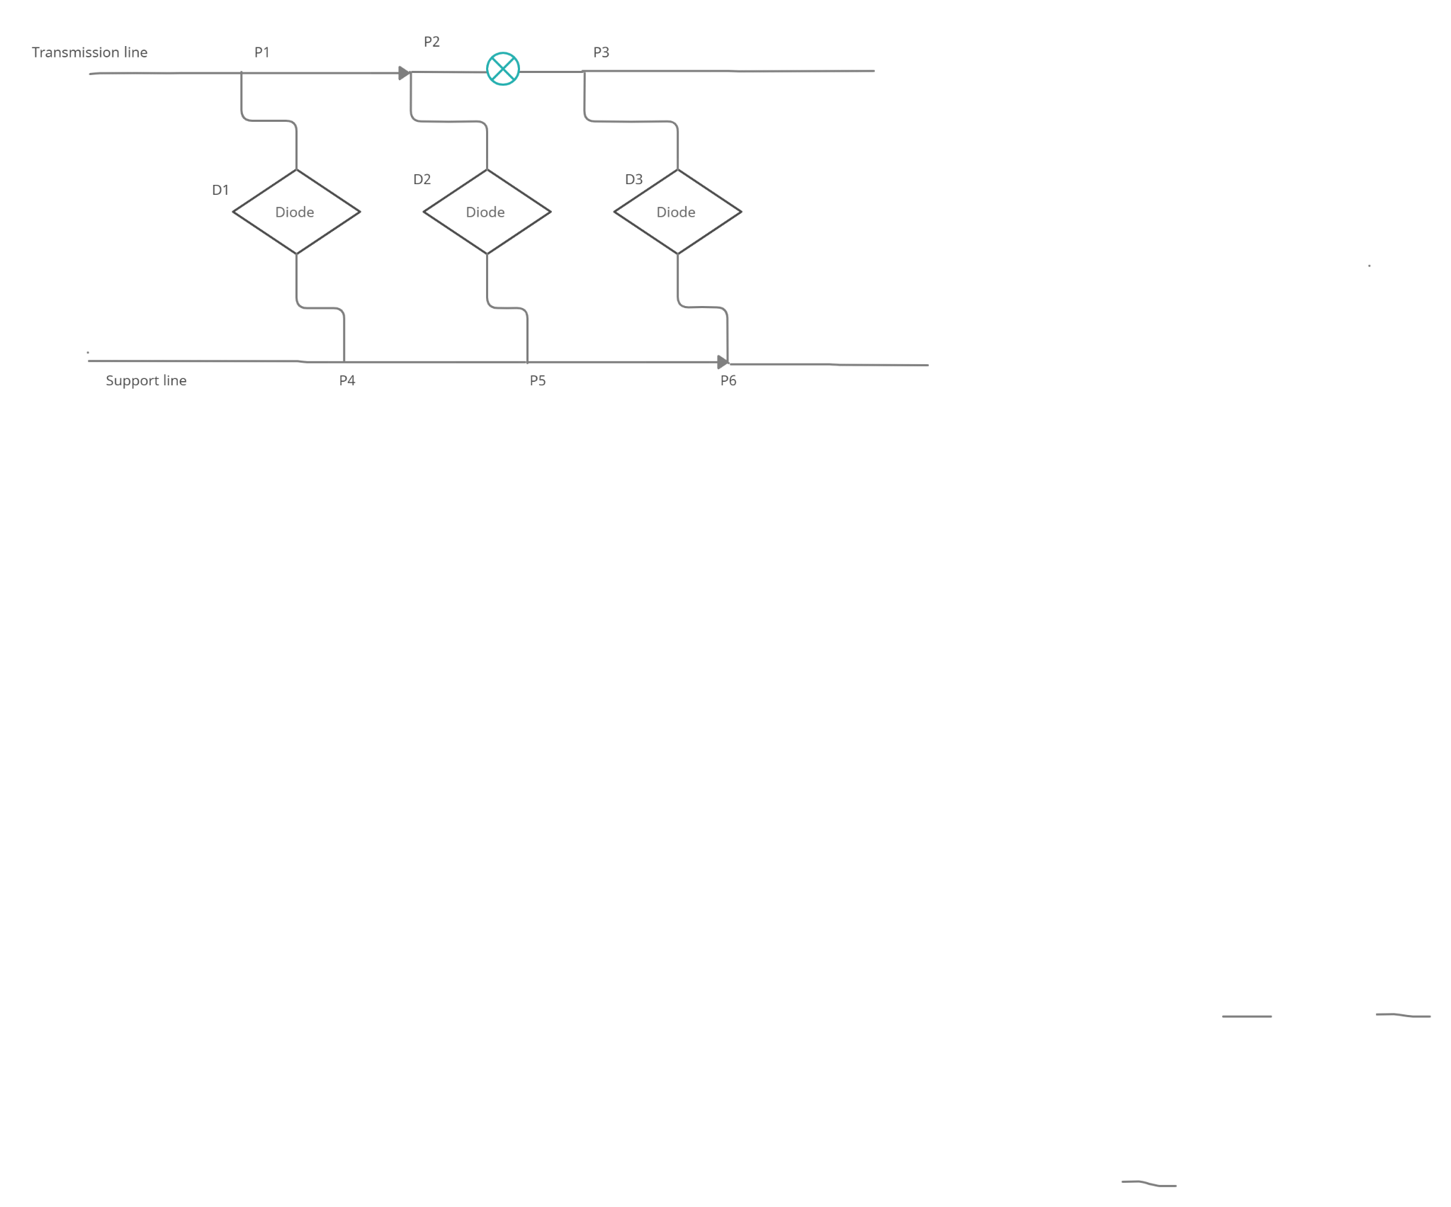
Novelty
R _{transmission} < R _{Support}
R + pL/A= V/I
An ideal transmission cable is attached to a comparatively high resistance wire (say Wire 1), at equal intervals.
Under normal circumstances, the current flow is normal from end-end. However, under fault conditions the current gets short circuited and we receive output from the wire 1.
This happens only if the fault resistance surpasses the threshold value of the transmission cable (usually greater than the resistance of wire 1)
Based on the voltage difference between the terminals, resistance and its corresponding length of the cable can be calculated.

Slide 5
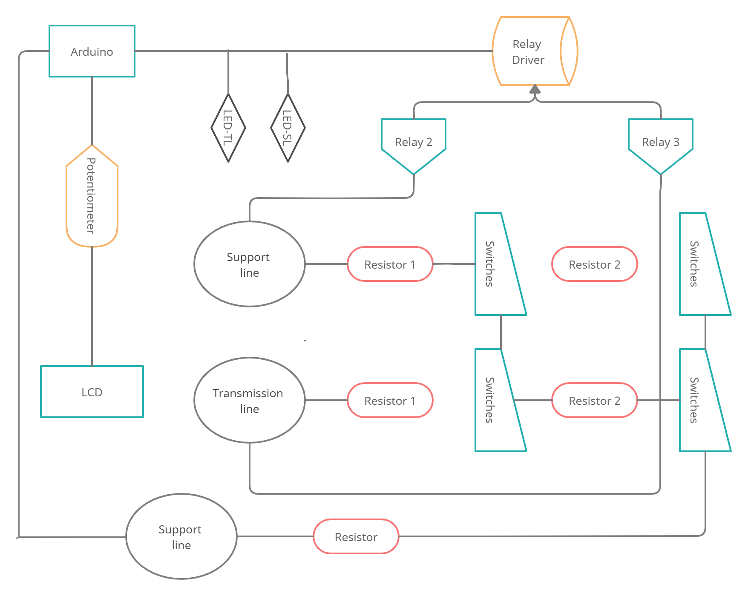
Schematic representation
Components
Arduino UNO
Relay Driver
- ULN2003A
Relay - 500ms
Resistor- 100 ᘯs
Switches
Potentiometer-10kᘯ
LCD Display
LEDs

Slide 6
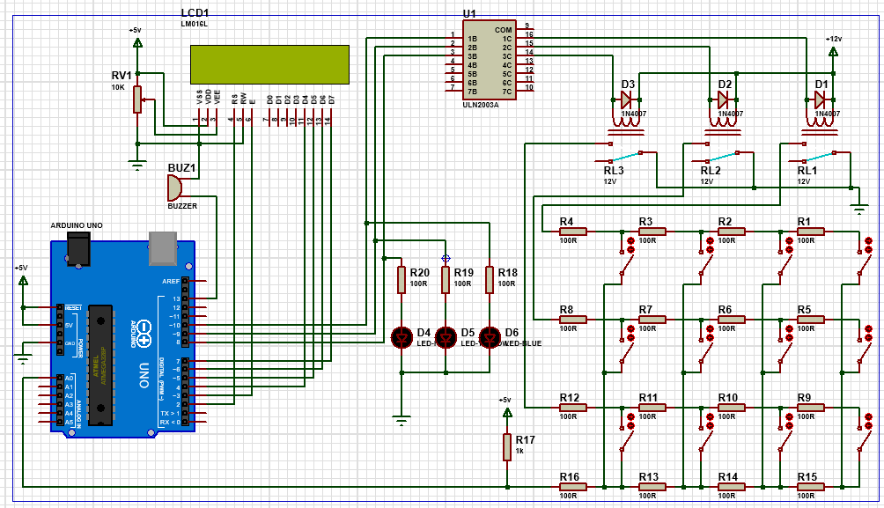
Working Principle
Figure 1:
Circuit diagram made using Proteus software

Slide 7
Working Principle
Concept
Use of Relays
Measurement
- Using OHM’s law, the fault in the circuit has been simulated using resistors connected in series representing the three phases and 3 phases in parallel.
- The distance of the fault is indicated in LCD display under the three phases.
- A buzzer sound has been added to the circuit to indicate there is a fault in that specific phase of the circuit.
- One 500ms relay for each phase R,Y and B as three relays are used and the common points of the relays are grounded.
- As supply needed for the relays is higher than that of the Arduino, Relay driver (ULN2003A) is used to boost the supply and provide it to the relays.
- This 5V DC is used to supply power to the arduino and the LCD.
- Power supply to the LCD is controlled using the voltage regulator (10 kΩ potentiometer).
- Each phase (R,G,B) has been constructed using 12 fault switches, 4 for each row.
- Each resistor is of 100 ohms and the maximum resistance that can be calculated in each phase is 400 ohms.
- Each 100 ohm has been calibrated to a 1 km fault.
There are 2 positions
Fault
No fault
- This is indicated in the circuit using switches.

Slide 8
Results and Discussions - 1
The previous image indicates the circuit works perfectly.
In the first Blue Phase, a fault has been induced at 1 km by connecting the switch. The fault is indicated in the LCD display in the Blue Phase.
There is a buzzer sound when a fault is identified in the Blue Line.
In the second Yellow Phase, the circuit has been constructed for a length of 4km with no faults.
Hence the LCD display indicates that there is no fault in the Yellow phase and there is no buzzer sound.
Similarly a fault has been induced in the red phase at a distance of 2 km.
There is a buzzer sound when the fault is identified in the red line.
The relay switches help to change the phase lines and led lights indicates that current is passing through a specific phase by getting switched on.
Arduino in this project controls the whole circuit by giving instructions to the relays and processes the signals received from support line and according to the case passes the instruction or the Output to be displayed to the LCD panel. The potentiometer is used to control the voltage supplied to the LCD panel

Slide 9
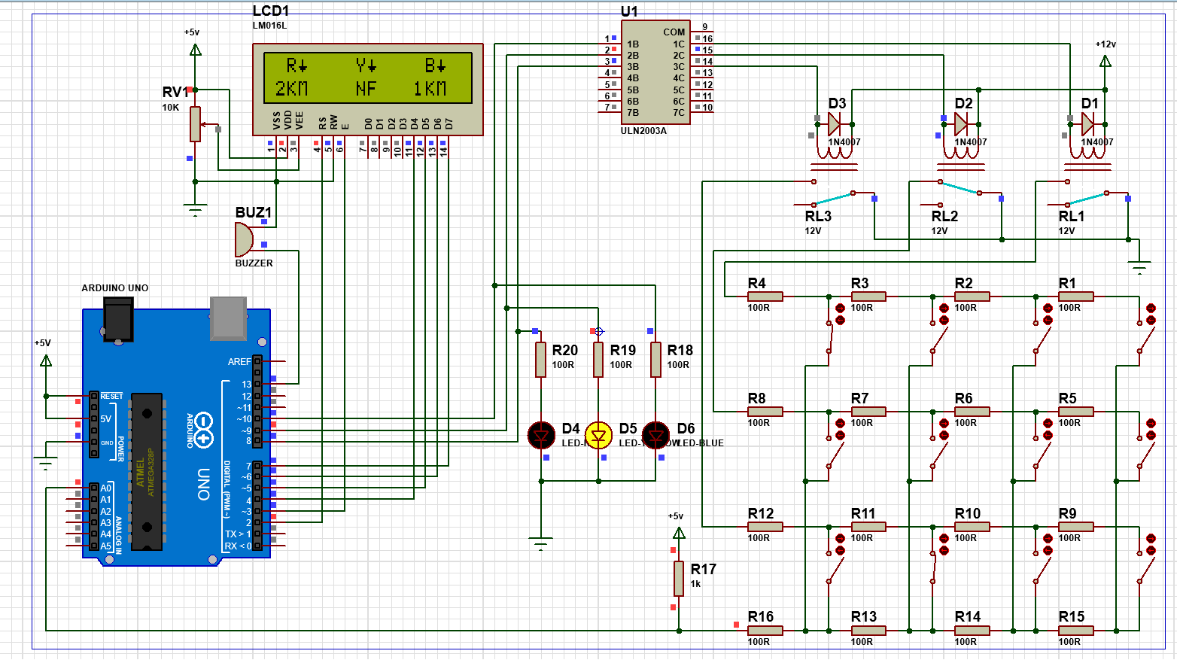

Slide 10
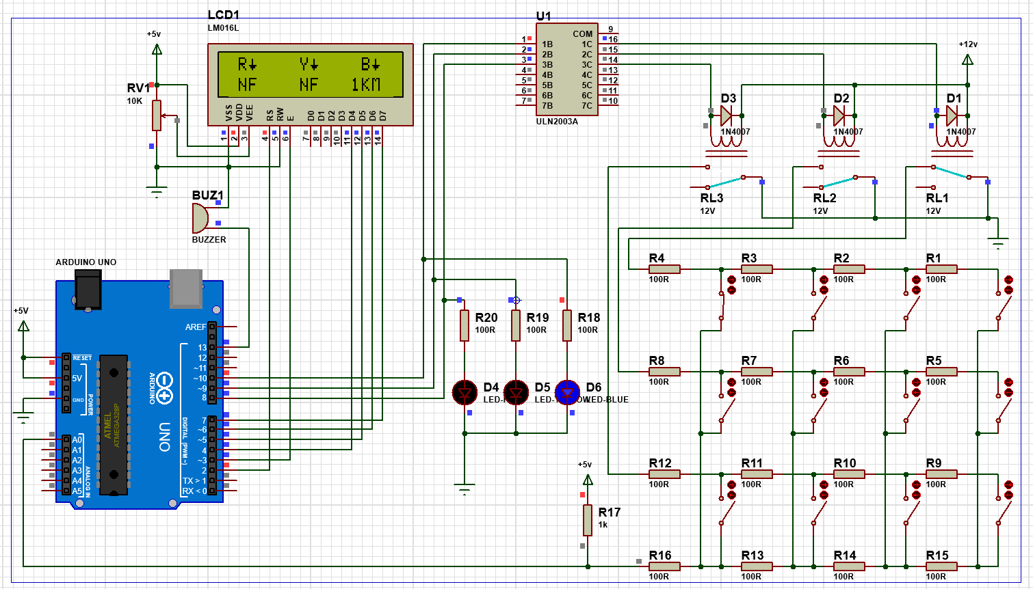
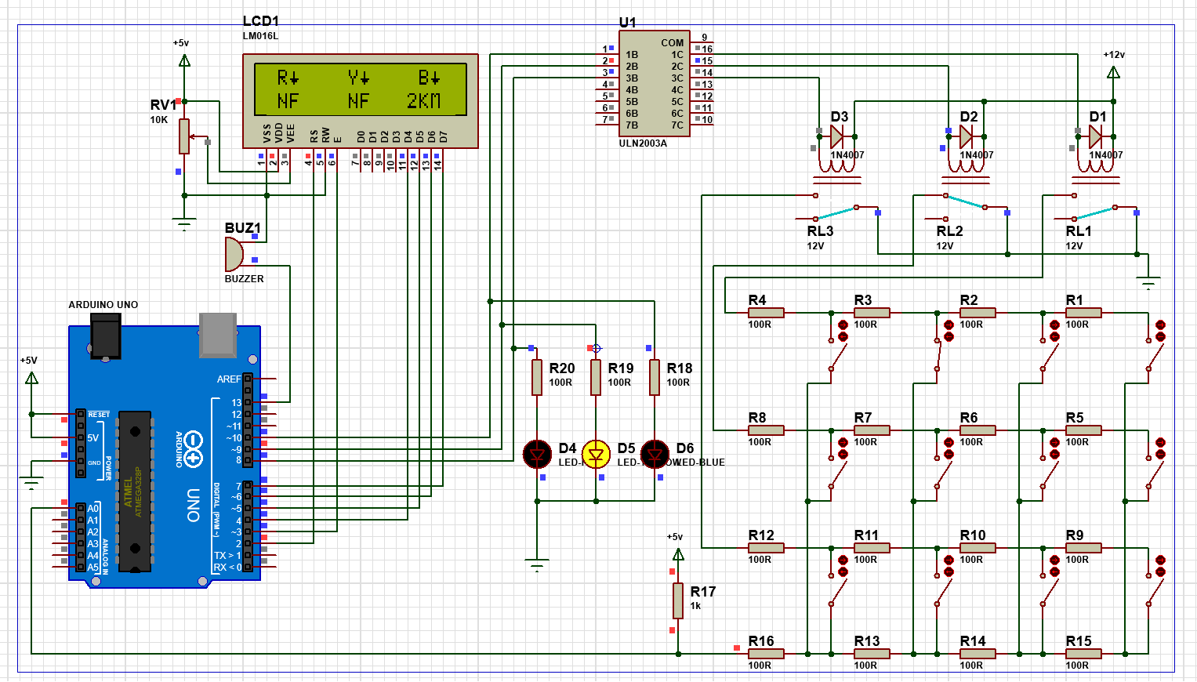
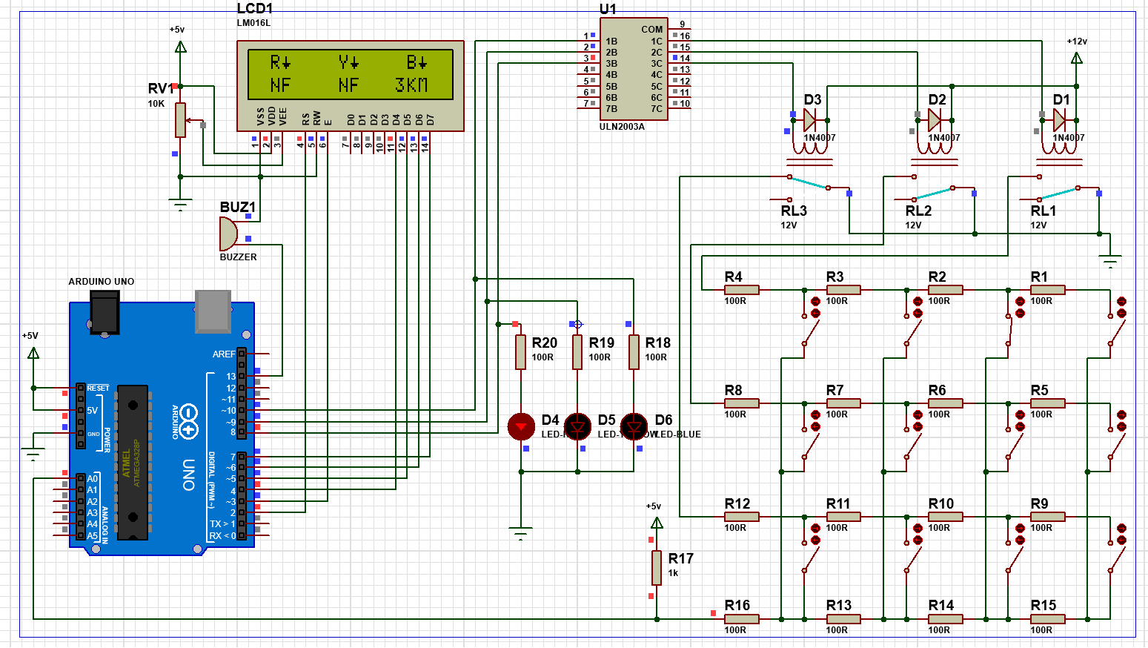
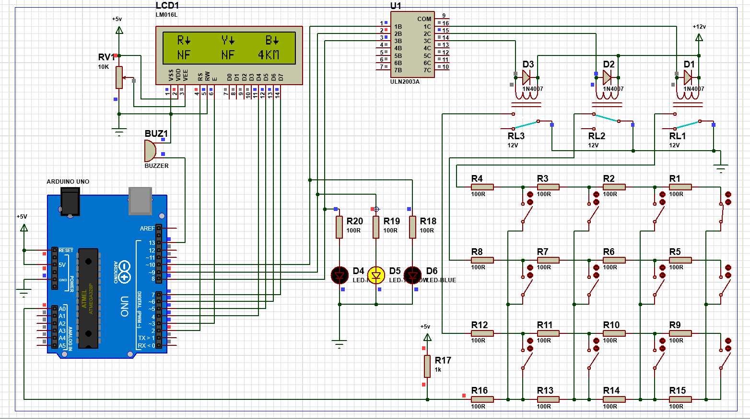

Slide 11
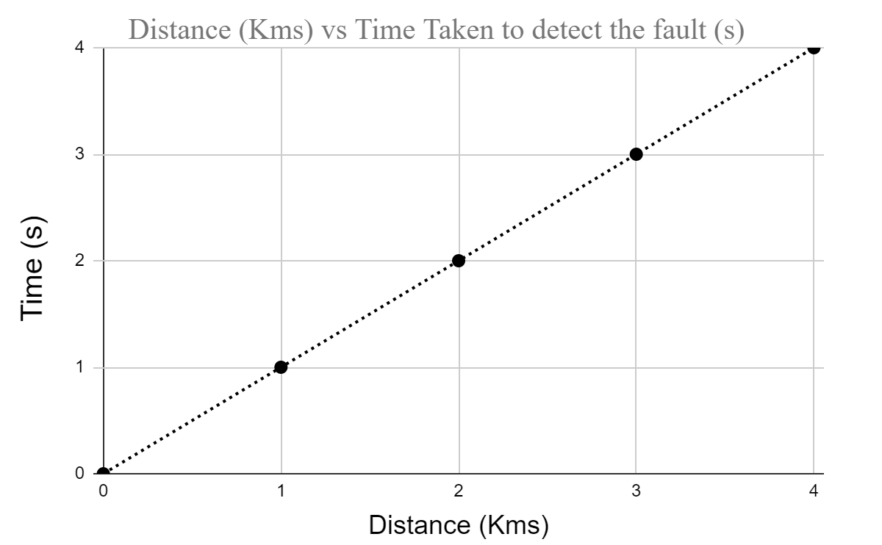
Results and Discussions - 2
Time taken to locate the first fault ( 1 km) is 1 sec ,
Time taken to locate the second fault (2 km) is 2 sec,
Time taken to locate the third fault (3 km) is 3 sec ,
Time taken to locate the fourth fault (4 km) is 4 sec .
A trial circuit was created and simulated for 8km using 8 resistors in each phase.
It was found that time taken to identify the fault and LCD display is directly proportional to the distance of the fault in the transmission line.

Slide 12
Future Enhancement
Optimizing the distance between nodes or junction points based on the available resources and feasibility criterias
Contactless detection of the faults using magnetoresistive sensors
Extended module for its application in detecting short circuit faults
Enhancing the time delay or latency in detecting the faults, thus making the more robust and effective

Slide 13




Team Members
Vishnu Vardhan
MFD18I028
Soorya Sriram
MDM18B049
Khirupasagar R MDM18B063
Rajendra Prasad JM
MDM18B037

