Slide 1
Hackathon Project Final Presentation
January 22th, 2022
TexasBBQ
Ethan Froelich, Rahul Nandakumar, , Soorya Sriram, Ziyu Dai
Petroleum and Geosystems Engineering, Cockrell School of Engineering
Operations Research and Industrial Engineering, Walker School of Mechanical Engineering

Slide 2
Executive Summary
What is the problem?
Predict “fail” or “not fail” within 30 days for 40 artificial lift Electronic Submersible Pumps. Failed Pumps were classified as 1 and Active Pumps as 0
2. What did your team do to address the problem?
We performed feature reduction using visualization techniques, imputation of missing values using mice, and a deviation-based time series analysis method to predict failure.
3. What did your team learn?
We learned many new methods to solve and navigate missing data in a large feature set of solving problems and different techniques to perform Feature Imputation and Model building with dynamic features. We understand so much better how to approach a large problem with a like this.
4. What does your team recommend going forward?
Machine Learning classification using the static features from the Well Dataset could have been used with Dynamic features of the Daily DataSet to improve the classification using Breakpoint Index.

Slide 3
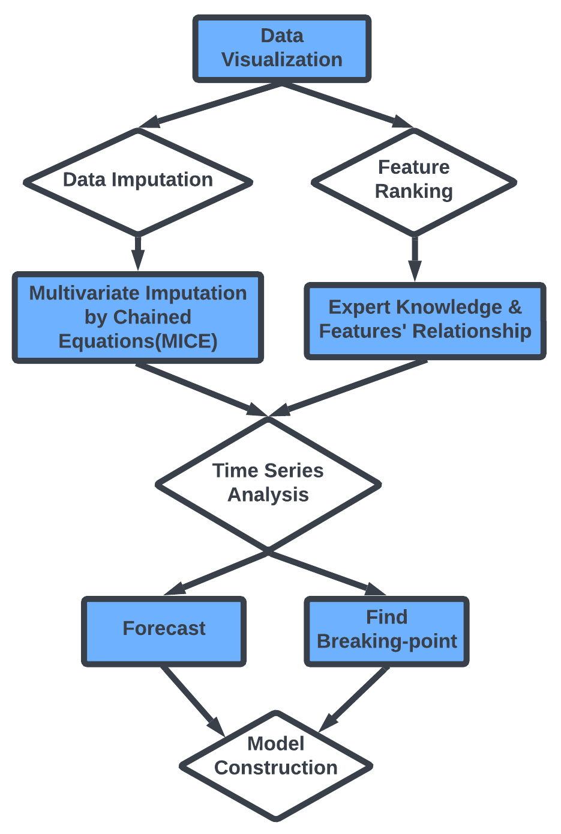
Workflow
Overview with Steps / Flow Chart

Slide 4
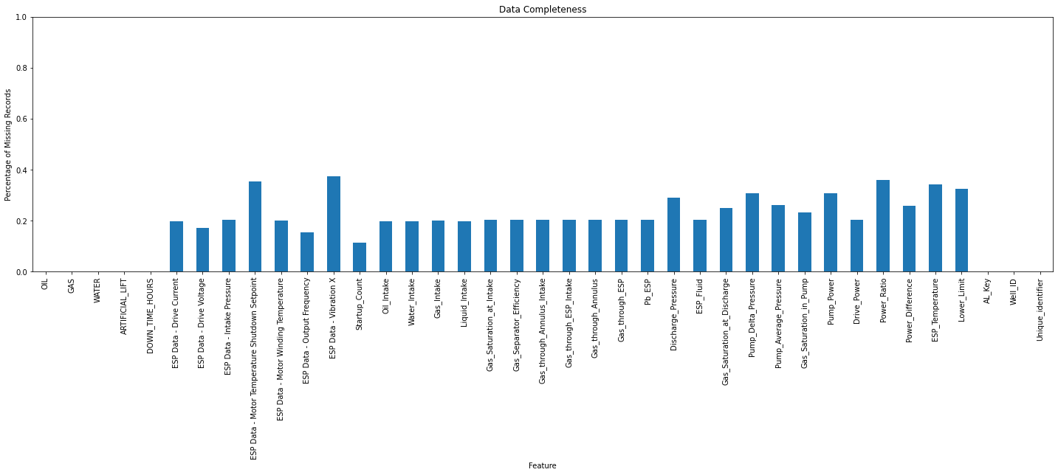
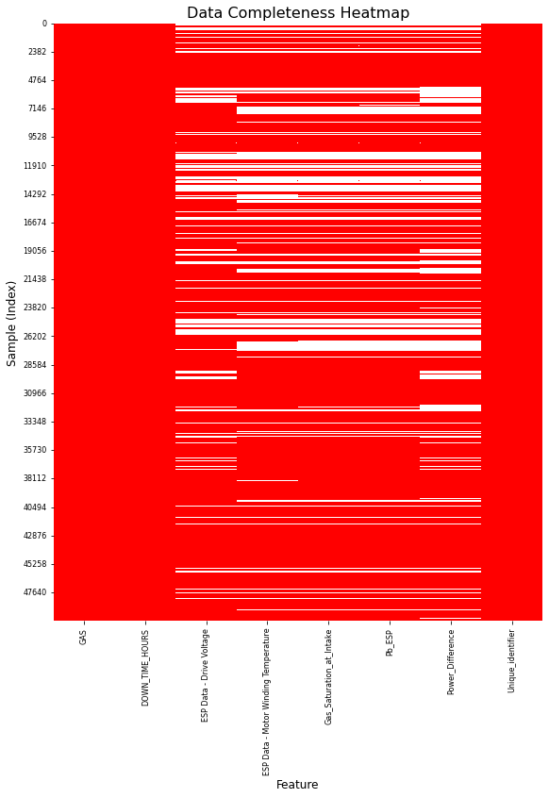
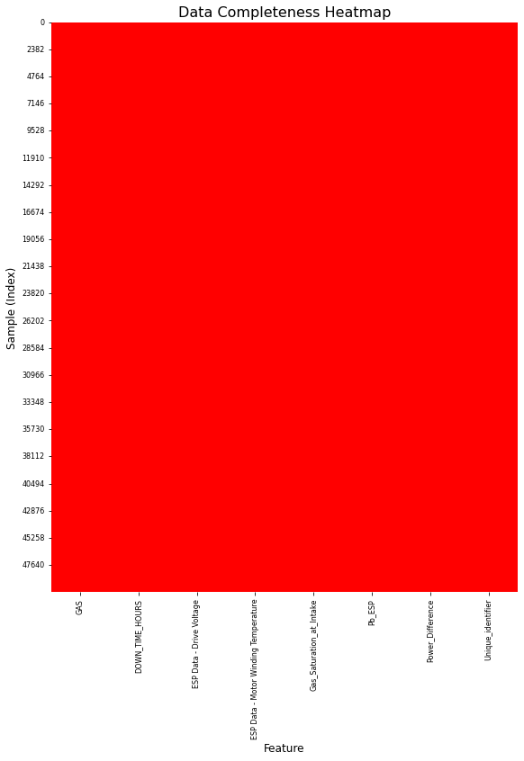
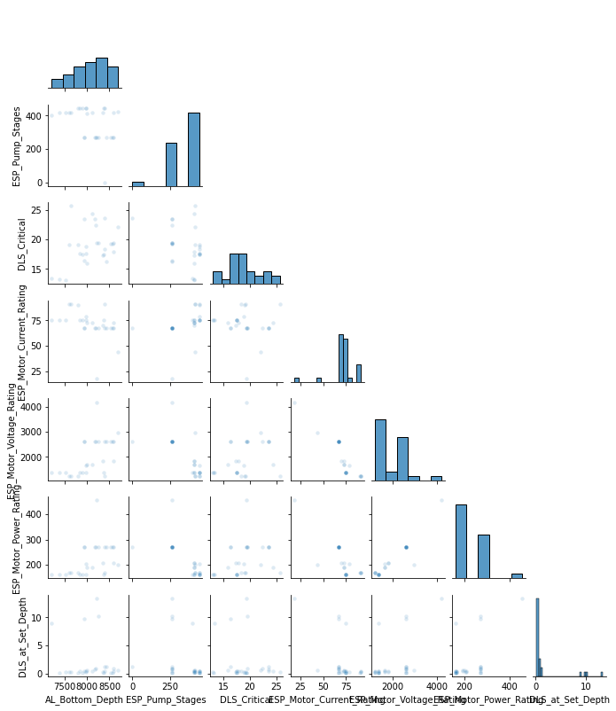
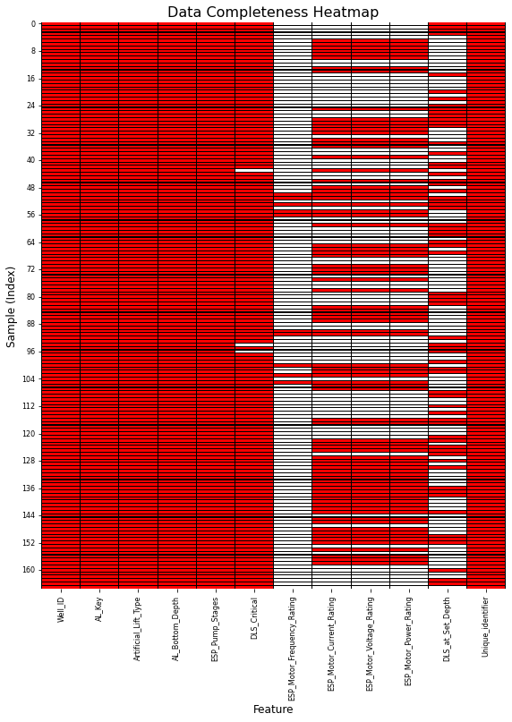
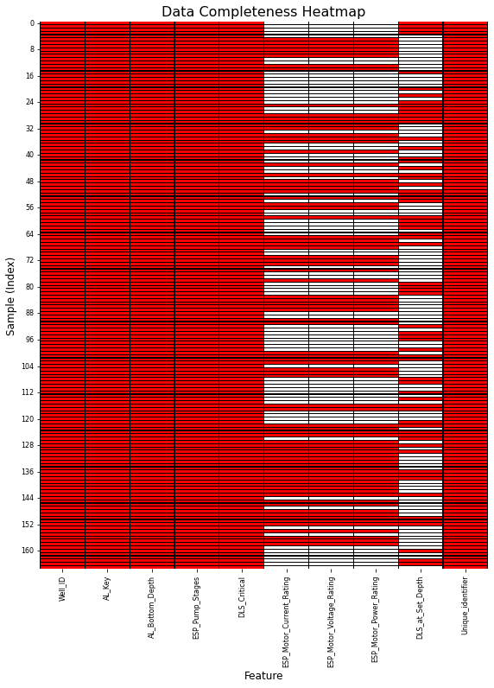
Exploratory Data Analysis for Feature Selection
Histogram for Missing Values for Daily_Data
Feature Heatmap for Well_Data
Feature Imputation for DLS_Critical
Feature Heatmap for Daily_Data
Feature Imputation for 6 Features
Pairwise Plot to identify correlations

Slide 5
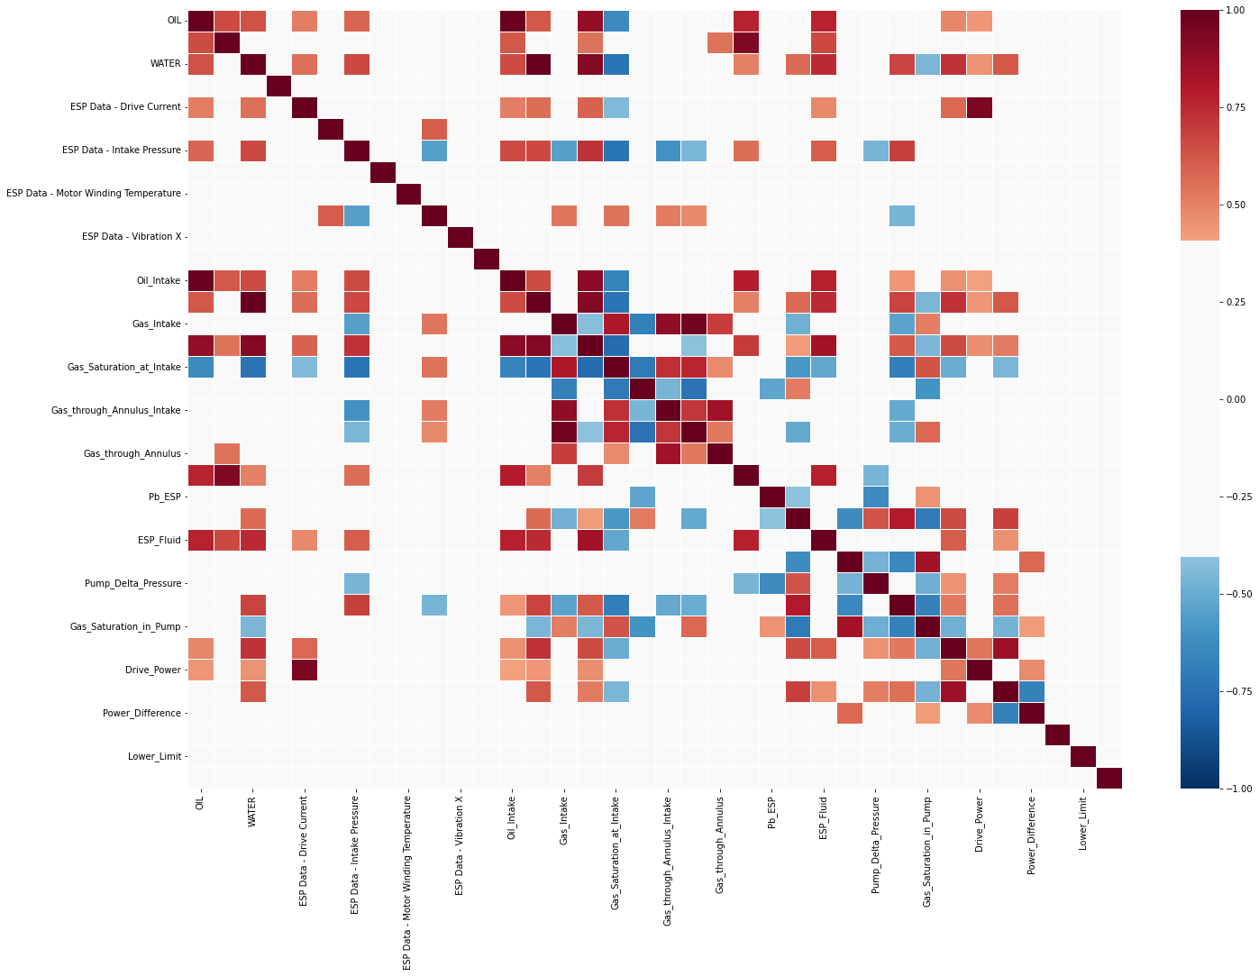
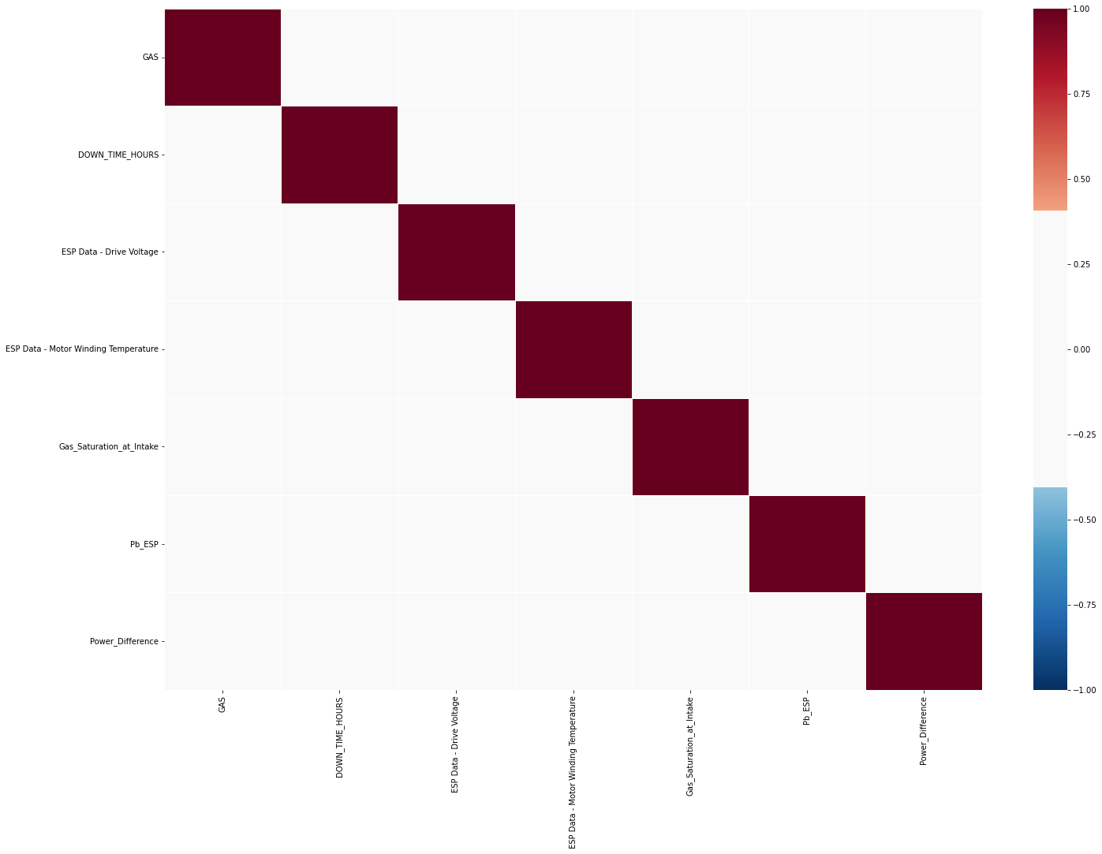
Ranking Method - Pairwise Correlation Coefficient
After
Before

Slide 6
Methodology
Tried to reduce the number of features present in Well Data and Daily Data
Used various visualisation techniques and feature imputation techniques such as MICE and KNN Inputer.
Converted the Object string values to numerical data and merged the “AL_Key” and “Well_ID” into a single Unique Identifier.
Regression Analysis was performed using Linear Regression, Polynomial Regression for degree 2 to 5, XGB Regressor to predict the 'DLS_at_Set_Depth' using the three features ("AL_Bottom_Depth", "ESP_Pump_Stages", "DLS_Critical"). It was found the R2 square was negative or too large for the test set accuracy when an accuracy of 0.8 or above was achieved using the training set which composed of only the 67 rows that did not have 'NaN' values in the 'DLE_at_Set_Depth' column.
Having reduced the number of features in Daily_Data to 6, we tried to fill the missing values in the feature columns using feature imputation.
Identified that if the number of 'NaN' values if above the threshold value 0.3 for each Unique Primary Key, feature imputation should not be performed so we dropped that Primary Key from our analysis. The number of pairs of Pump_Well Combination dropped to 124 after removing the combinations present in the solutions.csv.
Scaled all the data features so that it can be passed into our model.

Slide 7
Model
Model: Vector AutoRegression
Implemented the VAR model to fit for every PumpWell Combination for the total number of days it was active - the last 30 days.
Forecasted for the next 30 days for this training set. Identified that the feature "Gas_Saturation_at_Intake" had to maximized as that had the maximum effect on the Pumps failing.
Found the maximum deviation between the forecasted and actual Gas Saturation at Intake value for every Pump-Well combination.
Performed a weighted mean of the deviations.
Used VAR model to fit for the test set of 40 Pump-Well combinations.
We used domain expertise that the Gas Saturation Index value only increase with time and hence used the last timesteps' datapoint of every PumpWell combination as our lower limit for the forecast.
Obtained the deviation between the forecasted and this lower limit for the 40 PumpWell Combination in our test set.
Calculated the average of the Forecasted Gas Saturation at Intake and categorised the pump to Fail as False and pump to be activ beyond thirty days as True.

Slide 8

Results and DiscussionS
80% of fail, 20% of active
Missing data create dilemma for sequencing of Data
Imputation and Feature Rank
Missing Data drop or imputation
Number of selecting features Vs. Accuracy

Slide 9
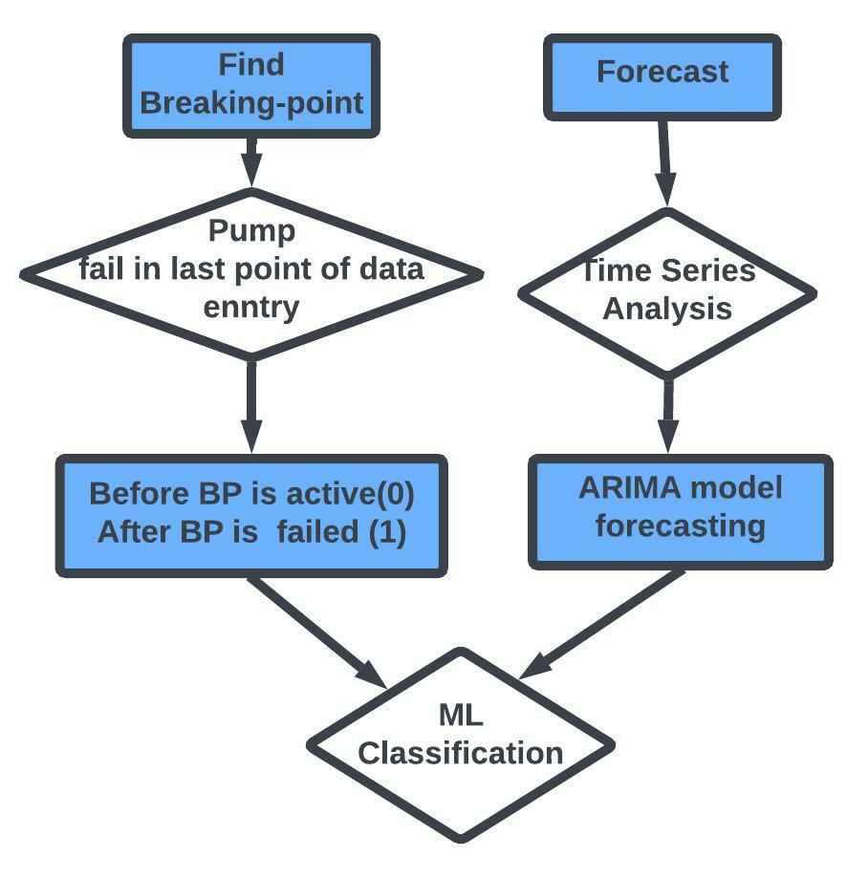
Results and Discussions

Slide 10
Feedback
What did your team learn?
The team learned a lot about machine learning methods, subsurface properties and relations, and how great the petroleum community is!
What did your team like?
Advisors were great, food was awesome.
What could we do to improve next year?
Could have shifts of advisors who could be present later into the night but not have to do the next day’s early morning session or something.

