Slide 1
Quality Inspection and Product Validation
MEC220T | MEC220P
Inspection, Validation of parts using Shape Detection by Harris corner detection and Canny Edge Detection
A study and analysis presented by
-Sujith J -MDM18B052
-Sreekiren D S - MDM18B050
-Soorya Sriram - MDM18B049
-Khirupasagar R - MDM18B063

Slide 2
Abstract
The below study and analysis is about inspecting the quality of a product, which is being manufactured or already out of the plant,i.e., in the customer's hands by using image processing techniques to measure and inspect the dimensions of an n-sided polygon. We shall start this paper by briefly explaining what the analysis is about and then move on to the present methods as well as our method, taking into account the advantages and disadvantages of both. We shall then study the core theory and look into the algorithm, codes and hence analyse the results. Concluding the paper, we will discuss the applications, feasibility and further extensions of the same. The references are stated in the end.

Slide 3
What’s the study about?
The scratch of the study is our products in hand, that is, they are the data we have, the job lies in inspecting this part, by using our image processing techniques and classify them if they can be accepted or rejected, i.e., in simple if they are within the dimensional and tolerance limits.
Quality is an important factor that has to be given the utmost priority when a product is bought into the market. And when it comes to bolts and nuts, it just looks like a small component, but plays a major role in all the major machinery from a bench vice to an aeroplane. Even small shape changes might cause biggest catastrophes, like we might have seen in some air accidents, when a small rivet is the whole cause. There are many such consequences ranging from the threaded part of a screw struck in a hole tap to collapsing of bridges, a bolt or nut defect can be a reason. Hence, it is very important to inspect the part (bolt and nut) before it is being used in any other application.

Slide 4
Present Methods
Sometimes the dimensions or tolerances are not even inspected after manufacturing the products nor the customers take effort in checking them. Even if some checking is done, it is by the following methods:
Visual and manual Inspection
CMMs
We will deal with each of these methods in a gist before we go to our method and algorithm.

Slide 5
Visual and Manual Inspection
The methods of visual inspection involve a wide variety of equipment, ranging from examination with the naked eye to the use of microscopes and other measurement devices for measuring the dimensions of the parts.
Advantages
Investment like purchasing devices and equipment and extensive labour need not be put in this mode of inspection and is far more cost efficient.
It is widely used for inspecting and determining the surface cracks as there are no requirements of prior knowledge of the measurement devices.
Disadvantages
Only surface inspection and large flaws can only be identified using visual inspection.
Manual inspection, using vernier callipers, micrometer and others lead to less accuracy due to parallax errors and backlash errors, thereby causing errors while validating the parts.

Slide 6
CMMs
CMMs consist of the machine itself and its probes and moving arms for providing measurement input, a computer for making rapid calculations and comparisons based on the measurement input, and the computer software that controls the entire system.
Advantages
High precision and accuracy
Requires Less Labor
Accurate dimensions can be obtained by knowing the coordinates and distance between the two reference points.
Disadvantages
The cost of CMMs is so high that small scale industries could not afford them.
Probe system errors
Geometric errors
Environmental errors
Space appears as a constraint as these machines are large and not compact.

Slide 7
Our method : Using Shape Detection by Harris corner detection and Canny Edge Detection
Procedure
Image of good clarity is feeded
Colour image if given as input is converted to a grayscale image.
The boundary or edges of the image are obtained using canny edge detection.
Then , the coordinate points of the part are calculated using harris corner detection
Each side dimension of the part (nut) is found using Coordinate distance formula.
Then, the calculated distance is compared to the size of the respective bolt head or appropriate spanner to the nut.
Finally, the user is informed if the spanner can be used on the given nut and whether the nut (part) is in accordance with the standard values of the bolt heads or spanner sizes.

Slide 8
About the method
Disadvantages
If the amount of smoothing required is important in the spatial domain it may be slow to compute.
For high accuracy, the quality of images should be very high and images must be clear.
Harris corner detection gives better results in black and white background and while converting color image to b&w image there would be data point losses.
On a real-time analysis, the images are to be captured and processed quickly, it is to be made sure that there is no compromise on quality in this process, as the rate of manufacturing is high.
Advantages
The presence of a Gaussian filter allows removal of any noise in an image.
Detects the edges in a noisy state by applying the thresholding method.
It can be used for a variety of functions, including: identification of shapes, measurement of distances and ranges, gauging of sizes and dimensions, determining orientation of parts and much more.
Cost and time are highly reduced during this process.

Slide 9
Theory
There are two main concepts we have used in studying the idea and formulating the results, they are ‘Harris corner detection’ and ‘Canny Edge Detection’. In both of these methods, we start by smoothing the image and thus ‘Gaussian Filters’ are used for that. Let us first understand these three concepts and then go to the algorithm and code in the next section.

Slide 10



Gaussian Filtering
Gaussian filtering, also called the gaussian blur is a method used in image processing to remove noise by blurring the images to some extent, based on the parameters set by the user.

Slide 11
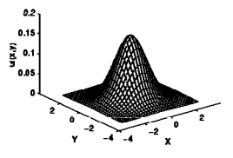
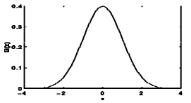
Gaussian Filtering
The distribution, as shown in the figure is assumed to have a mean of 0. Sigma(σ ), refers to the standard deviation and plays an important role in determining the Gaussian Kernel. A kernel is nothing but a square or array of pixels, whose elements are determined by the function given above.

Slide 12
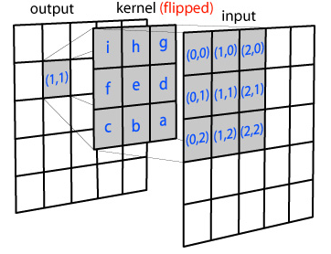
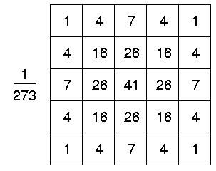
Gaussian Filtering
In the process of blurring the image, each pixel of the image gets multiplied with the corresponding elements of the kernel matrix. For example, the value at (1,0) in the input array by the value at (h) in the kernel array, and so on. Hence, the final image resulting after this product appears to be our blurred image.

Slide 13
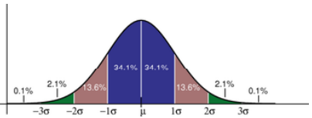
Gaussian Filtering
An advantage we have here is that the kernel matrix for the gaussian blur is always symmetrical, thus you can also multiply each axis (x and y) independently, which will decrease the total number of multiplications.This is because the Gaussian function is symmetrical. The values located between +/- σ account for 68% of the set, while two standard deviations from the mean (blue and brown) account for 95%, and three standard deviations (blue, brown and green) account for 99.7%. account for 99.7%. An example of a 5*5 kernel is given below, keeping the mean as 0 and standard deviation as 1.

Slide 14

Harris Corner Detection
The Harris point detection method is a standard technique for identifying and locating interest points in an image. The main idea is based on Moravec’s detector, that relies on the autocorrelation function of the image for measuring the intensity differences between a patch and windows shifted in several directions. The success of the Harris detector resides in its simplicity and efficiency.
The idea can be expressed through the autocorrelation function as follows

Slide 15

Harris Corner Detection
This last expression depends on the gradient of the image through the autocorrelation matrix, or structure tensor, which is given by
In order to improve the stability of the response, we propose a simple scale space approach by checking that the corner is still present after a zoom out.

Slide 16
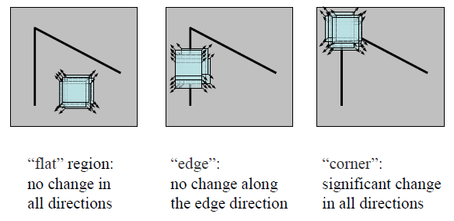
Harris Corner Detection
Analyzing their values, we may find three possible situations:
Both eigenvalues are small, λ1 ≈ λ2 ≈ 0, then the region is likely to be a homogeneous region with intensity variations due to the presence of noise.
One of the eigenvalues is much larger than the other one, λ1 ≫ λ2 ≈ 0, then the region is likely to belong to an edge, with the largest eigenvalue corresponding to the edge orthogonal direction.
Both eigenvalues are large, λ1 > λ2 ≫ 0, then the region is likely to contain large intensity variations in the two orthogonal directions, therefore corresponding to a corner-like structure.

Slide 17
Harris Corner Detection - Step 1
Smoothing the image
This stage is done by convolution with a Gaussian function and multiplying with the kernel matrix. This can be of two types, ‘Stack integral images’ (SII) method and ‘Discrete Gaussian’ method. We usually adopt the former method as it is faster, but though it is less accurate than the latter it is not of much importance in our case since we are dealing with basic shapes and not complex images.
It is also important to ensure that the detector has a high repeatability rate, i.e., it must be rotationally invariant in detecting the interest points as the image is rotated from 0 to 180 degree, then we say that the repeatability rate is high.

Slide 18
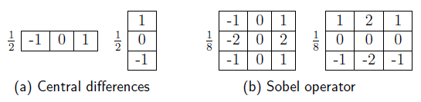
Harris Corner Detection - Step 2
Computing the gradient of the image
There are again two types of gradient masks we can adopt in order to compute the gradient. One, ‘Central difference approach’ and ‘Sobel operator’.

Slide 19

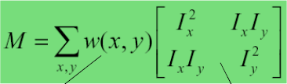
Harris Corner Detection - Step 3
Computing autocorrelation matrix
This is the main step of the entire algorithm and all the interest points are determined keeping this matrix as the base and initial data. The products of the derivatives are calculated at each position and the coefficients of the matrix are assigned values accordingly.

Slide 20
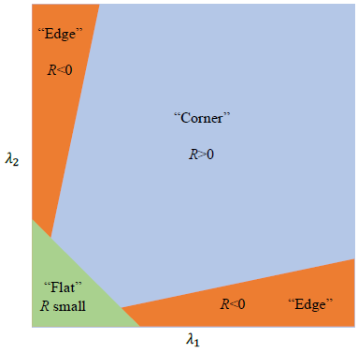
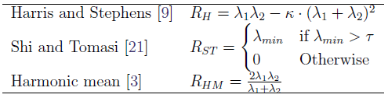
Harris Corner Detection - Step 4
Computing corner strength
The autocorrelation matrix is symmetric and positive semidefinite, yielding two real non-negative eigenvalues. Analyzing these eigenvalues, we may define corner response functions that are invariant to in-plane rotations. We implement the following any of the following standard functions.

Slide 21
Harris Corner Detection - Step 5
Non-maximum suppression
The purpose of the non-maximum suppression step is to find the best interest point in each local neighborhood.
We chose to implement a generic algorithm that extracts points using a radius ‘r’. Intuitively, this radius must be related to the size of the integration kernel, σi, used in Step 3. A reasonable choice is to calculate the radius as r = 2σi. In this way, the features will be separated by the area of influence of the Gaussian function. Computing the maximum of an array only requires one comparison per pixel, but finding the local maxima is much more cumbersome.
At the beginning, we take into account a threshold to skip low values in the corner strength function. This threshold depends on the level of noise in the image and on the function selected.

Slide 22
Harris Corner Detection - Step 6
Selecting output corners
Now as we have suppressed all the non-maximum corners, it is important to select the corners, or more precisely interest points we want, we can do this by either of the methods:
The simplest one is to select all the corners detected. In this case, the sorting is given by the non-maximum suppression algorithm, i.e. sorted by rows and then by columns.
All the corners are sorted by their corner strength values in descending order. This is interesting for applications that need to process the more discriminant features first.
Another alternative is to select a subset of the corners detected. The user specifies a number of corners to be found and the application returns the set with the highest discriminant values.
We may also select a set of corners equally distributed on the image. In that case, the user specifies a number of cells and the total number of points to be detected.

Slide 23

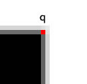
Harris Corner Detection - Step 7
Calculating subpixel accuracy
This is the final step in the process, let us see the images below
You can see that the corner does not lie on a single pixel. The corner is "spread out" (In fact, in real life situations, it's almost impossible to get corners to lie on exact pixels). So, with a corner detection algorithm like the Shi-Tomasi corner detector or the Harris corner detector, you will end up with a corner like (56, 120). But, scientists and other people want a corner like (56.768, 120.1432). This is subpixel accuracy. Hence, it becomes necessary to refine features with subpixel accuracy.

Slide 24
Canny Edge Detection
Canny Edge detection, a popular edge detection algorithm developed by John F. Canny in 1986. It is a multi-stage algorithm and we will go through each stage. Before we start proceeding towards the steps, it's important to first convert the image into grayscale as this detector is based on the grayscale images.

Slide 25
Canny Edge Detection - Step 1
Noise reduction
We get rid of the noise in the image by using a Gaussian filter/Gaussian Blur to smooth it. The extent of blur required can be adopted by choosing the kernel size as per our choice. Commonly, we use the 5*5 kernel.
Once the kernel matrix is generated, and multiplied with the image matrix, we get the blurred image, this is then passed onto the next step.

Slide 26


Canny Edge Detection - Step 2
Intensity Gradient Calculation
In this step, we calculate the edge intensity and direction by calculating the gradient of the image using edge detection operators. After the image is smoothed, the gradient (I) w.r.t ‘x’ and ‘y’ are calculated and can be convolved with Sobel kernels (K) along respective gradients (‘x’ and ‘y’) (used as a mask for edge detection). Examples of the Sobel kernels are of the form:
Thus, now the magnitude and slope of the gradient can be calculated as:

Slide 27
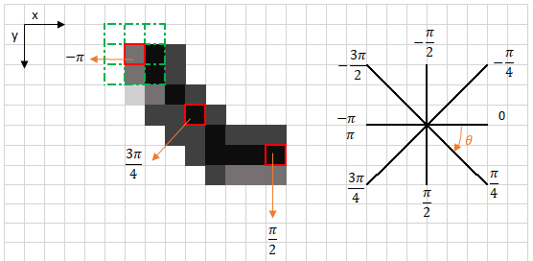
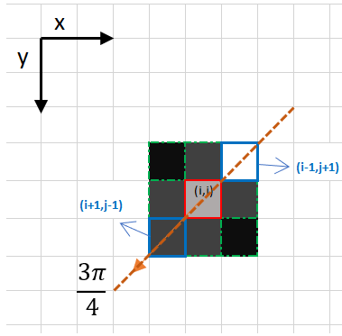
Canny Edge Detection - Step 3
Non-maximum suppression
After getting gradient magnitude and direction, a full scan of the image is done to remove any unwanted pixels which may not constitute the edge. For this, at every pixel, the pixel is checked if it is a local maximum in its neighborhood in the direction of gradient. If any of the pixels around it appears to be of a higher intensity, than the one being processed or surrounding it, then this pixel is kept and the other one’s intensity is accounted to 0. If there are no pixels in the edge direction having more intense values, then the value of the current pixel is kept.

Slide 28
Canny Edge Detection - Step 4
Double Threshold
This step aims at identifying strong, weak and non-relevant pixels in the image. The strong pixels alone contribute for the final edge while the other two don’t. Thus, for this we define two thresholds, high threshold to identify the strong pixels and low threshold to identify some of the non-relevant pixels.
All the pixels within these thresholds are classified as weak pixels and the hysteresis mechanism (next step) will help us identify the strong and non-relevant pixels that lie above the high threshold.
The end result of this step is that the image now just consists of two types of pixels, i.e., weak and strong pixels.

Slide 29
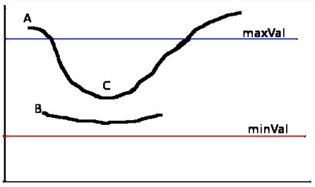
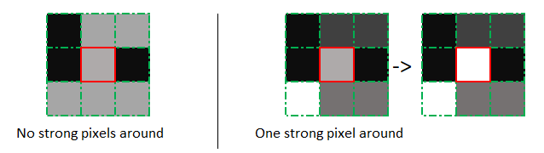
Canny Edge Detection - Step 5
Edge Tracking by Hysteresis
Based on the threshold results, the hysteresis consists of transforming weak pixels into strong ones, if and only if at least one of the pixels around the one being processed is a strong one.

Slide 30
Code and Algorithm
We deal primarily with two codes here, the first one deals with detecting the corners of the hexagon of the bolt head/nuts, calculating the side lengths and inspecting them. But some bolt heads are circular in shape, hence we cannot use a corner detection here, hence an edge detection algorithm is necessary, and our second code caters this need. From that the diameter can be calculated and inspected.

Slide 31
Code 1 : Harris Corner Detection
import cv2 import numpy as np img = cv2.imread('hex.png') gray = cv2.cvtColor(img, cv2.COLOR_BGR2GRAY) gray = np.float32(gray) dst = cv2.cornerHarris(gray,5,3,0.04) ret, dst = cv2.threshold(dst,0.1*dst.max(),255,0) dst = np.uint8(dst) ret, labels, stats, centroids = cv2.connectedComponentsWithStats(dst) criteria = (cv2.TERM_CRITERIA_EPS + cv2.TERM_CRITERIA_MAX_ITER, 100, 0.001) corners = cv2.cornerSubPix(gray,np.float32(centroids),(5,5),(-1,-1),criteria) for i in range(1, len(corners)): print(corners[i]) img[dst>0.1*dst.max()]=[0,0,255] cv2.imshow('image', img) cv2.waitKey(0) cv2.destroyAllWindows

Slide 32
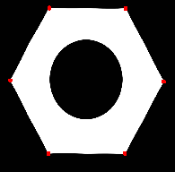

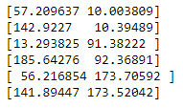
Analysing Results : Code 1
Output Image
Nut 1
Input Image
Output coordinates

Slide 33
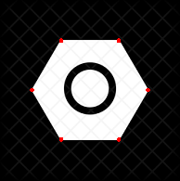

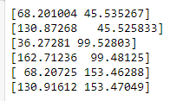
Analysing Results : Code 1
Output Image
Nut 2
Input Image
Output coordinates

Slide 34
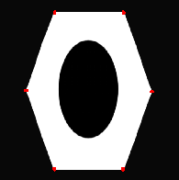

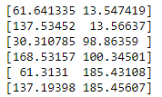
Analysing Results : Code 1
Output Image
Nut 3
Input Image
Output coordinates

Slide 35
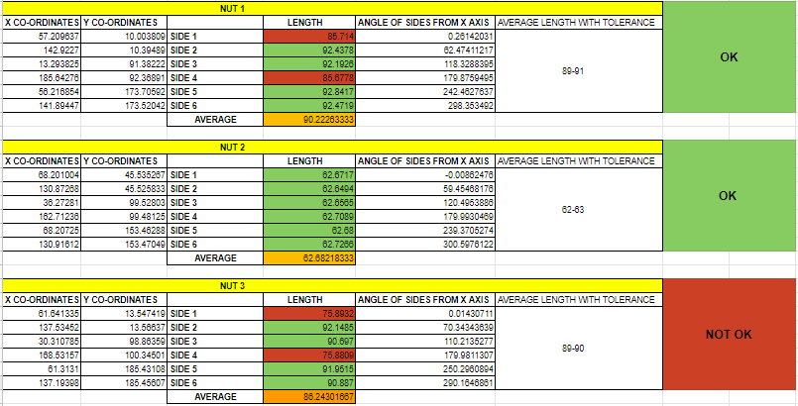
Analysing Results : Code 1 ; Approval & Rejection

Slide 36
Code 2 : title of code (1/6)
# USAGE # python object_size.py --image images/example_01.png --width 0.955 # python object_size.py --image images/example_02.png --width 0.955 # python object_size.py --image images/example_03.png --width 3.5 # import the necessary packages from scipy.spatial import distance as dist from imutils import perspective from imutils import contours import numpy as np import argparse import imutils import cv2 def midpoint(ptA, ptB): return ((ptA[0] + ptB[0]) * 0.5, (ptA[1] + ptB[1]) * 0.5)

Slide 37
Code 2 : title of code (2/6)
return ((ptA[0] + ptB[0]) * 0.5, (ptA[1] + ptB[1]) * 0.5) # construct the argument parse and parse the arguments ap = argparse.ArgumentParser() ap.add_argument("-i", "--image", required=True, help="path to the input image") ap.add_argument("-w", "--width", type=float, required=True, help="width of the left-most object in the image (in inches)") args = vars(ap.parse_args()) # load the image, convert it to grayscale, and blur it slightly image = cv2.imread(args["image"]) gray = cv2.cvtColor(image, cv2.COLOR_BGR2GRAY) gray = cv2.GaussianBlur(gray, (7, 7), 0)

Slide 38
Code 2 : title of code (3/6)
# perform edge detection, then perform a dilation + erosion to # close gaps in between object edges edged = cv2.Canny(gray, 50, 100) edged = cv2.dilate(edged, None, iterations=1) edged = cv2.erode(edged, None, iterations=1) # find contours in the edge map cnts = cv2.findContours(edged.copy(), cv2.RETR_EXTERNAL, cv2.CHAIN_APPROX_SIMPLE) cnts = imutils.grab_contours(cnts) # sort the contours from left-to-right and initialize the # 'pixels per metric' calibration variable (cnts, _) = contours.sort_contours(cnts) pixelsPerMetric = None # loop over the contours individually for c in cnts: # if the contour is not sufficiently large, ignore it if cv2.contourArea(c) < 100: continue

Slide 39
Code 2 : title of code (4/6)
# compute the rotated bounding box of the contour orig = image.copy() box = cv2.minAreaRect(c) box = cv2.cv.BoxPoints(box) if imutils.is_cv2() else cv2.boxPoints(box) box = np.array(box, dtype="int") # order the points in the contour such that they appear # in top-left, top-right, bottom-right, and bottom-left # order, then draw the outline of the rotated bounding # box box = perspective.order_points(box) cv2.drawContours(orig, [box.astype("int")], -1, (0, 255, 0), 2) # loop over the original points and draw them for (x, y) in box: cv2.circle(orig, (int(x), int(y)), 5, (0, 0, 255), -1) # unpack the ordered bounding box, then compute the midpoint # between the top-left and top-right coordinates, followed by # the midpoint between bottom-left and bottom-right coordinates (tl, tr, br, bl) = box (tltrX, tltrY) = midpoint(tl, tr) (blbrX, blbrY) = midpoint(bl, br)

Slide 40
Code 2 : title of code (5/6)
# compute the midpoint between the top-left and top-right points, # followed by the midpoint between the top-right and bottom-right (tlblX, tlblY) = midpoint(tl, bl) (trbrX, trbrY) = midpoint(tr, br) # draw the midpoints on the image cv2.circle(orig, (int(tltrX), int(tltrY)), 5, (255, 0, 0), -1) cv2.circle(orig, (int(blbrX), int(blbrY)), 5, (255, 0, 0), -1) cv2.circle(orig, (int(tlblX), int(tlblY)), 5, (255, 0, 0), -1) cv2.circle(orig, (int(trbrX), int(trbrY)), 5, (255, 0, 0), -1) # draw lines between the midpoints cv2.line(orig, (int(tltrX), int(tltrY)), (int(blbrX), int(blbrY)), (255, 0, 255), 2) cv2.line(orig, (int(tlblX), int(tlblY)), (int(trbrX), int(trbrY)), (255, 0, 255), 2) # compute the Euclidean distance between the midpoints dA = dist.euclidean((tltrX, tltrY), (blbrX, blbrY)) dB = dist.euclidean((tlblX, tlblY), (trbrX, trbrY))

Slide 41
Code 2 : title of code (6/6)
# if the pixels per metric has not been initialized, then # compute it as the ratio of pixels to supplied metric # (in this case, inches) if pixelsPerMetric is None: pixelsPerMetric = dB / args["width"] # compute the size of the object dimA = dA / pixelsPerMetric dimB = dB / pixelsPerMetric # draw the object sizes on the image cv2.putText(orig, "{:.1f}in".format(dimA), (int(tltrX - 15), int(tltrY - 10)), cv2.FONT_HERSHEY_SIMPLEX, 0.65, (255, 255, 255), 2) cv2.putText(orig, "{:.1f}in".format(dimB), (int(trbrX + 10), int(trbrY)), cv2.FONT_HERSHEY_SIMPLEX, 0.65, (255, 255, 255), 2) # show the output image cv2.imshow("Image", orig) cv2.waitKey(0)

Slide 42
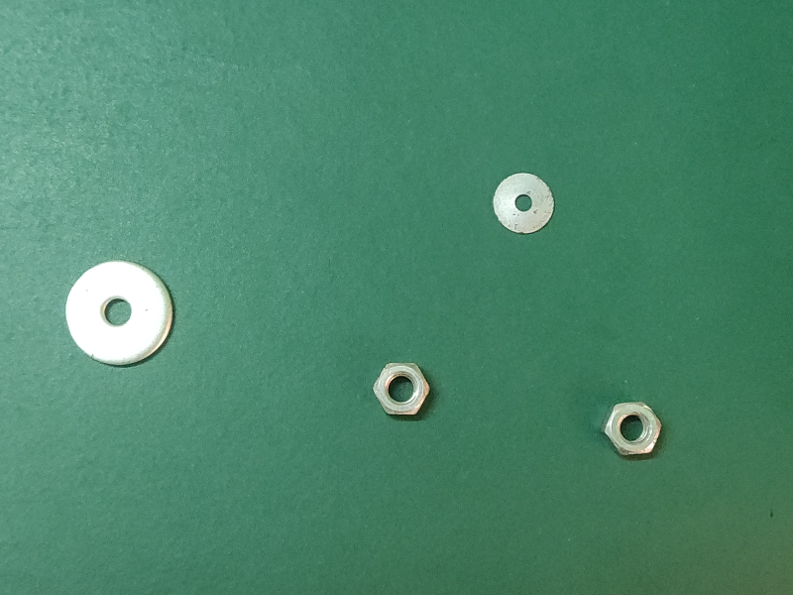
Analysing Results : Code 2
Input Image
Output Image

Slide 43
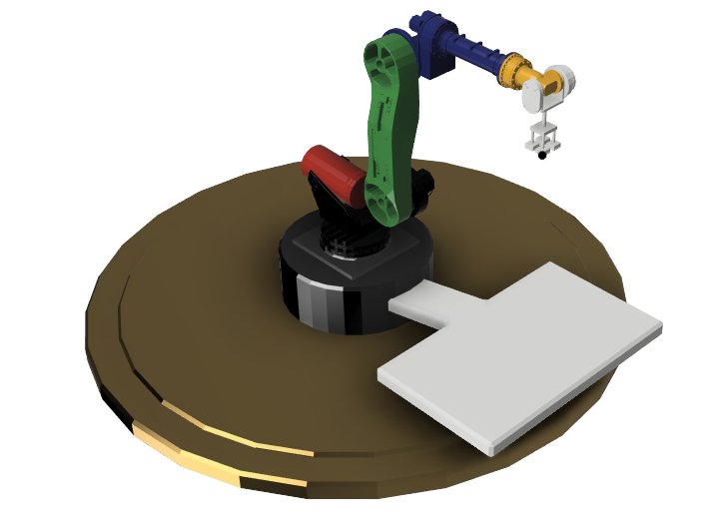
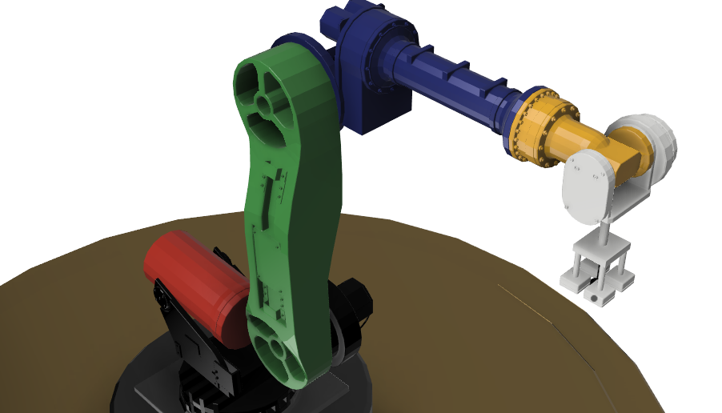
Our prototype (1/3)
Perspective View
Movable arms at multiple locations

Slide 44
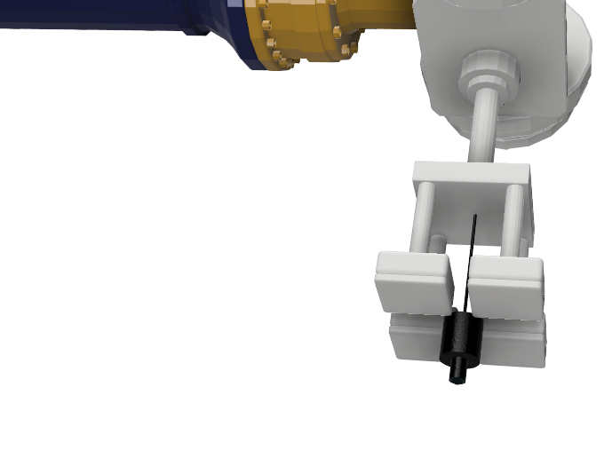
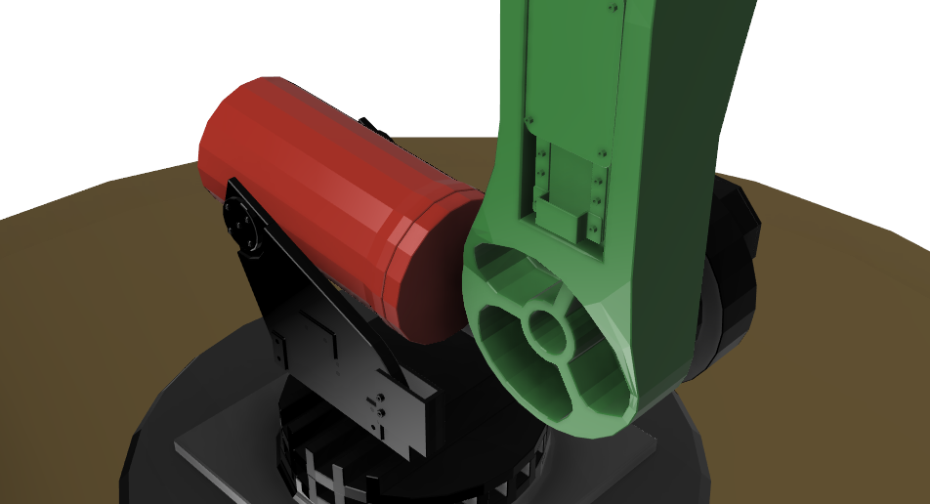
Our prototype (2/3)
Counter balancing mass for precision
Protective and Stiff Camera holders

Slide 45
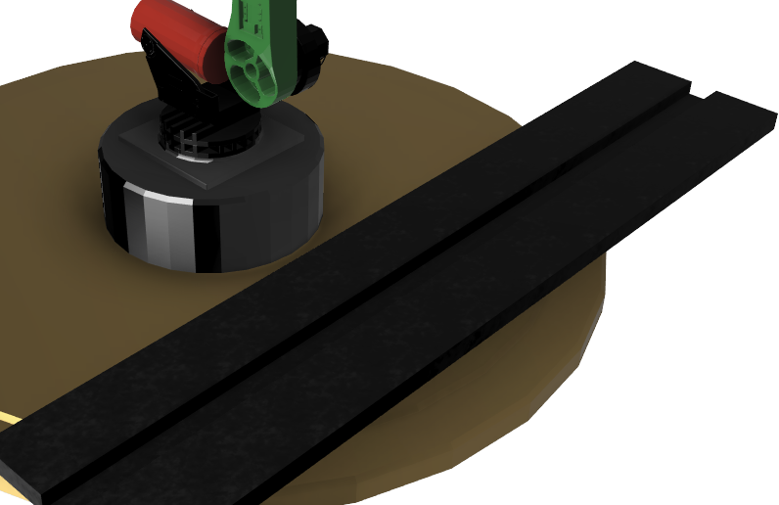
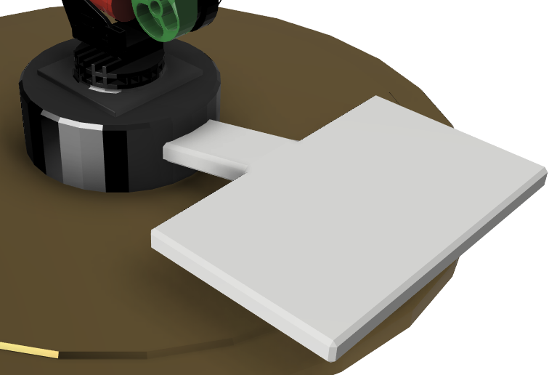
Our prototype (3/3)
The Part can be inspected when moving in a belt (left image) as well as individually using a portable platform (right image).

Slide 46
Application and Feasibility
1. Measure and compare the manufactured size of a bolt head with that of the actual size.
2. Inspection of parts whose shape is the same of any n-sided polygon.
3. Measurement of tiles of any fixtures of respective shape like squares and rectangles.
4. A slight modification in the code can be used for facial recognition
5. Any object/contour,in the image, can be found and the appropriate dimensions can be found.
Accounting for the feasibility of the above suggested method, it can be used directly in manufacturing plants. That is, when a part passes through a belt, a camera and a interface programmed with the same can be embedded along the belt at some point so that parts within the specified dimensions are taken to the next step and the rest can be rejected either through hand-picking or a seperate belt or any other mechanism.

Slide 47
Further Extensions
This is just the base and pillar of inspecting the product and the process can be embedded into a mobile application such that the customers can use the same to inspect such similar products at home. Some further developments in the program can be such that non-regular shapes or custom shapes can be programmed into the code. This might help us in areas like inspecting parameters of gears ( the tooth size, diameter of gear etc), finding the circularity and cylindricity of an object and many more. Hence, we can say that there exists a scope to expand this method into various domains on further work and developments.

Slide 48
Concluding Remarks
We have seen the pros and cons of the existing methods as well as our methods. From some of the previous methods we see that there are problems with accuracy in one and space, cost etc in the other. So in simple words, we would expect a solution that is economical, uncompromising on quality, compact, quick and easy to operate (i.e., user-friendly). We can clearly conclude that our method satisfies all the above expectations, also yielding very accurate results when respective parameters are set according to the domain of application and the part being inspected.

Slide 49
References
An Analysis and Implementation of the Harris Corner Detector by Javier S´anchez, Nelson Monz´on, Agust´ın Salgado,
Rick Szeliski’s lecture notes, CS courses, Paul G Allen School of Computer science and Engineering, Washington.
Patrices Lectures (Gaussian filters), School of Computer Science, The university of Auckland, NZ.
Stackexchange (Computer Graphics)
Stackexchange (DSP)
Towards Data Science
Open-CV python tutorials
Computer vision courses

Slide 50
Thank You
-Presented by
Sujith J
MDM18B052
Sreekiren D S
MDM18B050
Soorya Sriram
MDM18B049
Khirupasagar R
MDM18B063

