Slide 1
Hive Programming Fundamentals
Ali Zaidi
Data Scientist
Machine Learning Education Team

Slide 2
Understanding Hive and Hive QL

Slide 3
Apache HIVE: What is it?
A ‘Data Warehouse’ built using Hadoop for querying and analyzing big data
Enables you to view big data as ‘Tables’ and use familiar SQL-like operations on them.
Lets you impose a table-like view on big data
However, not a substitute for full-fledged RDBMS.
Hive tables can be queried using HiveQL, a SQL-like query language
HiveQL queries are eventually executed as MapReduce or Tez programs by Hadoop
Hive
HiveQL
Table View
HDFS

Slide 4
Enter the Hive
It is a data warehouse system for Hadoop
Developed at Facebook
It maintains metadata information about your big data stored on HDFS
It treats your HDFS directories as “tables”
It performs SQL-like operations on the data using a high-level declarative scripting language called HiveQL
Notes:
For most use cases:
- Pig is a good choice for ETL jobs, where unstructured data is reformatted so that it is easier to define a structure to it
- Hive is a good choice when you want to query data that has a certain known structure to it

Slide 5
Hive’s Alignment with SQL
SQL Datatypes |  | SQL Semantics
INT |  | SELECT, LOAD, INSERT from query
TINYINT/SMALLINT/BIGINT |  | Expressions in WHERE and HAVING
BOOLEAN |  | GROUP BY, ORDER BY, SORT BY
FLOAT |  | CLUSTER BY, DISTRIBUTE BY
DOUBLE |  | Sub-queries in FROM clause
STRING |  | GROUP BY, ORDER BY
BINARY |  | ROLLUP and CUBE
TIMESTAMP |  | UNION
ARRAY, MAP, STRUCT, UNION |  | LEFT, RIGHT and FULL INNER/OUTER JOIN
DECIMAL |  | CROSS JOIN, LEFT SEMI JOIN
CHAR |  | Windowing functions (OVER, RANK, etc.)
VARCHAR |  | Sub-queries for IN/NOT IN, HAVING
DATE |  | EXISTS / NOT EXISTS
Notes:
This slide is to simply demonstrate that HiveQL looks a lot like SQL. Do not discuss each item above – remember we are assuming the students are already familiar with SQL.

Slide 6
HiveQL: Execution Flow
ODBC
JDBC
Hive web interface (HWI)
Command line interface (CLI)
Hive clients send HiveQL queries to the driver
The driver sends query to the compiler for parsing and syntax checking.
The compiler gets the metadata from the store and returns a execution plan to the driver.
The driver sends the execution plan to the execution engine.
The execution engine submits the plan as a MR job to be executed by Hadoop. After Hadoop completes execution, the execution engine gets the results which are returned to the driver, which in turn returns the results to the Hive clients.
The execution engine can execute metadata operations against the Metastore
1
Thrift server
2
1
3
2
Driver
4
Compiler
4
MetaStore
3
5
Execution
5.1
5
5.1
Hadoop / HDFS

Slide 7
Invoking Hive Jobs on HDInsight

Slide 8
Submitting Hive Queries
Hive CLI
Traditional Hive “thick” client
$ hive hive>
Beeline
A new command-line client that connects to a HiveServer2 instance
$ beeline –u url –n username –p password beeline>
Ambari Views/Visual Studio Tools
Notes:
Hive queries are written using the HiveQL language, an SQL-like scripting language that simplifies the creation of MapReduce jobs. You have two options for executing HiveQL commands:
- Hive CLI
- Beeline

Slide 9
Hive Data Organization Hierarchy
Database
Table
Table
Table
Partition
Partition
Partition
Partition
Partition
Partition
Buckets / Clusters
Buckets / Clusters
Buckets / Clusters
Buckets / Clusters
Buckets / Clusters
Buckets / Clusters
Notes:
Databases: Namespaces that separate tables and other data units from naming confliction.
Tables: Homogeneous units of data which have the same schema. Partitions: Each Table can have one or more partition Keys which determines how the data is stored. Partitions - apart from being storage units - also allow the user to efficiently identify the rows that satisfy a certain criteria. For example, a date_partition of type STRING and country_partition of type STRING. Each unique value of the partition keys defines a partition of the Table. For example all "US" data from "2009-12-23" is a partition of the page_views table. Therefore, if you run analysis on only the "US" data for 2009-12-23, you can run that query only on the relevant partition of the table thereby speeding up the analysis significantly. Note however, that just because a partition is named 2009-12-23 does not mean that it contains all or only data from that date; partitions are named after dates for convenience but it is the user's job to guarantee the relationship between partition name and data content!). Partition columns are virtual columns, they are not part of the data itself but are derived on load.
Buckets (or Clusters): Data in each partition may in turn be divided into Buckets based on the value of a hash function of some column of the Table. For example the page_views table may be bucketed by userid, which is one of the columns, other than the partitions columns, of the page_view table. These can be used to efficiently sample the data.
Note that it is not necessary for tables to be partitioned or bucketed, but these abstractions allow the system to prune large quantities of data during query processing, resulting in faster query execution.

Slide 10
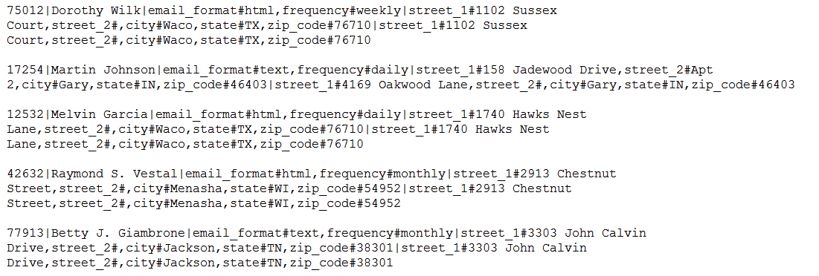
Sample Data – Customers File
Customer Id
Customer Name
Email Preferences
Shipping Address
Billing Address

Slide 11
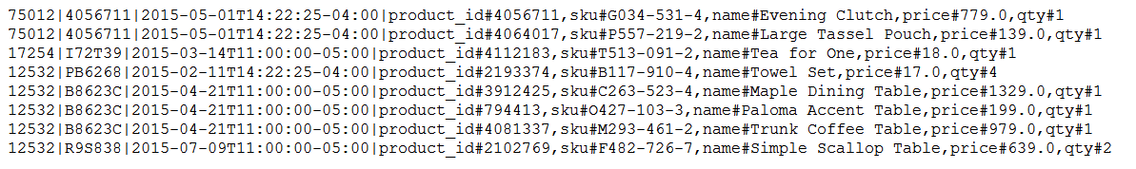
Sample Data – Orders File
Customer Id
Order Data and Time
Order Id
Product Details

Slide 12
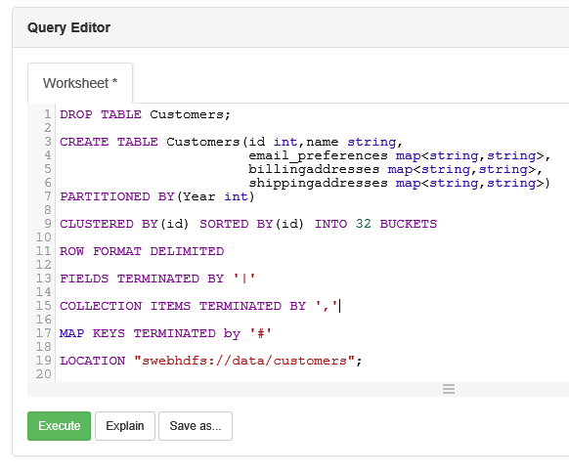
Hive Table Creation
Hive supports complex types such as “map”
Internal Tables | Manage/control the data. If an internal table is dropped, the associated data is deleted. Default.
External Tables | Do not manage/control the data. If an external table is dropped the associated data is not deleted.
LOCATION | Location of the data can be specified with LOCATION keyword Location can be a HDFS folder that already has the data. Or data can be added later to an empty folder. If not specified, default is: /hive/warehouse/
Multiple Views | Multiple tables can point to the same data
HDInsight Hive Tables can directly point to Azure Data Lake Store files
* Order table creation is shown in notes sections
Notes:
DROP TABLE Orders;
CREATE TABLE Orders(id int,orderid string,orderdate string,items map<string,string>)
ROW FORMAT DELIMITED
FIELDS TERMINATED BY '|'
COLLECTION ITEMS TERMINATED BY ','
MAP KEYS TERMINATED by '#';

Slide 13


Loading Data into Hive Tables
Options
Load local data | LOAD DATA LOCAL INPATH ... INTO TABLE … hadoop dfs –put ‘local source’ ‘destination’
Load data from other Hive tables | INSERT INTO TABLE ‘destination-hive-table’ SELECT ‘select-statement’ FROM ‘source-hive-table’
Insert values directly | INSERT INTO TABLE ‘tablename’ VALUES (row1_values), (row2_values), ….
Local File
/hive/warehouse/customer
‘/home/dataset/customers_address_hive’
Hadoop/HDFS
* Loading data into orders table is shown in the notes sections
Notes:
LOAD DATA LOCAL INPATH '/home/snapssh/dataset/customers_orders_hive' OVERWRITE INTO table Orders;
Note that all the data has been loaded into the year=2015 partition. Now the year can be used in queries for partition elimination as if it was a regular table column.

Slide 14
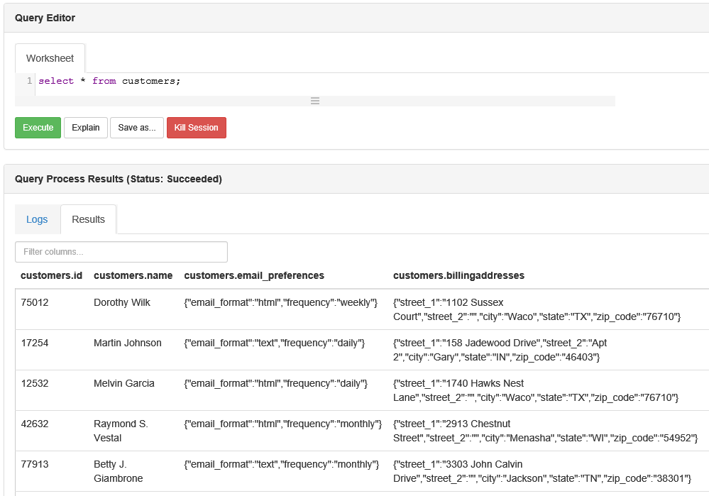
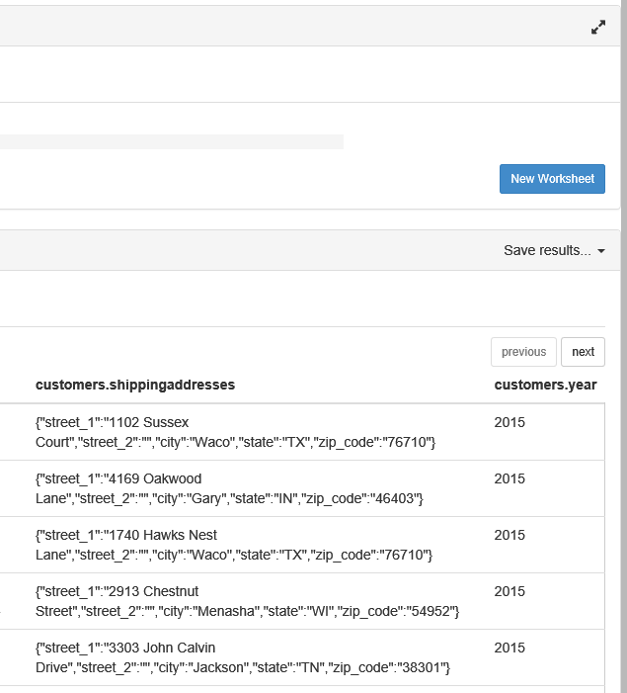
Customers Table

Slide 15
HiveQL Overview
SQL-like syntax: SELECT … FROM … WHERE
ALL and DISTINCT
Support for Partitioning
GROUP BY
SORT BY, ORDER BY, CLUSTER BY, DISTRIBUTE BY
JOINs: LEFT, RIGHT, FULL, OUTER, LEFT SEMI, CROSS JOIN
Built-in: Operators, Functions, Aggregate Functions
User Defined Functions (UDFs)
Support for Subqueries
Windowing and Analytics Functions
HiveQL

Slide 16
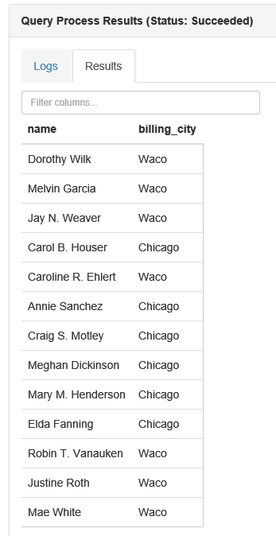
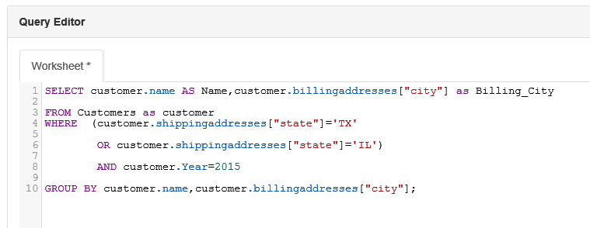
HiveQL
Query: Find name and billing city of customers with shipping addresses in ‘TX’ or ‘IL‘. Group by City.

Slide 17
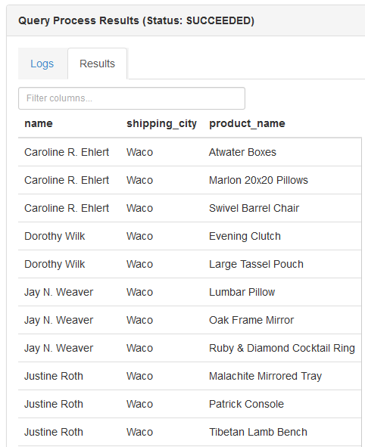
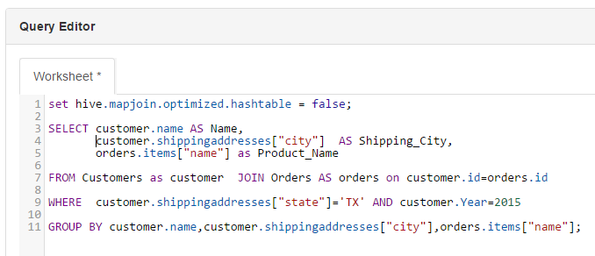
HiveQL
Query: Find names of products purchased by customers whose shipping address is in Texas.

Slide 18
HDI on Linux: HiveQL Execution Choices
Tool | Interactive Shell | Batch Processing | Client OS
Hive View |  |  | Any (browser based)
Beeline Command (from an SSH session) |  |  | Linux, Unix, Mac OS X, or Windows
Hive Command (from an SSH session) |  |  | Linux, Unix, Mac OS X, or Windows
Curl |  |  | Linux, Unix, Mac OS X, or Windows
HDInsight tools for Visual Studio |  |  | Windows
Windows PowerShell |  |  | Windows

Slide 19
Comparing RDBMS and Hive
 | RDBMS DW | Hive
Structure | Schema On Write | Schema On Read
Access | SQL | HiveQL
Indexes | Yes | Yes
Updates | Yes | No
Locking | Yes | Table and Partition
Referential Integrity | Yes | No
Query Optimization | Yes | No
Access Pattern | Read and Write many times | Write Once, Read-many-times
OLTP Applications | Yes | No

Slide 20
Defining a Hive-Managed Table
CREATE TABLE customer (
customerID INT,
firstName STRING,
lastName STRING,
birthday TIMESTAMP
) ROW FORMAT DELIMITED
FIELDS TERMINATED BY ',';
Notes:
A Hive managed table means that when the table is dropped, the underlying folder in HDFS is deleted.

Slide 21
Defining an External Table
CREATE EXTERNAL TABLE salaries (
gender string,
age int,
salary double,
zip int
) ROW FORMAT DELIMITED
FIELDS TERMINATED BY ',';
Notes:
If the table is EXTERNAL, then the data remains in HDFS if the table is dropped.

Slide 22
Defining a Table LOCATION
CREATE EXTERNAL TABLE SALARIES (
gender string,
age int,
salary double,
zip int
) ROW FORMAT DELIMITED
FIELDS TERMINATED BY ','
LOCATION '/user/train/salaries/';
Notes:
The LOCATION directive allows you to specify the folder that is associated with the table.

Slide 23
Loading Data into Hive
LOAD DATA LOCAL INPATH ’/tmp/customers.csv' OVERWRITE INTO TABLE customers;
LOAD DATA INPATH '/user/train/customers.csv' OVERWRITE INTO TABLE customers;
INSERT INTO TABLE birthdays
SELECT firstName, lastName, birthday
FROM customers
WHERE birthday IS NOT NULL;
Notes:
The data does not actually get “loaded” into anything, but the data does get moved:
- For Hive-managed tables, the data is moved into a special Hive subfolders of /apps/hive/warehouse
- For external tables, the data is moved to the folder specified by the LOCATION clause in the table’s definition

Slide 24
Performing Queries
SELECT * FROM customers;
FROM customers SELECT firstName, lastName, address, zip WHERE orderID > 0 ORDER BY zip;
SELECT customers.*, orders.* FROM customers JOIN orders ON (customers.customerID = orders.customerID);
Notes:
This is a simple slide that is meant to demonstrate how Hive queries look exactly like SQL queries.

Slide 25
Hive Partitions
Use the partitioned by clause to define a partition when creating a table:
create table employees (id int, name string, salary double)
partitioned by (dept string);
Subfolders are created based on the partition values:
/apps/hive/warehouse/employees
/dept=hr/
/dept=support/
/dept=engineering/
/dept=training/
Notes:
You can define a table to have a partition, which results in the underlying data being stored in files partitioned by a specified column (or columns) in the table. Partitioning the data can greatly improve the performance of queries because the data is already separated into files based on the column value, which can decrease the number of mappers and greatly decrease the amount of shuffling and sorting of data in the resulting MapReduce job.

Slide 26

Hive Buckets
input
records
the column value is hashed
The table’s data is divided up into buckets
bucket 0
bucket 1
bucket 2
Notes:
Hive tables can be organized into buckets, which imposes extra structure on the table and the way the underlying files are stored. Buckets are created using the clustered by clause.

Slide 27
Skewed Tables
CREATE TABLE Customers (
id int,
username string,
zip int
)
SKEWED BY (zip) ON (57701, 57702) STORED as DIRECTORIES;
Notes:
By specifying the values with heavy skew, Hive will split those out into separate files automatically and take this fact into account during queries so that it can skip whole files if possible.

Slide 28
Sorting Data
Hive has two sorting clauses:
order by: a complete ordering of the data
sort by: data output is sorted per reducer
Notes:
Order by implements a total ordering across all reducers.

Slide 29
Using Distribute By
insert overwrite table mytable
select gender,age,salary
from salaries distribute by age;
insert overwrite table mytable select gender,age,salary
from salaries
distribute by age
sort by age;
Notes:
Hive uses the columns in distribute by to distribute the rows among reducers. In other words, all rows with the same distribute by columns will go to the same reducer.

Slide 30
Storing Results to a File
INSERT OVERWRITE DIRECTORY '/user/train/ca_or_sd/' from names
select name, state where state = 'CA'
or state = 'SD';
INSERT OVERWRITE LOCAL DIRECTORY '/tmp/myresults/' SELECT * FROM bucketnames ORDER BY age;
Notes:
The only Hive queries the students have seen up until now have run from the Hive shell. Here we finally discuss how to store the result into a folder.

Slide 31
Specifying MapReduce Properties
SET mapreduce.job.reduces = 12
hive -f myscript.hive
-hiveconf mapreduce.job.reduces=12
SELECT * FROM names
WHERE age = ${age}
hive -f myscript.hive -hivevar age=33
Notes:
You can specify some of the properties of that underlying MapReduce job in Hive using the SET command.

Slide 32
Hive Join Strategies

Slide 33
Hive Join Strategies
Type | Approach | Pros | Cons
Shuffle Join | Join keys are shuffled using MapReduce, and joins are performed on the reduce side. | Works regardless of data size or layout. | Most resource-intensive and slowest join type.
Map (Broadcast) Join | Small tables are loaded into memory in all nodes, mapper scans through the large table, and joins. | Very fast, single scan through largest table. | All but one table must be small enough to fit in RAM.
Sort-Merge-Bucket Join | Mappers take advantage of co-location of keys to do efficient joins. | Very fast for tables of any size. | Data must be sorted and bucketed ahead of time.
Notes:
- Shuffle joins always work in the sense that if you cannot perform a more efficient type of join, two tables can always be joined using a shuffle join
- A map join is very efficient and ideal if one side of the join is a small enough dataset to fit into memory
- If a map join is not an option, then the next best option is a sort-merge-bucket join, which we will discuss in more detail.

Slide 34
Shuffle Joins
customer |  |  |  | orders
first | last | id |  | cid | price | quantity
Nick | Toner | 11911 |  | 4150 | 10.50 | 3
Jessie | Simonds | 11912 |  | 11914 | 12.25 | 27
Kasi | Lamers | 11913 |  | 3491 | 5.99 | 5
Rodger | Clayton | 11914 |  | 2934 | 39.99 | 22
Verona | Hollen | 11915 |  | 11914 | 40.50 | 10
SELECT * FROM customer JOIN orders ON customer.id = orders.cid;
{ id: 11911, { first: Nick, last: Toner }}
{ id: 11914, { first: Rodger, last: Clayton }}
…
M
R
{ id: 11911, { first: Nick, last: Toner }}
{ cid: 4150, { price: 10.50, quantity: 3 }}
…
{ cid: 4150, { price: 10.50, quantity: 3 }}
{ cid: 11914, { price: 12.25, quantity: 27 }}
…
M
R
{ id: 11914, { first: Rodger, last: Clayton }}
{ cid: 11914, { price: 12.25, quantity: 27 }}
Notes:
This is the first of 3 slides that have the exact same SELECT query, but each one executes differently. This one runs as a shuffle join. A shuffle join is the default join technique for Hive, and it works with any data sets (no matter how large).

Slide 35
Map (Broadcast) Joins
customer |  |  |  | orders
first | last | id |  | cid | price | quantity
Nick | Toner | 11911 |  | 4150 | 10.50 | 3
Jessie | Simonds | 11912 |  | 11914 | 12.25 | 27
Kasi | Lamers | 11913 |  | 3491 | 5.99 | 5
Rodger | Clayton | 11914 |  | 2934 | 39.99 | 22
Verona | Hollen | 11915 |  | 11914 | 40.50 | 10
SELECT * FROM customer JOIN orders ON customer.id = orders.cid;
{ id: 11914, { first: Rodger, last: Clayton }}
{ cid: 11914, { price: 12.25, quantity: 27 },
cid: 11914, { price: 12.25, quantity: 27 }}
M
Records are joined during
the map phase.
Notes:
If one of the datasets is small enough to fit into memory, then it can be distributed (broadcast) to each mapper and perform the join in the map phase.
In HDP 2.x, Hive joins are automatically optimized without the need for providing hints.

Slide 36
Sort-Merge-Bucket Joins
customer |  |  |  | orders
first | last | id |  | cid | price | quantity
Nick | Toner | 11911 |  | 4150 | 10.50 | 3
Jessie | Simonds | 11912 |  | 11914 | 12.25 | 27
Kasi | Lamers | 11913 |  | 11914 | 40.50 | 10
Rodger | Clayton | 11914 |  | 12337 | 39.99 | 22
Verona | Hollen | 11915 |  | 15912 | 40.50 | 10
SELECT * FROM customer join orders ON customer.id = orders.cid;
Distribute and sort by the most common join key.
CREATE TABLE orders (cid int, price float, quantity int)
CLUSTERED BY(cid) SORTED BY(cid) INTO 32 BUCKETS;
CREATE TABLE customer (id int, first string, last string)
CLUSTERED BY(id) SORTED BY(cid) INTO 32 BUCKETS;
Notes:
If you have two datasets that are too large for a map-side join, an efficient technique for joining them is to sort the two datasets into buckets. The trick is to cluster and sort by the same join key.

Slide 37
Invoking a Hive UDF
ADD JAR /myapp/lib/myhiveudfs.jar;
CREATE TEMPORARY FUNCTION ComputeShipping
AS 'hiveudfs.ComputeShipping';
FROM orders SELECT
address,
description,
ComputeShipping(zip, weight);
Notes:
Similar to Pig, Hive has the ability to use User-Defined Functions written in Java to perform computations that would otherwise be difficult (or impossible) to perform using the built-in Hive functions and SQL commands.

Slide 38
Computing ngrams in Hive
select ngrams(sentences(val),2,100) from mytable;
select context_ngrams(sentences(val), array("error","code",null), 100) from mytable;
Notes:
An ngram is a subsequence of text within a large document. The “n” represents the length of the subsequence. The result of an ngram is a frequency distribution

