Slide 1
VS_helper
Local Code Completion for VS Code
Soorya Prataap Ray
24BAI1008
SCOPE, VIT Chennai
DA Final Project Demo
Individual submission
1
Notes:
Introduce yourself and the project. This is the local Ollama version of the extension. Author details confirmed by the user and the project reports.

Slide 2
Problem Statement and Scope
Cloud code completion needs an external service and internet access.
The aim is to show code suggestions using a model on the same computer.
The extension supports Python, JavaScript, TypeScript, JSX and TSX.
It uses nearby code in the active file. Full repository search is outside the current scope.
2
Notes:
Cloud code assistants may send source context outside the computer. This project offers local active-document completion. It is a small extension, not a full repository assistant. Sources: src/core.ts, src/ollama.ts, src/extension.ts and the two supplied project reports.

Slide 3
System Architecture and Design
VS Code
editor
Context and
prompt
Local Ollama
model
Output
cleanup
Inline
suggestion
TypeScript extension + VS Code API + Ollama + Qwen 2.5 Coder 1.5B
Local endpoint: http://127.0.0.1:11434
The developer reviews the suggestion and presses Tab to insert it.
3
Notes:
Explain the path from typing to accepting a suggestion. The extension uses TypeScript and the VS Code inline-completion API. GET /api/tags lists installed local models. POST /api/generate generates code. The demo uses qwen2.5-coder:1.5b through local Ollama. Sources: src/extension.ts, src/core.ts, src/ollama.ts. API references: https://code.visualstudio.com/api/references/vscode-api and https://docs.ollama.com/api/generate.

Slide 4
Key Features
Native ghost-text suggestions with Tab to accept and Escape to dismiss.
Model selection, connection testing and an enable or disable control.
A short typing delay and cancellation of outdated requests.
Context limits and cleanup of repeated code or extra explanations.
Loopback-only Ollama addresses, with HTTP redirects blocked.
4
Notes:
These are implemented behaviors, not proposed features. Source: package.json, src/extension.ts, src/core.ts and src/ollama.ts. The active local mode does not use the optional Groq demo adapter.

Slide 5
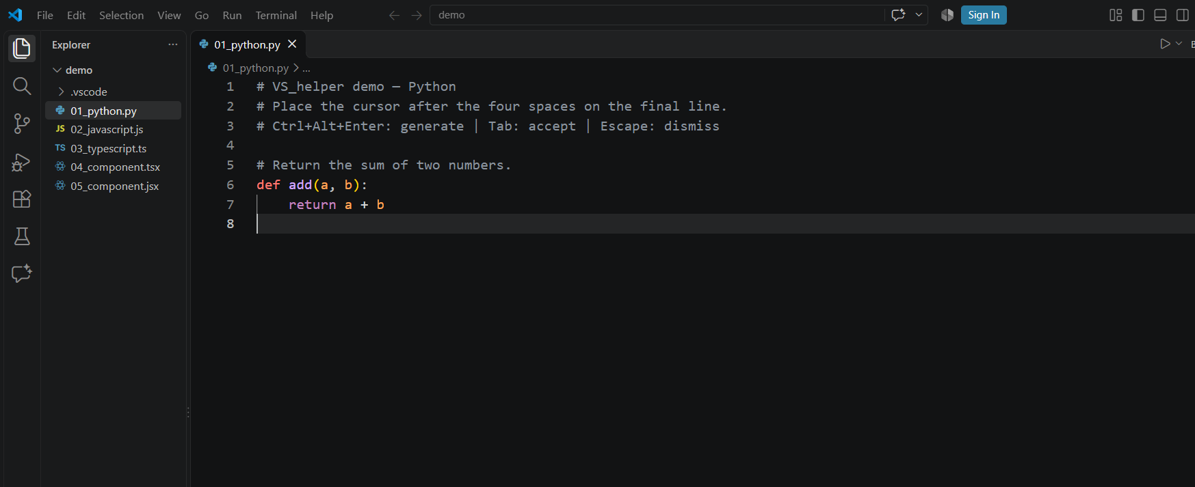
Live Demo Screenshot
Python example: the accepted suggestion completes the add function.
5
Notes:
Actual screenshot supplied by the user after accepting the Python completion. It shows the inserted return statement, not a fabricated ghost-text preview. Source: docs/python-completion.png. In the live recording, first remove the return statement, request a suggestion, show the grey preview, then accept it with Tab.

Slide 6
Testing and Current Result
43 unit tests passed for context, cleanup, cancellation and transport behavior.
Local Python, JavaScript and TypeScript examples passed simple function checks.
The live editor test passed native suggestion triggering and acceptance.
The current demo runs qwen2.5-coder:1.5b through local Ollama.
These small tests do not guarantee that every generated suggestion is correct.
6
Notes:
Current implementation validation: 43 unit tests passed, three real local-model function checks passed, and four live Extension Host checks passed including Python, JavaScript, TypeScript and native inline-trigger/commit. Sources: test/core.test.cjs, test/groq.test.cjs, results/local-verification.json and results/live-extension-test.json. Do not combine these results with the historical 72-generation Qwen/Mistral benchmark in the papers.

Slide 7
Challenges and Future Improvements
Challenges
Slow and interrupted model download
Extra code after the requested function
Shortcut conflicts with other apps
Future improvements
Test larger and more varied coding tasks
Compare more local code models
Measure real editing delay and suggestion acceptance
7
Notes:
Mention concrete issues from implementation. The model download stalled, so downloads were resumed and verified against SHA-256 digests. The model sometimes continued into unrelated code, so boundary cleanup and stop sequences were added. System-wide shortcuts conflicted, so an editor toolbar action and Command Palette route are available. Future improvements remain planned, not implemented.

Slide 8
Source Code and Local Setup
Public repository
https://github.com/Soorya-Ray/VS_helper
Install Node.js, VS Code and Ollama, then pull qwen2.5-coder:1.5b.
Run npm install and npm run package. Install the generated VSIX.
Select Ollama and test the provider connection in VS_helper.
Open a demo file, request a suggestion and accept it with Tab.
Live app URL: not applicable for this desktop extension.
8
Notes:
Public source repository: https://github.com/Soorya-Ray/VS_helper. A hosted live-app URL is not applicable because this is a desktop VS Code extension. The README includes setup, local runtime configuration and optional Groq SecretStorage instructions without keys. The demo video must be recorded with the student’s own narration or photo and uploaded directly to Teams.

