Slide 1
Real Time Monitoring of Pet-Health via IoT-Enabled Smart Systems.
SOORYA GANESH S ( 61781921103118 )
SANTHOSHRAJ G (61781921103111)
B.E ECE
Name of the Supervisor Dr.T. Shanthi.M.E.,PhD.
Associate Professor.

Slide 2
Introduction :
This IoT-based Pet Health Monitoring System tracks a pet’s heart rate, temperature, and location in real-time. It uses IoT sensors to collect biometric data and provide instant health insights. The system helps pet owners monitor their pet’s well-being remotely, ensuring timely intervention in case of abnormalities.

Slide 3
Problem Identified :
Pets often suffer from unnoticed health issues due to a lack of continuous monitoring. This project addresses the need for a real-time Pet Health Monitoring System that tracks vital signs like heart rate, temperature, and location. By providing instant health insights, the system enables early detection of abnormalities, ensuring timely medical attention and improved pet well-being.

Slide 4
Existing method :
Manual Checkups (Vet Visits)
What it is: Traditional method where pets are taken to a vet for routine checkups or if any illness is suspected.
Drawbacks:
Time-consuming and costly.
Camera-based Monitoring
What it is: CCTV or smart cameras for tracking movement and behavior remotely.
Drawbacks:
Cannot track internal health metrics.

Slide 5
Proposed Work :
Sensor Setup – Integrate pulse sensor, NTC temperature sensor, Respiratory rate sensor and GPS module to monitor pet health and location.
Real-Time Data Monitoring – Continuously collect and display health readings on a 16x2 LCD.
Abnormality Detection – Establish thresholds for vital signs and trigger alerts when readings exceed normal limits.
Testing & Validation – Test the system for accuracy and reliability in real-world scenarios.
Deployment – Implement the system on pets for continuous health monitoring and alerts.

Slide 6
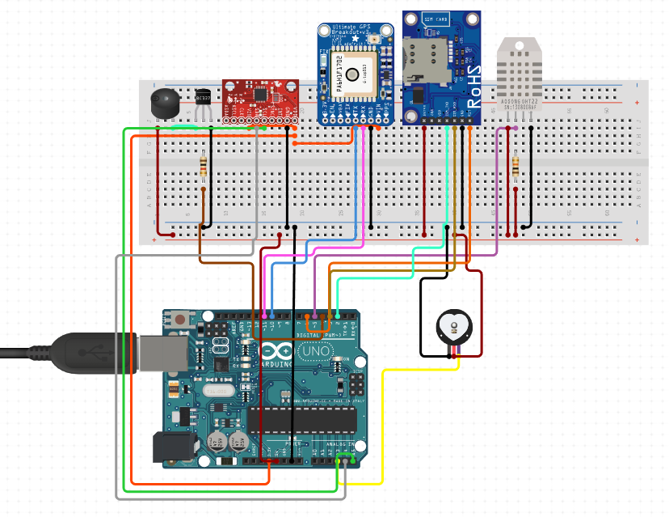
Work flow :
Temperature sensor(NTC thermistors)
Micro-controller
Monitoring Screen / cloud platform
Pulse Sensor
Alert Generation
MPU6050 sensor
GPS Module

Slide 7
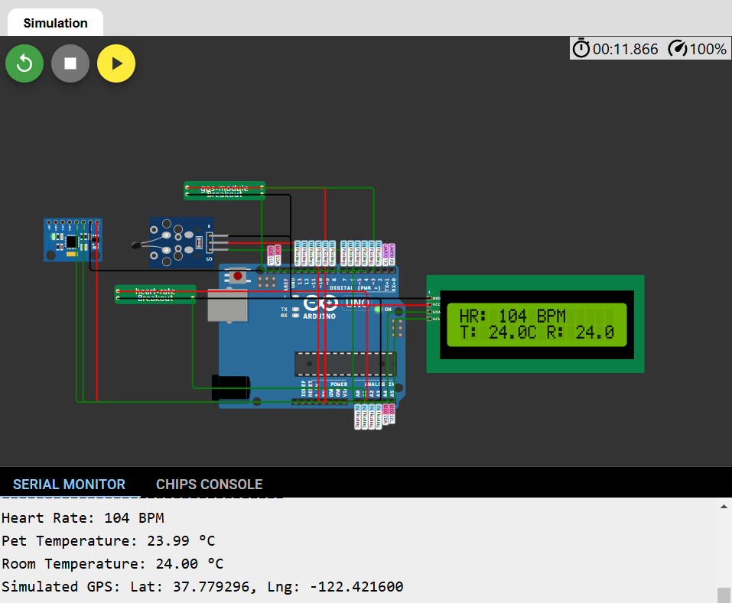
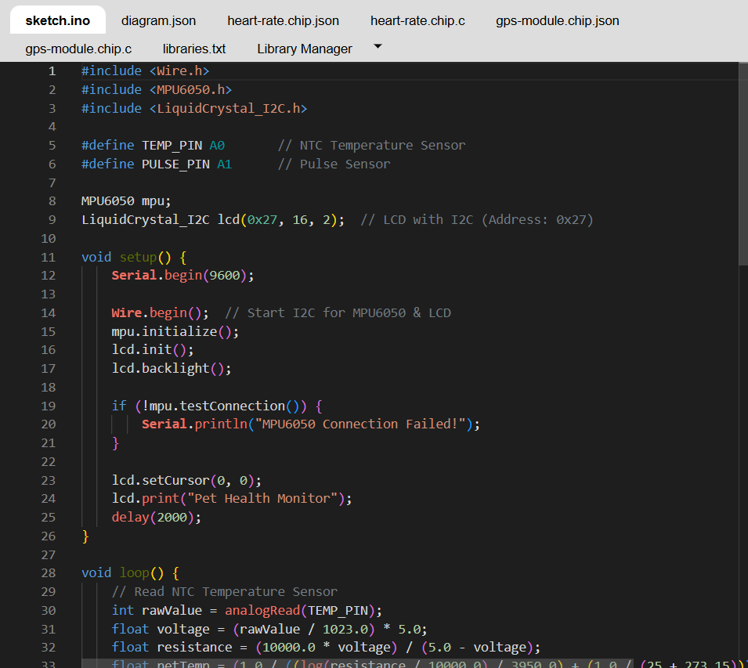
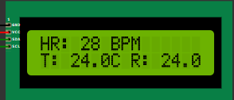
Proposed Output :

Slide 8
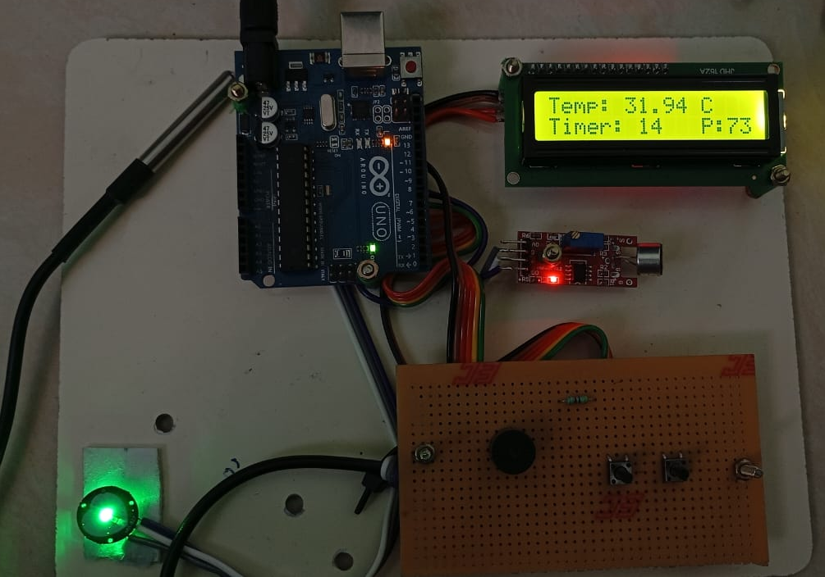
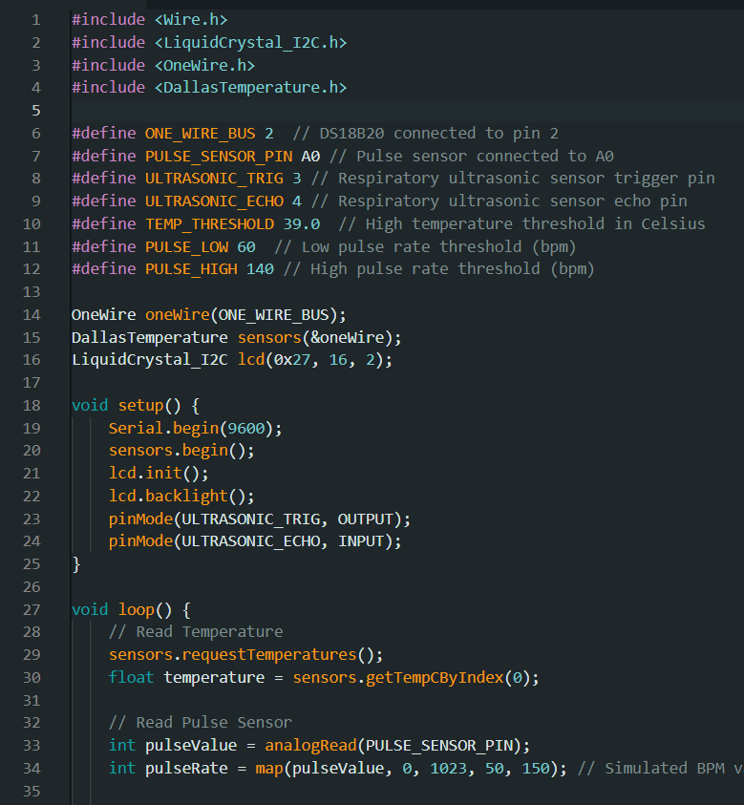
Hardware & Coding :

Slide 9
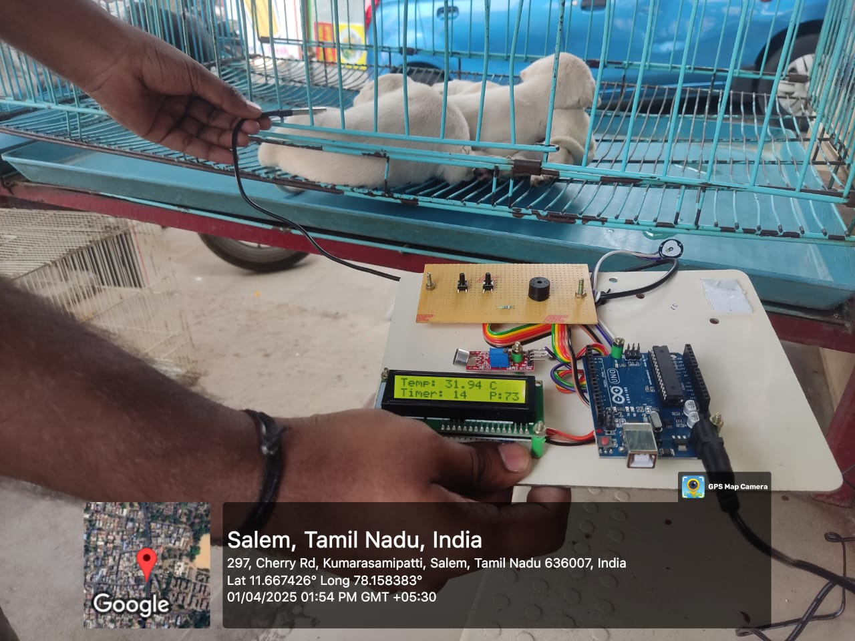
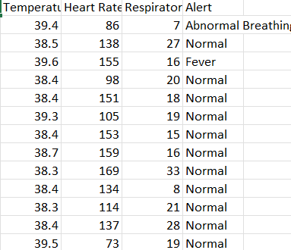
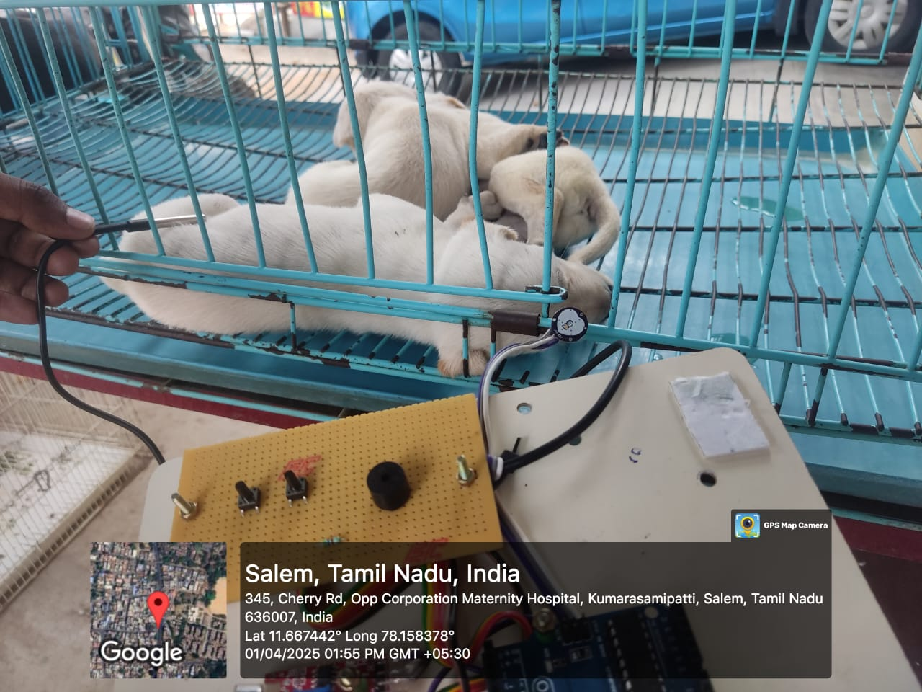
Results & real time data collected :

Slide 10
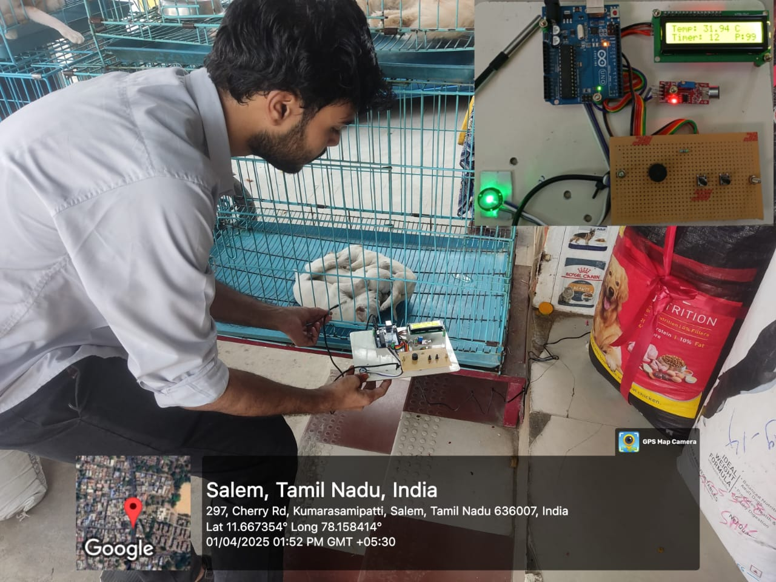
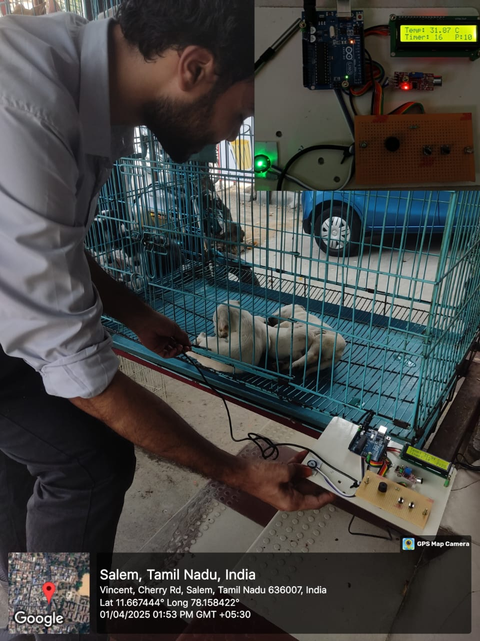
Results & real time data collected :

Slide 11
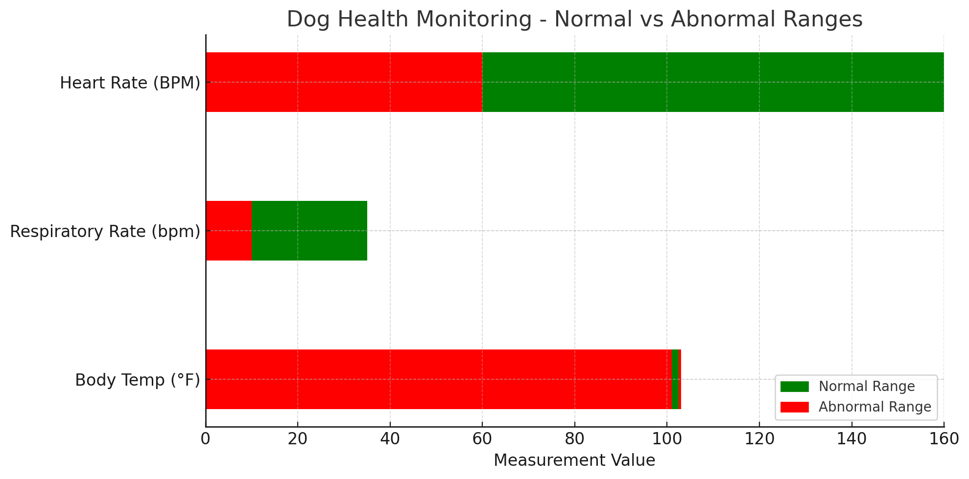
Threshold Values :
Parameter | Normal Range | Abnormal / Alert Threshold
Heart Rate (BPM) | 60–100 (large dogs) 100–160 (small dogs/puppies) | < 60 or > 160 BPM
Body Temperature | 101°F – 102.5°F (38.3°C – 39.2°C) | < 100°F (37.7°C) or > 103°F (39.4°C)
Respiratory Rate | 10–35 breaths per minute | < 10 or > 35 breaths/min (if tracked)

Slide 12
Conference/publication status :
Name of the conference applied | status
3rd International Conference on Applications of AI in Smart Technologies and Manufacturing (AISTM - 2025)-Marri Laxman Institute of Technology March 07 & 08 2025. | Manuscript has been accepted by the conference. Presentation has been done on the Aistm conference. Paper will be published on Taylor & Francis on May firs week.

Slide 13
References:
V. B. Shalini, "Smart Health Care Monitoring System based on Internet of Things (IOT)," 2021 International Conference on Artificial Intelligence and Smart Systems (ICAIS), Coimbatore, India, 2021, pp. 1449-1453.
S. Gera, M. Mridul and S. Sharma, "IoT based Automated Health Care Monitoring System for Smart City," 2021 5th International Conference on Computing Methodologies and Communication (ICCMC), Erode, India, 2021, pp. 364-368.
Y. Xu et al., "Intelligent pet protection system based on IoT devices," 2022 IEEE International Conference on Mechatronics and Automation (ICMA), Guilin, Guangxi, China, 2022, pp. 629-634.
J. E. Mackewn et al., "PET Performance Evaluation of a Pre-Clinical SiPM-Based MR-Compatible PET Scanner," in IEEE Transactions on Nuclear Science, vol. 62, no. 3, pp. 784-790, June 2015.
M. Bembde, A. Chavan, P. Kamble, A. Yelmar and R. Mane, "Automatic Pet Day–Care Robot," 2022 OPJU International Technology Conference on Emerging Technologies for Sustainable Development (OTCON), Raigarh, Chhattisgarh, India, 2023.

Slide 14
References:
S. Nithin Wilfred Reyu and J. Pearly Princess, "IoT based Pet Health Monitoring System for Sick Pets," 2024 3rd International Conference on Applied Artificial Intelligence and Computing (ICAAIC), Salem, India, 2024, pp. 1648-1652,
M. Tauseef, E. Rathod, S. M. Nandish and M. G. Kushal, "Advancements in Pet Care Technology: A Comprehensive Survey," 2024 4th International Conference on Data Engineering and Communication Systems (ICDECS), Bangalore, India, 2024, pp. 1-6.
Williams Evan, Zachary Cleghern, Marc Foster, Timothy Holder, David Roberts and Alper Bozkurt, "A smart collar for assessment of activity levels and environmental conditions for guide dogs", 2020 42nd Annual International Conference of the IEEE Engineering in Medicine & Biology Society (EMBC), pp. 4628-4631.
Darwis Dedi, Abhishek R. Mehta, Novi Eka Wati, Selamet Samsugi and Priya R. Swaminarayan, "Digital Smart Collar: Monitoring Cow Health Using Internet of Things", 2022 International Symposium on Electronics and Smart Devices (ISESD), pp. 1-5, 2022.

Slide 15
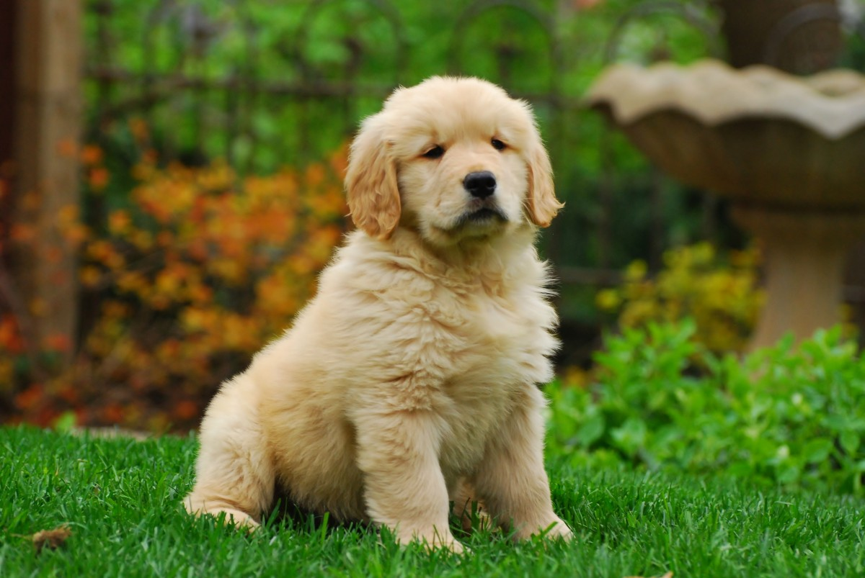

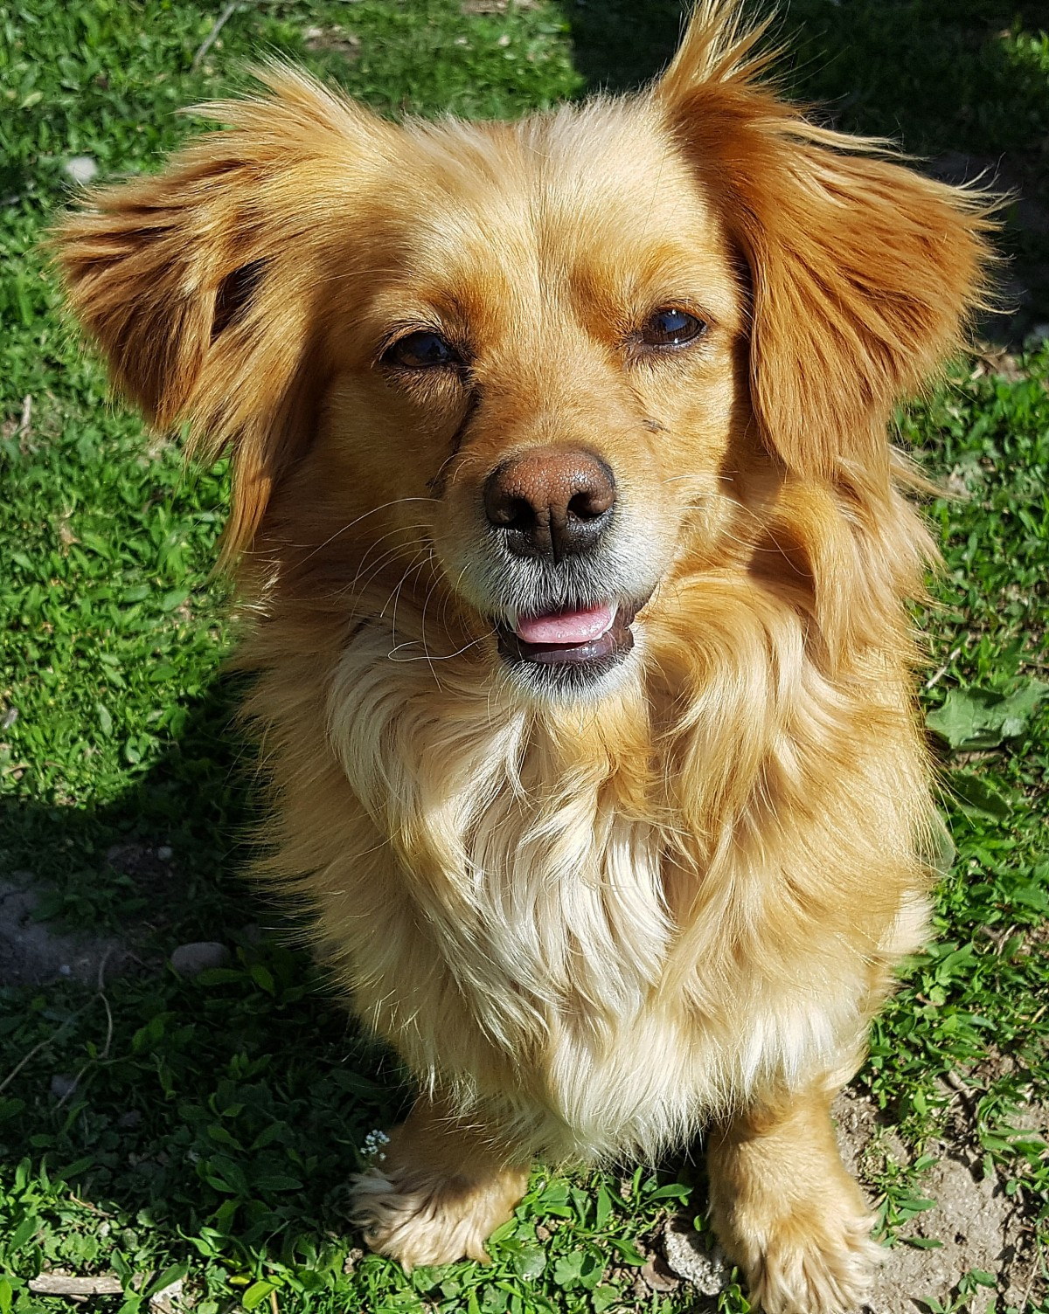

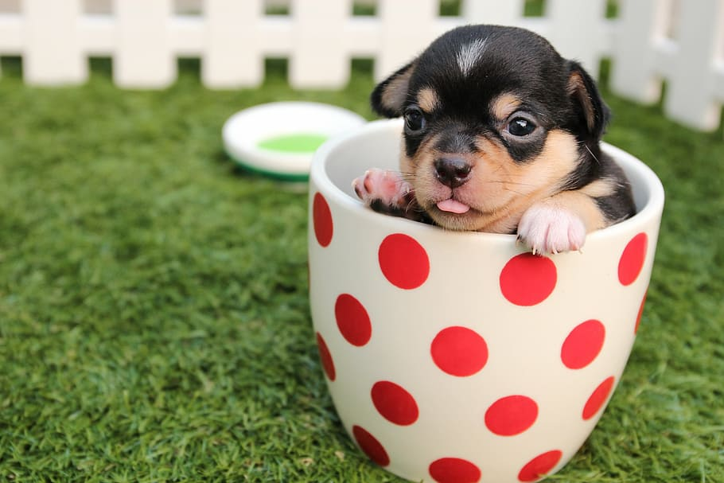
THANK
YOU!!

