Slide 1
Imbalanced Binary Classification using User-Automated Artificial Neural Networks
-Akash Choudhuri
M.Sc in Mathematics with Data Science

Slide 2
Topics:
Introduction to Machine Learning.
Neural Networks and Artificial Neural Networks
Tensorflow and Keras
Live Demonstration

Slide 3
Introduction to Machine Learning

Slide 4
What is Machine Learning?
A computer program is said to learn from experience E with respect to some class of tasks T and performance measure P, if its performance at tasks in T, as measured by P, improves with experience E.
-Tom Mitchell

Slide 5
Types of Learning
Supervised Learning: Given a data set and already know what our correct output should look like, having the idea that there is a relationship between the input and the output.
Unsupervised Learning: Little or no idea what our results should look like. We can derive structure from data where we don’t necessarily know the effect of the variables.
Reinforcement Learning: How software agents ought to take actions in an environment so as to maximize some notion of cumulative reward. Concept of Rewarding and Punishment.

Slide 6
Supervised Learning
Classification: Predict results in a discrete output. In other words, we are trying to map input variables into discrete categories.
Regression: Predict results within a continuous output, meaning that we are trying to map input variables to some continuous function.

Slide 7
Neural Networks and Artificial Neural Networks (A bit of Deep Learning too)

Slide 8
What is Deep Learning?
Deep Learning is a subfield of machine learning concerned with algorithms inspired by the structure and function of the brain called artificial neural networks.
Andrew Ng formally founded Google Brain that eventually resulted in deep learning technologies across a large number of Google services.
The core of deep learning according to Andrew is that we now have fast enough computers and enough data to actually train large neural networks.
As we construct larger neural networks and train them with more and more data, their performance continues to increase. This is generally different to other machine learning techniques that reach a plateau in performance.

Slide 9
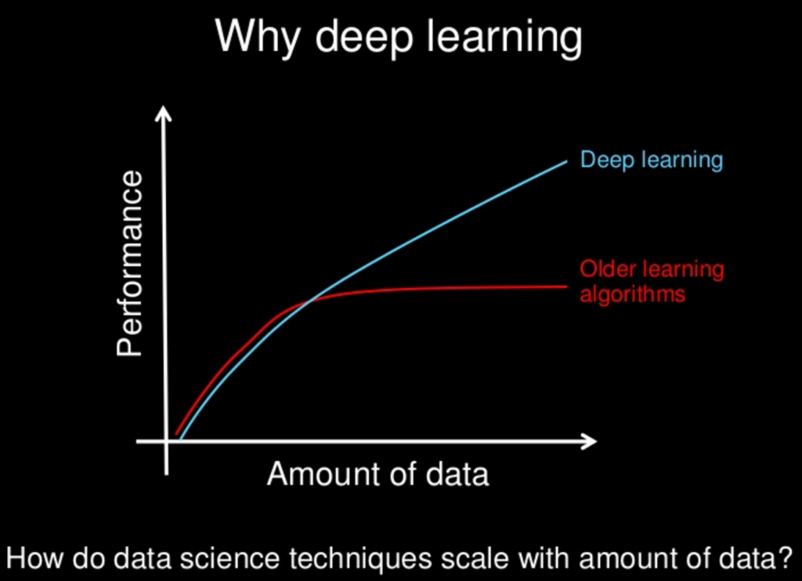
Machine Learning vs Deep Learning

Slide 10
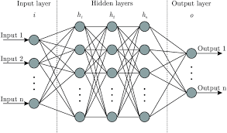
Artificial Neural Networks
Input Layer
Hidden Layer(s)
Weight Initializer and Activation Function
Optimizer and Learning Rate
Output Layer

Slide 11
Tensorflow and Keras

Slide 12

Tensorflow
TensorFlow is a Python library for fast numerical computing created and released by Google.
It is a foundation library that can be used to create Deep Learning models directly or by using wrapper libraries that simplify the process built on top of TensorFlow.
It can run on single CPU systems, GPUs as well as mobile devices and large scale distributed systems of hundreds of machines.
TensorFlow works with Python 2.7 and Python 3.3+.

Slide 13

Keras
Keras is a minimalist Python library for deep learning that can run on top of Theano or TensorFlow.
It was developed to make implementing deep learning models as fast and easy as possible for research and development.
Keras was developed and maintained by François Chollet, a Google engineer.
The focus of Keras is the idea of a model. The main type of model is called a Sequence which is a linear stack of layers. You create a sequence and add layers to it in the order that you wish for the computation to be performed.

Slide 14
You can try to discover TensorFlow from:
https://www.tensorflow.org/
Or view their Github repository:
https://github.com/tensorflow
You can try to discover Keras from:
https://keras.io/
Or view their Github repository:
https://github.com/keras-team/keras-io

Slide 15
Live Demonstration

