Slide 1
EpiDeep: Exploiting Embeddings for Epidemic Forecasting
Bijaya Adhikari, Xinfeng Xu, Naren Ramakrishnan and B. Aditya Prakash

Slide 2
Key Contributions
A novel Deep Learning Approach for ILI forecasting using Query Length and Full Length Data Clustering.
High performance which has been used as a comparative model for various latter studies.
Leverages the usage of finding similarities in current data trend from historical data trend.

Slide 3
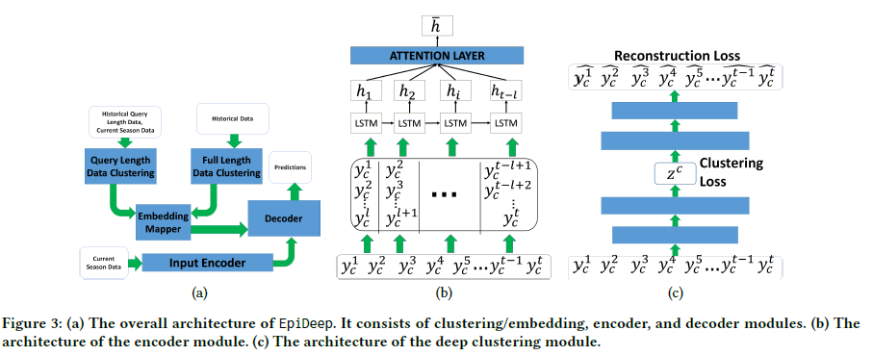
Model Architecture

Slide 4
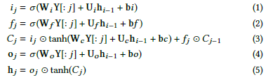

Input Encoding
For the jth input to LSTM of Y represented by Y[: j], the equations are:
However, due to backfill of Data, the output of the LSTM should be a weighted sum of previous states: the Context vector Hj= ∑z αjzhjz where,

Slide 5

Closest Season based on Deep Clustering
This consists of Clustering for query length data and the same for full length data. Improved Deep Embedded Clustering Approach is used here.
For given encoded vector zi obtained from the encoder, we compute similarity measures of it with the cluster mean using T- Distribution (qij) and then quantify it in clustering objective:
Where pij is the target distribution given by:

Slide 6
Steering a Historical Disease Forecasting Model Under a Pandemic: Case of Flu and COVID-19
Alexander Rodríguez, Nikhil Muralidhar, Bijaya Adhikari, Anika Tabassum,
Naren Ramakrishnan, B. Aditya Prakash

Slide 7
Key Contributions
This work seems to leverage and modify EpiDeep on the context of Covid-19 to give better forecasting for ILI data consisting of both Influenza and Covid Cases.
It adapts the idea of Heterogenous Transfer Learning and tries to amalgamate information from their proposed CAEM Model and EpiDeep CN.

Slide 8
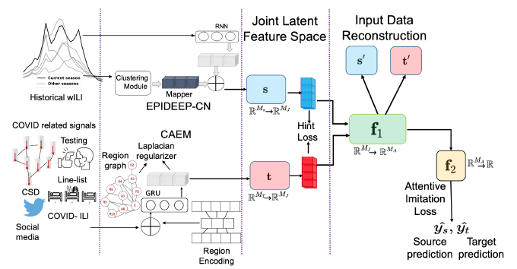
Model Architecture

Slide 9

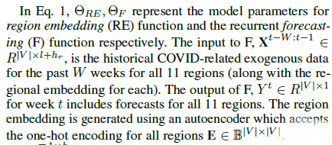
COVID- Augmented Exogenous Model (CAEM)
It jointly models all regions exploiting regional interplay characteristics.
Each region embedding r (produced by an auto-encoder) is encoded and passed to CAEM along with exogenous input data of the region for a particular week.
In each step, GRU receives exogenous data signal and region embedding ri concatenated to form GRU input.
Optimization Objective of CAEM is:

Slide 10
When in Doubt: Neural Non-Parametric Uncertainty Quantification for Epidemic Forecasting
Harshavardhan Kamarthi, Lingkai Kong, Alexander Rodríguez, Chao Zhang, B. Aditya Prakash

Slide 11
Key Contributions
A new deep generative neural Gaussian processes framework for epidemic forecasting, which automatically learns stochastic correlations between query sequences and historical data sequences for non-parametric uncertainty quantification.
It models the output forecast distribution based on similarity between current season’s data till current week and data from each of the historical seasons in a latent space.
Latent variables capture global information of historical seasons and local view of sequence.

Slide 12
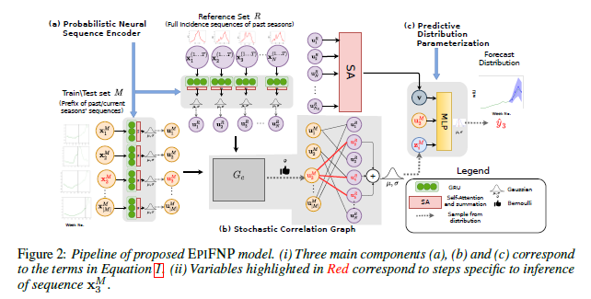
Model Architecture

Slide 13


Probabilistic Neural Sequence Encoder
Input Sequence is passed through a GRU:
As ILI Data is delayed, we cannot depend fully on the last hidden state:
Ui is then computed as a Gaussian having probability Distribution:
Where g1 and g2 are 2 MLPs and [.]k is the k-th dimension of the variable.

Slide 14

Stochastic Data Correlation Graph (Most Important part of This Work)
It is a bipartite graph from the reference set R to the training set M based on the similarity between their sequence embeddings. It models correlation among sequences.
First we construct complete bipartite graph Gc.
But we use G (a stochastic binary bipartite Graph) to encode data correlations.
The Binary Adjacency Matrix is Parameterized by:

Slide 15

Parameterizing Predictive Distribution
Functional uncertainty is captured from different perspectives:
Local latent variable: Summarizes the information of the correlated reference points for each training point and captures the uncertainty of data correlations. It is given by:
Global latent variable: Encodes the information in all the reference points.
Sequence embedding: A direct path from the latent embedding of the training sequence to the final prediction to enable the neural network to extrapolate beyond the distribution of the reference sequences. This is useful in novel/unprecedented patterns where the input sequence can not rely only on reference sequences from historical data for prediction.

Slide 16



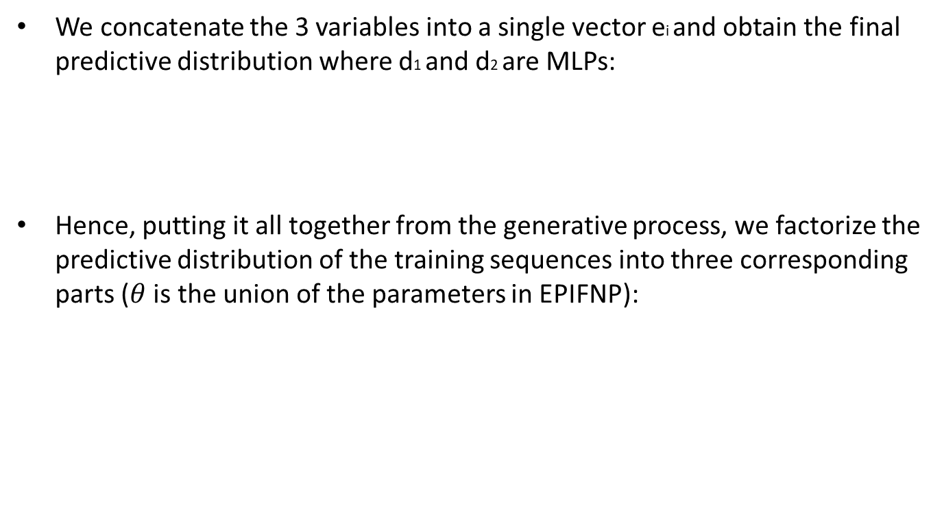
Parameterizing Predictive Distribution (cont)
We concatenate the 3 variables into a single vector ei and obtain the final predictive distribution where d1 and d2 are MLPs:
Hence, putting it all together from the generative process, we factorize the predictive distribution of the training sequences into three corresponding parts ($θ$ is the union of the parameters in EPIFNP):

Slide 17

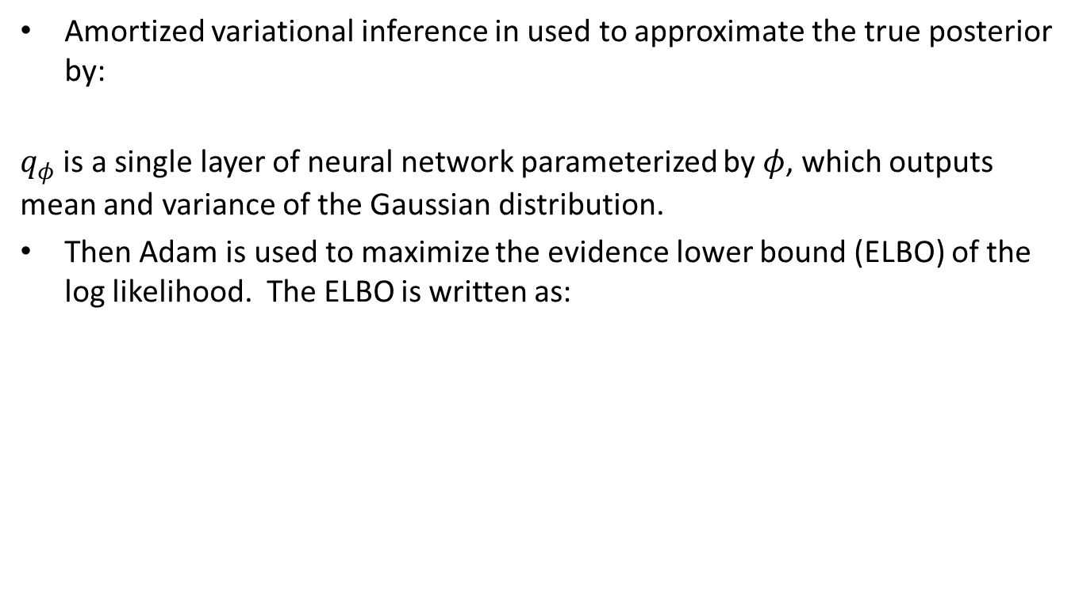
Learning Model Parameters during Training
Amortized variational inference in used to approximate the true posterior by:
$q_{φ}$ is a single layer of neural network parameterized by $φ$, which outputs mean and variance of the Gaussian distribution.
Then Adam is used to maximize the evidence lower bound (ELBO) of the log likelihood. The ELBO is written as:

Slide 18
Back2Future: Leveraging Backfill Dynamics for Improving Real-time Predictions in Future
Harshavardhan Kamarthi, Alexander Rodríguez, B. Aditya Prakash

Slide 19
Key Contributions
It introduces a multivariate backfill problem, which generalizes prior works and discovers various patterns in backfill dynamics.
Based on their findings, the authors introduce a deep-Learning Model Back2Future (B2F), which models backfill revision patterns and derives latent encodings for features. B2F combines GCN and deep sequential models.
The B2F model improves performances of several top performing COVID-19 forecasting Models.

Slide 20
Nature of Backfill Dynamics
Backfill error is significant.
It takes maximum 20 weeks and minimum 7 weeks for the entire dataset to be stable.
The average of the average Backfill Error is around 4 weeks with target Deaths taking over 3 weeks to reach stable values.

Slide 21
Back2Future (B2F)
It is a deep-learning model that uses revision information from BSEQ to refine predictions.
B2F combines these ideas through its four modules:
GRAPHGEN: Generates a signal graph (where each node corresponds to a signal in Reg X Feat) whose edges are based on BSEQ curve similarities.
BSEQENC: Leverages the signal graph as well as temporal dynamics of BSEQs to learn a latent representation of BSEQs using a Recurrent Graph Neural Network.
MODELPREDENC: Encodes the history of model’s predictions, real-time value of target, and past revisions of target through a recurrent neural network.
REFINER: Combines encodings from BSEQENC and MODELPREDENC to predict the correction to model’s real-time prediction.

Slide 22
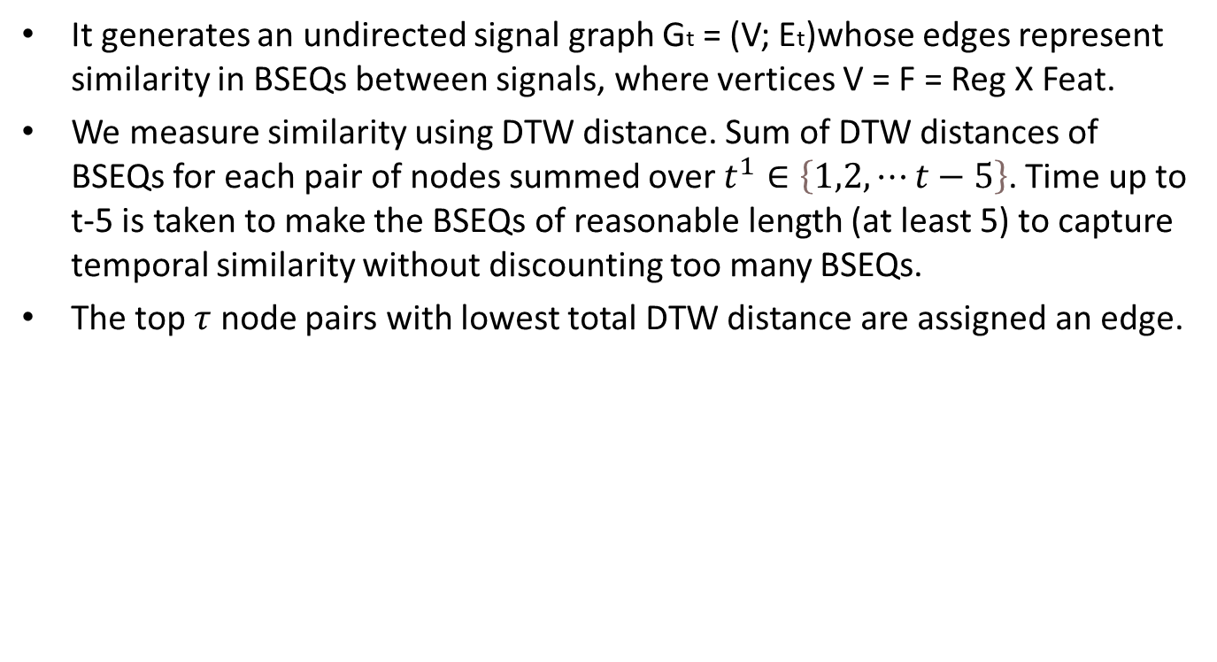
GRAPHGEN
It generates an undirected signal graph Gt = (V; Et)whose edges represent similarity in BSEQs between signals, where vertices V = F = Reg X Feat.
We measure similarity using DTW distance. Sum of DTW distances of BSEQs for each pair of nodes summed over $t^{1}∈\left\{1,2,⋯t−5\right\}$. Time up to t-5 is taken to make the BSEQs of reasonable length (at least 5) to capture temporal similarity without discounting too many BSEQs.
The top $τ$ node pairs with lowest total DTW distance are assigned an edge.

Slide 23
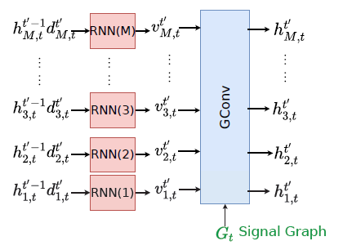
BSEQENC
The structural prior of graph Gt generated by GRAPHGEN is used to train an autoregressive model BSEQENC which consists of graph recurrent neural network to encode a latent representation for each of backfill sequence.

Slide 24
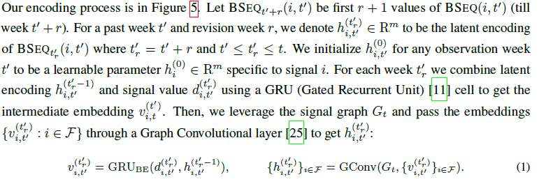
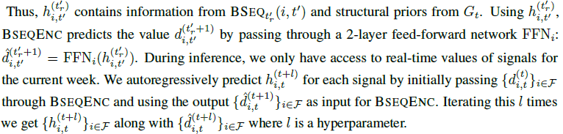
BSEQ Cont.

Slide 25
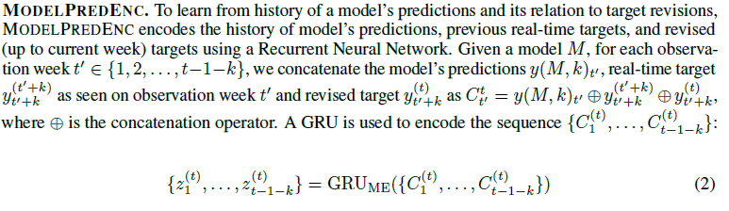
MODELPREDENC

Slide 26



REFINER
It receives the latent encodings of signals ${\left\{h_{i,t}^{\left(t+L\right)}\right\}}_{i}$ from BSEQENC, $z_{t−k−1}^{\left(t\right)}$from MODELPREDENC, and the model’s prediction y(M; k)t for week t.
Take attention over BSEQ encodings from all signals ${\left\{h_{i,t}^{\left(t+L\right)}\right\}}_{i}$ w.r.t y(M; k)t. Multiplicative attention Mechanism with learnable parameter w is used.

