Slide 1
Counterfactual and Factual Reasoning over Hypergraphs for Interpretable Clinical Predictions on EHR
Ran Xu, Yue Yu, Chao Zhang, Mohammed K Ali, Joyce C Ho, Carl Yang
AlgoEpi Reading Group, Fall 2023
14th September 2023

Slide 2
Overview
Integrates higher-order interactions among medical codes and their causal relations towards downstream clinical predictions.
Proposed Model (CACHE) addresses the following challenges:
Limited expressive power:
Each visit has Multiple medical codes
Each code can appear across a set of visits
Crucial to represent the set information to capture relationships between these units.
Non-interpretable prediction:
Prior works try to improve predictions in downstream tasks
Understand how predictions are made by the model is crucial for clinical experts to plan for the treatment

Slide 3
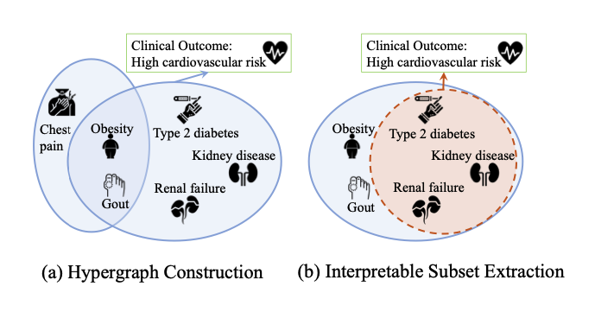
Interpretability
Extract an important set of medical codes for each visit that are both sufficient and necessary for making the correct clinical predictions
In the Figure, the subset constructed is an important set that contains the key factors of the hyperedge, as kidney disease, diabetes and heart disease are highly correlated
There is a subset generation module that considers factual and counterfactual reasoning objectives simultaneously which target sufficiency and necessity respectively

Slide 4
Problem Overview
Given: Clinical EHR consisting of multiple types of Medical Codes (C) including diseases, medications, procedures and services. For each patient, the input of our method is the medical record X containing a set of medical codes, where X ⊂ C.
Objective:
Predict the clinical outcome y of that patient
Generate a subset X’ ⊂ X of the most important elements in X that provides interpretations into the predictions

Slide 5
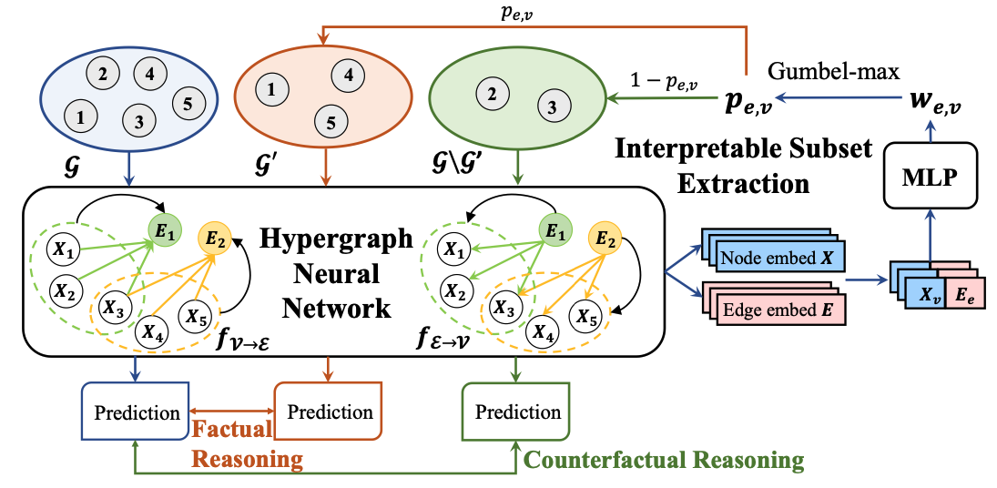
Model Overview
2 important components:
Hypergraph Neural Network: Takes the original hypergraph G as input to learn its node and hyperedge embeddings
Interpretable Subset Extraction: The subset extraction model learns a weight for each node in a hyperedge. Then the interpretable subset G′ and its complementary set G \G′ are generated

Slide 6


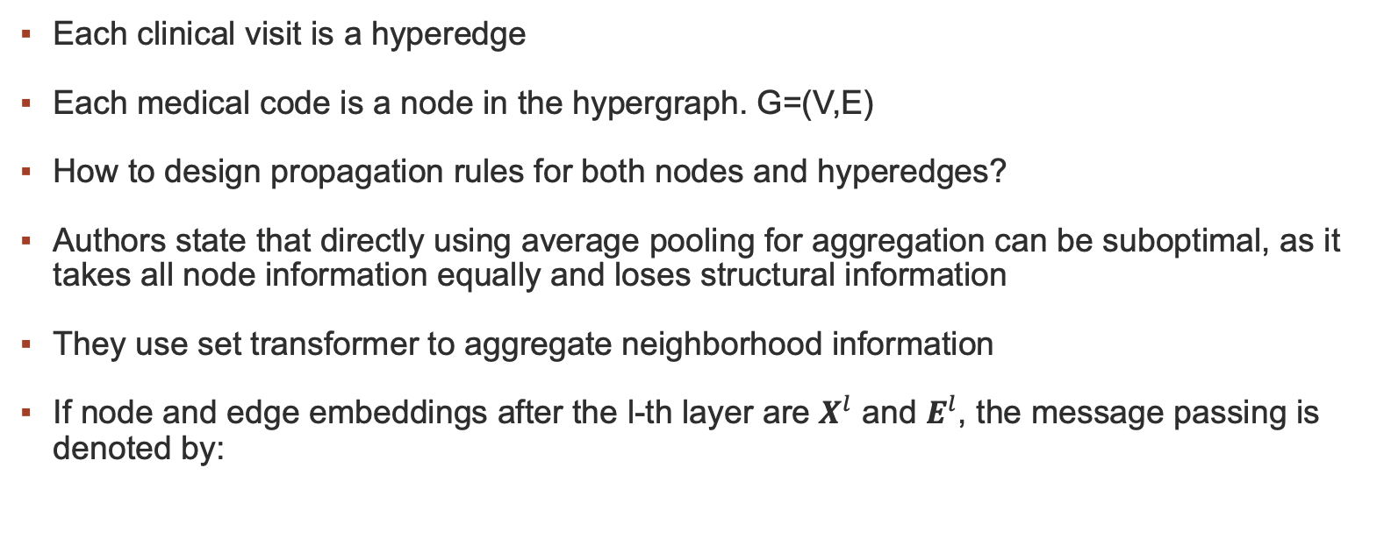
Hypergraph Construction and Learning
Each clinical visit is a hyperedge
Each medical code is a node in the hypergraph. G=(V,E)
How to design propagation rules for both nodes and hyperedges?
Authors state that directly using average pooling for aggregation can be suboptimal, as it takes all node information equally and loses structural information
They use set transformer to aggregate neighborhood information
If node and edge embeddings after the l-th layer are $X^{l}$ and $E^{l}$, the message passing is denoted by:

Slide 7







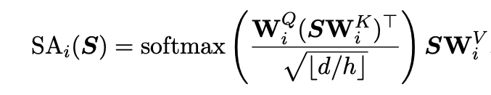

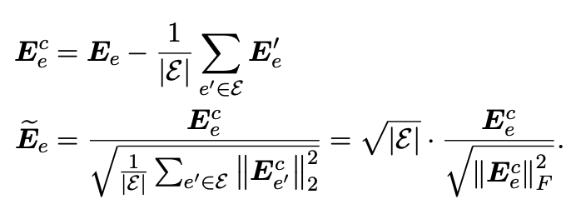
Details about the Message Passing Step
Note that S is the input embedding set
The model has over-smoothing issue (which is evident from some of our experiments as well). Solution: Additional Normalization (?). Pairnorm
This keeps the total pairwise embedding distances over hyperedges unchanged across layers

Slide 8
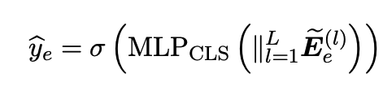

Prediction and loss
To support the downstream task, they stack a classification head on the visit embeddings from all layers (jumping knowledge)
Overall Loss:

Slide 9




Interpretable Subset Extraction
2 Key properties of the generated subset:
Sufficiency: The prediction of f_{θ}(G′) using the subsets only will be consistent based on factual reasoning
Necessity: Removing the subset will result in opposite predictions for f_{θ}(G\G′) based on counterfactual reasoning.
For each hyperedge e with nodes v, assign a RV. Where v is preserved in hyperedge e if p_{e,v} > 0.5 and filtered otherwise.

Slide 10

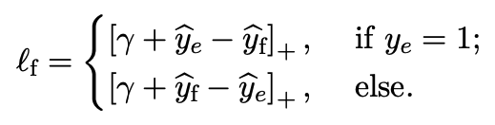
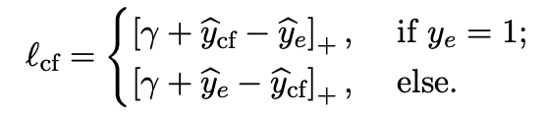
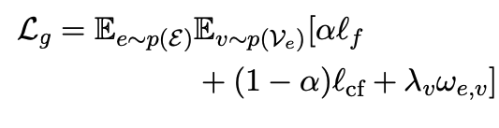
Interpretable Subset Extraction
With the generated subgraph, the prediction for factual and counterfactual reasoning for each hyperedge e with label as:
The losses are:
The overall learning objective is:

Slide 11
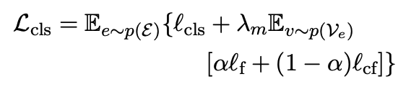
Alternate Training
For overall training, the loss becomes:
Joint optimization is challenging. So, the authors use alternate gradient descent:
First Train the task specific layers for 10 epochs as warmup
Then train the interpretable subset section by fixing the parameters of the hypergraph NN
Then retrain the task specific layer by fixing the parameters of the interpretable subset generation layers…

Slide 12
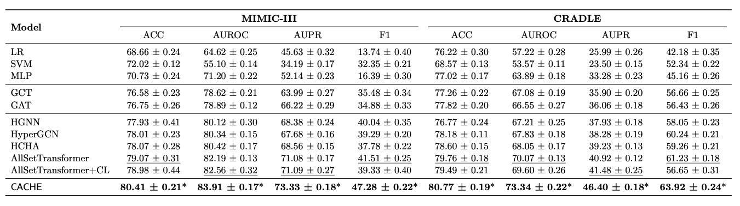
Experiments and Results
Tasks:
Phenotyping prediction in MIMIC-III (Multi-label classification that predicts whether the 25 acute care conditions will be present in patients’ next visits, given their current ICU records)
Outcome Prediction task on CRADLE (predicts whether the patients with type 2 diabetes would experience cardiovascular disease (CVD) end- points within a year after the initial diagnosis)

Slide 13
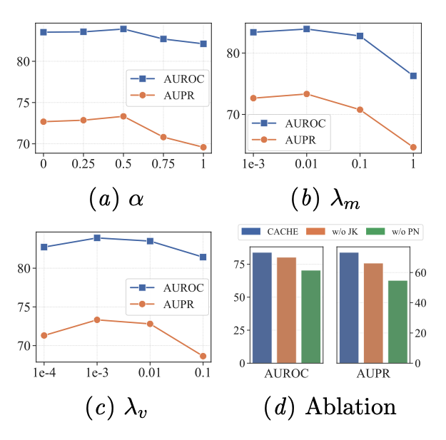
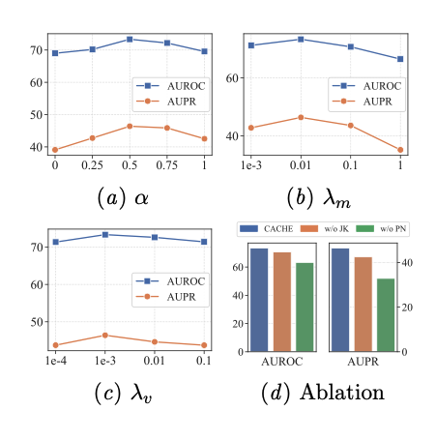
Further Results: Ablation Study
MIMIC-III
CRADLE

Slide 14
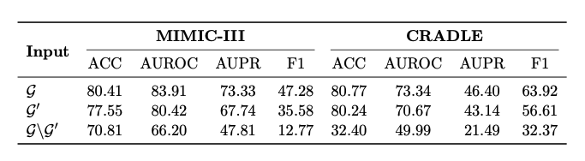
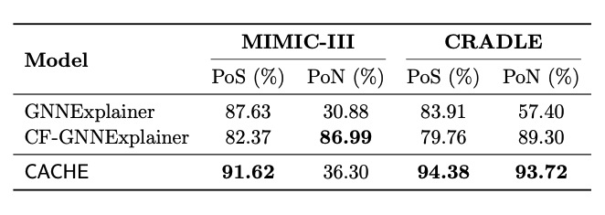
Interpretability Analysis

