Slide 1
BST
5I
Emmanuel Buenrostro Briseño 22300891
Hugo Isaac Morales Algaba 22300885
Emilio Mateo Rico García 22300895
Emiliano Arzate Gutierrez 22300929

Slide 2
Index
What’s a data structure?
What’s a tree?
What’s a node?
What’s a BST?
BST Operations
Insert operation
Delete operation
BST Aplications

Slide 3
The basics

Slide 4
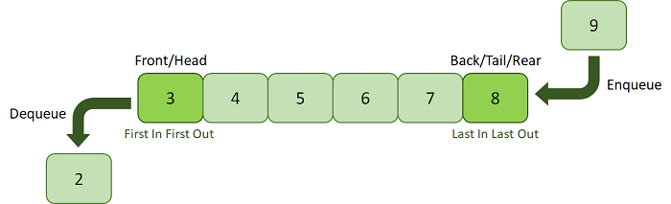
What is a “Data Structure”
A data structure is like a "tool" we use to organize and store data efficiently based on what we need to do with it. The main idea is to facilitate operations such as searching, adding, deleting, or modifying data.
Data structures allow us to organize data in a logical and efficient way.

Slide 5
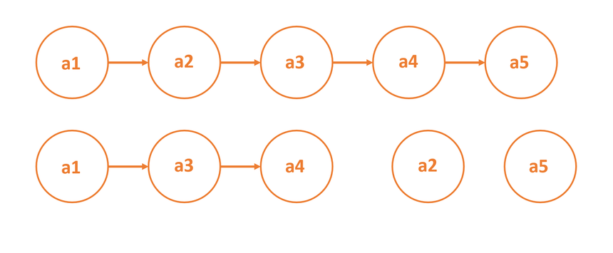
What is a Node
A node is like a small "container" that stores information within a data structure. Additionally, this container usually has "doors" or "connections" that link it to other nodes. It is a fundamental unit in many data structures, such as trees, graphs, and linked lists.
A node typically contains:
Data: Information within itself
References: The locations of other nodes it connects to.

Slide 6
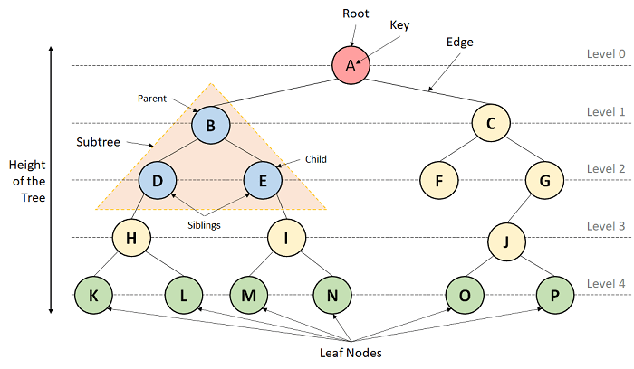
What is a “Tree”
A tree is a type of data structure that stores it’s information hierarchically, having a root at the top, which the whole tree is based on.
The tree has 3 types of nodes, the root, at the top, the parents, nodes that have one or child nodes and child nodes, nodes that don’t have child’s but have parents

Slide 7
BST
What it is and how it works

Slide 8
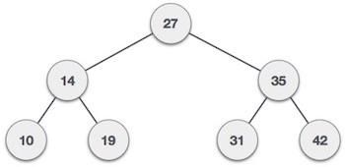
What is a BST?
A BST (Binary Search Tree) is a type of tree that can only have two branches or child’s, the left one and the right one.
The biggest characteristic about this tree is that it sends the nodes with smaller values than the value of the root to the left and the bigger values than the value of the root to the right

Slide 9
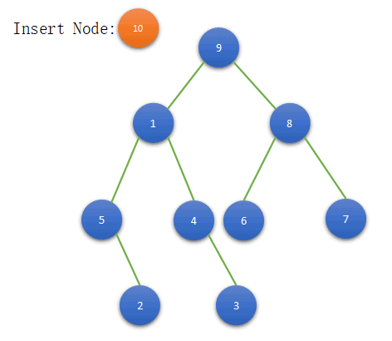
BST Operations
When we talk about an “operation” in a BST whe refer to any sort of movement inside that the tree that requires either the insertion/elimination of a certain node or some sort of transversal action.
Some examples are: Insertion, Elimination and Search.

Slide 10
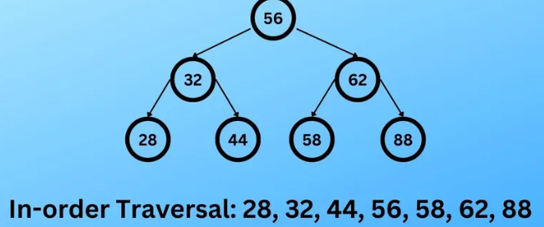
In-order transversal
A type of transversal is the “In-order transversal, on which the values of the nodes in the tree are printed in ascending order. The way this works is it start at the root, then it goes to the left child, if that left child has another child, it continues till a left child is not found, in which case the process repeats on the right child and then the parent node

Slide 11
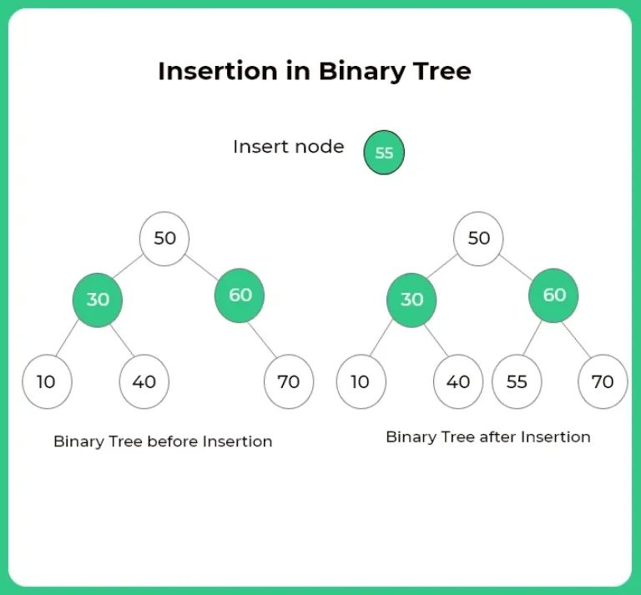
Insertion Operation
This is one of the most common operations on a BST, where you create a node with its own value, the node will then be compared with the root, if the node it’s smaller, it goes to the left, if it’s bigger, it goes to the right. This process is then continued until the inserted node becomes a child node

Slide 12
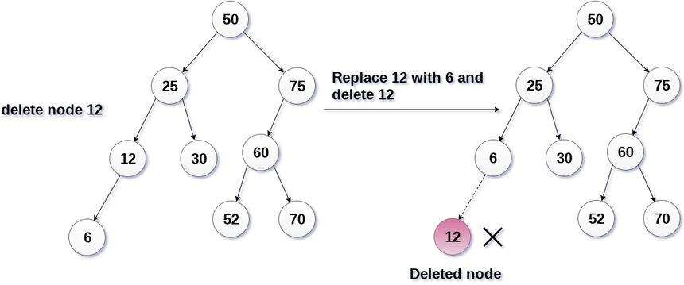
Elimination Operation
This operation consists of searching a node in the tree, and if it’s found, then it’s deleted, and the tree needs to be reestructured.
If the deleted node is a child node, there is no need for a reestructuration, but if the root or a parent node is deleted, then we need to reestructure the tree again

Slide 13

Aplications of the BST
A BST can help sort information for databases that have way to many for it to be manually sorted / organized
A BST can be used in decision-making processes for machine learning
A BST can help organize information for some type of file system that needs them organized all the time

Slide 14
Thanks for your attention

