Slide 1

A Chatbot for the Climate Policy of Vienna
Sophie Hamann | 136031 UE GenAI for Humanists

Slide 2
What is Klip?
Climate Protection Programme
Initiated in 1999 and extended in 2009 until 2021
Some of the established fields of action:
Living
Mobility and Urban Structure
District heating and power generation
Over 4 Million tonnes of greenhouse gas emissions were saved because of KLiP
In 2022 the Vienna Climate Roadmap was established

Slide 3
Vienna Climate Roadmap (Wiener Klimafahrplan)
In 2020, the coalition government (ÖVP & the Green Party) announced the commitment to achieving climate neutrality by 2040
In 2022, after the end of KLiP, the Wiener Klimafahrplan was established to help with climate neutrality by 2040
Some of its principles are:
Climate Justice
Citizen Participation
Creating Green Jobs (Jobs in the environmental sector)

Slide 4
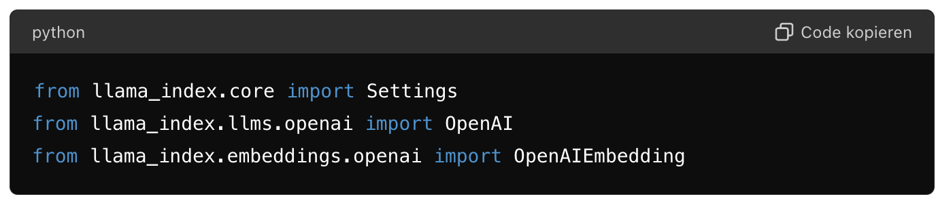
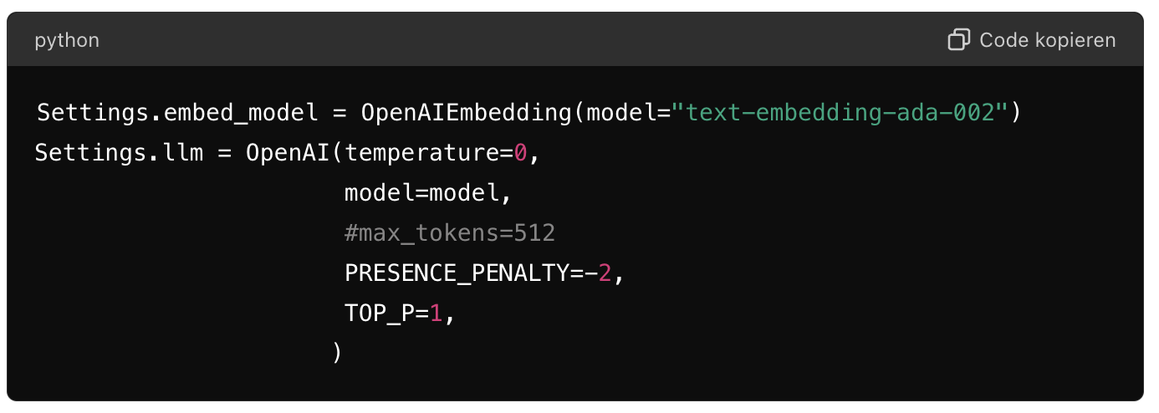
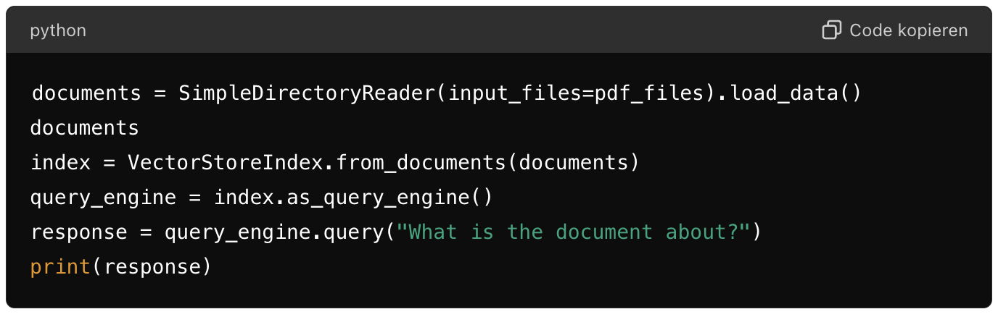
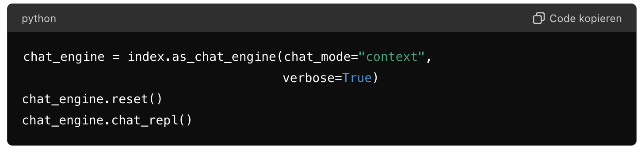
Creating the Chatbot
Import Statements (os, openai, llamaindex…)
Model Selection: gpt-3.5-turbo
Embedding and LLM Settings
Loading Documents and Creating Index
Advanced Query Engine Configuration
Creating a simple interactive chatbot

Slide 5
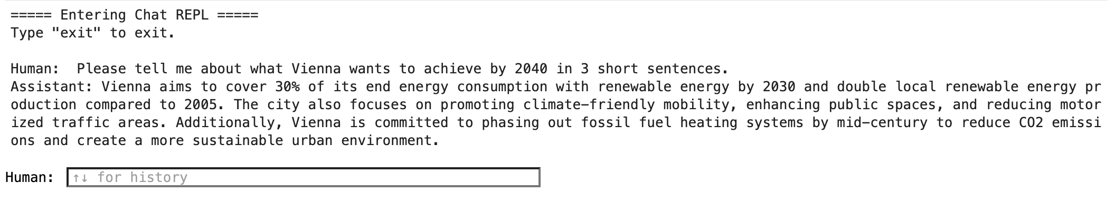
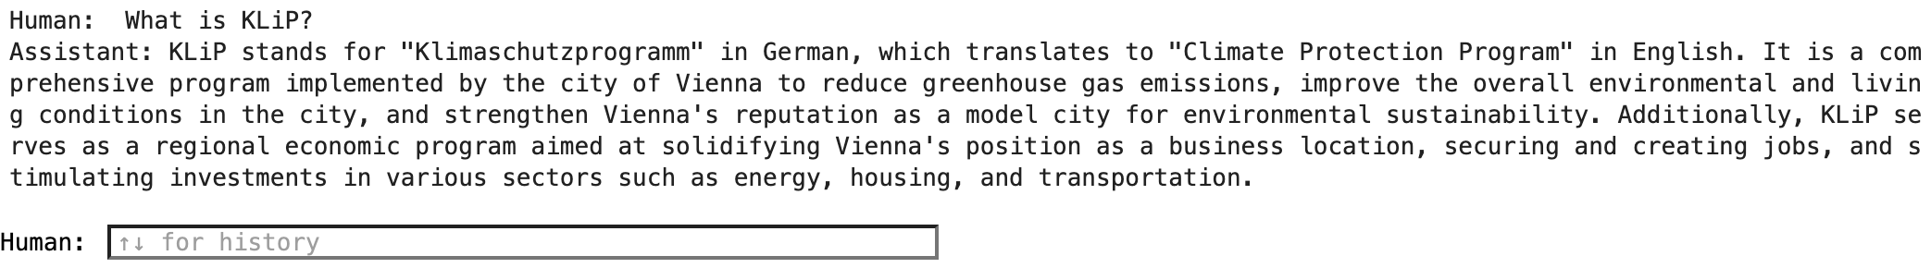
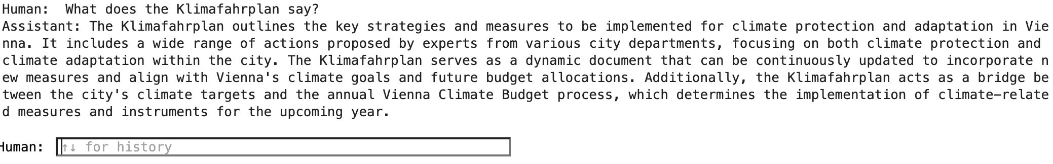
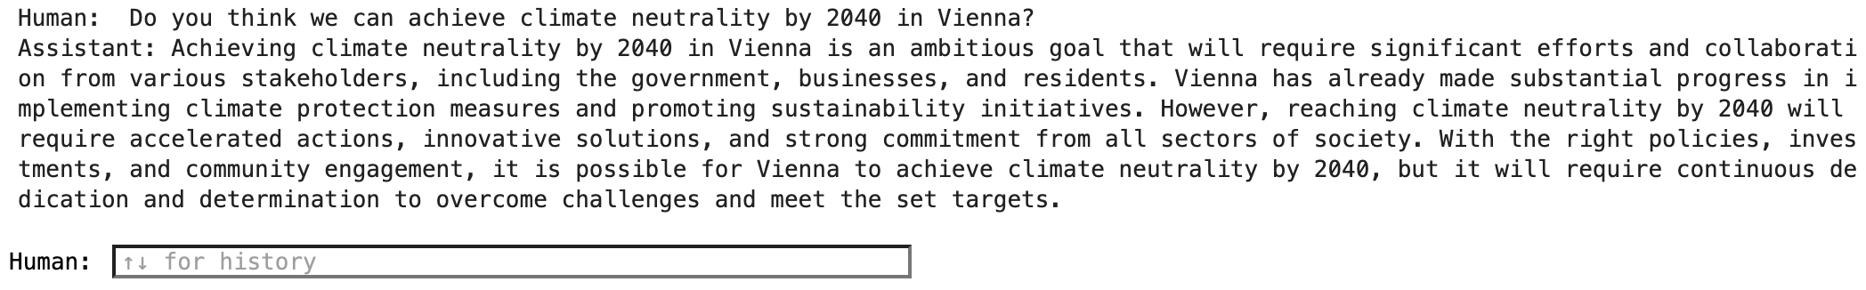

Slide 6
Future Dimensions
Clean Out Metadata
Enhance Chatbot
Benchmarking
Create Small website to host the chatbot

Slide 7
Sources
https://www.wien.gv.at/umwelt/programm-klip
https://www.wien.gv.at/spezial/klimafahrplan/

