Slide 1

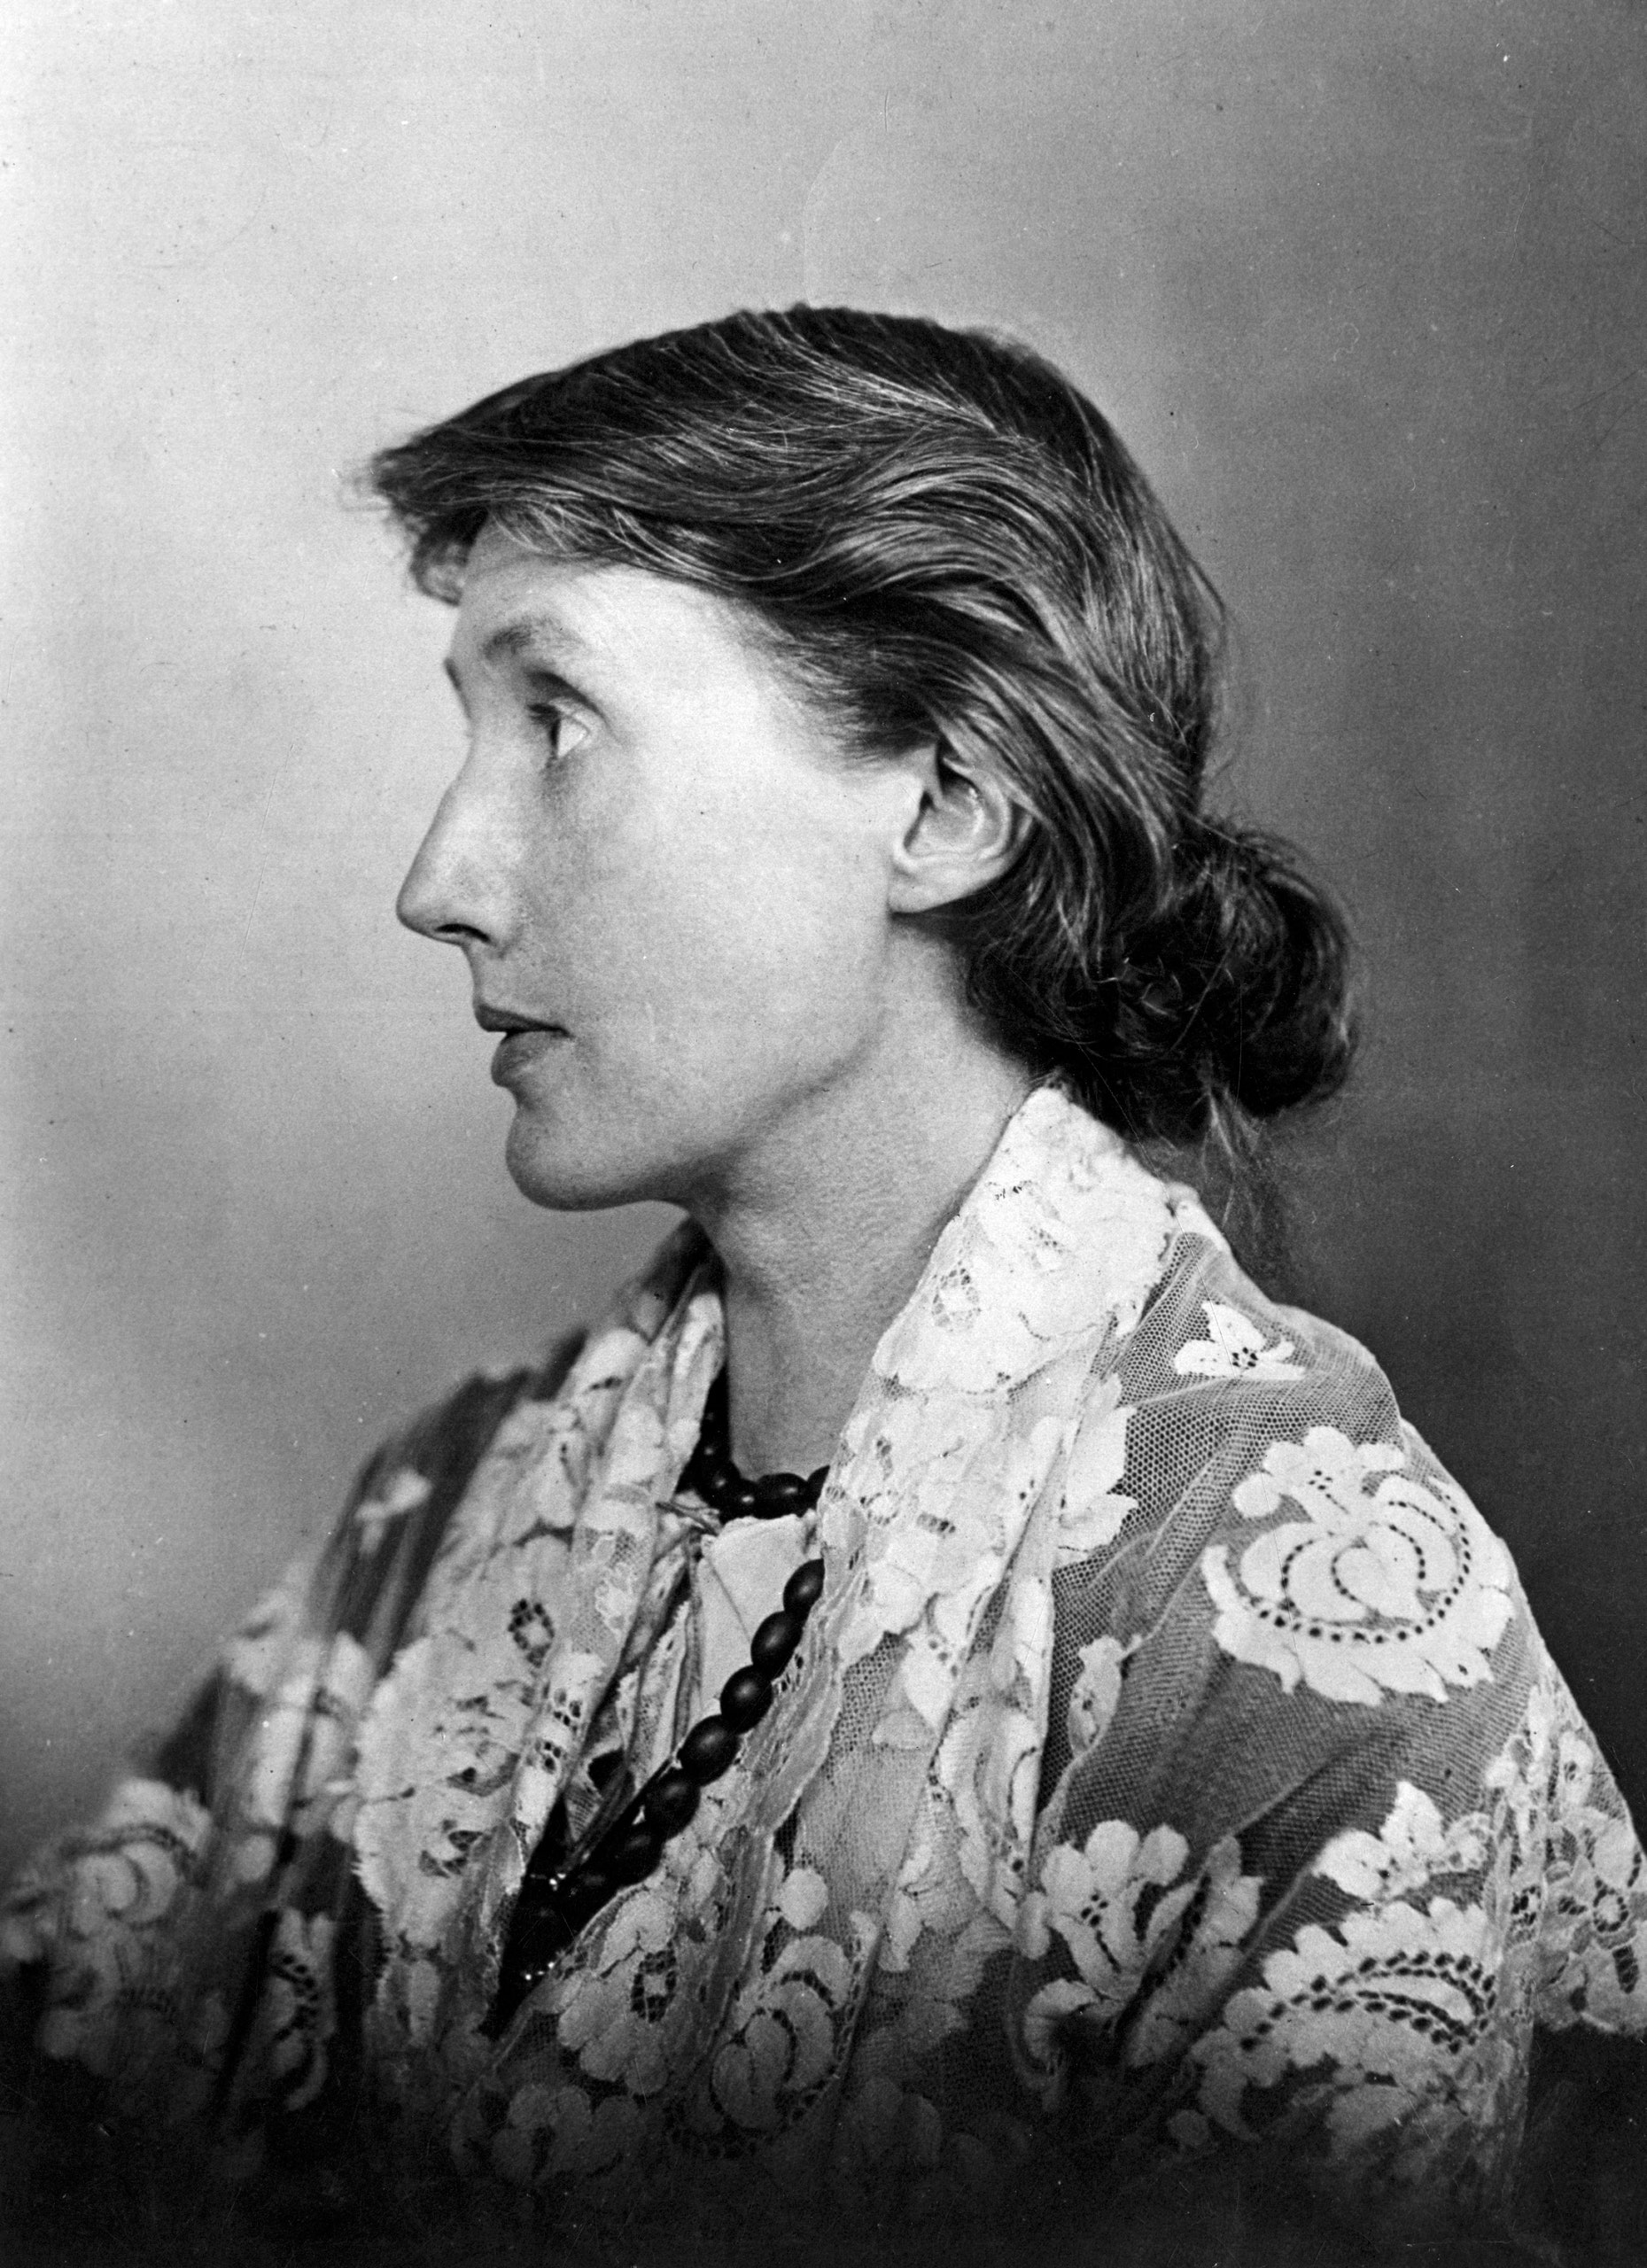
Emotion Analysis of A Room of One´s Own by Virginia Woolf

Slide 2
Natural Language Pre-Processing
Reading the text file
Natural Language Toolkit Library
Tokenizing the Text
Removing Stopwords
Lemmatization
deeper linguistic understanding of the word than Stemming

Slide 3
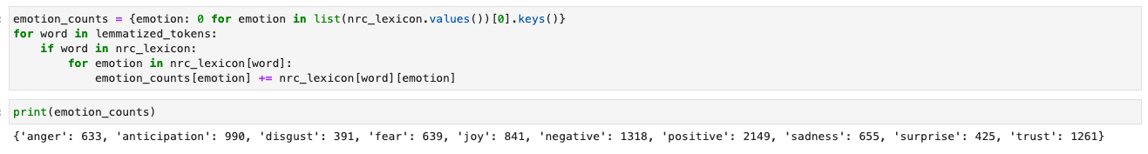
NRC Emotion Lexicon
List of English words and their associations with eight basic emotions (anger, fear, anticipation, trust, surprise, sadness, joy and disgust) and two sentiments (positive and negative)

