Slide 1
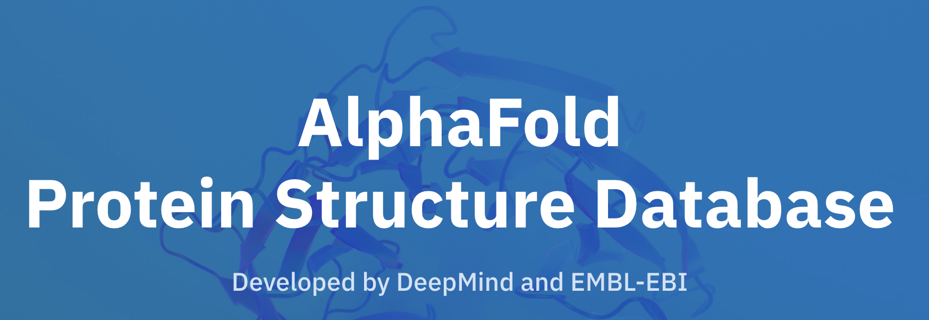

Comparing Jpred and Alphafold
Sophia Constantinou
Week 5
Notes:
Results..??

Slide 2
Merged files
Took merged file (DSSP, SIFTS etc) and added AF (uniprot sequence + prediction) and Jpred (pdb sequence + prediction)
AF and Jpred sequences matched exactly – 332 pdb id’s
Notes:
ProIntVar repo
Checked which sequences were a complete match – for valid comparison

Slide 3
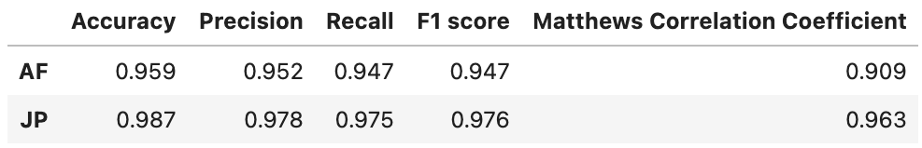
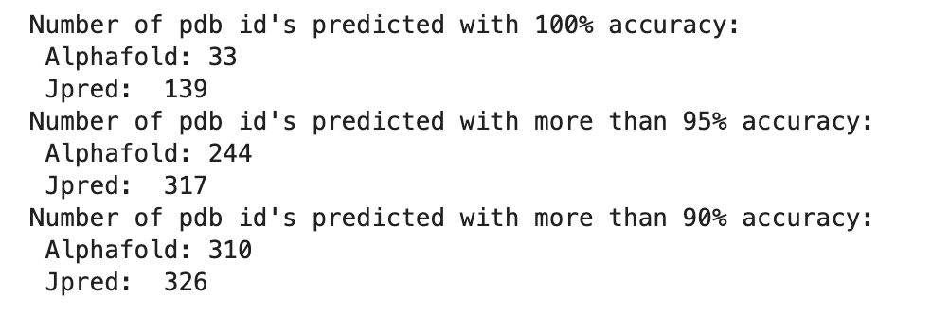
For each pdb - accuracy, precision, recall, f1
Things to note:
Jpred and Alphafold both predict 100% correctly 17 pdb id’s
Average agreement between Alphafold and Jpred: 0.949 (consistency)
Notes:
(332)
So, for each pdb, calculated acc, prec, etc and then took an average over all of them
I checked how many pdb’s are predicted correctly (JP predicts almost half correctly)
AF doesn’t predict a lot 100% but most of them 95% and above
<90%: AF – 22, JP - 6
JP seems to outperform AF
Out of those predicted correctly – both got 17
Consistency – 95%
I’m not really sure why Jpred is doing better than Alphafold??? – maybe it’s cause I only took 330 out of 880 – skews results
(a bit more than a third of the data)
More than 95% accurate:
AF – 73.5% of pdb’s
JP – 95.4% of pdb’s
Accuracy – (Tp + tn / sum of total)
Precision – Percentage of positive instances out of the total predicted positive instances.
Tp / tp + fp
helical proteins?? 17
Recall/Sensitivity - Percentage of positive instances out of the total actual positive instances.
Tp / tp + fn
F1 score - harmonic mean of precision and recall
2 / ( 1/precision + 1/recall)
Matthews Correlation Coefficient – basically a measure of how much of the data falls along the diagonal cells in a confusion matrix (?)– close to 1, then most falls along diagonal

Slide 4
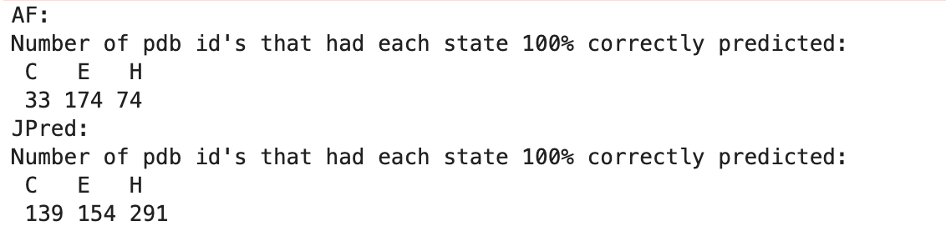
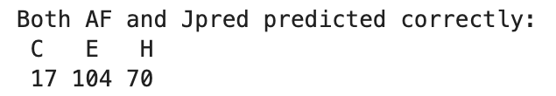
Differentiate between C, H, E in each PDB
Average accuracy:
Average recall:
Notes:
Metrics – accuracy, recall
In each pdb – counted the number of pdb’s that had 100% accuracy in each state
AF seems to favour E
Jpred is much better at recognising coil and helices
Both predict E with higher accuracy, but JP predicts H with the highest accuracy
Recall – interesting to note that in JP for E and H it’s one – implies that there are no false negatives
Avg acc - (find accuracy for each pdb and then take average):
I’m not really sure if this makes sense??)

Slide 5
Over all pdb id’s – accuracy, recall
Accuracy (overall):
Average accuracy:
Recall (overall):
Average recall:
Notes:
The next step was to do it for all of them and not for each pdb
Add up true positive/true neg values over all pdb id’s and find average + stats
Left hand side
Right hand side – same ones as before – I just put them so that the comparison is easier
Basically show the same trends but over each pdb id it’s a bit more pronounced that JP performs better

Slide 6
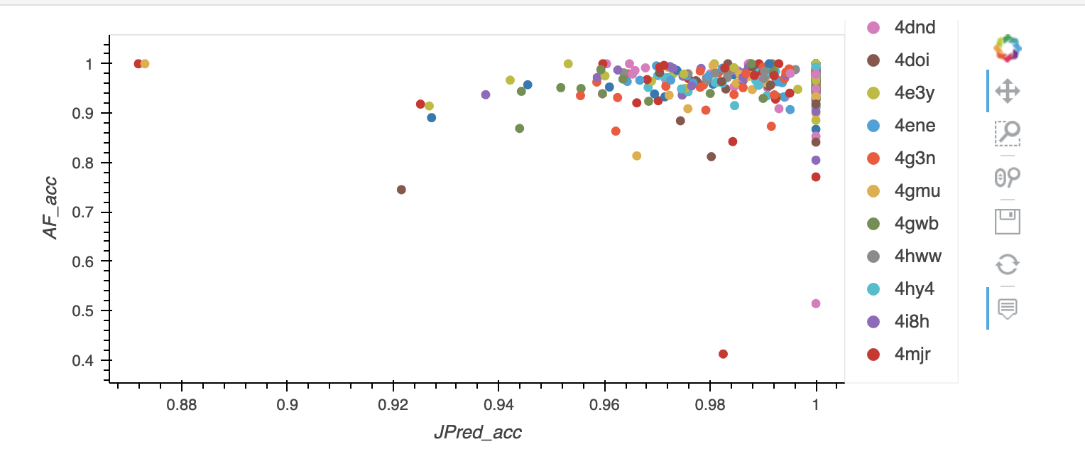
Scatter plot – AF accuracy vs Jpred accuracy
Notes:
propotrion of SS in each pdb

Slide 7
Next steps
Only did it for 332 pdb id’s – need to fix the rest
More stats?
Notes:
Can do specificity, matthews, recall etc for all – only worked with accuracy
If there’s something else you want me to do
Maybe I could look into the effect of the length of the sequence to the accuracy?
I haven’t taken into account how long the sequence is on the accuracy
Could compare confidence score to accuracy?
Composition by SS
blind

