Slide 1
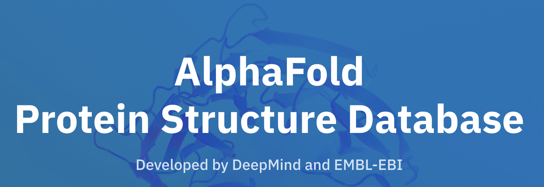

Comparing Jpred and Alphafold
Sophia Constantinou
Week 6
Notes:
Overview of everything I’ve done this week
Talkyyy talk

Slide 2
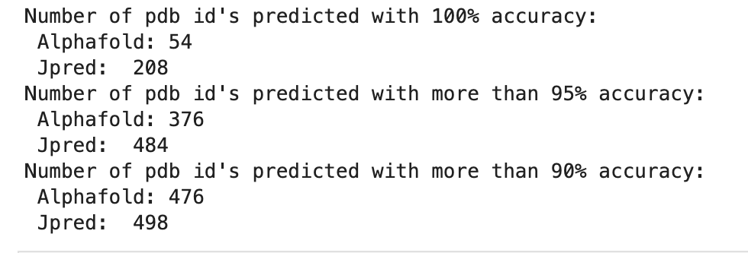
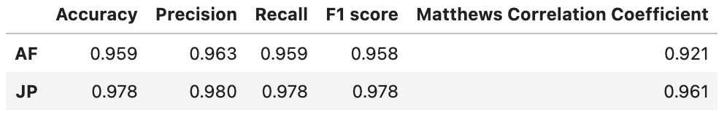
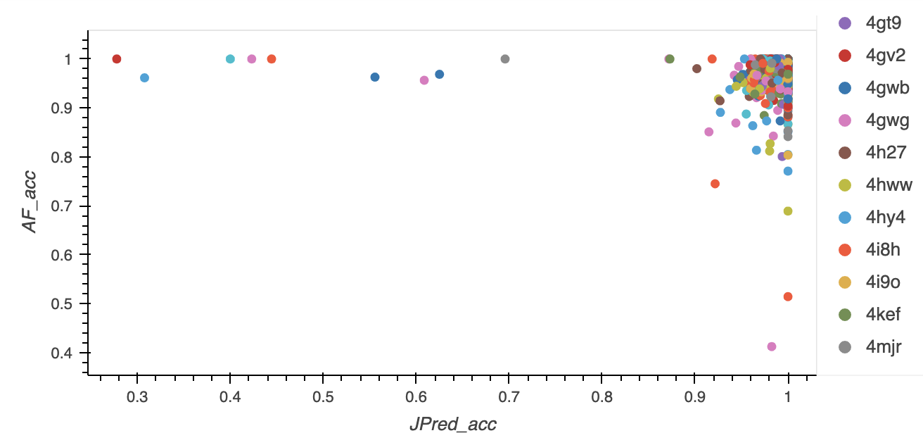
Managed to get 685 pdb id’s
1gk9
2dlb
2cxy
Notes:
From 332 last week,
Out of 887
Fix formatt

Slide 3
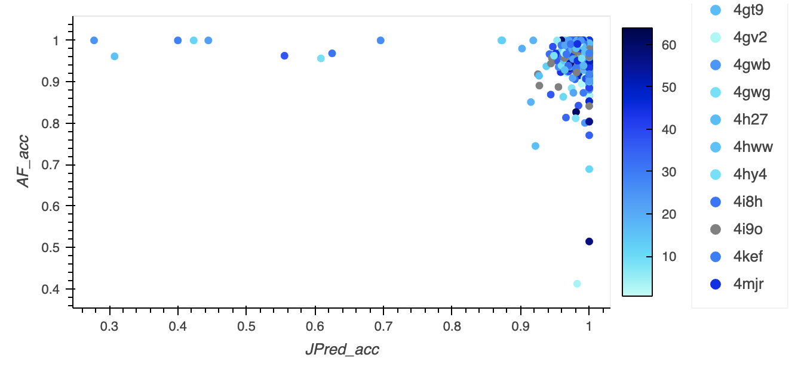
According to % composition of each state, (C)
Notes:
Maybe include accuracy averages for each state

Slide 4
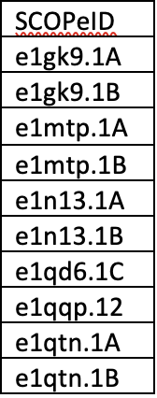
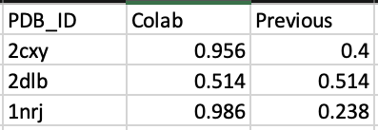
Excluded data
Invalid SCOPe ID’s:
AF colab - run some of the outliers
(download pdb file, run dssp, align with true SS)
Accuracy:
Notes:
I realised I was only using single versions of pdb id’s
But in AF and JP there were multiple variations for some
956 were a complete match but too small to make valid comparison

Slide 5
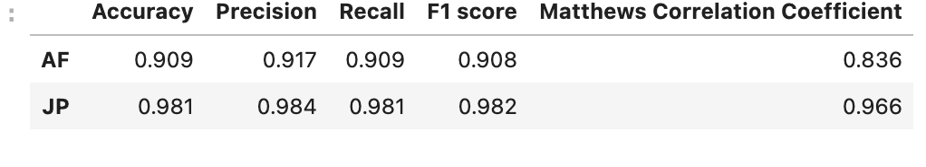
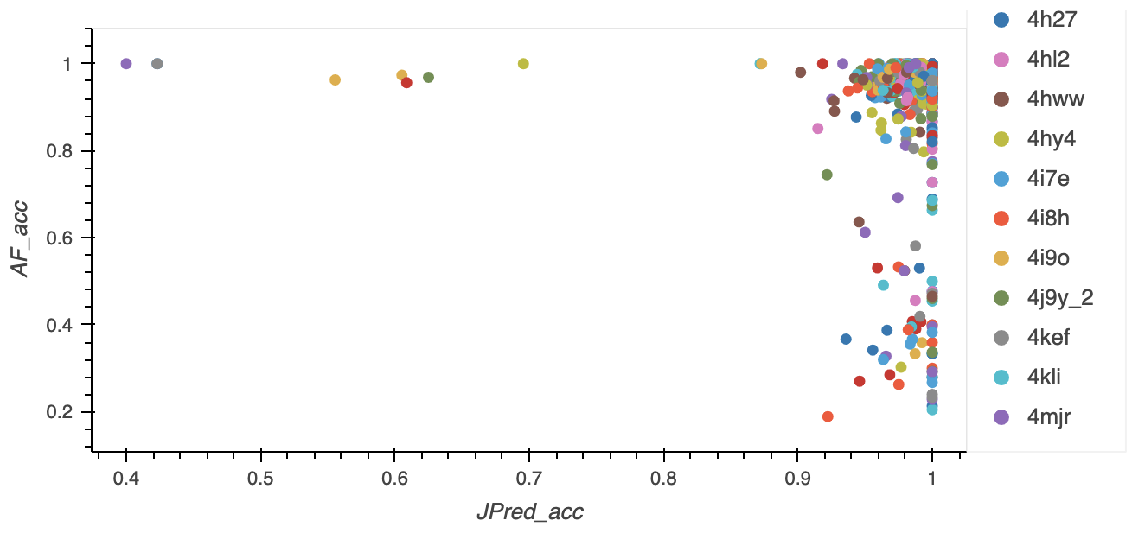
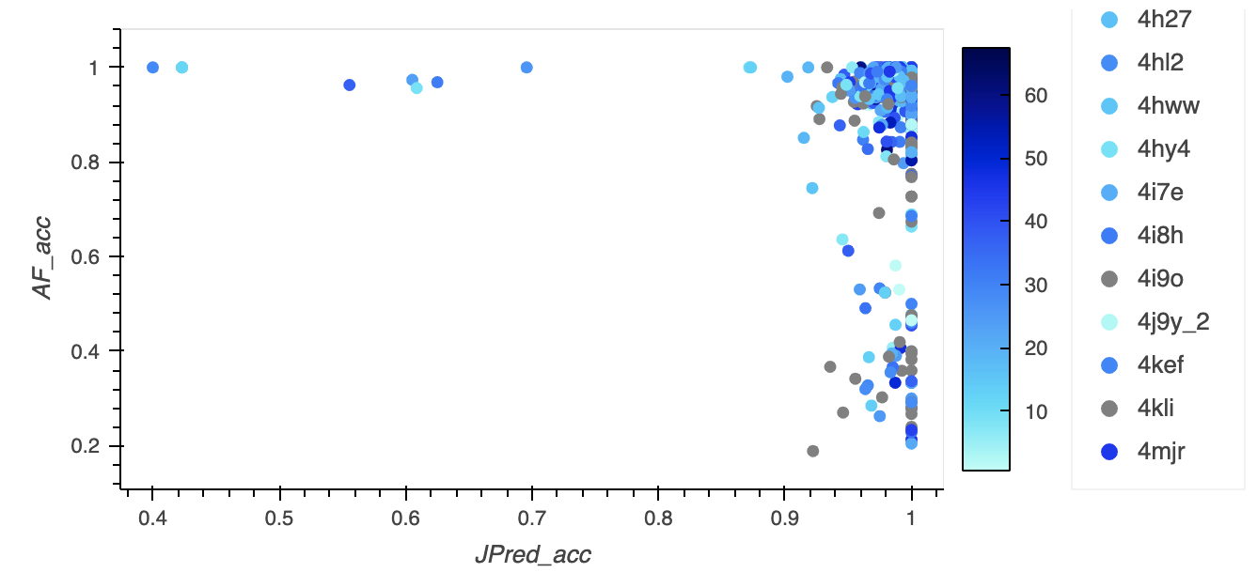
Excluding AF colab (3) and invalid SCOP (6),
Notes:
Fixed some manually – 1vkm
I excluded some AF with low accuracy, but there’s a lot….what do I do with them??

Slide 6
Obtain missing data
Some pdb id’s were repeated (different versions)
1153 files (AF)
1348 (Jpred)
Merging ProIntVar (data from DSSP, SIFTS, etc) with AF
1153 → 1120 (mmcif → pdb, prediction/sequence not large enough to align)
Merge all – 1325 (862 pdb id’s) have valid data that can be correctly aligned for both JP and AF
736 (731 pdb id’s) are complete matches (sequence) – big enough to make valid comparison
Notes:
I realised I was only using single versions of pdb id’s
But in AF and JP there were multiple variations for some
956 were a complete match but too small to make valid comparison
1536 – 868 unique pdb id’s
1325 – 862 unique pdb id’s
734 – 729 unique pdb id’s
1536 files (868 pdb id’s) → -- aligning AF
From 1526 to 1325 – aligning Jpred
From 862 to 731 – sequences don’t match? – just different

Slide 7
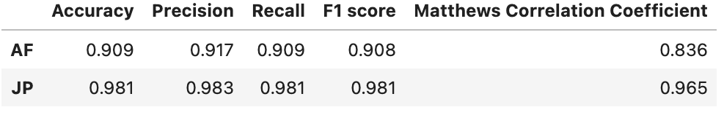
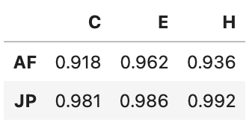
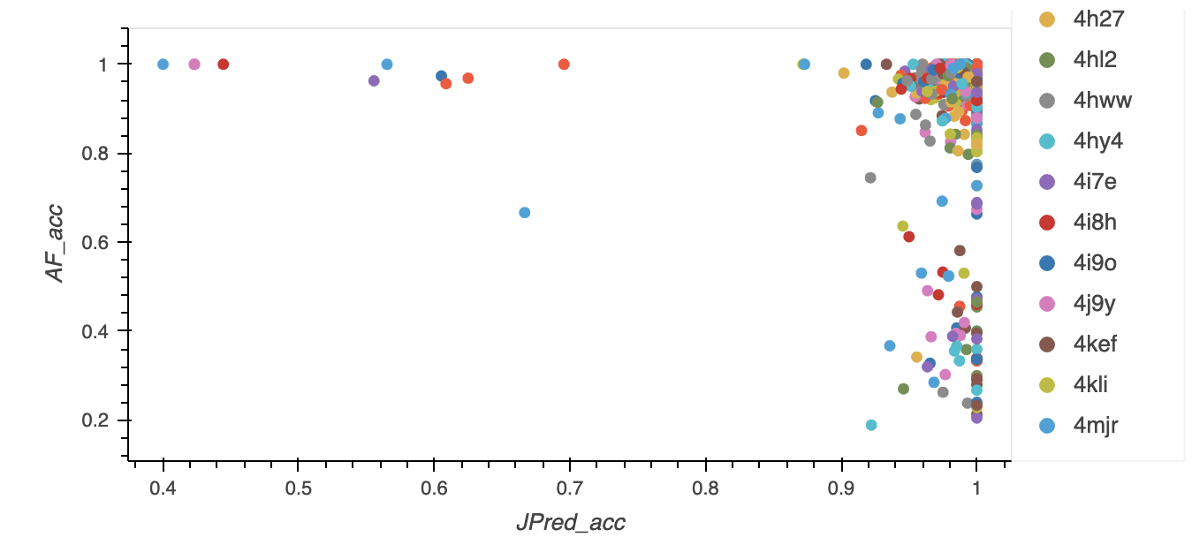
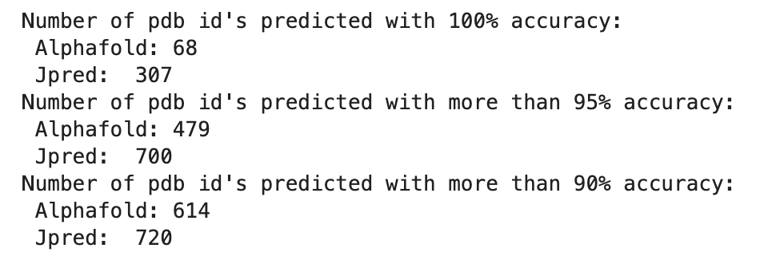
Final - 731 pdb id’s
Avg accuracy

Slide 8
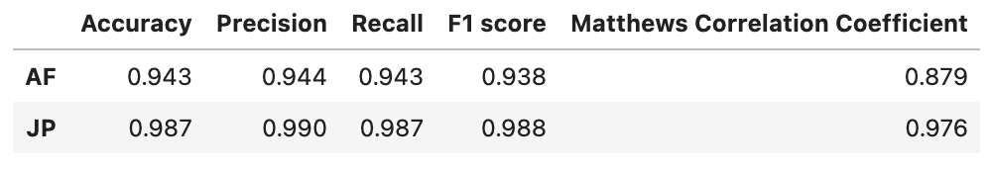
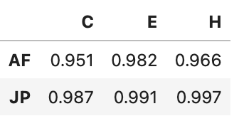
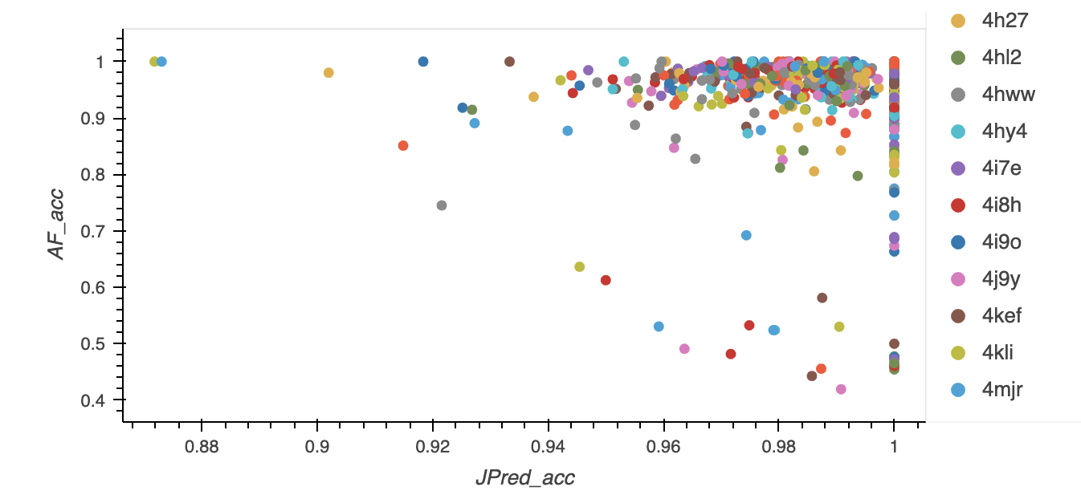
Use z-score to exclude outliers
Notes:
Lots of pdb have low AF accuracy
C, H, E accuracy??

Slide 9
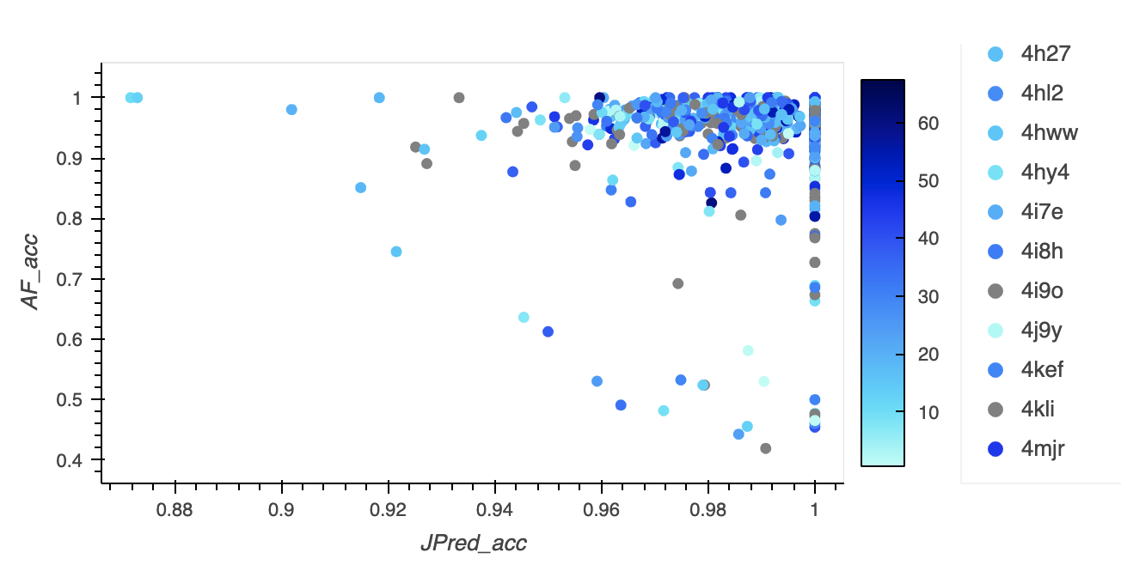
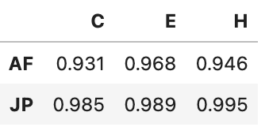
Exclude outliers (cont.)
Averaging for each pdb and then taking an average:
Overall average (averaging once):
AF accuracy vs Jpred accuracy by % content of coils (C)
Notes:
I realised I was only using single versions of pdb id’s
But in AF and JP there were multiple variations for some
956 were a complete match but too small to make valid comparison

