Slide 1


Comparing Jpred and Alphafold
Sophia Constantinou
Week 7
Notes:
Talk about server – locked out (had to set up)
+ poster

Slide 2
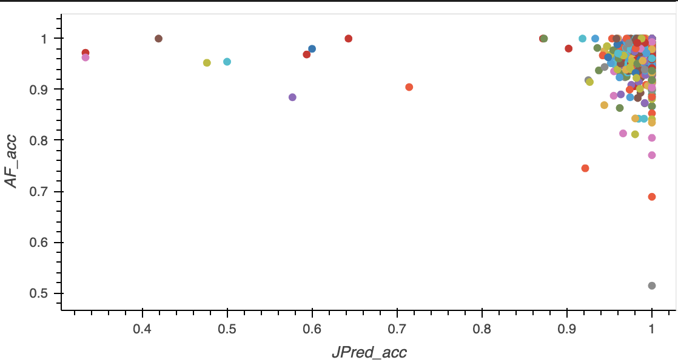
Downloaded everything again
Merged – 893 unique pdb id’s (1642 files)
Exact match – 556 unique (560 files)
1lsh
2dlb
Notes:
AF – 893 unique pdb id’s (1152 files)
JP – 1235 unique pdb id’s (1348 files)
Prointvar files: should be 893
Pdb - 893
Dssp - 893
Merged (prointvar_merged) – 893
Merged chain (prointvar_col_chain) - 893
Chain – 889 (some invalid files)
Merged Pro with AF (AF_Pro): 1147
Merged all: 1637
Exact matches:

Slide 3
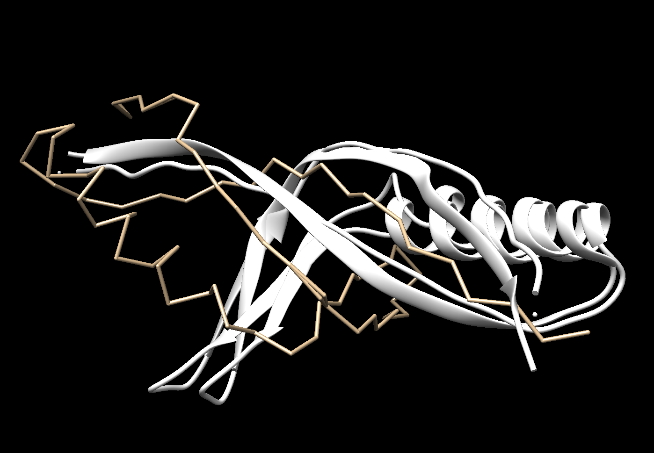
2dlb
Notes:
Predicts coil instead of strand??

Slide 4
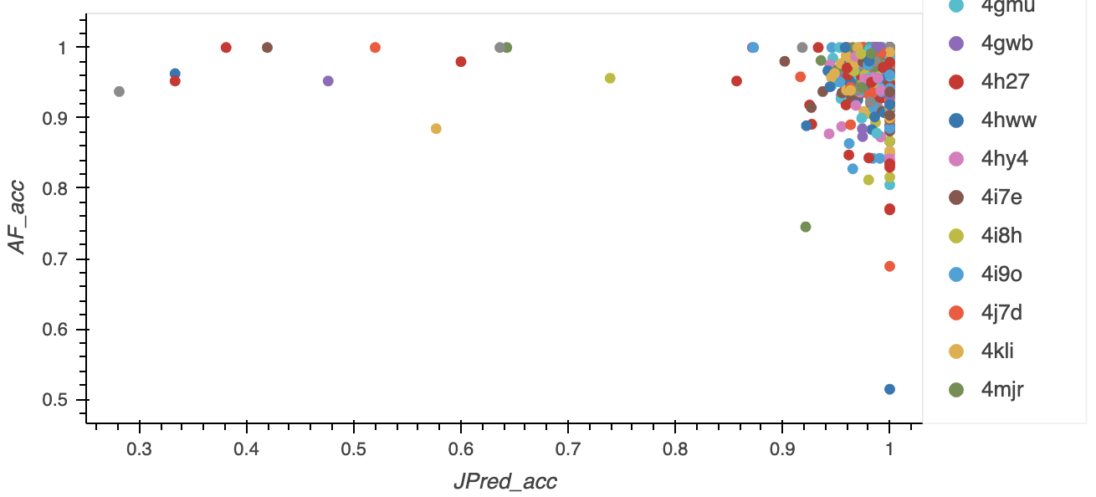
676 files
Notes:
67

Slide 5
Not in SIFTS:
1a9x – SCOPe starts at 403, but can’t find it in SIFTS

