Slide 1


Comparing Jpred and Alphafold
Sophia Constantinou
Week 3
Notes:
First step – ise Jpred’s training data and run it in Alphafold and compare

Slide 2
DSSP – Alphafold (AF) data
Ran DSSP on pdb files obtained from Alphafold website
Obtained 432 csv files that contain 3-state secondary structure (ss) and Uniprot sequence
Data manipulation to get a single data file for AF data
Notes:
Last week I was stuck on running DSSP code – managed to run it and read DSSP output
Took me a while to figure out how to have the reduced version, and then find it
Iterated through all the pdb files and had 432 dssp outputs
Data manipulation – pdb, ss, sequence, uniprot
Pandas / data frames

Slide 3
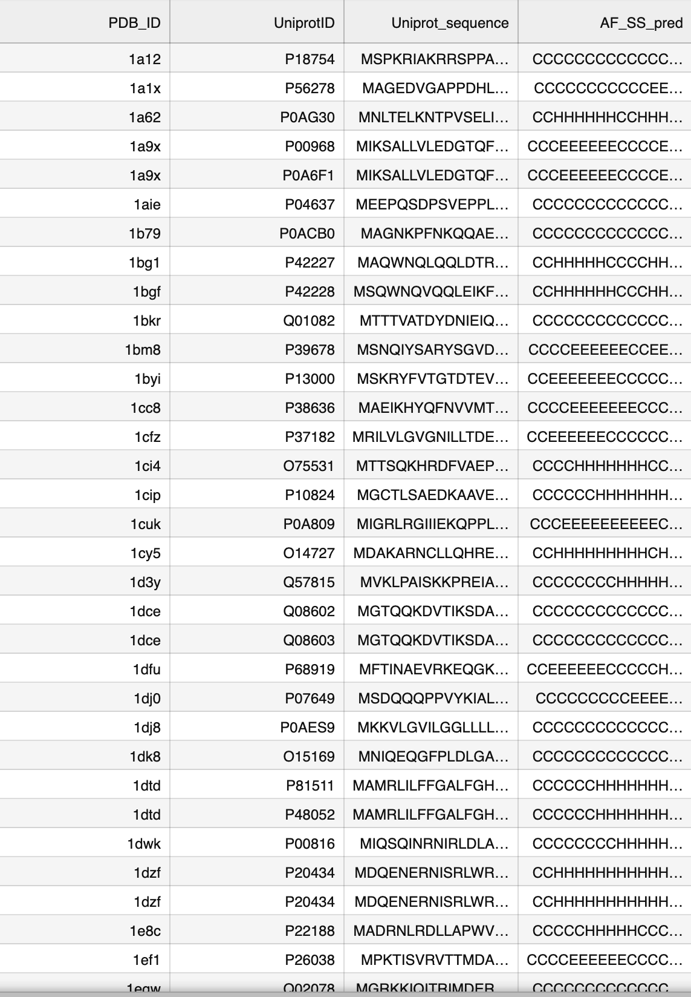
AF data (cont)
Concatenated files – single data file with pdb id, Uniprot id, sequence and secondary structure prediction
Correct alignment between pdb id and information from DSSP (sequence and SS)
Notes:
Took me some time to figure out how to concatenate– had some trouble with mapping correctly and making sure that the pdb id’s match the sequence and the ss prediction – solved? But took up a bit of my time
Found out halfway through – sequence+ss correctly lined up with pdb_id

Slide 4
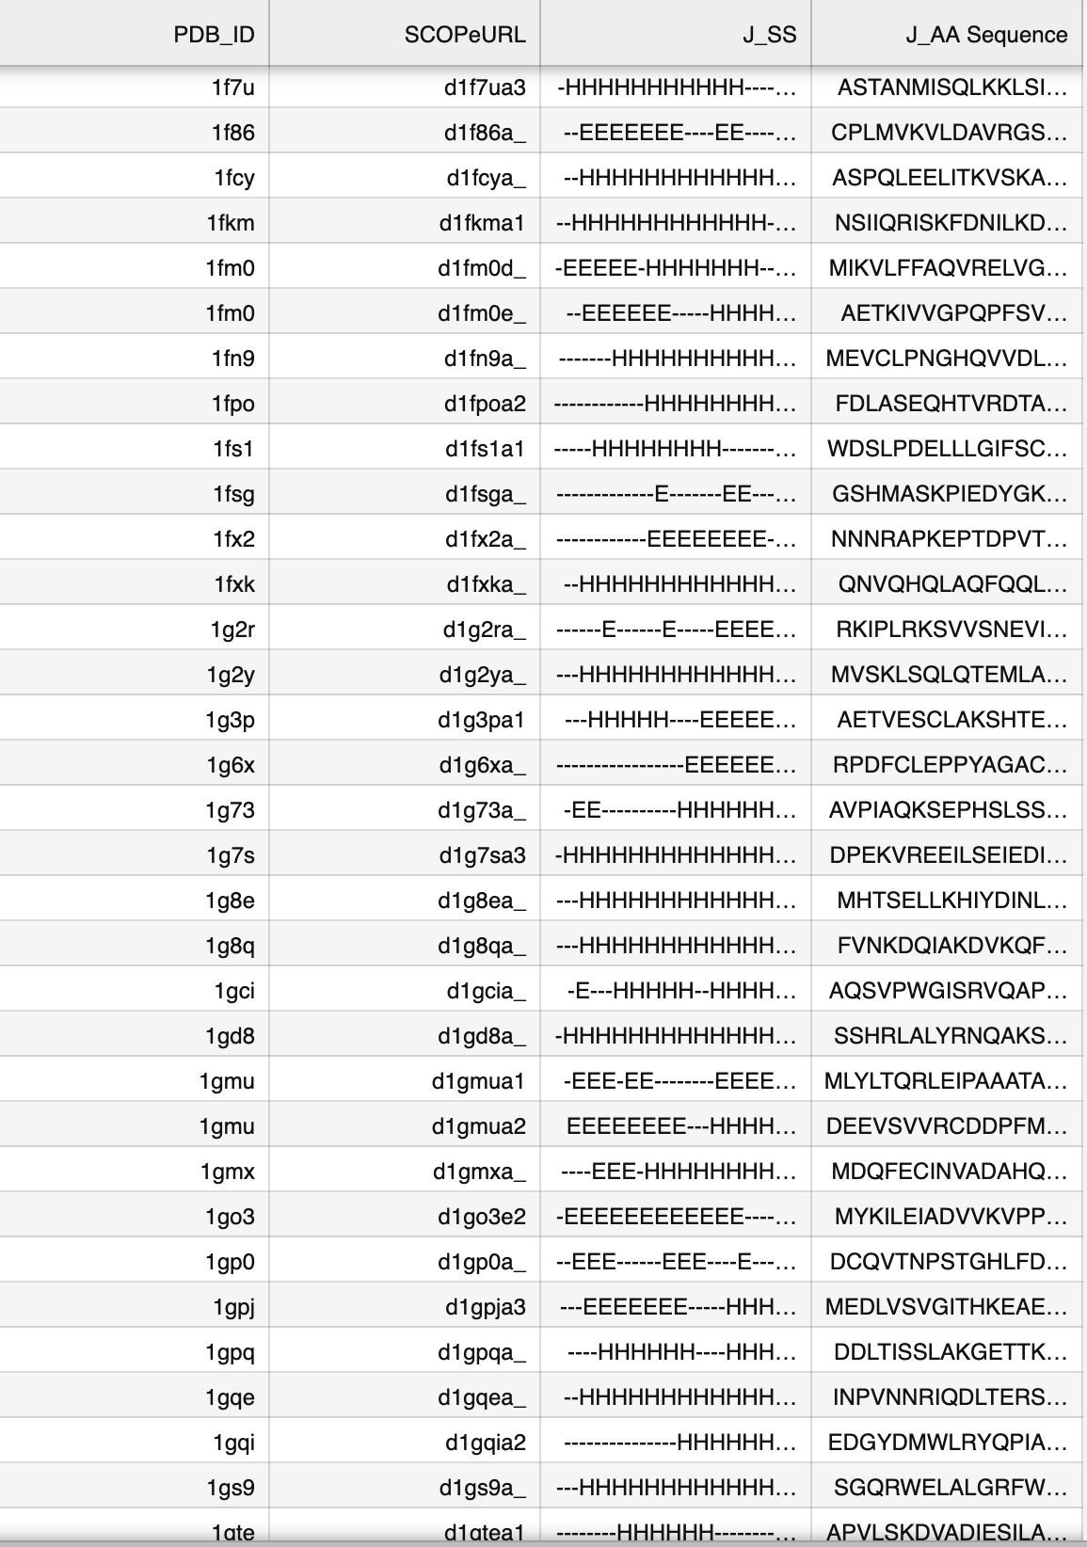
Jpred data
Obtained training data (sequence, secondary structure) from Jpred website
Concatenate into one data file: pdb_id, sequence, ss prediction
Notes:
Initially I got it from JG files – but halfway through I realised that some data for the secondary structure prediction was missing, so I got it from the website
Had some trouble with getting the data in a format I could manipulate, and making sure that all of the data is there and ordered
Initially, used a data frame for sequence and pdb_id from Jia Geng, but missing data --

Slide 5
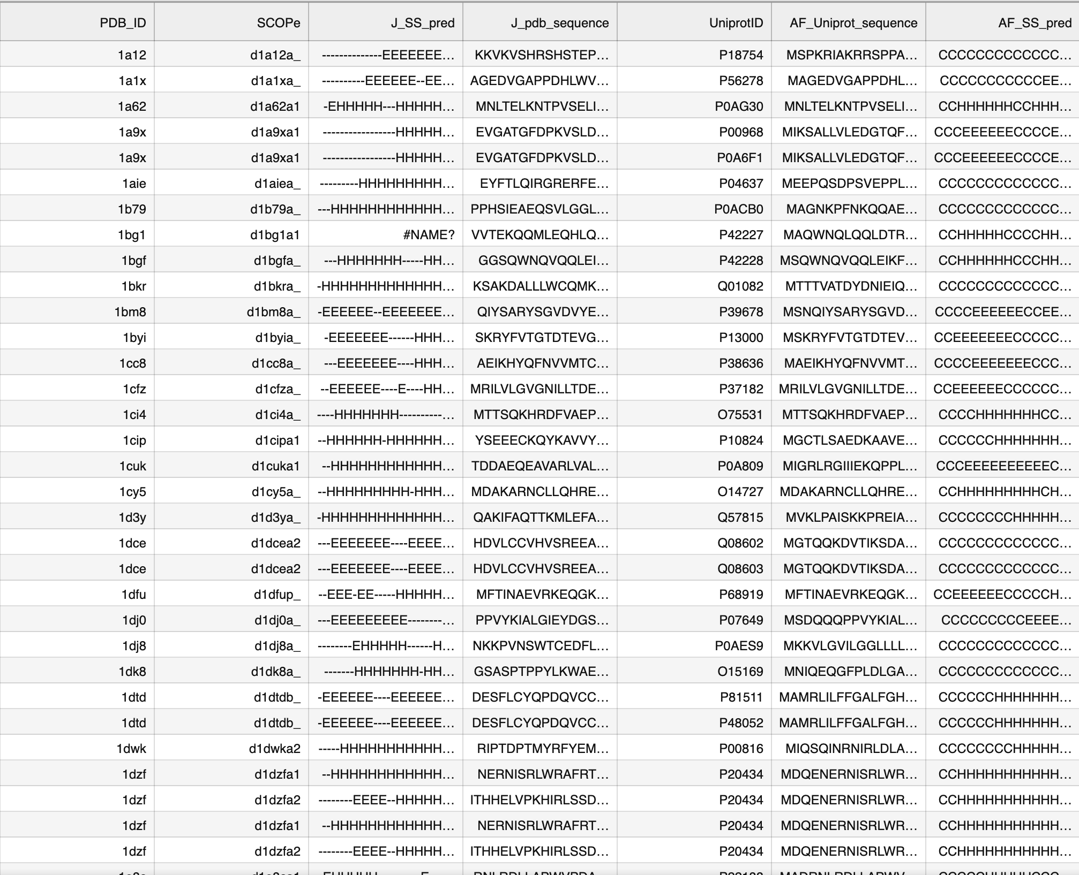
Data Frame containing both Jpred and Alphafold predictions:
Notes:
600 rows

Slide 6
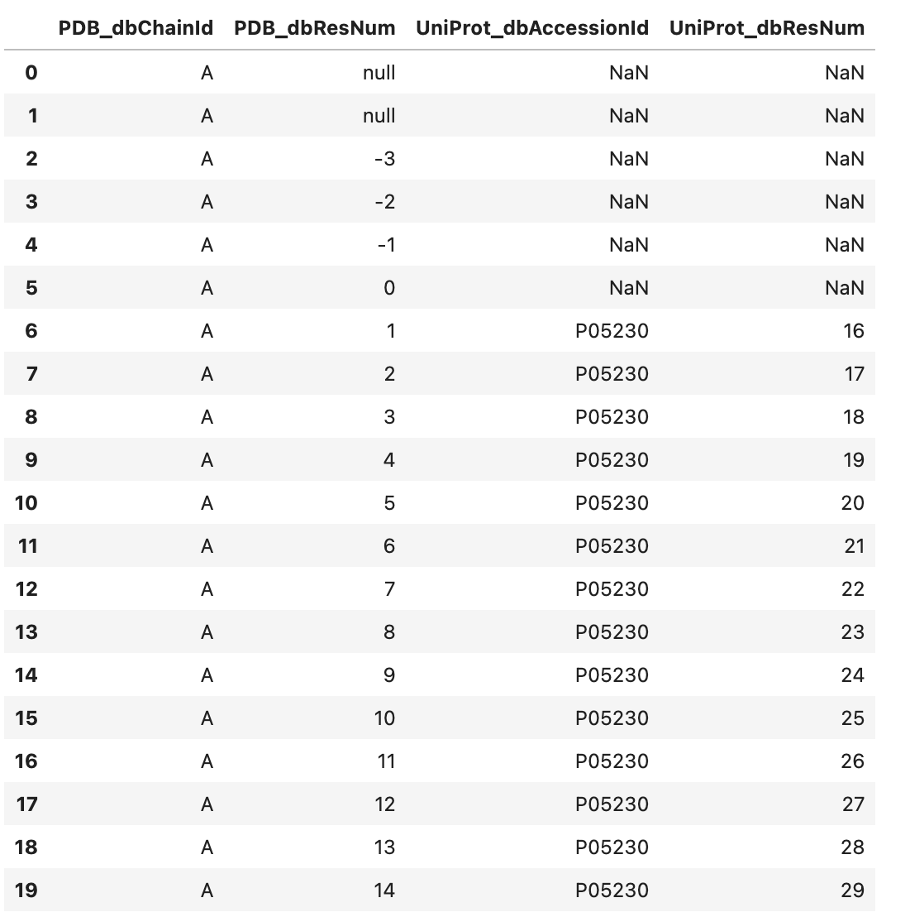
What I’m doing now
Add true secondary structure for valid comparisons – PDBe API
Missing data from Jpred SS
Align the sequences using SIFTS + indexing to go from Uniprot sequence (AF) to PDB sequence (Jpred)
Notes:
PDB SS– for valid comparisons – doesn’t seem to work – emailed, waiting for response
There are some pdb_id’s that are not found in SIFTS – manually

