Slide 1
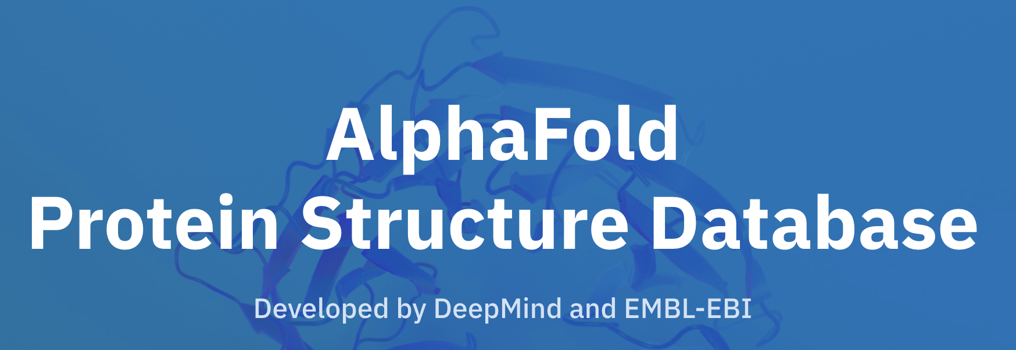

Comparing Jpred and Alphafold
Sophia Constantinou
Week 4

Slide 2
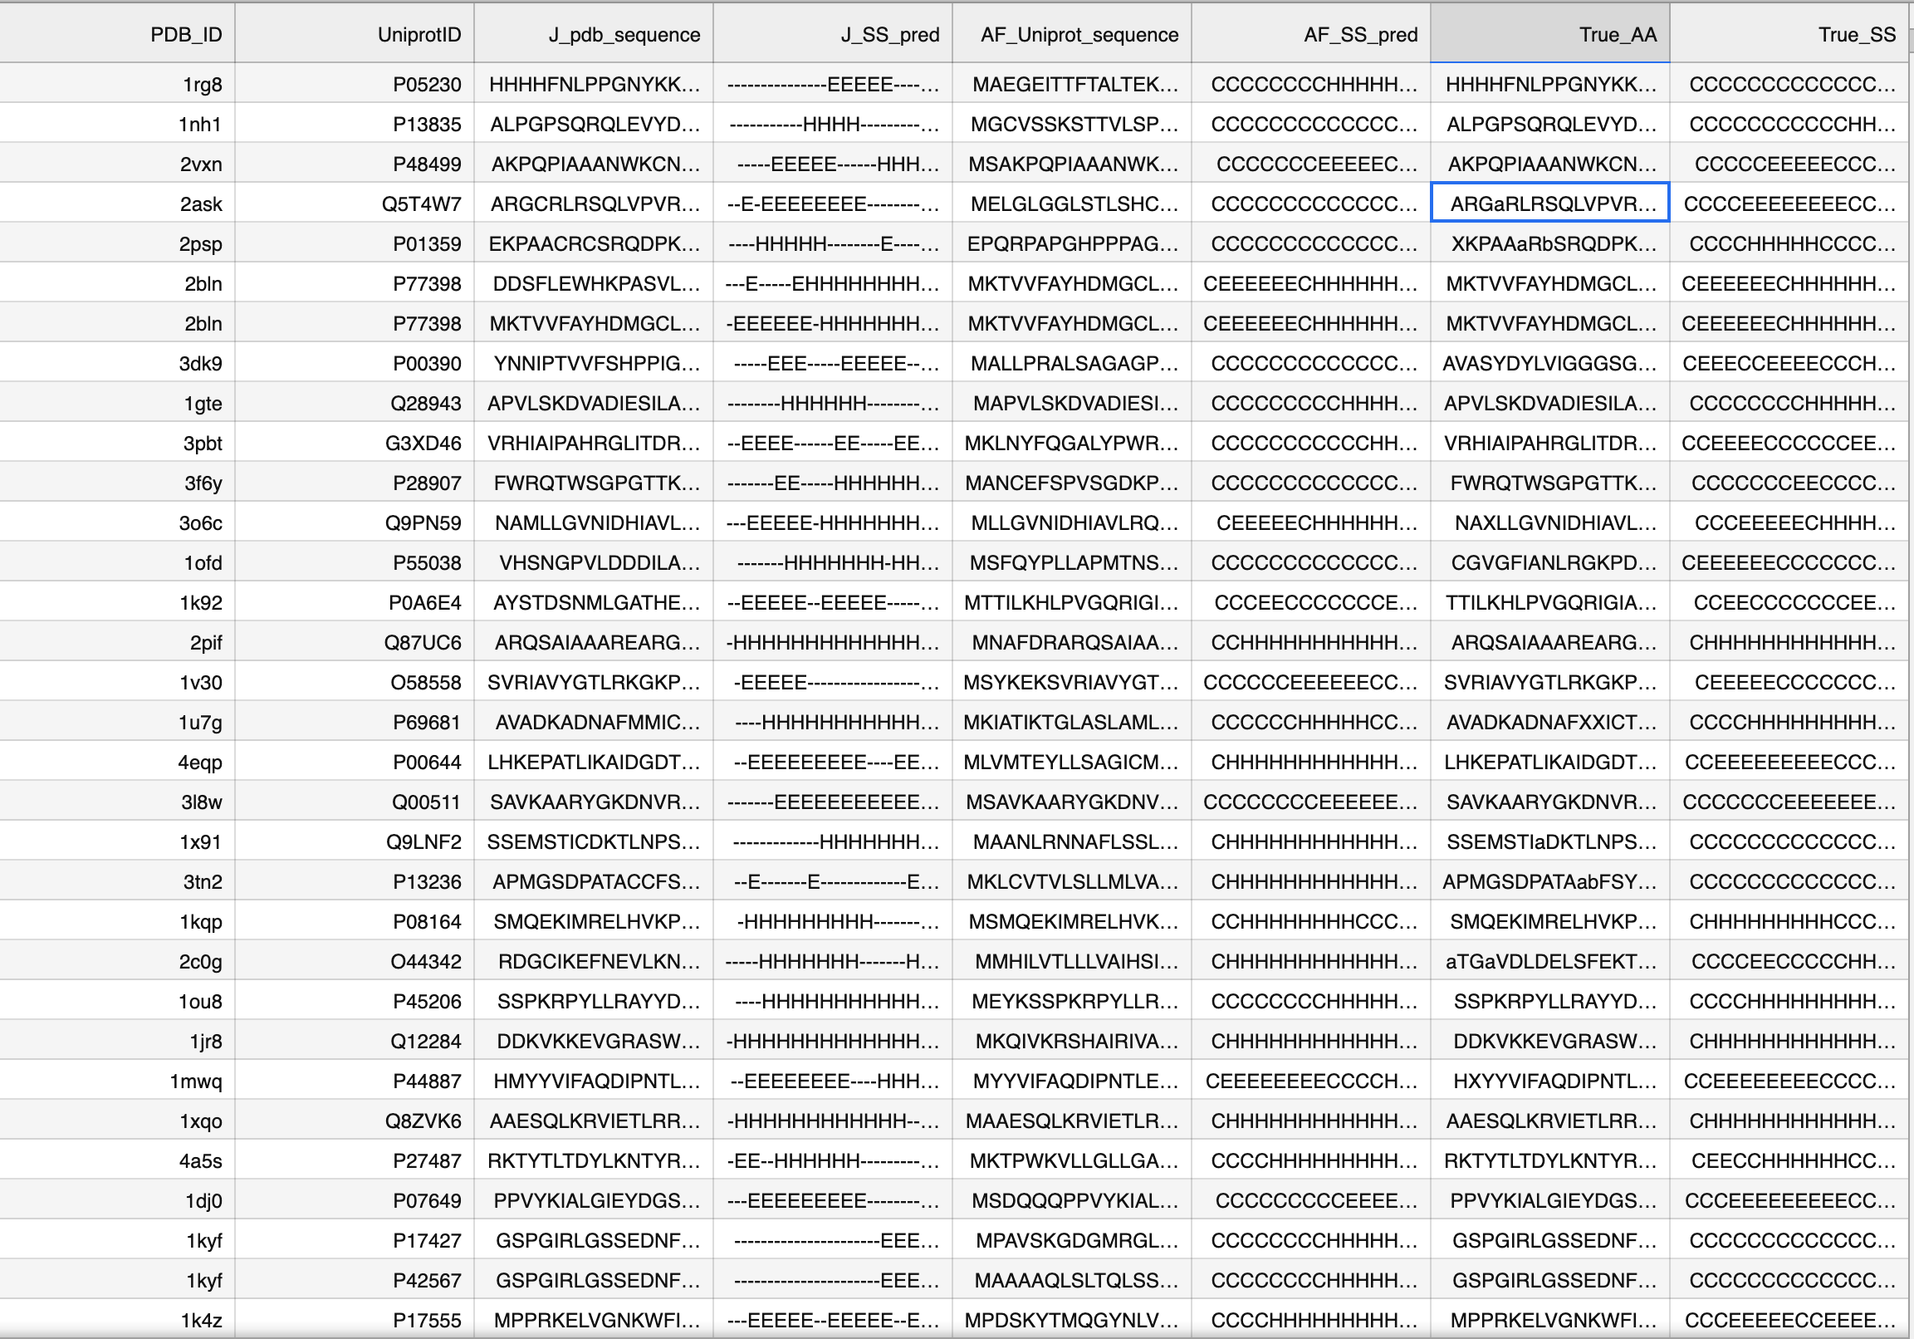
True secondary structure - DSSP
Some sequences don’t match
→ Choose chain
Invalid data?
Need to align - matches sometimes with PDB and sometimes with Uniprot sequence
Notes:
Last week, I had run DSSP and had the sequences of AF and Jpred
So to add the true secondary structure, downloaded files, ran DSSP and read it,
Added it with others
Noticed some potential problems with data:
Sequences don’t match – at first thought it was chain
got the right chain
– extra/different letters – how do I deal with those? (manually?)
Need to align? – need to check both pdb and uniprot sequences – shift accordingly
(Haven’t done yet)

Slide 3
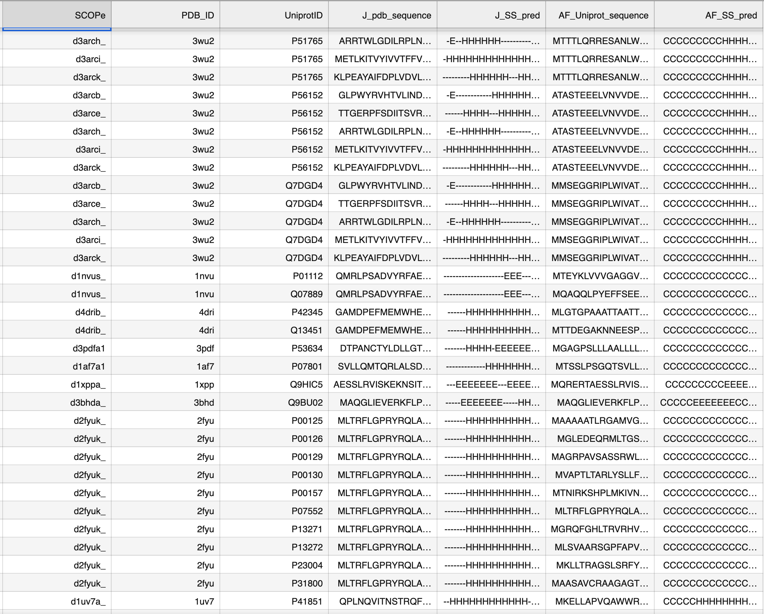
Missing data
Fixed missing data:
Deprecated pdb ID’s
Alphafold website
432 files → 883 unique pdb id’s
Final merged file has 1697 sequence predictions
Notes:
While I was doing that, I was getting errors for some pdb id’s -- I found some deprecated pdb id’s – switched those in my previous code (AF)
The next thing I did – while running AF - only had 430 files out of 1348
Looked at some of my code in AF and fixed it – converting to url’s I managed to get more valid pdb files from AF website – reaelised that I wasn’t using the url to search the latest AF database

Slide 4
Quick overview of numbers
1348 SCOPe ID’s → 1235 PDB ID’s → 1514 Uniprot ID’s (15 pdb id’s not mapped)
1220 PDB files from AF website (291 uniprot id’s not found)
After running DSSP → 883 unique pdb id’s (1135 Uniprot)
SIFTS → 883 unique pdb id’s
Different SCOPe ID configuration – excluded 4 pdb id’s (see next slide)
Also excluded 5 pdb id’s with invalid data from SIFTS (see next slide)
PDB and Uniprot → 874 files containing shifted sequence

Slide 5
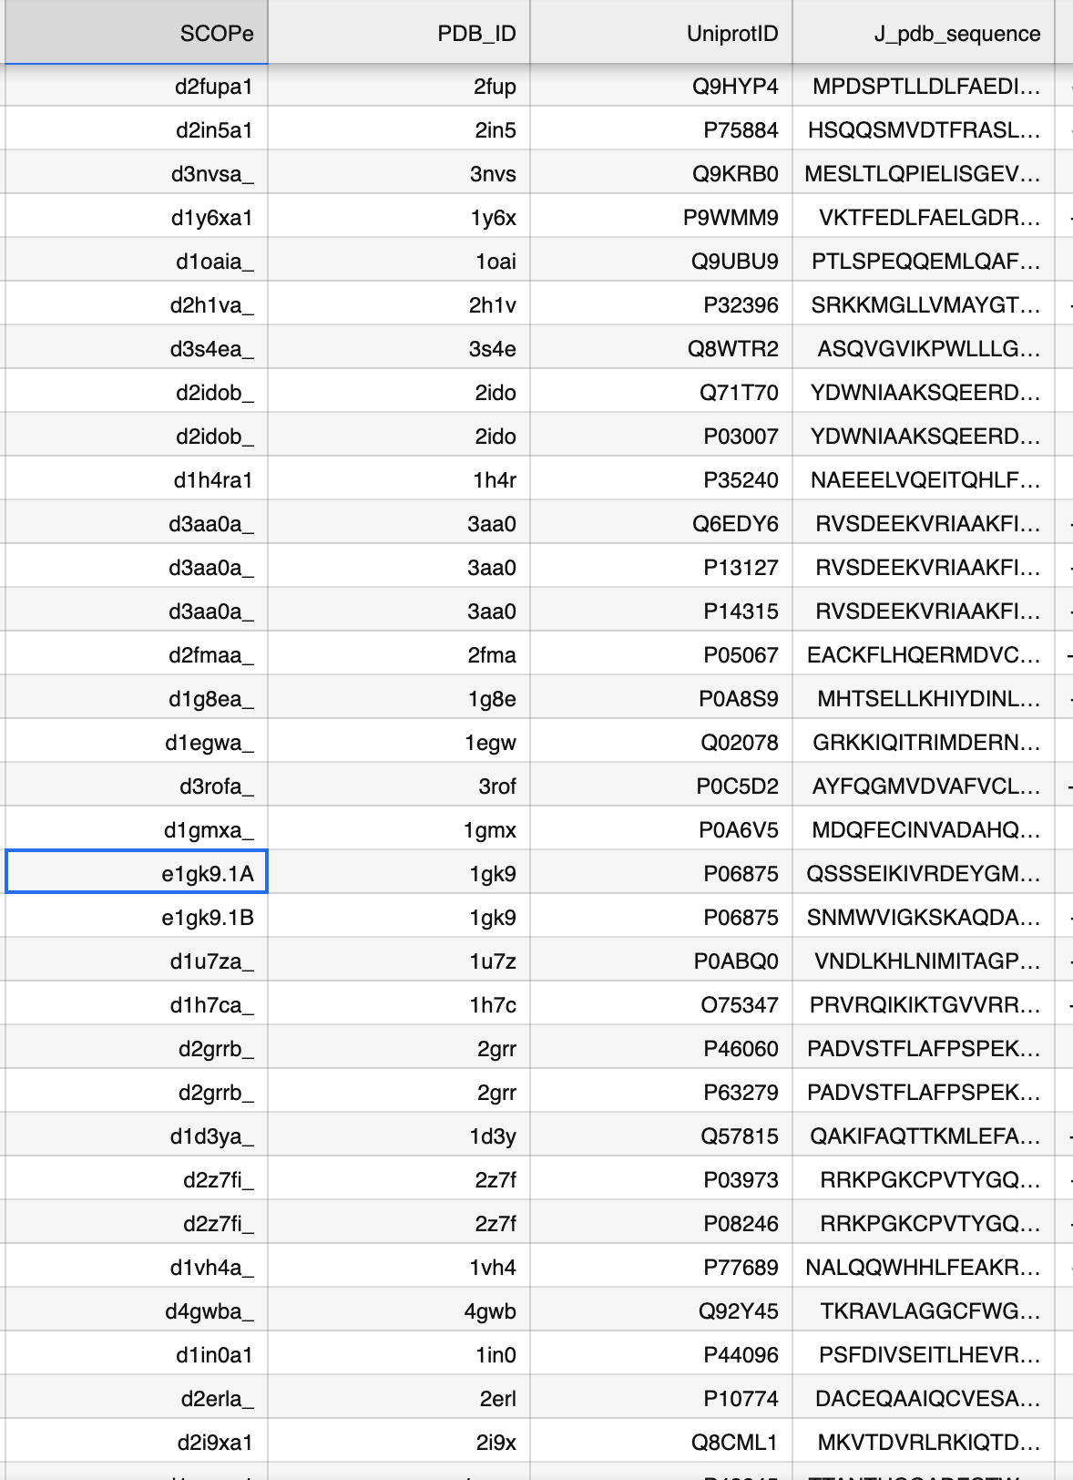
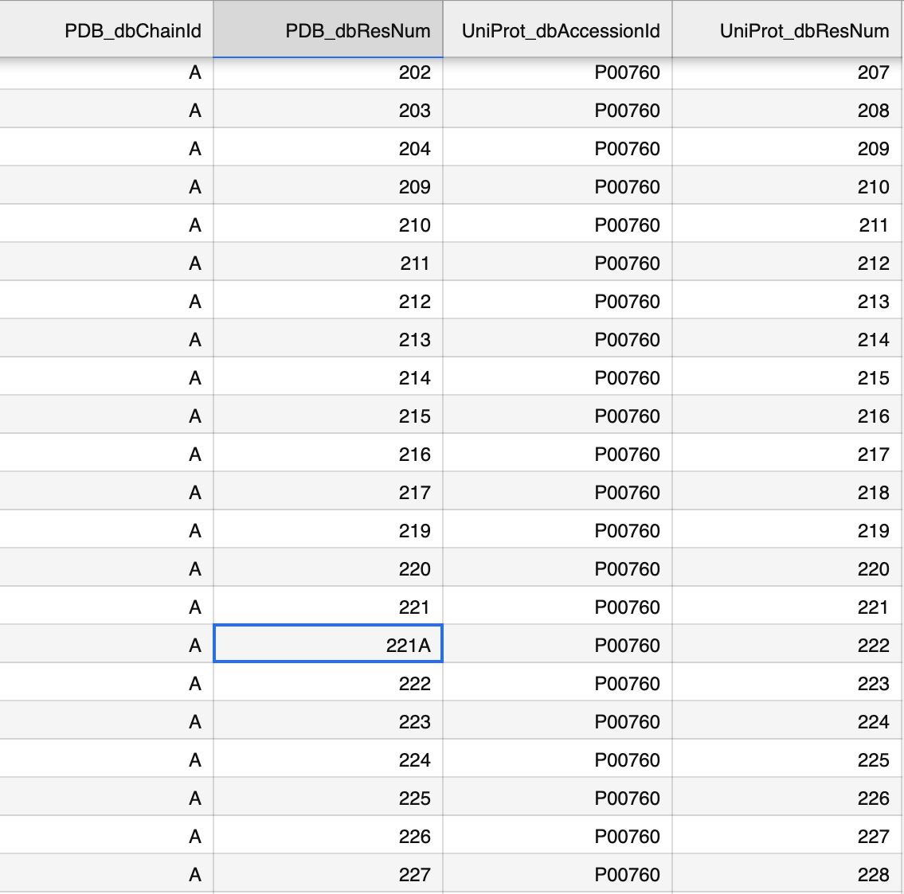
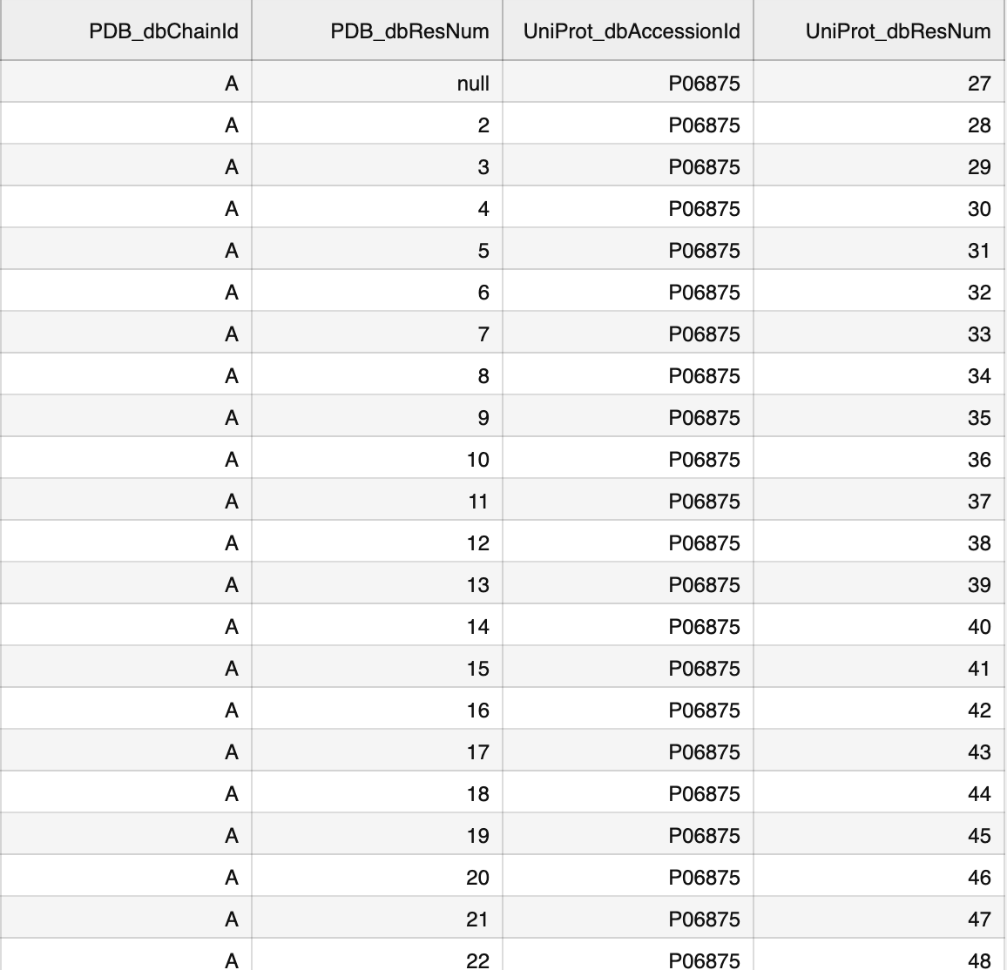
SIFTS – files excluded:
11 files (7 unique pdb id’s)
8 files (4 unique pdb id’s)
Notes:
I just excluded it – because then all the alignment is off -- incorporated that into the code?
Assumed that chain is 2 from the end in scop id but sometimes isn’t the case – mess up some of the data later on?

Slide 6
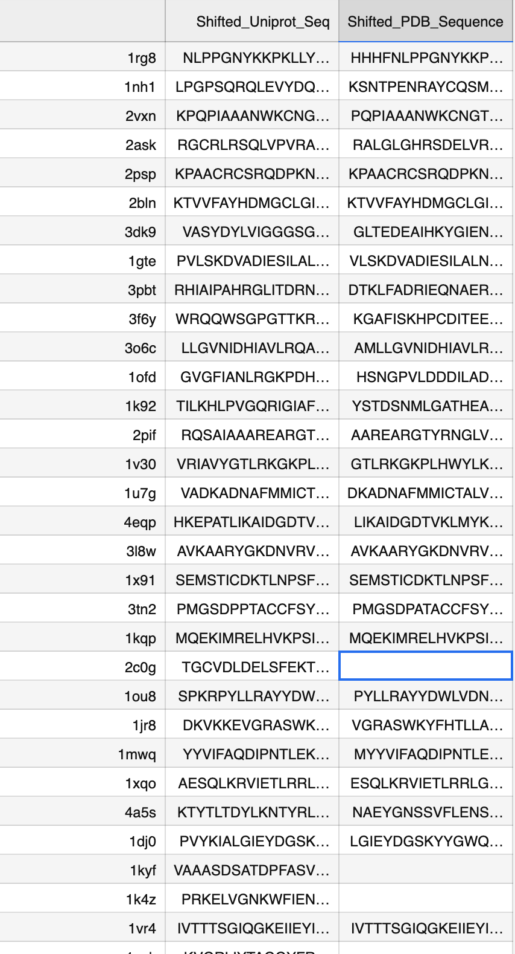
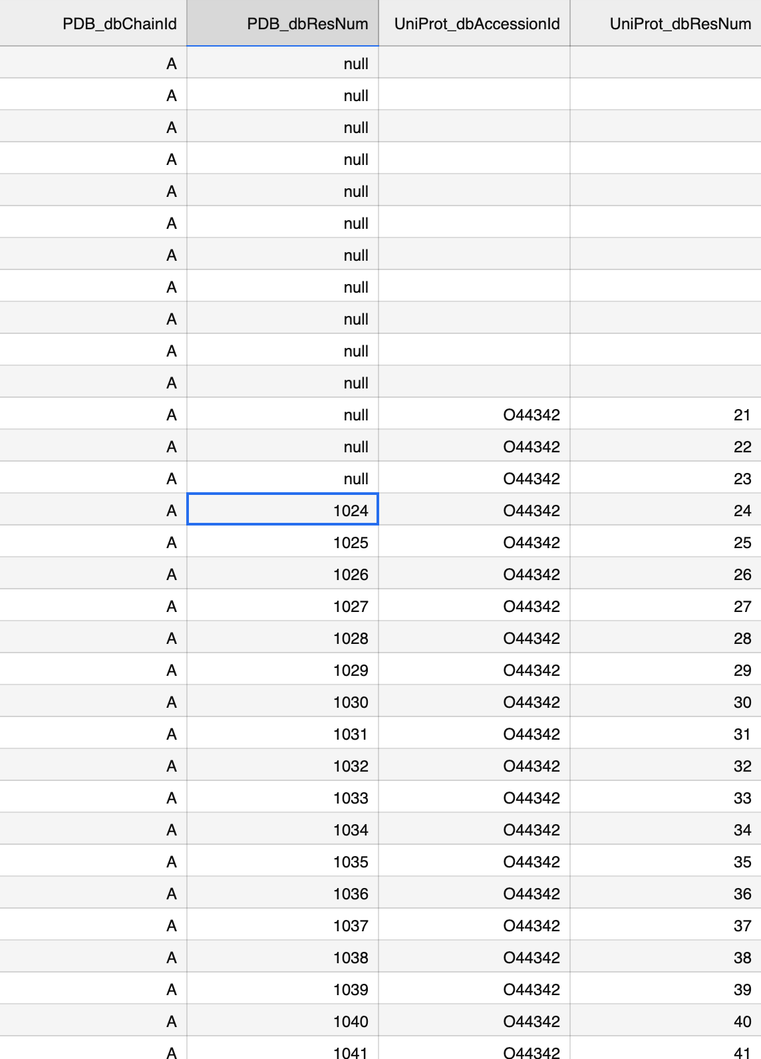
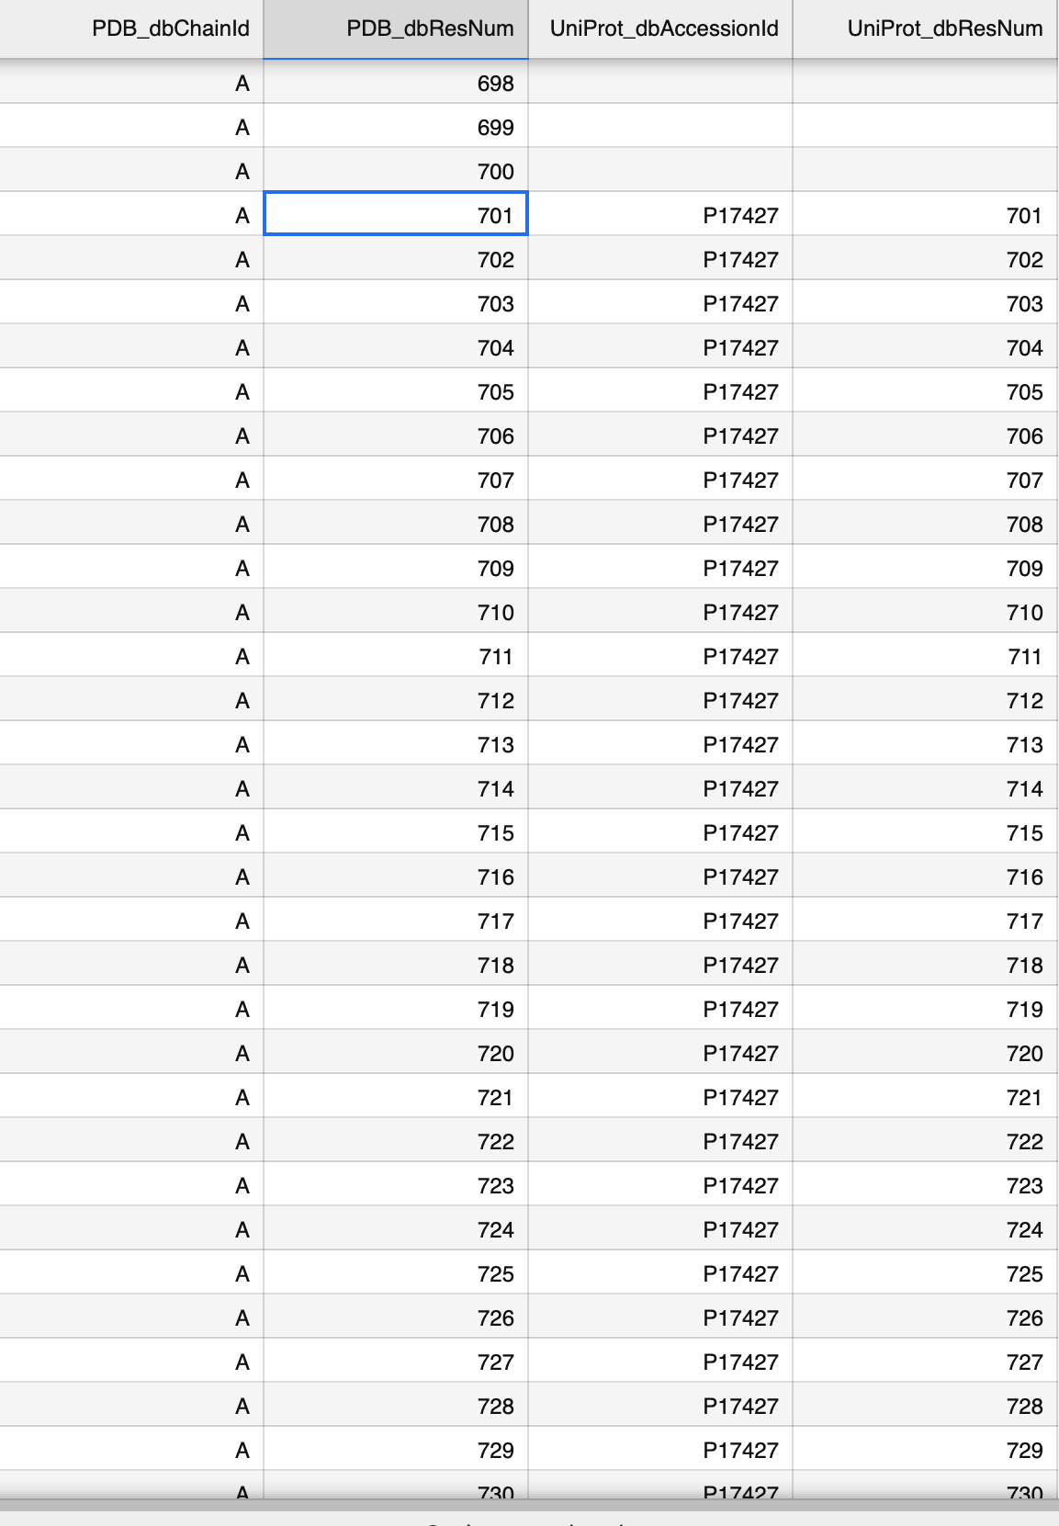
What I’m investigating now
Missing data → SIFTS: invalid data
Some sequences don’t match – what went wrong there?
Notes:
(Get offset from SIFTS files
Index pdb and uniprot sequences
878 csv files containing pdb id and sequence for both pdb and uniprot)
Multiple pdb chains in one SIFTS file – match chain to scope id
Some rows in which there’s data missing in one of them – should I just remove those rows?
Some the numbers are just too big for one of them (eg. 1kyf)
Some don’t match – suspect it’s due to invalid data from SIFTS – should I just remove those too?
Some start with negative numbers – find a way to incorporate that into the code
There’s slight mismatches – I think it has to do with whether it starts from 0/1 in each case

Slide 7
Challenges
Disk quota exceeded
2 home directories
Problems with servers (DSSP, SIFTS)
Getting code to work properly for indexing
Notes:
Unable to download files/run notebooks
Take all the data from one dir to another
Getting SIFTS to work – sometimes works, sometimes doesn’t
More data – had to run everything over again – took a while – didn’t manage to run SIFTS again – might explain some discrepancy in data? Idk
Figure out if the code is wrong or the data is just invalid – how to deal with the data properly

Slide 8
Next steps
Fix shifting of sequences
Align predictions based on sequences – index predictions
Align true secondary structure
Notes:
So, theoretically I’ve aligned the sequences, I just need to add a bit of code to align the predictions
True SS – write code to match with PDB/Uniprot sequence
Devise an algorithm to give a score?

