Slide 1


Comparing Jpred and Alphafold
Sophia Constantinou
Week 8

Slide 2
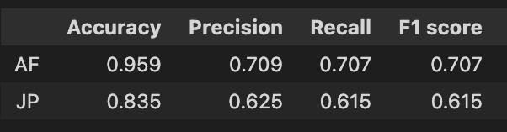
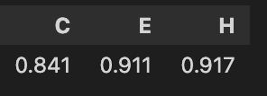
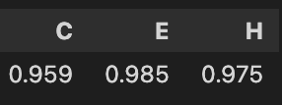
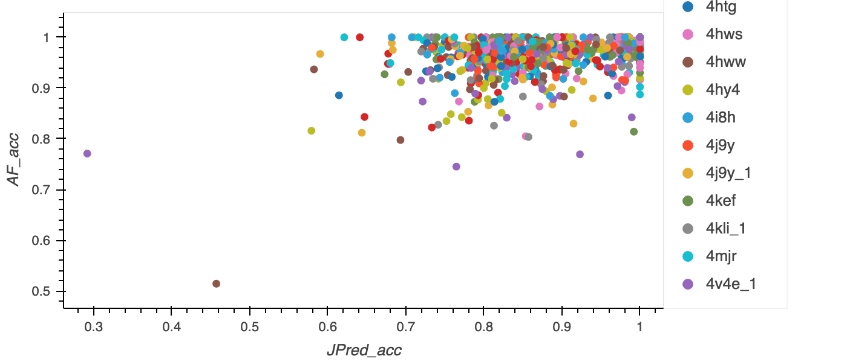
Final stats and plot
JP
AF
2o9u
2dlb
Notes:
AF performs better than JP,
JP has low pred. accuracy in C
diagonal
example table

Slide 3
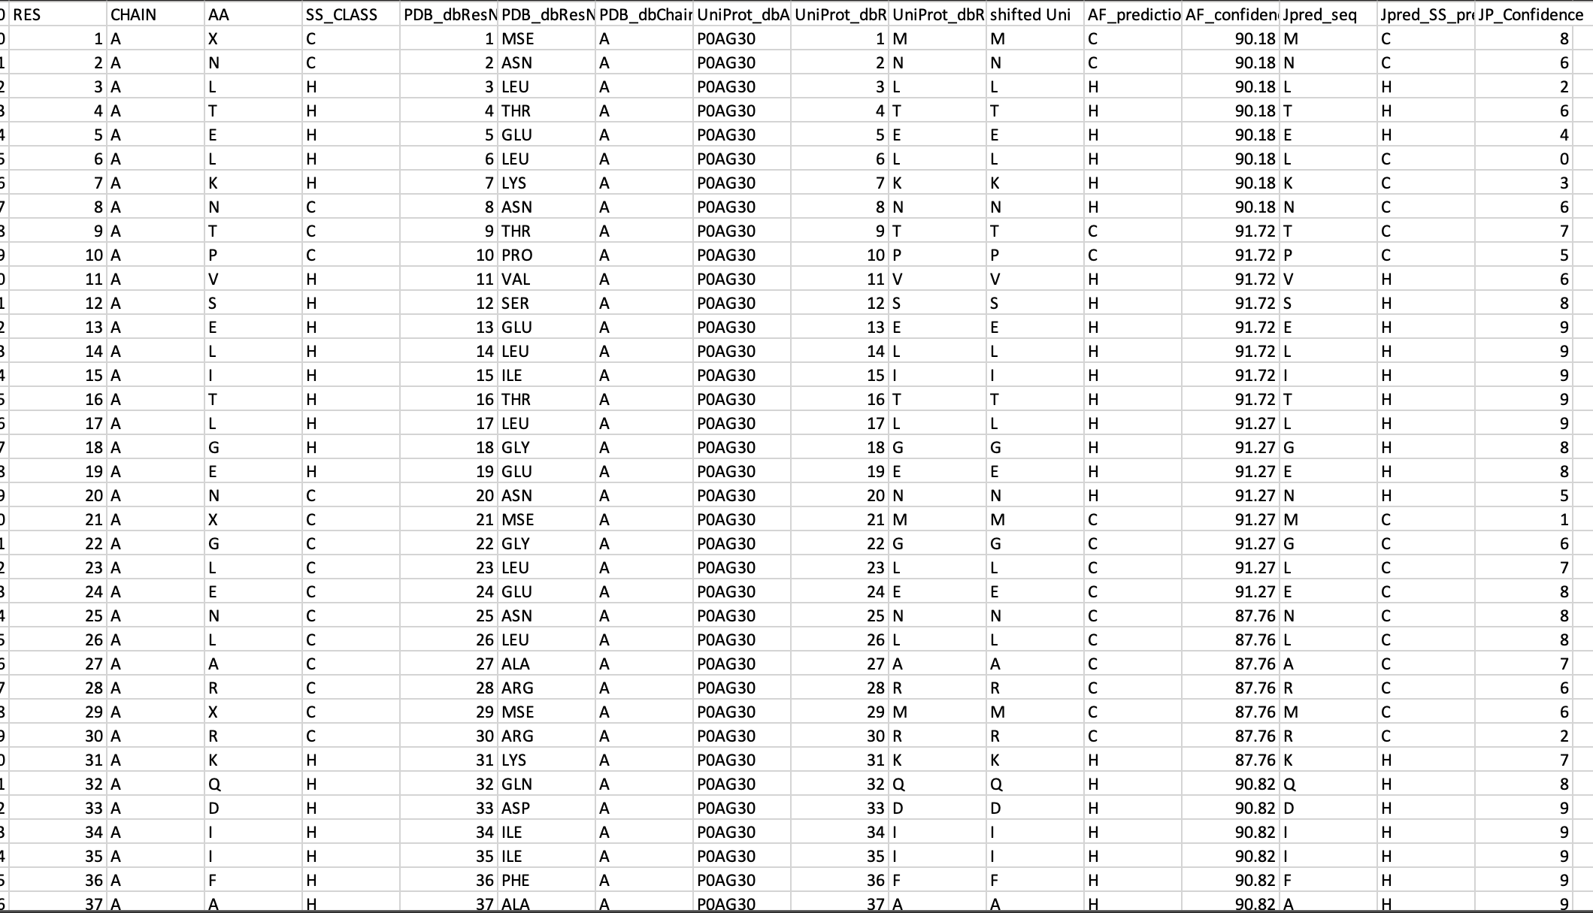
Confidence score
Notes:
Average confidence score for each pdb??
confidence level vs accuracy at that level
curves

Slide 4
Look at ones that jpred gets correct but AF doesn’t

