Slide 1
UW Misinformation
Summer Ai, Runting Shao, Ningji Shen, Chang Xu, Joyce Zhang

Slide 2
About this Project
Problems caused by Misinformation:
Aggregate political tension
Undermine trust between races and gender
Increased the risk of violence
Our Goal:
Investigate the correlation between misinformation and related features (financial gains, topics, emotions, etc.)

Slide 3
Key Data Features
From The Carter Center
Emotions: fear, anger, neutral, joy, sadness associated with the posts
From NewsGuard
Orientation: political polarization (left leaning, right leaning) of the post
Ratings: whether the domain is labeled as truthful, untruthful, or repeat offender (domains that repeatedly spread misinformation after they have already been fact-checked. They are likely malicious actors instead of simply ignorant).
From GDI
Topics: Topics associated with the news. Such as coronavirus, whitesupremacy, antivaxx, etc.
Notes:
Ask GDI data source

Slide 4
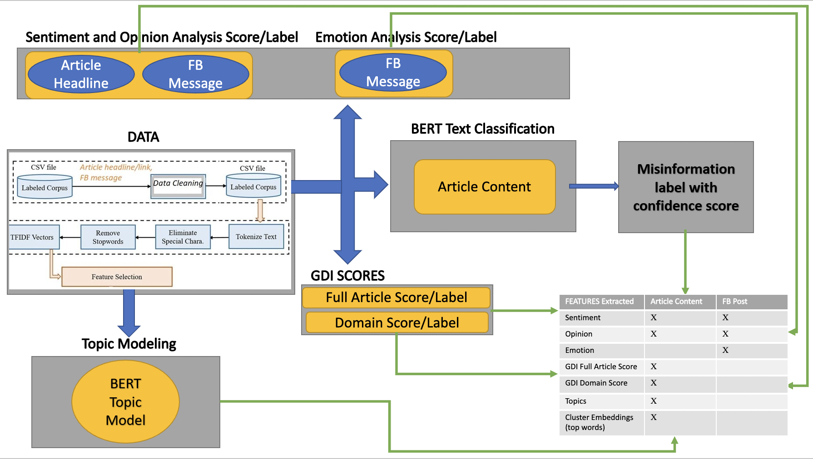
FB Data Architecture ​
Notes:
Get rid of self-Supervised Deep Clustering
Modify GPT-3 to BERT; Headline+message to Article Content
Topic Modeling: remove Neural Topic Model
Result: Article Headline to Article Content

Slide 5
Financial Terms Extractor
Our goal: looking into the insights of financial gains behind the spread of misinformation.
Possible financial beneficiaries on domains with content creation are mostly from:
platform advertising, sponsorship, web traffic, crowdfunding and selling merchandise
To get the insights of financial gains behind the spread of misinformation, we decided to extract data from 3 aspects:
Advertisement information of domains
Financial-related terms in sublinks of domains
Financial-related terms in ads content of domains
Notes:
Add the 4 elements for plausible financial gains correlation

Slide 6
Financial Terms Extractor - Advertisement
This part of web scraper is used to extract two files from each domain: ads.txt and sellers.json.
We aggregated the data we obtain from ads.txt and sellers.json to produce the following attributes for each domain:
Total number of digital sellers that placed advertisements on the domain.
Total number of digital sellers that placed advertisements on the domain that has a certification authority from the Trustworthy Accountability Group (TAG).
Highest ads count: The highest number of advertisements placed by a single seller.
Ads domain with highest count: The seller that placed the highest number of advertisements.

Slide 7

Financial Terms Extractor - Sublinks
Financial Terms: “Donation”, “Shop/Store”, “Subscription”, “Advertising”, Discount”, “Free”, “Money”, ”Buy”, “Newsletter”

Slide 8

Financial Terms Extractor - Ad Content
Ads inside an iframe:
These ads are usually tailored based on users’ browsing patterns. Different users will see different ads while visiting the same webpage. This kind of ads is excluded from this extractor since it may bring up potential biases.

Slide 9

Financial Terms Extractor - Ad Content
Financial Terms: “Donation”, “Shop/Store”, “Subscription”, “Advertising”, Discount”, “Free”, “Money”, ”Buy”, “Newsletter”
Ads inside an anchor tag:
These ads are usually non-behavioral ads. Different users get to the same ads as they visit the webpage.

Slide 10
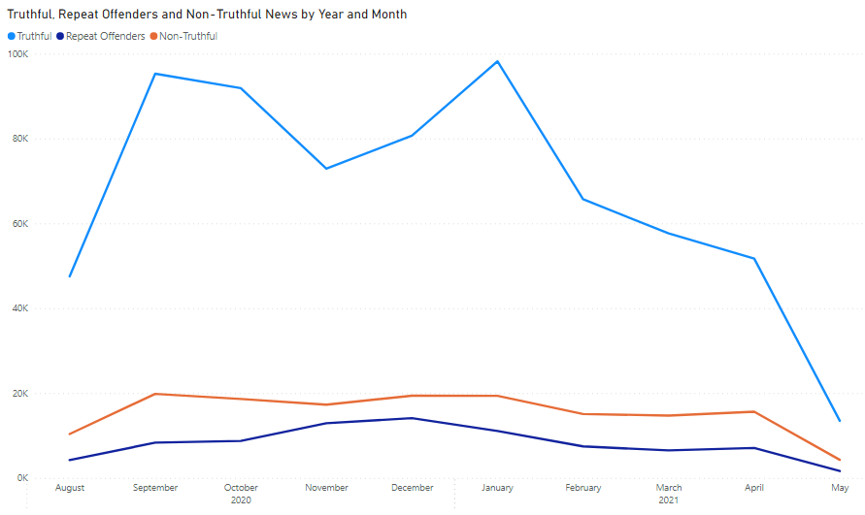
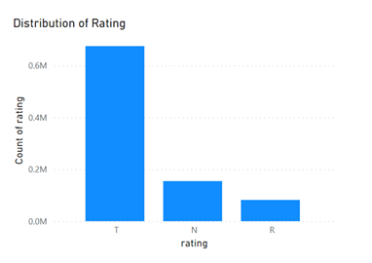
Exploratory Data Analysis
We see large variability in this figure (right) but cannot draw concrete conclusions.
Notes:
Add slide about the data at the beginning, explain the source & def of ratings
We see large variability in data but cannot draw concrete conclusions.

Slide 11
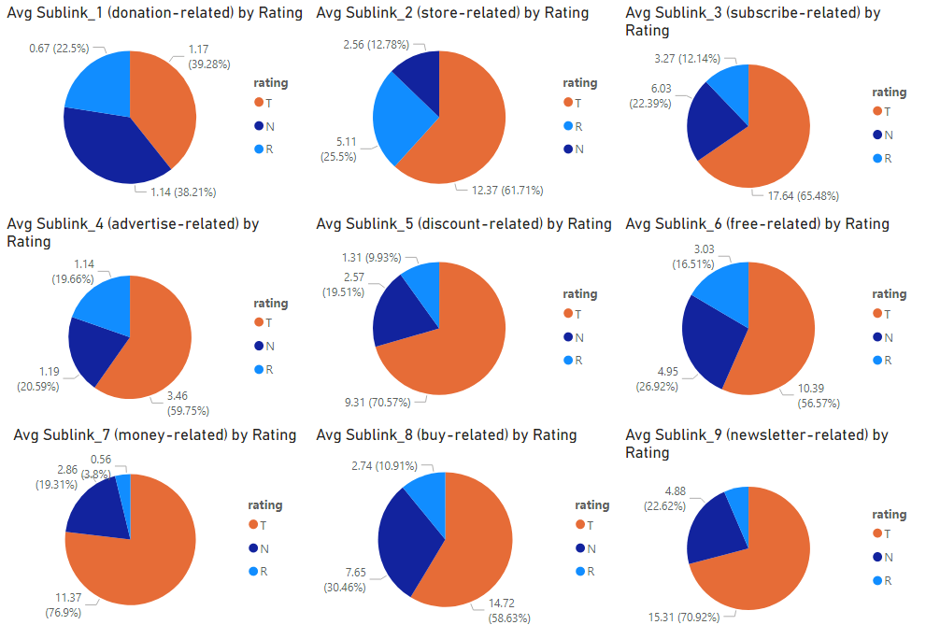
Sublink by Rating
Most of the contents are labelled truthful.
Cannot correlate repeat offender sites and financial terms using Sublink data.
Notes:
This graph shows the average number of “sublink” keywords which are truthful, non-truthful, or repeat offenders. For example, on average there are 1.17 donation-related sublink keywords that appeared in truthful news.
For sublink, most of the contents are truthful. Sublink_1(Donation-related) has the highest percentage of non-truthful content
Key: cannot correlate repeat offender sites and financial terms using sublink data

Slide 12
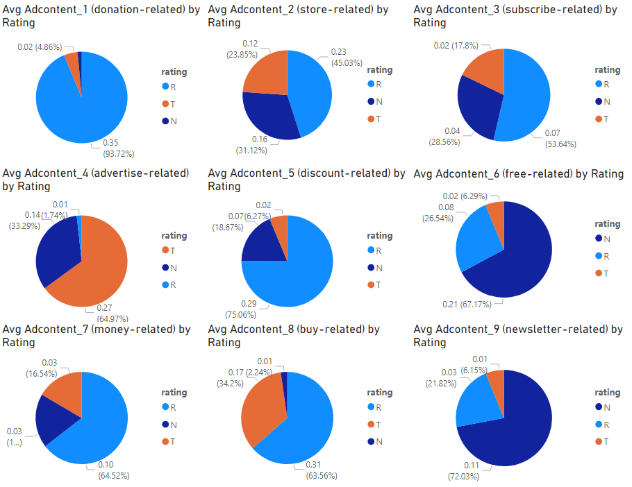
Ad Content by Rating
Donation, subscribe, discount, money, and buy related ad content tagging have the highest portions of repeat offenders
Given the less number of repeat offender sites, we still see large number of financial term correlation from repeat offender sites
Notes:
This graph shows the average number of “ad content” keywords which are truthful, non-truthful, or repeat offenders. For example, on average there are 0.02 donation-related ad content keywords that appeared in truthful news.
AdContent_1(Donation-related), AdContent_3(subscribe-related), AdContent_5(Discount-related), AdContent_7(Money-related) and AdContent_8(buy-related) have the highest portions of repeat offenders. AdContent_6(Free-related) and AdContent_9(Newsletter-related) have the highest portions of non-truthful contents. AdContent_7(Money-related) are not driving non-truthful contents. For ad content, the user bases are driving non-truthful content, such as newsletter-related contents and increasing the user follower number, instead of asking for money or donations.
Key: given the less number of repeat offender sites, we still see large number of financial term correlation from repeat offender sites

Slide 13
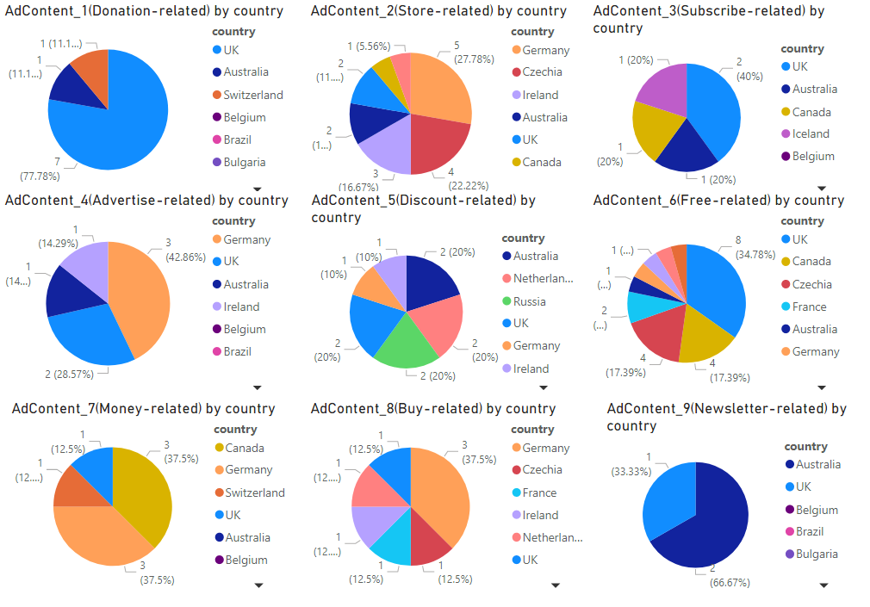
Ad Content for Domains Outside of U.S.
The English speaking countries such as UK and Australia have higher portions of ad content tagging (e.g. Donation-related, Newsletter-related), therefore we cannot draw conclusions due to the size of this dataset.
Notes:
Add topics

Slide 14
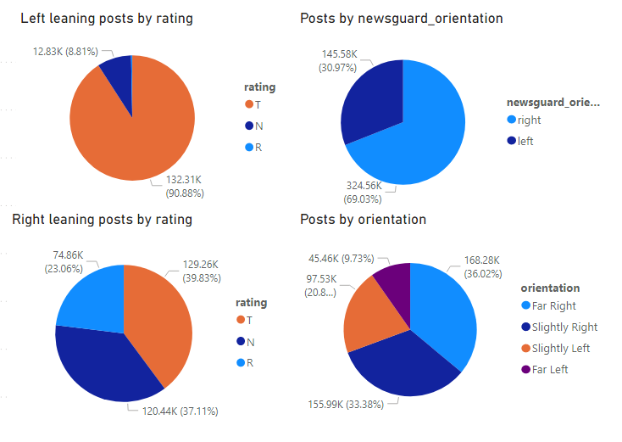
Political Orientation by Rating
Note: The data was balanced on the orientation upon collection by TCC, then became less balanced after joining with the Newsguard labeled dataset.
Right leaning posts have a higher correlation with the repeat offender sites.
Notes:
Explain source, when create the data, it was balanced based on the orientation. Became less balanced after joining with the newgard data
Just keep the pie charts
Key: right political orientation have a higher correlation with the repeat offender sites

Slide 15
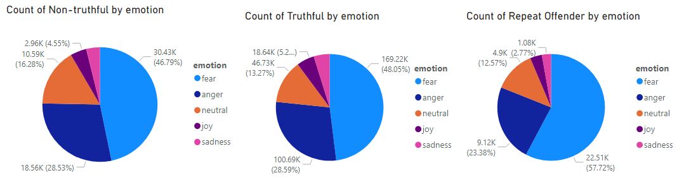
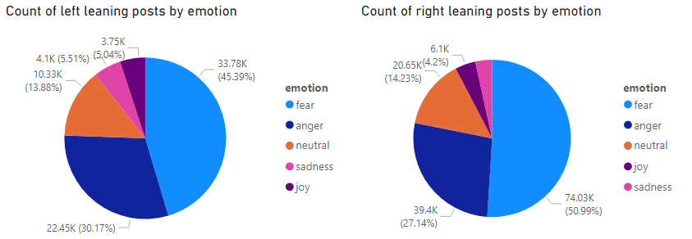
Emotions -- Led by fear and anger
Notes:
Key: most led by fear and anger

Slide 16
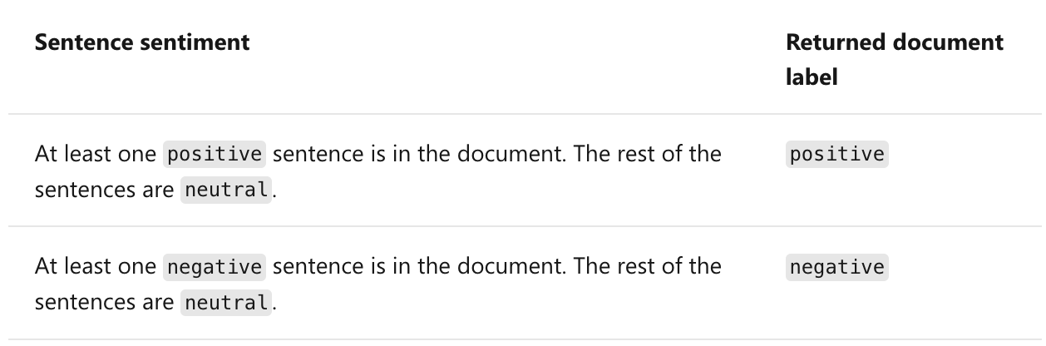
Sentiment Analysis in Azure Cognitive Service for Language
Can be used through AI model / API requests
Applies sentiment labels to text, which are returned at a sentence and document level, with a confidence score for each.
The labels are positive, negative, and neutral.
Confidence scores range from 1 to 0. Scores closer to 1 indicate a higher confidence in the label's classification. The predicted scores associated with the labels add up to 1.
We use it to get sentiment of headlines and Facebook messages
Notes:
MS sentiment analysis model

Slide 17
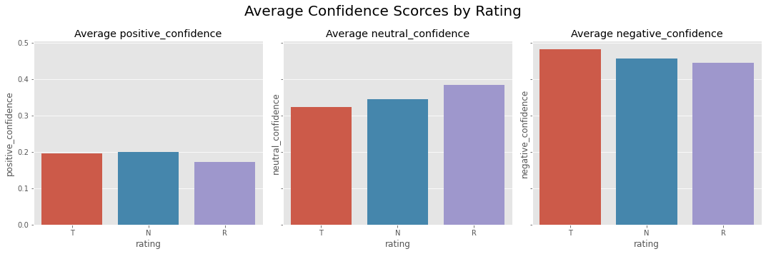
Exploration of Sentiment Confidence Scores
Notes:
Add a slide about the MS sentiment analysis model

Slide 18
GDI Topics
antilatinx | illegal alien, Latino,Latina,Latinx…
antilgbt | transgender,gay,lesbian,bisexual,bi, homophobic,..
antiblack | GeorgeFloyd,racism,racist,Black Lives Matter,...
antiimmigrant | immigration,immigrant,illegal alien,illegal aliens, …
pseudoscience | pharmaceuticals, medicine, homeopathic,cure, cancer,.
bigtech | apple, google, microsoft, big tech companies, …
antiasian | asian, hate crime, stop asian hate, etc…,
antisemitic | Jewish,synagogue,anti-semitic,anti-Semite,Israel…
antimuslim | Muslim,Islam,Islamic,Allah,Muhammad,Sharia, …
qanon | QAnon,q anon,Deep State,q anon,deep state
voterfraud | Election Day,mail-in voting,voter fraud,...
misogyny | feminism,feminist,women's rights,gender equality,...
votinglaws | election law, voting rights, voter laws, …
aliens | immigration, alien, foreign nationals…
coronavirus | covid-19,SARS-CoV-2,african variant,self isolation, …
whitesupremacy | white genocide,white power,anti-white…
antivaxx | vaccination,vaccines,antibodies,anti-vaxxer,pfizer,...
biden | Biden, Joe Biden
climatedenial | climate change, global warming, Greta Thunberg
5g | 5g, wave,...
Notes:
v1

Slide 19
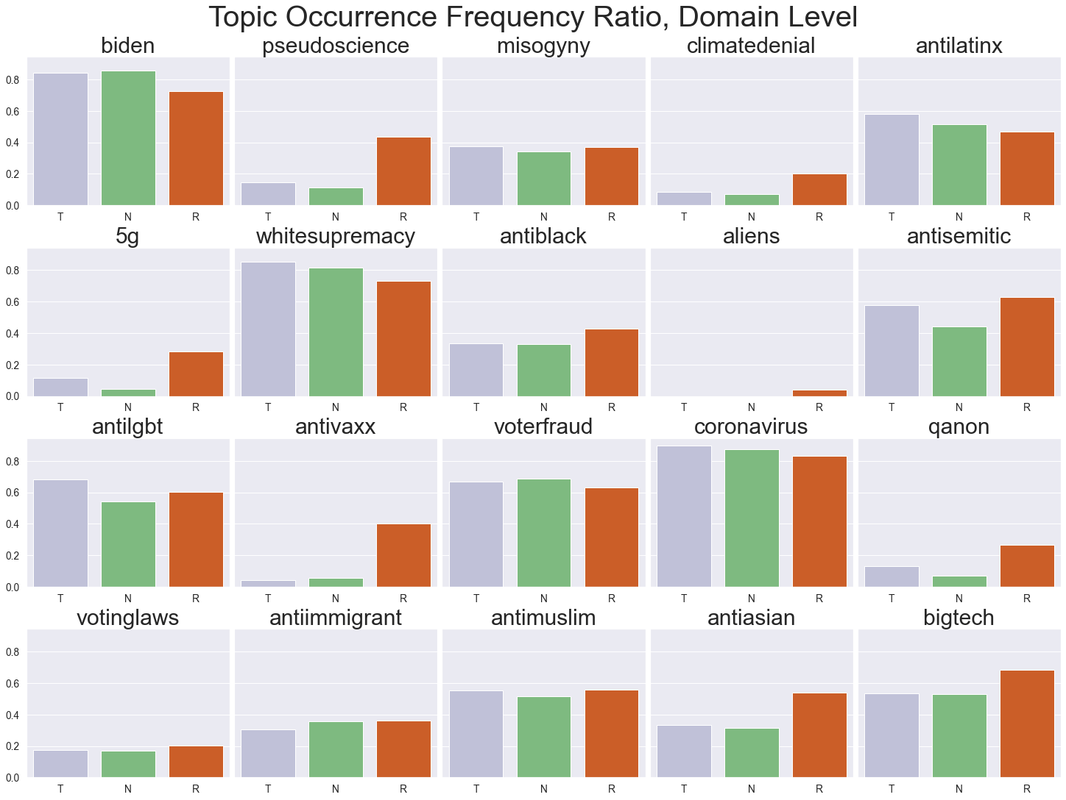
Topics
Occurrence Frequency Ratio, Domain Level:
The occurrence frequency of domain topic among all the unique domains that have topic information provided by GDI.
Count (topic occurrence among all the unique domains with rating T/N/R)
Total counts of unique domains with rating T/N/R
Notes:
Add a slide about the Topic

Slide 20
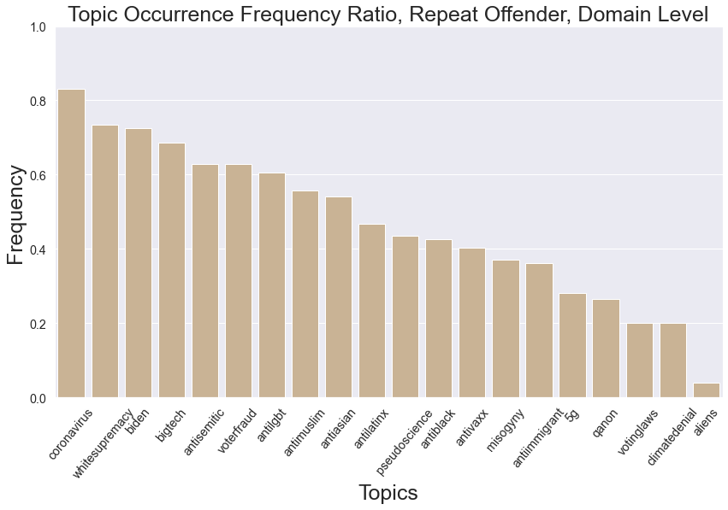
Topics (Repeat Offender)
Notes:
Add the plot for the domains out of US.

Slide 21
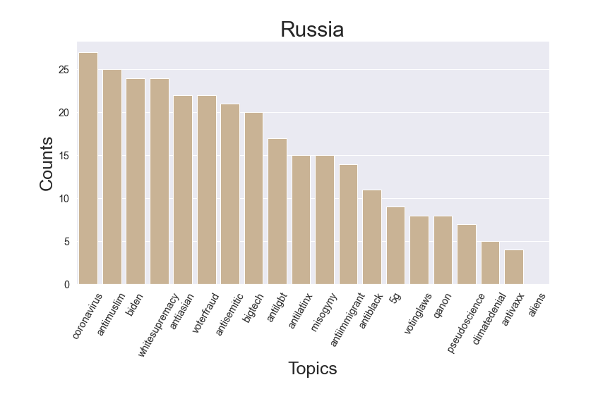
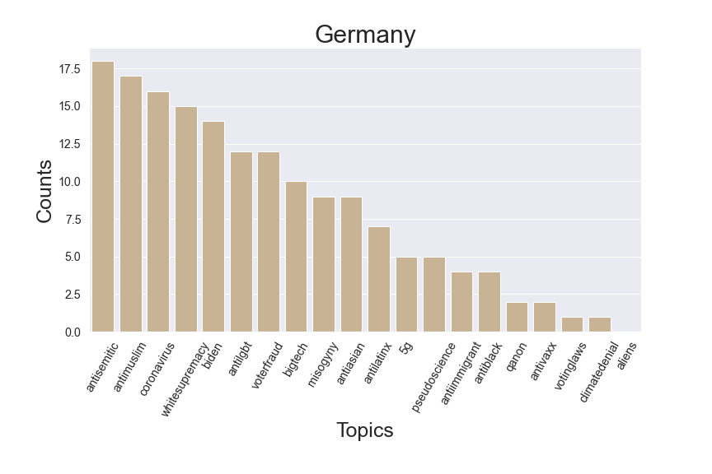
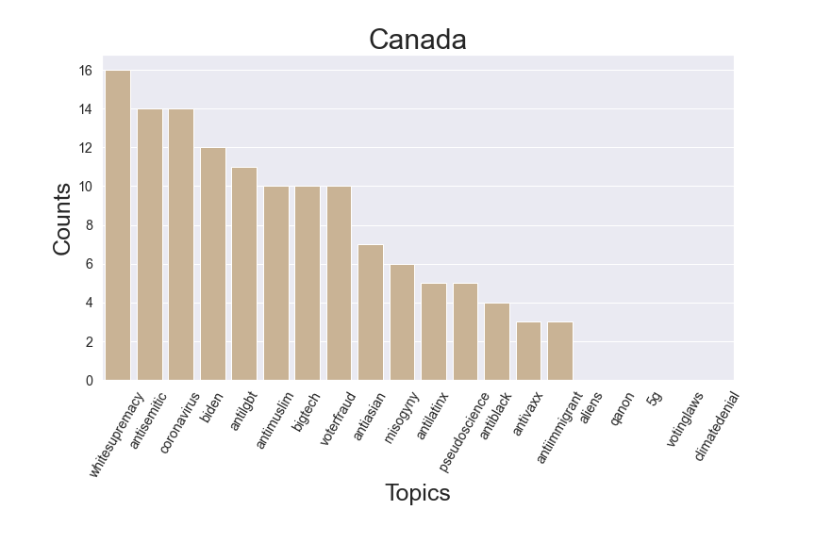
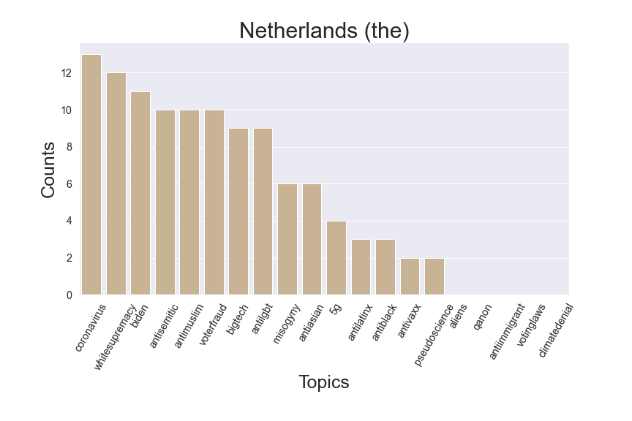
Countries Outside of U.S. (By Country)
Notes:
Count of Countries outside of U.S. whose posts are forwarded the most
For posts from russia, coronavious, antimusulin, biden and whitesupremacy are the frequently forwarded post topics

Slide 22
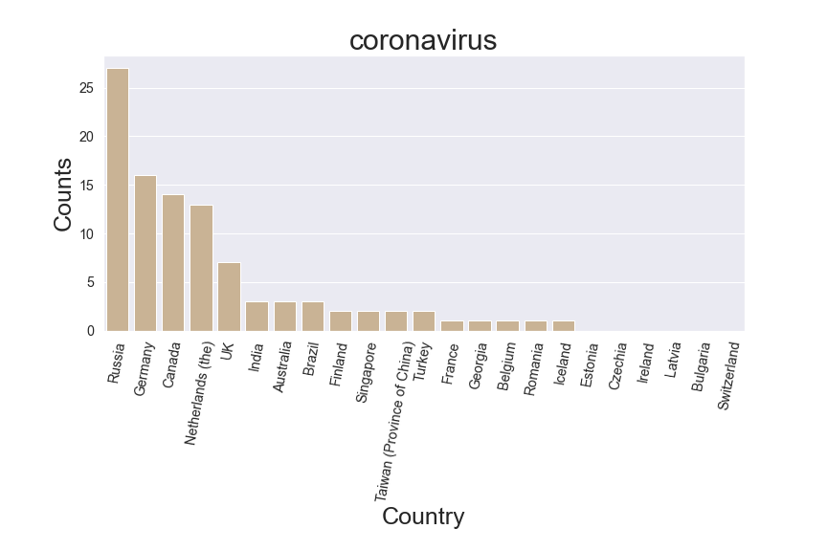
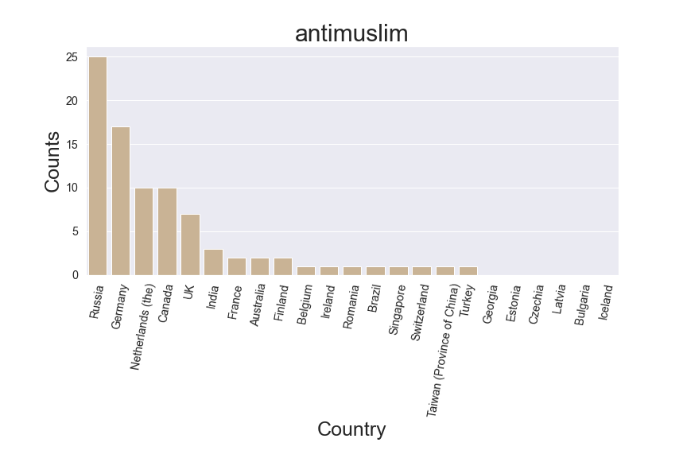
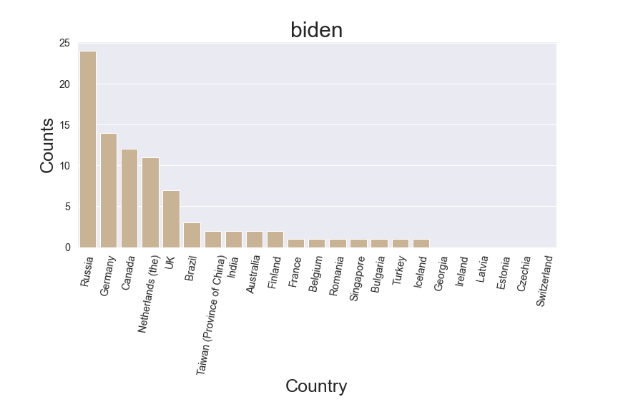

Countries Outside of U.S.(By Topic)

Slide 23
Bert MultiLabel Classification Model for Topics
Our plots show correlations between topics and different attributes
Supervised v.s. Unsupervised
Evaluated on out-of-temporal and in-temporal data
Notes:
Supervised trained on pre labeled news data, unsupervised clustered based on news content; TCC collect, join NewsGuard

Slide 24
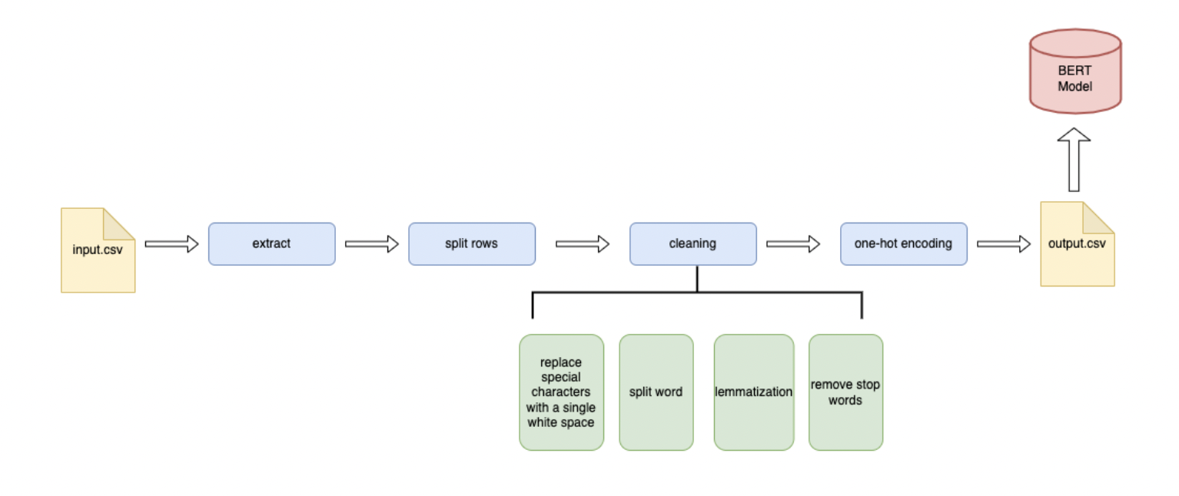
Data Preprocessing
Notes:
Scraper Python Package Used: Newspaper
The scraper extract article contents from news links, save the contents as full_text, along with the unique id (uid) and the news link (url).

Slide 25
Topic Multilabel Classification - Supervised Model
Multilabel model based on BERT model
Trained using pre-labeled data
16 topics evaluated: abortion, antiasian, antiblack, antiimmigrant, antilatinx, antilgbt, antimuslim, antisemitic, antivaxx, biden, bigtech, coronavirus, misogyny, pseudoscience, voterfraud, whitesupremacy
Notes:
Check the name of the model BERT large

Slide 26
Cross Validation Performance
id | Label | accuracy | precision | recall | AUC
1 | abortion | 0.9878 | 0.6148 | 0.4451 | 0.9809
2 | antiasian | 0.9903 | 0.6455 | 0.0597 | 0.9552
3 | antiblack | 0.9875 | 0.5543 | 0.2110 | 0.9766
4 | antiimmigrant | 0.9564 | 0.5301 | 0.0370 | 0.9578
5 | antilatinx | 0.9515 | 0.5345 | 0.0884 | 0.9538
6 | antilgbt | 0.9680 | 0.6299 | 0.4371 | 0.9619
7 | antimuslim | 0.9777 | 0.6165 | 0.4076 | 0.9549
8 | antisemitic | 0.9847 | 0.5882 | 0.1536 | 0.9603
9 | antivaxx | 0.9970 | 0.7229 | 0.1661 | 0.9734
10 | biden | 0.7867 | 0.7503 | 0.6070 | 0.8745
11 | bigtech | 0.9677 | 0.6453 | 0.3415 | 0.9391
12 | coronavirus | 0.9164 | 0.7139 | 0.4535 | 0.9342
13 | misogyny | 0.9936 | 0.7832 | 0.1349 | 0.9525
14 | pseudoscience | 0.9967 | 0.9191 | 0.1460 | 0.9794
15 | voterfraud | 0.8772 | 0.6855 | 0.5161 | 0.9281
16 | whitesupremacy | 0.9354 | 0.6712 | 0.4456 | 0.9497

Slide 27
Topic Multilabel Classification - Unsupervised Model
Created clusters based on news article content using BERT-Large and HDBSCAN
Reduced dimension to 50 with UMAP
Select the top 5 words with highest c-TF-IDF score in each cluster to extract cluster topic
Notes:
Change BERT to BERTOPIC

Slide 28
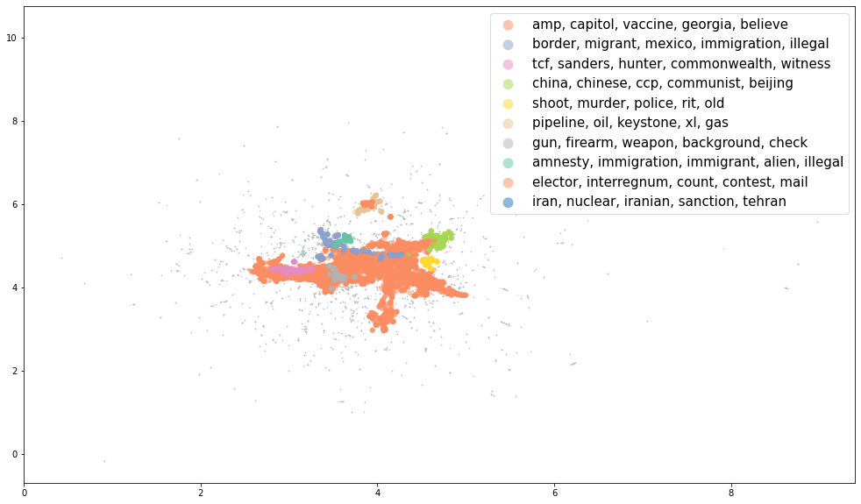
Cluster based on the first two UMAP dimensions
Notes:
Remove the green

Slide 29
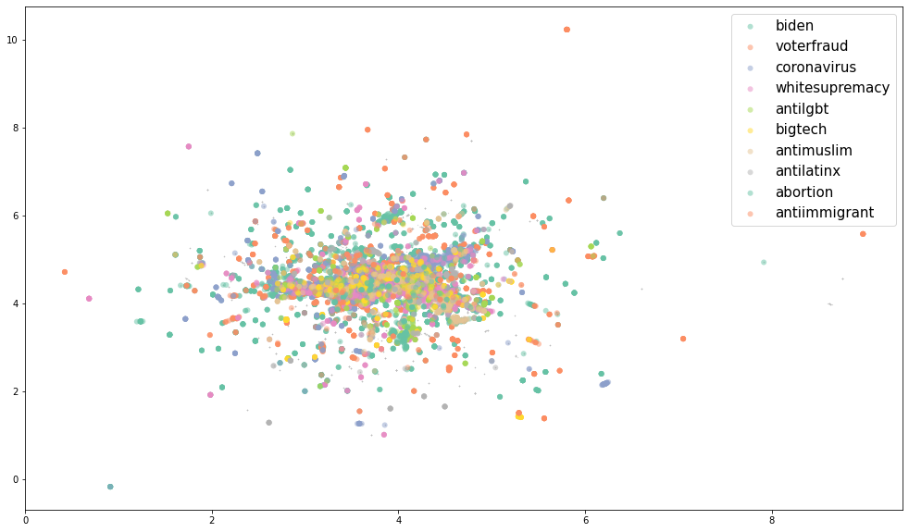
Predicted label from Supervised Model
Notes:
Hard to see clusters.
Supervised more on the terms based on the information stored in the model

Slide 30
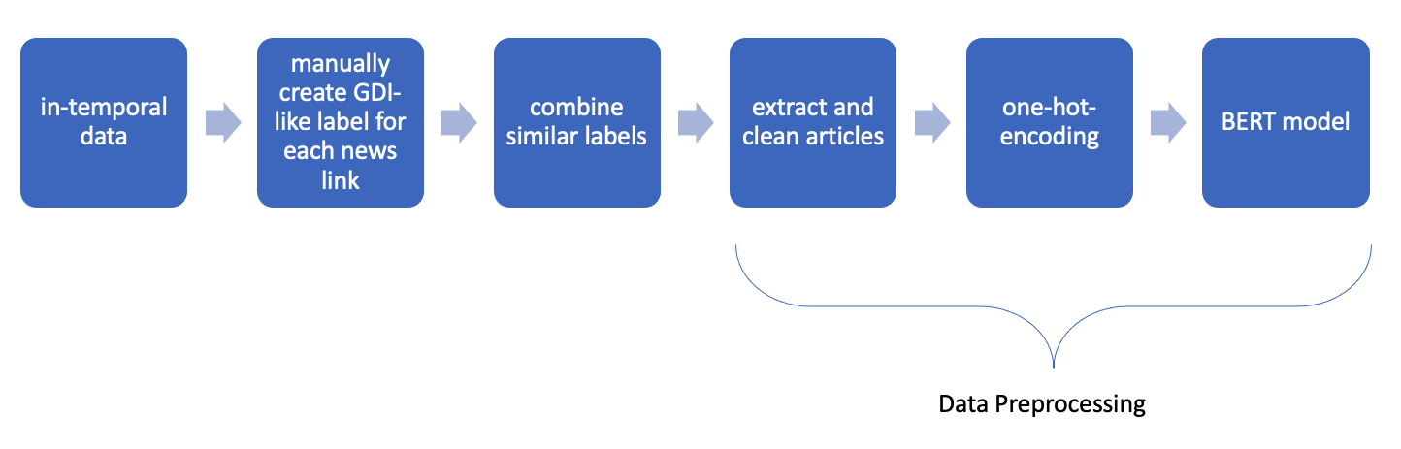
Manual Labeling
Notes:
On more recent news data to see how our model generalize information. We manual label the data.

Slide 31
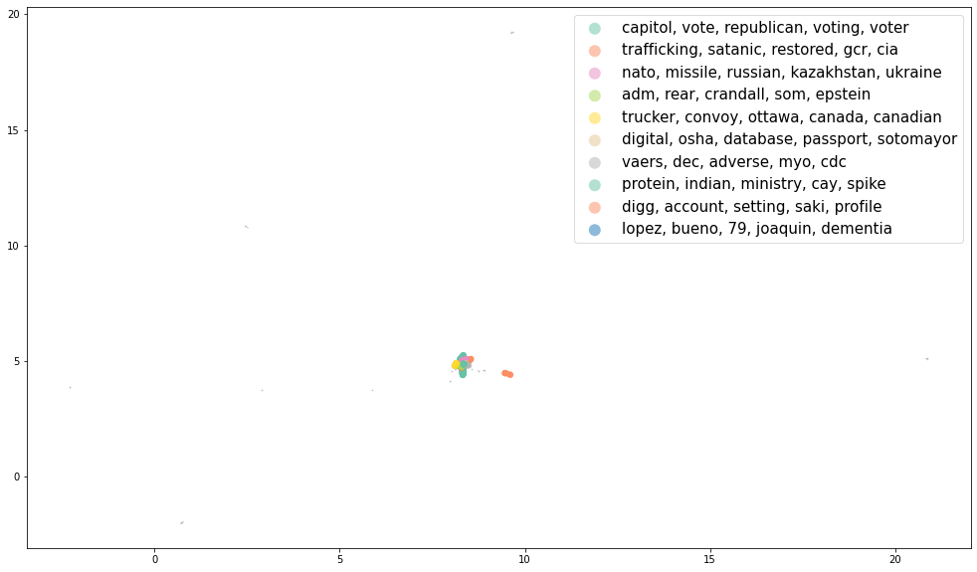
Unsupervised Clusters for Manual Labeling Data

Slide 32
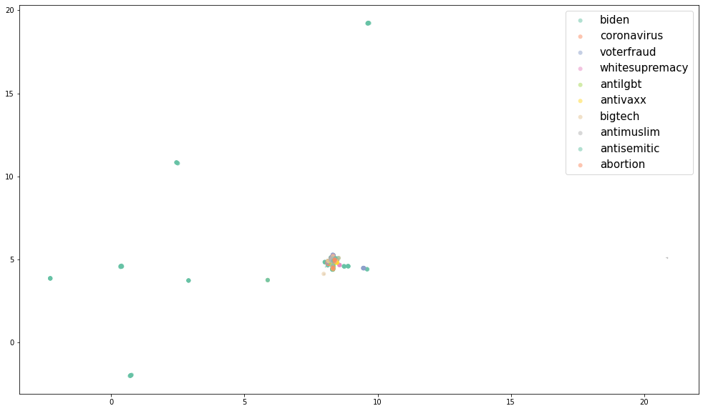
Supervised Clusters for Manual Labeling Data

Slide 33
Going Forward
Based on the superior performance of the unsupervised BERT topic classification approach, this approach shows the most promise for developing a generalized model for identifying topics of misinformation from out of sample sources.
The Carter Center intends to use this model in our efforts to monitor for misinformation narratives, particularly during election cycles.

Slide 34
Thank you!

