Slide 1

The Carter Center Democracy Program
Observed 113 elections in more than 40 countries since 1989.
Launched the Digital Threats to Democracy initiative in 2019.

Slide 2
Threat of Misinformation
Misinformation undermines democratic institutions
False narratives can foment unrest and incite violence

Slide 3
Mitigation Efforts
Surfacing misinformation narratives to produce the most effective counter narratives.
Monitoring for mis/disinformation with the help of local organizations.
Targeted research of coordinated inauthentic behavior and online political advertising to advocate for better social media platform management.

Slide 4
Data Collection
Repeat Offenders: Media sources known to repeatedly publish false and misleading information
Repeat Offender media sources identified by NewsGuard, non-partisan Silicon Valley-based organization that tracks content that has been fact-checked and debunked
Applied social network analysis and community detection algorithms to identify and partition left- and right-leaning Facebook groups
Collected ~5 Million posts from 883 public Facebook groups between August 17, 2020, and March 9, 2021

Slide 5
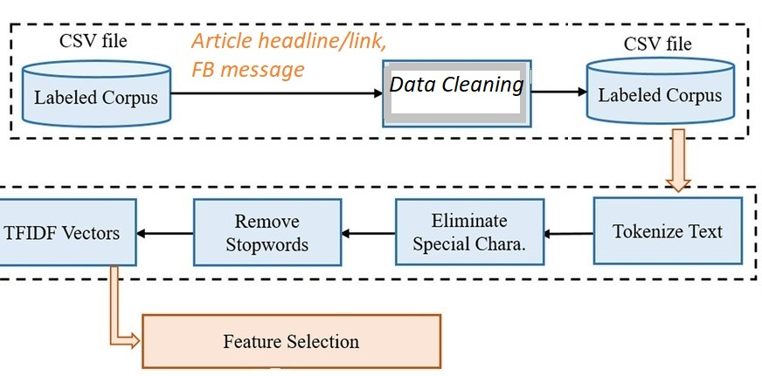
Sentiment and Opinion Analysis Score/Label
Emotion Analysis Score/Label
Self-Supervised Deep Clustering
Article Headline
FB Message
FB Message
Article Headline
GPT-3 Text Classification
DATA
Article Headline
Misinformation label with confidence score
FB Message
Article Headline
+
FB Message
GDI SCORES
Full Article Score/Label
FEATURES Extracted | Article Headline | FB Post
Sentiment | Χ | Χ
Opinion | Χ | Χ
Emotion |  | Χ
GDI Full Article Score | Χ
GDI Domain Score | Χ
Topics | Χ
Cluster Embeddings (top words) | Χ
Domain Score/Label
Topic Modeling
BERT Topic Model
Neural Topic Model

