Slide 1
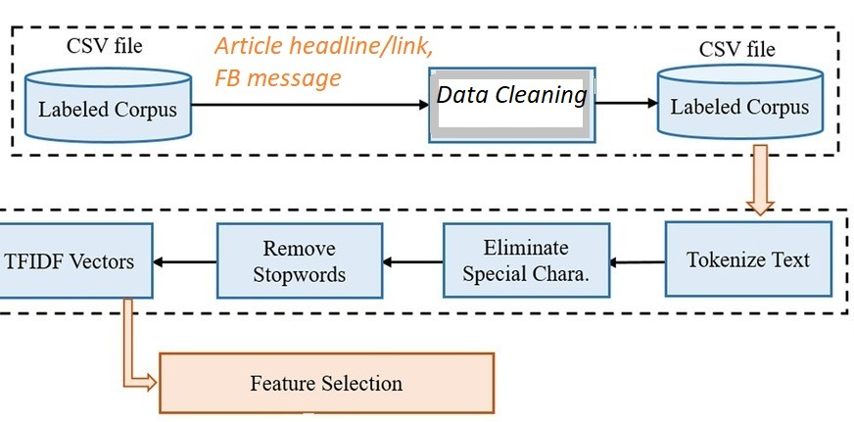
Sentiment and Opinion Analysis Score/Label
Emotion Analysis Score/Label
Self-Supervised Deep Clustering
Article Headline
FB Message
FB Message
Article Headline
GPT-3 Text Classification
DATA
Article Headline
Misinformation label with confidence score
FB Message
Article Headline
+
FB Message
GDI SCORES
Full Article Score/Label
FEATURES Extracted | Article Headline | FB Post
Sentiment | Χ | Χ
Opinion | Χ | Χ
Emotion |  | Χ
GDI Full Article Score | Χ
GDI Domain Score | Χ
Topics | Χ
Cluster Embeddings (top words) | Χ
Domain Score/Label
Topic Modeling
BERT Topic Model
Neural Topic Model

