Slide 1
Engr 220 Lab
Calvin College Engineering Department
2022

Slide 2
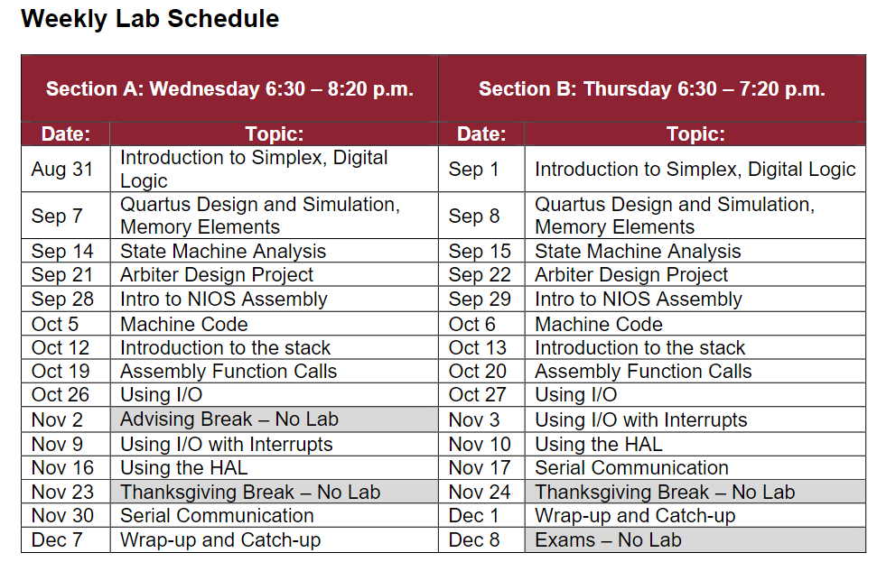

Slide 3
Last Week
ASCII Characters & C-Strings
Serial Communication
DE2 Board LCD Device
SignalTap Analyzer
Questions?
No assembly this week

Slide 4
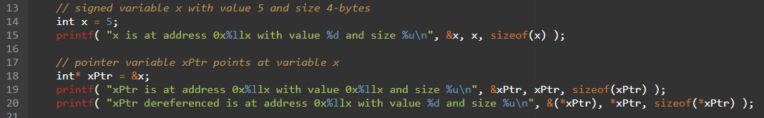

Pointers in C
Variables have addresses which can be pointed to (remember Lab10)
Pointers can be dereferenced

Slide 5
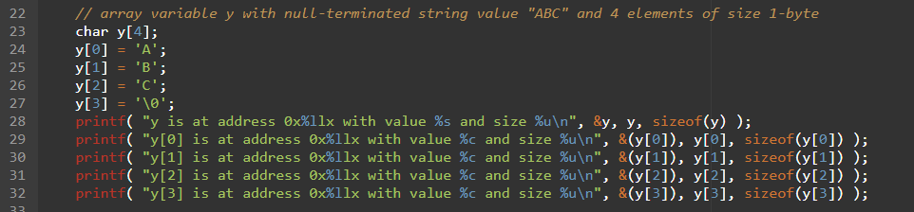
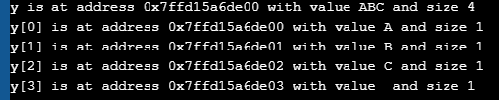
Pointers in C
Arrays are similar to pointers to the first element (remember Lab 8)

Slide 6
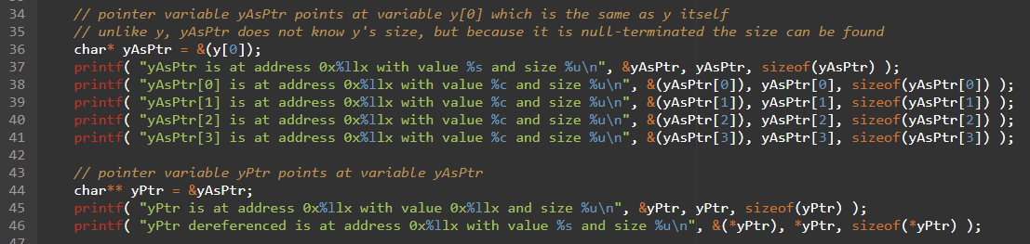
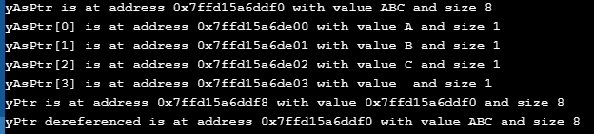
Pointers in C
char* is similar to char[], both can be used as strings

Slide 7
Pointers in C
Online Tutorials
https://www.tutorialspoint.com/cprogramming/c_pointers.htm
http://www.geeksforgeeks.org/pointers-in-c-and-c-set-1-introduction-arithmetic-and-array/
https://www.programiz.com/c-programming/c-pointers
https://www.cprogramming.com/tutorial/c/lesson6.html

Slide 8
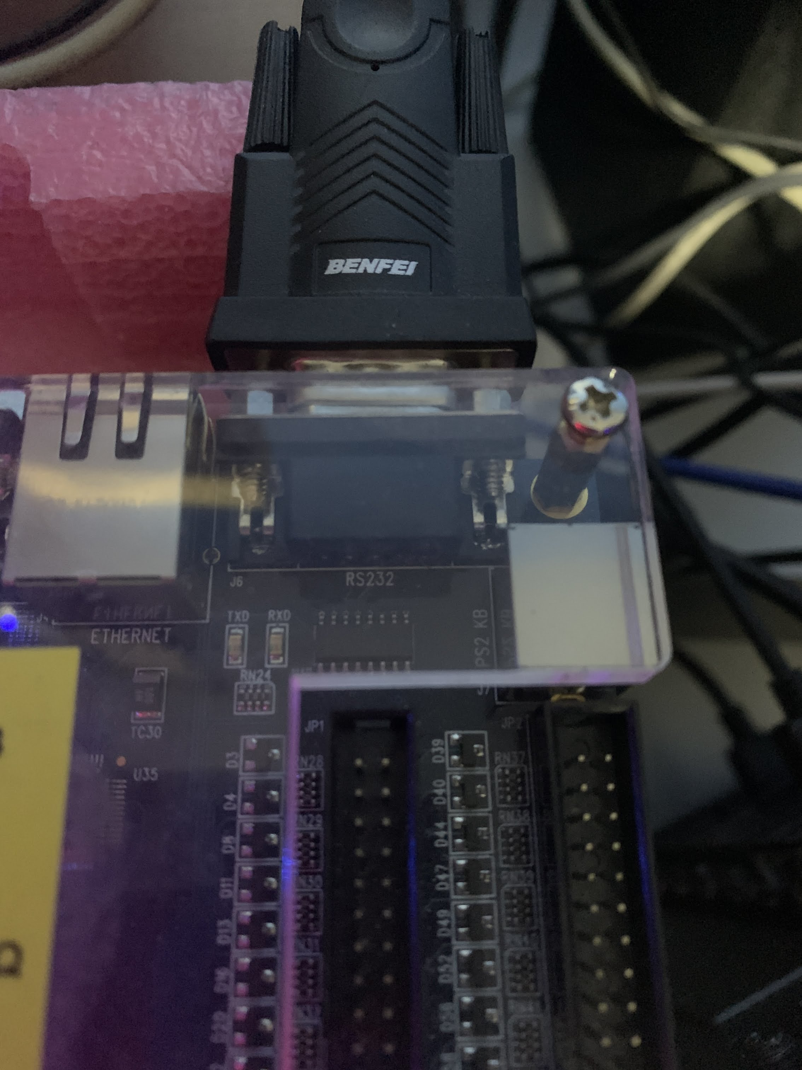
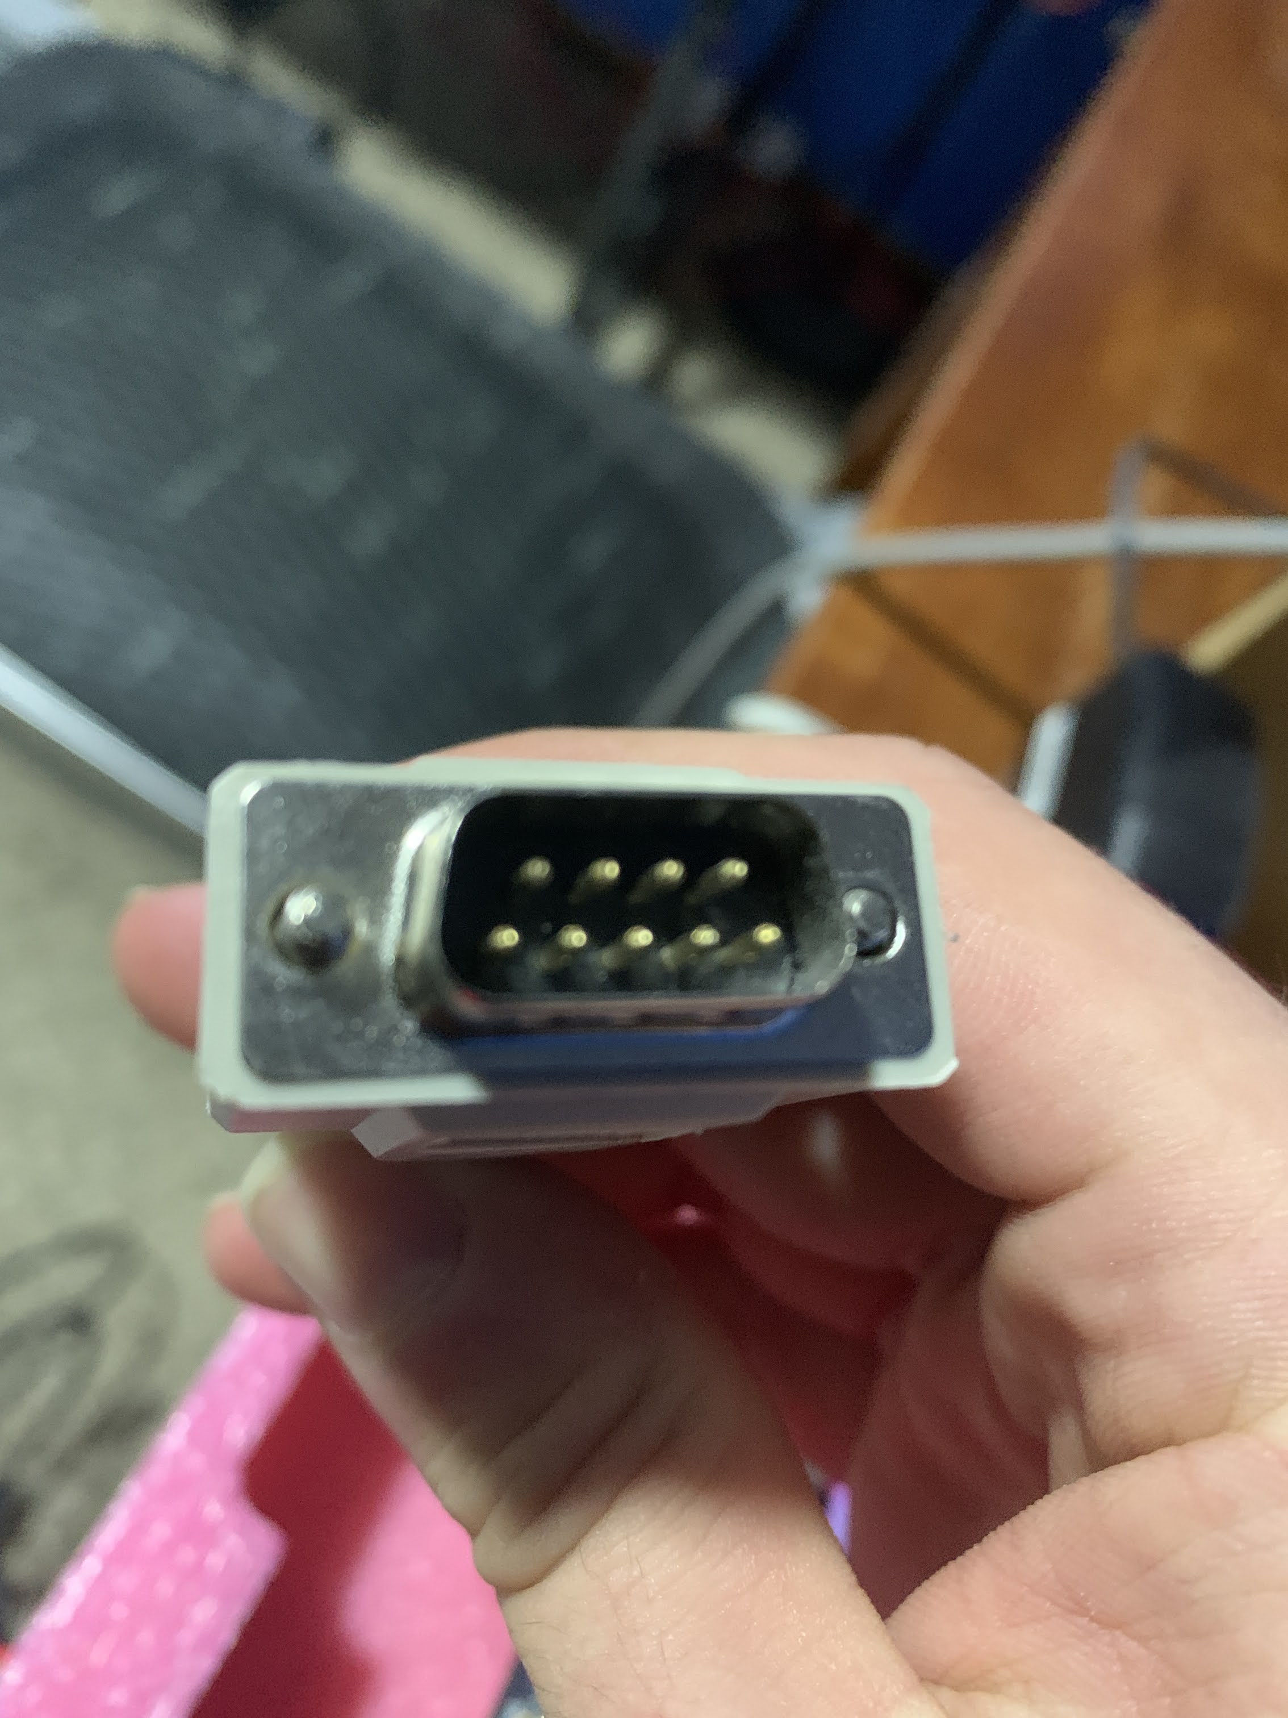
DE2 UART Device
Another I/O device which is capable of sending and receiving bytes of data
9 pins, 7 data, RX, and TX
https://www.circuitbasics.com/basics-uart-communication/
https://en.wikipedia.org/wiki/RS-232

Slide 9
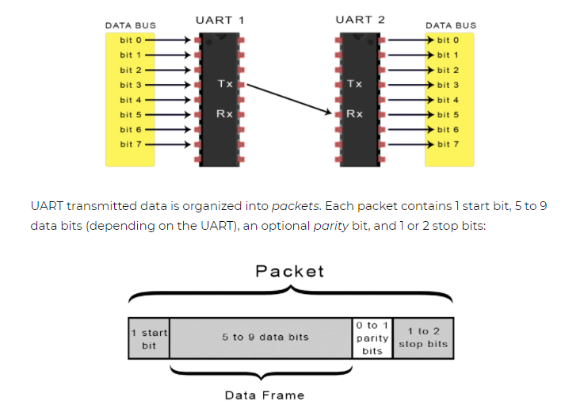
DE2 UART Device
Another I/O device which is capable of sending and receiving bytes of data
9 pins, 7 data, RX, and TX
https://www.circuitbasics.com/basics-uart-communication/
https://en.wikipedia.org/wiki/RS-232

Slide 10
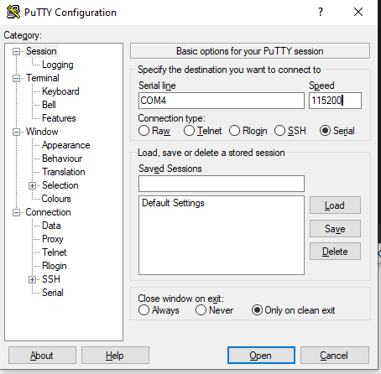
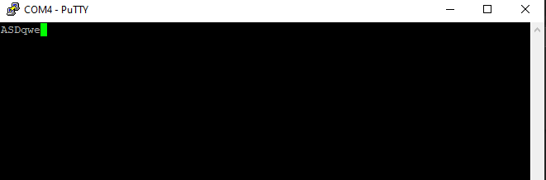
DE2 UART Device
Another I/O device which is capable of sending and receiving bytes of data
9 pins, 7 data, RX, and TX
https://www.circuitbasics.com/basics-uart-communication/
https://en.wikipedia.org/wiki/RS-232

Slide 11
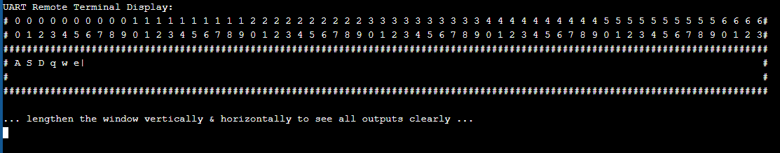
DE2 UART Device
Another I/O device which is capable of sending and receiving bytes of data
9 pins, 7 data, RX, and TX
https://www.circuitbasics.com/basics-uart-communication/
https://en.wikipedia.org/wiki/RS-232

Slide 12
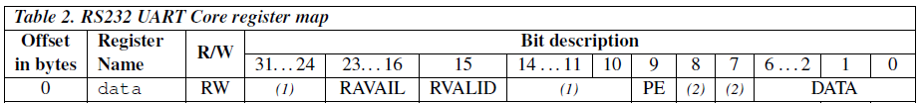
UART Serial Communication
DE2 Board UART Device Register Bit-Fields
7-bits of ASCII data provided in time
RAVAIL shows quantity of data remaining, decreases to 0

Slide 13
UART Serial Communication
DE2 Board UART Device Register Bit-Fields
7-bits of ASCII data provided in time
RAVAIL shows quantity of data remaining, decreases to 0
Implicit data queue (FIFO) is hidden from us, RAVAIL is its size
What might happen if we publish to queue faster than we consume from it?

Slide 14
UART Serial Communication
Windows 10 PC
Quartus
Altera DE2 Board
NIOS Processor Image
FGPA
Peripheral Devices
(Ex: switches, buttons, hex displays)
NIOS Processor Image
(Flashed)
Switches
Keys
Altera DM
NIOS Processor Image
LEDs
Software (Executing)
Can debug code &
access mem./dev.s
LCD
7Seg Displays
Software (Loading/Debugging)
UART
Timer
Putty
QST can view
UART traffic & LCD traffic
from signals on “wires”
Q. SignalTap

Slide 15
DE2 UART Device
Show reference examples
https://calvincollege-my.sharepoint.com/:v:/g/personal/ajj6_calvin_edu/Ec8zCBIvzV9JhnlDqSoTUOYB6hY3tL6xGzq6SKRyXgZdPg?e=mAnhyd
https://calvincollege-my.sharepoint.com/:v:/g/personal/ajj6_calvin_edu/EYrKXugFCtRGg6XEoi1rj6gBdhFvdQHWlWG2H98QmUrXsQ?e=j6iMpO
(Links from 2020)

Slide 16
Lab 12 Tips
Refer to the LCD reference & example therein
Refer to the UART reference
Take a minute to review Lab 11, Lab 12 is based on Lab 11
Refer to the Lab 11 slide deck for examples of ASCII characters & strings
Use “Program with Device Driver Support” to get the BSP

Slide 18
Lab Components
Altera DE2 Board
Windows 10 PC
Quartus
FGPA
Peripheral Devices
(Ex: switches, buttons, hex displays)
NIOS Processor Image
NIOS Processor Image
(Flashed)
Switches
Keys
Software (Executing)
Altera DM
LEDs
NIOS Processor Image
7Seg Displays
Timer
Software (Loading/Debugging)

Slide 19
C Code
Refer to Lab 5 Quartus Process & Projects reference slides for more detail
Factorial Prelab: “portable” C-Code
Compiling
Assembly Code
Compiler-Generated for NIOS: view in debugger, depends on optimization
Assembling
Machine Code
Compiler-Generated for NIOS: view in memory, determine from reference
Loading
NIOS Processor Image
Loading
We made a system configuration for this FPGA component in Lab 5, it executes our program and can be viewed by the debugger
Flashed
We are using these in Engr220 Lab
NIOS Processor Hardware
Altera DE2 FPGA Hardware
We don’t have these in Engr220 Lab

Slide 20
Char and String Example
/******************************************************************************
Online C Compiler.
Code, Compile, Run and Debug C program online.
Write your code in this editor and press "Run" button to compile and execute it.
*******************************************************************************/
#include <stdio.h>
#include <string.h>
int main()
{
// We looked at printf codes before, %c is for characters %s is for strings
printf( "We will show some examples of characters like '%c' "
"and strings like \"%s\"\n", 'A', "Hi" );
// Here is a character
char letterY = 'Y';
printf( "letterY: %c\n", letterY );
// We can do math on characters, because they are just numbers
char letterZ = ( letterY + 1 );
printf( "letterZ: %c\n", letterZ );
// char* or char[] is an array of characters, meaning a string
char* stringABC = "ABC";
printf( "stringABC: %s\n", stringABC );
// strings must be null-terminated (\0 not shown when hard-coded)
char stringXYZ[4];
stringXYZ[0] = 'X';
stringXYZ[1] = 'Y';
stringXYZ[2] = 'Z';
stringXYZ[3] = '\0';
printf( "stringXYZ: %s\n", stringXYZ );
// string lengths do not usually include the null-terminating char
printf( "stringXYZ is %u in length\n", strlen(stringXYZ) );
return 0;
}
Copy/Paste text from powerpoint into text editor to view

Slide 21
Pointers Example
/******************************************************************************
Welcome to GDB Online.
GDB online is an online compiler and debugger tool for C, C++, Python, PHP, Ruby,
C#, VB, Perl, Swift, Prolog, Javascript, Pascal, HTML, CSS, JS
Code, is at address 0x%llx with value 0x%llx and size %u\n", &xPtr, xPtr, sizeof(xPtr) );
printf( "xPtr dereferenced is at address 0x%llx with value %d and size %u\n", &(*xPtr), *xPtr, sizeof(*xPtr) );
// array variable y with null-terminated string value "ABC" and 4 elements of size 1-byte
char y[4];
y[0] = 'A';
y[1] = 'B';
y[2] = 'C';
y[3] = '\0';
printf( "y is at address 0x%llx with value %s and size %u\n", &y, y, sizeof(y) );
printf( "y[0] is at address 0x%llx witCompile, Run and Debug online from anywhere in world.
*******************************************************************************/
#include <stdio.h>
int main()
{
// signed variable x with value 5 and size 4-bytes
int x = 5;
printf( "x is at address 0x%llx with value %d and size %u\n", &x, x, sizeof(x) );
// pointer variable xPtr points at variable x
int* xPtr = &x;
printf( "xPtr h value %c and size %u\n", &(y[0]), y[0], sizeof(y[0]) );
printf( "y[1] is at address 0x%llx with value %c and size %u\n", &(y[1]), y[1], sizeof(y[1]) );
printf( "y[2] is at address 0x%llx with value %c and size %u\n", &(y[2]), y[2], sizeof(y[2]) );
printf( "y[3] is at address 0x%llx with value %c and size %u\n", &(y[3]), y[3], sizeof(y[3]) );
// pointer variable yAsPtr points at variable y[0] which is the same as y itself
// unlike y, yAsPtr does not know y's size, but because it is null-terminated the size can be found
char* yAsPtr = &(y[0]);
printf( "yAsPtr is at address 0x%llx with value %s and size %u\n", &yAsPtr, yAsPtr, sizeof(yAsPtr) );
printf( "yAsPtr[0] is at address 0x%llx with value %c and size %u\n", &(yAsPtr[0]), yAsPtr[0], sizeof(yAsPtr[0]) );
printf( "yAsPtr[1] is at address 0x%llx with value %c and size %u\n", &(yAsPtr[1]), yAsPtr[1], sizeof(yAsPtr[1]) );
printf( "yAsPtr[2] is at address 0x%llx with value %c and size %u\n", &(yAsPtr[2]), yAsPtr[2], sizeof(yAsPtr[2]) );
printf( "yAsPtr[3] is at address 0x%llx with value %c and size %u\n", &(yAsPtr[3]), yAsPtr[3], sizeof(yAsPtr[3]) );
// pointer variable yPtr points at variable yAsPtr
char** yPtr = &yAsPtr;
printf( "yPtr is at address 0x%llx with value 0x%llx and size %u\n", &yPtr, yPtr, sizeof(yPtr) );
printf( "yPtr dereferenced is at address 0x%llx with value %s and size %u\n", &(*yPtr), *yPtr, sizeof(*yPtr) );
return 0;
}
Copy/Paste text from powerpoint into text editor to view

