Slide 1
AIPI 520: Modeling Process & Algorithms

Slide 2
Context
“It is easy to sit in your office and run an algorithm on a data set you downloaded from the web.
It is very hard to identify a problem for which machine learning may offer a solution, determine what data should be collected, select or extract relevant features, chose an appropriate learning method, select an evaluation method, interpret the results, involve domain experts, publicize the results to the relevant scientific community, persuade users to adopt the technique, and (only then) to truly have made a difference.”
- Wagstaff, “Machine Learning that Matters”

Slide 3
What we will learn
Modeling process best practices
Modeling, evaluation, interpretation
Key algorithms
How they work
Strengths and limitations
How to get the most from them
Applying ML to real-world structured data

Slide 4
Syllabus review

Slide 5
Introduction to Machine Learning

Slide 6
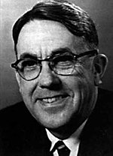
What is Machine Learning?
“Field of study that gives computers the ability to learn without being explicitly programmed” – Arthur Samuel, IBM, 1959
Learning is usually defined as “gaining skill or knowledge through experience”
Two different types of learning:
Task-based – build expertise at a task
Generalization – transfer of learning from narrow situations to broader ones

Slide 7
Why do we need ML?
There is some benefit to automating tasks
Perform better, faster and/or cheaper than humans
It is unfeasible to do manually with traditional software
Specifying the rules may be too complex
We may not know the rules

Slide 8
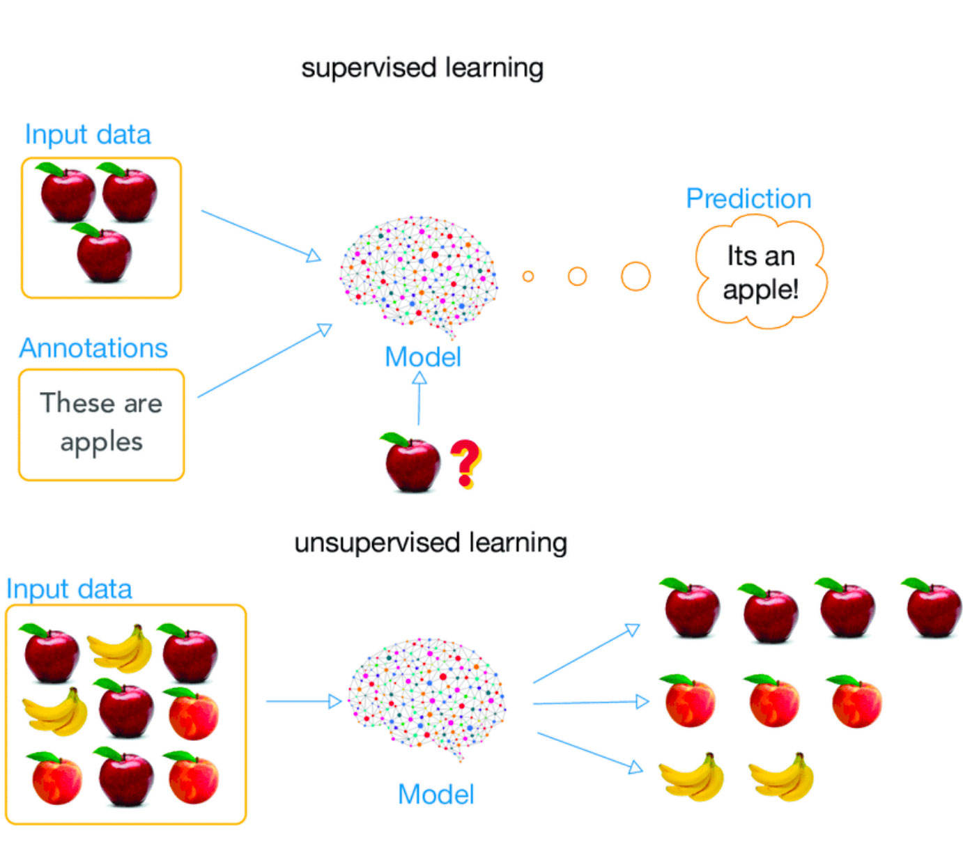
What is a model?
A model is a useful approximation of a non-random phenomenon
Model y=f(x)+𝛆
Input variable(s)
x
Output variable(s)
y
We might think of models as a method of compressing knowledge into a finite set of numbers (parameters)

Slide 9
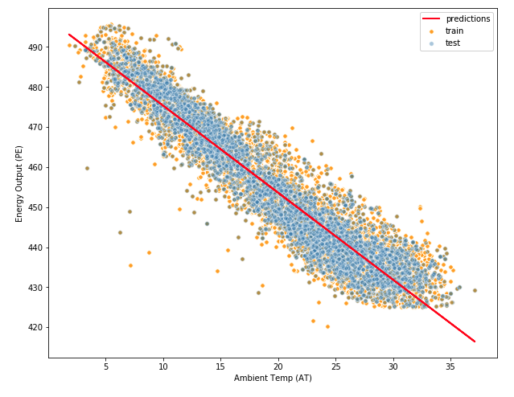

What is a model?
$$\hat{y}=mx+b$$
Output variable
Input variable

Slide 10
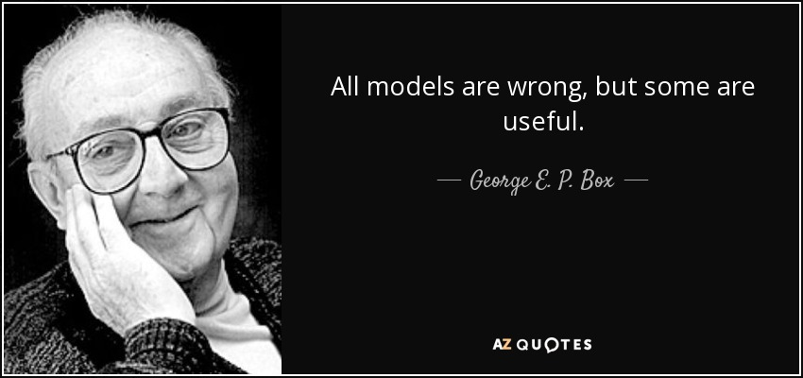

Slide 11
Structured data
Targets /
Labels /
Annotations /
Response /
Y Variable / Dependent Variable
Features / Factors / Predictors / X Variables / Independent Variables / Attributes / Dimensions
 | Neighbor-hood | School district | Square footage | Number of bedrooms | Year built | Market sale price
House 1 | Weycroft | Wake | 3400 | 4 | 2010 | $612,000
House 2 | Horton Creek | Wake | 4200 | 5 | 2008 | $675,000
House 3 | Cary Park | Chatham | 3250 | 4 | 2012 | $520,000
… | … | … | … | … | … | …
Observations / Instances /
Examples / Feature Vectors

Slide 12
Supervised vs. unsupervised learning
Supervised learning
Unsupervised learning
At least some observations of the features (X_{i}) and targets (Y_{i}) are known and used to build a model
We only have observations of the features (X_{i}). We need to use the observations to guess what the targets (Y_{i}) would have been and build a model from there
https://www.researchgate.net/figure/Supervised-learning-and-unsupervised-learning-Supervised-learning-uses-annotation_fig1_329533120

Slide 13
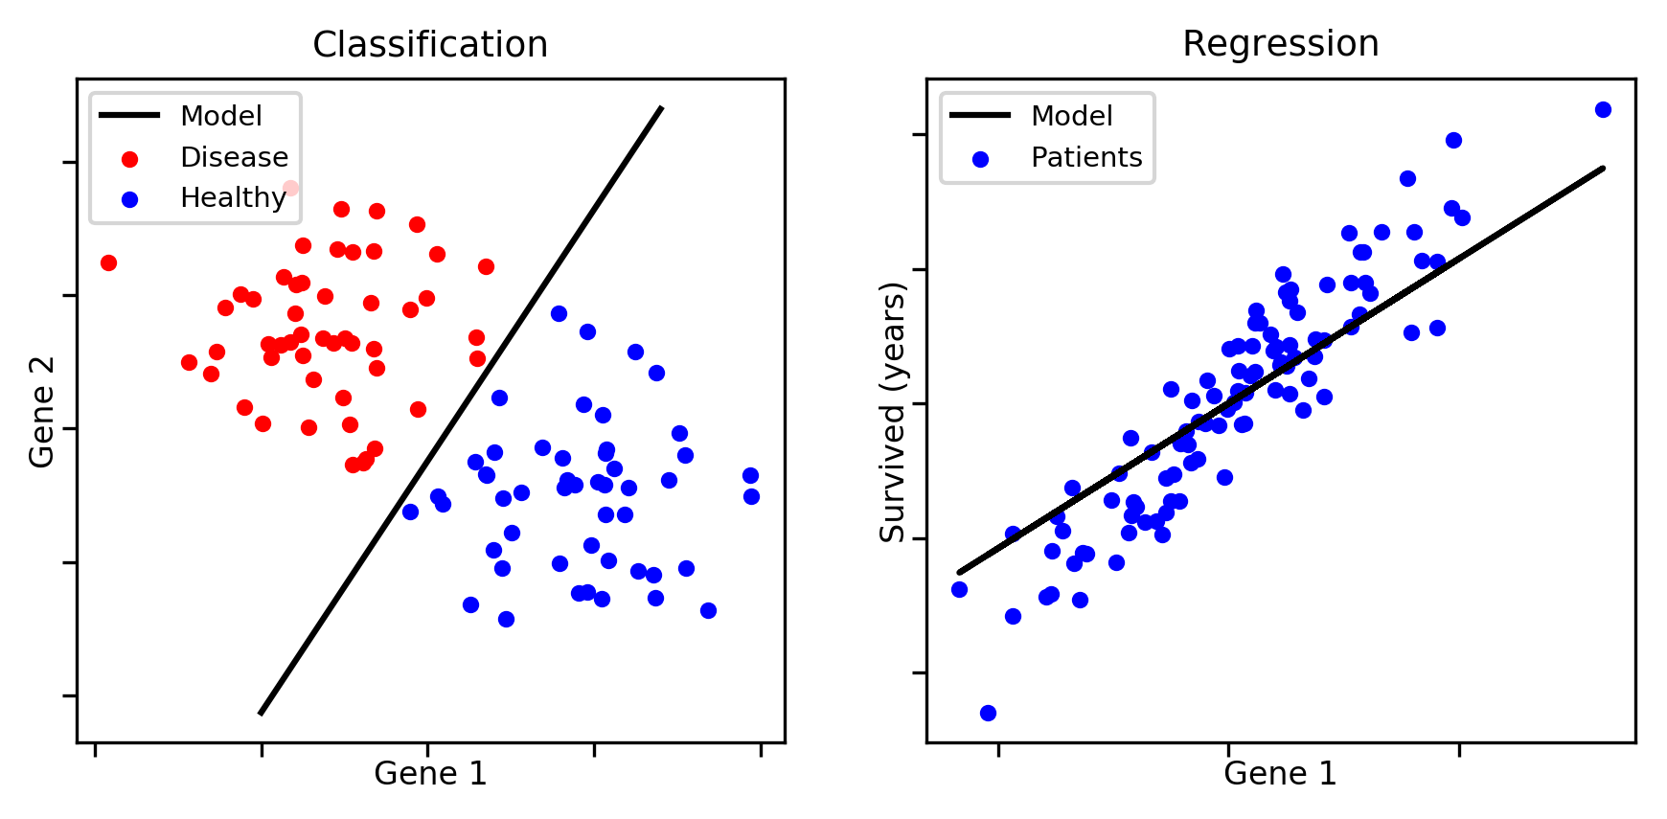
Supervised learning types
Regression
Classification
Predict one or more numerical target variables
E.g. home price, number of power outages, product demand
Predicts a class / category – either binary or out of a set
E.g. lung disease detection, identifying types of plants, sentiment analysis, detecting spam
Image source: https://aldro61.github.io/microbiome-summer-school-2017/sections/basics/

Slide 14
Practice: Regression or classification?
Detecting “fake news”
Predicting a stock price
Determining a new driver’s risk level for insurance
Finding a certain object in camera images – e.g. a self-driving car identifying a pedestrian

Slide 15
ML vs Heuristics

Slide 16
Heuristics
Methods of solving problems using a simplified set of rules based on past experience
Hard-coded business rules rather than machine learning
Examples:
Demand prediction: Predicting the mean value for sub-groups
Product classifier: Classifying based on title (e.g. Walmart)
Product recommender: recommend the highest rated
App recommender: recommend the most popular (# installs)

Slide 17
Heuristics versus ML
Benefits of Heuristics
Benefits of ML
Easier to create and maintain
Minimal computational cost
High interpretability
Often better performing
Can evolve with re-training
Suitable for a wider range of problems (e.g. big data, computer vision)

Slide 18

Example: using heuristics
How might we predict the daily sales at the University Store using heuristics, rather than building a model?

Slide 19
Establishing a baseline
Performance
Is ML necessary to reach a satisfactory level?
Is ML worth the boost in performance?
Project Start
Heuristic Baseline
ML
Baseline
ML v2
ML v3

Slide 20
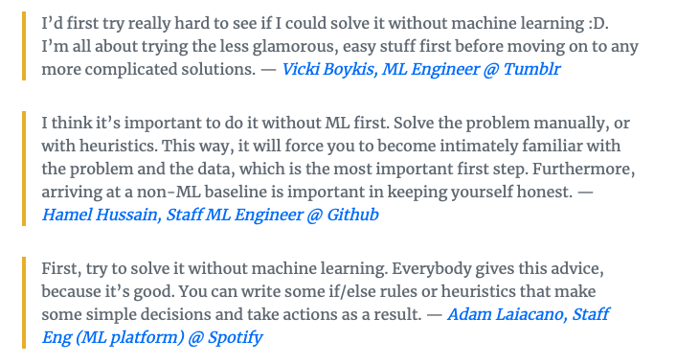
Heuristics as a baseline
Question:
”Imagine you’re given a new, unfamiliar problem to solve with machine learning. How would you approach it?”
https://eugeneyan.com/writing/first-rule-of-ml/

Slide 21
Modeling Process

Slide 22
Algorithm selection
Depending on our task, we have a variety of algorithms to choose from
No one algorithm is always better (“no free lunch theorem”)
Our selection will depend on three criteria:
Interpretability
Algorithm Selection
Computational Cost
Performance

Slide 23

Performance vs Interpretability
“Suppose you have cancer and you have to choose between a black-box AI surgeon that cannot explain how it works but has a 90% cure rate and a human surgeon with an 80% cure rate. Do you want the AI surgeon to be illegal?”
- Geoffrey Hinton

Slide 24

Occam’s Razor
All else being equal, choose the simpler solution.

Slide 25
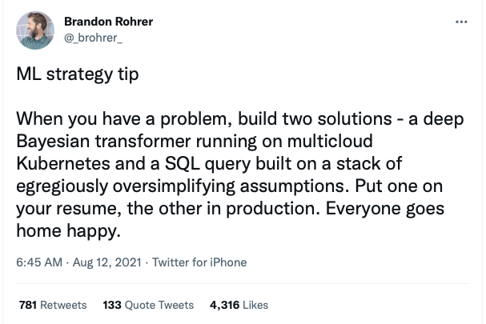

Slide 26
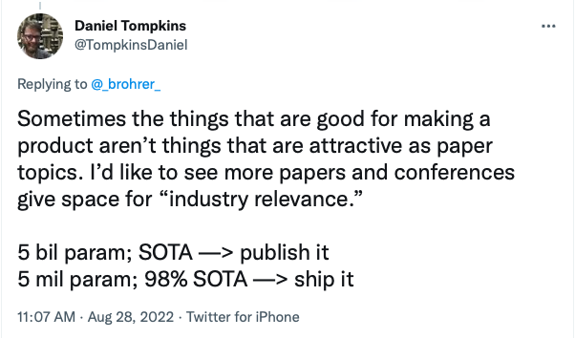

Slide 27
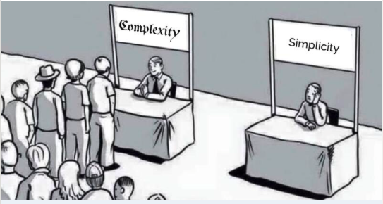
Why are simpler systems better
Easier to build, scale and maintain
Lower operational costs
Generalize better and are more robust to data drift
Do not necessarily perform worse than complex models
Tree-based models > deep neural networks on 45 mid-sized tabular datasets
Simple averaging ≥ complex optimizers on multi-task learning problems
Simple methods > complex methods in forecasting accuracy across 32 papers
Dot product > neural collaborative filtering in item recommendation and retrieval
Recommended article: https://eugeneyan.com/writing/simplicity/

Slide 28
Algorithm selection best practice
Start with developing a simple but reasonable heuristic, and measure the performance using your heuristic to make predictions
Next, apply a simple ML algorithm (e.g. linear regression, or KNN for classification) and evaluate performance to get a baseline
Now, experiment with different algorithms, keeping in mind the right balance between your three goals:
Performance
Interpretability
Computational efficiency

Slide 29
Model Evaluation

Slide 30
Training & Test Sets
Goal of predictive modeling is to create a model that makes accurate predictions on new unseen data
We cannot estimate performance on data we do not have, so instead we split our data into two sets
Training set - build and train the model
Test set – Evaluate model performance performance
Test
(~10-20%)
Training (~80-90%)
Use for model building & training
Use to evaluate final model

Slide 31
Sampling
Why do we sample?
We don’t have access to all possible data
It is infeasible to process all the data we have access to
Sampling occurs at multiple points
Sampling from the entire population to create training data
Sampling from the training data to create a test set
Sampling from the training data to do quick experiments
Two main types of sampling: nonprobability sampling and random sampling

Slide 32
Nonprobability sampling
Nonprobability sampling is when the selection of data is not based on any probability criteria
Types of nonprobability sampling:
Convenience sampling – samples selected based on their availability
E.g. Use Google Image Search for pictures of flowers to train on
Snowball sampling – Future samples selected based on existing samples
E.g. scraping Twitter accounts based on users you follow
Judgment sampling – Domain experts decide what samples to use
Quota sampling – Select samples based on quotas for sub-groups
E.g. a survey where you collect 100 responses from users of each age group

Slide 33
Nonprobability sampling
Samples are not representative of real-world data and thus are highly likely to cause bias in your model
However, this is a very common approach in practice
Examples:
Large language models are trained on easily collected data – Wikipedia, Reddit, Common Crawl etc
Sentiment analysis models often trained on IMDB movie reviews or Amazon reviews – biased towards people who leave reviews online
Self-driving cars – initially trained only on Phoenix, AZ and Bay Area. Waymo later expanded to include Kirkland, WA for rainy weather

Slide 34
Random sampling
Random sampling involves randomly choosing samples from population
Several types:
Simple random sampling – all samples have equal probability of being selected
Downside – certain rare categories may not appear in the sampled data
Stratified sampling – divide population into groups you care about and sample a % randomly from each group
One challenge is that some observations may fall into multiple groups
Weighted sampling – each sample is given a weight which determines the probability of being selected
Allows you to apply domain expertise in selection e.g. weight recent data higher
Helps when your available data has a different distribution than the true data

Slide 35
Sampling for test set
Take a random sample of indices to use for test set, use remainder for training
Use Scikit-learn’s train_test_split method
If we want to do stratified sampling we use the ‘stratify’ parameter

Slide 36
Data Leakage
“Data leakage” occurs when some of our test set data “leaks” into model building and influences the development of the model
For example, if we use all of our data to select our features, or compare algorithms
This invalidates the estimated performance of the model and causes it to be overoptimistic
In severe cases, it can cause our model to be worthless

Slide 37

Data Leakage
Data from the future is accidentally used within training data

Slide 38
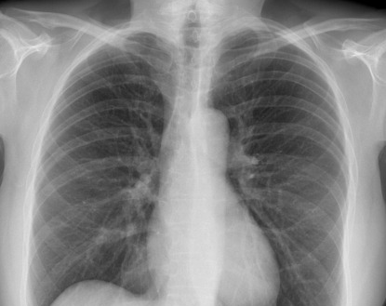
Data Leakage
A variable within the training data is an indicator of the target

Slide 39
Common causes of data leakage
Not great
Bad
Selecting features before splitting
Scaling before splitting
Filling missing values before splitting
Grouped observations are separated into different splits
E.g. two CT scans from the same patient taken a week apart
Splitting time series data randomly instead of by time
Failure to remove duplicate observations
Particularly dangerous when merging multiple datasets together
Common issue in several studies using ML to detect COVID-19
Different data generation processes for different classes

Slide 40
Comparing Models

Slide 41
Comparing models- validation sets
Often we want to compare models to select the optimal model
If we use the test set to compare model performance, it is not longer an unbiased indicator of performance
Instead, we split the data 3 ways into training, validation and test sets
We use the validation set for model selection, and report performance on the test set
Training
(~60-80%)
Validation
(~10-20%)
Test
(~10-20%)
Use for model comparison/selection
Use to evaluate final model

Slide 42
Question
What might be some potential problems with using a validation set to do your model selection?
Training
(~70-80%)
Validation
(~10-20%)
Test
(~10-20%)
Use for model comparison/selection
Use to evaluate final model
Notes:
It takes away data from training, which can be a problem if the dataset is small
The model performance calculation is strongly influenced by selection of which points are in the validation set

Slide 43
Cross-Validation

Slide 44
K-Folds Cross Validation
Rather than using a fixed validation set, we train and run the model(s) multiple times, each time using a different subset (“fold”) as the validation set
K=5 Folds
Training + cross-validation
(~80-90%)
Test
(~10-20%)
Iteration 1
Val set
Iteration 2
Val set
Iteration 3
Val set
Iteration 4
Val set
Iteration 5
Val set
Use for model comparison/selection
Use to evaluate final model
K
Validation fold
Training folds

Slide 45

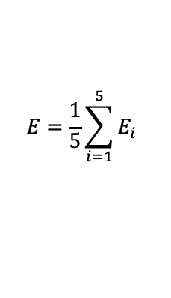




K-Folds Cross Validation
We calculate the error on the validation fold for each iteration, and then average them together to get the average error
K=5 Folds
Iteration 1
Val set
$$E_{1}$$
Iteration 2
Val set
$$E_{2}$$
$$E=\frac{1}{5}\sum_{i=1}^{5}{E_{i}}$$
Iteration 3
Val set
$$E_{3}$$
Iteration 4
Val set
$$E_{4}$$
Iteration 5
Val set
$$E_{5}$$
K
Validation fold
Training folds

Slide 46
Other types of cross-validation
ShuffleSplit cross-validation
For each fold, we randomly select a % of observations to use for validation and use the rest for training
E.g. we can set K=4 and validation % = 10%. Each fold, we randomly select 10% of observations for validation
This can cut down on compute time, but the tradeoff is we may use observations multiple times, or not use some observations, introducing bias
Leave-one-out cross-validation
Set K = number of points
Each observation becomes a validation set one time, and all other observations are used for training
Average your performance over all K folds

Slide 47
Why use cross-validation?
Maximizes the data available for training the model – important for small datasets
Provides a better evaluation of how well the model can generalize to new data – validation performance is not accidentally biased by choice of datapoints to use for validation
Cross-validation is the typical approach used in industry for model selection and tuning, except in cases of very large datasets

Slide 48
CV and Model Evaluation
Remember, when you complete your cross-validation and do your model selection, you still need to evaluate your model on the test set for a fair approximation of performance
Training + cross-validation
(~80-90%)
Test
(~10-20%)
Iteration
1
2
3
4
5
Val set
Val set
Val set
Val set
Val set
Use for model comparison/selection
Use to evaluate final model
Validation fold
Training folds

Slide 49


CV using Scikit-learn
Divide data into ”k” folds
For each model you want to compare:
For each of “k” iterations:
Get the training folds and the validation fold for the iteration
Fit the model on the training data
Get predictions for the validation fold, calculate performance and store it
Calculate mean validation performance across all iterations
Compare CV average performance and select model

Slide 50
Model Selection: The Bias-Variance Tradeoff

Slide 51
Model Complexity
Model Complexity
Number of Features
Algorithm
Hyper-parameter Values

Slide 52
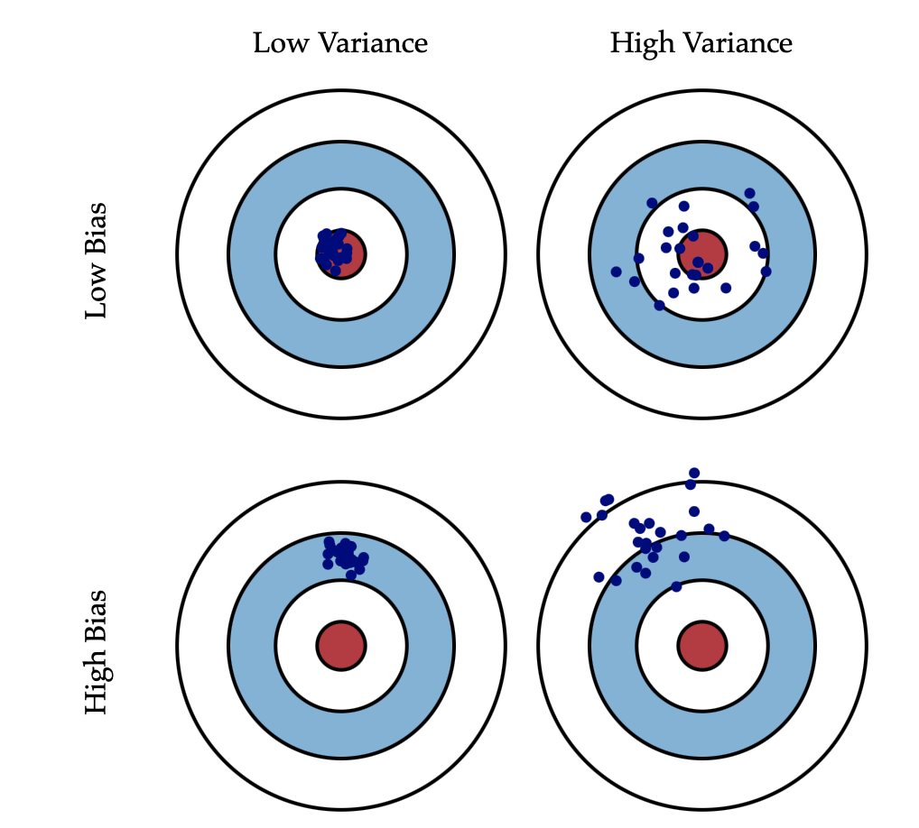
Bias and Variance
Bias is error from incorrect assumptions within the model
Often introduced by modeling a real-life problem using a simpler model that is unable to fully capture the underlying patterns in data
Variance refers to the sensitivity of the model to fluctuations in the training data
Usually due to model fitting itself to fine patterns which may just be noise
See: http://scott.fortmann-roe.com/docs/BiasVariance.html

Slide 53

Bias – Variance Tradeoff
For a model y= $\hat{f}\left(x\right)$, at any point (x,y):
Bias
Predictions $\hat{f}\left(x\right)$
$$(y−E\left[\hat{f}\left(x\right)\right])$$
Expected Squared Error $=E\left[{\left(y−\hat{f}\left(x\right)\right)}^{2}\right]$
=${ (y−E\left[\hat{f}\left(x\right)\right])}^{2} + E\left[({\hat{f}\left(x\right)−E\left[\hat{f}\left(x\right)\right])}^{2}\right]+σ_{e}^{2}$
Target $y$
$$E\left[\hat{f}\left(x\right)\right]$$
Bias²
Variance
Expected Error
Deviation
$$E\left[\hat{f}\left(x\right)−E\left[\hat{f}\left(x\right)\right]\right]$$
= ${Bias}^{2}+Var+σ_{e}^{2}$
Irreducible error

Slide 54
Bias – Variance Tradeoff
$Total Error= {Bias}^{2}+Var+σ_{e}^{2}$
Bias and variance move in opposite directions
Simpler models often have higher bias and lower variance
Complex models typically have lower bias but higher variance
Optimal model complexity
Total error
Variance
Error
Bias²
Model complexity

Slide 55
Underfitting vs. Overfitting
Underfitting
Model is too simple
Total error
Overfitting
Model is too complex
Optimal model complexity
Optimal model complexity
Total error
Variance
Variance
Error
Error
Bias²
Bias²
Model complexity
Model complexity
Image source: http://scott.fortmann-roe.com/docs/BiasVariance.html

Slide 56
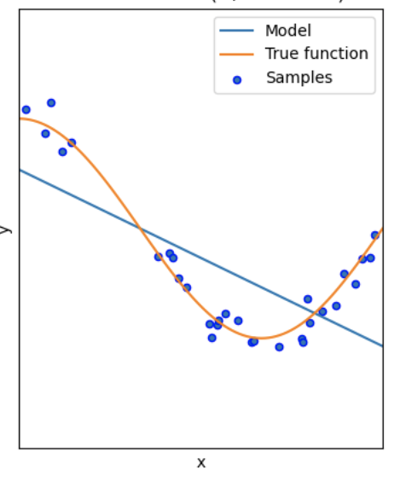
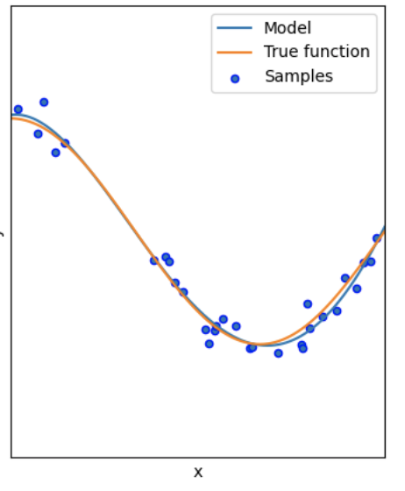
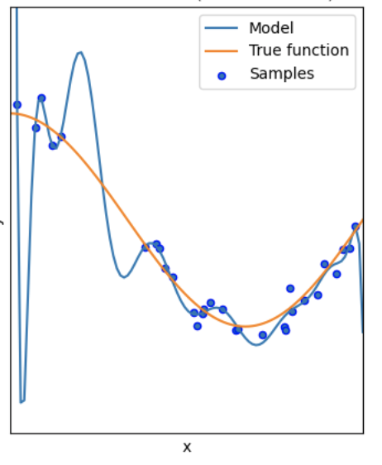
Underfitting vs. Overfitting
Underfitting
Model is too simple
Good Fit
Model fits well, with some error
Overfitting
Model is too complex
Image source: Scikit Learn documentation

Slide 57
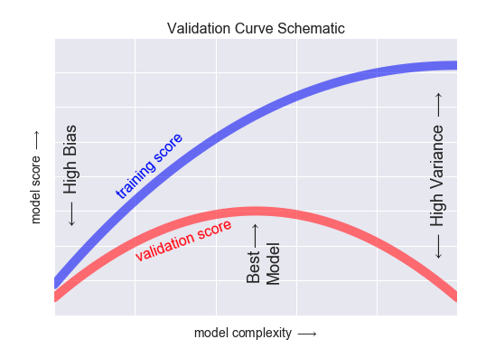
How do we recognize overfitting?
As we increase complexity, training score continues to improve
However, validation score improves to a point but then drops as model overfits the training data
Eventually, training performance & validation performance diverge indicating model is overfit
Image source: Python Data Science Handbook

Slide 58
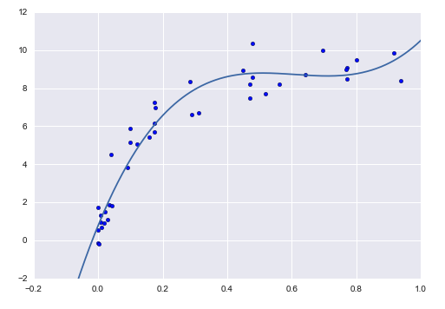
Finding the optimal model
Our goal is to find the optimal model complexity to balance bias and variance, thereby minimizing error
What influences complexity?
Choice of algorithm
Number of features
Hyperparameter settings
Optimal complexity varies with amount of data – the more data, the more complex model you can use
We find this using the validation approaches we discussed last class
Image source: Python Data Science Handbook

Slide 59
DEMO Notebook: Validation Curves

Slide 60
Metrics

Slide 61
Outcomes vs. Outputs
Outcome
Output
Refers to the desired business impact on your organization or for your customer
Stated in terms of the expected impact (which is often $)
Does NOT contain model performance metrics or other technical metrics
Refers to the desired output from the model
Measured in terms of a model performance metric
Typically not communicated to the customer
Set this AFTER setting the desired outcome

Slide 62
Outcomes vs. Outputs
A tool to predict turbulence for airlines
A power demand forecasting tool for a utility
Outcome
Low # of safety incidents per year, or lower $ of safety-related claims
Lower cost per MWh of power produced
Lower emissions rate per MWh
Output
AUROC or precision/recall of turbulence prediction (binary or 1-5 scale)
MSE (most likely) or MAE/MAPE

Slide 63
Baselines
Metrics are meaningless without a baseline for comparison
There are a few important baselines to determine:
Zero rule baseline (Most common class / mean value)
Heuristic baseline
Human baseline
Existing solution baseline

Slide 64
Regression Error Metrics

Slide 65
MSE, MAE and MAPE
Mean Squared Error
Mean Absolute Error
Mean Absolute % Error
$$MSE= \frac{1}{n}\sum_{i}{{(y_{i}−{\hat{y}}_{i})}^{2}}$$
$$MAE= \frac{1}{n}\sum_{i}{|y_{i}−{\hat{y}}_{i}}|$$
$$MAPE= \frac{1}{n}\sum_{i}{\frac{|y_{i}−{\hat{y}}_{i}|}{y_{i}}}$$
Most popular regression error metric
Heavily influenced by outliers - penalizes large errors much more than small ones
Influenced by scale of data
Sometimes used as RMSE
Also influenced by scale
More robust to outliers
Can be easier to interpret in context of the problem
Abs value is less desirable for calculations (squared terms are easier to minimize via differentiation)
Converts error to a percentage
Popular among non-technical managers because it is easily understood
Skewed by high % errors for low values of y

Slide 66
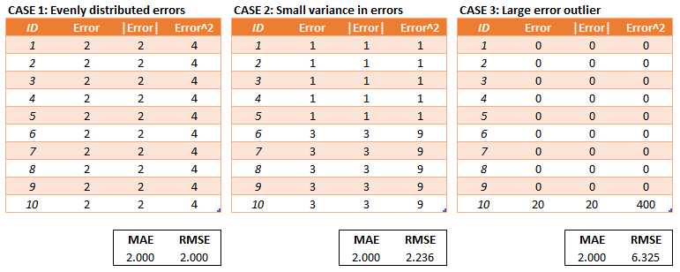
Example: MAE vs. MSE/RMSE
MSE/RMSE penalizes severe errors much more than MAE
This can be desirable if being off by a lot one time is much worse than being off by a little every time
Image source: https://medium.com/human-in-a-machine-world/mae-and-rmse-which-metric-is-better-e60ac3bde13d

Slide 67
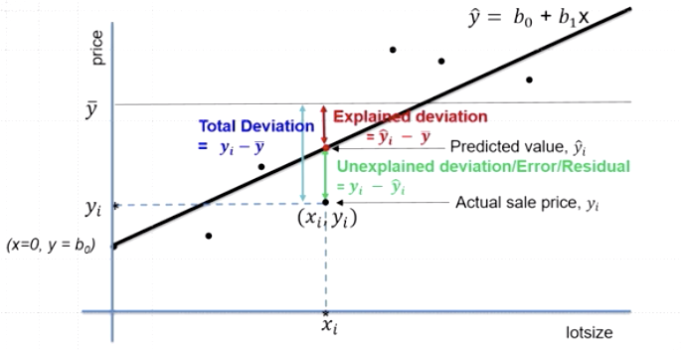
Coefficient of determination (R²)
Deviation of points from mean can be broken down into two components:
”Explained deviation” – portion of deviation predicted by your model
“Unexplained deviation” – difference between prediction and actual point

Slide 68
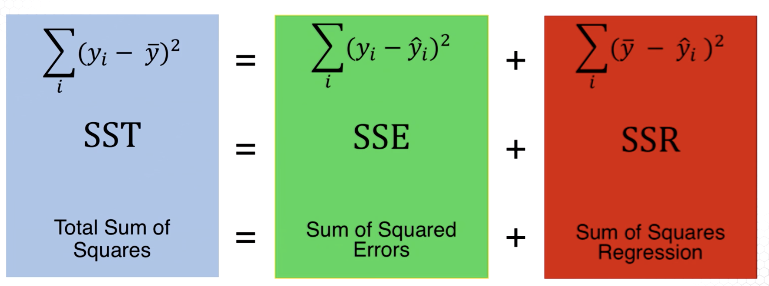
Coefficient of determination (R²)
Total deviation from mean
Unexplained deviation (error)
Deviation explained by model
$$R^{2}=\frac{SSR}{SST}=1−\frac{SSE}{SST}$$
R-squared is typically used to communicate how well your feature variables (X) explain the variability in your target variable (y)
R² ranges between 0 and 1

Slide 69
Adjusted R²
R-squared is often viewed as a measure of goodness of fit rather than prediction ability -> calculated “in-sample” on the training data itself
As we add more features, the R-squared almost always goes up because the model finds additional patterns of correlation (which might be noise)
However, this does not mean the model can generate better predictions on new data -> remember our discussion on overfitting
To help with this problem, we often report ”adjusted R-squared”, which penalizes for more features (added complexity)
$$Adjusted R^{2}=1−\frac{(1−R^{2})(n−1)}{(n−p−1)}$$
“Is R-squared useless?”: https://data.library.virginia.edu/is-r-squared-useless/

Slide 70
Questions?

Slide 71
For next week
Read:
Machine learning that matters
The first rule of ML: start without ML
Google’s Rules of ML

