Slide 1
Model Evaluation

Slide 2
Training & Test Sets
Goal of predictive modeling is to create a model that makes accurate predictions on new unseen data
We cannot estimate performance on data we do not have, so instead we split our data into two sets
Training set - build and train the model
Test set – Evaluate model performance performance
Test
(~10-20%)
Training (~80-90%)
Use for model building & training
Use to evaluate final model

Slide 3
Sampling
Why do we sample?
We don’t have access to all possible data
It is infeasible to process all the data we have access to
Sampling occurs at multiple points
Sampling from the entire population to create training data
Sampling from the training data to create a test set
Sampling from the training data to do quick experiments
Two main types of sampling: nonprobability sampling and random sampling

Slide 4
Nonprobability sampling
Nonprobability sampling is when the selection of data is not based on any probability criteria
Types of nonprobability sampling:
Convenience sampling – samples selected based on their availability
E.g. Use Google Image Search for pictures of flowers to train on
Snowball sampling – Future samples selected based on existing samples
E.g. scraping Twitter accounts based on users you follow
Judgment sampling – Domain experts decide what samples to use
Quota sampling – Select samples based on quotas for sub-groups
E.g. a survey where you collect 100 responses from users of each age group

Slide 5
Nonprobability sampling
Samples are not representative of real-world data and thus are highly likely to cause bias in your model
However, this is a very common approach in practice
Examples:
Large language models are trained on easily collected data – Wikipedia, Reddit, Common Crawl etc
Sentiment analysis models often trained on IMDB movie reviews or Amazon reviews – biased towards people who leave reviews online
Self-driving cars – initially trained only on Phoenix, AZ and Bay Area. Waymo later expanded to include Kirkland, WA for rainy weather

Slide 6
Random sampling
Random sampling involves randomly choosing samples from population
Several types:
Simple random sampling – all samples have equal probability of being selected
Downside – certain rare categories may not appear in the sampled data
Stratified sampling – divide population into groups you care about and sample a % randomly from each group
One challenge is that some observations may fall into multiple groups
Weighted sampling – each sample is given a weight which determines the probability of being selected
Allows you to apply domain expertise in selection e.g. weight recent data higher
Helps when your available data has a different distribution than the true data

Slide 7
Sampling for test set
Take a random sample of indices to use for test set, use remainder for training
Use Scikit-learn’s train_test_split method
If we want to do stratified sampling we use the ‘stratify’ parameter

Slide 8
Data Leakage
“Data leakage” occurs when some of our test set data “leaks” into model building and influences the development of the model
For example, if we use all of our data to select our features, or compare algorithms
This invalidates the estimated performance of the model and causes it to be overoptimistic
In severe cases, it can cause our model to be worthless

Slide 9

Data Leakage
Data from the future is accidentally used within training data

Slide 10
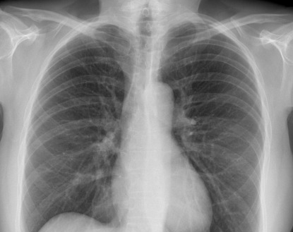
Data Leakage
A variable within the training data is an indicator of the target

Slide 11
Common causes of data leakage
Not great
Bad
Selecting features before splitting
Scaling before splitting
Filling missing values before splitting
Grouped observations are separated into different splits
E.g. two CT scans from the same patient taken a week apart
Splitting time series data randomly instead of by time
Failure to remove duplicate observations
Particularly dangerous when merging multiple datasets together
Common issue in several studies using ML to detect COVID-19
Different data generation processes for different classes

Slide 12
Comparing Models

Slide 13
Comparing models- validation sets
Often we want to compare models to select the optimal model
If we use the test set to compare model performance, it is not longer an unbiased indicator of performance
Instead, we split the data 3 ways into training, validation and test sets
We use the validation set for model selection, and report performance on the test set
Training
(~60-80%)
Validation
(~10-20%)
Test
(~10-20%)
Use for model comparison/selection
Use to evaluate final model

Slide 14
Question
What might be some potential problems with using a validation set to do your model selection?
Training
(~70-80%)
Validation
(~10-20%)
Test
(~10-20%)
Use for model comparison/selection
Use to evaluate final model
Notes:
It takes away data from training, which can be a problem if the dataset is small
The model performance calculation is strongly influenced by selection of which points are in the validation set

Slide 15
Cross-Validation

Slide 16
K-Folds Cross Validation
Rather than using a fixed validation set, we train and run the model(s) multiple times, each time using a different subset (“fold”) as the validation set
K=5 Folds
Training + cross-validation
(~80-90%)
Test
(~10-20%)
Iteration 1
Val set
Iteration 2
Val set
Iteration 3
Val set
Iteration 4
Val set
Iteration 5
Val set
Use for model comparison/selection
Use to evaluate final model
K
Validation fold
Training folds

Slide 17

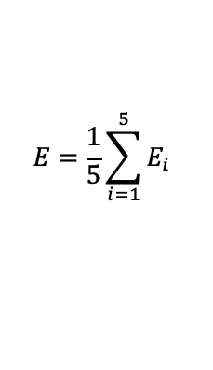




K-Folds Cross Validation
We calculate the error on the validation fold for each iteration, and then average them together to get the average error
K=5 Folds
Iteration 1
Val set
$$E_{1}$$
Iteration 2
Val set
$$E_{2}$$
$$E=\frac{1}{5}\sum_{i=1}^{5}{E_{i}}$$
Iteration 3
Val set
$$E_{3}$$
Iteration 4
Val set
$$E_{4}$$
Iteration 5
Val set
$$E_{5}$$
K
Validation fold
Training folds

Slide 18
Other types of cross-validation
ShuffleSplit cross-validation
For each fold, we randomly select a % of observations to use for validation and use the rest for training
E.g. we can set K=4 and validation % = 10%. Each fold, we randomly select 10% of observations for validation
This can cut down on compute time, but the tradeoff is we may use observations multiple times, or not use some observations, introducing bias
Leave-one-out cross-validation
Set K = number of points
Each observation becomes a validation set one time, and all other observations are used for training
Average your performance over all K folds

Slide 19
Why use cross-validation?
Maximizes the data available for training the model – important for small datasets
Provides a better evaluation of how well the model can generalize to new data – validation performance is not accidentally biased by choice of datapoints to use for validation
Cross-validation is the typical approach used in industry for model selection and tuning, except in cases of very large datasets

Slide 20
CV and Model Evaluation
Remember, when you complete your cross-validation and do your model selection, you still need to evaluate your model on the test set for a fair approximation of performance
Training + cross-validation
(~80-90%)
Test
(~10-20%)
Iteration
1
2
3
4
5
Val set
Val set
Val set
Val set
Val set
Use for model comparison/selection
Use to evaluate final model
Validation fold
Training folds

Slide 21


CV using Scikit-learn
Divide data into ”k” folds
For each model you want to compare:
For each of “k” iterations:
Get the training folds and the validation fold for the iteration
Fit the model on the training data
Get predictions for the validation fold, calculate performance and store it
Calculate mean validation performance across all iterations
Compare CV average performance and select model

Slide 22
Model Selection: The Bias-Variance Tradeoff

Slide 23
Model Complexity
Model Complexity
Number of Features
Algorithm
Hyper-parameter Values

Slide 24
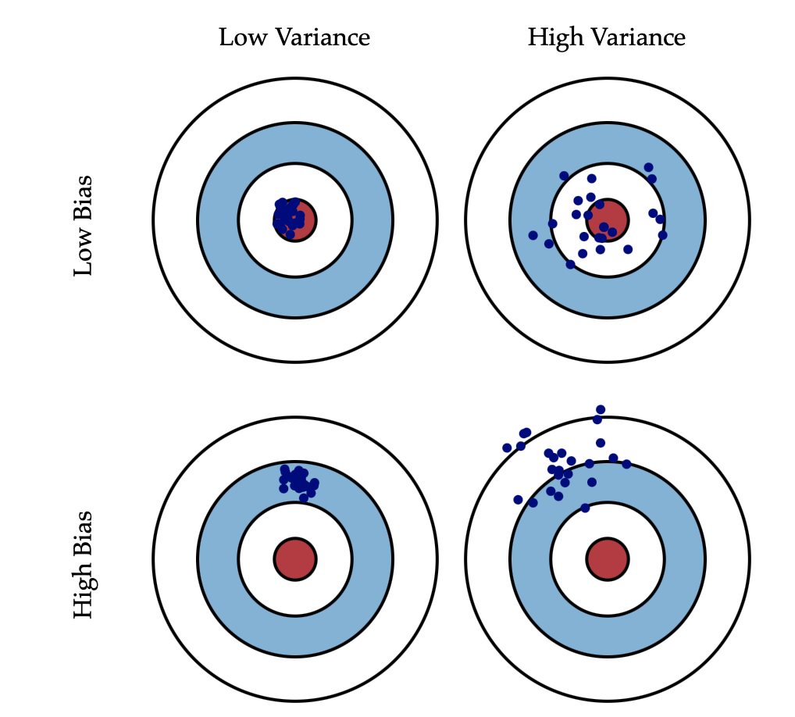
Bias and Variance
Bias is error from incorrect assumptions within the model
Often introduced by modeling a real-life problem using a simpler model that is unable to fully capture the underlying patterns in data
Variance refers to the sensitivity of the model to fluctuations in the training data
Usually due to model fitting itself to fine patterns which may just be noise
See: http://scott.fortmann-roe.com/docs/BiasVariance.html

Slide 25

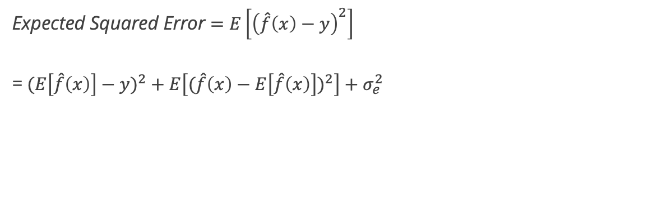


Bias – Variance Tradeoff
For a model y= $\hat{f}\left(x\right)$, across all points (x,y):
Bias
Predictions $\hat{f}\left(x\right)$
$$(E\left[\hat{f}\left(x\right)\right]−y)$$
Expected Squared Error $=E\left[{\left(\hat{f}\left(x\right)−y\right)}^{2}\right]$
=${ (E\left[\hat{f}\left(x\right)\right]−y)}^{2} + E\left[({\hat{f}\left(x\right)−E\left[\hat{f}\left(x\right)\right])}^{2}\right]+σ_{e}^{2}$
Target $y$
$$E\left[\hat{f}\left(x\right)\right]$$
Bias²
Variance
Expected Error
Deviation
$$\hat{f}\left(x\right)−E\left[\hat{f}\left(x\right)\right]$$
= ${Bias}^{2}+Var+σ_{e}^{2}$
Irreducible error

Slide 26
Bias – Variance Tradeoff
$Total Error= {Bias}^{2}+Var+σ_{e}^{2}$
Bias and variance move in opposite directions
Simpler models often have higher bias and lower variance
Complex models typically have lower bias but higher variance
Optimal model complexity
Total error
Variance
Error
Bias²
Model complexity

Slide 27
Underfitting vs. Overfitting
Underfitting
Model is too simple
Total error
Overfitting
Model is too complex
Optimal model complexity
Optimal model complexity
Total error
Variance
Variance
Error
Error
Bias²
Bias²
Model complexity
Model complexity
Image source: http://scott.fortmann-roe.com/docs/BiasVariance.html

Slide 28
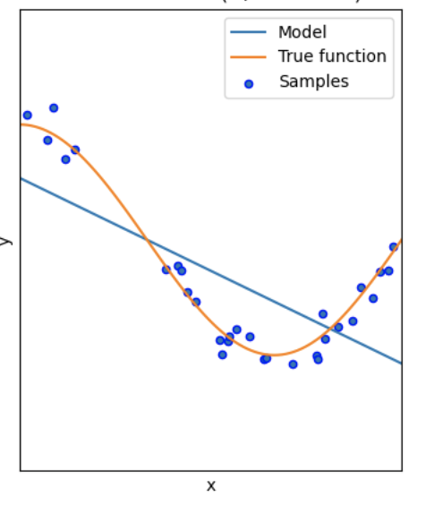
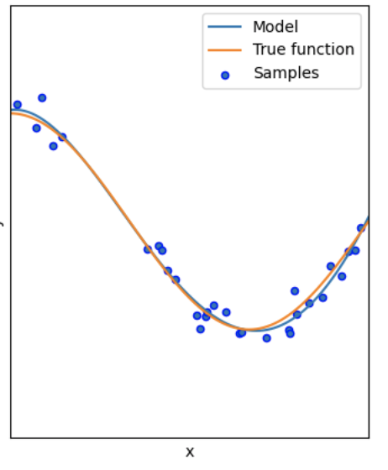
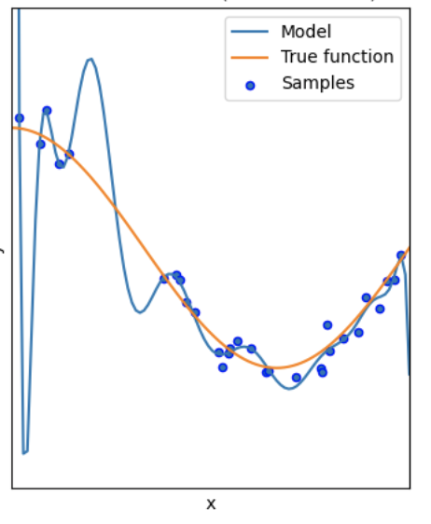
Underfitting vs. Overfitting
Underfitting
Model is too simple
Good Fit
Model fits well, with some error
Overfitting
Model is too complex
Image source: Scikit Learn documentation

Slide 29
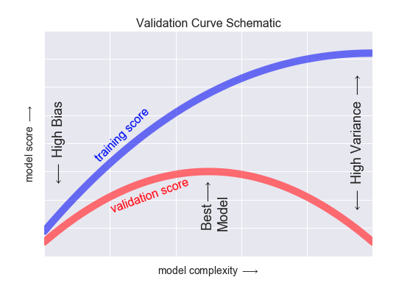
How do we recognize overfitting?
As we increase complexity, training score continues to improve
However, validation score improves to a point but then drops as model overfits the training data
Eventually, training performance & validation performance diverge indicating model is overfit
Image source: Python Data Science Handbook

Slide 30
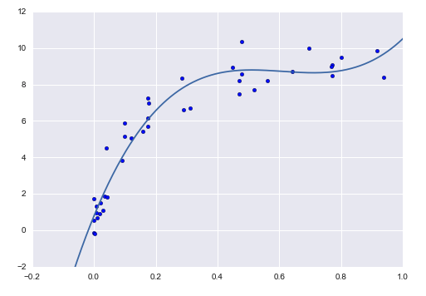
Finding the optimal model
Our goal is to find the optimal model complexity to balance bias and variance, thereby minimizing error
What influences complexity?
Choice of algorithm
Number of features
Hyperparameter settings
Optimal complexity varies with amount of data – the more data, the more complex model you can use
We find this using the validation approaches we discussed last class
Image source: Python Data Science Handbook

Slide 31
DEMO Notebook: Validation Curves

Slide 32
Metrics

Slide 33
Outcomes vs. Outputs
Outcome
Output
Refers to the desired business impact on your organization or for your customer
Stated in terms of the expected impact (which is often $)
Does NOT contain model performance metrics or other technical metrics
Refers to the desired output from the model
Measured in terms of a model performance metric
Typically not communicated to the customer
Set this AFTER setting the desired outcome

Slide 34
Outcomes vs. Outputs
A tool to predict turbulence for airlines
A power demand forecasting tool for a utility
Outcome
Low # of safety incidents per year, or lower $ of safety-related claims
Lower cost per MWh of power produced
Lower emissions rate per MWh
Output
AUROC or precision/recall of turbulence prediction (binary or 1-5 scale)
MSE (most likely) or MAE/MAPE

Slide 35
Baselines
Metrics are meaningless without a baseline for comparison
There are a few important baselines to determine:
Zero rule baseline (Most common class / mean value)
Heuristic baseline
Human baseline
Existing solution baseline

Slide 36
Regression Error Metrics

Slide 37
MSE, MAE and MAPE
Mean Squared Error
Mean Absolute Error
Mean Absolute % Error
$$MSE= \frac{1}{n}\sum_{i}{{(y_{i}−{\hat{y}}_{i})}^{2}}$$
$$MAE= \frac{1}{n}\sum_{i}{|y_{i}−{\hat{y}}_{i}}|$$
$$MAPE= \frac{1}{n}\sum_{i}{\frac{|y_{i}−{\hat{y}}_{i}|}{y_{i}}}$$
Most popular regression error metric
Heavily influenced by outliers - penalizes large errors much more than small ones
Influenced by scale of data
Sometimes used as RMSE
Also influenced by scale
More robust to outliers
Can be easier to interpret in context of the problem
Abs value is less desirable for calculations (squared terms are easier to minimize via differentiation)
Converts error to a percentage
Popular among non-technical managers because it is easily understood
Skewed by high % errors for low values of y

Slide 38
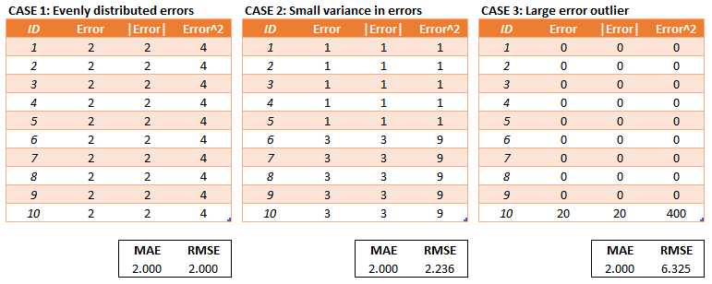
Example: MAE vs. MSE/RMSE
MSE/RMSE penalizes severe errors much more than MAE
This can be desirable if being off by a lot one time is much worse than being off by a little every time
Image source: https://medium.com/human-in-a-machine-world/mae-and-rmse-which-metric-is-better-e60ac3bde13d

Slide 39
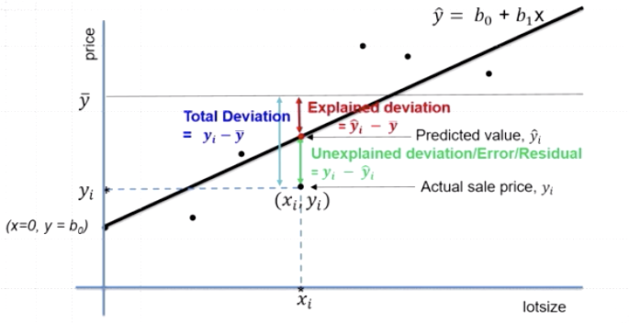
Coefficient of determination (R²)
Deviation of points from mean can be broken down into two components:
”Explained deviation” – portion of deviation predicted by your model
“Unexplained deviation” – difference between prediction and actual point

Slide 40
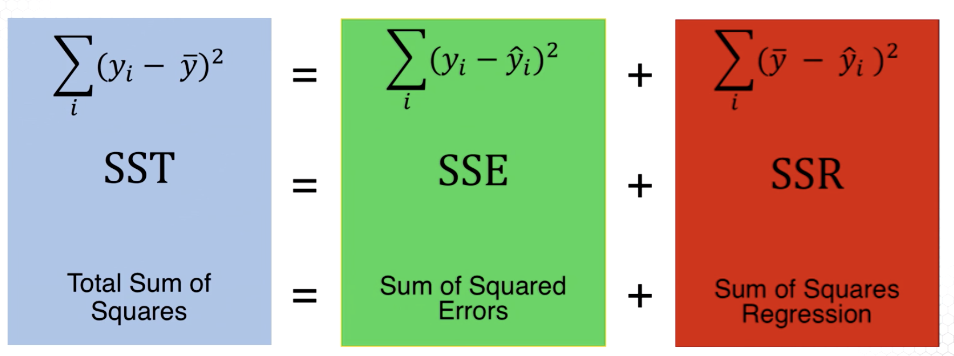
Coefficient of determination (R²)
Total deviation from mean
Unexplained deviation (error)
Deviation explained by model
$$R^{2}=\frac{SSR}{SST}=1−\frac{SSE}{SST}$$
R-squared is typically used to communicate how well your feature variables (X) explain the variability in your target variable (y)
R² ranges between 0 and 1

Slide 41
Adjusted R²
R-squared is often viewed as a measure of goodness of fit rather than prediction ability -> calculated “in-sample” on the training data itself
As we add more features, the R-squared almost always goes up because the model finds additional patterns of correlation (which might be noise)
However, this does not mean the model can generate better predictions on new data -> remember our discussion on overfitting
To help with this problem, we often report ”adjusted R-squared”, which penalizes for more features (added complexity)
$$Adjusted R^{2}=1−\frac{(1−R^{2})(n−1)}{(n−p−1)}$$
“Is R-squared useless?”: https://data.library.virginia.edu/is-r-squared-useless/

Slide 42
Classification Error Metrics

Slide 43
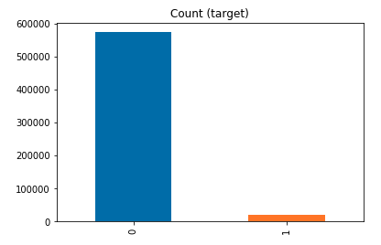
Accuracy
Accuracy is the most popular and easiest to understand error metric
However, accuracy can be deceiving when there is a class imbalance
Consider this situation:
I am building a model to predict whether patients will have a certain rare disease
I gather a dataset with thousands of patients and several features, along with a label of whether they were diagnosed with the rare disease (“1”) or not (“0”)
Using this dataset, I create a classifier with 99.4% accuracy!
What’s the problem?
My dataset had very high class imbalance
My model just predicted “0” for every patient
And it was right 99.4% of the time!

Slide 44
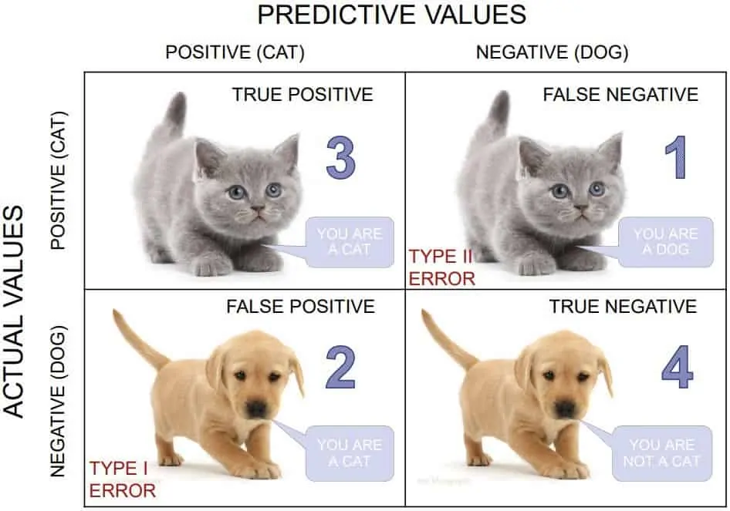
Confusion Matrix – Binary Classification
Predicted class, $\hat{y}$
1
(Positive)
0
(Negative)
True positives
False negatives
1
(Positive)
True class, $y$
False positives
True negatives
0 (Negative)

Slide 45
Confusion Matrix – Binary Classification
Predicted class, $\hat{y}$
True Positive Rate (TPR)
Recall
Sensitivity
How many of all positives did the model correctly classify as positives?
1
(Positive)
0
(Negative)
True positives
False negatives
1
(Positive)
True positives
True class, $y$
False positives
True negatives
0 (Negative)
All positives
True positives
False negatives
+

Slide 46
Confusion Matrix – Binary Classification
Predicted class, $\hat{y}$
False Positive Rate (FPR)
How many of all negatives did the model incorrectly classify as positives?
1
(Positive)
0
(Negative)
True positives
False negatives
1
(Positive)
False positives
True class, $y$
False positives
True negatives
0 (Negative)
All negatives
False positives
True negatives
+

Slide 47
Confusion Matrix – Binary Classification
Predicted class, $\hat{y}$
Precision
How many of the predicted positives are actually positives?
1
(Positive)
0
(Negative)
True positives
False negatives
1
(Positive)
True positives
True class, $y$
False positives
True negatives
0 (Negative)
All predicted positives
True positives
False positives
+

Slide 48
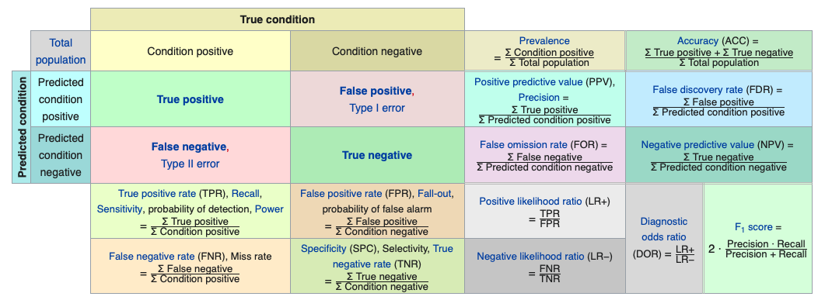
Confusion matrix cheat sheet
Source: Wikipedia

Slide 49
Question
Our model predicts every observation as “positive”
Is the recall / true positive rate high or low?
What about the false positive rate?
How about the precision?

Slide 50
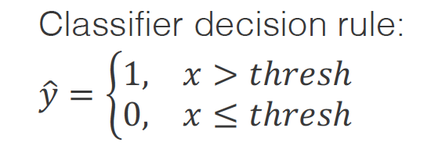
ROC Curves
A Receiver Operating Characteristic (ROC) curve plots the True Positive Rate (TPR) and False Positive Rate (FPR) for different threshold values
What is a threshold?
Most classification models return the probability of the positive class
The data scientist sets a threshold for the positive class – if the probability returned by the model is above threshold, the assigned label is positive
Typically the threshold is set to 0.5 by default
What happens to TPR if we increase the threshold to 0.9?
What about FPR?
What if we go the other way to 0.1?

Slide 51
ROC Curves
 | Model Output | Actual Target | Thresh = 0.3 | Thresh = 0.5 | Thresh = 0.7
1 | 0.85 | 1 | 1 | 1 | 1
2 | 0.04 | 0 | 0 | 0 | 0
3 | 0.62 | 1 | 1 | 1 | 0
4 | 0.37 | 0 | 1 | 0 | 0
5 | 0.55 | 0 | 1 | 1 | 0
TPR |  |  | 2/2 | 2/2 | 1/2
FPR |  |  | 2/3 | 1/3 | 0/3
To build a ROC curve:
Run the model and get the output probabilities
For each value in range(0,1):
Set value as threshold value
Calculate predictions by comparing model output probabilities to threshold
Compare the predictions to targets and calculate the TPR and FPR values
Plot the values for all thresholds on a graph of TPR vs FPR

Slide 52
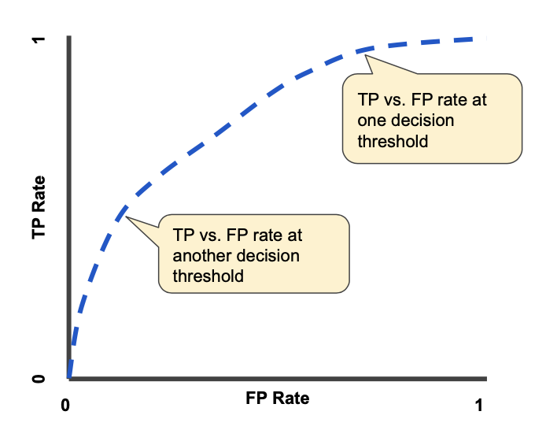
ROC Curves
True positives
True positives
+
False negatives
To build a ROC curve:
Run the model and get the output probabilities
For each value in range(0,1):
Set value as threshold value
Generate predictions by comparing model output probabilities to threshold
Compare the predictions to targets and calculate the TPR and FPR values
Plot the values for all thresholds on a graph of TPR vs FPR
False positives
False positives
+
True negatives
Image source: https://developers.google.com/machine-learning/crash-course/classification/roc-and-auc

Slide 53
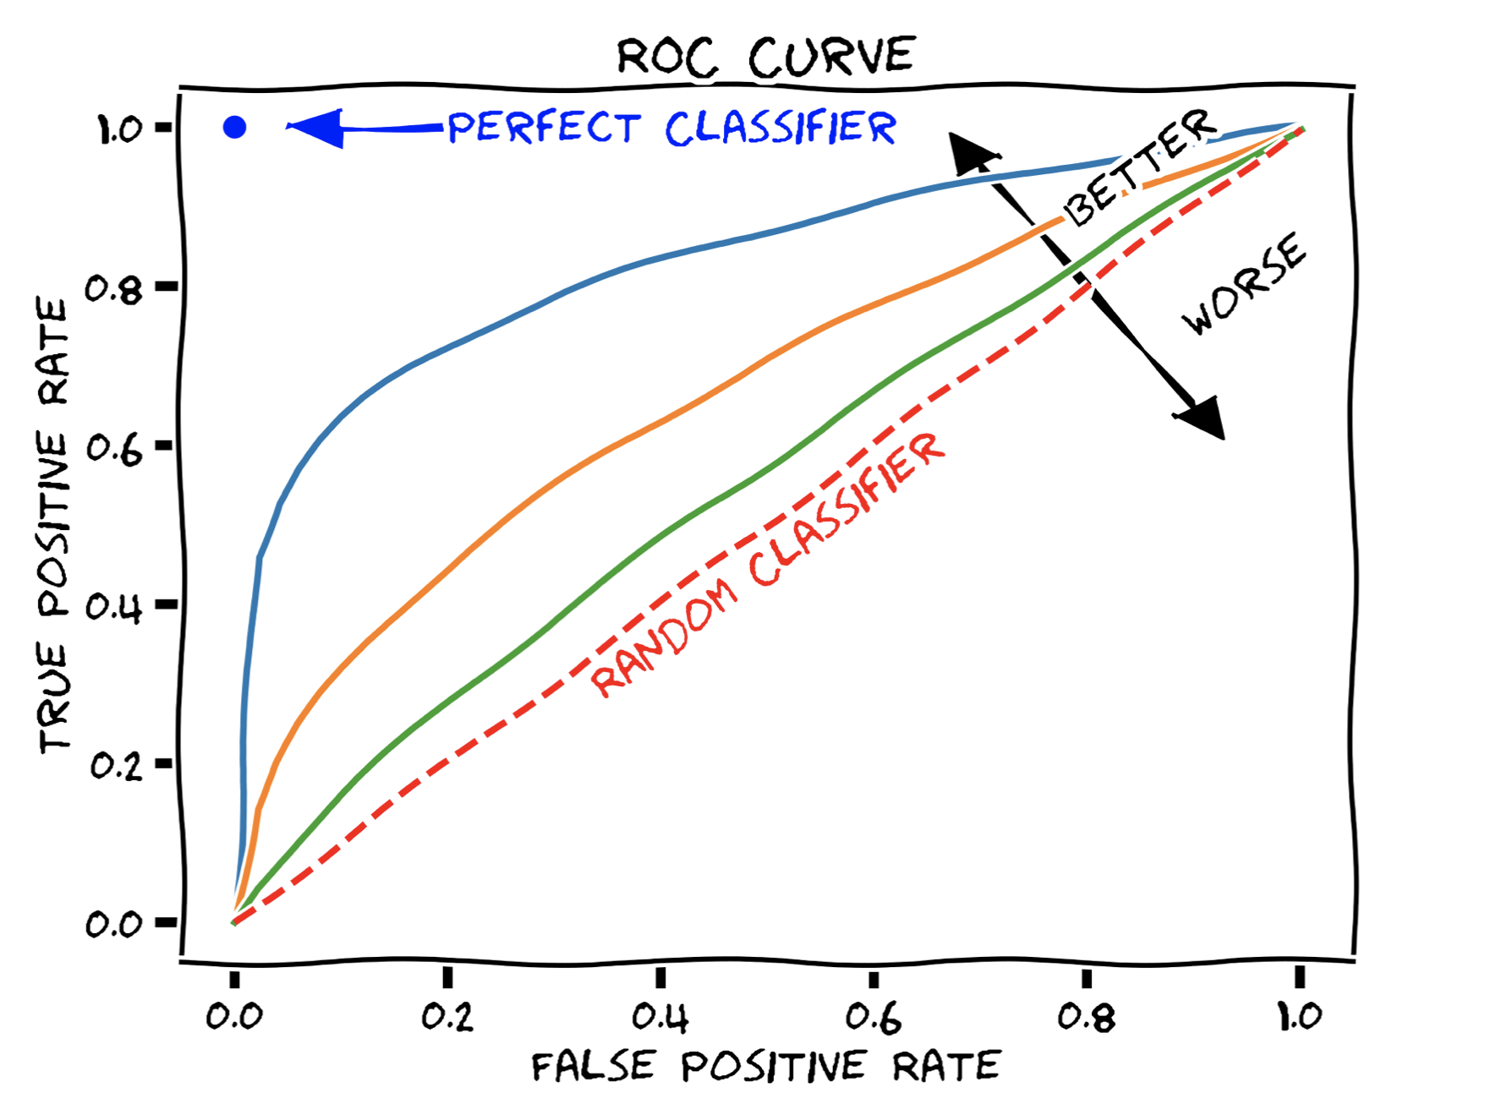
Area Under ROC (AUROC)
A common error metric for classification models is AUROC
This represents the area under the ROC curve
A perfect classifier will have have AUROC=1
A random classifier will have AUROC=0.5
Why? See: https://datascience.stackexchange.com/questions/31872/auc-roc-of-a-random-classifier
Therefore, a model should have an AUROC between 0.5 and 1 (higher is better)
https://en.wikipedia.org/wiki/Receiver_operating_characteristic#/media/File:Roc-draft-xkcd-style.svg

Slide 54
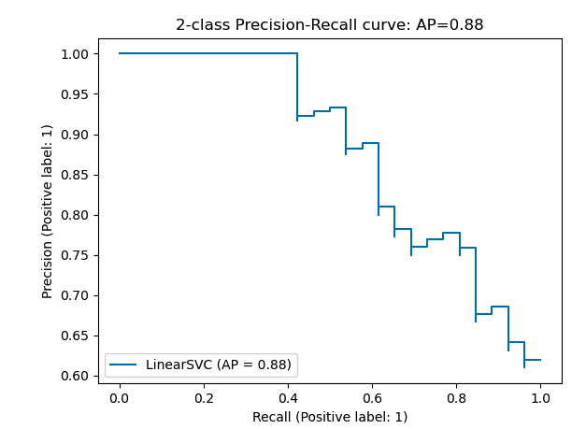
Precision-Recall Curve
True positives
Another evaluation technique is the precision-recall (PR) curve
This measures the tradeoff between recall and precision as the model threshold is varied (just like we did for the ROC)
PR curves are especially useful if we have high class imbalance (e.g. a lot of 0’s and only a few 1’s)
Unlike ROC curves, they do not factor in True Negatives
True positives
+
False positives
True positives
True positives
+
False negatives
Image source: https://scikit-learn.org/stable/auto_examples/model_selection/plot_precision_recall.html#sphx-glr-auto-examples-model-selection-plot-precision-recall-py

Slide 55
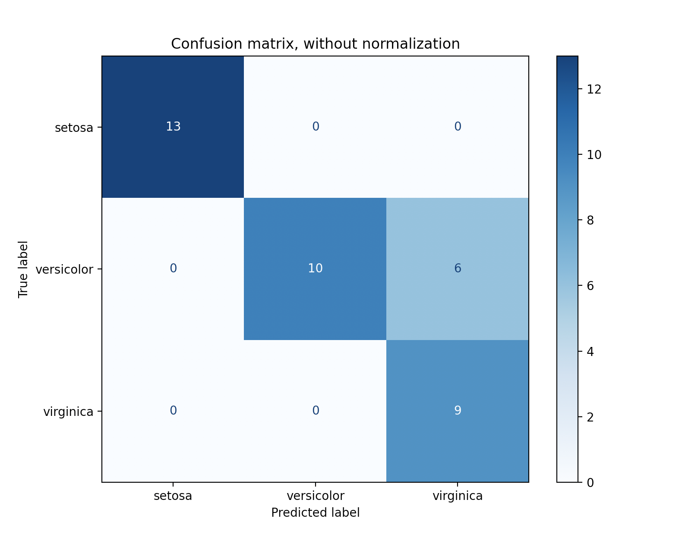
Multiclass Confusion Matrix
The multiclass confusion matrix shows us where the classifier model is struggling to differentiate between classes
A perfect classifier would have values only on the diagonals
To plot the confusion matrix we use scikit learn’s plot_confusion_matrix() method

Slide 56
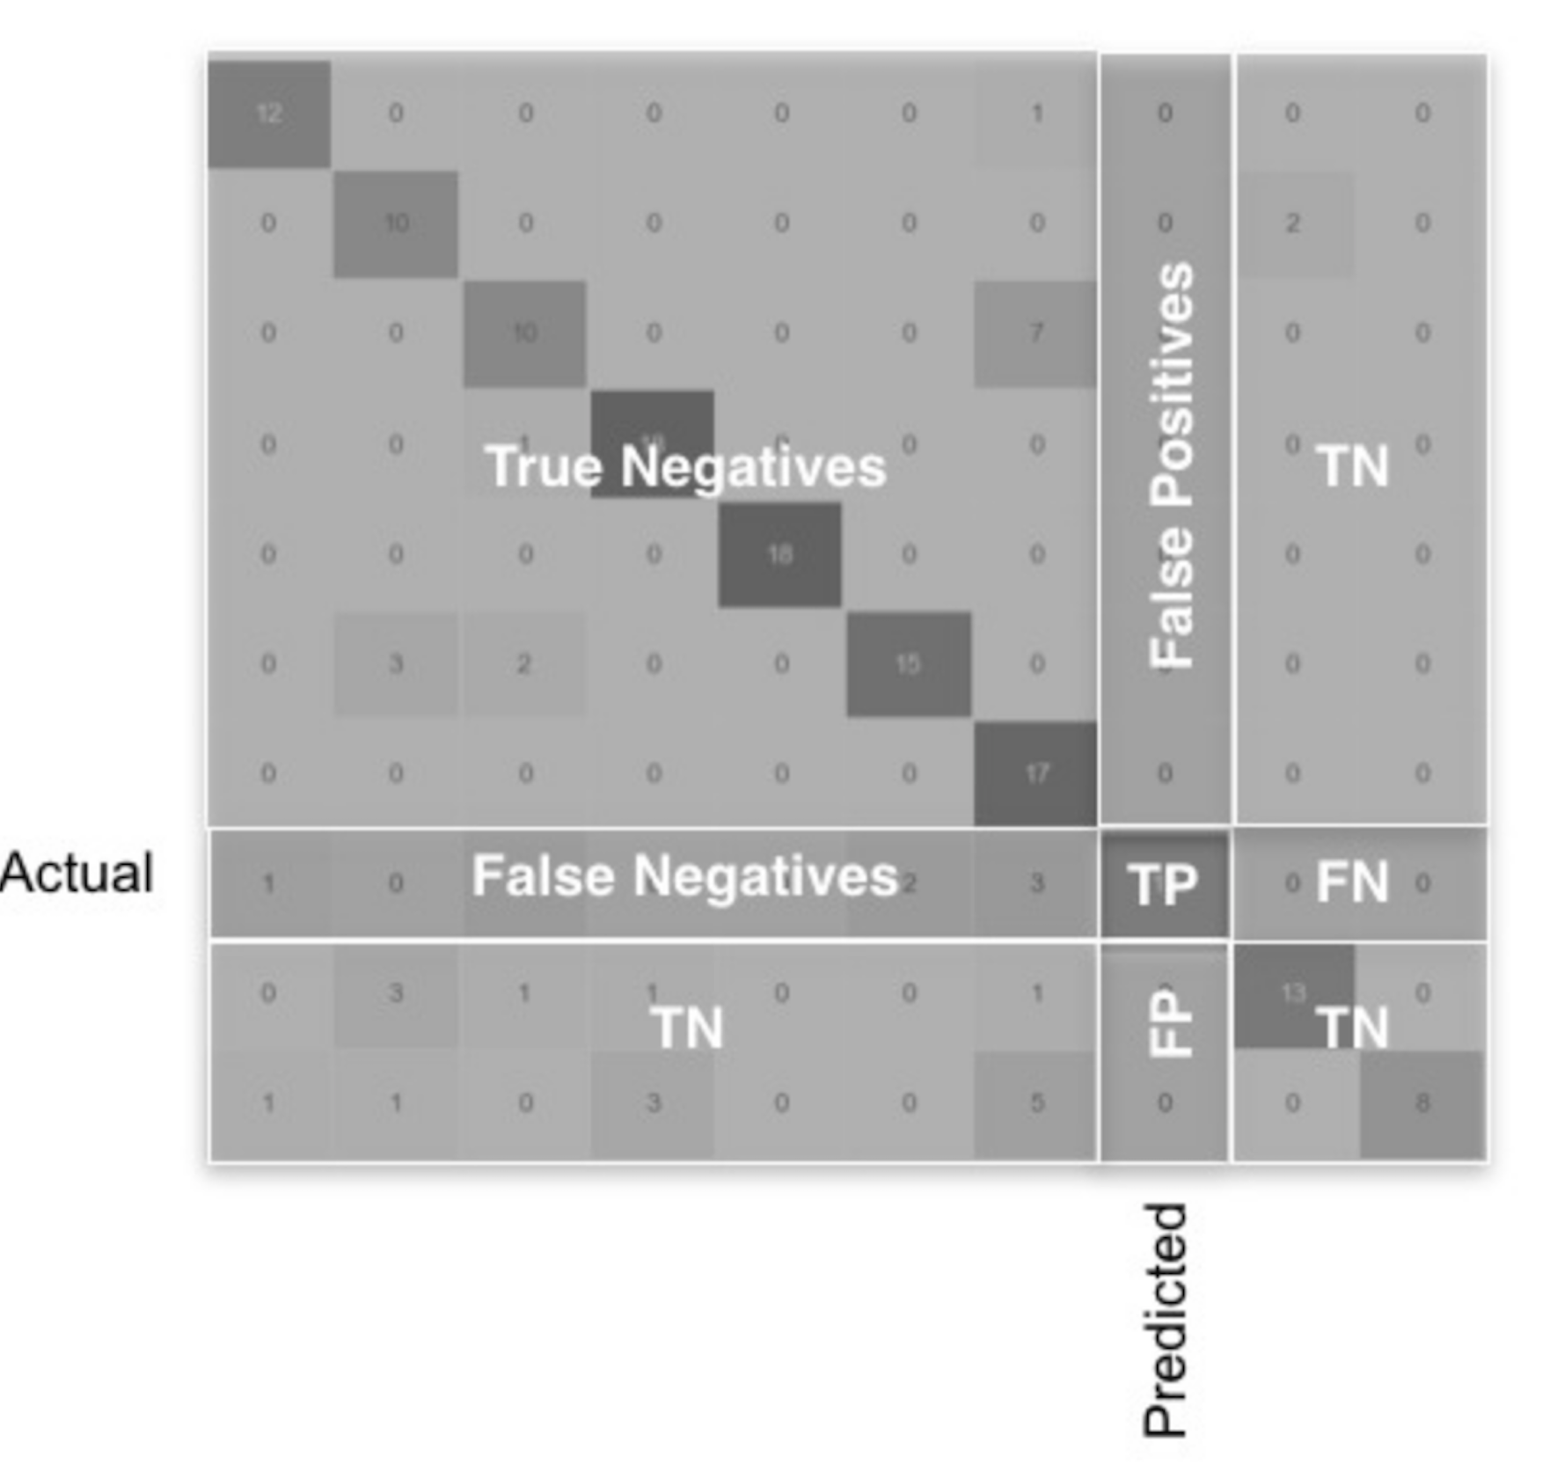
Multiclass Confusion Matrix
We can calculate the same metrics as we did before, but now we do it for each class
Scikit learn will do this for us using the classification_report() method
We can also report overall “macro-averaged” precision and recall using a simple average across all classes
Image source: https://towardsdatascience.com/multi-class-classification-extracting-performance-metrics-from-the-confusion-matrix-b379b427a872

Slide 57
F₁ Score
Precision or recall alone do not give us the whole picture of how well our classifier is doing, particularly for data with high class imbalance
We can use the F₁ score, which takes both precision and recall into account
$$F_{1}=2∗\frac{precision∗recall}{precision+recall}$$
This is common in academic papers but needs to be used carefully, because it gives equal weight to precision and recall
E.g. classifying a healthy person as sick can have very different consequences as classifying a sick person as healthy

Slide 58
Preparing for Modeling

Slide 59
Aspects of preparing data
Splitting data - train/test sets
Feature selection
Creating new derivative features
Encoding categorical features
Scaling/standardizing features
Adjusting for class imbalance

Slide 60
Feature Selection

Slide 61
Why do feature selection?
Reduces model overfitting / improves generalization performance
Reduces training time
Reduces complexity / improves model interpretability

Slide 62
Feature selection methods
 | Filter Methods | Wrapper Methods | Embedded Methods
Methods | Univariate methods Information gain Correlation matrix | Forward selection Backward elimination Recursive feature elimination | Regularization methods (LASSO) Random Forest feature importance
Characteristics | Rely on characteristics of the data – do not use a model Computationally inexpensive Use before modeling as screen to remove irrelevant features | Train model on subsets of features Computationally very expensive Often unfeasible for real-world modeling | Can be run while training a model Extracts features which contribute most to training of model

Slide 63
Univariate selection
Generally performed during Data Preparation, before starting any modeling
Focus at this point is simplifying the data – remove unnecessary features
We are NOT trying to select the optimal combination for modeling
Two objectives:
Remove features which have very little to contribute in predicting the response (e.g. features with no/low correlation to the output)
Identify features which are correlated with each other and determine how to resolve (this is called multicollinearity)

Slide 64
Univariate selection methods
Input Type
Numeric
Categorical
Output Type
Numeric (Regression)
Pearson’s Correlation
Spearman’s Correlation
ANOVA
Mutual Information
Categorical (Classification)
ANOVA
Mutual Information
Chi-Squared
Mutual Information

Slide 65
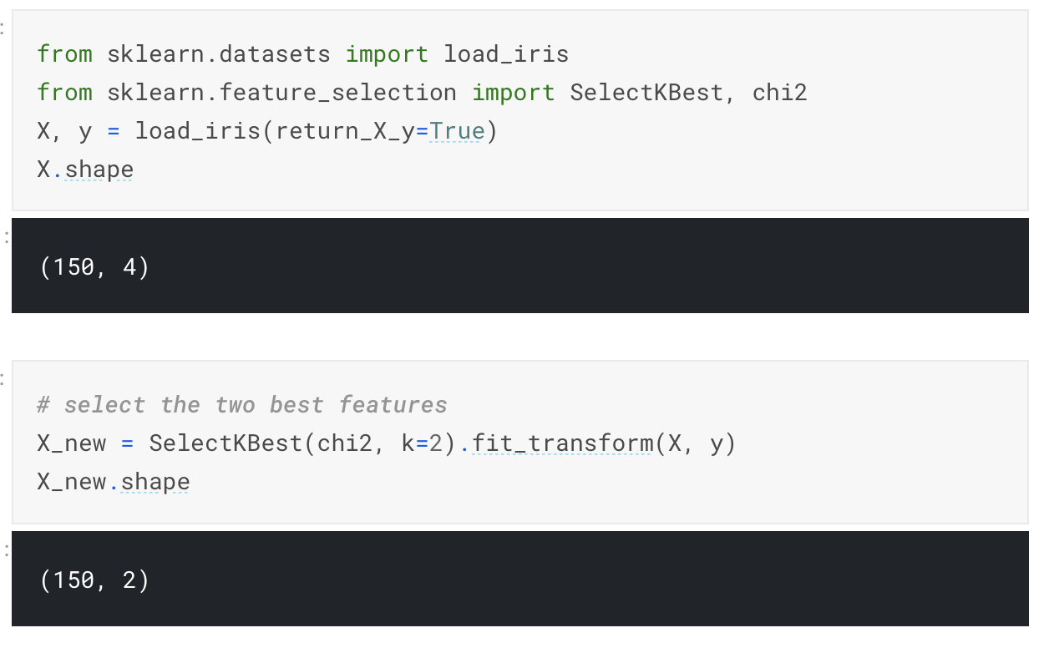
Univariate selection using scikit-learn
Scikit-learn provides the SelectKBest class
Select a user-specified number of features which score highest on a univariate statistical test
Inputs: features (X), response (y), number to select (k), statistical test (score-func)
Do not use this blindly – always look at the details and confirm the selection makes sense!

Slide 66
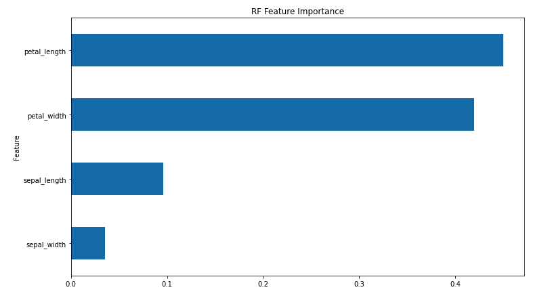
Embedded Methods – Random Forest
We can calculate the relative importance of each feature using the random forest’s model.feature_importances_ attribute
“Feature importance” is calculated by looking at how much the nodes that use each feature reduce gini impurity on average (across each tree and then all trees in the forest), weighted by number of samples at node

Slide 67
Feature selection strategy
Remove any features with significant (>50%) null values
Use filter method(s) to reduce feature set to a manageable number
Use one or more embedded methods to perform final selection
Different approaches may give different results. Might combine multiple approaches

Slide 68
Working with Categorical Features

Slide 69
Continuous vs categorical features
Continuous
Numeric variable that has an infinite number of values between any two values
E.g. length of a part, temperature, height, time
Categorical
Finite number of categories / distinct groups
May or may not have a logical order
E.g. gender, student major, material type, color
Discrete
Numeric variable that has a countable number of values between two values
E.g. age, number of parts, year made
Rule of thumb – if number of possible values small, treat as categorical

Slide 70
Encoding categorical features
Many machine learning models are algebraic and only know how to accept numerical inputs
We need to convert our categorical (string) features into number codes
Two ways to do this:
Numerical (ordinal) encoding
One-hot encoding

Slide 71
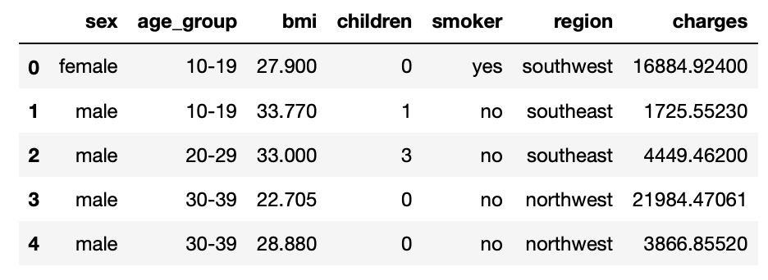
Example – predicting health insurance claims
Objective is to predict the total medical claims of customers of a health insurance company based on demographic data
Features:
Sex – categorical
Age_group – categorical
Body Mass Index (BMI) - continuous
Children - continuous
Smoker – categorical (binary)
Region – categorical
Response:
Charges - continuous
How should we handle the categorical variables?

Slide 72
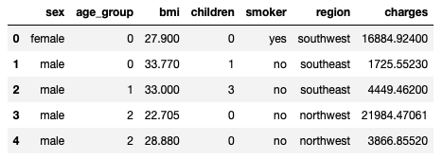
Method 1: Ordinal encoding
For ordered data there is value in preserving the ordering (e.g. education level, class grade)
Converts ordinal categories to numerical codes
Can also use for non-ordered data (but creates risk that model will learn artificial relationships)

Slide 73
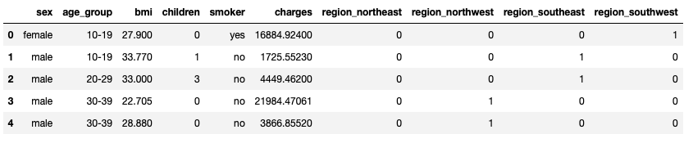
Method 2: One-hot encoding
Each categorical variable with n categories is split into n different binary features (0/1)
Pros | Cons
Does not create an artificial relationship between categories based on assigned numerical values Allows each category to be treated as a separate feature – works well in practice | Can create a large number of features, which can be difficult to work with and cause modeling issues (overfitting the training data)

Slide 74
Scaling/Standardizing

Slide 75
Why scale/standardize your data?
Some distance-based models (e.g. clustering or K Nearest Neighbors) will only work when features are on the same scale
E.g. trying to compare two people using the dimensions “Age” and “Household Income” via a distance metric such as Euclidian distance will not be useful
Other machine learning models may converge faster/better (e.g. logistic regression, neural networks)
Improves interpretability of models results (e.g. can directly compare coefficients of a regression model and interpret intercept)

Slide 76
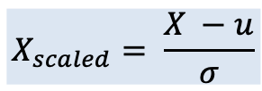
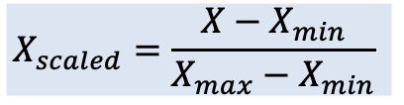
Scaling vs. Standardizing
Min-Max Scaling (Normalization)
Standardization
(Z-score normalization)
Change the values for each feature so they fall in a fixed range – usually 0 to 1
Commonly used for computer vision applications (scaling pixel values to 0–255)
Used when data distribution is not approximately normal
May diminish the impact of outliers
Change the values for each feature so they have properties of a standard normal distribution with μ=0 and σ=1
Important for clustering analysis and PCA, helps neural networks
May distort differences between features if not approximately normally distributed
$$X_{scaled}=\frac{X−X_{min}}{X_{max}−X_{min}}$$
$$X_{scaled}= \frac{X −u}{σ}$$
Scikit learn: MinMaxScaler()
Scikit learn: StandardScaler()

Slide 77
Rules of Thumb
Some algorithms require either scaling or standardizing
Distance-based algorithms such as KNN, clustering
Regression with L1/L2 penalty
Some (e.g. PCA) require standardizing
It never hurts to scale/standardize, and even if not required it often helps improve convergence

Slide 78
Class Imbalance

Slide 79
Bias from class imbalance
“Class imbalance” means that one label class is significantly more common in the training dataset than others
Class imbalance may be inherent in the phenomenon being modeled:
Car insurance claims
Financial fraud
Side effects of new medicine
It may also be introduced through sampling bias in building the training dataset:
IBM’s facial recognition software
Amazon’s AI-based resume screening system

Slide 80
Why does class imbalance matter?
The model learns that if it predicts the majority class more, it will perform better
As a result, it’s ability to predict the minority class when it occurs is impaired
Selection of metrics can make this worse
E.g. if we use a simple metric like “accuracy”, we could convince ourselves we have a great model if it predicts a “0” 100% of the time!

Slide 81
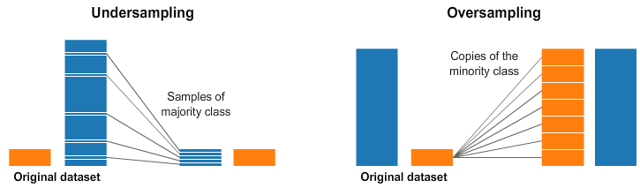
Dealing with class imbalance
If the class imbalance is a result of bias in collecting training data, fix the root problem by collecting more data
If the imbalance is inherent in the problem, two common techniques uses are undersampling the majority class, and oversampling the minority class
https://www.kaggle.com/rafjaa/resampling-strategies-for-imbalanced-datasets

Slide 82
Pipelines

Slide 83
Pipelines
We can think of the steps in preparing & modeling our data as a “pipeline”
We “fit” the pipeline using the training data only, and then we can apply it to new data going forward (including the test set)
New data
Data pipeline
Predictions
Fill missing data
Reduce feature set
Encode
categorical data
Scale numerical data
Model

Slide 84
Pipelines in Scikit-learn
ColumnTransformer
Categorical data
Fill missing data using mode
One-hot encode
Input data
Model
Predictions
Fill missing data using median
Standardize
Numeric data
Pipeline.fit(X_train, y_train)
Pipeline.predict(new_data)

Slide 85
Benefits of pipelines
Fit once, then reuse for testing, production
Less code to maintain
Ease of adaptation to changing data
Reproducibility / data lineage

Slide 86
Questions?

