Slide 1
Go to:
fastapi-app-690891431278.us-central1.run.app/
Enter code
d147bbc6-c9db-46c2-b704-a4373e55690b
https://fastapi-app-690891431278.us-central1.run.app/student/quiz/d147bbc6-c9db-46c2-b704-a4373e55690b

Slide 2
Linear Regression

Slide 3
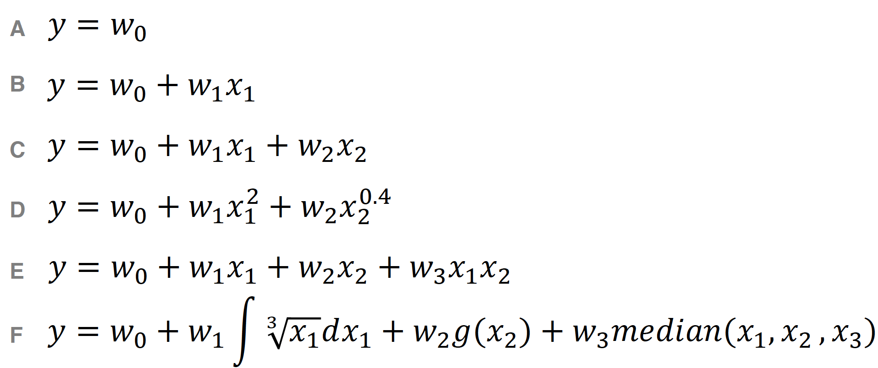
Which are linear models?
Linear models are linear in the parameters w. They can be used to model non-linear relationships between inputs & outputs

Slide 4
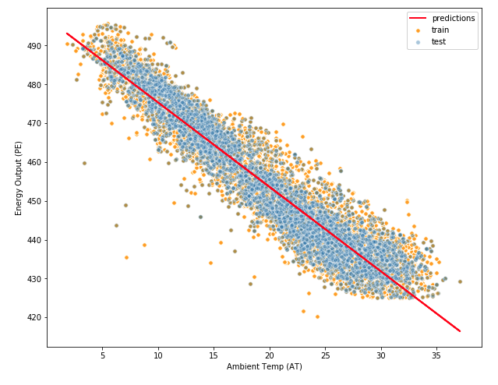
Linear regression
What is linear regression?
Model which assumes linear relationships between the features and targets
Why should we care about linear regression?
Forms the basis of more complex ML models
Can be surprisingly effective if you know how to use it
Great first model to apply to get a benchmark
Helps us understand relationships between inputs and outputs (feature and targets)

Slide 5
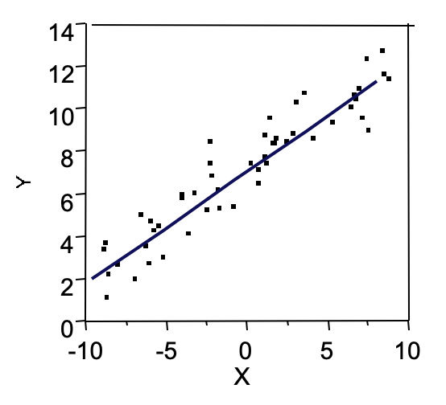
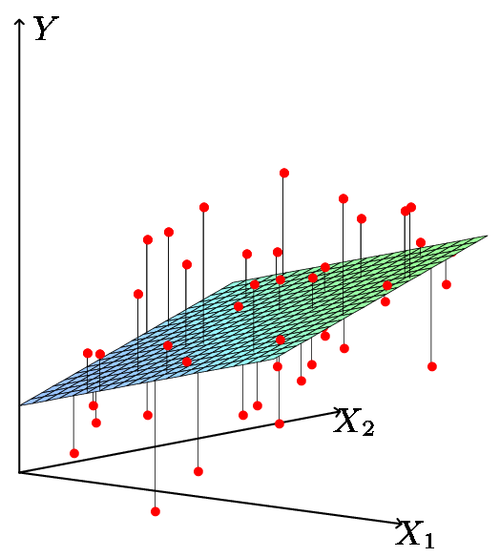
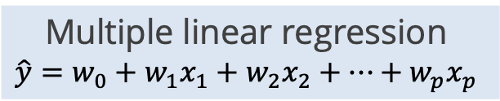
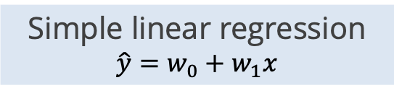
Simple vs. multiple linear regression
Simple linear regression models y as a function of a single feature x
Multiple linear regression models y as a function of a feature vector x containing multiple features x₁,x₂…x_{n}
Simple linear regression $$\hat{y}=w_{0}+w_{1}x$$
Multiple linear regression $$\hat{y}=w_{0}+w_{1}x_{1}+w_{2}x_{2}+…+w_{p}x_{p}$$
Image source: https://www.alsharif.info/iom530

Slide 6
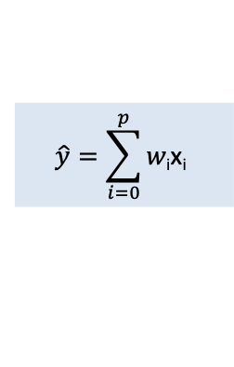



The Linear Regression Model
For an observation (x,y):
$$\hat{y}=\sum_{i=0}^{p}{w\text{i}\text{x}\text{i}}$$
$$\hat{y}=w_{0}+w_{1}x_{1}+w_{2}x_{2}+…+w_{p}x_{p}$$
$$\hat{y}=w^{T}x$$
where x₀$≜$1
The parameters are easy to interpret
w₀ is the intercept (the average value for y if all the x’s are 0)
w_{i} is the average increase in y when x_{i} is increased by 1 and all other x’s are held constant

Slide 7
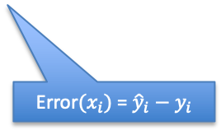
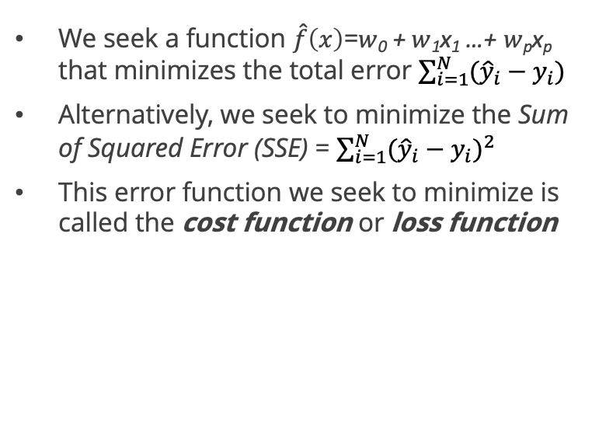
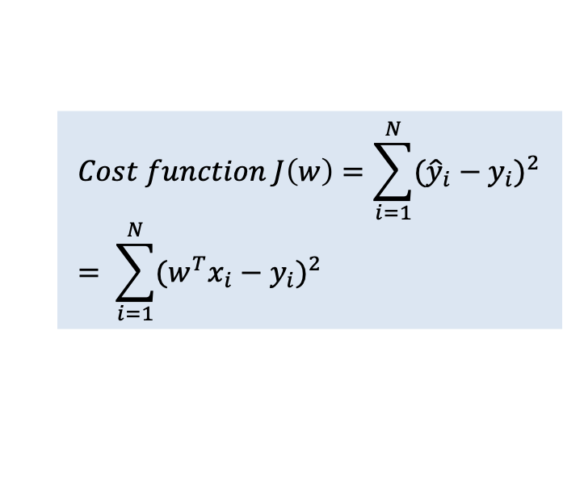

Estimating the parameters
We seek a function $\hat{f}\left(x\right)$=$w$₀ + $w$₁x₁ …+ $w$_{p}x_{p} that minimizes the total error $\sum_{i=1}^{N}{({\hat{y}}_{i}−y_{i})}$
Alternatively, we seek to minimize the Sum of Squared Error (SSE) = $\sum_{i=1}^{N}{{({\hat{y}}_{i}−y_{i})}^{2}}$
This error function we seek to minimize is called the cost function or loss function
y
$\hat{f}\left(x\right)$= $w$₀ + $w$₁x₁ …+ $w$_{p}x_{p}
Error$(x_{i})$ = ${\hat{y}}_{i}−y_{i}$
$$Cost function J\left(w\right)=\sum_{i=1}^{N}{{({\hat{y}}_{i}−y_{i})}^{2}}= \sum_{i=1}^{N}{{{(w}^{T}x_{i}−y_{i})}^{2}}$$
x

Slide 8
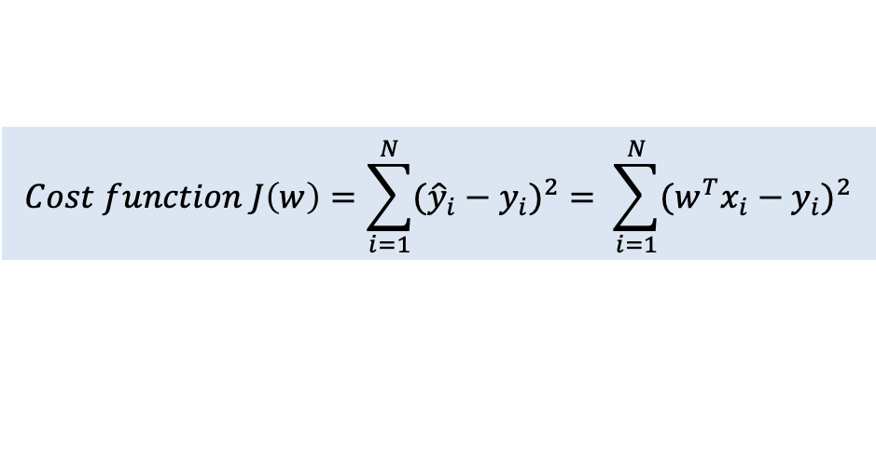
Estimating the parameters
$$Cost function J\left(w\right)=\sum_{i=1}^{N}{{({\hat{y}}_{i}−y_{i})}^{2}}= \sum_{i=1}^{N}{{{(w}^{T}x_{i}−y_{i})}^{2}}$$
We want to minimize this cost function
We cannot change the data (X,y) so we adjust w
How do we find values for w₀…w_{i} that minimize this cost function?
Closed form solution – take the derivative of the cost function and set equal to 0
Apply a gradient descent search algorithm to converge on the optimal values

Slide 9
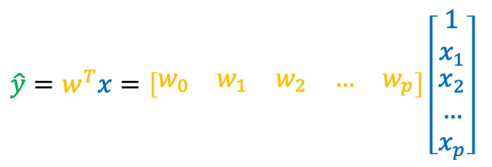
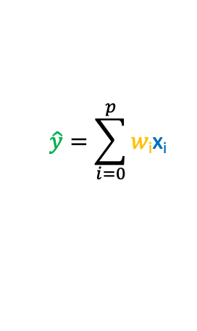
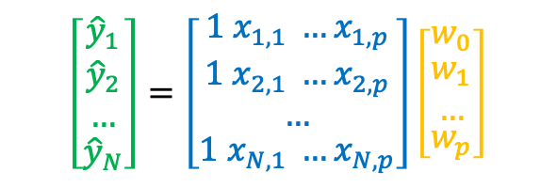


Vectorized form
For a single observation:
For many observations:
$$\hat{y}=\sum_{i=0}^{p}{w\text{i}\text{x}\text{i}}$$
Predictions
Data
Coefficients
where x₀=1
$$\hat{y}=Xw$$
N x 1
=
N x p+1
p+1 x 1
$$\hat{y}$$
X
w
Written in vectorized form:
$$\hat{y}=w^{T}x=\left[\begin{matrix}w_{0} & w_{1} & w_{2} & … & w_{p}\end{matrix}\right]\left[\begin{matrix}\begin{aligned}1 \\ x_{1}\end{aligned} \\ x_{2} \\ … \\ x_{p}\end{matrix}\right]$$
$$\left[\begin{matrix}{\hat{y}}_{1} \\ \begin{aligned}{\hat{y}}_{2} \\ …\end{aligned} \\ {\hat{y}}_{N}\end{matrix}\right]=\left[\begin{matrix}1 x_{1,1} …x_{1,p} \\ \begin{aligned}1 x_{2,1} …x_{2,p} \\ …\end{aligned} \\ 1 x_{N,1} …x_{N,p}\end{matrix}\right]\left[\begin{matrix}w_{0} \\ \begin{aligned}w_{1} \\ …\end{aligned} \\ w_{p}\end{matrix}\right]$$

Slide 10
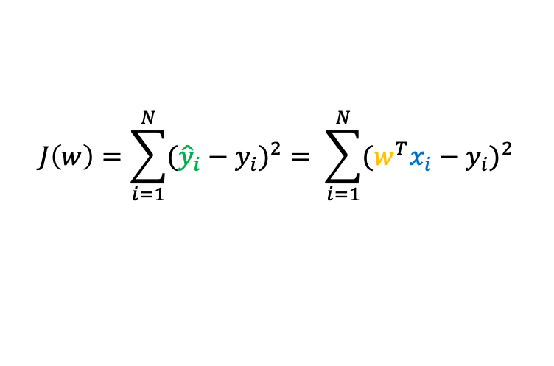


Closed form solution
$$\hat{y}=\sum_{i=0}^{p}{w\text{i}\text{x}\text{i}}$$
Our model is:
Our cost function is:
We can rewrite this in vectorized form as:
$$J\left(w\right)=\sum_{i=1}^{N}{{({\hat{y}}_{i}−y_{i})}^{2}}= \sum_{i=1}^{N}{{{(w}^{T}x_{i}−y_{i})}^{2}}$$
$$J\left(w\right)={\left(Xw−y\right)}^{T}(Xw−y)$$

Slide 11
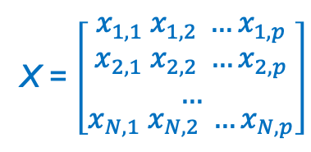
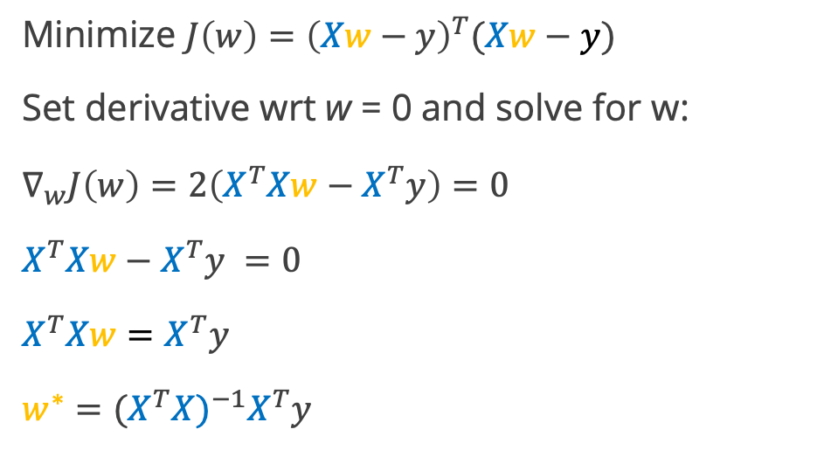


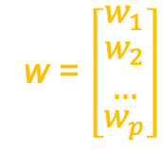
Closed form solution
$y$= $\left[\begin{matrix}y_{1} \\ \begin{aligned}y_{2} \\ …\end{aligned} \\ y_{N}\end{matrix}\right]$
Minimize $J\left(w\right)={\left(Xw−y\right)}^{T}(Xw−y)$
Set derivative wrt w = 0 and solve for w:
$$∇_{w}J\left(w\right)=2\left(X^{T}Xw−X^{T}y\right)=0$$
$$X^{T}Xw−X^{T}y =0$$
$$X^{T}Xw=X^{T}y$$
$$w^{∗}={(X^{T}X)}^{−1}X^{T}y$$
X = $\left[\begin{matrix}x_{1,1} x_{1,2} …x_{1,p} \\ \begin{aligned}x_{2,1} x_{2,2} …x_{2,p} \\ …\end{aligned} \\ x_{N,1} x_{N,2} …x_{N,p}\end{matrix}\right]$
(Normal equation)
w = $\left[\begin{matrix}w_{1} \\ \begin{aligned}w_{2} \\ …\end{aligned} \\ w_{p}\end{matrix}\right]$
$$\hat{y}={Xw}^{∗}$$
Reference on inverse of a matrix: https://www.mathsisfun.com/algebra/matrix-inverse.html

Slide 12
Assumptions of linear regression
Linear regression makes three key assumptions:
Expected value of y for any given x is a linear function of x
Errors are uncorrelated random variables with 0 mean and constant variance σ²
Feature variables are independent
Model fit issues can result from violations of these assumptions:
Non-linearity of the target-features relationship
Non-constant variance or correlation of error terms
Collinearity or multicollinearity of feature variables
Good explanation: https://statisticsbyjim.com/regression/ols-linear-regression-assumptions/

Slide 13
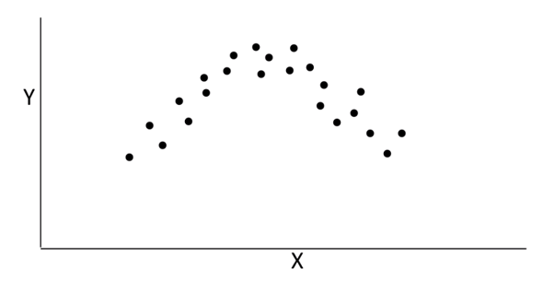

Checking for problems
Problem: Non-linearity of the target-features relationship
Method 1: Scatterplot of target vs. each feature
Method 2: Scatterplot of residuals (errors) vs features or vs. predictions
$$\hat{y}$$
Target should be roughly linearly related to the features (difficult to assess with many features)
Errors should be uniformly distributed around the 0 line

Slide 14
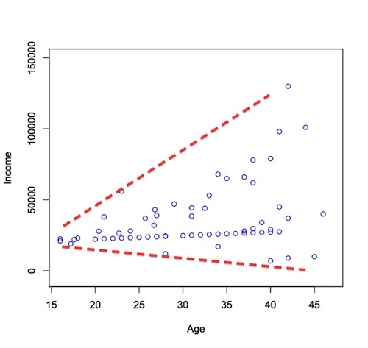
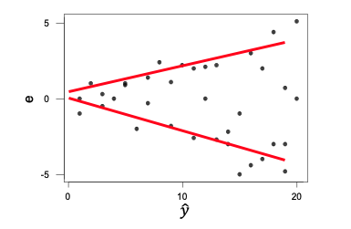
Checking for problems
Problem: Non-constant variance of errors (heteroscedasticity)
Scatterplot of target vs. a feature
Scatterplot of residuals (errors) vs. predictions
In the residuals plot, variance should be evenly scattered around the 0 line and should not increase or decrease with the predicted values (no funnel shape)

Slide 15
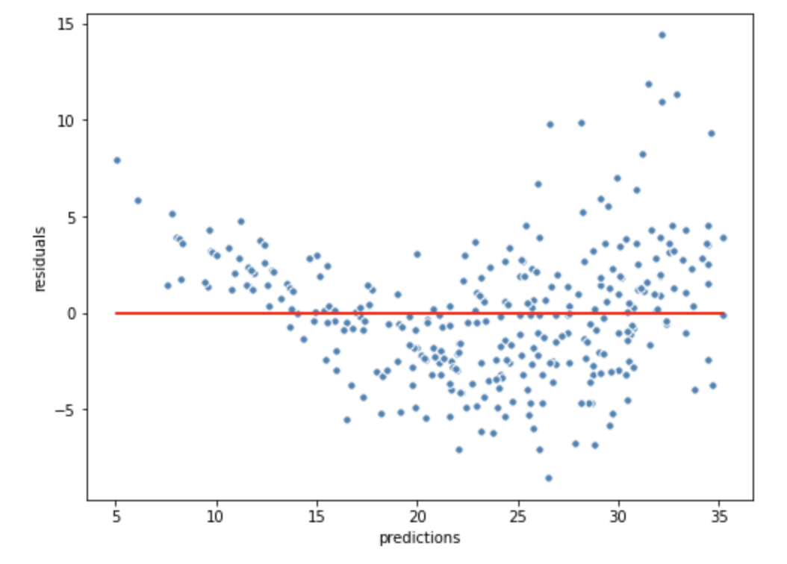
Checking for problems
Based on the residuals plot, do you see evidence of any problems with using linear regression:
Non-linearity of the target-features relationship?
Non-constant variance or correlation of error terms?
Collinearity or multicollinearity of feature variables?

Slide 16
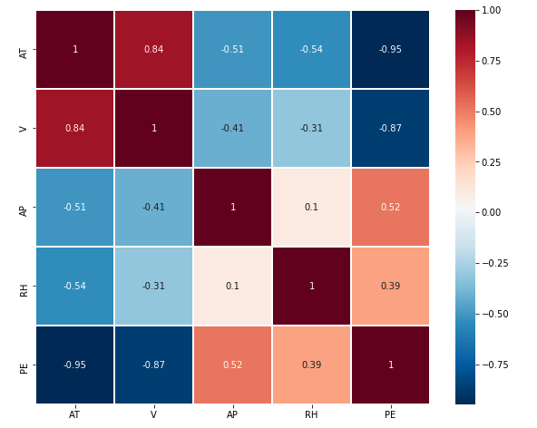
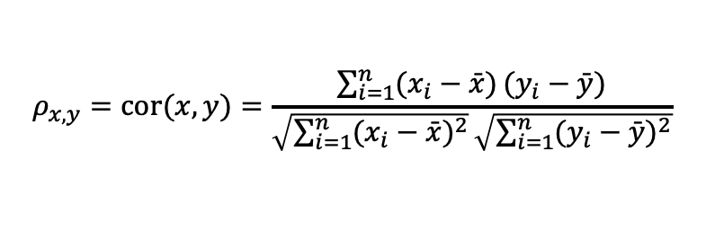
Checking for problems
Problem: Collinearity or multicollinearity of feature variables
Visualize with a correlation matrix:
Collinearity means that one variable is nearly linearly dependent on another variable. We can detect this by looking at the correlation between two features:
$$ρ_{x,y}=cor(x,y)=\frac{\sum_{i=1}^{n}{(x_{i}−\bar{x})}(y_{i}−\bar{y})}{\sqrt{\sum_{i=1}^{n}{(x_{i}−\bar{x})^{2}}}\sqrt{\sum_{i=1}^{n}{(y_{i}−\bar{y})^{2}}}}$$
Severe collinearity or multicollinearity can result in major swings of the correlated variable coefficients as the training data changes, making interpretation difficult
However, it usually does not significantly impact model’s prediction ability

Slide 17
Checking for problems
Violations of the linear regression assumptions do NOT mean that your model has no value
The purpose of checking for these problems is to guide us in how to improve our fit:
Non-linearity may imply we should transform our input feature variables
Non-constant variance may indicate we should transform our output target variable
Collinearity may mean we should reduce our features to simplify

Slide 18
What do we do if we violate an assumption?
If we observe non-linearity between features and target:
We can transform our input features so that we have a linear relationship between the new features and the target
If we observe non-constant variance of errors across values of y-hat:
We can transform our output so that we have constant variance of error terms

Slide 19
Handling Nonlinear Relationships

Slide 20
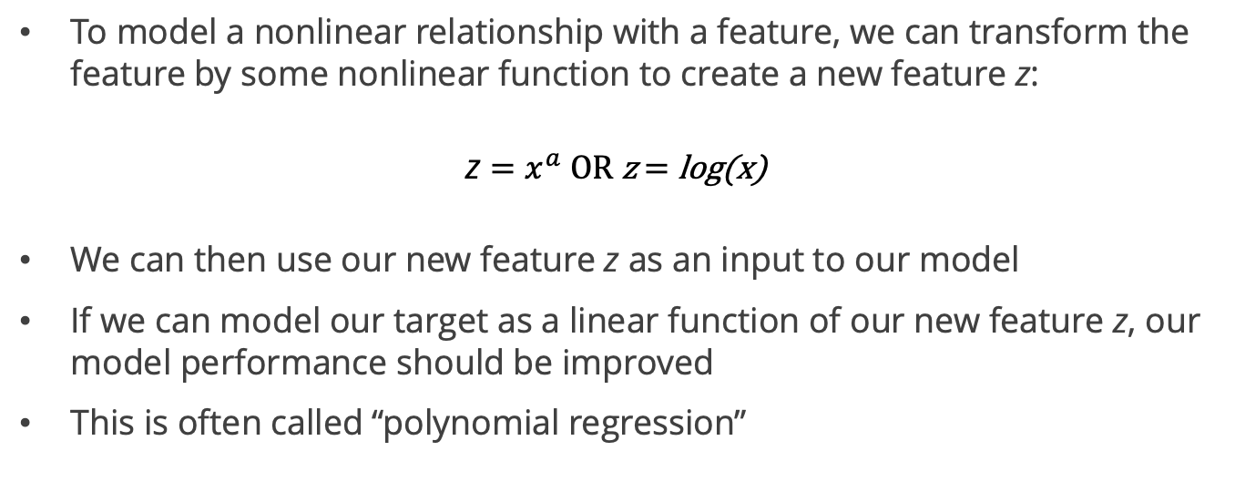
Feature variable transformation
To model a nonlinear relationship with a feature, we can transform the feature by some nonlinear function to create a new feature z:
z $=x^{a} \text{OR} \text{z}\text{ = }\text{log}\text{(}\text{x}\text{) }$
We can then use our new feature z as an input to our model
If we can model our target as a linear function of our new feature z, our model performance should be improved
This is often called “polynomial regression”

Slide 21
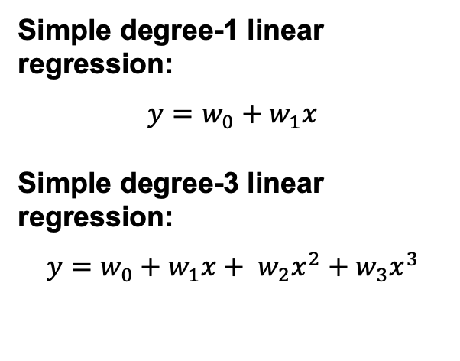
Polynomial regression
Generally when we use polynomial regression with degree = n we include a feature with every degree from 1 to n
We now need to learn n+1 parameters in our model
We can easily do this in Scikit Learn using the PolynomialFeatures class to transform our input data before we build a model
Simple degree-1 linear regression:
$$y={w_{0}+w}_{1}x$$
Simple degree-3 linear regression:
$$y={w_{0}+w}_{1}x+ w_{2}x^{2}+w_{3}x^{3}$$
Remember: Linear Regression is linear in the coefficients

Slide 22

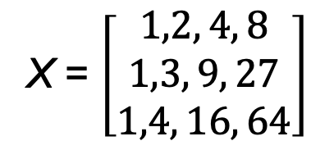
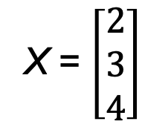


Polynomial transformation
Degree-1 linear regression
Degree-3 linear regression
$$y={w_{0}+w}_{1}x_{1}$$
$$y={w_{0}+w}_{1}x+ w_{2}x^{2}+w_{3}x^{3}$$
X₁
X₀ X₁ X₂ X₃
X = $\left[\begin{aligned}2 \\ 3 \\ 4\end{aligned}\right]$
X = $\left[\begin{matrix}1,2, 4, 8 \\ 1,3, 9, 27 \\ 1,4, 16, 64\end{matrix}\right]$

Slide 23
Interaction Terms
Linear Regression assumes that the effect of each feature is independent of the other features
If we increase feature x₁ by 1 unit, we increase the target by w₁ units (coefficient of x₁)
In real life, we sometimes have synergy effects (or “interaction” effects), of features with each other
Changing the value of one feature causes the relationship of another feature to the target to change
These can be observed graphically, but usually rely on domain expertise to know they exist

Slide 24
Example – Power Outage Prediction
Power outages are generally caused by wind blowing trees onto lines
Thus, wind speed is a key feature
However, when the ground is very wet from recent rain, smaller increases in wind speed can cause more trees to fall
Thus, the presence of this feature (recent rain) changes the relationship between another feature (wind speed) and target (# of outages)

Slide 25

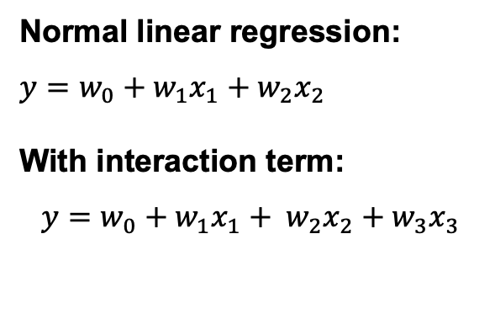
Using Interaction Terms
Normal linear regression:
$$y={w_{0}+w}_{1}x_{1}+w_{2}x_{2}$$
With interaction term:
$$y={w_{0}+w}_{1}x_{1}+ w_{2}x_{2}+w_{3}x_{3}$$
We can add features to account for potential interaction terms
Scikit Learn’s PolynomialFeatures() creates interaction terms automatically using the degree provided
We can also use ONLY the interaction terms if we wish and exclude the polynomial terms
$${x_{3}=x}_{1}x_{2}$$

Slide 26
Regularization

Slide 27
Motivation for Regularization
The training method (minimizing sum of squared error) we have been using tends to reward complexity / overfitting
More complex models fit the training data better and reduce training error
However, we know that complex models have higher variance and thus may not predict as well on new data
How can we build a regression model in a more balanced way?
We add a penalty factor to our cost function to penalize complexity
The penalty term we add to the cost function penalizes complexity in terms of number of features and their magnitude of contribution

Slide 28
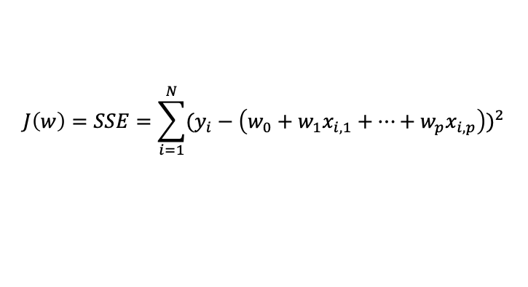
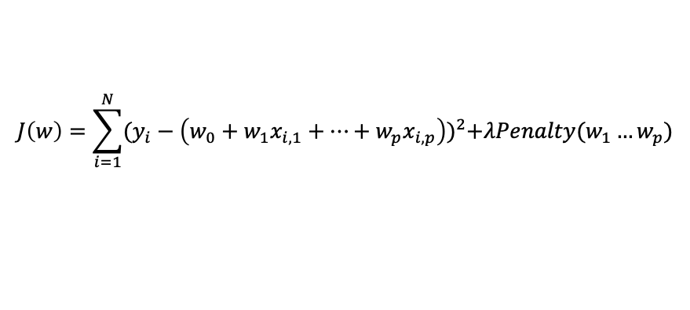

Regularization
Normal linear regression cost function:
$$J\left(w\right)=SSE=\sum_{i=1}^{N}{{(y_{i}−\left(w_{0}+w_{1}x_{i,1}+…+w_{p}x_{i,p}\right))}^{2}}$$
We add a penalty term to the cost function that is a function of the sum of the coefficients
Now, higher number or values of coefficients increases the cost function
Minimizing this new cost function seeks optimal balance of the model fit with the number & magnitude of coefficients
Cost function with regularization:
$$J\left(w\right)=\sum_{i=1}^{N}{{(y_{i}−\left(w_{0}+w_{1}x_{i,1}+…+w_{p}x_{i,p}\right))}^{2}+λPenalty(w_{1}…w_{p})}$$
$$λ controls strength of the penalty$$

Slide 29
Regularization: LASSO & Ridge Regression

Slide 30
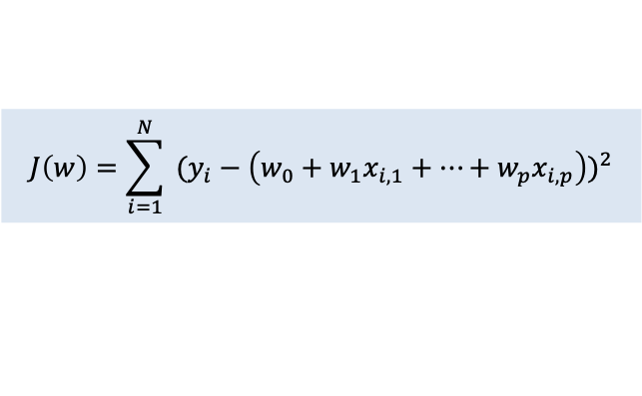
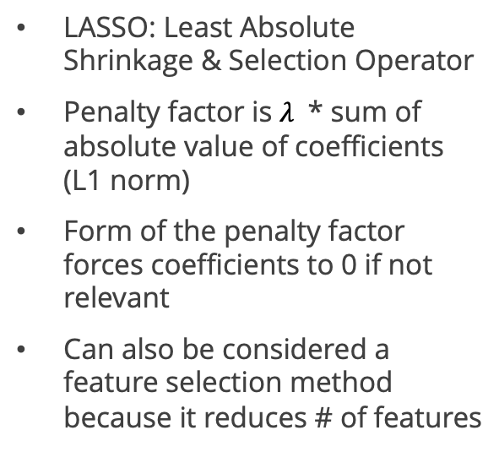
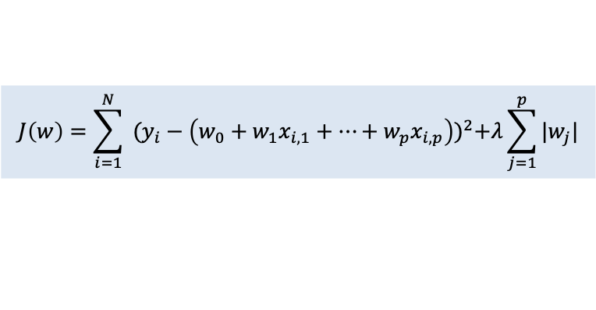
LASSO (L1) Regression
LASSO: Least Absolute Shrinkage & Selection Operator
Penalty factor is $λ$ * sum of absolute value of coefficients (L1 norm)
Form of the penalty factor forces coefficients to 0 if not relevant
Can also be considered a feature selection method because it reduces # of features
Linear regression cost function:
$$J\left(w\right)=\sum_{i=1}^{N}{ {(y_{i}−\left(w_{0}+w_{1}x_{i,1}+…+w_{p}x_{i,p}\right))}^{2}}$$
LASSO regression cost function:
$$J\left(w\right)=\sum_{i=1}^{N}{ {(y_{i}−\left(w_{0}+w_{1}x_{i,1}+…+w_{p}x_{i,p}\right))}^{2}+λ\sum_{j=1}^{p}{|w_{j}|}}$$

Slide 31
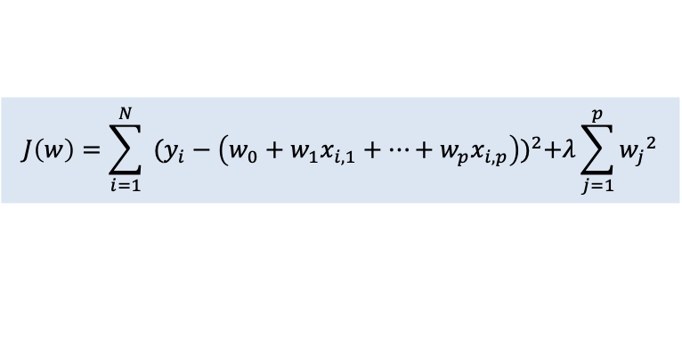
Ridge (L2) Regression
Penalty factor is the sum of squared coefficients (squared L2 norm)
Forces the coefficients of irrelevant variables to be small but not to 0 -> does not perform feature selection
Mathematically more convenient
Linear regression cost function:
$$J\left(w\right)=\sum_{i=1}^{N}{ {(y_{i}−\left(w_{0}+w_{1}x_{i,1}+…+w_{p}x_{i,p}\right))}^{2}}$$
Ridge regression cost function:
$$J\left(w\right)=\sum_{i=1}^{N}{ {(y_{i}−\left(w_{0}+w_{1}x_{i,1}+…+w_{p}x_{i,p}\right))}^{2}+λ\sum_{j=1}^{p}{{w_{j}}^{2}}}$$

Slide 32
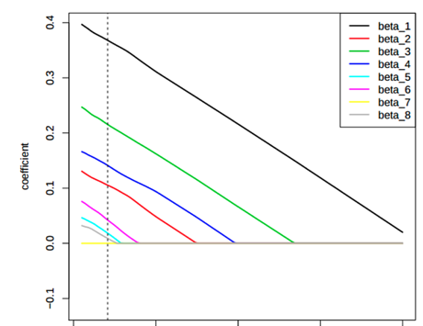
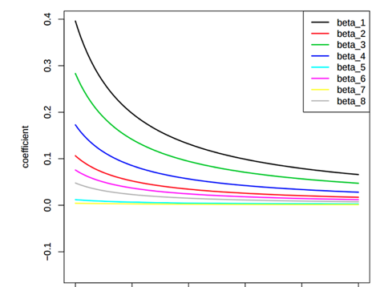


LASSO vs. Ridge Regression
LASSO Regression
Ridge Regression
$$λ$$
$$λ$$

Slide 33
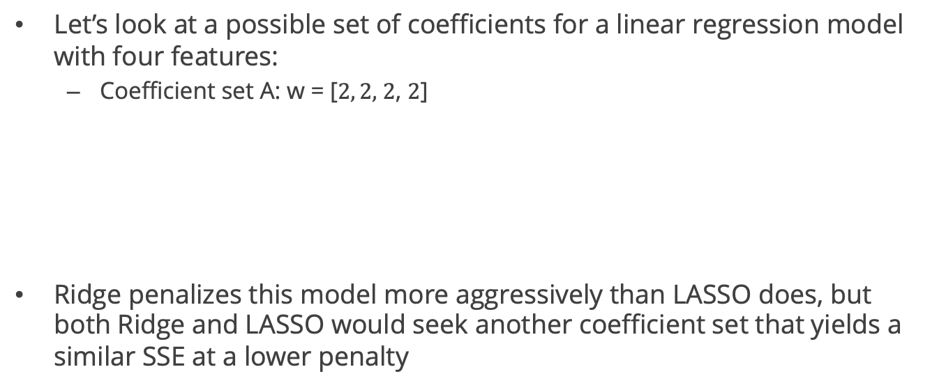
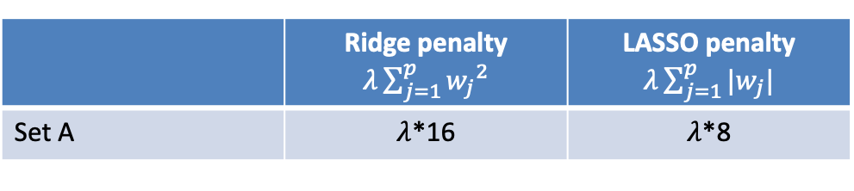
Example: LASSO vs Ridge
Let’s look at a possible set of coefficients for a linear regression model with four features:
Coefficient set A: w = [$2, 2,$ $2$, $2$]
Ridge penalizes this model more aggressively than LASSO does, but both Ridge and LASSO would seek another coefficient set that yields a similar SSE at a lower penalty
 | Ridge penalty $λ\sum_{j=1}^{p}{{w_{j}}^{2}}$ | LASSO penalty $λ\sum_{j=1}^{p}{|w_{j}|}$
Set A | $λ$*16 | $λ$*8

Slide 34
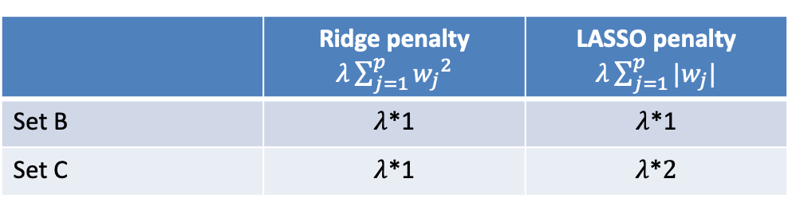
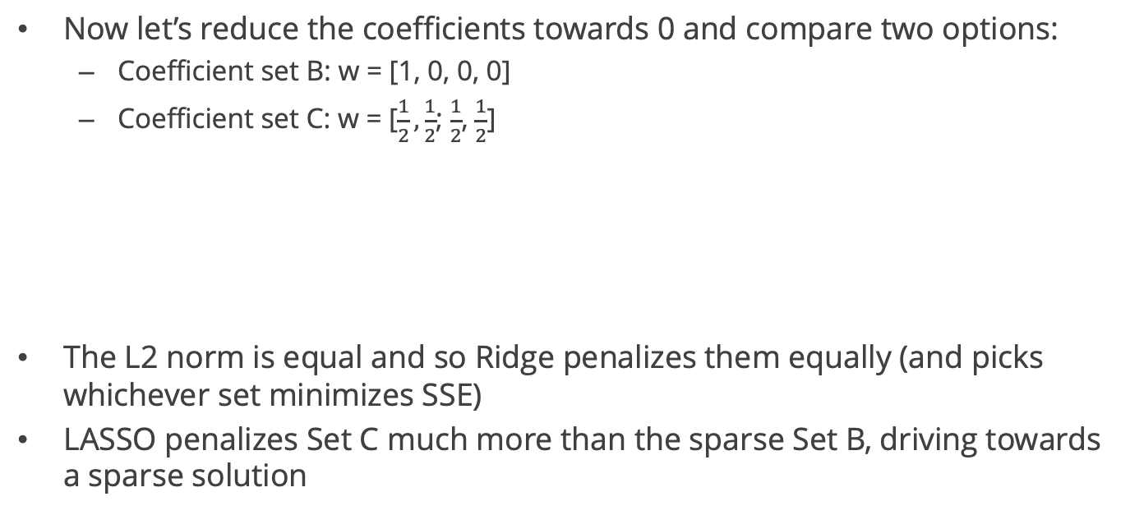
Example: LASSO vs Ridge
Now let’s reduce the coefficients towards 0 and compare two options:
Coefficient set B: w = [1, 0, 0, 0]
Coefficient set C: w = [$\frac{1}{2},\frac{1}{2}$; $\frac{1}{2}$, $\frac{1}{2}$]
The L2 norm is equal and so Ridge penalizes them equally (and picks whichever set minimizes SSE)
LASSO penalizes Set C much more than the sparse Set B, driving towards a sparse solution
 | Ridge penalty $λ\sum_{j=1}^{p}{{w_{j}}^{2}}$ | LASSO penalty $λ\sum_{j=1}^{p}{|w_{j}|}$
Set B | $λ$*1 | $λ$*1
Set C | $λ$*1 | $λ$*$2$

Slide 35
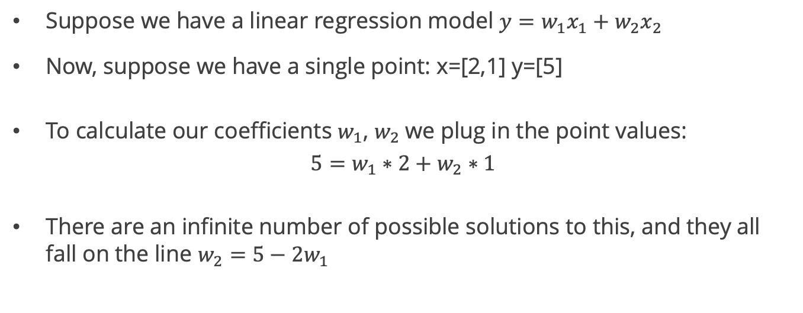
A geometric perspective
Suppose we have a linear regression model $y=w_{1}x_{1}+w_{2}x_{2}$
Now, suppose we have a single point: x=[2,1] y=[5]
To calculate our coefficients $w_{1}$, $w_{2}$we plug in the point values:
$5=w_{1}∗2+w_{2}∗1$
There are an infinite number of possible solutions to this, and they all fall on the line $w_{2}=5−2w_{1}$

Slide 36


A geometric perspective - LASSO
$$w_{2}$$
Cost = SSE + L1 penalty
Any point on this line yields a perfect model with SSE=0
A larger diamond would intersect at a non-sparse point, but then it would not be minimizing the cost function (SSE + L1 penalty)
5
2.5
$$w_{1}$$
Each diamond represents points that have an equal L1 penalty. Increasing size means higher L1 penalty
The intersection of a diamond of given size (same L1 penalty) and the perfect model line falls at a sparse point (one coefficient is 0)

Slide 37
Now let’s add more training data
$$w_{2}$$
Cost = SSE + L1 penalty
The intersection of the smallest possible diamond and smallest possible constant SSE curve is likely to fall at a sparse point (one coefficient is 0)
We now have a single set of values for w1,w2 with SSE=0
We can draw curves of constant SSE around the point
$$w_{1}$$
Each diamond represents points that have an equal L1 penalty. Increasing size means higher L1 penalty

Slide 38
A geometric perspective - Ridge
$$w_{2}$$
Cost = SSE + L2 penalty
Any point on this line yields a perfect model with SSE=0
The intersection of a circle of given size (same L2 penalty) and the perfect model line falls at a point that is not sparse (but one coefficient close to 0)
5
2.5
$$w_{1}$$
Each circle represents points that have an equal L2 penalty. Increasing radius means higher L2 penalty

Slide 39
Now let’s add more training data
$$w_{2}$$
Cost = SSE + L1 penalty
The intersection of a circle of given size (same L2 penalty) and the smallest possible constant SSE curve does not fall at a sparse point
We now have a single set of values for w1,w2 with SSE=0. We can draw curves of constant SSE around the point
$$w_{1}$$
Each circle represents points that have an equal L2 penalty. Increasing size means higher L2 penalty

Slide 40
Summary: LASSO vs. Ridge
LASSO | Ridge
Minimizes SSE + sum of absolute value of coefficients | Minimizes SSE + sum of coefficients squared
Performs feature selection by forcing coefficients of irrelevant features to zero (rewards sparsity) | Retains all features but shrinks coefficients toward each other – can underestimate coefficients of most significant features
Produces simpler models that are highly interpretable | Works better for more complex patterns in data influenced by many features
In cases of collinearity, randomly picks one feature to keep out of the correlated features | Performs better under collinearity – does not discard variables

Slide 41
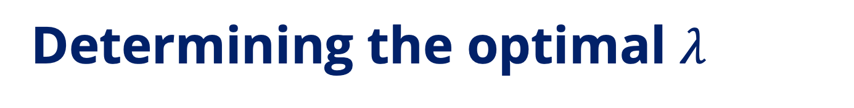

Determining the optimal $λ$
Lambda is a hyperparameter that should be optimized
Low values of lambda result in more complex models (more variables with higher coefficients) and high lambdas result in simpler models
The optimal lambda that minimizes error (MSE/MAE) can be found using a validation set or cross-validation
LASSO regression
$$λ$$

Slide 42
Conclusion: LASSO & Ridge
Applying regularization will often give us a better model when we are dealing with complex data (many features)
You might have a reason to prefer one method or the other:
Desire a simpler, more interpretable model -> LASSO
Complex relationship of target to many features with collinearity -> Ridge
If not sure, default to Ridge regression or evaluate both
Whichever one you choose, be sure to:
Scale the data before you begin
Determine the optimal lambda using a validation set / cross-validation

Slide 43
Wrapping up Linear Regression
For regression problems, linear regression is a great place to start
Establish a baseline for model performance
Better understand relationships between features and target
Be sure to visualize your data and residuals to identify problems / opportunities to improve fit
Use polynomial regression and/or regularization to improve fit
Use cross-validation to adjust hyperparameters (polynomial degree or lambda)
Then, try more advanced algorithms and compare results

