Slide 1
Time Series Week 4

Slide 2
http://classwise.org/student/quiz/4a03f4d9-0b33-4ba2-b399-f00e94f41b20

Slide 3
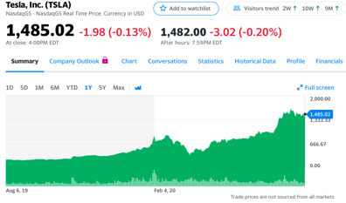
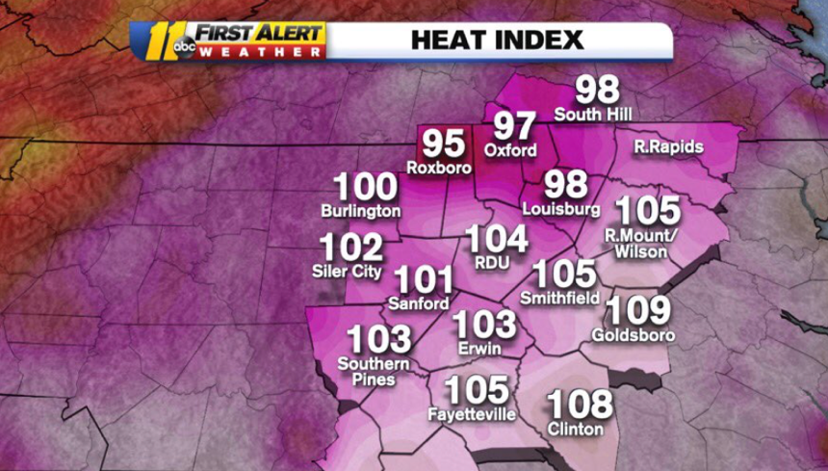
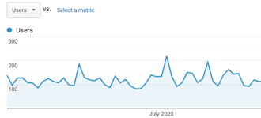
Time Series
A time series is a sequence of data points taken at successive equally spaced points in time
Has a natural temporal ordering to the observations
Time ordered data is not necessarily time series (e.g. medical records)
Most data from hardware/sensors is time series

Slide 4
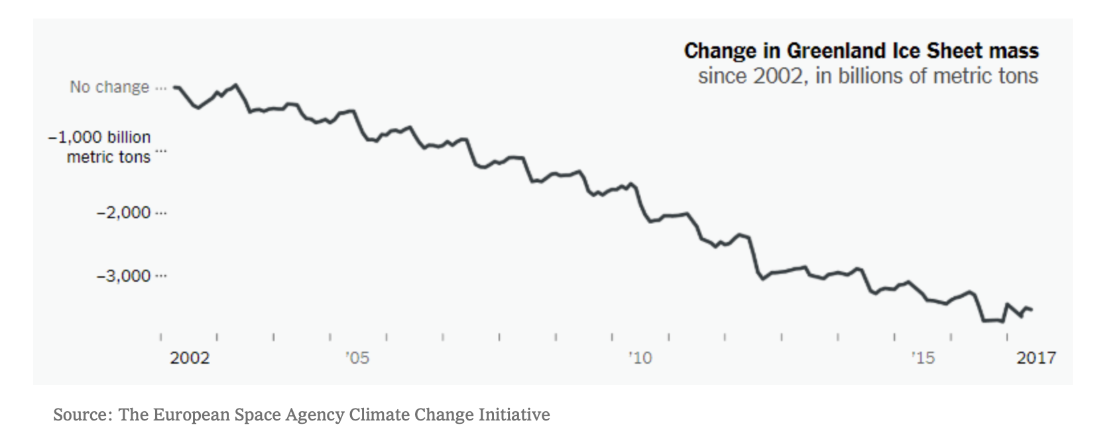
Trend and Seasonality
We can break time series down into two main components:
Trend: the long-term trend of the data
Seasonality: the cyclical fluctuations in the data

Slide 5
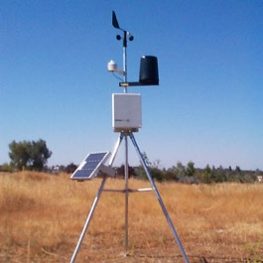
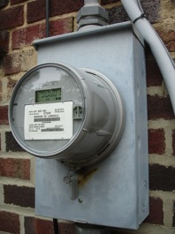

Seasonality
Data can have seasonality (periodicity) on multiple scales: hourly, daily, weekly, annually etc.
Temperature
Power Demand
Bookstore Sales

Slide 6
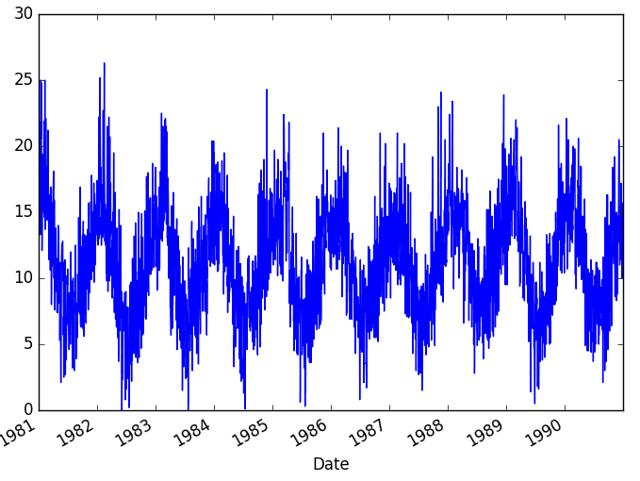
Time Series Modeling
A key assumption of regression models is that the X,y observations are independent of each other
This does not hold true with time series – present is correlated with the past
Key to modeling is to understand the patterns of correlation across time
Many modeling approaches: ARIMA, exponential smoothing, etc.

Slide 7
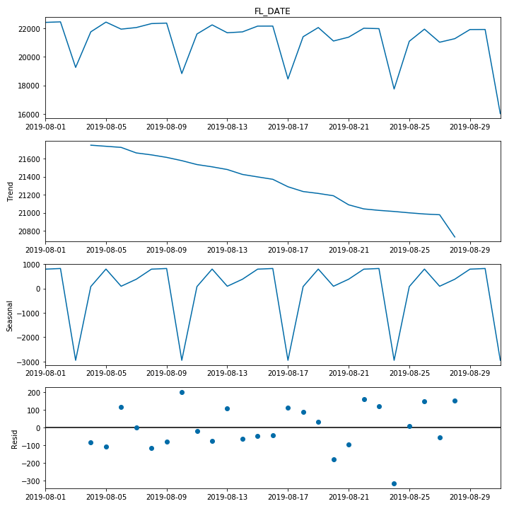


Time Series Decomposition
We can decompose a time series into three main components:
Trend
Seasonality
Residuals
They are combined using the additive or multiplicative model
Additive:
$$y_{t}=T_{t}+S_{t}+R_{t}$$
Multiplicative:
$$y_{t}=T_{t}∗S_{t}∗R_{t}$$

Slide 8
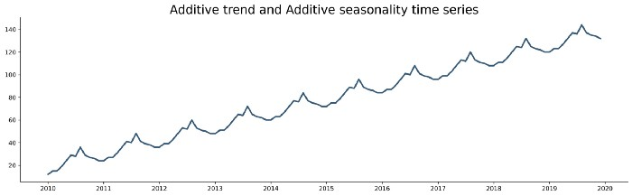
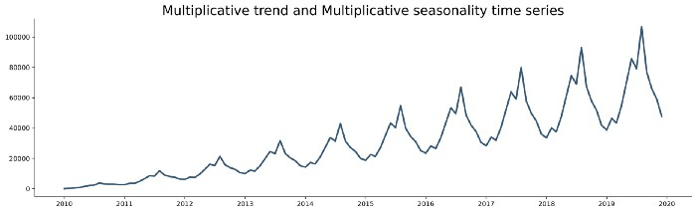


Additive vs. Multiplicative
Additive model:
Linear trend
Constant seasonal periods over time
Multiplicative model:
Non-linear trend
Width or height of seasonal periods changes over time
$$y_{t}=T_{t}+S_{t}+R_{t}$$
$$y_{t}=T_{t}∗S_{t}∗R_{t}$$

Slide 9
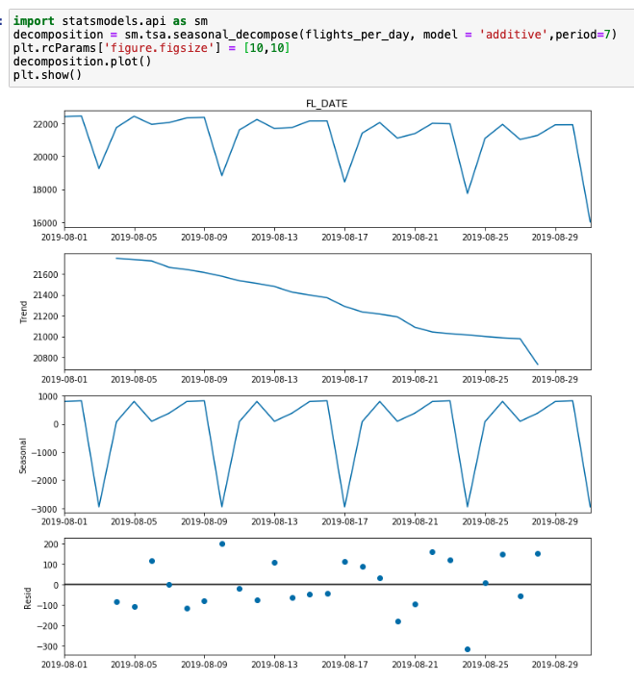
Decomposing Time Series
We can use the seasonal_decompose() function from the statsmodels package to decompose time series into their trend, seasonal, and residual components
We must select additive or multiplicative time series and input the estimated period
Be careful about automated time series decomposition
It may do well at identifying trend, but sometimes finds seasonal patterns that don’t really exist

Slide 10
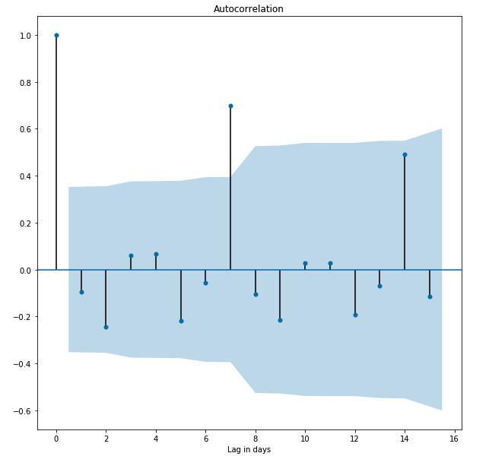
Autocorrelation
Autocorrelation is the correlation of a signal with a delayed (lagged) copy of itself
Detected using the Durbin-Watson test or using the Pearson correlation coefficient of the two series (actual and lagged)
Autocorrelation is an indicator of seasonality

Slide 11
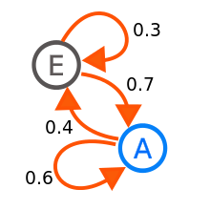
Markov Processes
A process with full autocorrelation with a lag = 1 is called a Markov process or a Markov chain
The current state depends only on the state attained at the previous timestep
A transition matrix specifies the probabilities of shifting between states
Markov models are used in the sciences, predicting stock market prices, and ranking web search results (PageRank)
https://en.wikipedia.org/wiki/Markov_chain

Slide 12
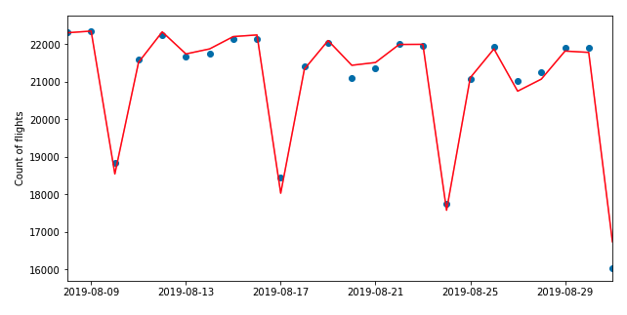
Autoregression Model
If we identify strong correlation with the past, we can build a model using the past values as features
This is called an autoregression model
We can create features using past data at one lag or multiple

Slide 13
Time series demo

Slide 14
Exercise

Slide 15
Project 1

Slide 16
Project 1 objective
Predict the hourly temperature measured at RDU airport for the period 12am September 17 – 11pm September 30’
Rules
Any data (other than ground truth)
Any inputs/features
Any model(s)
MUST include 1 linear regression model + 1 other model
Deliverables
Presentation: Inputs, data pipeline, features, models, eval approach, performance
Code repo
Writeup (2-4 pages): your approach to the problem, how you applied what we learned in class

