Slide 1
Modeling Process & Algorithms Week 5

Slide 2
https://classwise.org/student/quiz/89ef76e5-f054-4500-a4cc-1a4b5b5e67de

Slide 3
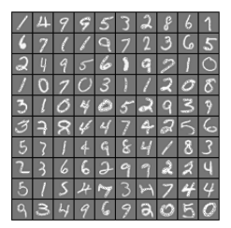

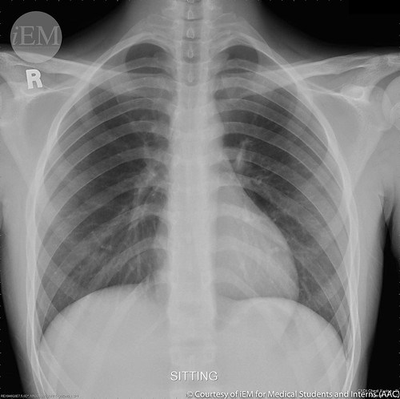
Classification
Classification models predict a categorical target:
Handwritten characters
Benign vs. malignant tumors
Type of lung disease
What word comes next in a sequence
We can have two (binary) or more classes
Classes can also be numerical in nature through binning:
Income in bins of $10k
Sales lead scoring 1-5
Unlike regression, classification models cannot extrapolate

Slide 4
Let’s Tackle a Classification Problem
We now want to predict a class (e.g. 0 or 1) rather than a numerical target
We could use linear regression to do so
1.0
Problems:
How do we interpret predictions between 0 and 1?
What about predictions greater than 1?
The linear regression will almost always predict the wrong value
0.8
0.6
y
0.4
0.2
0.0
.0
.1
.2
.3
.4
.5
.6
.7
.8
.9
1.0
x

Slide 5
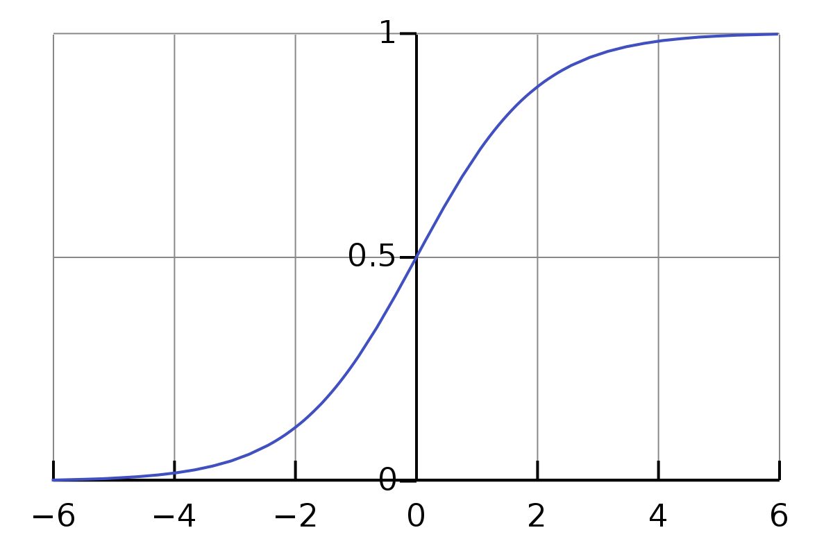
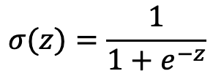
Solution: Predict the Probability y=1
Rather than predicting y, let’s predict the probability P(y=1), which falls between 0 and 1
We could use linear regression, but what do we do with predicted values <0 and >1?
A better option would be a function that predicts outputs between 0 and 1
One alternative: the sigmoid (logistic) function
$$σ(z)=\frac{1}{1+e^{−z}}$$
Source: Wikipedia

Slide 6



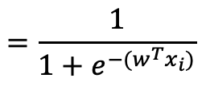





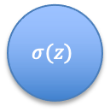

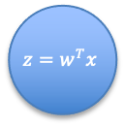



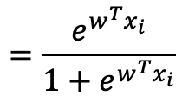


Solution: Predict the Probability y=1
We want the output of our model to be P(y=1)
We can use the sigmoid function to get outputs between 0 and 1
As input to the sigmoid function we provide the output of our linear regression (w₀+w₁x)
$$P\left(y_{i}=1\right)=σ\left(z_{i}\right)$$
$$=σ\left(w^{T}x_{i}\right)$$
$$=\frac{1}{1+e^{−(w^{T}x_{i})}}$$
X
$$1$$
$$w_{0}$$
$$=\frac{e^{w^{T}x_{i}}}{1+e^{w^{T}x_{i}}}$$
$$x_{1}$$
$$w_{1}$$
$$w_{2}$$
$$z=w^{T}x$$
$$z$$
$$σ(z)$$
$$x_{2}$$
$$P\left(y=1\right)=σ\left(w^{T}x_{i}\right)$$
$$w_{…}$$
$$…$$
$$w_{p}$$
$$x_{p}$$

Slide 7
Estimating the parameters
How do we estimate the parameters w₁,w₂…w_{p}?
Define our cost function J(w)
Find the weight/coefficient values that minimize the cost function
Calculate the gradient (derivative)
Set the gradient equal to 0
Solve for the coefficients
But this time it’s a bit trickier:
SSE is not convex for logistic regression
We can use a different cost function that is, but it has no closed form solution

Slide 8


Maximum likelihood estimation
Instead of SSE, we use maximum likelihood estimation to establish our cost function
Our logistic regression model gives us:
We now have an x-y relationship characterized by the parameters w
Our objective is to find the parameter set w which is the maximum likelihood estimator
Results in the highest likelihood - probability of observing the correct y₁, y_{2…} y_{N} given inputs x₁, x_{2…} x_{N}
$$P\left(y_{i}=1 | x_{i}\right)=σ\left(w^{T}x_{i}\right)$$
$$P\left(y_{i}=0 | x_{i}\right)=1−σ\left(w^{T}x_{i}\right)$$

Slide 9





Maximum likelihood estimation
The likelihood of our model for a single observation of x_{i},y_{i} is:
$P\left(y_{i}=1 | x_{i}\right)$ if $y_{i}=1$
combine
$$P\left(y_{i} | x_{i}\right)=$$
$$P\left(y_{i} | x_{i}\right)=P{\left(y_{i}=1 | x_{i}\right)}^{y_{i}}∗P{\left(y_{i}=0 | x_{i}\right)}^{{1−y}_{i}}$$
$P\left(y_{i}=0 | x_{i}\right)$ if $y_{i}=0$
And from our logistic regression model we have:
$$P\left(y_{i}=1 | x_{i}\right)=σ\left(w^{T}x_{i}\right)$$
$$P\left(y_{i}=0 | x_{i}\right)=1−σ\left(w^{T}x_{i}\right)$$
Combining the above we get the likelihood of one observation as:
$$P\left(y_{i} | x_{i}\right)=({σ\left(w^{T}x_{i}\right))}^{y_{i}}∗(1−{σ\left(w^{T}x_{i}\right))}^{{1−y}_{i}}$$

Slide 10
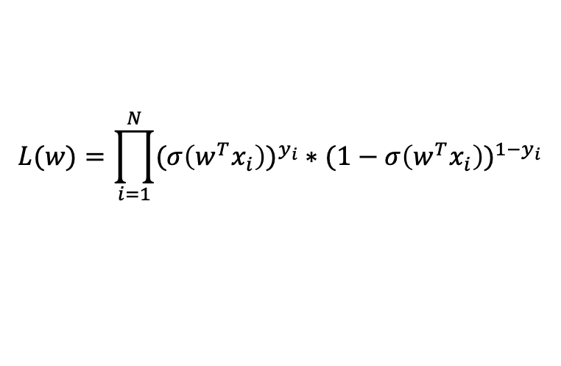
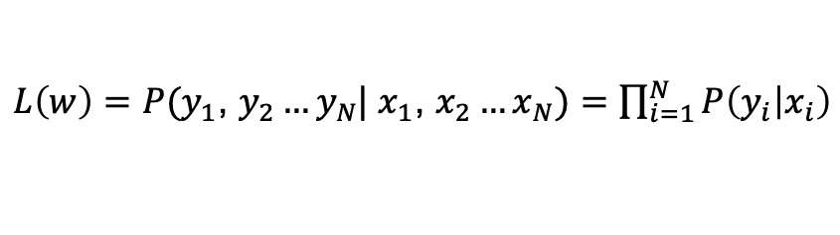
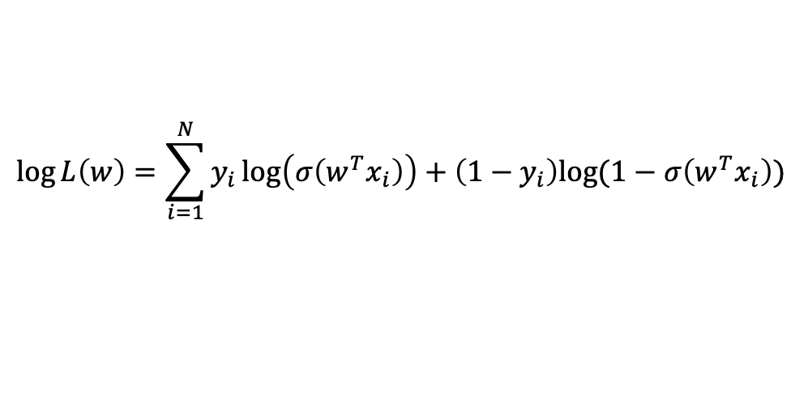
Maximum likelihood estimation
Now that we have the likelihood for one observation, we can get the likelihood for all observations:
$L\left(w\right)=P(y_{1}$, $y_{2}…y_{N}$| $x_{1}$, $x_{2}…x_{N})=\prod_{i=1}^{N}{P\left(y_{i} | x_{i}\right)}$
$$L(w)=\prod_{i=1}^{N}{({σ\left(w^{T}x_{i}\right))}^{y_{i}}∗(1−{σ\left(w^{T}x_{i}\right))}^{{1−y}_{i}}}$$
We want to find the parameter set w that maximizes this. However, it’s difficult to calculate the gradient (derivative) with respect to w so instead we maximize the log of it, called the log likelihood
$$\log{L\left(w\right)=\sum_{i=1}^{N}{y_{i}\log\left(σ\left(w^{T}x_{i}\right)\right)+\left(1−y_{i}\right)log(1−σ\left(w^{T}x_{i}\right))} }$$

Slide 11
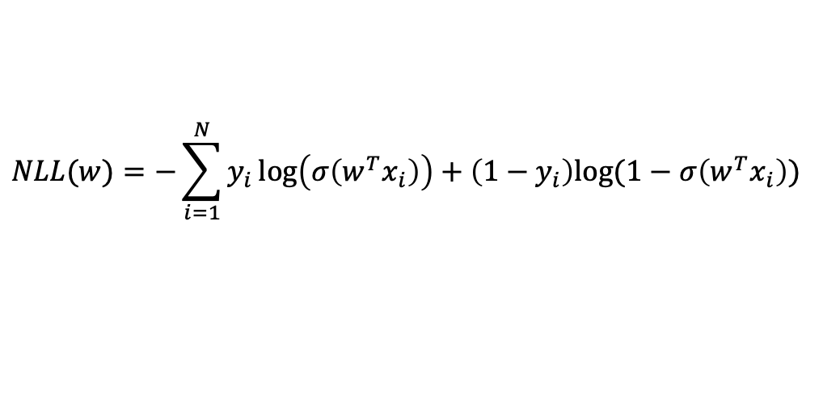
Maximum likelihood estimation
We can now maximize the log likelihood
Or alternatively we can minimize the negative log likelihood (NLL)
To be consistent with what we did in linear regression, we will use NLL as our cost function and find the w that minimizes it
However, there is no closed form solution so we need to use an iterative solving method for w
$$NLL(w)=−{\sum_{i=1}^{N}{y_{i}\log\left(σ\left(w^{T}x_{i}\right)\right)+\left(1−y_{i}\right)log(1−σ\left(w^{T}x_{i}\right))} }$$

Slide 12
Gradient Descent

Slide 13
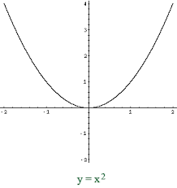
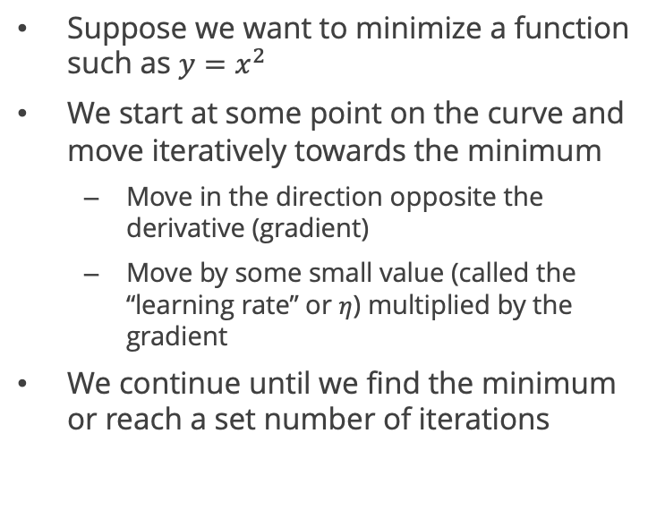
Gradient descent
Suppose we want to minimize a function such as $y=x^{2}$
We start at some point on the curve and move iteratively towards the minimum
Move in the direction opposite the derivative (gradient)
Move by some small value (called the “learning rate” or $η$) multiplied by the gradient
We continue until we find the minimum or reach a set number of iterations
Derivative points this way
We move the opposite way

Slide 14



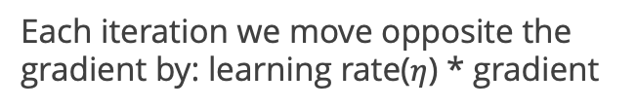


Gradient descent example
Let’s try to minimize
$$f(x)=x^{2}$$
Gradient:
$$∇f(x)=2x$$
Each iteration we move opposite the gradient by: learning rate($η$) * gradient
0
$$x_{i+1}=x_{i}−η∇f(x_{i})$$
2
1
3
$$y_{i+1}=x_{i+1}^{2}$$
i | x_{i} | y_{i}
0 | 1 | 1
1 | 0.8 | 0.64
2 | 0.64 | 0.410
3 | 0.512 | 0.262
Assume $η=0.1$and let’s start at x₀=1
$$x_{i+1}=x_{i}−0.1∗2x_{i}=x_{i}−0.2x_{i}=0.8x_{i}$$

Slide 15
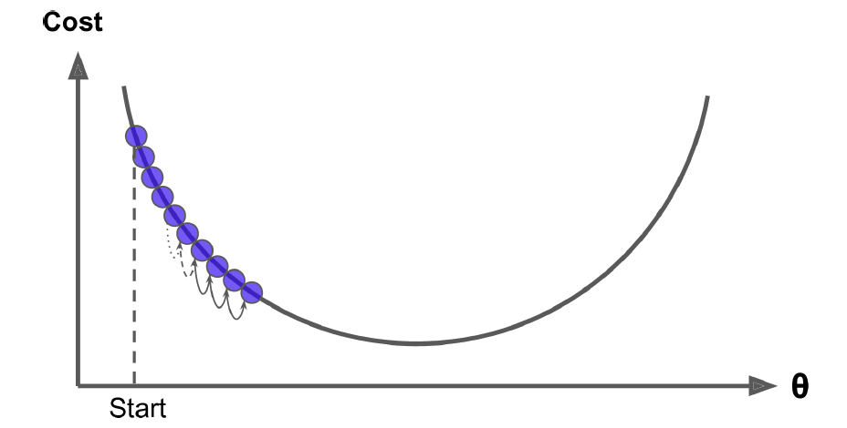
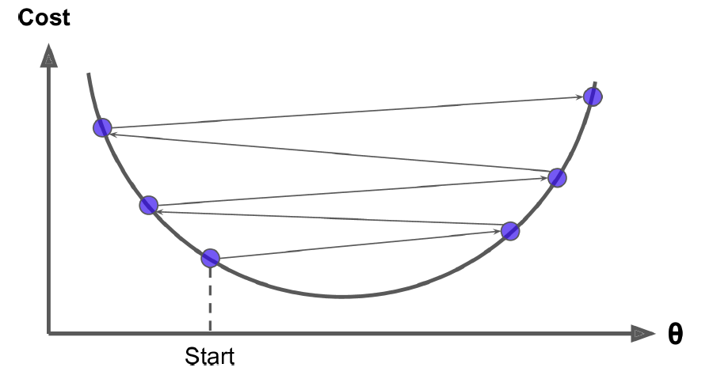
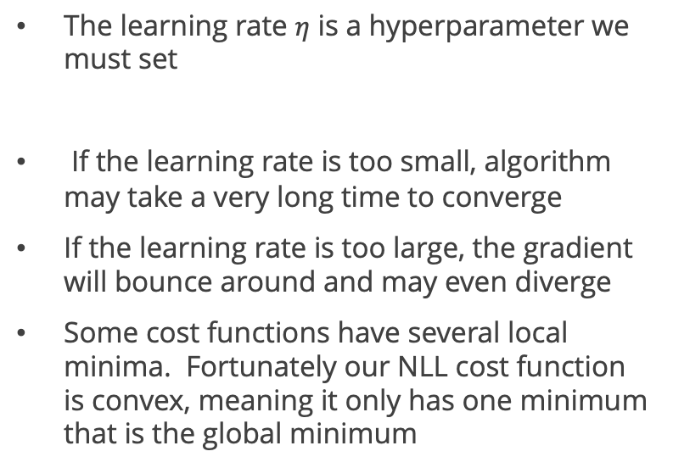

Learning rate
Learning rate too small
The learning rate $η$ is a hyperparameter we must set
If the learning rate is too small, algorithm may take a very long time to converge
If the learning rate is too large, the gradient will bounce around and may even diverge
Some cost functions have several local minima. Fortunately our NLL cost function is convex, meaning it only has one minimum that is the global minimum
$$x_{i+1}=x_{i}−η∇f(x_{i})$$
Learning rate too large
Source: “Hands—On Machine Learning with Scikit Learn & Tensorflow”

Slide 16
Gradient Descent demo

Slide 17
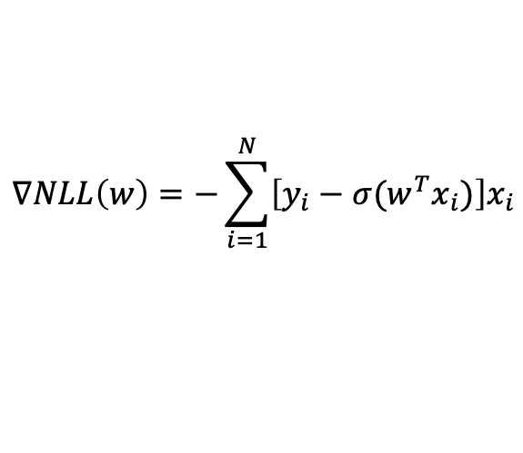
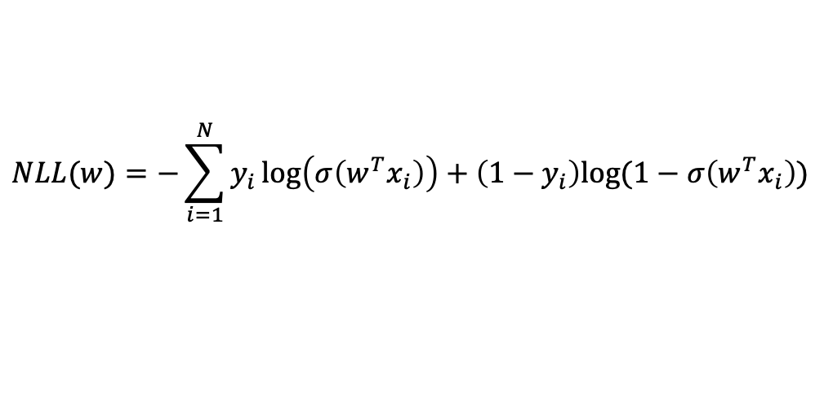
Batch gradient descent on NLL
Our cost function is the negative log likelihood (NLL):
$$NLL(w)=−{\sum_{i=1}^{N}{y_{i}\log\left(σ\left(w^{T}x_{i}\right)\right)+\left(1−y_{i}\right)log(1−σ\left(w^{T}x_{i}\right))} }$$
So our gradient is:
$$∇NLL\left(w\right)=−\sum_{i=1}^{N}{\left[y_{i}−σ(w^{T}x_{i})\right]x_{i}}$$

Slide 18

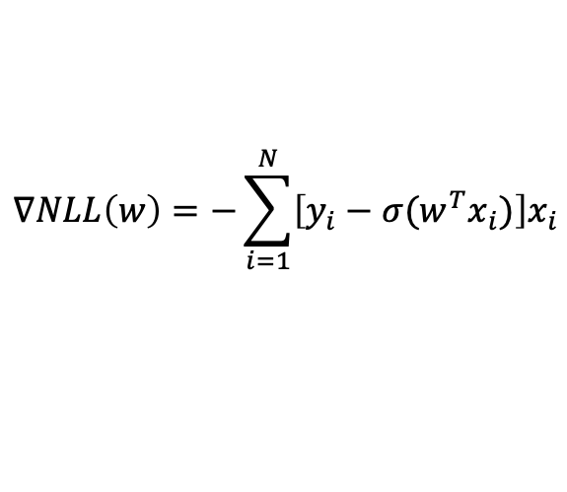
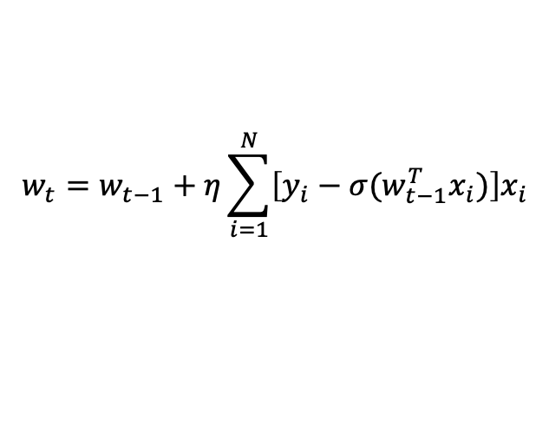
Batch gradient descent on NLL
Our gradient is:
$$∇NLL\left(w\right)=−\sum_{i=1}^{N}{\left[y_{i}−σ(w^{T}x_{i})\right]x_{i}}$$
Therefore, our gradient descent equation is:
$$w_{t}=w_{t−1}−η∇NLL$$
$$w_{t}=w_{t−1}+η\sum_{i=1}^{N}{\left[y_{i}−σ(w_{t−1}^{T}x_{i})\right]x_{i}}$$

Slide 19
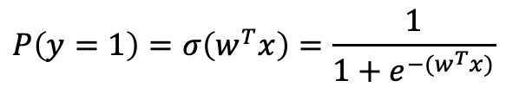
Recap so far
In logistic regression we use the logistic/sigmoid function to predict the probability of the positive class (y=1)
We calculate the likelihood of w and our cost function we seek to minimize is the negative log likelihood
We typically use gradient descent to find values of the parameters w that minimize the NLL
Then we have a model that can generate probabilistic predictions
We convert those probabilities into a 0/1 prediction by setting our threshold (default = 0.5)
$$P\left(y=1\right)=σ\left(w^{T}x\right)=\frac{1}{1+e^{−(w^{T}x)}}$$

Slide 20
Logistic regression in SKLearn
Scikit-learn makes it very easy for us to run a logistic regression classifier
Behind the scenes SKLearn uses an iterative solving method to get the parameters w
We can generate predictions in two ways:
model.predict(X) gives us 0/1 predictions
model.predict_proba(X) gives us the probabilities from 0 to 1
We then apply a threshold to convert to 0/1 predictions
We can also apply regularization just as we do in linear regression. In fact, SKLearn applies the L2 penalty (ridge) by default

Slide 21
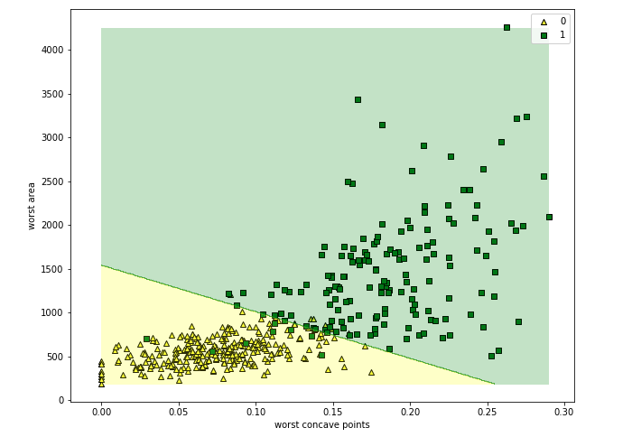
Decision boundary
Logistic regression is still considered a linear model
It is a linear combination of the coefficients w – no interactions between coefficients
We can plot its predictions vs. features and see that it forms a linear boundary separating each predicted class

Slide 22
What if we have more than two classes?

Slide 23

















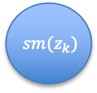
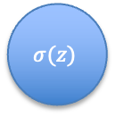





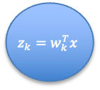

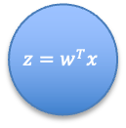



Predicting multiple classes
Logistic regression function gave us the probability of the positive class
But what if we have several classes – which one is “positive”?
We can use softmax regression to get a prediction for each class
Binary (2 classes)
Multiclass
$$P\left(y_{i}=1|x_{i}\right)=σ\left(w^{T}x\right)$$
$$P\left(y_{i}=k|x_{i}\right)=softmax\left(w_{k}^{T}x\right)$$
X
X
$$x_{0}$$
$$w_{0}$$
$$x_{0}$$
$$w_{k}^{0}$$
For each class k:
$$x_{1}$$
$$w_{1}$$
$$x_{1}$$
$$w_{k}^{1}$$
$$w_{2}$$
$$z=w^{T}x$$
$$z$$
$$σ(z)$$
$$z_{k}=w_{k}^{T}x$$
$$z_{k}$$
$sm(z_{k})$
$$x_{2}$$
$$P(y=1)$$
$$x_{2}$$
$$w_{k}^{2}$$
$$P(y=k)$$
$$w_{…}$$
$$w_{k}^{…}$$
$$…$$
$$…$$
$$w_{p}$$
$$w_{k}^{p}$$
$$x_{p}$$
$$x_{p}$$

Slide 24

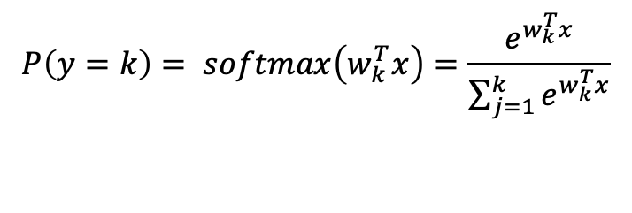



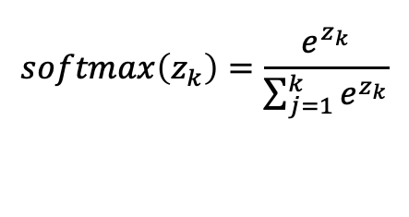



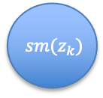


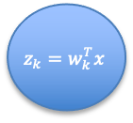


Softmax regression
In logistic regression we had a single set of weights w
In softmax regression we have a set of weights for each class: w_{k}
We multiple the weights by x to get a “score” z for each class
We then apply the softmax function to normalize the scores so that they sum to 1
X
For each class k:
$$x_{0}$$
$$w_{k}^{0}$$
$$x_{1}$$
$$w_{k}^{1}$$
$$w_{k}^{2}$$
$$z_{k}=w_{k}^{T}x$$
$$z_{k}$$
$sm(z_{k})$
$$x_{2}$$
$$P(y=k)$$
$$w_{k}^{…}$$
$$…$$
$$w_{k}^{p}$$
$$x_{p}$$
The “prediction” is the class with the highest score, or all scores above a threshold
$$softmax\left(z_{k}\right)=\frac{e^{z_{k}}}{\sum_{j=1}^{k}{e^{z_{k}}}}$$
$$P\left(y=k\right)= softmax\left(w_{k}^{T}x\right)=\frac{e^{w_{k}^{T}x}}{\sum_{j=1}^{k}{e^{w_{k}^{T}x}}}$$

Slide 25






































Softmax regression
X
$$x_{0}$$
$$w_{k}^{0}$$
k = “dog”
$$x_{1}$$
$$w_{k}^{1}$$
$$w_{k}^{2}$$
$$z_{dog}=w_{k}^{T}x$$
$$z_{k}$$
$$softmax$$
$$(z_{dog})$$
Dog: 0.9
$$x_{2}$$
$$P(y=“dog”)$$
$$…$$
$$w_{k}^{…}$$
$$w_{k}^{p}$$
$$x_{p}$$
X
$$x_{0}$$
$$w_{k}^{0}$$
k = “cat”
$$x_{1}$$
$$w_{k}^{1}$$
$$w_{k}^{2}$$
$$z_{cat}=w_{k}^{T}x$$
$$z_{k}$$
$$softmax$$
$$(z_{cat})$$
$$x_{2}$$
$$P(y=“cat”)$$
Cat: 0.05
$$…$$
$$w_{k}^{…}$$
$$w_{k}^{p}$$
$$x_{p}$$
X
$$x_{0}$$
$$w_{k}^{0}$$
k = “bear”
$$x_{1}$$
$$w_{k}^{1}$$
$$w_{k}^{2}$$
$$z_{bear}=w_{k}^{T}x$$
$$z_{k}$$
$$softmax$$
$$(z_{bear})$$
Bear: 0.05
$$x_{2}$$
$$P(y=“bear”)$$
$$…$$
$$w_{k}^{…}$$
$$w_{k}^{p}$$
$$x_{p}$$

Slide 26

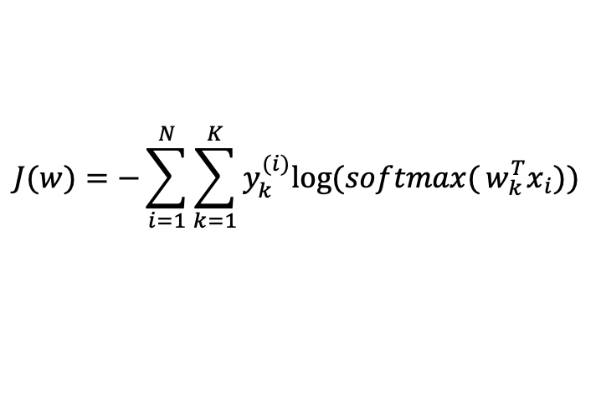
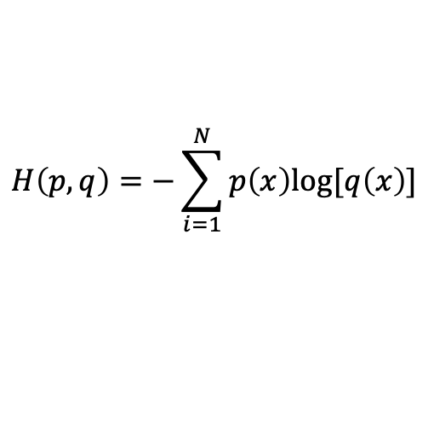
Softmax regression
In softmax regression we use cross entropy as the cost function instead of negative log likelihood as we did for logistic regression
$$H\left(p,q\right)=−\sum_{i=1}^{N}{p\left(x\right)log⁡[q\left(x\right)]}$$
$$J(w)=−{\sum_{i=1}^{N}{\sum_{k=1}^{K}{y_{k}^{(i)}log⁡(softmax(}}w_{k}^{T}x_{i}))}$$
$y_{k}^{(i)}$ is the probability that the i^{th} instance belongs to class k (0 or 1)
When there are just 2 classes, we can show that the above cost function is equivalent to negative log likelihood
As in logistic regression, we solve for w that minimizes this using gradient descent. We can then apply our model and take the class with the highest probability as the predicted class

Slide 27
K Nearest Neighbors

Slide 28
K Nearest Neighbors
x₂
k = 1
One very simple way we can predict the class of a new datapoint is by assigning it the same class as the closest training point (nearest neighbor)
A more robust method would be to take the majority vote over the k nearest points (“K Nearest Neighbors”)
K is a hyperparameter we can set
x₁

Slide 29
K Nearest Neighbors
x₂
k = 3
One very simple way we can predict the class of a new datapoint is by assigning it the same class as the closest training point (nearest neighbor)
A more robust method would be to take the majority vote over the k nearest points (“K Nearest Neighbors”)
K is a hyperparameter we can set
x₁

Slide 30
K Nearest Neighbors
We have a few important choices to make
The number and selection of dimensions
The distance/similarity function (e.g. Euclidian distance, cosine similarity etc)
The choice of k

Slide 31
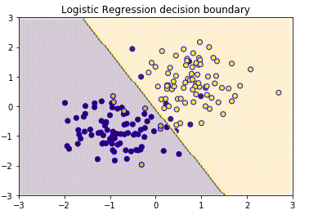
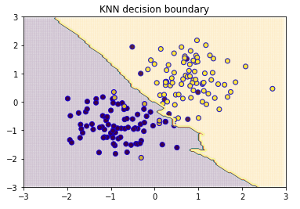
K Nearest Neighbors
KNN can perform better than other algorithms (e.g. logistic regression) when the relationship is highly non-linear
While it often performs decently, it is rarely the “best” and is easy to overfit using a small value for k
It is also computationally/memory intensive

Slide 32



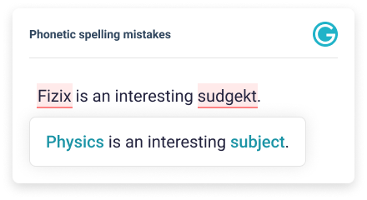
Nearest Neighbor Search
While KNN is not commonly used for prediction, we often use nearest neighbor search:

Slide 33
Support Vector Machines

Slide 34

Support Vector Machines
SVM is an algorithm that can be used for both regression and classification
We more often find it in use for classification problems
Historically it has been one of the most popular algorithms, but more recently has been largely replaced by neural networks
Image source: https://www.classcentral.com/course/support-vector-machines-scikit-learn-19237

Slide 35
History
Pre 1980:
Almost all statistical learning methods learned linear decision boundaries
Theoretically nice but not powerful on real-world problems
1980s
Decision trees and neural networks enabled efficient learning of non-linear decision boundaries
However, they lacked a strong theoretical foundation and suffered from overfitting (local minima)
1990s
Developed efficient learning methods for non-linear functions with stronger generalization capabilities and strong theoretical foundation

Slide 36
Innovations of SVM
Use of non-linear transformations (“kernel functions”) to separate non-linear regions
Formulation of a convex optimization problem to avoid the local minima issues with neural networks
Net result: allowed us to efficiently model non-linear relationships and highly complex feature sets e.g. basic computer vision

Slide 37
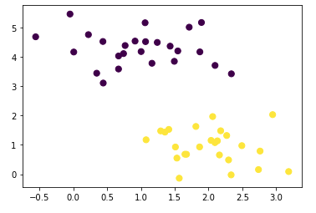
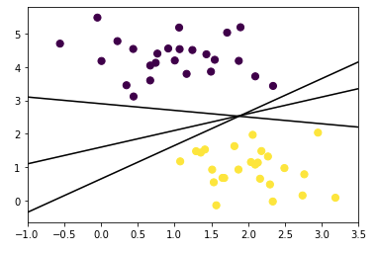
Support Vector Classifiers
Suppose we have two classes and our goal is to draw a line to separate them
But there are often many possible lines we can draw to separate them – which one should we choose?

Slide 38
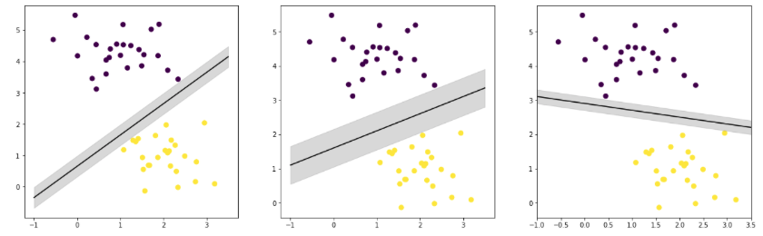

Support Vector Classifiers
One option is to choose the one that separates the classes by the widest margin
We draw a margin from our line to the nearest point of each class
The line with the largest margin is selected as the optimal model

Slide 39
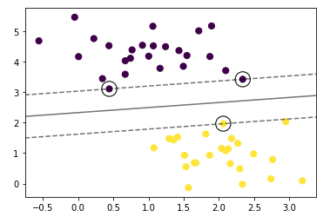
What are support vectors?
The points which touch the margin are called the “support vectors”
They are the most difficult points to classify
Only the support vectors influence the fit of the model
Points further out from the margin do not make a difference, because they do not contribute to the cost function

Slide 40
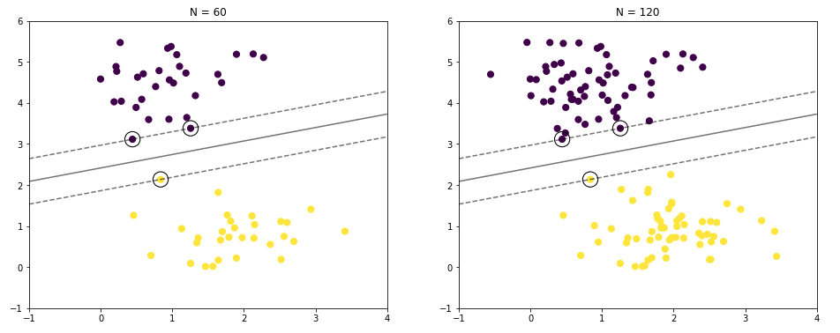
What are support vectors?
Even though we have a different number of points, in both cases the same 3 points determine the margin
Thus, the model is exactly the same in both cases

Slide 41

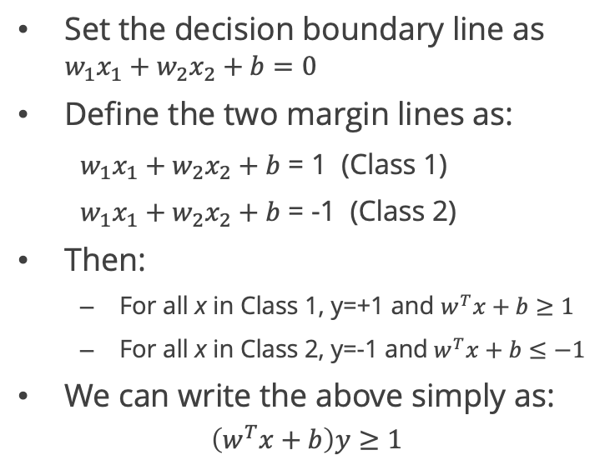


Building the SVC model
x₂
Set the decision boundary line as $w_{1}x_{1}+w_{2}x_{2}+b=0$
Define the two margin lines as:
$w_{1}x_{1}+w_{2}x_{2}+b$ = 1 (Class 1)
$w_{1}x_{1}+w_{2}x_{2}+b$ = -1 (Class 2)
Then:
For all x in Class 1, y=+1 and $w^{T}x+b≥1$
For all x in Class 2, y=-1 and${ w}^{T}x+b≤−1$
We can write the above simply as:
$$\left(w^{T}x+b\right)y≥1$$
H₁
H₀
H₂
Class 1:
y = +1
$$w_{1}x_{1}+w_{2}x_{2}+b=1$$
Class 2:
y = -1
$$w_{1}x_{1}+w_{2}x_{2}+b=0$$
$$w_{1}x_{1}+w_{2}x_{2}+b=−1$$
x₁

Slide 42
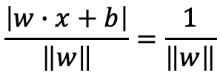
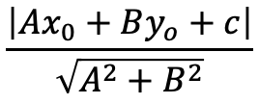

How to calculate the margin?
The distance from a point (x_{o},y_{o}) to a line Ax + By + c = 0 is:
Therefore, the distance between H₀ and H₁ is:
So the total distance between H₁ and H₂ is:
$$\frac{\left|Ax_{0}+By_{o}+c\right|}{\sqrt{A^{2}+B^{2}}}$$
$$\frac{\left|w∙x+b\right|}{\left\|w\right\|}=\frac{1}{\left\|w\right\|}$$
$$\frac{2}{\left\|w\right\|}$$

Slide 43
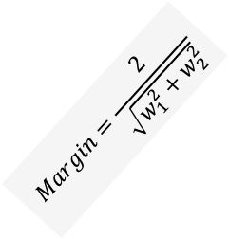

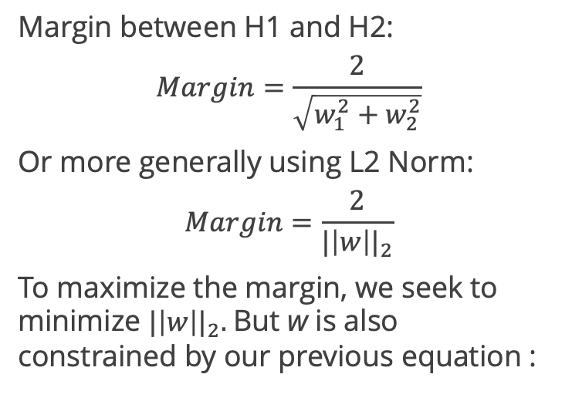



Building the SVC model
x₂
Margin between H1 and H2:
$$Margin=\frac{2}{\sqrt{w_{1}^{2}+w_{2}^{2}}}$$
Or more generally using L2 Norm:
$$Margin=\frac{2}{{|\left|w\right||}_{2}}$$
To maximize the margin, we seek to minimize ${|\left|w\right||}_{2}.$But w is also constrained by our previous equation :
$$Margin=\frac{2}{\sqrt{w_{1}^{2}+w_{2}^{2}}}$$
Class 1:
y = +1
$$w_{1}x_{1}+w_{2}x_{2}+b=1$$
Class 2:
y = -1
$$w_{1}x_{1}+w_{2}x_{2}+b=0$$
$$w_{1}x_{1}+w_{2}x_{2}+b=−1$$
$$\left(w^{T}x+b\right)y≥1$$
x₁

Slide 44

Building the SVC model
Now we have a constrained optimization problem:
$${Minimize |\left|w\right||}_{2}$$
$$subject to:\left(w^{T}x+b\right)y≥1$$
$$for every (x,y)$$
This is a convex constrained optimization problem, meaning there is a single global minimum that we can find
When we solve for the optimal w that satisfies the constraint, we have the coefficients of our decision boundary and can use it for predictions

Slide 45
Soft Margin SVC
Decision boundary A
x₂
What if the data is not perfectly separable by a line?
We allow some misclassification or points within the margins
We seek the best balance between a wide separation margin and a low total misclassification error on the training set
Which decision boundary is more likely to generalize better – A or B?
Decision boundary B
Class 1:
y = +1
Class 2:
y = -1
x₁

Slide 46

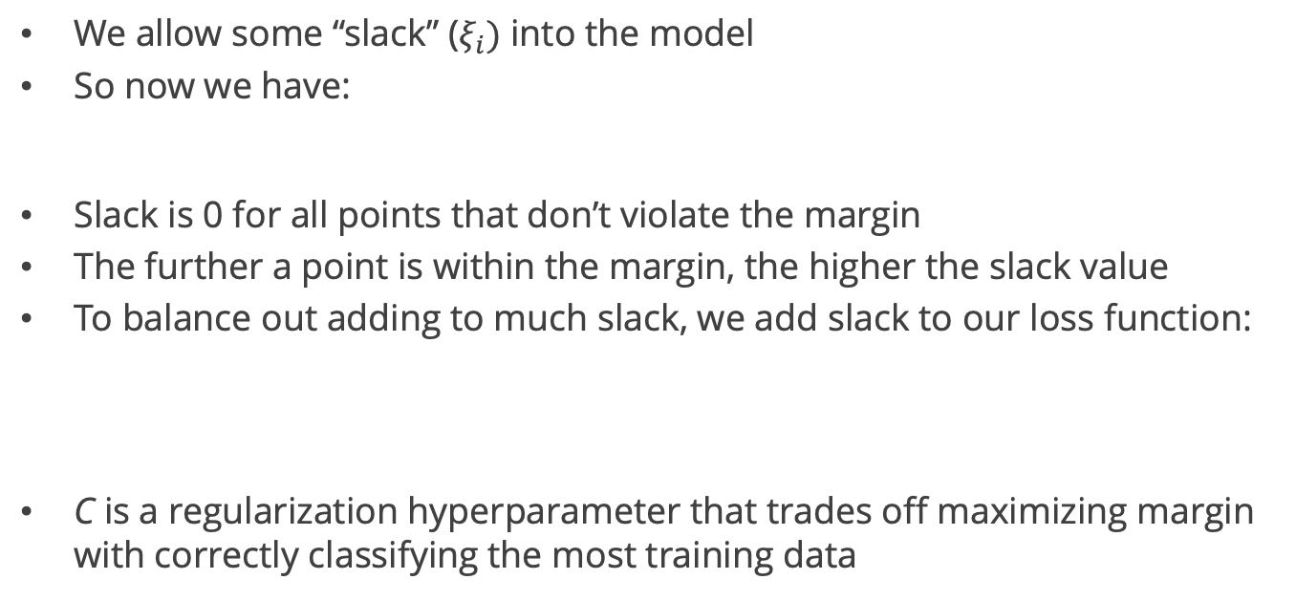
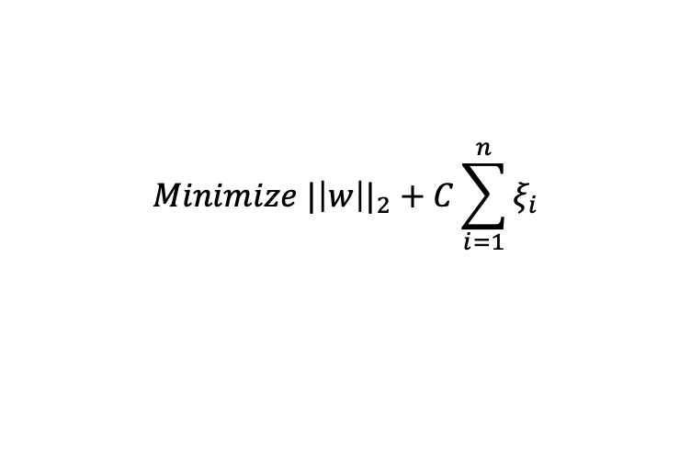
Soft margin SVC
We allow some “slack” ($ξ_{i})$ into the model
So now we have:
Slack is 0 for all points that don’t violate the margin
The further a point is within the margin, the higher the slack value
To balance out adding to much slack, we add slack to our loss function:
C is a regularization hyperparameter that trades off maximizing margin with correctly classifying the most training data
$\left(w^{T}x+b\right)y≥1−ξ_{i}$ for all i
$${Minimize |\left|w\right||}_{2}+C\sum_{i=1}^{n}{ξ_{i}}$$

Slide 47
Soft margin SVC
 | Small C | Large C
Objective | Maximize margin | Minimize misclassification of training datapoints
Risk | Underfitting (misclassifies much of the training data) | Overfitting (fits well on training data but does not generalize)
Outliers | Less sensitive | Very sensitive

Slide 48
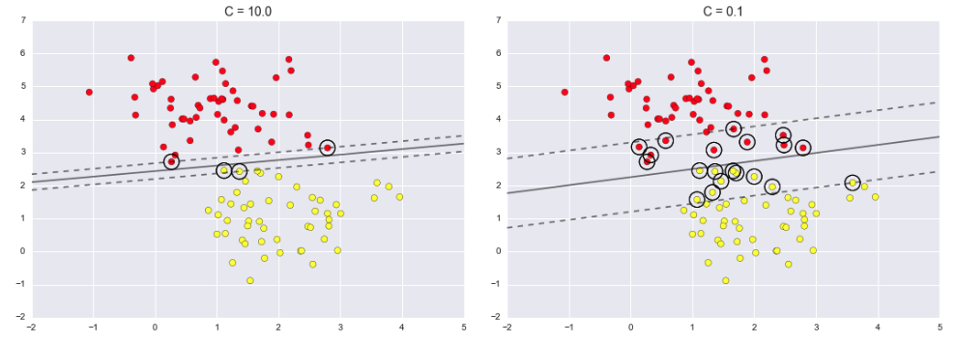
Soft Margin SVC
This balance in SKLearn is controlled by a hyperparameter C:
Think of 1/C as a “budget” for # of training points we are willing to misclassify
Large C: smaller margin but less misclassification in training set (more complex)
Small C: wider margin but higher misclassification error in training (less complex)

Slide 49

Nonlinear SVC
Similar to what we did in Polynomial Regression, we can use the “kernel trick” to map data into a higher-dimensional space where they are linearly separable
Polynomial kernel applies a polynomial transformation of degree n
Polynomial kernel
Image source: https://towardsdatascience.com/svm-kernels-what-do-they-actually-do-56ce36f4f7b8

Slide 50

Polynomial kernels
Image source: https://people.eecs.berkeley.edu/~jrs/189/lec/04.pdf

Slide 51

Polynomial kernels
Image source: https://people.eecs.berkeley.edu/~jrs/189/lec/04.pdf

Slide 52

Radial basis function kernel
We can choose a “landmark” and create a feature representing each point’s distance from the landmark
RBF kernel
Image source: https://web.mit.edu/6.034/wwwbob/svm.pdf

Slide 53



SVC in Scikit Learn
Standardize/scale data first!
Instantiate a SVC instance
Select kernel
Select degree (if polynomial kernel)
Set value for C (balance between wide margin and misclassification for training data)
Can select kernel and C value through cross-validation
Linear kernel:
Polynomial kernel:
Radial basis function kernel:

Slide 54

Platt Scaling
One significant disadvantage of SVCs is that they only produce discrete class predictions
We can get probabilistic predictions using Platt Scaling
Fit a logistic regression model using the SVC function predictions as input
We add coefficients A and B which are learned

Slide 55
SVC pros and cons
Advantages
Disadvantages
Highly flexible due to kernel choices and regularization hyperparameter (C)
Work well in high-dimensional spaces (computer vision, text)
Convex optimization problem – efficient solving methods
Often outperformed by other models (random forests or neural networks)
Difficult to train on large datasets (with kernel)
No inherent probabilistic output – created via post-processing
SVMs generally work well on “short and fat” datasets

