Slide 1
Week 6
Natural Language Processing I

Slide 2
NLP Module
This Week:
Introduction, NLP Neural Networks, Implementation
Next Week:
NLP Applications, Transformers, Advanced Topics (LLMs)

Slide 3
Agenda
Introduction to Natural Language Processing
Tasks, Challenges, & Applications
Text Preprocessing
Traditional Approaches
NLP Neural Networks
Word Embeddings (Word2Vec)
Recurrent Neural Networks
LSTM and GRU architectures
NLP Implementation

Slide 4


Introduction to Natural Language Processing
Image Source: nadi borodina, Surendran MP
Notes:
Photo by nadi borodina on Unsplash
Photo by Surendran MP on Unsplash

Slide 5
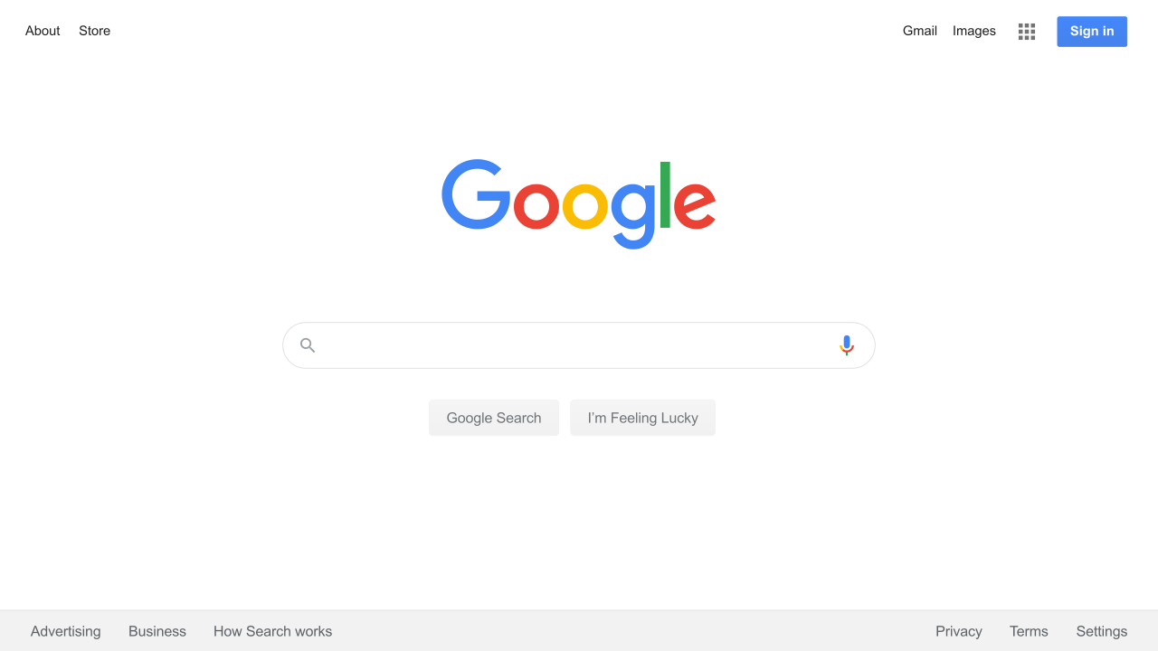
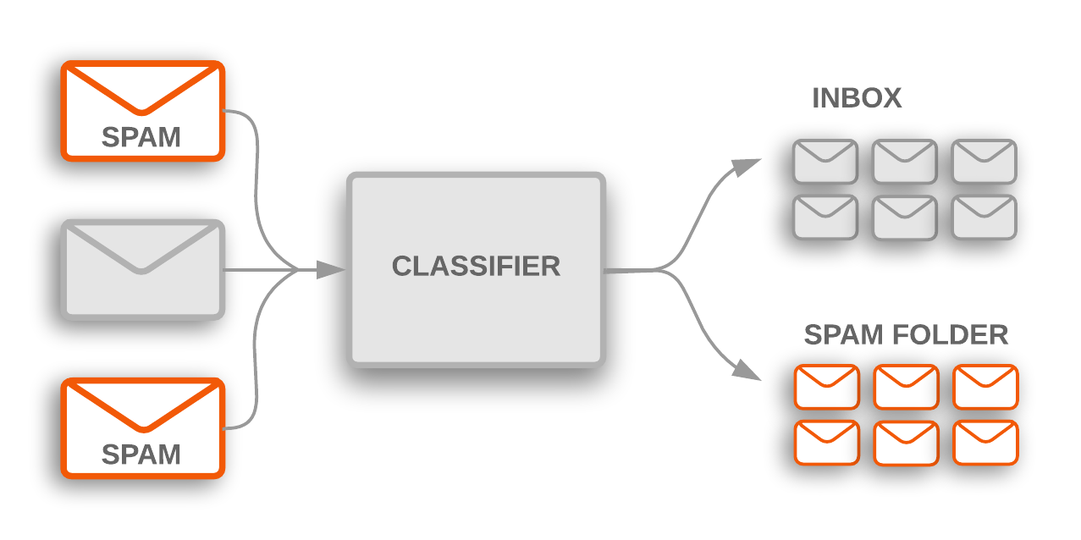
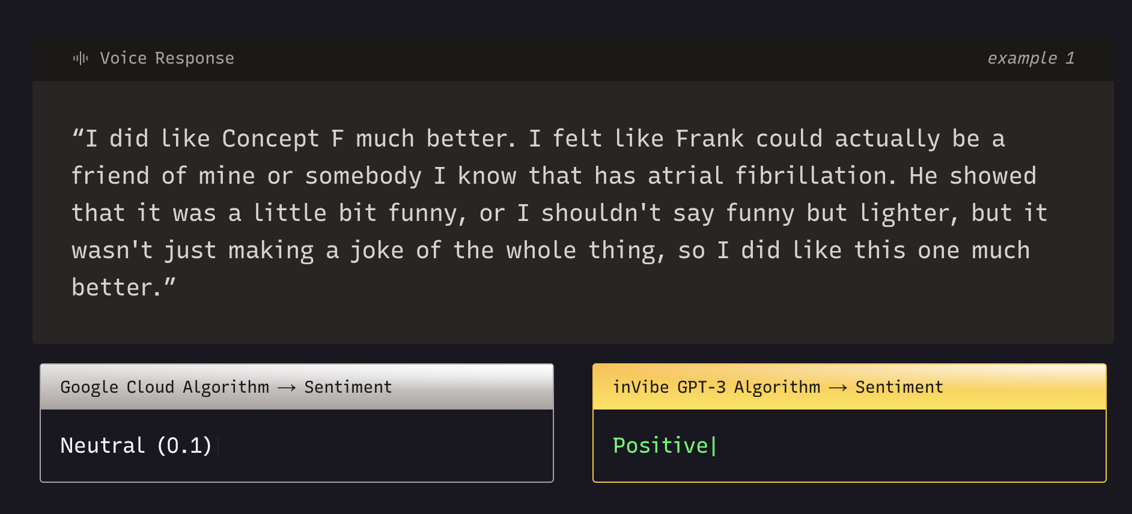

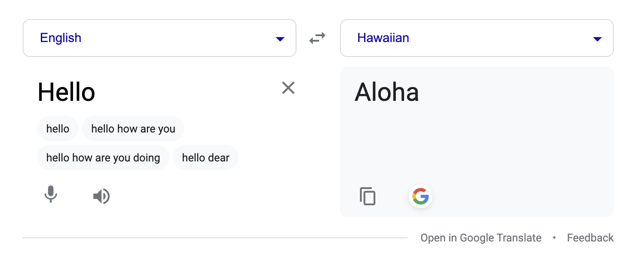
Overview
Search
Search within app
Search Engines (ie Google, Bing)
Machine Translation
Google Translate
Translation Apps
Text Classification
Spam tagging
Sorting articles
Sentiment Analysis
Market Research
Behavioral studies
Social media analysis
Text Similarity
Plagiarism checkers
Notes:
https://www.aclu-mn.org/en/news/biased-technology-automated-discrimination-facial-recognition
Infinity AI
https://mphy0026.readthedocs.io/en/latest/segmentation/segmentation_methods.html
https://medium.com/@kalidrafts/exploring-basketball-spacing-through-computer-vision-broadcast-data-cdff8a118c4f

Slide 6
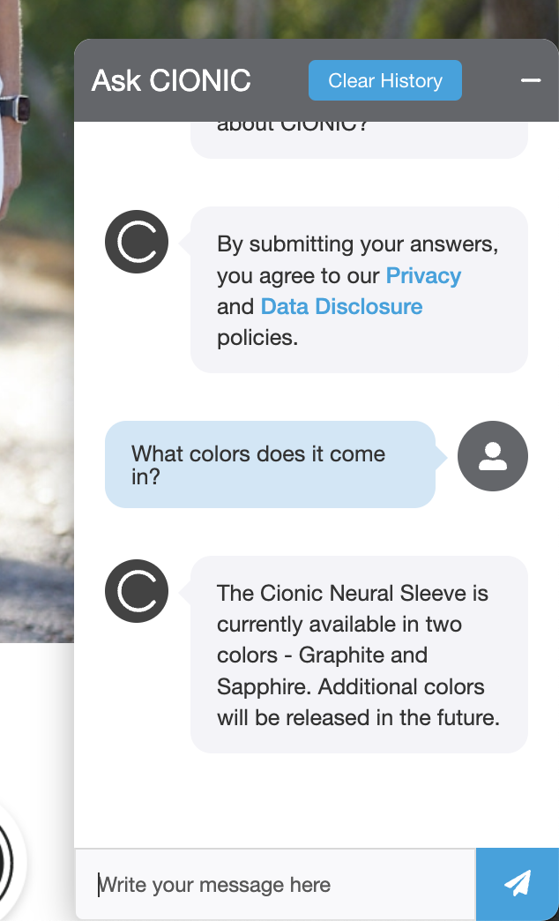
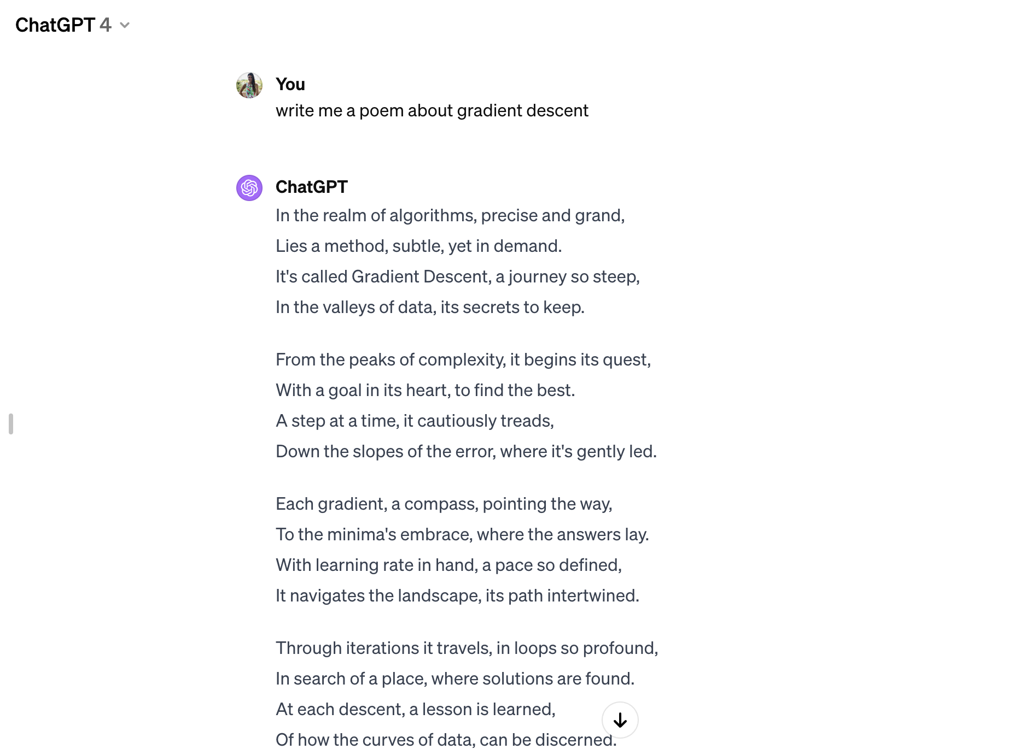
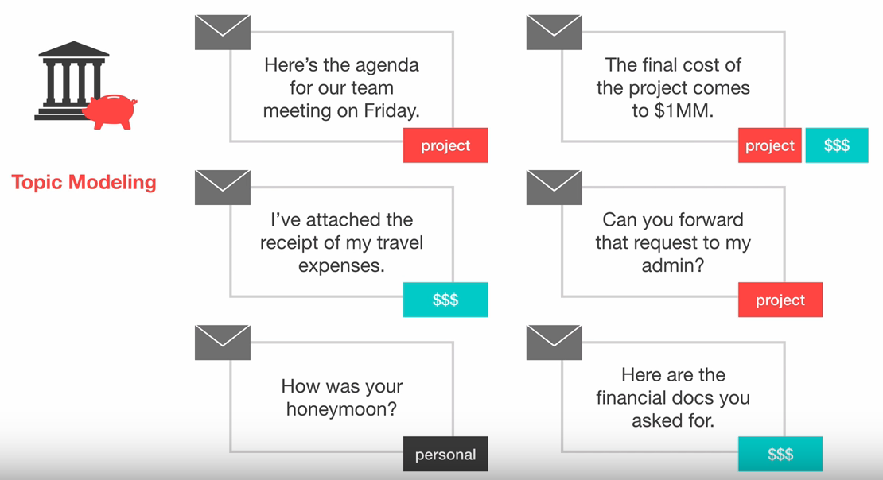
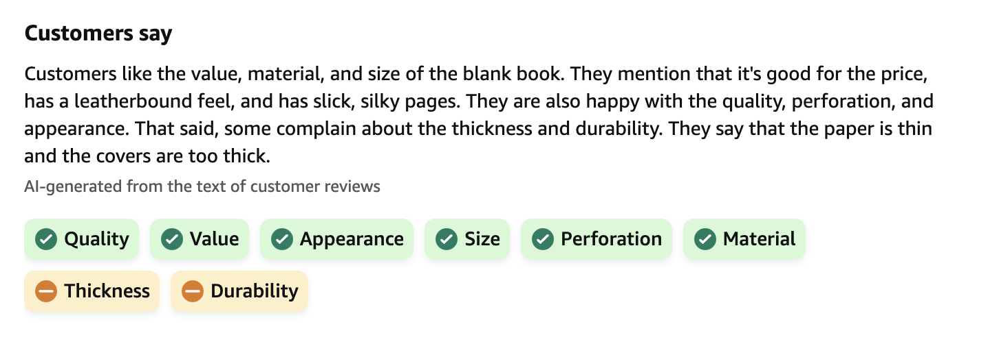
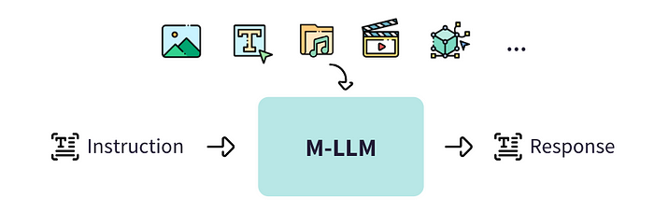
Overview
Topic Modeling
Auto-tag web articles
Attributes in product reviews
Q&A
Chatbots
Text Summarization
Amazon Review Summaries
Text Generation
ChatGPT, Claude, Gemini
Multimodal (NLP+)
Applications combining text and images (or other modalities)
Multimodal LLMs
Notes:
https://devopedia.org/topic-modelling
Infinity AI
https://mphy0026.readthedocs.io/en/latest/segmentation/segmentation_methods.html
https://medium.com/@kalidrafts/exploring-basketball-spacing-through-computer-vision-broadcast-data-cdff8a118c4f

Slide 7
Representing Text
bank of the river
[34, 56, 24, ….. 23, 56]

Slide 8
Representing Text
bank of the river
[34, 56, 24, ….. 23, 56]
deposited money at the bank
[51, 22, 19, ….. 40, 95]

Slide 9
Challenges
bank of the river
[34, 56, 24, ….. 23, 56]
deposited money at the bank
[51, 22, 19, ….. 40, 95]
Words with different meanings (homonyms)

Slide 10
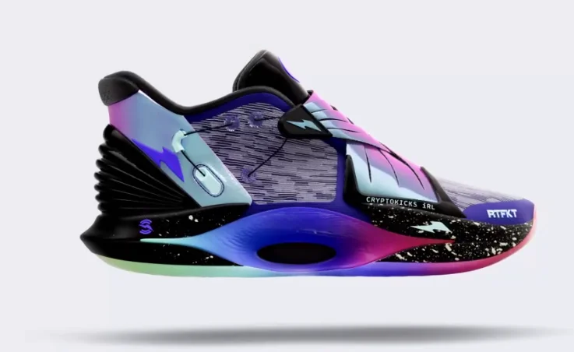
Challenges
Words with different meanings (homonyms)
Words with the same meaning (synonyms)
Sneakers, running shoes, tennis shoes

Slide 11

Challenges
Words with different meanings (homonyms)
Words with the same meaning (synonyms)
Observations are not independent. History matters.
The dog ate the bone. It tasted good.
Image Source: Karin Hiselius
Notes:
Photo by Karin Hiselius on Unsplash

Slide 12


Challenges
Words with different meanings (homonyms)
Words with the same meaning (synonyms)
Observations are not independent. History matters.
Semantic Ambiguity
I saw the boy on the beach with my binoculars
Image Source: Jen Theodore, Shane Dawson
Notes:
Photo by Jen Theodore on Unsplash
Photo by Shane Dawson on Unsplash

Slide 13
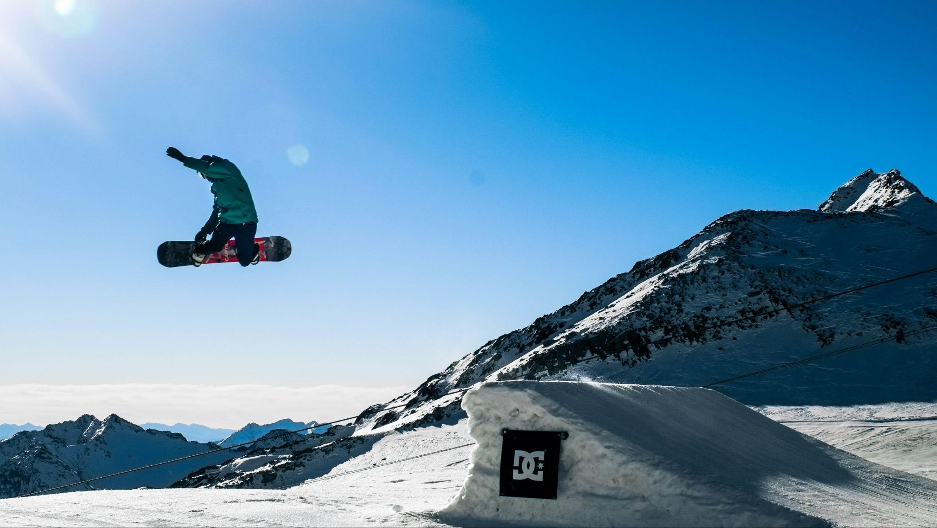
Challenges
Words with different meanings (homonyms)
Words with the same meaning (synonyms)
Observations are not independent. History matters.
Semantic Ambiguity
Slang/colloquialisms
That snowboarder did a sick jump
Image Source: Markos Mant
Notes:
Photo by Markos Mant on Unsplash

Slide 14
Challenges
Words with different meanings (homonyms)
Words with the same meaning (synonyms)
Observations are not independent. History matters.
Semantic Ambiguity
Slang/colloquialisms
Acronyms
Master of Engineering in AI

Slide 15
Challenges
Words with different meanings (homonyms)
Words with the same meaning (synonyms)
Observations are not independent. History matters.
Semantic Ambiguity
Slang/colloquialisms
Acronyms
Variable length sequences
Sentences have different numbers of words. So do documents! Do they? Yes.

Slide 16
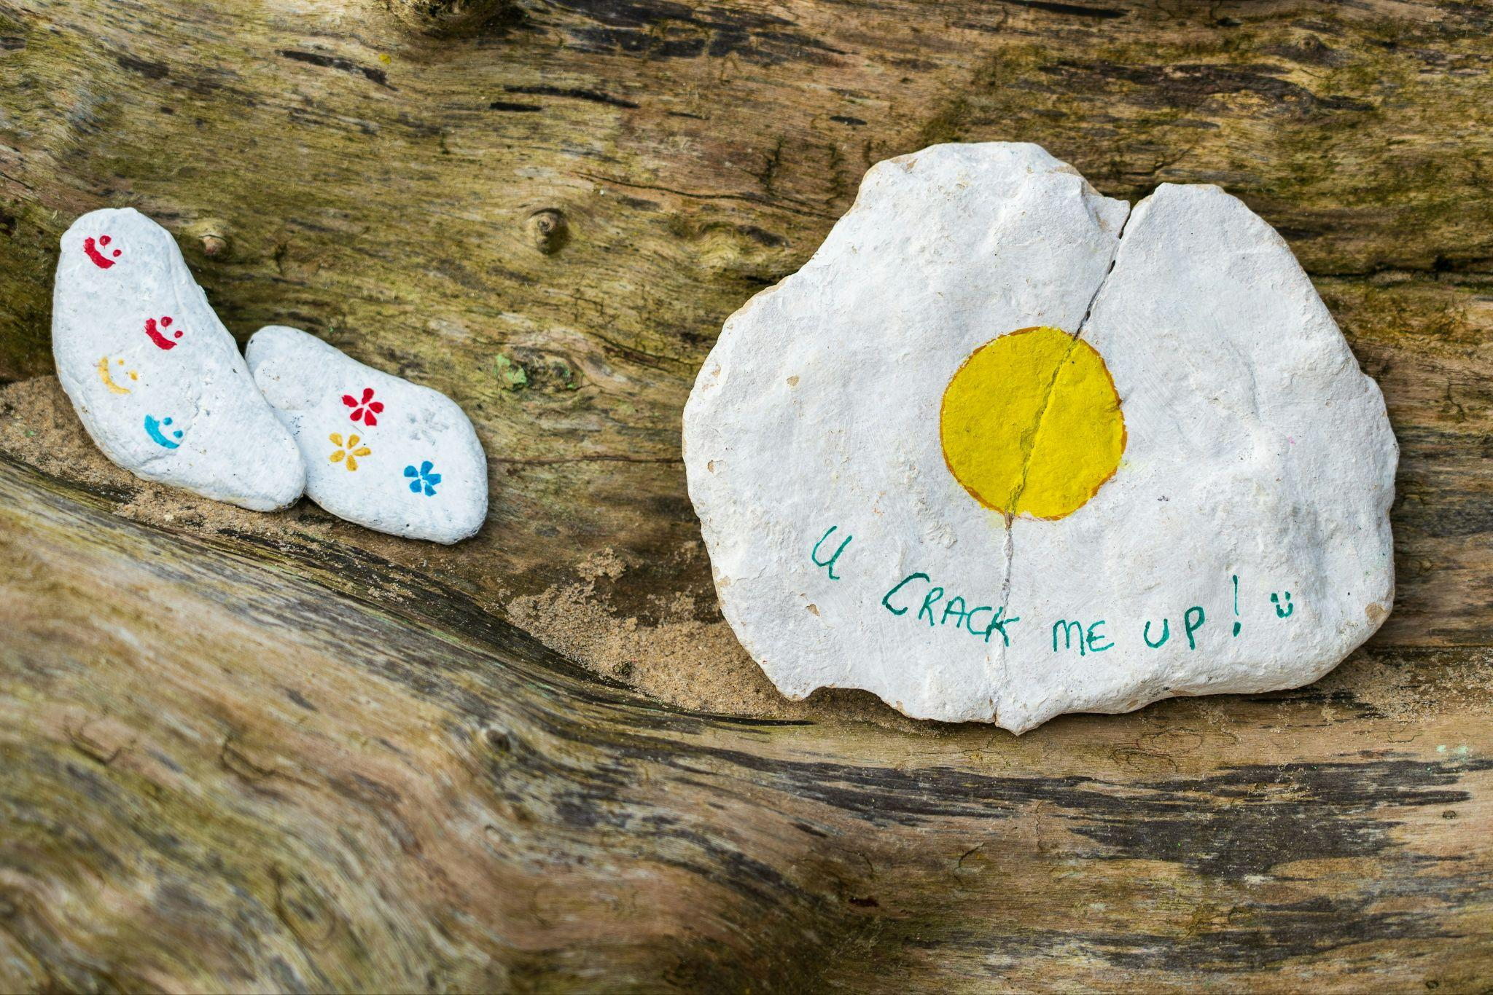
Challenges
Words with different meanings (homonyms)
Words with the same meaning (synonyms)
Observations are not independent. History matters.
Semantic Ambiguity
Slang/colloquialisms
Acronyms
Variable length sequences
Sarcasm / Humor
Image Source: Nick Fewings
Notes:
Photo by Nick Fewings on Unsplash

Slide 17
Representing Text
bank of the river
[34, 56, 24, ….. 23, 56]
?

Slide 18
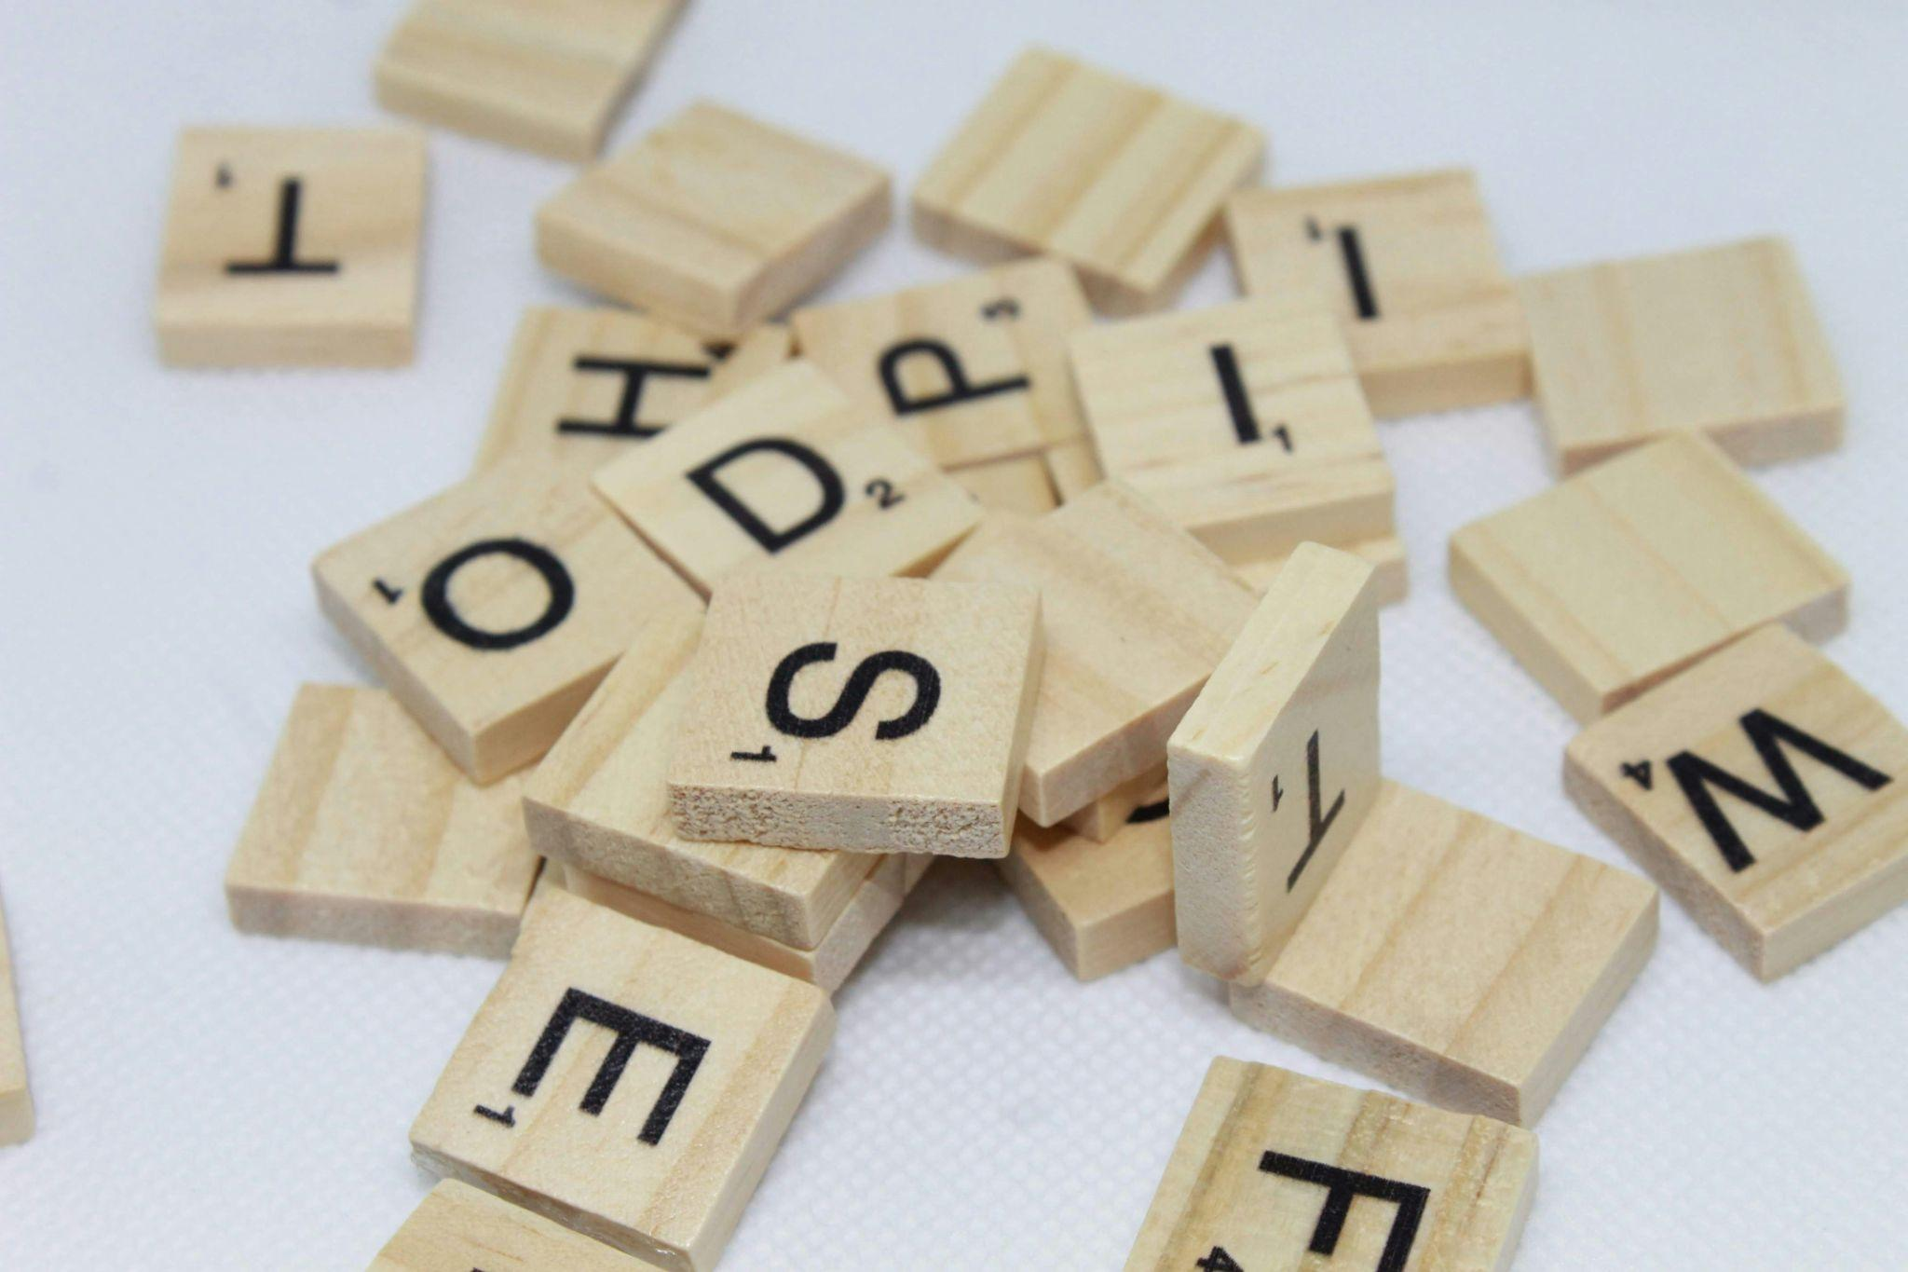

Text Preprocessing
Image Source: Clarissa Watson, Brett Jordan
Notes:
Photo by Clarissa Watson on Unsplash
Photo by Brett Jordan on Unsplash

Slide 19
Preprocessing Pipeline
Raw Text
Tokenize
Remove Stop Words + Punctuation
Lemmatize/Stem words
Model

Slide 20
1. Tokenization
Tokenization divides text strings into lists of substrings
Primarily splits text on whitespace and punctuation
“Which class is the best class at Duke? Deep Learning Applications.”
[‘Which’, ‘class’, ‘is’, ‘the’, ‘best’, ‘class’, ‘at’, ‘Duke’, ‘?’, ‘Deep’, ‘Learning’, ‘Applications’, ‘.’]
Tokenizer Model

Slide 21
1. Tokenization
# Tokenize by word
Input: "Tokenization is an important NLP task."
Output: ["Tokenization", "is", "an", "important", "NLP", "task", "."]
# Tokenize by sentence
Input: "Tokenization is an important NLP task. It helps break down text into smaller units."
Output: ["Tokenization is an important NLP task.", "It helps break down text into smaller units."]
# Tokenize by subword
Input: "tokenization"
Output: ["token", "ization"]
# Tokenize by character
Input: "Tokenization"
Output: ["T", "o", "k", "e", "n", "i", "z", "a", "t", "i", "o", "n"]

Slide 22
1. Tokenization
If working with a particular pre-trained model, you will want to use their tokenizer (ie BERT tokenizer, GPT tokenizer)

Slide 23
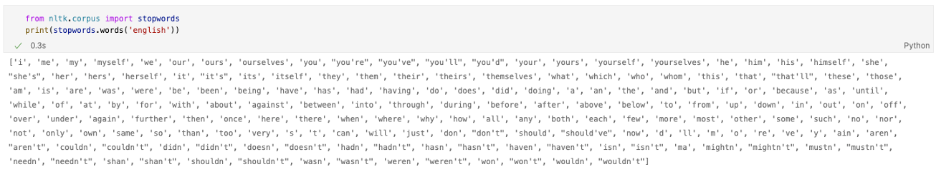
2. Stop Word Removal
Many common words add little value to our understanding of a sentence or document
We usually remove these words (stopwords) so our model can focus on the words that matter

Slide 24
2. Stop Word Removal
We can also add stop words to the list to remove depending on our task
[‘Which’, ‘class’, ‘is’, ‘the’, ‘best’, ‘class’, ‘at’, ‘Duke’, ‘?’, ‘Deep’, ‘Learning’, ‘Applications’, ‘.’]
[‘Which’, ‘class’, ‘best’, ‘class’, ‘Duke’, ‘Deep’, ‘Learning’, ‘Applications’]
Remove Stop Words

Slide 25
3. Lemmatize/Stem
A common challenge is identifying that different forms of a word refer to the same thing (e.g. plurals)
We replace the words with their root to reduce complexity
branch
branches
branching
branched
branch

Slide 26
3. Lemmatize/Stem
Stemming
Lemmatizing
Reduces words to their stem (part to which we add a suffix)
Even if the stem is not an actual word
Crude but fast
Reduces words to a normalized form through a mapping dictionary
The normalized form is still a word
Slower but usually better

Slide 27
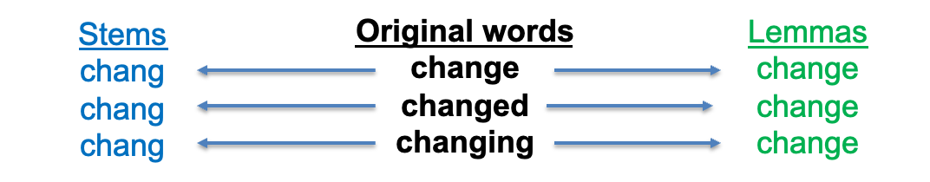
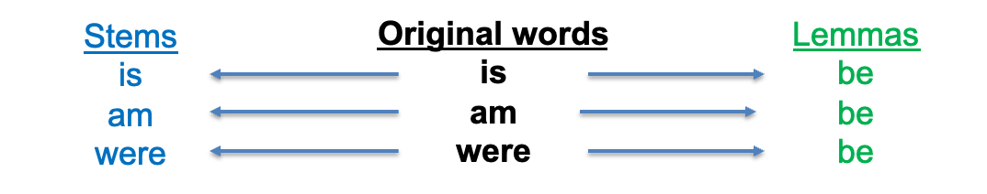
3. Lemmatize/Stem

Slide 28
Traditional NLP
Bag of Words
Term Frequency-Inverse Document Frequency (TF-IDF)

Slide 29

Bag of Words
Represents text by the frequency of each word, disregarding order and context
Converts text into a fixed-length numerical vector
Counts word frequencies while disregarding grammar and word order
Creates a vocabulary from all unique words in the corpus
Image Source: Kelly Sikkema
Notes:
Photo by Kelly Sikkema on Unsplash

Slide 30
Bag of Words
Example
Corpus of data
Positive reviews:
- "Great movie, amazing, amazing plot"
- "Loved it, fantastic acting"
- "Best film this year"
Negative reviews:
- "Terrible waste of time"
- "Bad acting, horrible plot"
- "Worst ever movie ever made"

Slide 31
Bag of Words
Example
vocabulary = [acting, amazing, bad, best, ever, fantastic, film, great, horrible, it, loved, made, movie, plot, terrible, time, waste, worst, year]
review_vectors = [
# “Great movie, amazing, amazing plot”
[0, 2, 0, 0, 0, 0, 0, 1, 0, 0, 0, 0, 1, 1, 0, 0, 0, 0, 0],
# “Loved it, fantastic acting”
[1, 0, 0, 0, 0, 1, 0, 0, 0, 1, 1, 0, 0, 0, 0, 0, 0, 0, 0],
# "Best film this year"
[0, 0, 0, 1, 0, 0, 1, 0, 0, 0, 0, 0, 0, 0, 0, 0, 0, 0, 1],
# "Terrible waste of time"
[0, 0, 0, 0, 0, 0, 0, 0, 0, 0, 0, 0, 0, 0, 1, 1, 1, 0, 0],
# "Bad acting, horrible plot"
[1, 0, 1, 0, 0, 0, 0, 0, 1, 0, 0, 0, 0, 1, 0, 0, 0, 0, 0],
# "Worst ever movie ever made"
[0, 0, 0, 0, 2, 0, 0, 0, 0, 0, 0, 1, 1, 0, 0, 0, 0, 1, 0] ]
labels = [1, 1, 1, 0, 0, 0]

Slide 32
Bag of Words
Example
Now, train your traditional model (i.e. naive bayes) sentiment classifier on review vectors and labels.

Slide 33
Issue
BoW may overemphasize common words (i.e. “movie”)

Slide 34
TF-IDF
Term Frequency-Inverse Document Frequency (TF-IDF)
TF captures how important a word is to that specific document (more occurrences = more important)
IDF reduces the weight of common words that appear in many documents (i.e. "movie")
Words that appear frequently in one document but are rare across all documents get the highest TF-IDF scores

Slide 35
TF-IDF
BoW = TF only
# “Great movie, amazing, amazing plot”
[0, 2, 0, 0, 0, 0, 0, 1, 0, 0, 0, 0, 1, 1, 0, 0, 0, 0, 0],
TF-IDF = (number of times word appears in document) x log (total docs/number of docs containing word)
# “Great movie, amazing, amazing plot”
[0, 1.56, 0, 0, 0, 0, 0, 0.79, 0, 0, 0, 0, 0.48, 0.48, 0, 0, 0, 0, 0]
“amazing”
TF = appears 2 times
IDF = log(6/1) - appears in ⅙ documents
TF-IDF = 2 x log(6) = ~1.56
“movie”
TF = 1
IDF = log(6/2)
TF-IDF = 1 x log(3) = ~0.48

Slide 36
Issue
These approaches:
Lose negation ("not good" counts "good" as positive)
Lose word order ("terrible acting but great plot" might be misclassified)

Slide 37
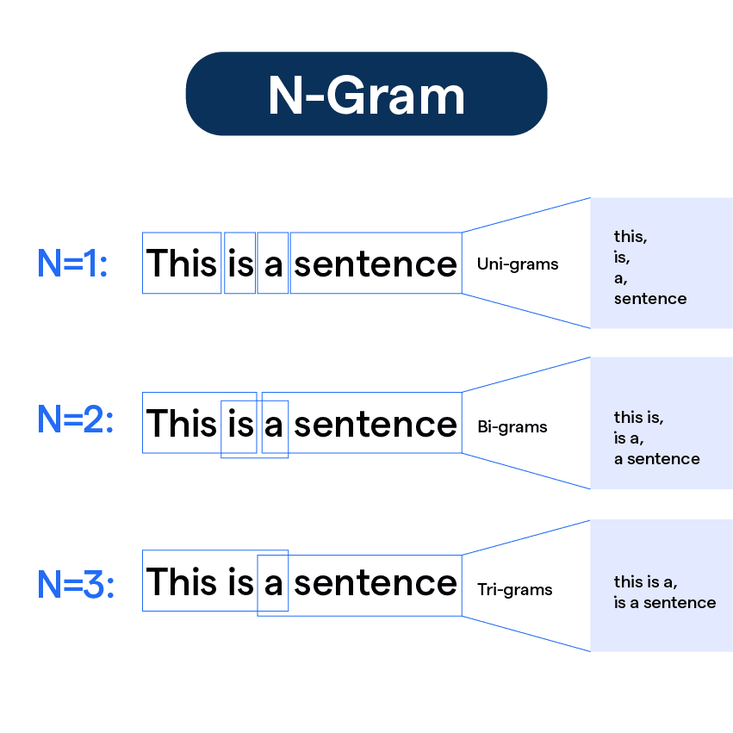
N-grams
Use to capture sequences of words:
Unigrams (regular BoW):
"great": 1
"movie": 1
"amazing": 1
"plot": 1
Bigrams (2-word sequences):
"great movie": 1
"movie amazing": 1
"amazing plot": 1
Trigrams (3-word sequences):
"great movie amazing": 1
"movie amazing plot": 1

Slide 38
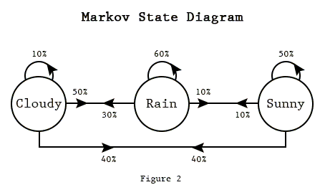
Hidden Markov Models
Statistical model that models sequences.
Based on Markov chains:
Image Source
Notes:
https://techeffigytutorials.blogspot.com/2015/01/markov-chains-explained.html

Slide 39
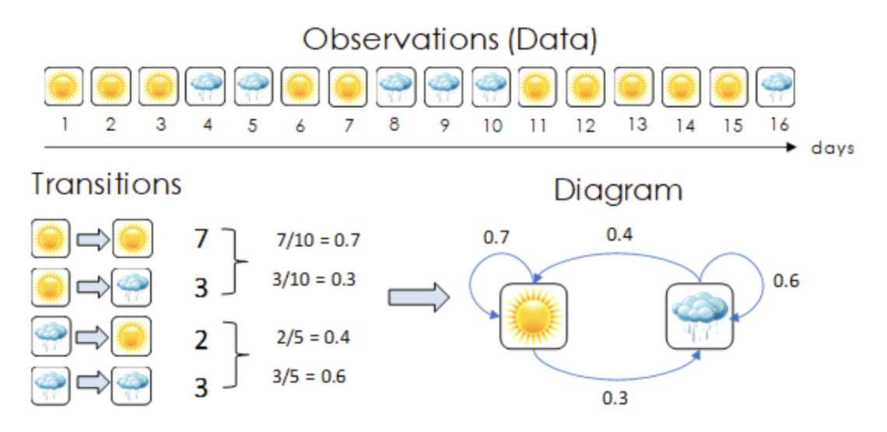
Hidden Markov Models
To predict tomorrow’s weather, we need to know the probability of each possible sequence:
Rain -> Sun
Rain -> Rain
Sun -> Rain
Sun -> Sun
So we collect data:
Image Source: Scoyoc

Slide 40
Hidden Markov Models
Image Source: Scoyoc
Notes:
https://techeffigytutorials.blogspot.com/2015/01/markov-chains-explained.html

Slide 41
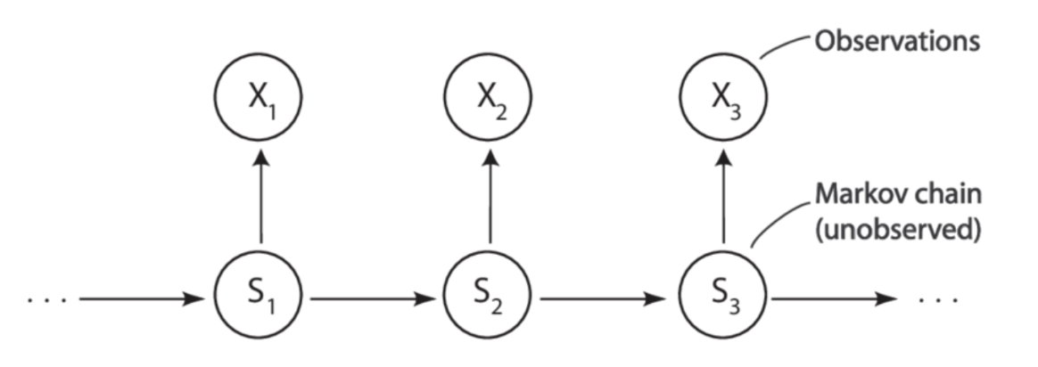
Hidden Markov Models
We can’t always directly measure our observations! Sometimes we have to infer them from other variables:
😀 ☹️
☁️ ☀️ 🌧️
We can observe our friend’s emotional state
We don’t know the weather
Image Source: Scoyoc
Notes:
https://techeffigytutorials.blogspot.com/2015/01/markov-chains-explained.html

Slide 42
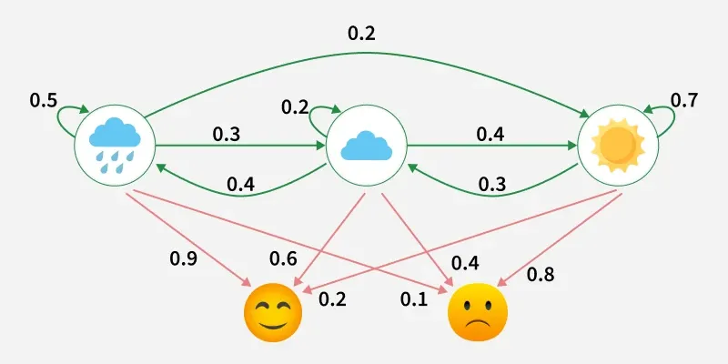
Hidden Markov Models
By combining both the transition probabilities (likelihood of a given state continuing or changing) and the emission probabilities (proximate data sources that can help us determine the hidden state) we can estimate the most likely hidden state and state sequence.
Learn More Here
Image Source: G4G
Notes:
https://techeffigytutorials.blogspot.com/2015/01/markov-chains-explained.html

Slide 43

HMM text generation, predicts the next word, trained on the novel Pride and Prejudice:
Love
conveyed him and his five cousins at a suitable hour to Meryton and the girls may go or you may send them by themselves you know â Elizabeth was distressed She felt that Janeâ s feelings she is not half so handsome as Jane nor half so good humoured as Lydia But you are always giving _her_ the preference â â They have none of them do we â Darcy had walked away to another part of the business On finding Mrs Bennet Elizabeth and one of its narrowest parts They crossed it by a simple bridge in character with the general air of the scene it was a spot less adorned than any they had yet visited and the valley here contracted into a glen allowed room only for the stream and a narrow walk amidst the rough coppice wood which bordered it Elizabeth longed to observe that Mr Bingley had been a most delightful friend so easily guided that his worth was invaluable but she checked herself She remembered that he had but just courage enough to make her former assurance of her sisterâ s ready acquiescence â I hope â said she â Your cousinâ s conduct does not suit my feelings Why was he to be the judge â â You are then resolved to have him â â I have two small favours to request First that you will always exceed your income â â I hope not so Imprudence or thoughtlessness in money matters would be unpardonable in _me_ â â Exceed their income My dear Mr Bennet But I knew not I was afraid of doing too much Wretched wretched mistake â Darcy made no answer and seemed desirous of changing the subject At that moment Sir William Lucas appeared close to them meaning to pass

Slide 44


Slide 45
Issues
Doesn’t take into account contextual information
Doesn’t address many of our challenges, like homonyms and synonyms
Why you may use traditional methods:
Computationally inexpensive, easy to implement
Context may not be necessary for text classification or text clustering tasks

Slide 46
Neural Networks for Natural Language Processing
Word Embeddings (Word2Vec)

Slide 47
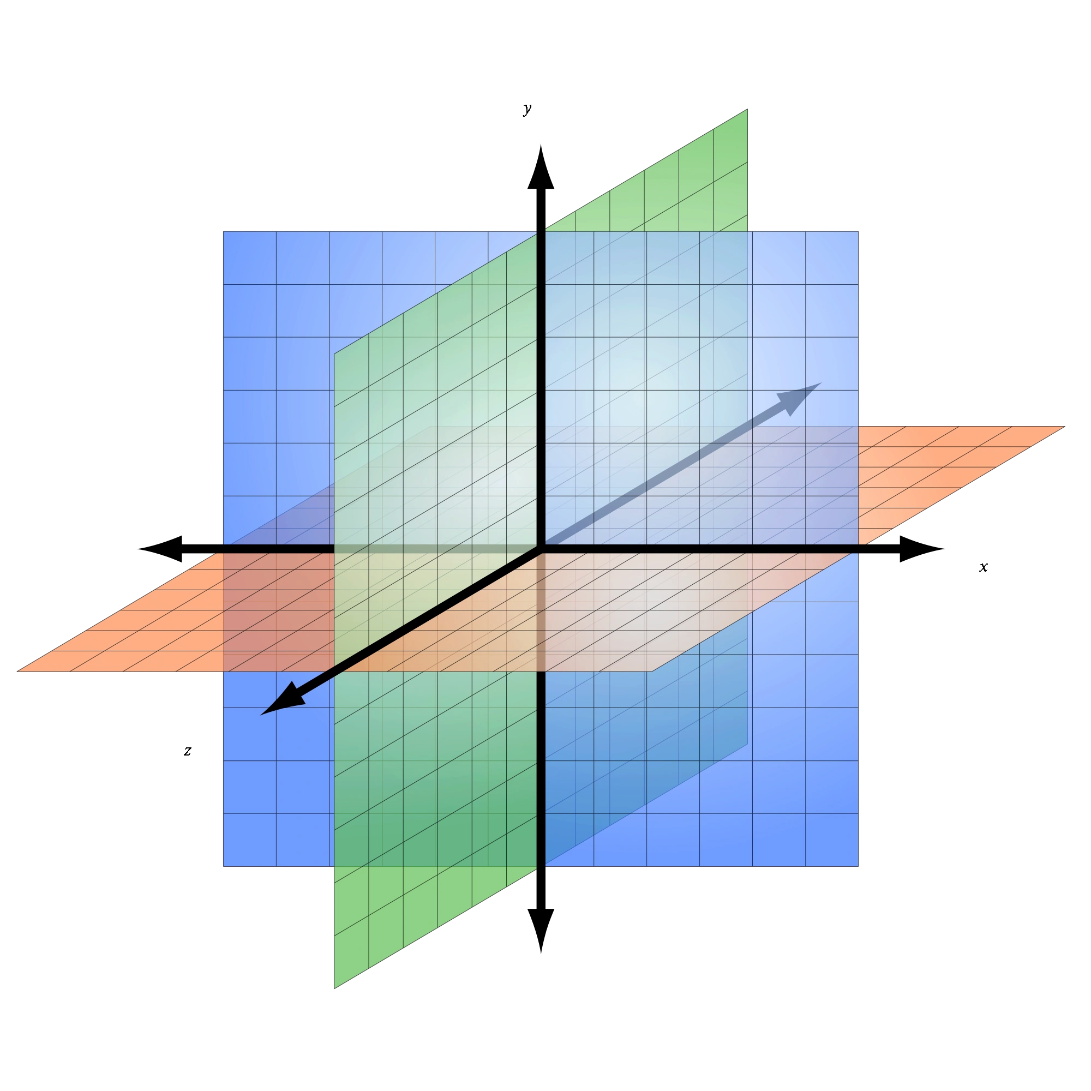
Representing Text
“like”
Corpus to train BoW: “I like cats”
“cats”
[0,1,0]
“I”

Slide 48
Representing Text
In a larger corpus, you will have hundreds or thousands of dimensions, where each dimension corresponds to a single word/phrase from your training corpus.
?
[0,1,0,…,1,1,0]

Slide 49
Representing Text
470,000 entries in a standard English dictionary [Source]
Having a dimension for each of these seems inefficient.

Slide 50
Representing Text
bank of the river
[34, 56, 24, ….. 23, 56]
We want this to actually encode something about the meaning of the text rather than each word itself.
?

Slide 51
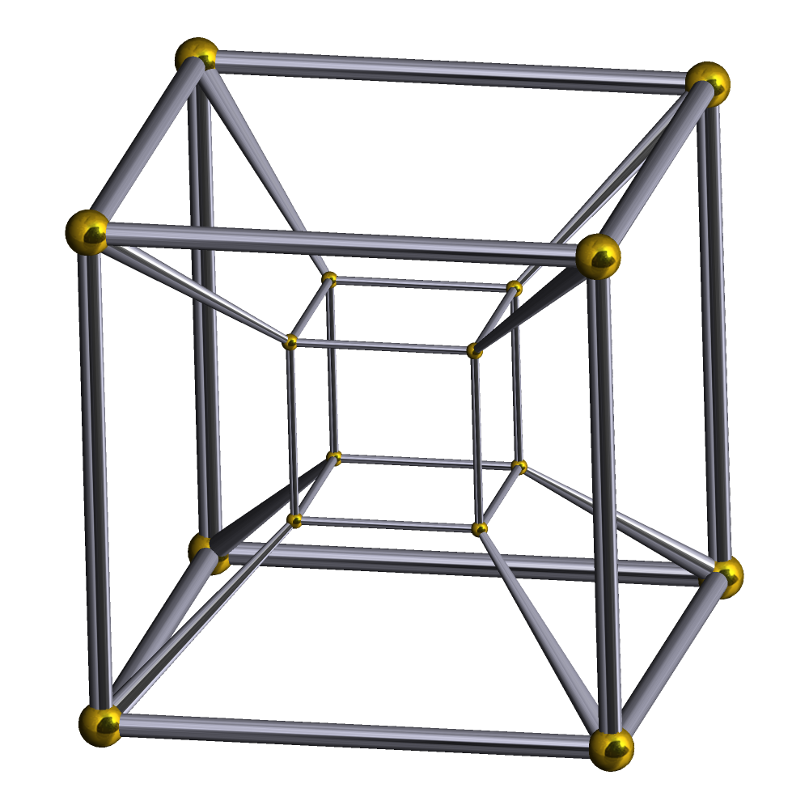
Representing Text
[34, 56, 24, ….. 23, 56]
We want this to actually encode something about the meaning of the text
→
We want to map it into multidimensional space of textual meaning, where each dimension corresponds to some aspect of “meaning”

Slide 52
Neural Networks!
1
1
b₁⁽³⁾
b₁⁽²⁾
z₁⁽²⁾
w_{1,1}⁽³⁾
z⁽³⁾
w_{1,1}⁽²⁾
x₁
Φ₁⁽²⁾
Φ⁽³⁾
x₂
z₂⁽²⁾
Φ₂⁽²⁾
x₃

Slide 53
Word Embeddings
Learn a compact representation of the original data, capturing its essential aspects.

Slide 54
Word Embeddings
Captures semantic relationships, making it possible for words with similar meanings to have similar representations.
Dimensionality Reduction: Reduces the complexity of text data.
Capturing Semantics: Encodes meanings based on word usage and context.
Distance Measures: Similarity in meaning often correlates with proximity in vector space.

Slide 55
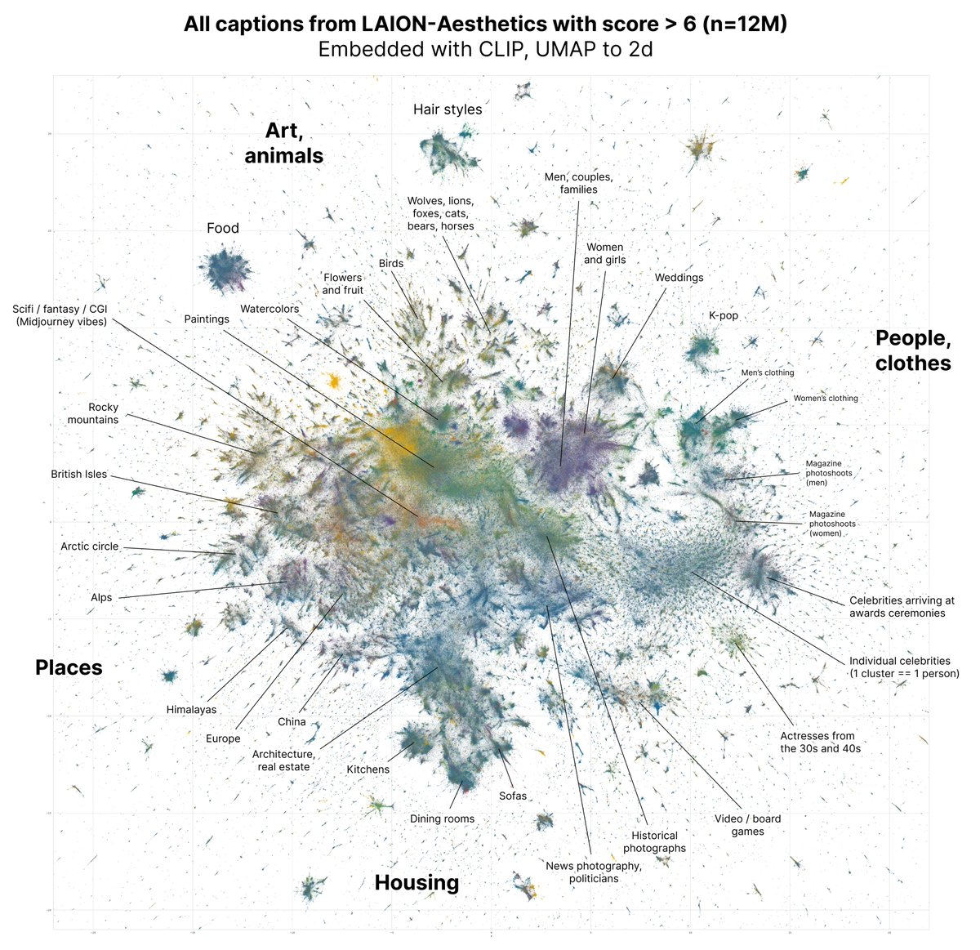
512 dimensions!
Image Source: David McClure Twitter
Notes:
Clip-vit-base-patch32
https://huggingface.co/datasets/dclure/laion-aesthetics-12m-umap?row=0

Slide 56
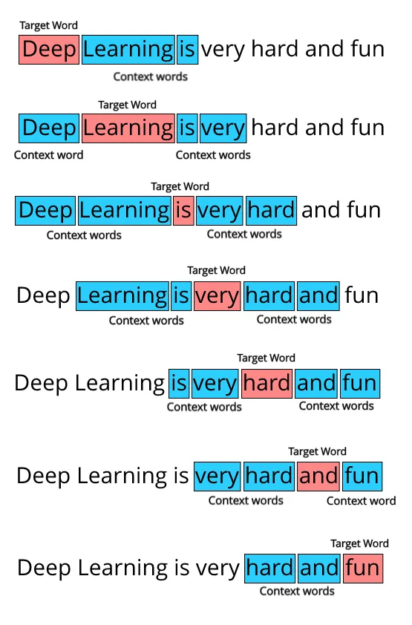
What does the data look like?
Creating a dataset:
Pass a selected N context window through a corpus of text data
Find all pairs of target and context words to form a dataset in the format of target word and context word.

Slide 57
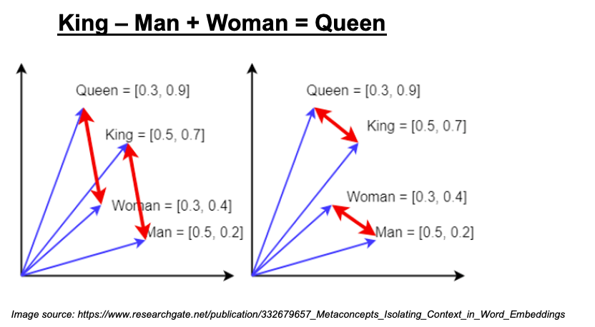
Word2Vec (2013)
Shallow neural network architecture
Vectors encode semantic and syntactic word relationships
Enables arithmetic operations on words: king - man + woman = queen

Slide 58
Word2Vec
Single hidden layer neural network
Input layer: One-hot encoded vectors (vocabulary size)
Hidden layer: Dense linear projection (embedding dimension)
Output layer: Softmax over vocabulary
No non-linear activations between layers
Weights between input and hidden layer become final word embeddings

Slide 59
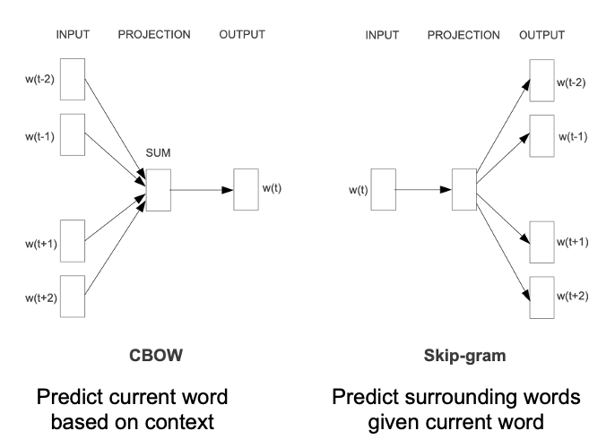
Word2Vec
Two training methods:
Skip-gram: Predict context words given center word
Better for rare words, works better with small training data
Continuous Bag of Words (CBOW): Predict center word from context
Faster training, better for frequent words

Slide 60
Word2Vec
embedding layer transforms these into dense, lower-dimensional vectors
input = words are one-hot encoded vectors (sparse, high-dimensional)

Slide 61
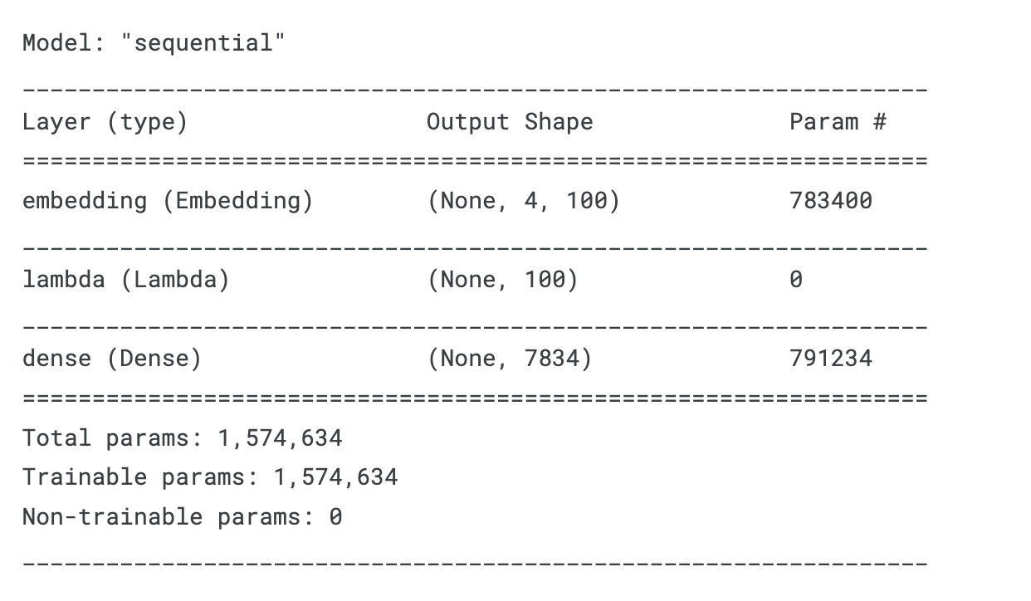
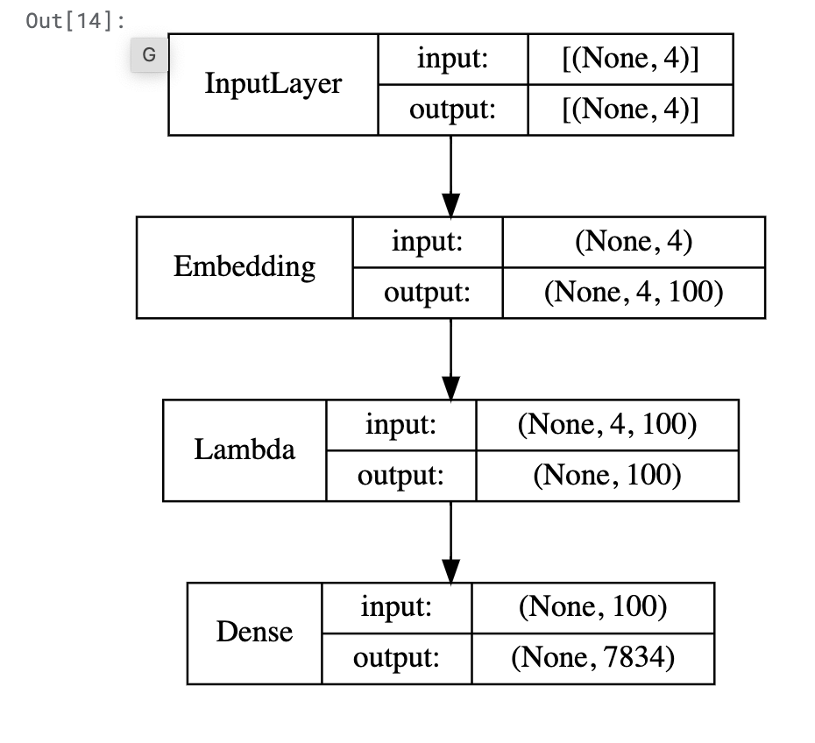
input = words are one-hot encoded vectors (sparse, high-dimensional)
Word2Vec - CBOW
embedding layer transforms these into dense, lower-dimensional vectors
predicting probabilities over vocabulary (7834 tokens in vocabulary)
Input layer = 2*window_length
window_size = 2
Don’t you think deep learning is very fun?
Notes:
We have input context words of dimensions (2 x window_size), we will pass them to an embedding layer of size (vocab_size x embed_size) which will give us dense word embeddings for each of these context words (1 x embed_size for each word). Next up we use a lambda layer to average out these embeddings and get an average dense embedding (1 x embed_size) which is sent to the dense softmax layer which outputs the most likely target word. We compare this with the actual target word, compute the loss, backpropagate the errors to adjust the weights (in the embedding layer) and repeat this process for all (context, target) pairs for multiple epochs.
https://www.kdnuggets.com/2018/04/implementing-deep-learning-methods-feature-engineering-text-data-cbow.html

Slide 62
Word2Vec - CBOW
Lambda layer averages context word embeddings
CBOW assumes all context words contribute equally to predicting the target
Averaging creates a fixed-size representation regardless of window size
Helps capture the general context rather than specific word positions
Makes the model more robust to word order variations
Notes:
We have input context words of dimensions (2 x window_size), we will pass them to an embedding layer of size (vocab_size x embed_size) which will give us dense word embeddings for each of these context words (1 x embed_size for each word). Next up we use a lambda layer to average out these embeddings and get an average dense embedding (1 x embed_size) which is sent to the dense softmax layer which outputs the most likely target word. We compare this with the actual target word, compute the loss, backpropagate the errors to adjust the weights (in the embedding layer) and repeat this process for all (context, target) pairs for multiple epochs.
https://www.kdnuggets.com/2018/04/implementing-deep-learning-methods-feature-engineering-text-data-cbow.html

Slide 63
Word2Vec - CBOW
Dense layer acts as a classifier over entire vocabulary
Softmax used at dense layer
Each output represents the probability of that word being the target
Through training via backpropagation, model learns optimized embeddings for all words in the vocab (loss typically categorical crossentropy)
Notes:
We have input context words of dimensions (2 x window_size), we will pass them to an embedding layer of size (vocab_size x embed_size) which will give us dense word embeddings for each of these context words (1 x embed_size for each word). Next up we use a lambda layer to average out these embeddings and get an average dense embedding (1 x embed_size) which is sent to the dense softmax layer which outputs the most likely target word. We compare this with the actual target word, compute the loss, backpropagate the errors to adjust the weights (in the embedding layer) and repeat this process for all (context, target) pairs for multiple epochs.
https://www.kdnuggets.com/2018/04/implementing-deep-learning-methods-feature-engineering-text-data-cbow.html
cbow.compile(loss='categorical_crossentropy', optimizer='rmsprop')

Slide 64
Word2Vec - CBOW
Getting embeddings:
Directly extract weights of embedding layer = word embeddings
Why does this work? We are NOT using nonlinear activations!
Notes:
We have input context words of dimensions (2 x window_size), we will pass them to an embedding layer of size (vocab_size x embed_size) which will give us dense word embeddings for each of these context words (1 x embed_size for each word). Next up we use a lambda layer to average out these embeddings and get an average dense embedding (1 x embed_size) which is sent to the dense softmax layer which outputs the most likely target word. We compare this with the actual target word, compute the loss, backpropagate the errors to adjust the weights (in the embedding layer) and repeat this process for all (context, target) pairs for multiple epochs.
https://www.kdnuggets.com/2018/04/implementing-deep-learning-methods-feature-engineering-text-data-cbow.html
cbow.compile(loss='categorical_crossentropy', optimizer='rmsprop')

Slide 65
Word2Vec:
Input → Linear → Linear → Softmax
No nonlinear activation between embedding and output.
Yet it works because:
The task (predicting context) shapes the embedding space.
It’s more like matrix factorization than deep feature extraction.
The model adjusts weights so that:
Words appearing in similar contexts get similar embeddings.
If:
"deep" often appears near "learning"
"deep" often appears near "neural"
Their embeddings move closer.
No nonlinear activation needed.
The prediction objective shapes the space.

Slide 66
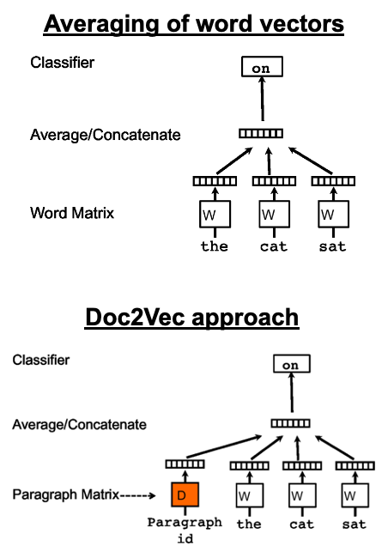
Doc2Vec
Similar to Word2Vec CBOW
Adds a paragraph vector to the inputs to capture the topic of the paragraph/document
Each paragraph/doc gets its own learnable vector.
That vector participates in predicting words.
It acts like a “memory” of the document’s topic.

Slide 67
Averaging Word2Vec embeddings weakens document representation because it ignores word order and treats all words equally, potentially diluting important information. Doc2Vec learns a dedicated document vector trained to capture global semantic meaning, resulting in a stronger representation.

Slide 68
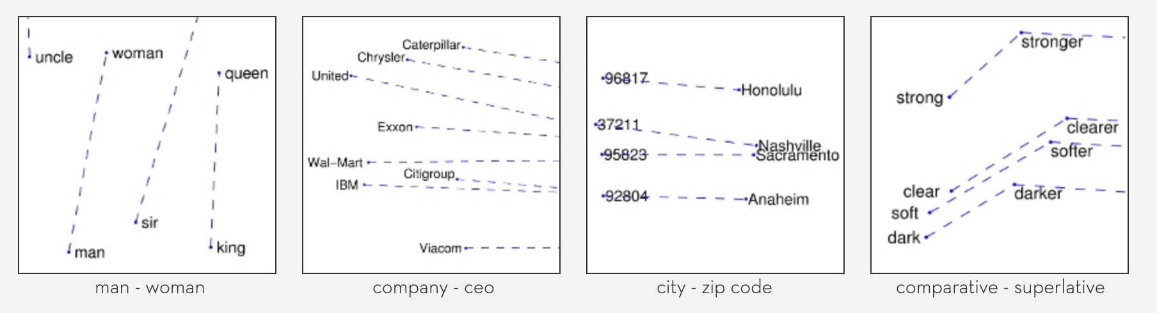
GloVe (2014)
A matrix factorization based method for learning word embeddings by analyzing word co-occurrence statistics using a log-bilinear regression model (often used as input into NN)
Image Source

Slide 69
GloVe (Global Vectors for Word Representation)
👉 Word2Vec = prediction-based 👉 GloVe = count-based (matrix factorization)
🔹 Core Idea
GloVe builds a word co-occurrence matrix.
It counts:
How often does word i appear near word j?
Example corpus:
“I like deep learning” The co-occurrence matrix tracks:
how often “deep” appears near “learning”
GloVe factorizes this large co-occurrence matrix into lower-dimensional word vectors.
GloVe is a word embedding method that learns vector representations by factorizing a global word co-occurrence matrix. Unlike Word2Vec, which is prediction-based, GloVe uses corpus-wide co-occurrence statistics to learn embeddings that capture semantic relationships.

Slide 70
Neural Networks for Natural Language Processing
Recurrent Neural Networks

Slide 71
So far, we have only looked at feedforward neural networks
Signals flow in one direction, from input → output
input
output
hidden layer
Notes:
https://www.youtube.com/watch?v=y9PLF2GsD-c

Slide 72
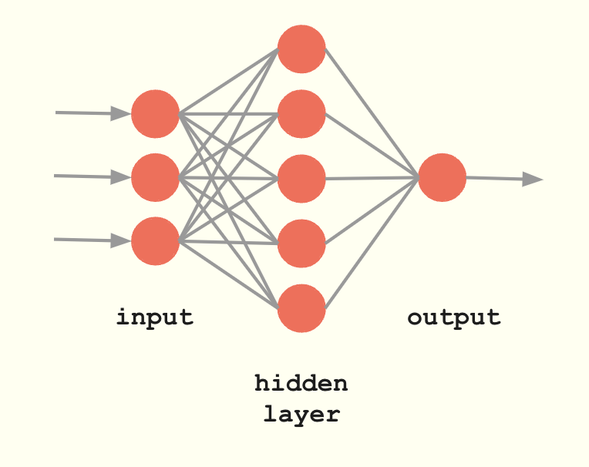
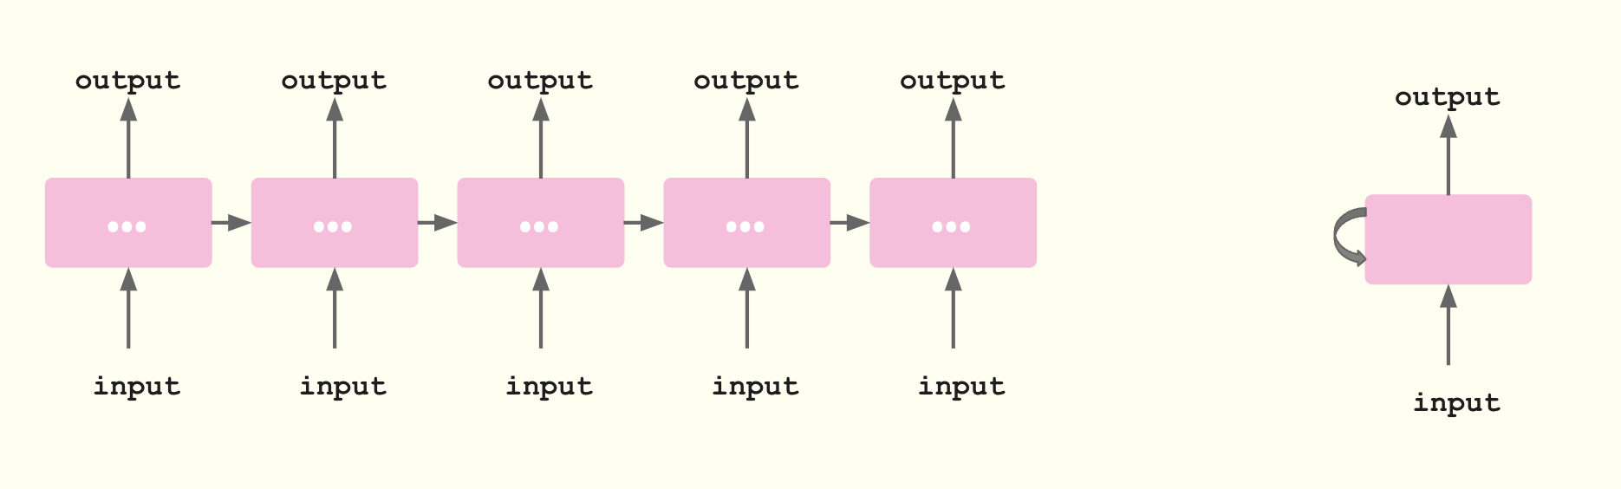
So far, we have only looked at feedforward neural networks
Signals flow in one direction, from input → output
In Sequence models (RNNs, LSTMs, GRUs), the output of a layer is added to the next input and fed back into the same layer

Slide 73
Input observations are independent of one another
In sequences, observations are closely related to their neighbors in time or space
By treating them as independent we lose valuable information
RNNs allow us to retain information about the history

Slide 74
output
output
output
output
output
output
…
…
…
…
…
input
input
input
input
input
input

Slide 75
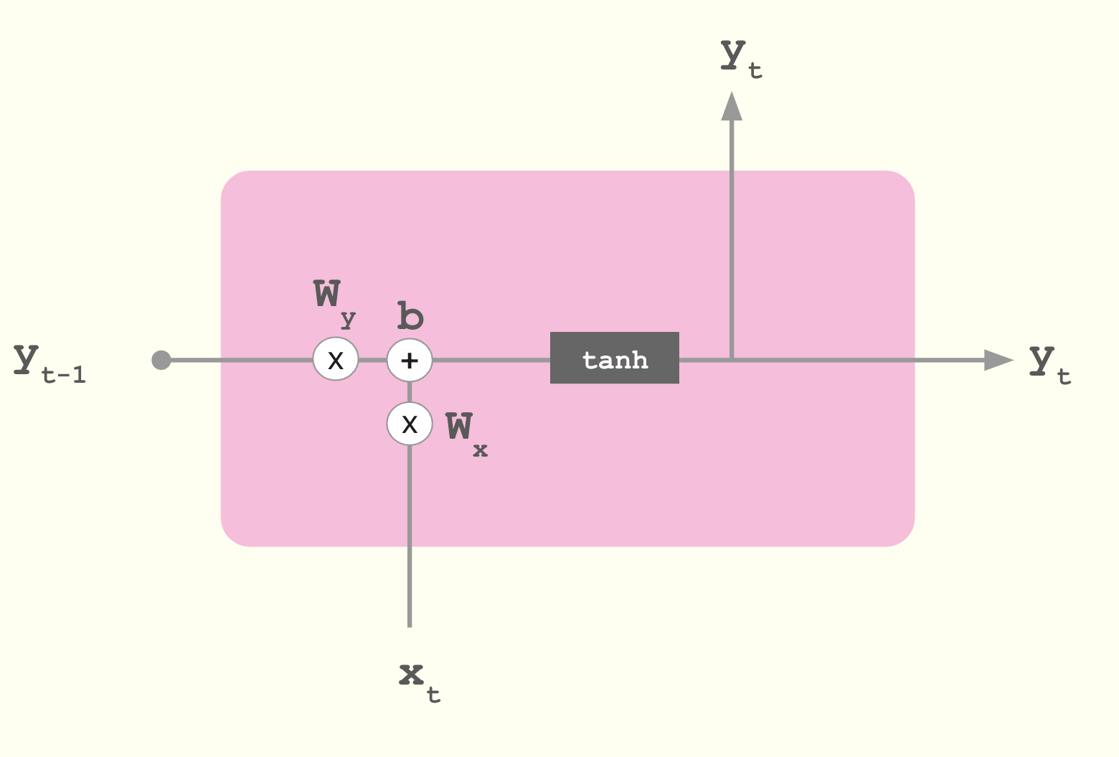
output
output
output
output
output
output
…
…
…
…
…
input
input
input
input
input
input

Slide 76
y_{t} = α(W_{x}x_{t} + W_{y}y_{t-1} + b)
y_{t}
W_{y}
b
y_{t-1}
y_{t}
X
+
tanh
X
W_{x}
x_{t}

Slide 77
y_{t} = α(W_{x}x_{t} + W_{y}y_{t-1} + b)
y_{t}
softmax
W_{y}
b
h_{t-1}
h_{t}
X
+
tanh
X
W_{x}
x_{t}

Slide 78
y0
y1
y2
y3
y4
y4
…
…
…
…
…
…
…
…
…
…
x0
x1
x2
x3
x4
x0
x1
x2
x3
x4
Sequence-to-sequence
Example: price forecasting
Sequence-to-vector
Spam or not
Encoder
Decoder
y0
y1
y2
y3
y4
y2
y3
y4
…
…
…
…
…
…
…
…
…
…
x0
0
0
0
0
x0
x1
0
0
0
Vector-to-sequence
Image captioning
Encoder-decoder
Machine translation
Notes:
Needs to see whole sentence first to do translation (context may change) then you predict each word at a time in the decoder part

Slide 79
Training an RNN
Backpropagation through time (BPTT)
Compute the gradient of the loss across all timesteps of the sequence contributing to the current prediction using the chain rule
y0
y1
y2
y3
y4
…
…
…
…
…
x0
x1
x2
x3
x4

Slide 80
Challenge
For longer sequences, the chain can get very long and the gradient can get very close to 0 - vanishing gradient
Because of this, RNNs have difficulty remembering information far back in history.

Slide 81
Vanilla RNNs
It feeds the previous hidden state forward in time.
suffer from vanishing gradients because during backpropagation through time, gradients are repeatedly multiplied by weight matrices and activation derivatives. If these values are less than 1, the gradient shrinks exponentially, preventing the model from learning long-range dependencies.
The hidden state in an RNN is
internal memory representation of everything the network has seen so far.
the internal memory vector that carries information from previous time steps and is updated at each step using the current input and previous hidden state.

Slide 82
Imagine this sentence: "The cat sat"
Time steps:
t=1 → "The" t=2 → "cat" t=3 → "sat"
At each step:
Step 1: Input: "The" Output: h₁
Step 2: Input: "cat" Also uses: h₁ Produces: h₂
Step 3: Input: "sat" Also uses: h₂ Produces: h₃
During training (backpropagation): The gradient must flow:
h₃ → h₂ → h₁
Each step multiplies by weights. If weights are small, gradient shrinks. That’s the vanishing gradient problem.

Slide 83
Challenge
For longer sequences, the chain can get very long and the gradient can get very close to 0 - vanishing gradient
Because of this, RNNs have difficulty remembering information far back in history.
Solution: Architecture variations - LSTMs, GRUs

Slide 84
In RNN: Memory update is mostly multiplicative.
In LSTM: Memory update is additive.
1️⃣ Forget Gate
Decides what old information to remove.
Example: If sentence switches topic, forget previous context.
2️⃣ Input Gate
Decides what new information to add.
Example: If important keyword appears, store it in memory.
3️⃣ Output Gate
Decides what part of memory to expose as hidden state.
LSTMs solve the vanishing gradient problem by introducing a cell state with additive updates controlled by gating mechanisms (forget, input, and output gates). The additive memory path allows gradients to flow across many time steps without shrinking exponentially, enabling learning of long-range dependencies.

Slide 85
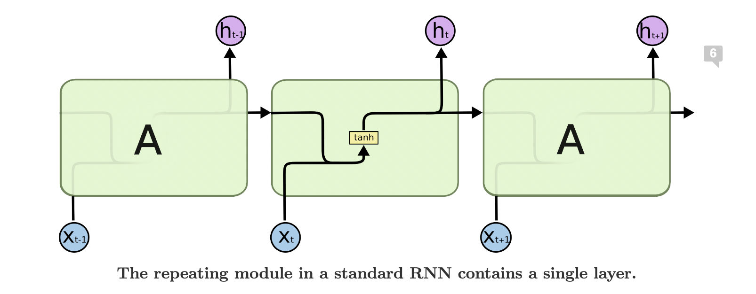
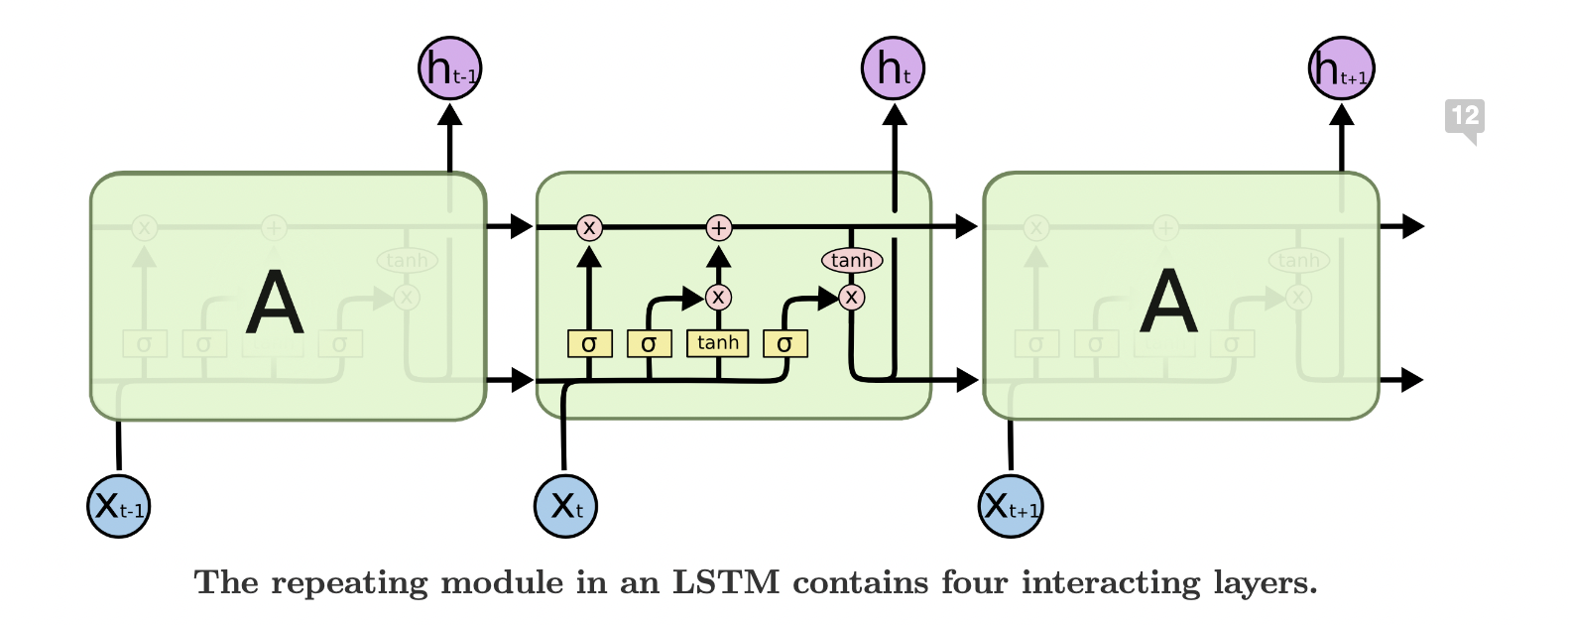
Long-Short Term Memory (LSTM)
Image Source

Slide 86
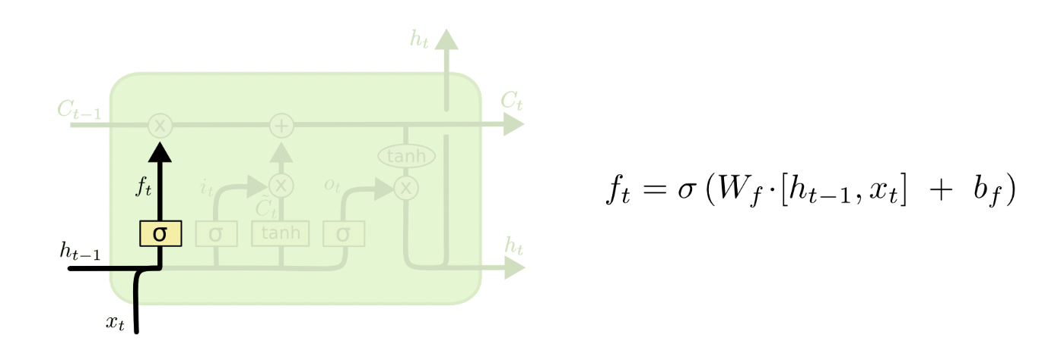
Step 1. Forget Gate
What It Does: Decides what information to remove from the cell's memory.
How It Works: Uses a sigmoid layer to look at previous output and current input, outputting values between 0 (forget) and 1 (keep).
Image Source

Slide 87
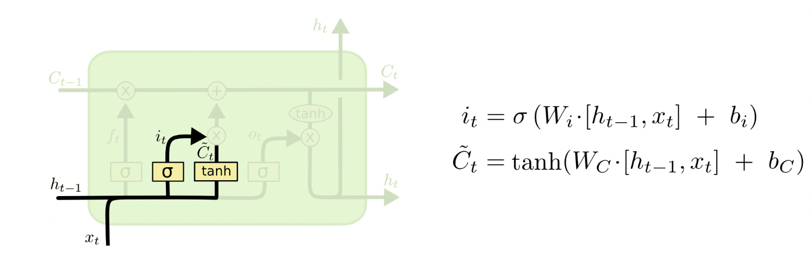
Step 2. Input Gate
What It Does: Decides what new information to add to the cell's memory.
How It Works:
A sigmoid layer chooses which values to update.
A tanh layer generates new candidate values to be possibly added to the memory.
Image Source

Slide 88
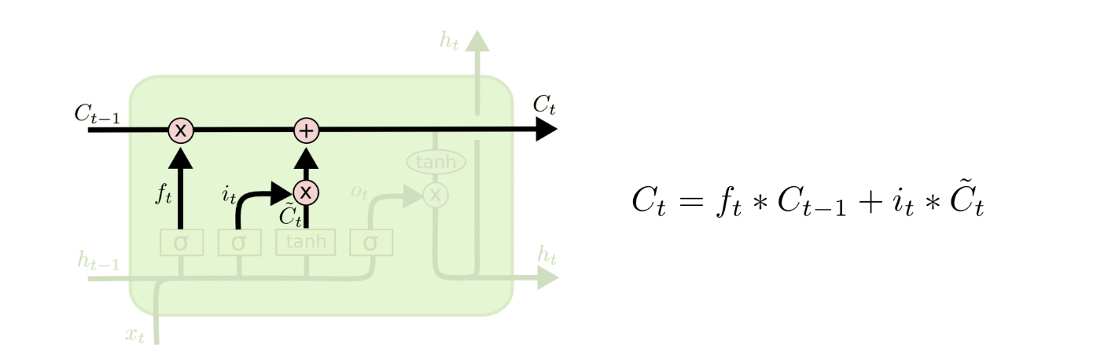
Step 3. Update Cell State
What It Does: Updates the cell's memory with new information while removing unnecessary information.
How It Works:
Multiplies old information by the forget gate's output to remove unwanted data.
Adds new candidate values scaled by the input gate's output to update the memory.
Image Source

Slide 89
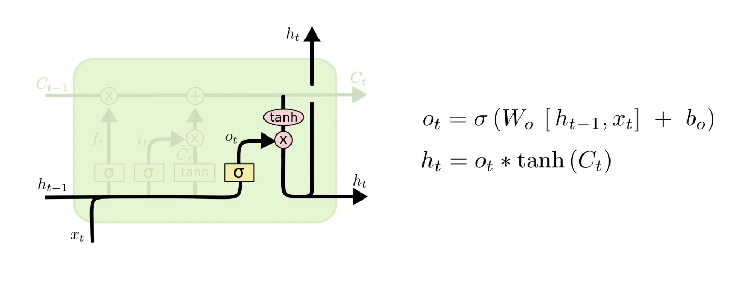
Step 4. Output Gate
What It Does: Decides and filters what output to generate from the cell state.
How It Works:
A sigmoid layer selects parts of the cell state for output.
The cell state is normalized between -1 and 1 using a tanh layer.
This normalized state is multiplied by the sigmoid layer's output to create the final output.
Image Source

Slide 90
What happened to the vanishing gradient?
→ Cell Update Equation
By using operations that are additive (e.g., adding C_{t} scaled by i_{t}) rather than multiplicative, LSTMs allow the gradient to flow across many time steps without diminishing.
This additive nature of the cell state updates, combined with the gating mechanisms that control the flow of information, helps mitigate the vanishing gradient problem by preserving the gradient magnitude over long sequences.
Image Source

Slide 91

Gated Recurrent Unit (GRU)
Image Source

Slide 92
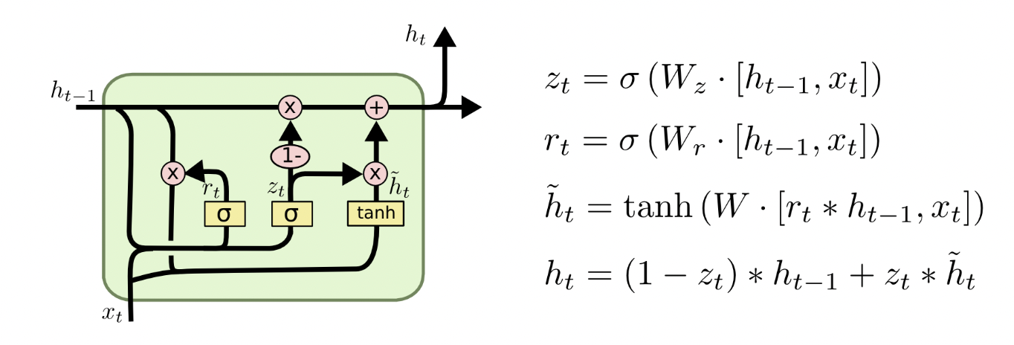
Changes from LSTM:
The GRU model combines the forget and input gates into a single “update gate.”
Merges the cell state and hidden state
The resulting model is simpler than standard LSTM models.
Gated Recurrent Unit (GRU)
Image Source

Slide 93
concatenated vector
Update Gate
What It Does: The gate decides how much of the past information should be passed along
How It Works:
Sigmoid layer takes as input concatenated h_{t-1} and x_{t} multiplied by a weight matrix W
z_{t} acts as a mixing ratio between the previous hidden state and the new candidate state
Image Source

Slide 94
Reset Gate
What It Does: The gate decides how much of the past state should be forgotten
How It Works:
Sigmoid layer takes as input concatenated h_{t-1} and x_{t} multiplied by a weight matrix W
Image Source
Notes:
Also uses sigmoid activation
Determines how much of the past state should be forgotten
Controls access to previous hidden state when computing new candidate state

Slide 95
“Candidate” Hidden State
What It Does: Creates a candidate for the new hidden state
How It Works:
Hyperbolic tangent activation function
r_{t} * h_{t-1} represents element-wise multiplication with reset gate
Image Source
Notes:
This is the "candidate" hidden state
Uses tanh activation function
rt * ht-1 represents element-wise multiplication with reset gate
Creates a candidate for the new hidden state
tanh ensures values are between -1 and 1

Slide 96
Final Hidden State
What It Does: Combines previous hidden state and candidate state
How It Works:
z_{t} controls balance between previous (h_{t-1}) and candidate (h̃_{t}) states
If z_{t} close to 1, favors new candidate state
If z_{t} close to 0, keeps more information from previous state
Image Source
Notes:
This is the final hidden state computation
Combines previous hidden state and candidate state
zt controls the balance between previous (ht-1) and candidate (h̃t) states
If zt is close to 1, favors the new candidate state
If zt is close to 0, keeps more information from previous state

Slide 97
GRU
Has 2 gates:
Update gate
Reset gate
No separate cell state
Cell state and hidden state are merged
So GRU is simpler.
🔥 Key Difference Summary
LSTM: Separate memory (cell state) + 3 gates
GRU: Combined memory + 2 gates

Slide 98
Challenges
They have issues with sequences of different lengths
The size of the network depends on the length of the sequence, so optimization requires a longer time to train and lots of steps
They don’t work well with long text documents
Issues with long-range dependencies
They are hard to train
SLOW: They do not allow for parallel computation (all computation occurs sequentially and therefore cannot be parallelized)
CHALLENGING HYPERPARAMETER TUNING: Lots of parameters that are interlinked with one another

Slide 99
RNNs struggle with long-range dependencies because information must pass sequentially through many time steps, and they cannot be parallelized during training. Transformers address these limitations using self-attention, which allows all tokens to interact directly and enables parallel computation.

Slide 100
NLP Implementation
Handling variable-length sequences
Data Augmentation for text
Handling imbalanced text data
Data splitting best practices
Transfer Learning / Fine-tuning
Popular NLP libraries

Slide 101
Variable-length sequences
Natural text has varying lengths
Neural networks need fixed-size inputs
Batching requires consistent dimensions

Slide 102
Variable-length sequences
Padding
Add special tokens (i.e. 0s or <PAD> tokens) to shorter sequences
All sequences padded to length of longest sequence
Use padding masks to ignore padded values
Padding masks are used in loss calculation, RNN hidden state, and/or in attention scores (transformers)
Sequence | Padding Sequence | Padding Mask
“hello world” (length=2) | [5,2,0,0] | [1,1,0,0]
“deep learning is fun” (length=4) | [1,3,48] | [1,1,1,1]
“transformers” (length=1) | [7,0,0,0] | [1,0,0,0]

Slide 103
Variable-length sequences
Packed Sequences
PyTorch optimization for RNNs
Only processes actual sequence elements
Reduces unnecessary computation on padding
Timestep 1: (batch size = 3) ["hello", "deep", "transformers"]
Timestep 2: (batch size = 2) ["world", "learning"] (sequence "transformers" done)
Timestep 3: (batch size = 1) ["is"] (sequence "hello world" done)
Timestep 4: (batch size = 1) ["fun"]
Sequence
“hello world” (length=2)
“deep learning is fun” (length=4)
“transformers” (length=1)
data = [hello, deep, transformers, world, learning, is, fun]
lengths = [2, 4, 1]
batch = [3, 2, 1, 1]

Slide 104
1️⃣ Handling Variable-Length Sequences
❓ Why do neural networks require special handling for variable-length sequences?
✅ Model Answer (Exam-Ready)
Neural networks require fixed-size inputs for efficient computation and batching. Since text sequences vary in length, they must be padded or packed to ensure consistent tensor dimensions. Without this, batching and parallel processing would not be possible.
🧠 Intuition
Computers work with matrices. If one sentence has 5 words and another has 12, you can’t stack them into the same matrix unless you pad the shorter one.
❓ What are the two main solutions?
✅ Model Answer
The two main approaches are padding and packed sequences. Padding adds special tokens (e.g., <PAD>) to shorter sequences, while packed sequences allow frameworks like PyTorch to process only valid time steps without computing over padding.

Slide 105
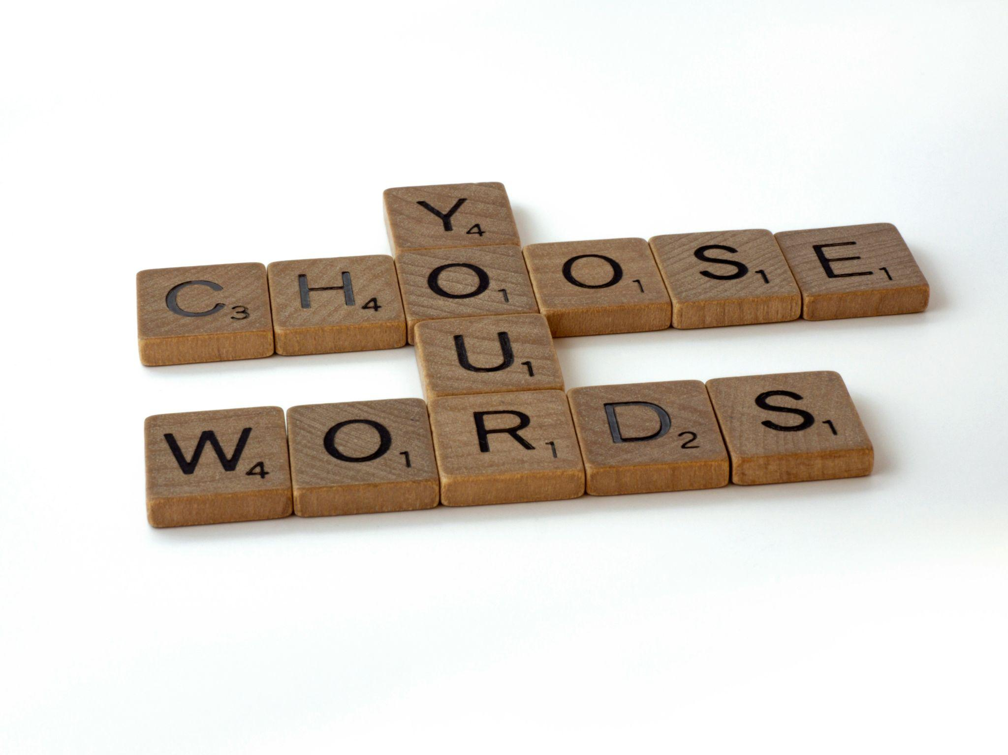
Data Augmentation
Back-translation
Translate text to another language and back
Synonym Replacement
Replace words with their synonyms [NLTK Synsets in WordNet]
Random Insertion
Random Deletion
Random Swap
Random Substitution
Image Source: Brett Jordan
Notes:
Photo by Brett Jordan on Unsplash

Slide 106
Data Augmentation
Best Practices:
Ensure augmentations don't change the meaning/label
Apply augmentation equally across classes
Manually check samples of augmented data
Combine methods for better diversity

Slide 107
❓ Why is data augmentation harder in NLP than in computer vision?
✅ Model Answer
Text augmentation is harder because small changes to words can alter meaning or label. Unlike images where flipping or rotating preserves semantics, replacing or deleting words in text may change sentiment or intent.
🧠 Intuition
Changing one word in text can completely reverse meaning: “good” → “not good”
That’s why augmentation must be careful.
❓ Name common text augmentation techniques.
✅ Model Answer
Common techniques include back-translation, synonym replacement, random insertion, random deletion, and random word swapping. Back-translation is often most reliable because it preserves semantic meaning.

Slide 108

Handling Imbalanced Data
Challenge:
Real-world text datasets often have severe class imbalance:
Spam detection (99% normal, 1% spam)
Hate speech detection (majority non-toxic)
Intent classification (some intents rare)
Image Source: Samuel Regan-Asante
Notes:
Photo by Samuel Regan-Asante on Unsplash

Slide 109
Handling Imbalanced Data
Sampling Techniques
Undersampling majority class
Oversampling minority class
Random oversampling, SMOTE for text (with word embeddings)
Loss Function Modifications
Class weights in cross-entropy loss
Inverse frequency weighting, Sqrt inverse frequency weighting
Architectural Approaches
Two-stage training
First train on balanced subset
Fine-tune on full dataset
Ensemble methods
Train multiple models on balanced subsets
Combine predictions with weighted voting
Notes:
Photo by Samuel Regan-Asante on Unsplash

Slide 110
❓ Why is class imbalance a serious issue in NLP?
✅ Model Answer
In imbalanced datasets, models tend to favor the majority class, leading to poor performance on minority classes. This results in misleading accuracy scores and poor real-world generalization.
❓ How can we handle imbalance?
✅ Model Answer
Imbalance can be addressed through sampling techniques (oversampling/undersampling), modifying the loss function using class weights, or using ensemble methods trained on balanced subsets.

Slide 111
Data Splitting Best Practices
Challenges:
Temporal dependencies in text data
News articles should be split by date
Social media conversations need chronological splits
Cross-contamination between splits
Similar documents may appear across splits
Duplicate or near-duplicate content

Slide 112
Data Splitting Best Practices
Split by document source/author when possible
Prevents data leakage from writing style
Important for authorship attribution tasks
Maintain similar topic distributions across splits
Account for domain shift between train/val/test
Conversation data
Split by conversation thread, not individual messages
Keep context-reply pairs together
Sequential data
Time-based splits for forecasting tasks

Slide 113
❓ Why is random splitting sometimes dangerous in NLP?
✅ Model Answer
Random splitting can cause data leakage when similar or duplicate documents appear across train and test sets. This leads to overly optimistic evaluation results.
❓ What is best practice for splitting sequential or conversational data?
✅ Model Answer
Sequential data should be split chronologically to prevent future information from leaking into training. Conversation data should be split by entire threads rather than individual messages.

Slide 114
Transfer Learning / FT
Full Fine-tuning
Update all model parameters
Requires more compute and data
Frozen Backbone
Only train task-specific layers
Preserves pretrained knowledge
Less prone to overfitting
Partial Freezing
Update only top N layers
Common strategy: freeze embeddings + first few layers

Slide 115
Transfer Learning / FT
Gradual Unfreezing
Process:
Start with all layers frozen except final layer
Train for N epochs
Unfreeze next layer
Repeat until desired depth
Benefits:
Prevents sudden changes to pretrained weights
Allows model to adapt gradually
Reduces overfitting risk

Slide 116
❓ What is the difference between full fine-tuning and frozen backbone?
✅ Model Answer
Full fine-tuning updates all model parameters, while frozen backbone training keeps pretrained layers fixed and only trains task-specific layers. Freezing reduces overfitting and computational cost.
❓ What is gradual unfreezing?
✅ Model Answer
Gradual unfreezing involves training the final layer first, then progressively unfreezing earlier layers. This prevents sudden disruption of pretrained weights and stabilizes training.

Slide 117
❓ What is the difference between NLTK, spaCy, and HuggingFace Transformers?
✅ Model Answer
NLTK is primarily used for traditional NLP tasks and educational purposes. spaCy provides efficient industrial-grade NLP pipelines. HuggingFace Transformers offers pretrained state-of-the-art transformer models for tasks like classification, generation, and summarization.

Slide 118
NLP libraries
NLTK (Natural Language Toolkit)
Easy-to-use interfaces for over 50 corpora and lexical resources. Used commonly in text classification, sentiment analysis, tokenization and word segmentation, part-of-speech tagging, named entity recognition, and syntactic parsing.
Documentation
spaCy
Python library for fast and efficient tokenization, pre-trained statistical models and word vectors, named entity recognition, dependency parsing, and sentence segmentation.
Documentation
transformers 🤗
Transformers is a library from HuggingFace that provides state-of-the-art machine learning models for NLP tasks. You can access to pre-trained models like BERT, GPT-2, T5, and many others. You can use their APIs to fine-tune models on custom tasks, and it supports both PyTorch and TensorFlow backends. (Also useful for non-NLP tasks like computer vision and audio)
Documentation

Slide 119
NLP libraries
👉 Code tutorial for applications in main libraries:
NLTK
Tokenization
Parts-of-speech Tagging
spaCy
Named Entity Recognition
Dependency Parsing
transformers
Sentiment Analysis
Text Summarization
Text Generation

Slide 120
Next Week:
Attention & Transformers
Attention Fundamentals
Transformer Architecture
Popular Implementations (BERT, GPT)
Applied NLP
Text Similarity
Text Summarization
Topic Modeling
Advanced Topics
LLMs
Multimodal models (CLIP)

