Slide 1



Temperature Prediction
RDU Airport Hourly Forecasting
Roshan • Yifei • Keming

Slide 2
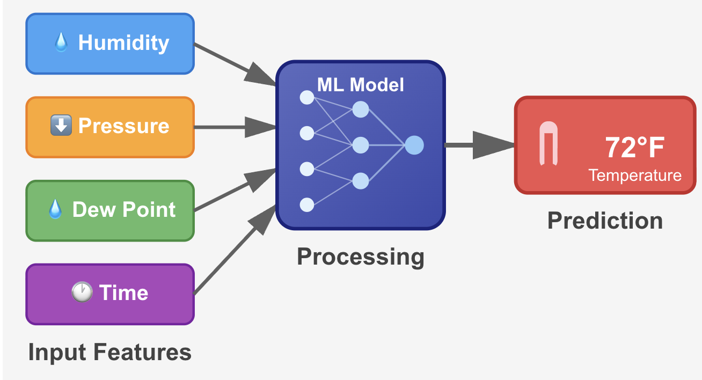
Goal
Predict hourly temperature at RDU Airport for:
September 17–30, 2025
Models we used:
Linear Regression
XGBoost
Random Forest
LSTM
Notes:
So our project focuses on hourly temperature forecasting at RDU Airport, from September 17th to 30th, 2025.
Specifically, we experimented with Linear Regression, XGBoost, Random Forest, and LSTM to handle this task.

Slide 3
Data Pipeline
1
Data Collection
Open Meteo API 1 year of hourly data (Sep 16 2024–Sep 16 2025)
2
Feature Selection
Humidity, pressure, dew point, cyclical time transformation
3
Preprocessing
Remove missing values • 80/20 temporal train/val split
4
Model Training & Evaluation
Multiple models. MAE, RMSE, R² metrics

Slide 4


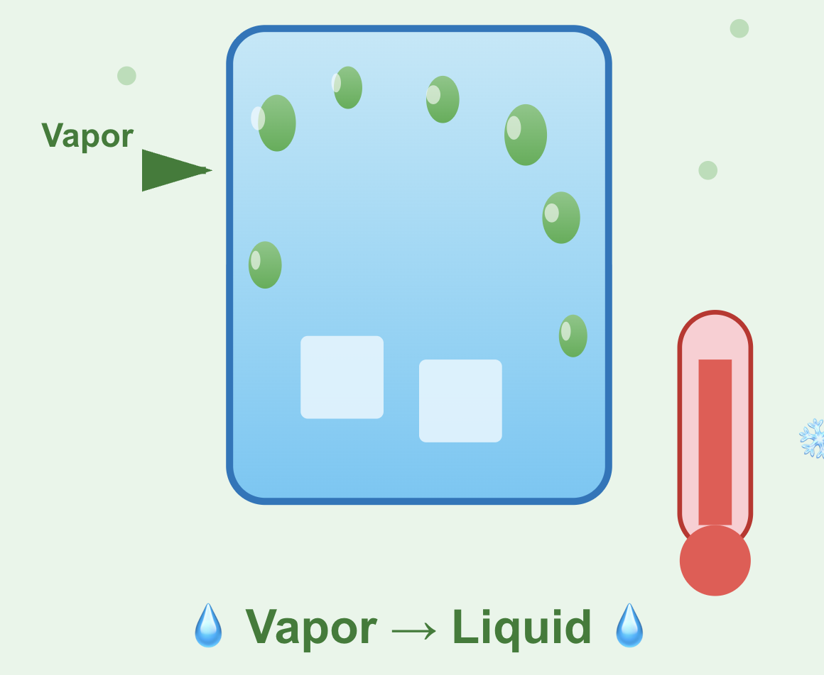
Atmospheric Features
Amount of water captured in air affects how warm or cool it feels
Air pressure changes bring different temperatures
Temperature when water vapor turns to dew shows moisture level

Slide 5
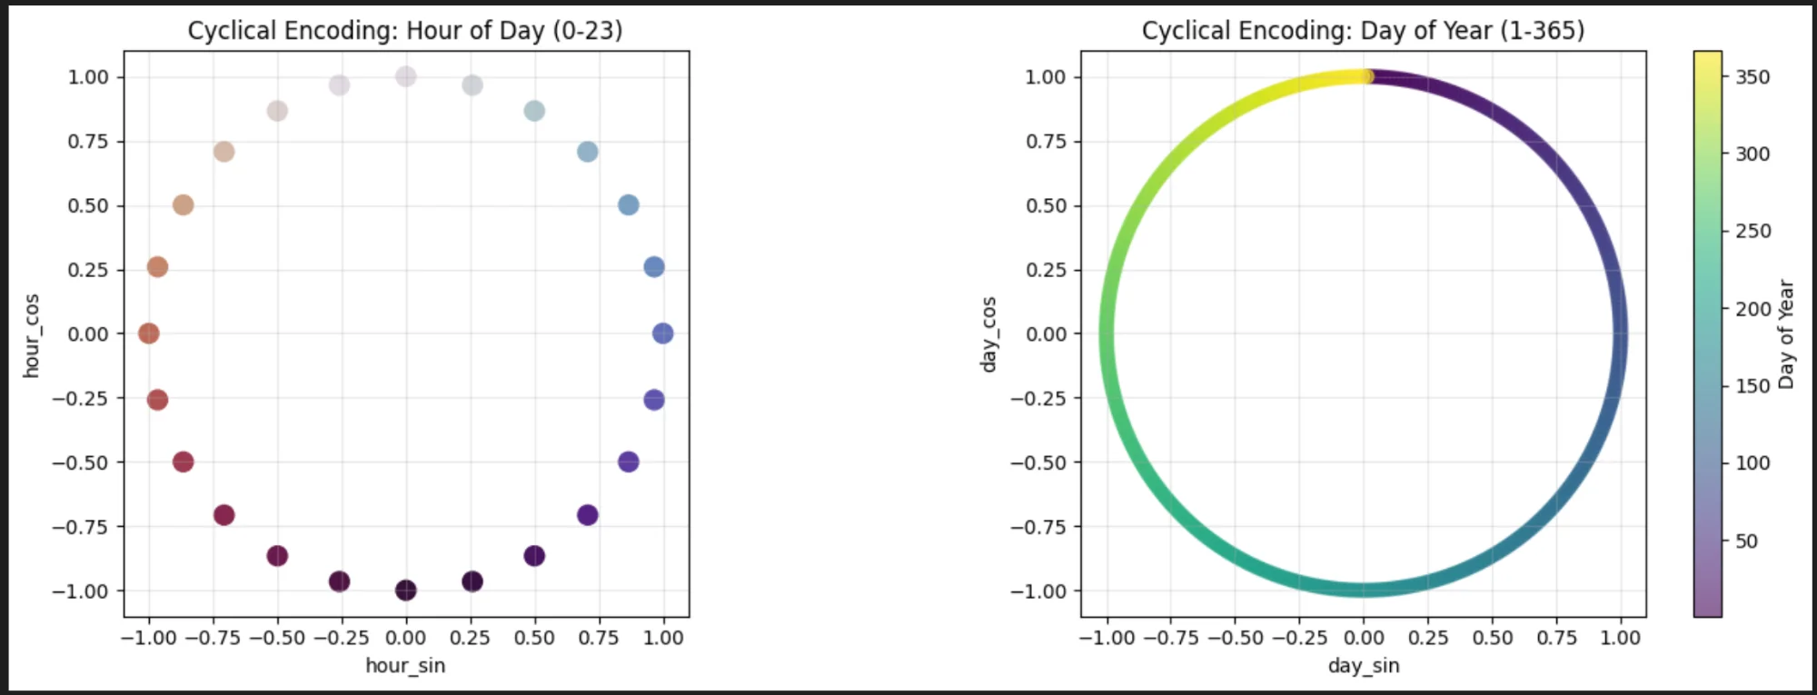
Cyclical Transformation
Hour and day transformed using sin/cos to capture circular nature of time
Why??
Hour 23 and Hour 0 are close by, not 23 units apart! Same goes for Day 1 and Day 365

Slide 6
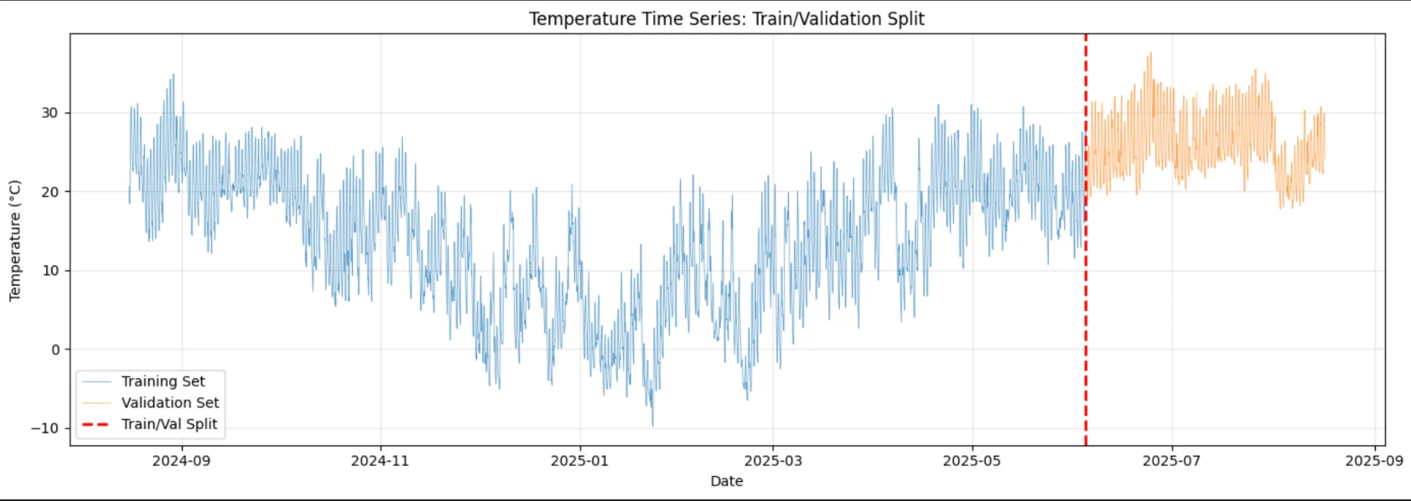
Train/Val/Test Strategy
Temporal Split (80/20): Mimics real world forecasting and prevents data leakage
Train: Aug 16, 2024 → Jun 4, 2025 (7,027 records)
Validation: Jun 4, 2025 → Aug 16, 2025 (1,757 records)
Test: Sep 17–30, 2025 (336 hours)

Slide 7
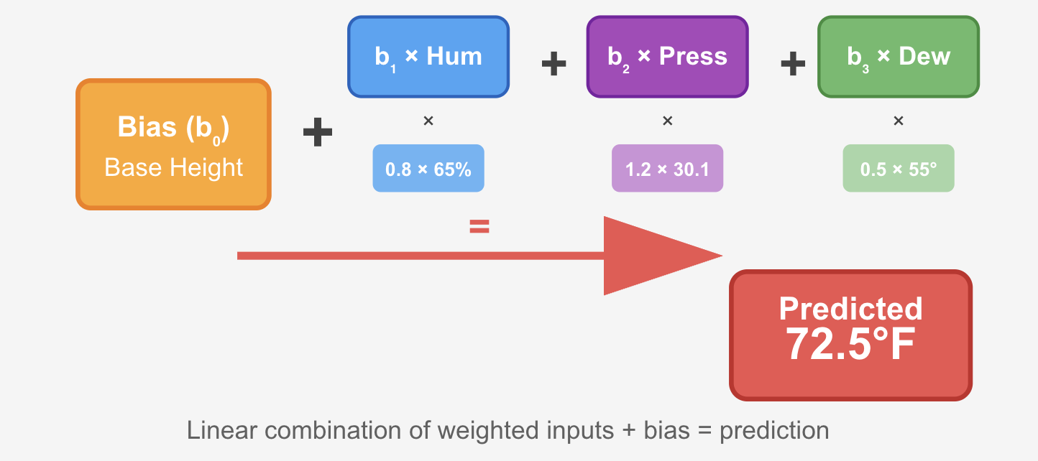
Linear Regression
Maps linear relationships between atmospheric conditions and temperature using weighted features
Why Begin Here?
Coefficients show feature importance
Fast to train and evaluate
Strong baseline for comparison

Slide 8
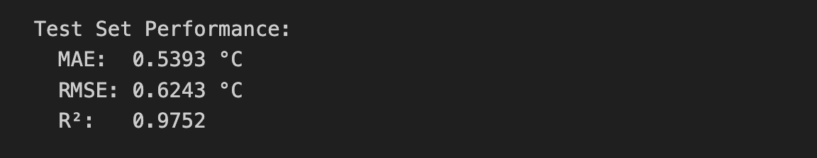
Results
R² of 0.975 explains 97.5% of temperature variance, meaning our features capture almost all predictable temperature patterns with only 2.5% left to random noise.
With an MAE of 0.54°C, our model's predictions are typically wrong by just half a degree Celsius
An RMSE of 0.62°C determines that even our worst predictions rarely went over a 1-2° error, indicating consistent accuracy without any extreme outliers.

Slide 9
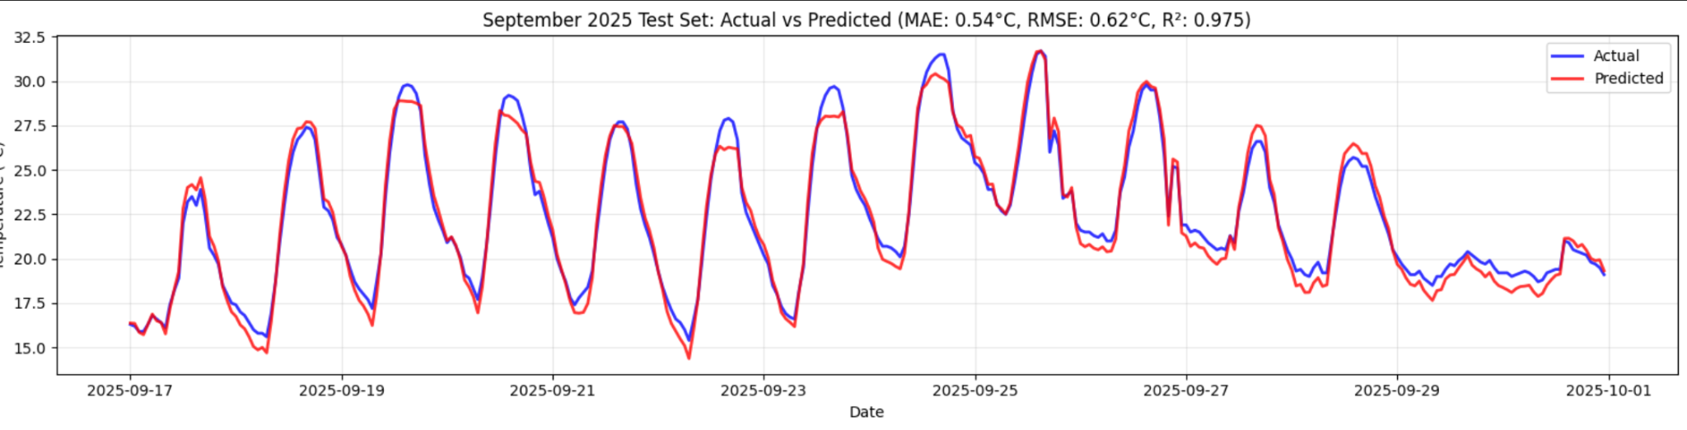
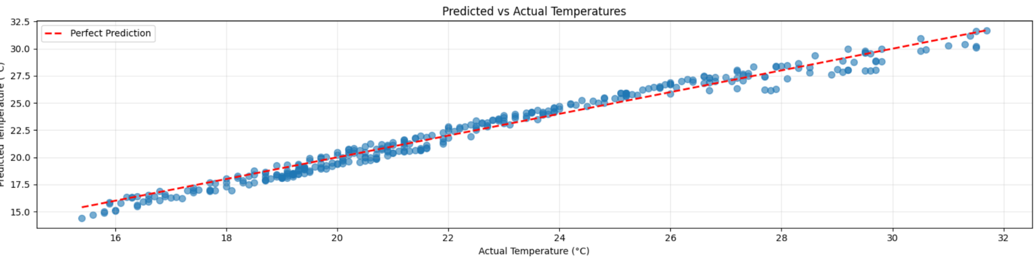
Charts!

Slide 10
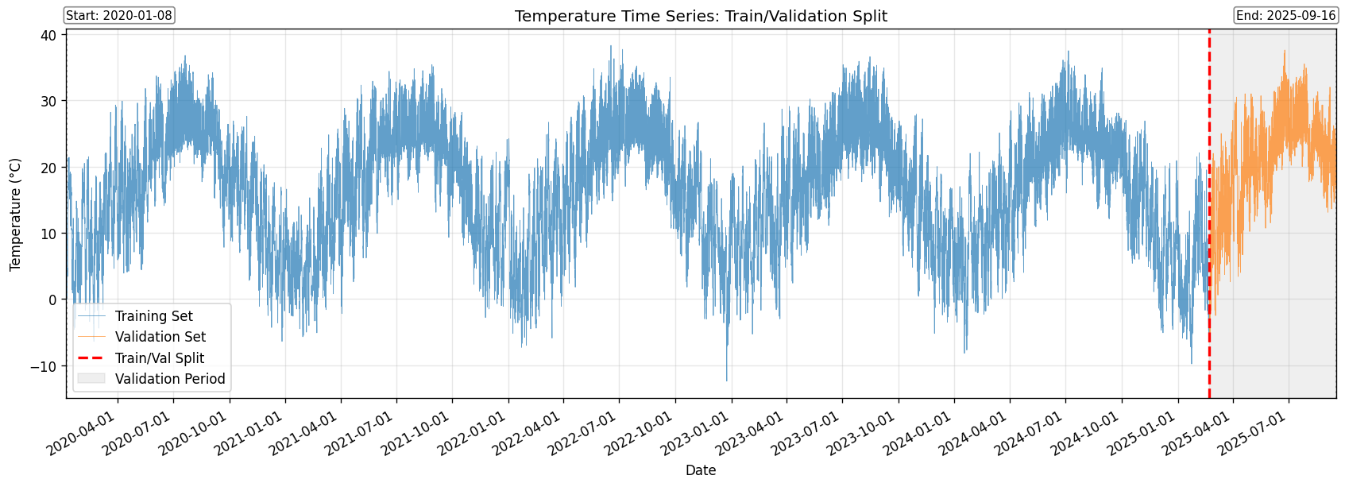
🌳 XGBoost - Data & Features
Leakage-safe test construction (9/17–9/30)
Use real observed values if available.
Use average of the same month-day-hour over 2020–2024 if real values not available.
Never peeking past 9/16.
Time/Cyclical (leak-free)
hour, day_of_week, is_weekend
sin_hour, cos_hour (24-hour cycle)
sin_doy, cos_doy (365-day cycle)
Lag & Diff (from observed temps)
Lags: temp_lag_1, temp_lag_24, temp_lag_48, temp_lag_72, temp_lag_168
First difference: temp_diff_1 = temp(t-1) − temp(t-2)
Rolling statistics (pandas, min_periods=24)
Means: roll_mean_24, roll_mean_168
STDs: roll_std_24, roll_std_168
Notes:
20s
For XGBoost, we uses hourly temperatures from 2020 to 2025 with standard time and lag features.
The key point is that to avoid data leakage, all future-dependent test features were simply replaced with 5-year historical averages.

Slide 11
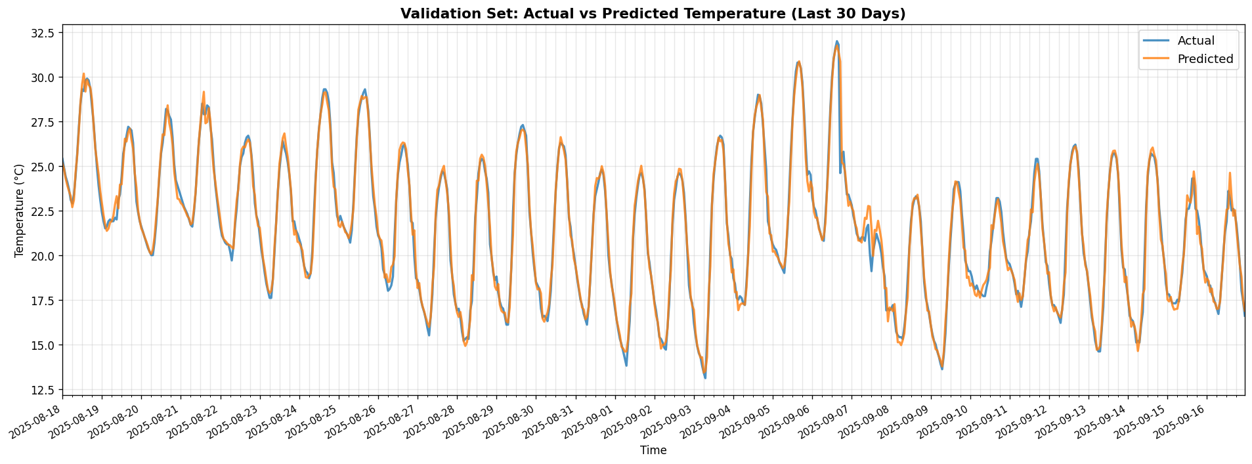
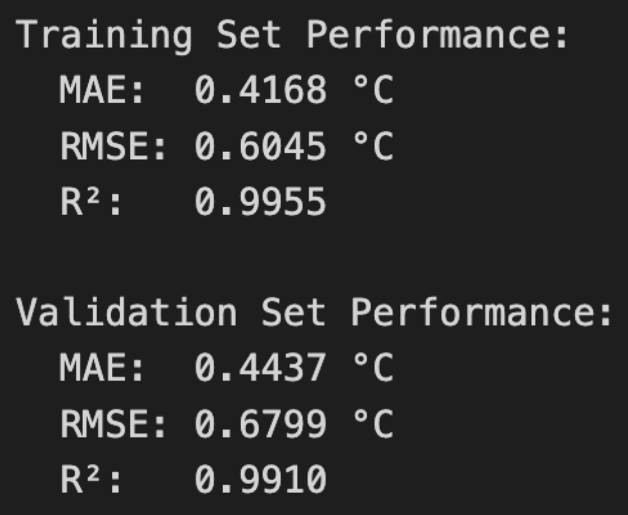
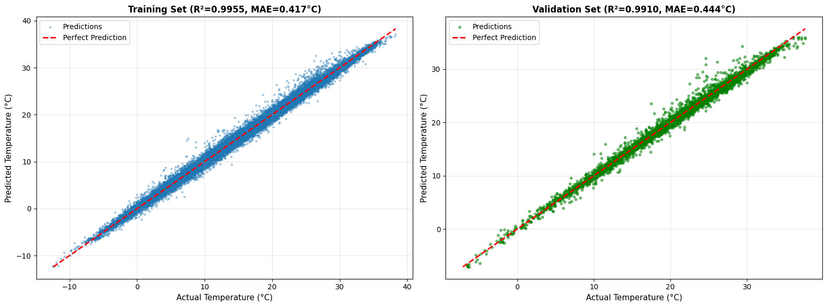
🌳 XGBoost - Training & Validation
Notes:
9s
First, we trained our XGBoost model on the training and validation datasets and the performance was excellent on both sets.

Slide 12
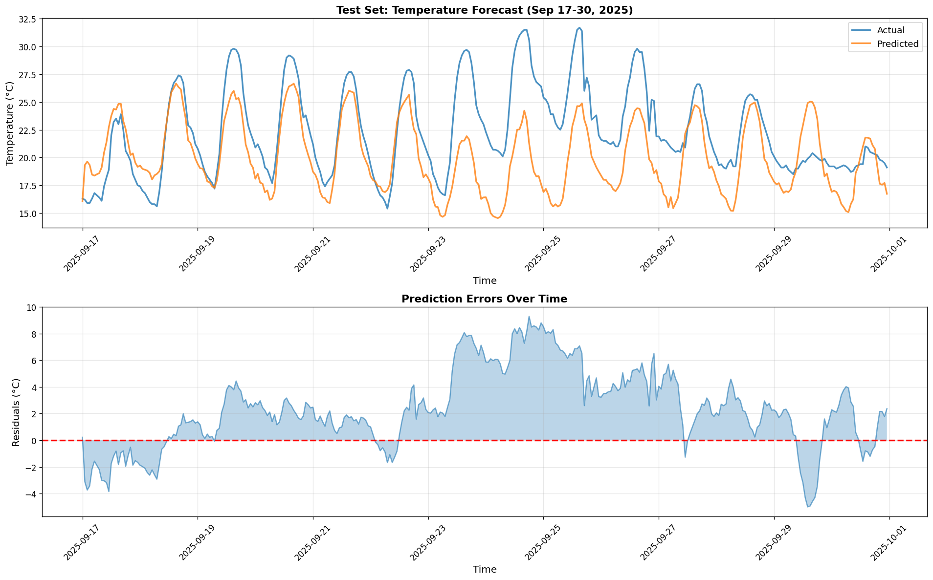
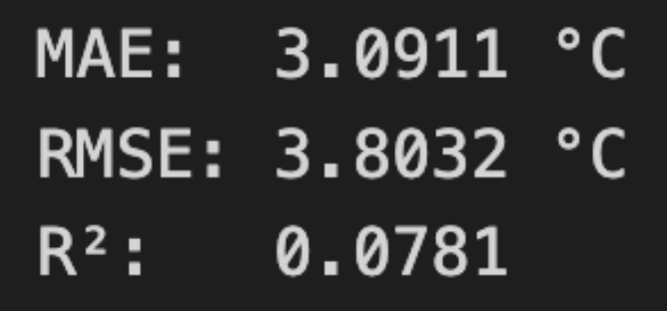
🌳 XGBoost - Testing
Why?
Notes:
9s
However, when we applied this to the actual test set, the performance dropped dramatically. So we asked why?

Slide 13
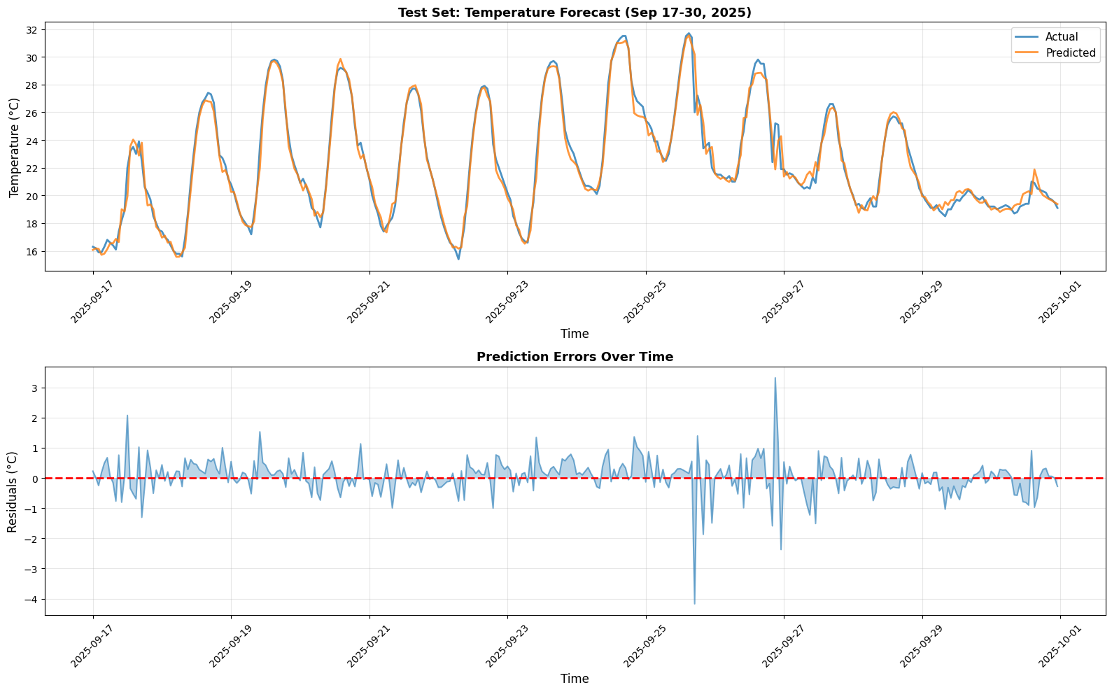
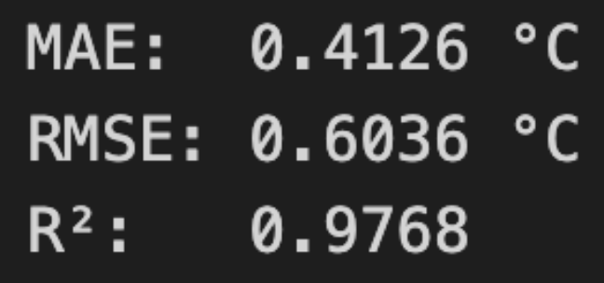
🌳 XGBoost - Test on the Dataset
Peek in the real values from the test period (lags, roll mean etc.)
Use the features based on real values for the testing inference
Notes:
32s
Our theory was that the input features were the problem. For a real forecast, we can't use future data, so we filled features like temperature lags with historical averages.
To test this, we ran a 'cheat' experiment using the actual test values to create the features. The performance immediately returned to its previous high level. This proved the model isn't the problem—the quality of its input data is.

Slide 14
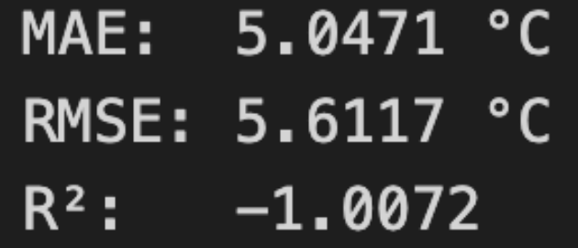
🌳 XGBoost - Test on Rolling
Why the Drop?
⚙️ Error Accumulation
Small prediction errors loop back into the model.
Each step compounds the previous bias → errors snowball over time.
📊 Distribution Shift
Model trained on real observed data.
During rolling inference, it relies on its own predictions, which deviate from the true data distribution → rapid performance decay.
Rolling Forecast Setup
Historical averages didn’t work → we tried a rolling forecast.
Predict next hour’s temperature → feed it back as input for the next step.
Repeat this process hour by hour for the 14-day test window.
Notes:
31s
Since historical data failed, we tried a rolling forecast, where the model uses its own predictions as inputs for the next step.
However, this was even worse. The reason is twofold: First, Error Accumulation, where small mistakes snowball over time. And second, Distribution Shift; the model was trained on real data and gets lost when it's only fed its own predictions.

Slide 15
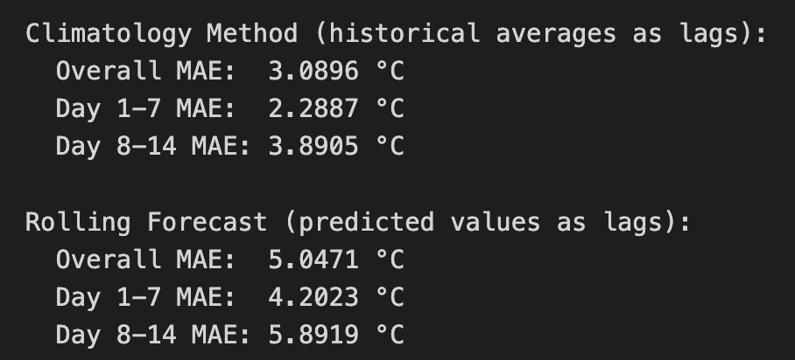
🌳 XGBoost - Errors in 2 Weeks
Error Trend Overview
For both methods, the error clearly increases in the second week.
Key Observation (Sep 23–26)
The actual temperature shows a noticeable upward trend.
The model prediction stays flat, failing to capture this short-term rise.
Notes:
31s
Looking at the two-week error, you can see it gets worse in the second week, which is expected as forecasts extend further out.
More importantly, notice the large error in the middle. The model's prediction stayed flat while the actual temperature rose. This is a clear sign that the historical data we used for its features failed to capture this specific weather event, creating a large systematic error.

Slide 16
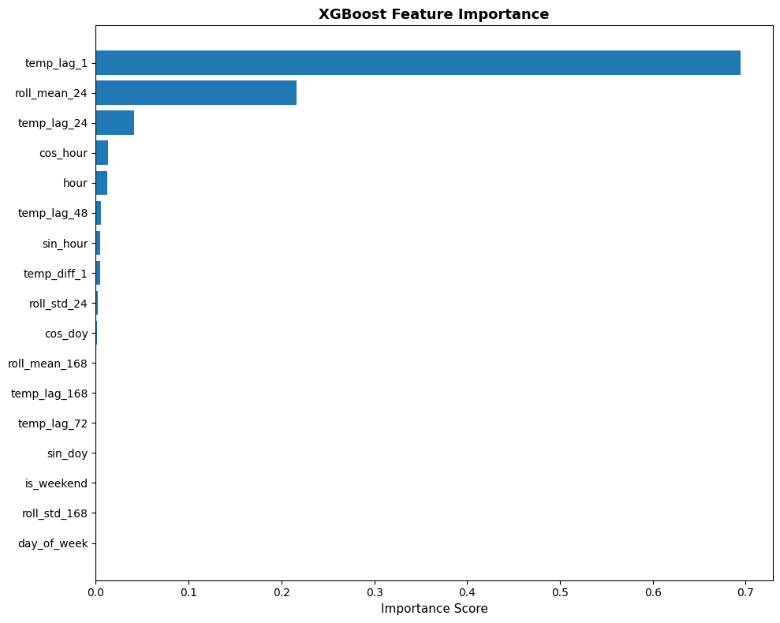
🌳 XGBoost - How the model thinks
Feature Importance
The chart shows the model relies heavily on temp_lag_1, the temperature from the previous hour.
That’s reasonable, temperature changes smoothly over short time intervals.
The Core Issue
Only the first prediction used a true value for temp_lag_1.
Every following step used non-real data, either historical averages or the model’s own previous outputs.
This created a feedback loop of unreliable inputs, causing errors to grow over time.
Notes:
40s
This feature importance chart explains exactly why the model failed. It's almost completely dependent on temp_lag_1, the temperature from the previous hour.
While this is logical, it's the fatal flaw. Only our very first prediction used a real past temperature. After that, every forecast was fed either a historical average or its own prior prediction. This feedback loop of bad data can easily cause the model to fail.
So, now that we've identified what doesn't work, next let's see what actually works.

Slide 17
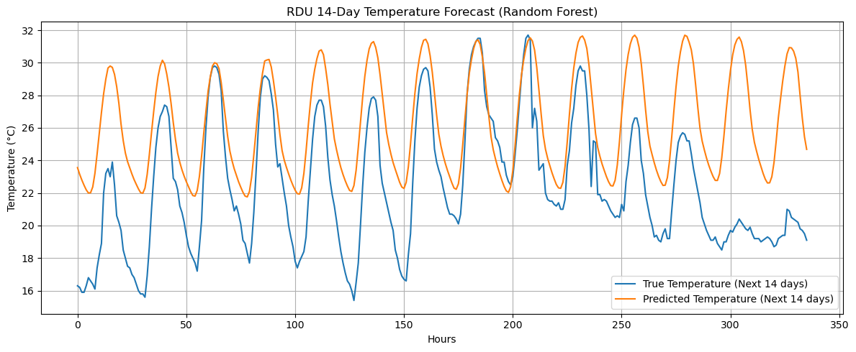
🌲 Random Forest
Predictions are smooth and robust, yet lag behind sudden changes.
Captures average behavior but not sequential dynamics.
it doesn’t ‘see’ the order of events, so while it’s robust, it can’t respond quickly to short-term shifts like temperature spikes or drops.
Notes:
Although Random Forest performs well on structured tabular data, its static nature prevents it from understanding temporal continuity. Each tree in the ensemble treats every record as an independent sample — it does not know that one hour follows another or that a sudden cold front at 3 AM is related to temperature trends at 2 AM. This means it can only learn average conditional relationships like “high humidity → lower temperature,” but not temporal transitions such as “a sharp humidity drop in consecutive hours indicates an upcoming temperature rise.” Consequently, Random Forest tends to smooth out fluctuations, producing forecasts that are stable but insensitive to abrupt shifts. In time-series contexts, this leads to underreaction during short-term temperature spikes or drops, as the model cannot propagate information from one timestamp to the next.

Slide 18
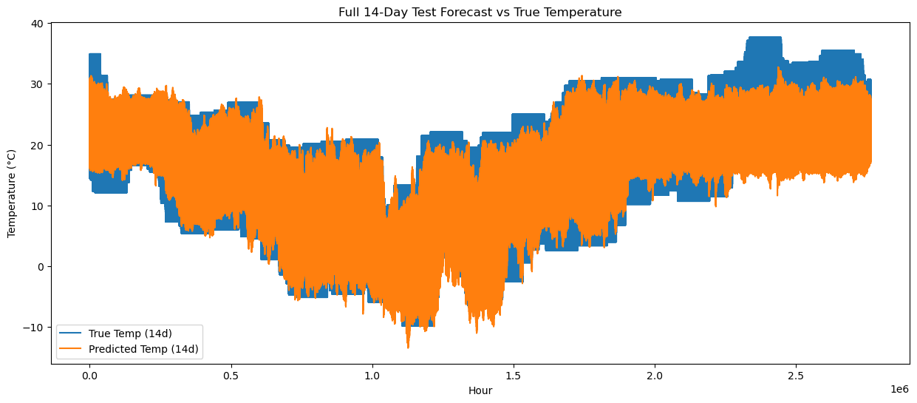

🔄 LSTM
An encoder–decoder LSTM captures both short- and long-term temporal dependencies from past observations to produce multi-step forecasts.
Cyclical encoding (sin/cos) for hour/day to reflect time continuity
Rolling stats & differences capture local temperature trends
Holiday & weekend features add context for urban heat effects
BatchNorm + Dropout + adaptive learning rate
Notes:
The LSTM model treats temperature as a dynamic sequence. We added cyclic time encoding using sine and cosine functions so the model understands that hour 23 and hour 0 are adjacent. We also included rolling means, differences, weekends, and even holidays — since airports experience heat island effects during low-traffic periods. Combined with dropout, batch normalization, and adaptive learning rates, this setup helped the model adapt to limited data and still capture the time-series rhythm quite well.

Slide 19
⚖️ Model–Problem Fit
Understanding Model Behavior
Linear Regression | XGBoost
Random Forest | LSTM
Type: Time-series regression on small, continuous, site-specific data (RDU Airport). Data: Strong autocorrelation & daily periodicity, limited variability, mild noise (urban heat island). Key Challenge: Small dataset size limits deep model performance.
Model Fit:
Linear Regression: Best stable global fit, low overfitting. Random Forest / XGBoost: Capture nonlinearities but static, lack temporal continuity. LSTM: Learns dynamics but constrained by small data; mild overfitting.
For small, smooth time-series data, simple models can outperform complex ones — sometimes, simplicity wins.
Notes:
LSTM: Dynamic and adaptive, learns from past sequences
Random Forest: Static and memoryless, predicts from fixed rules
Small-data limitation: LSTM’s performance still below ideal due to limited samples
RF = stability, LSTM = flexibility — both valuable in practice
Deep models excel in temporal pattern recognition, but feature design remains essential

Slide 20
🌤️
Thank You!
Questions?

