Slide 1


Introduction to Julia Programming Language
Alper Kinaci, PhD
Sr. Computational Specialist
akinaci@northwestern.edu
Pascal Paschos, PhD
Sr. HPC Specialist
pascal.paschos@northwestern.edu
Research Computing
Services

Slide 2
Outline
Introduction to Julia (short presentation)
Live coding (using Jupyter notebook)
Parallelization demonstration

Slide 3
Julia Language
“Walk like Python, run like C”
Designed for ease-of-use (Python, MATLAB, R) and speed (C, C++) for high performance computational science
Borrowing from Python, C, C++, MATLAB, Lisp, Perl, Lua, Ruby
Open source, object-oriented, good for general-purpose programming
Designed for parallelism and distributed computing
Call for C & Fortran functions directly (no wrappers or special API)
20+ years younger than Python, still maturing in terms of available packages and extensibility

Slide 4
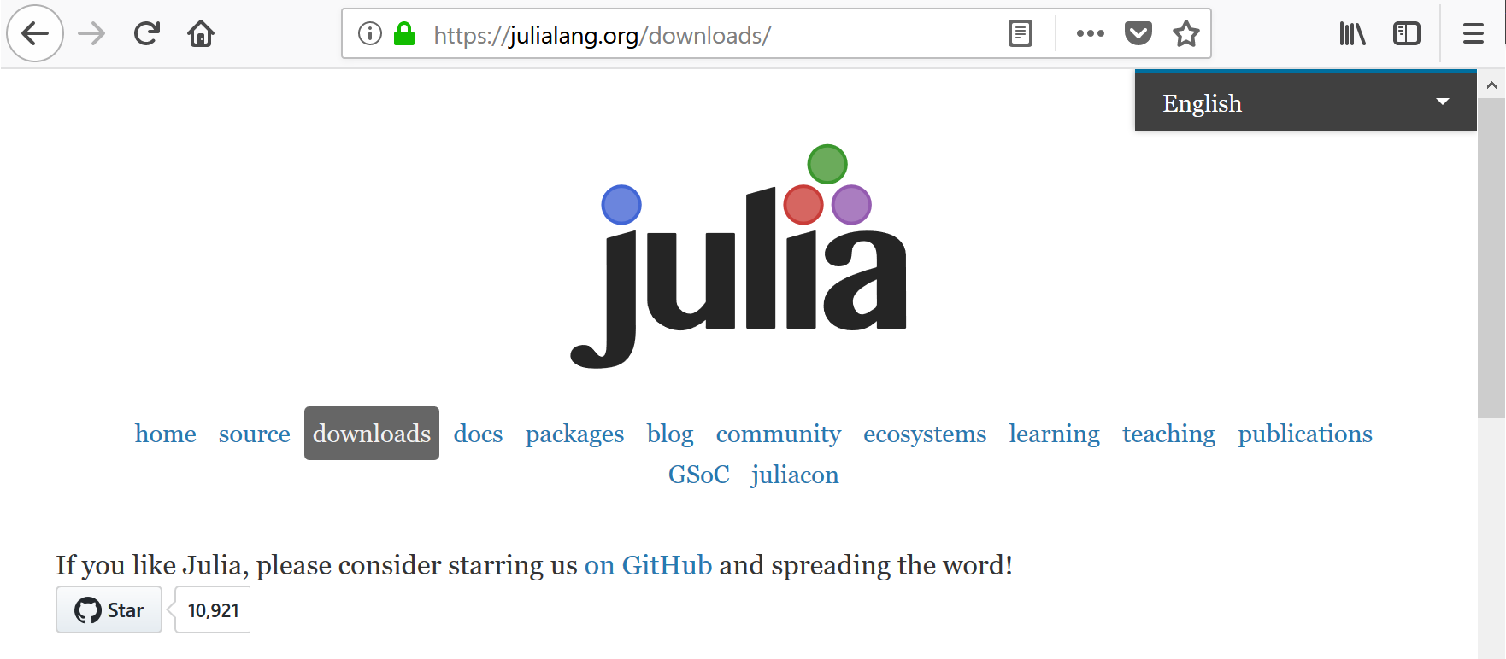
How to Get Julia
https://julialang.org/downloads/

Slide 5
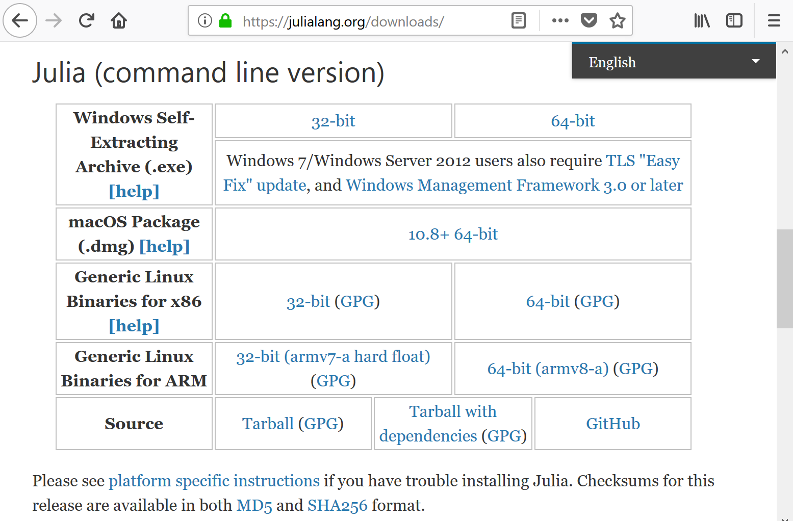
How to Get Julia

Slide 6
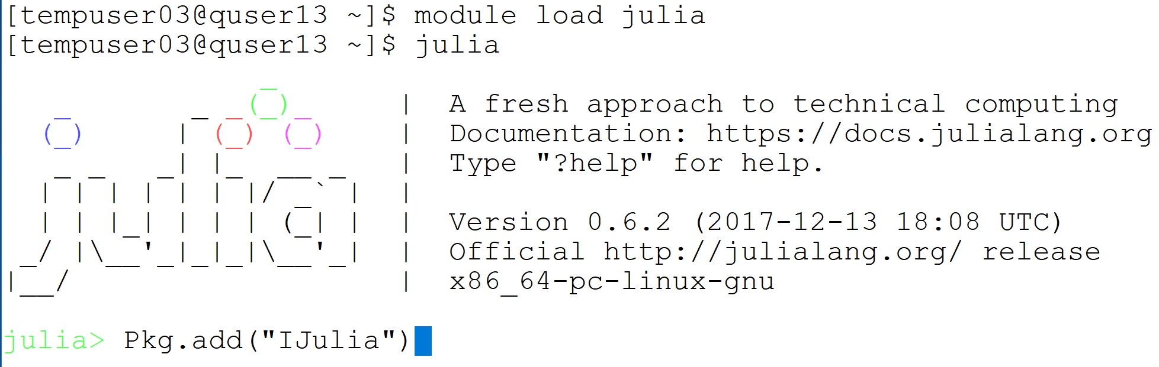

How to Get IJulia
https://github.com/JuliaLang/IJulia.jl

Slide 7
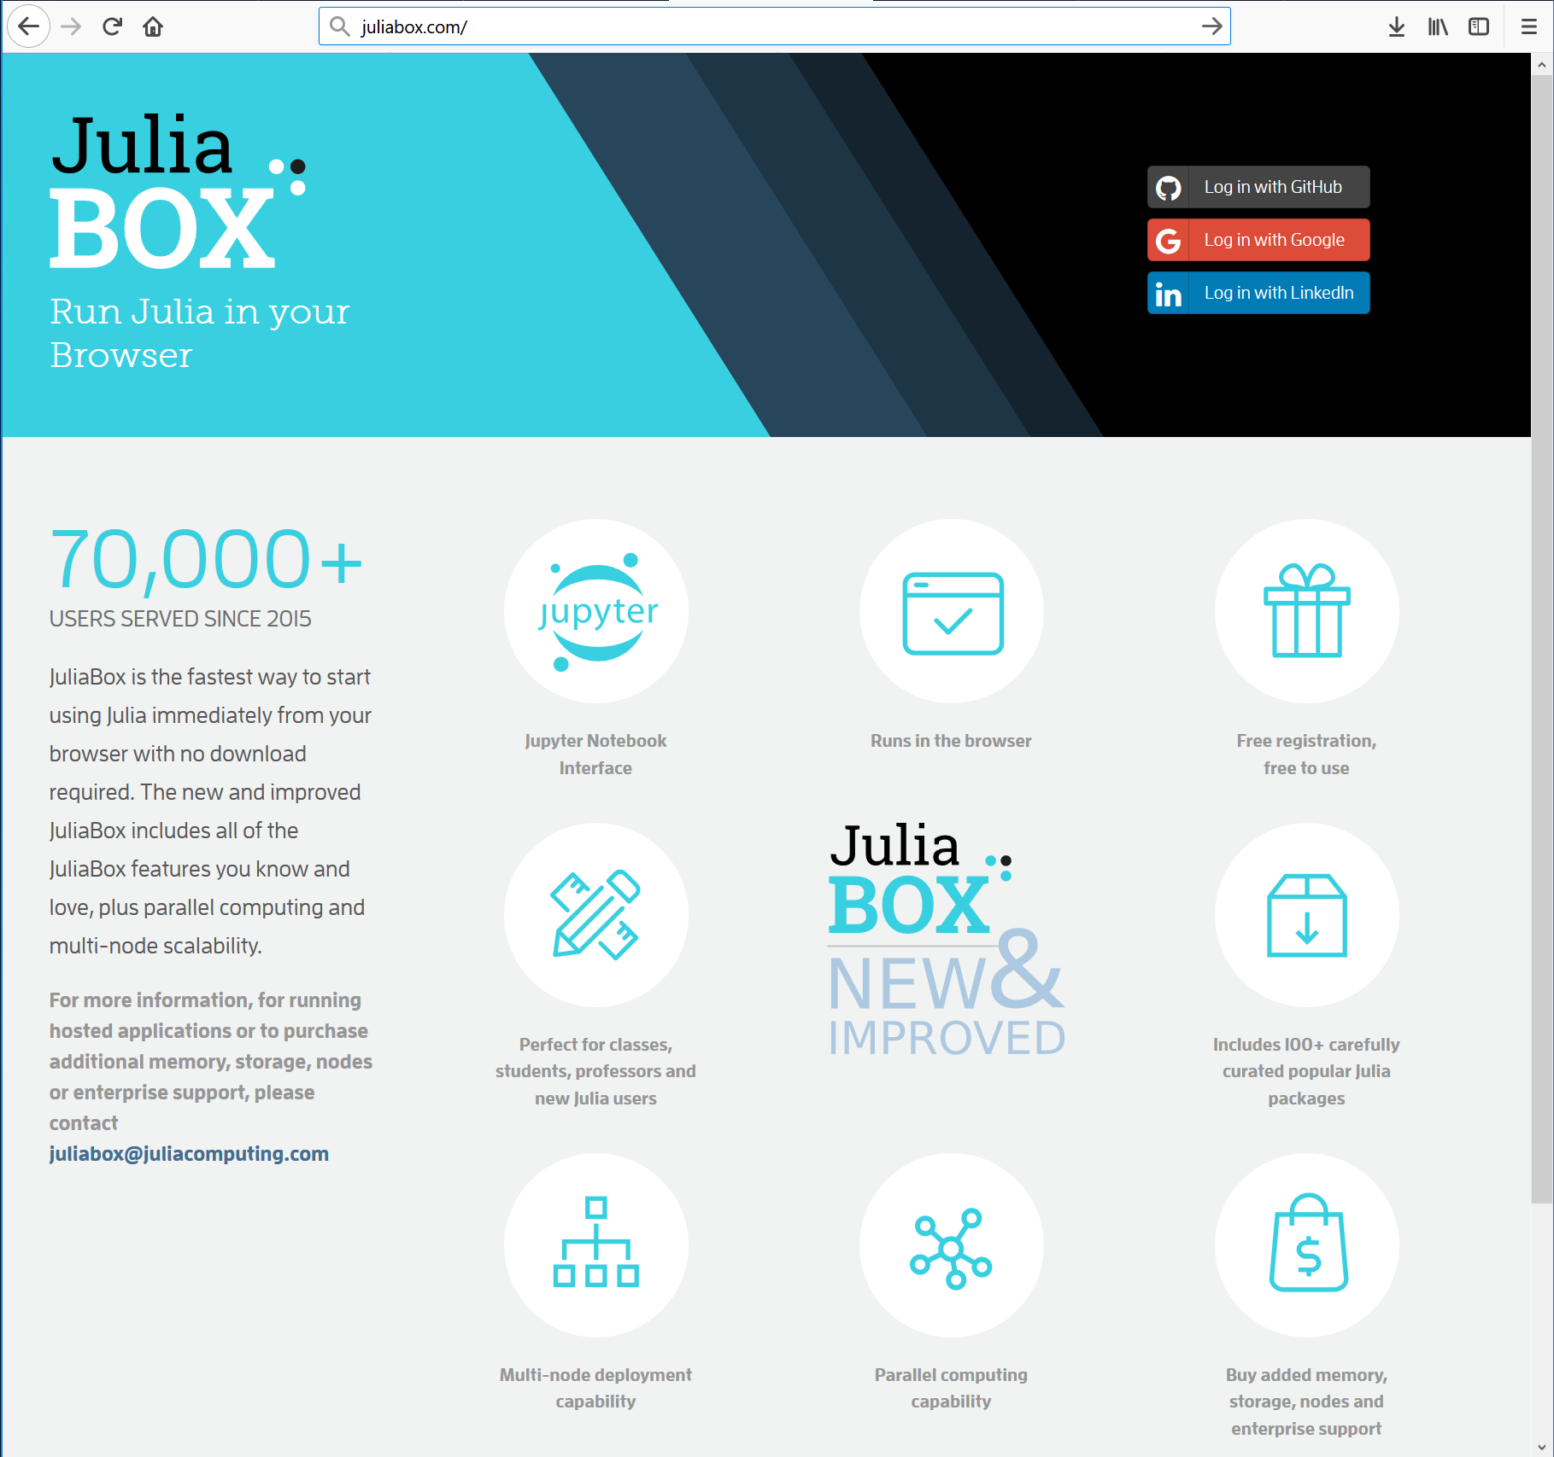
Instant Julia
https://juliabox.com

Slide 8
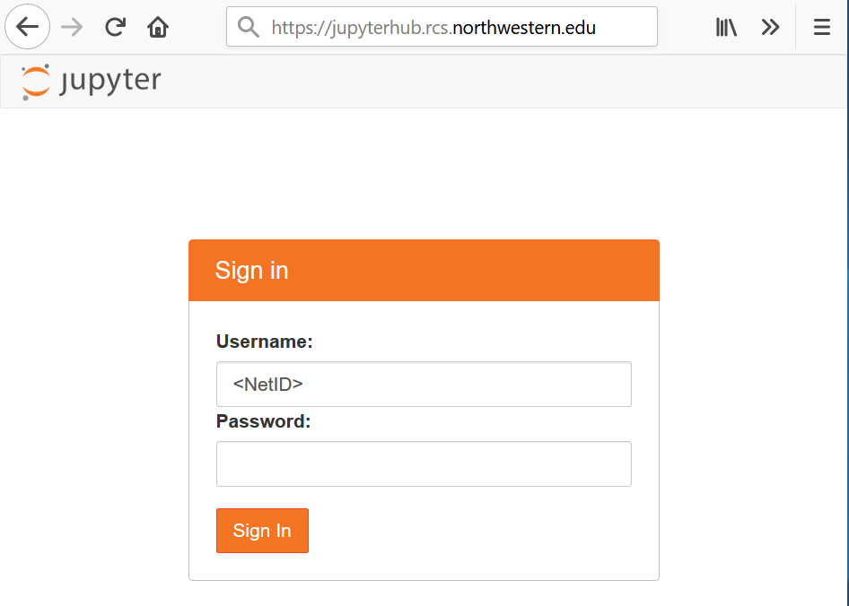
Connect to Jupyter Hub
The live coding part will use Jupyter notebook
The Jupyter Hub will be available during the session
https://jupyterhub.rcs.northwestern.edu

Slide 9
References
Julia documentation [https://docs.julialang.org/en/stable/index.html]
http://samuelcolvin.github.io/JuliaByExample/
http://math.mit.edu/~stevenj/Julia-cheatsheet.pdf
http://courses.csail.mit.edu/18.337/2017/
Beginning Julia Programming, Sandeep Nagar, 2017[https://link.springer.com/book/10.1007%2F978-1-4842-3171-5]

Slide 10
Parallel Computing in Julia
We will be demonstrating two ways of using Julia for parallel computing – We will not discuss the Coroutine method or native multithreading as of ver. 0.6
Native distributed multiprocessing. Limited to a single machine (node)
Julia MPI implementation - Multinode extension

Slide 11
Native Distributed Multiprocessing
You can invoke Julia as: julia –p (n-1) to launch (n-1) workers + master
Caution. Significant changes in the syntax between current and earlier versions
One sided communication to remote objects with distributed memory allocation
Use of functions and macros to launch tasks and collect results, e.g.
remotecall(func,id,args): launch a task to worker id
fetch(value_of_remotecall): return remote calculation to master
@everywhere : launch to all – including master
@spawnat : evaluates on remote
@parallel: automatic loop parallelization

Slide 12
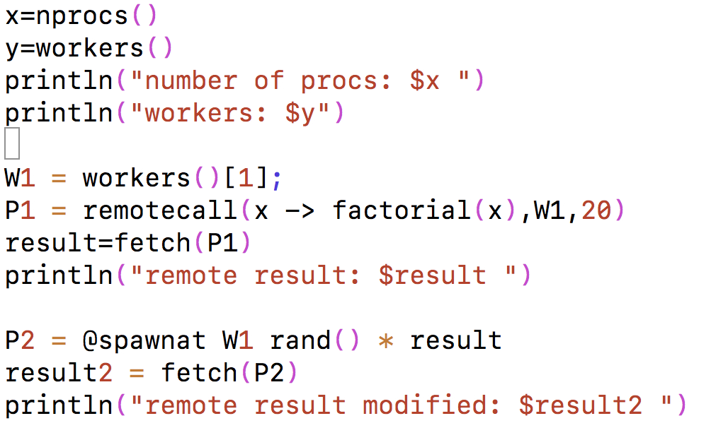
Native Distributed Multiprocessing

Slide 13
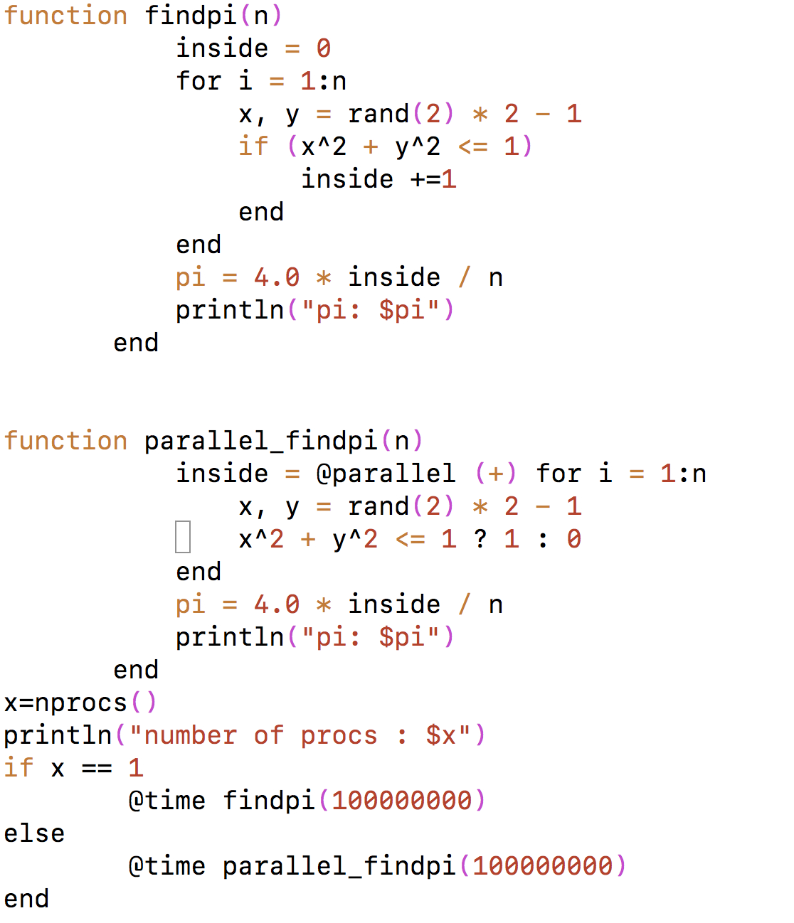
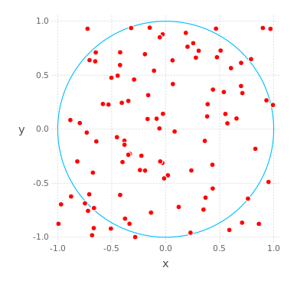
Parallel Pi in Julia
π = 4 x fraction of points in circle

Slide 14
MPI with Julia
MPI is one of Julia’s packages.
Restores communication to MPI standard allowing Julia tasks to be distributed over a network of computers (nodes), aka cluster
Remarkably similar to Python’s mpi4py
julia> Pkg.add(“MPI”)
User must supply the MPI wrappers, e.g. mpirun
On Quest:
mpirun –np <N> julia <Julia_mpi_code>.jl

