Slide 1
TASK 3: INTERACTIVE SALES DASHBOARD DESIGN
PRESENTED BY: NMERIBE SOPHIA
Objective Design an interactive Power BI dashboard for business stakeholders using the Global Superstore dataset.
Dataset & Tools Global Superstore Dataset (Kaggle) Tool: Microsoft Power BI Data Preparation: Power Query
Data Cleaning & Preparation • Dataset: 24 columns, 51,290 rows • Removed duplicate records • Removed Postal Code column due to null values and irrelevance • Retained negative profit values as valid business losses • Created a Date Table and DAX measures
KPIs • Total Revenue: $12.64M • Total Profit: $1.47M • Total Orders: 51K • Profit Margin: 11.6%

Slide 2
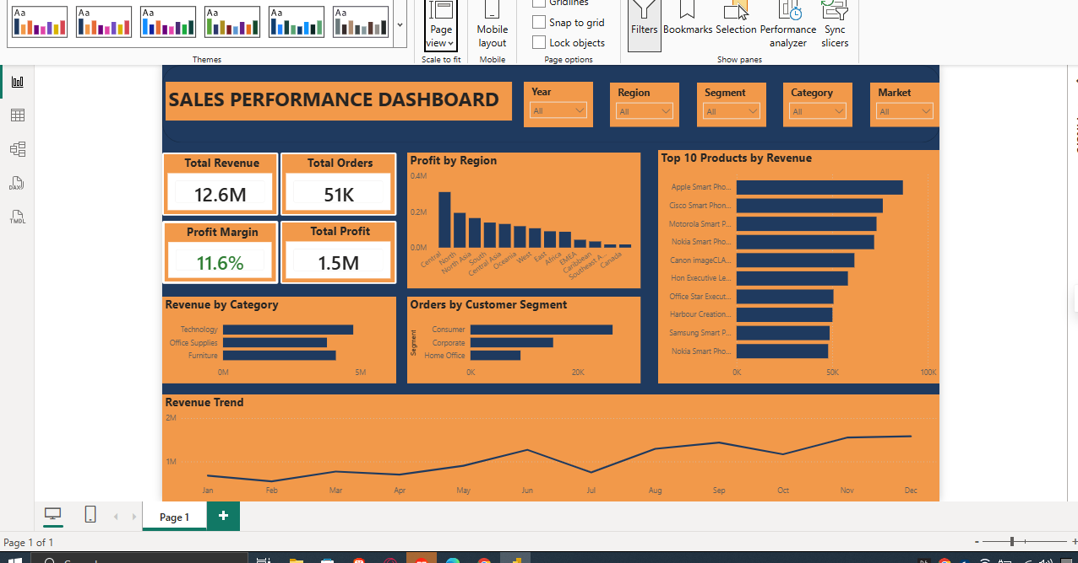
KEY BUSINESS INSIGHTS
Revenue fluctuated across the year, with peak sales in September, November and December.
The Central Region generated the highest overall profit.
Technology was the highest revenue-generating category, followed by Furniture.
The Consumer segment recorded the highest patronage, while Home Office had the lowest.
Apple Smart Phone generated the highest revenue among all products.
The dashboard enables stakeholders to monitor performance, identify profitable regions and products, and make

