Slide 1
Sprint 3
For the user story: I want to use a different EA.

Slide 2
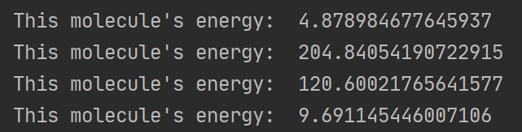
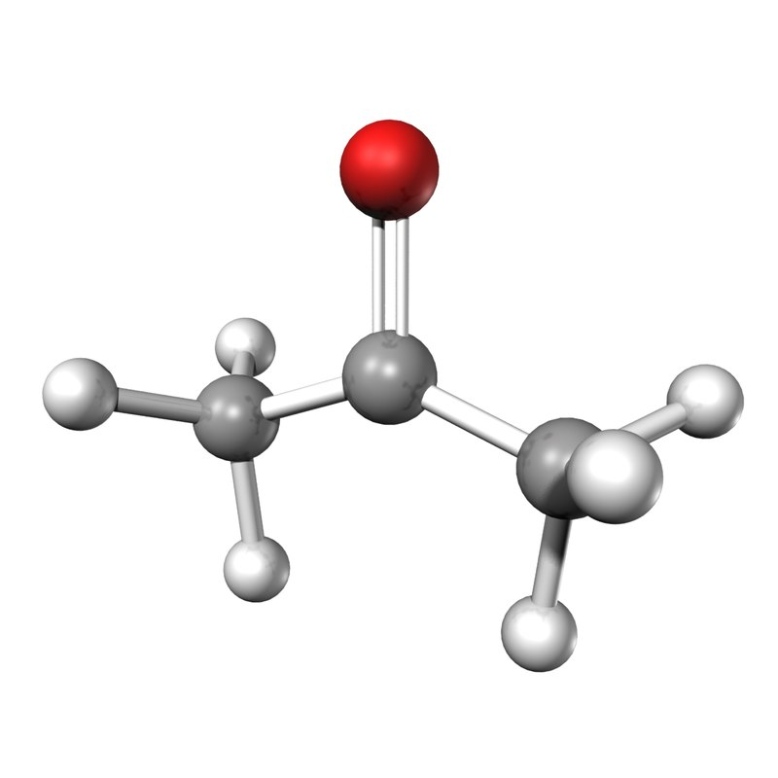
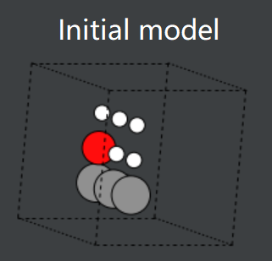
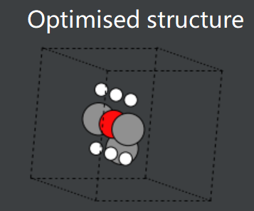
The previous sprint
It didn’t perform well. It immediately found a (poor) local minimum and stayed there, because:
Population was too small. Improved.
Mutations were too big or too small. Improved.
Atom movements were almost always unfavourable, apart from permutations. Not improved.
Stopping criterion wasn’t thorough/specific enough. Improved.
Effective Medium Theory is not accurate. Not improved.
Acetone example:
Actual structure
It is closer to the actual structure, but it’s not very good.

Slide 3
New EA – Idea
Previous problem: Atom movements were almost always unfavourable, apart from permutations.
Previous problem: Atoms move too far apart.
For the new EA, try moving 1 atom at a time.
Start with 2 atoms in the cell, and add one at a time.
Each time an atom is added, adjust all atoms in the cell.
Move using a Gaussian distribution around the centre of each atom.

Slide 4
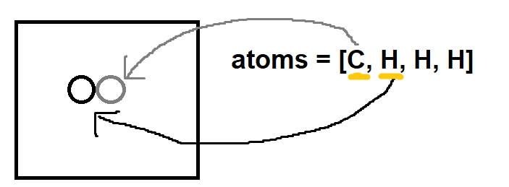
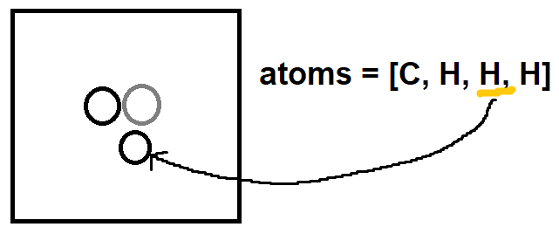
New EA – Plan
Start with 2 atoms in the cell, and add one at a time.
1
2

Slide 5
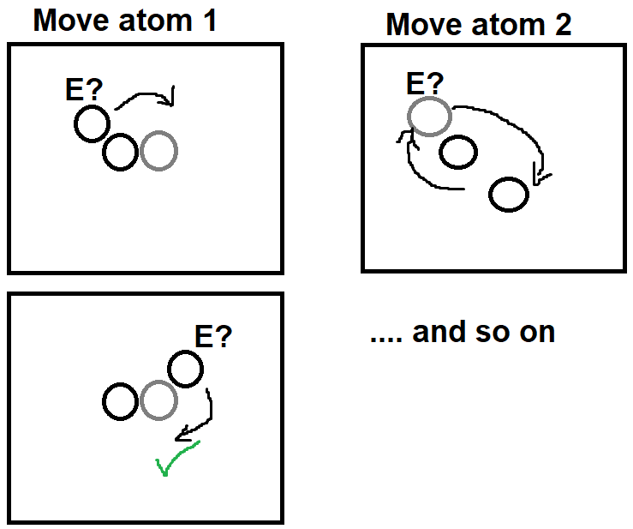
New EA – Plan
Each time an atom is added, adjust all atoms in the cell.
Move using a Gaussian distribution around the centre of each atom.

Slide 6
Show comparison

Slide 7
New EA - problems
Exponential increase in time taken (lots of nested for loops) as input size increases.
Atom movements are still mostly unfavourable.
Still getting stuck in local minima.
EMT is still being used (instead of DFT).
My poor, trusty computer is working really hard - thousands of calculations, array changes & function calls per iteration.

Slide 8

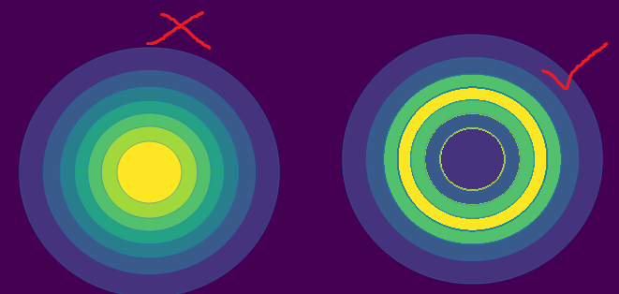
Next steps for the end of sprint 3
Get VASP or another DFT calculator working.
Try using each atom’s relative size as a way of defining the standard deviation of the Gaussian distribution for atom movements, to create more favourable movements.
Use Python’s Multiprocessing to reduce time spent in loops.
Specifically move atoms closer or further apart as the algorithm progresses rather than just moving them randomly.
Apply code optimisations like those learnt in the Vasilios module.
Use a radial distribution function (doughnut) instead of Gaussian:

Slide 9
Ask David:
Please can you help me with the VASP installation? Zach has tried to help me but we couldn’t do it.

