Slide 1
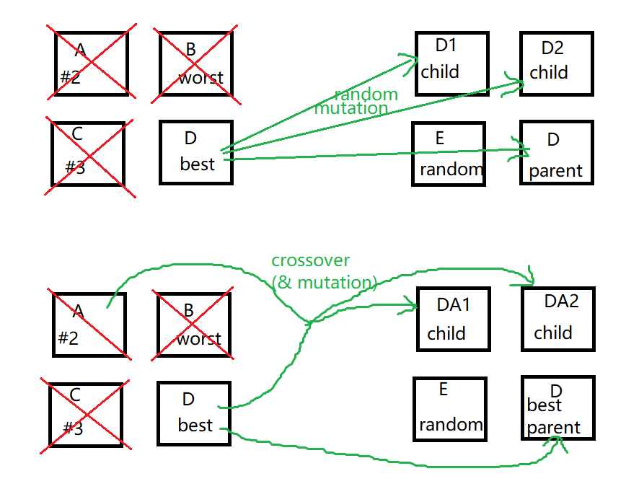
SPRINT 2: Predict the shape of a molecule.
A few different approaches to try for the EA.
Try this one →

Slide 2
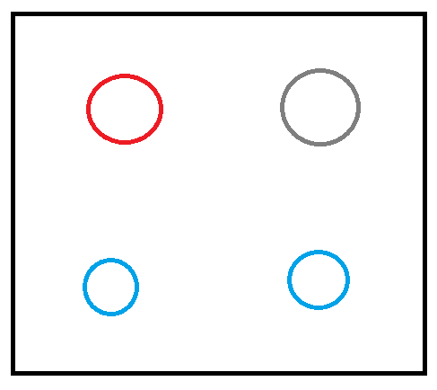
1. Initial model
Evenly spaced out, in no particular order.
This was done in the previous sprint, which was to create a model molecule.

Slide 3
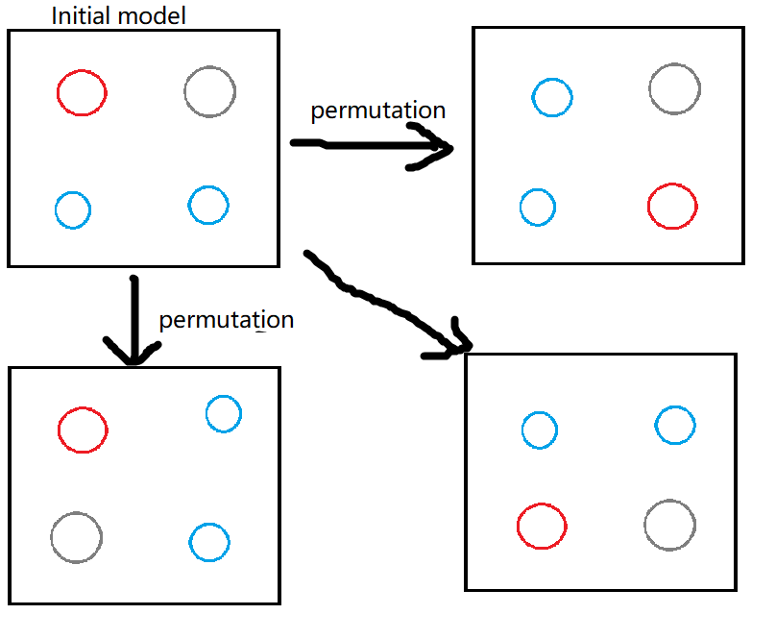
2. Permutations – plan
Recombine the atoms, still evenly spaced but with different orders.

Slide 4
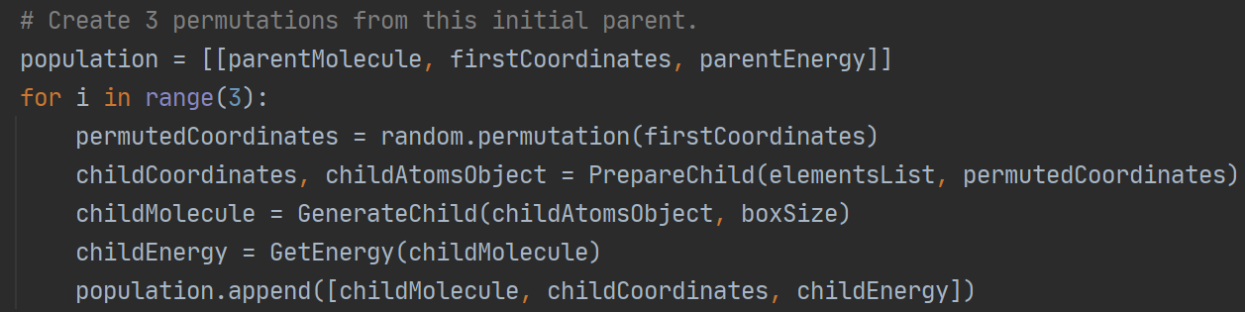
2. Permutations – code
Recombine the atoms, still evenly spaced but with different orders.

Slide 5
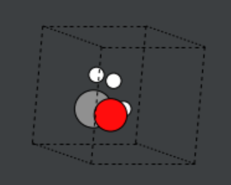
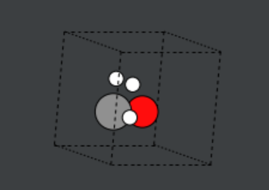
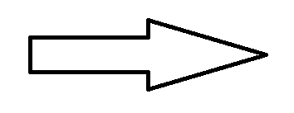
2. Permutations – result
Randomly re-order the atoms, still at the same points but in different orders.
A permutation
Original

Slide 6
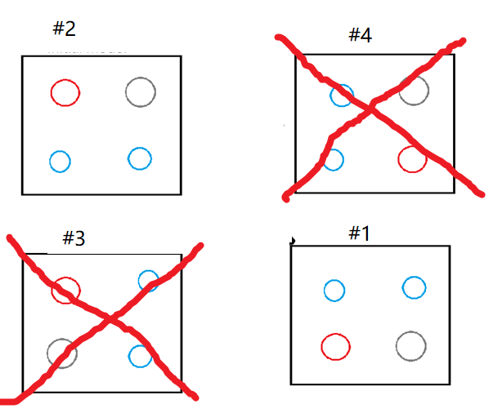
3. Selection - plan
Rank by lowest energy first.
Keep the 2 best combinations and destroy the 2 worst.

Slide 7
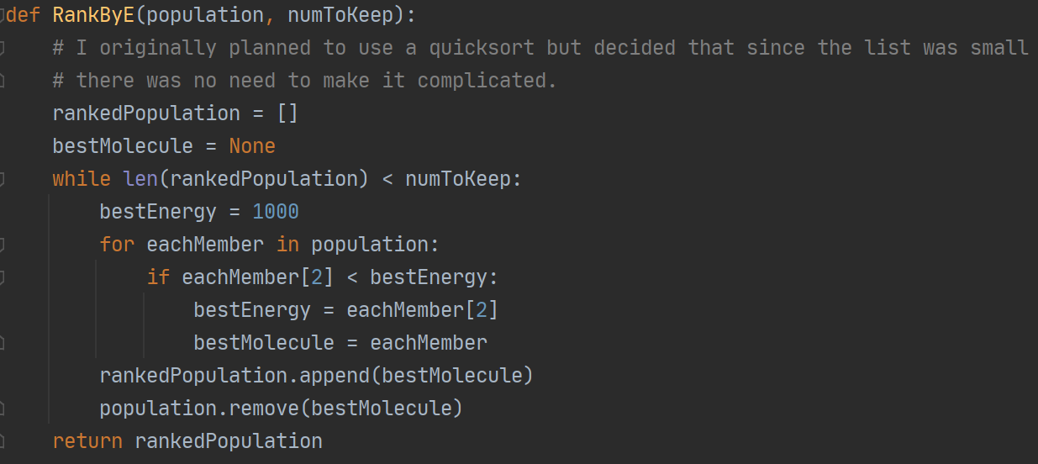
3. Selection - code
Rank by lowest energy first.
Keep the 2 best combinations and destroy the 2 worst.

Slide 8
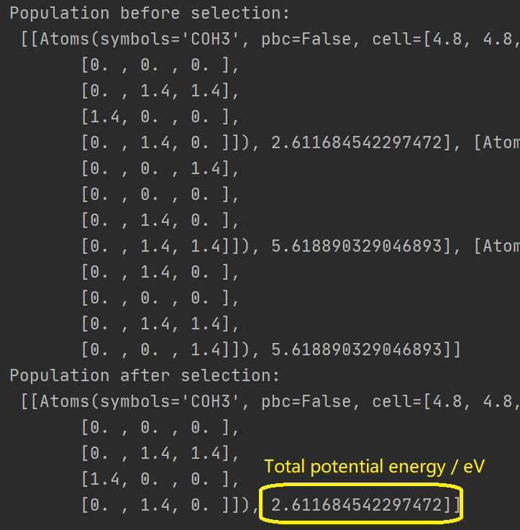
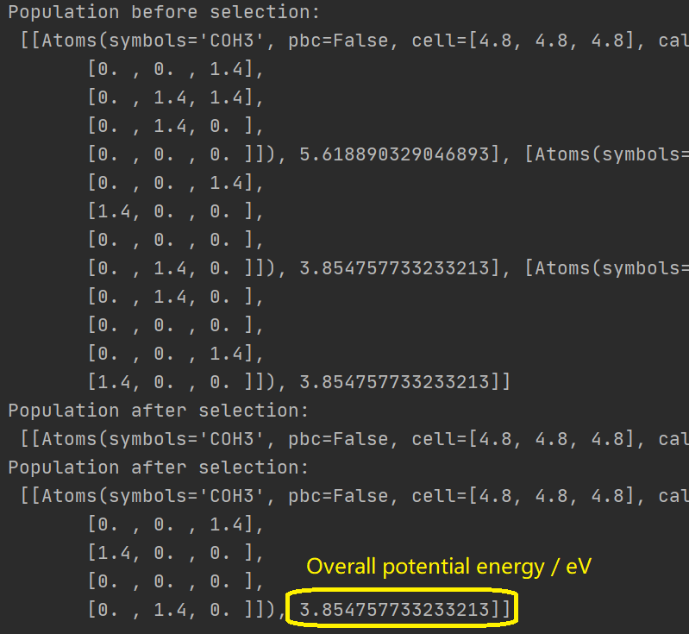
3. Selection - result
Rank by lowest energy first.
Keep the 2 best combinations
and destroy the 2 worst.

Slide 9
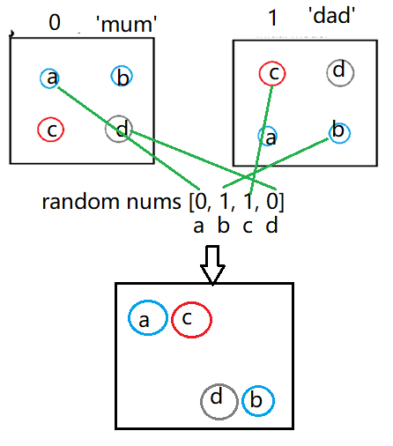
4. Crossover - plan
Randomly combine co-ordinates from the two parents selected in the last step.
As shown here, it might not work very well for the initial generation.

Slide 10
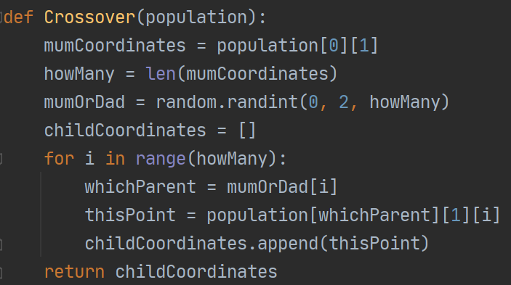
4. Crossover - code
Randomly combine co-ordinates from the two parents selected in the last step.

Slide 11
4. Crossover - result
Randomly combine co-ordinates from the two parents selected in the last step.
It works better for later generations.
It is better for the initial generation to skip this and go straight to mutation.
It is just one method of many to try.
It works much better for large molecules with many atoms, and is less useful for small ones.

Slide 12
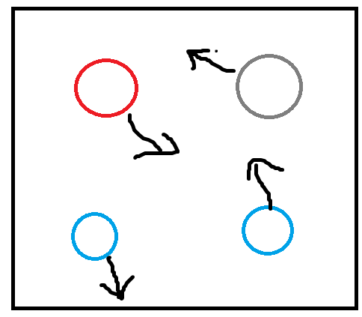
5. Mutation - plan
Random movement of atoms.
Small random movement for parents’ descendants.
Large random movement for new ‘stranger’ introduced to diversify the population and avoid getting stuck at a local minimum.

Slide 13
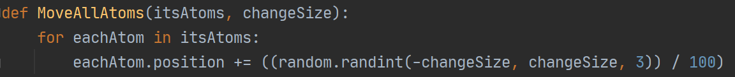
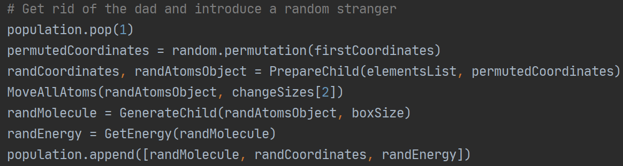
5. Mutation - code
Random movement of atoms.
Small random movement for parents’ descendants.
Large random movement for new ‘stranger’ introduced to diversify the population and avoid getting stuck at a local minimum.

Slide 14
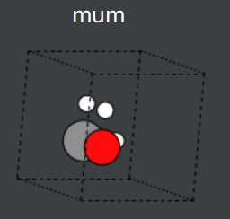
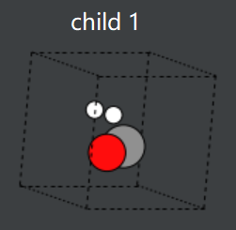
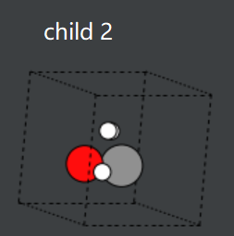
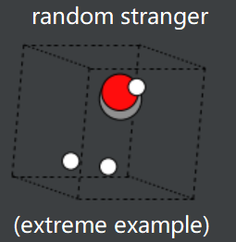
5. Mutation - result
Random movement of atoms.
Small random movement for parents’ descendants.
Large random movement for new ‘stranger’ introduced to diversify the population and avoid getting stuck at a local minimum.
Now go back to selection stage and carry on!

Slide 15
6. Stopping criterion - plan
If the best energy value doesn’t change very much for 3 consecutive iterations, it is probably finished.

Slide 16
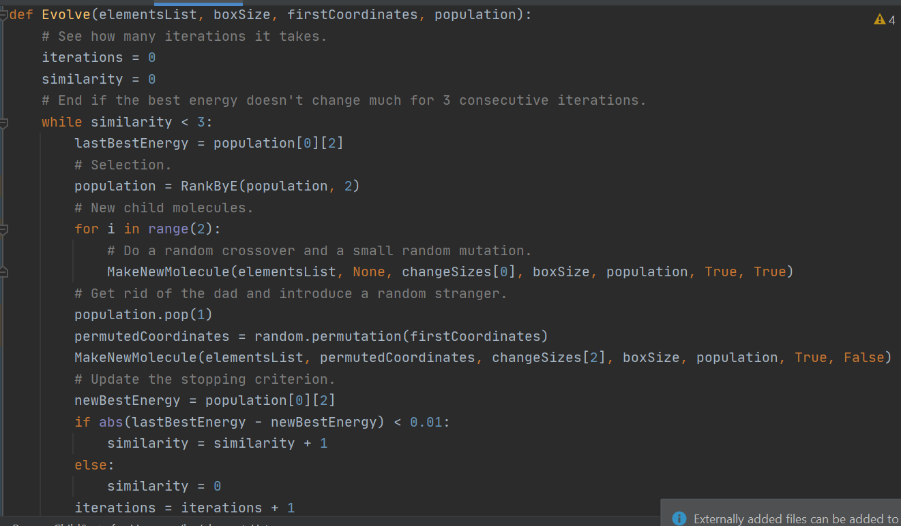
6. Stopping criterion - code
If the best energy value doesn’t change very much for 3 consecutive iterations, it is probably finished.

Slide 17
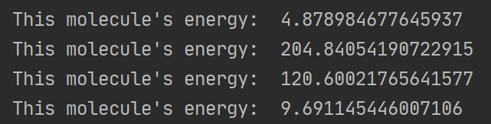
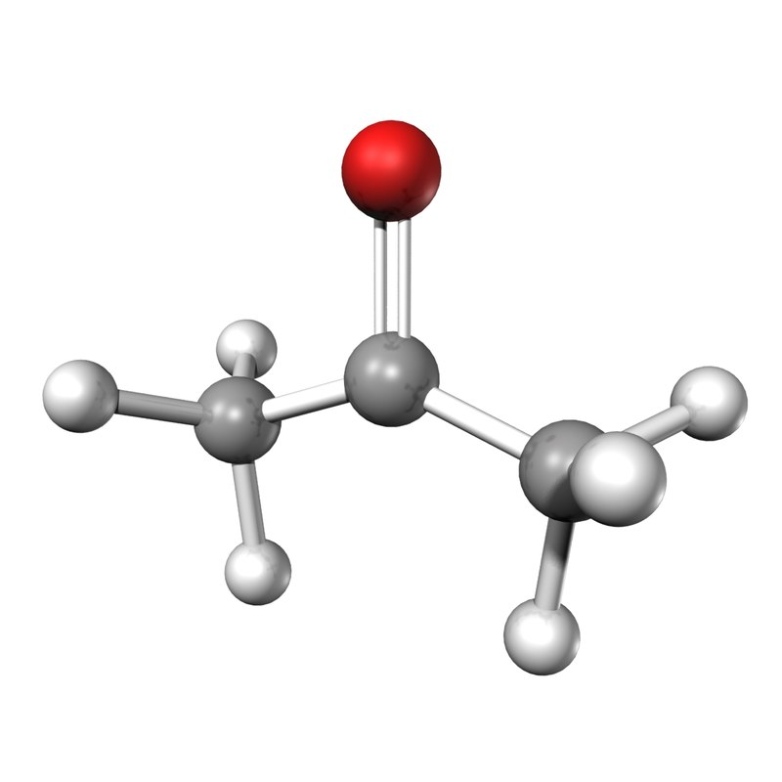
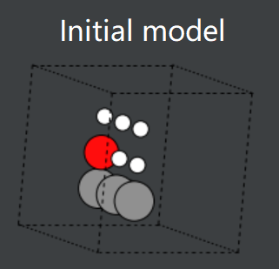
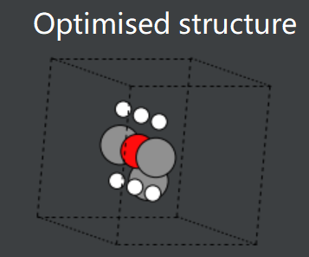
7. Testing it
It didn’t work. It immediately found a (terrible) local minimum and stayed there, because:
Population was too small.
Mutations were too big or too small.
Atom movements were almost always unfavourable, apart from permutations.
Stopping criterion wasn’t thorough/specific enough.
Effective Medium Theory is not an accurate calculation method.
Acetone example:
Actual structure
It is closer to the actual structure, but it’s not very good.

Slide 18
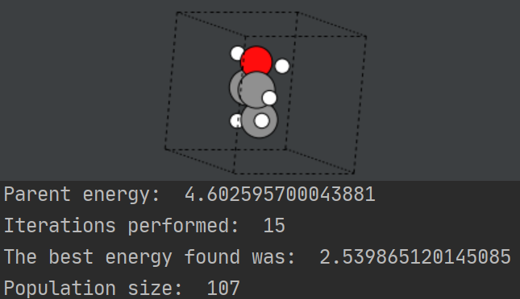
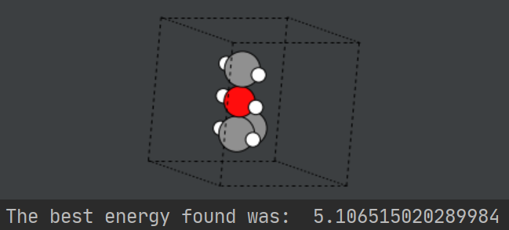
8. Improving it
Stopped using crossover. Only used mutation and permutation.
Increased population size.
Introduced more regular permutations, as these produced the best results.
Adjusted random mutation ranges and changed it from uniform to Gaussian.
Introduced an extra random structure at each iteration with less extreme alterations.
Specified stricter stopping criteria.
Decreased space between atoms in initial model.
Acetone example:
After: The shape is still bad but the energy is better.
Actual shape
Before:

Slide 19
Issues - other
Workload / time management – I can’t keep up with the sprints. Having to work too long (all weekend + evenings + all the time) which is unhealthy.

