Slide 1
Sprint 3
For the user story: I want to use a different EA.

Slide 2
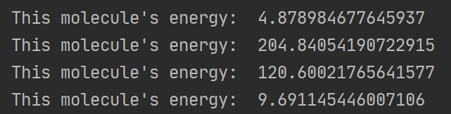
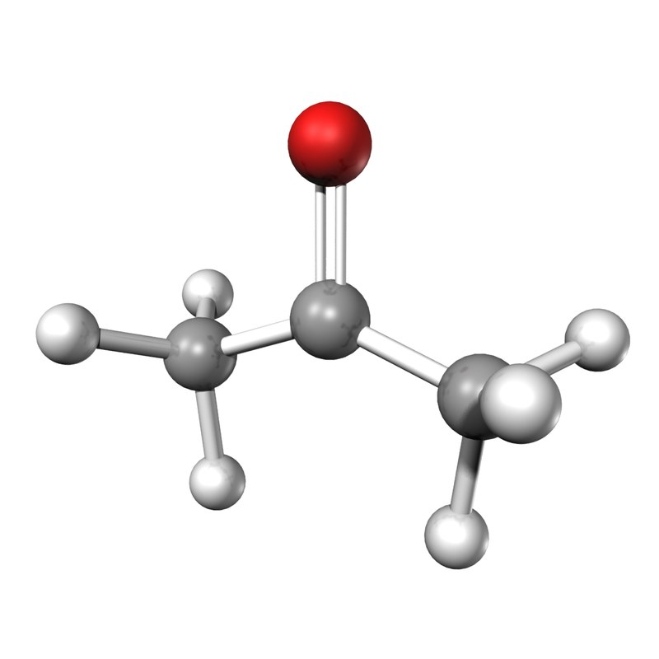
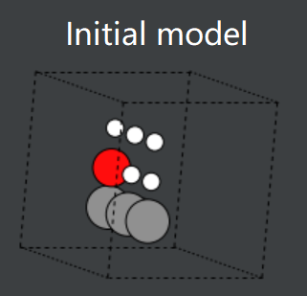
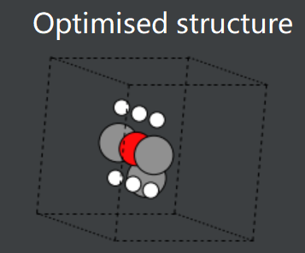
The previous sprint
It didn’t perform well. It immediately found a (poor) local minimum and stayed there, because:
Population was too small. Improved.
Mutations were too big or too small. Improved.
Atom movements were almost always unfavourable, apart from permutations. Not improved.
Stopping criterion wasn’t thorough/specific enough. Improved.
Effective Medium Theory is not accurate. Not improved.
Acetone example:
Actual structure
It is closer to the actual structure, but it’s not very good.

Slide 3
New EA – Idea
Previous problem: Atom movements were almost always unfavourable, apart from permutations.
Previous problem: Atoms move too far apart.
For the new EA, try moving 1 atom at a time.
Start with 2 atoms in the cell, and add one at a time.
Each time an atom is added, adjust all atoms in the cell.
Move using a Gaussian distribution around the centre of each atom.

Slide 4
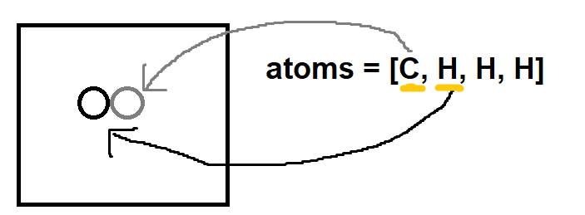
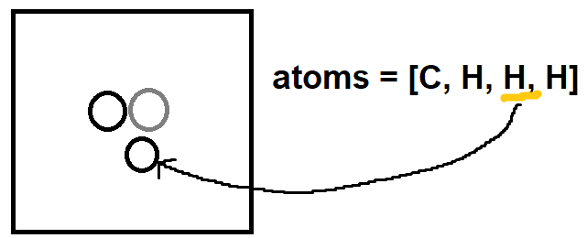
New EA – Plan
Start with 2 atoms in the cell, and add one at a time.
1
2

Slide 5
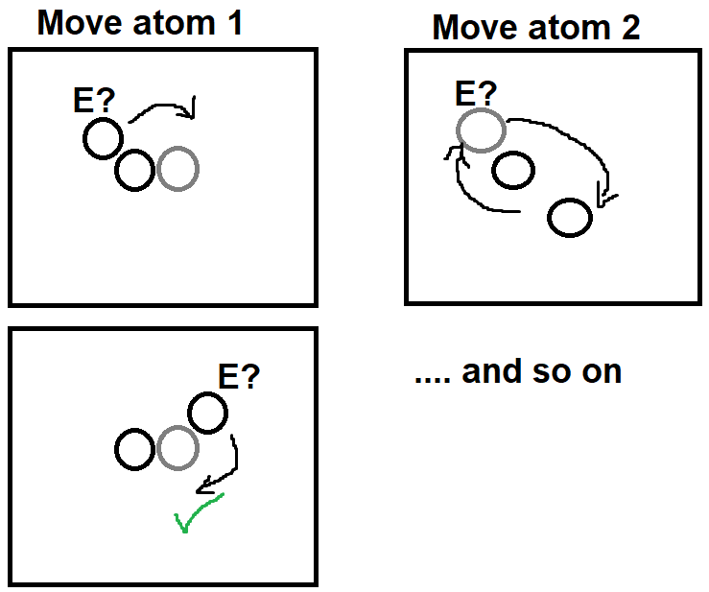
New EA – Plan
Each time an atom is added, adjust all atoms in the cell.
Move using a Gaussian distribution around the centre of each atom.

