Slide 1
Failure Modes and Effects Analysis
Overview and benefits for an application to open source product development

Slide 2



Introduction
The Failure Modes and Effects Analysis (FMEA) is one of the major reliability and risk analysis tools
It is legally required and standard practice in almost every manufacturing industry internationally
Recommended for medical devices (DIN EN ISO 13485 & ISO 14971)
Required for proof of exoneration (product liability)
Fun fact: FMEA was introduced 1963 by Nasa to ensure safety of skyrockets

Slide 3
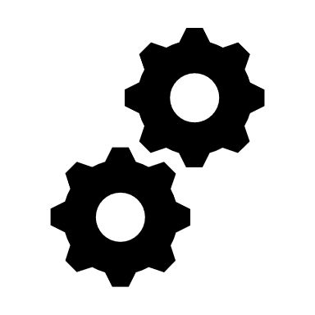




Benefits
FMEA reveals construction failures and ensures functionality in an early development stage.
FMEA is crucial for risk mitigation and reliability. Make your product safe!
FMEA enhances transparency. Help the community understand your product at first glance and set focus areas for further contributions.
FMEA helps structure your product. Get an overview about each module, assembly and functionality
FMEA ensures product quality. Make your product valuable!

Slide 4
How it works
FMEA is
a systematic approach to identify and assess all potential failure modes, their effects and causes in your product.
completed within 5 steps.
team based!
a structured approach where each task can be modularly processed. In the end you can be sure no failures are overseen!
1
2
3
4
5
Definition
System Analysis
Risk Assessment
Corrective Actions
Proof of efficiency

Slide 5
What you need
A Team of different skilled contributors (design, production, testing, quality …)
Supplemental information about the product that is assessed (e.g. scientific papers, bill of material, assembly instruction, list of specifications CAD-files etc.)
FMEA template (provided)
Some time and engagement to get the best out of it!

Slide 6
Next steps
Scope of analysis
Mechanical Subsystem
Purpose of analysis:
Exploration of design robustness
Identify disfunctionalities & opportunities for reliability improvements
Identify risks
Explore benefits of FMEA for OSPD
COSI Measure
Electronic Subsystem
Software
1
2
3
4
5
Definition
System Analysis
Risk Assessment
Corrective Actions
Proof of efficiency

