Slide 1
機器視覺-臉部偵測理論與實作
Face Detection
講者：顏銘炫
2019/07/24

Slide 2
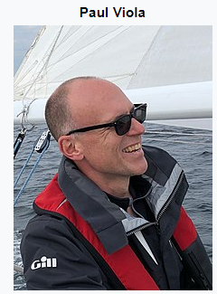

Viola-jones框架
是由Viola,Jones於「Robust Real-Time Face Detection」
論文提出來的概念
是知名的臉部偵測方法，透過海爾特徵(Haar-like)來進行
臉部偵測，再透過AdaBoost來建立層級表(Cascades)
Haar-like
AdaBoost
Cascades

Slide 3
簡單的概念
透過一個簡單的方框來特徵擷取

Slide 4
Haar(哈爾特徵)
哈爾特徵(Haar-like features)是用於物體識別的一種數字圖像特徵，
類似上頁提到的方框。
按右邊的特徵放到人臉區域上，白色區域的像素和減去黑色的像素和，
則為人臉的特徵值。
而人臉區域的特徵會與非人臉區域的值相差非常多，藉此就可以建立
特徵。
將右邊數值轉為層級表之後，就可以透過分類器來實現人臉辨識。“
http://alereimondo.no-ip.org/OPENCV/34

Slide 5
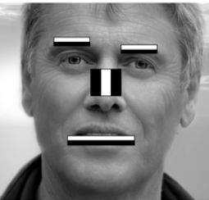
哈爾特徵(Haar-like features)
0~255 | 0~255 | 0~255 | 0~255
0~255 | 0~255 | 0~255 | 0~255
0~255 | 0~255 | 0~255 | 0~255
0~255 | 0~255 | 0~255 | 0~255
0~255 | 0~255 | 0~255 | 0~255
0~255 | 0~255 | 0~255 | 0~255
0~255 | 0~255 | 0~255 | 0~255
0~255 | 0~255 | 0~255 | 0~255
B-W(黑減白)=0.56-0.16=0.4
0.16 | 0.2 | 0.4 | 0.56
0.1 | 0.2 | 0.4 | 0.4
0.1 | 0.2 | 0.4 | 0.4
0.1 | 0.2 | 0.4 | 0.5
0.1 | 0.2 | 0.5 | 0.4
0.1 | 0.2 | 0.5 | 0.4
0.1 | 0.2 | 0.5 | 0.4
0.1 | 0.2 | 0.5 | 0.4
正規化

Slide 6
積分影像(Integral Image)
1 | 2 | 5 | 7 | 2 | 8 | 0 | 6 | 4 | 6
9 | 8 | 0 | 4 | 9 | 5 | 10 | 7 | 10 | 3
7 | 6 | 10 | 2 | 0 | 10 | 4 | 9 | 10 | 8
3 | 8 | 1 | 5 | 4 | 8 | 0 | 9 | 5 | 8
9 | 5 | 0 | 1 | 3 | 4 | 1 | 9 | 6 | 1
1 | 2 | 5 | 6 | 9 | 9 | 0 | 2 | 4 | 0
1 | 2 | 4 | 1 | 6 | 6 | 10 | 4 | 2 | 5
5 | 6 | 2 | 10 | 5 | 3 | 9 | 10 | 10 | 2
8+0+0+4+1+9+9+0=33
積分值

Slide 7
積分影像(Integral Image)
Image
Integral image
1 | 2 | 5 | 7 | 2 | 8 | 0 | 6 | 4 | 6
9 | 8 | 0 | 4 | 9 | 5 | 10 | 7 | 10 | 3
7 | 6 | 10 | 2 | 0 | 10 | 4 | 9 | 10 | 8
3 | 8 | 1 | 5 | 4 | 8 | 0 | 9 | 5 | 8
9 | 5 | 0 | 1 | 3 | 4 | 1 | 9 | 6 | 1
1 | 2 | 5 | 6 | 9 | 9 | 0 | 2 | 4 | 0
1 | 2 | 4 | 1 | 6 | 6 | 10 | 4 | 2 | 5
5 | 6 | 2 | 10 | 5 | 3 | 9 | 10 | 10 | 2
 |  | 25

Slide 8
積分影像(Integral Image)
Image
Integral image
1 | 2 | 5 | 7 | 2 | 8 | 0 | 6 | 4 | 6
9 | 8 | 0 | 4 | 9 | 5 | 10 | 7 | 10 | 3
7 | 6 | 10 | 2 | 0 | 10 | 4 | 9 | 10 | 8
3 | 8 | 1 | 5 | 4 | 8 | 0 | 9 | 5 | 8
9 | 5 | 0 | 1 | 3 | 4 | 1 | 9 | 6 | 1
1 | 2 | 5 | 6 | 9 | 9 | 0 | 2 | 4 | 0
1 | 2 | 4 | 1 | 6 | 6 | 10 | 4 | 2 | 5
5 | 6 | 2 | 10 | 5 | 3 | 9 | 10 | 10 | 2
1 | 3 | 8 | 15 | 17 | 25 | 25 | 31 | 35 | 41
10 | 20 | 25 | 36 | 47 | 60 | 70 | 83 | 97 | 1-5
17 | 33 | 48 | 61 | 72 | 95 | 109 | 131 | 155 | 172
20 | 44 | 60 | 78 | 93 | 124 | 138 | 169 | 198 | 223
29 | 58 | 74 | 93 | 111 | 146 | 161 | 201 | 236 | 262
30 | 61 | 82 | 107 | 134 | 178 | 193 | 235 | 274 | 300
31 | 64 | 89 | 115 | 148 | 198 | 223 | 269 | 310 | 341
36 | 75 | 102 | 138 | 176 | 229 | 263 | 319 | 270 | 403
235-83+47-134=65

Slide 9
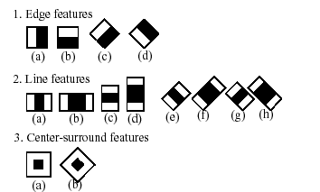
特徵差值計算方式
為「黑色」與「白色」
的灰階差值。
如：眼球區域的灰階總和
會大於眼皮的灰階總和
2方框=>6點t
3方框=>8點
4方框=>9點

Slide 10
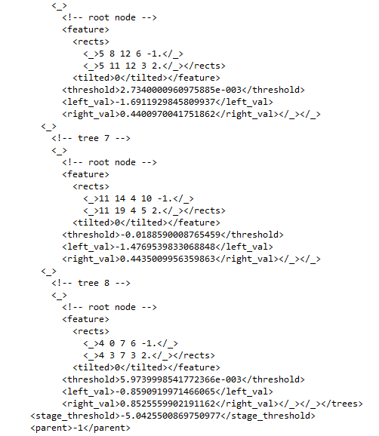
Cascades(層級)
Cascades(層級)
把要辨識的3000個classifiers，
分成數個階段來做比對
就像是一種決策樹的模型

Slide 11
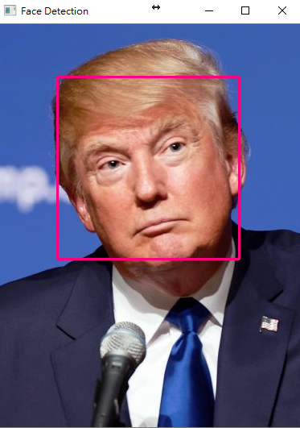
臉部偵測
import numpy as np
import cv2
face_classifier = cv2.CascadeClassifier("haarcascade_frontalface_default.xml")
image = cv2.imread("Donald.jpg")
gray = cv2.cvtColor(image, cv2.COLOR_BGR2GRAY)
faces = face_classifier.detectMultiScale(gray, 1.3,5)
if faces is ():
print("No faces found")
for (x,y,w,h) in faces:
cv2.rectangle(image, (x,y), (x+w,y+h), (127,0,255), 2)
cv2.imshow('Face Detection', image)
cv2.waitKey(0)
cv2.destroyAllowWindows()

Slide 12
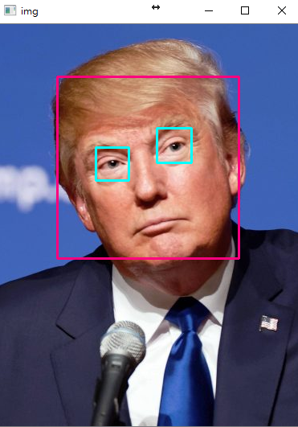
臉部與眼睛偵測
import numpy as np
import cv2
face_classifier = cv2.CascadeClassifier("haarcascade_frontalface_default.xml")
eye_classifier = cv2.CascadeClassifier("haarcascade_eye.xml")
img = cv2.imread("Donald.jpg")
gray = cv2.cvtColor(image, cv2.COLOR_BGR2GRAY)
faces = face_classifier.detectMultiScale(gray, 1.3,5)
if faces is ():
print("No faces found")
for (x,y,w,h) in faces:
cv2.rectangle(img, (x,y), (x+w,y+h), (127,0,255), 2)
cv2.imshow('img', img)
cv2.waitKey(0)
roi_gray = gray[y:y+h, x:x+w]
roi_color = img[y:y+h, x:x+w]
eyes = eye_classifier.detectMultiScale(roi_gray)
for (ex,ey,ew,eh) in eyes:
cv2.rectangle(roi_color,(ex,ey),(ex+ew,ey+eh),(255,255,0),2)
cv2.imshow('img',img)
cv2.waitKey(0)
cv2.destroyAllowWindows()
cv2.destroyAllowWindows()

Slide 13
Webcam Demo
import cv2
import numpy as np
face classifier = cv2.CascideClassifier(‘Harrcascades/haarcacade_frontface_default.xml’)
eye_classifier = cv2.CascadeClassifier(“Harrcascades/haarcascade_eye.xml’)
Def face_detector(img, size=0.5)
gray = cv2.cvtColor(img, cv2_COLOR_BGR2GRAY)
faces = face_classifier.detectMultScale(gray, 1.3, 5)
if faces is ():
return img
for (x,y,w,h) in faces:
x = x – 50
w = w + 50
y = y – 50
h = h + 50
cv2.rectangle(img.(x,y),(x+w,y+h),(255,0,0),2)
roi_gray = gray[y:y+h, x:x+w]
roi_color = img[y:y+h, x+x+w]
eyes = eye_classifier.detectMultiScale(roi_gray)
for (ex,ey,ew,eh) in eyes:
cv2.rectangle(roi_color,(ex,ey),(ex+ew,ey+eh),(0,0,255),2)
Roi_color = cv2.flig(roi_color,1)
Return roi_color
cap = cv2.VideoCapture(0)
while True:
ret, frame = cap.read()
cv2.imshow(‘Out Face Extrector’, face_detector(frame))
k = cv2.waitKey(1) & 0xFF
if k == 27 :
break
cap.release()
cv2.destroyAllWindows()

Slide 14
臉部偵測-透過Dlib
Face Detection

Slide 15
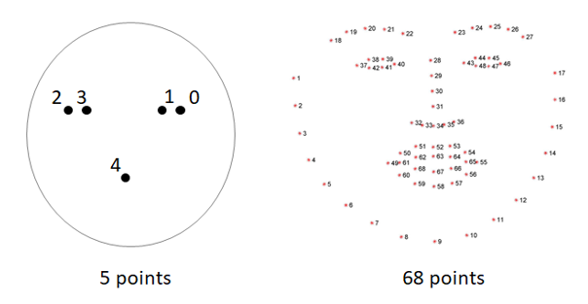
Dlib工具
Dlib：Dlib是一個跨平台的C++公共庫，除了線程支持，網路支持，
提供測試以及大量工具等等優點，DLIB還是一個強大機器學習的
C++庫，包含了許多機器學習常用的算法。同時支持大量的數值算法
如矩陣，大整數、隨機數運算等等。
他在臉部特徵抓取的功能有很強的效果。

Slide 16
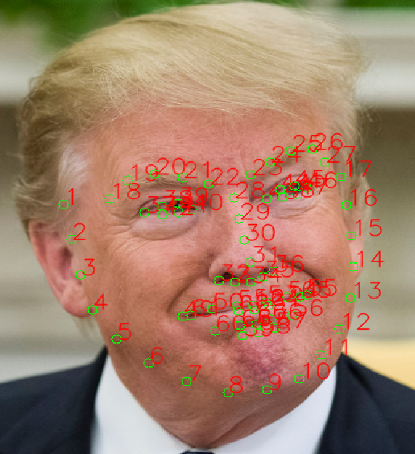
Dlib-取得臉部特徵值
import dlib
from PIL import Image
import numpy as np
import cv2
detector = dlib.get_frontal_face_detector()
pedictor = dlib.shape_predictor(‘shape_predictor_68_face_iandmarks.dat’)
img_cv2 = cv2.imread(“images/Trump.jpg”)
img_cv2 = Image.open(“image/Trump.jpg”).convert(‘RGBA’)
img_gray = np.array(img_PIL.convert(‘L’))
rects = detector(img_gray, 0)
for I in range(len(rects)):
landmarks = np.matrix([[p.x,p.y] for p in predictor(img_cv2, rects[i].parts()])
img_cv2 = img_cv2.copy()
for idx, point in enumerate(landmarks):
pos = (point[0,0],point[0,1])
cv2.circle(img_cv2, pos, 5,color=(8,255,0))
font = cv2.FONT_HERSHEY_SIMPLEX
cv2.putText(img_cv2,str(idx+1),pos,font,0.8,(0,0,255),1,cv2.LINE_AA)
cv2.namedWindow(“img_cv2”,2)
cv2.imshow(“img_cv2”,img_cv2)
cv2.waitKey(0)

Slide 17
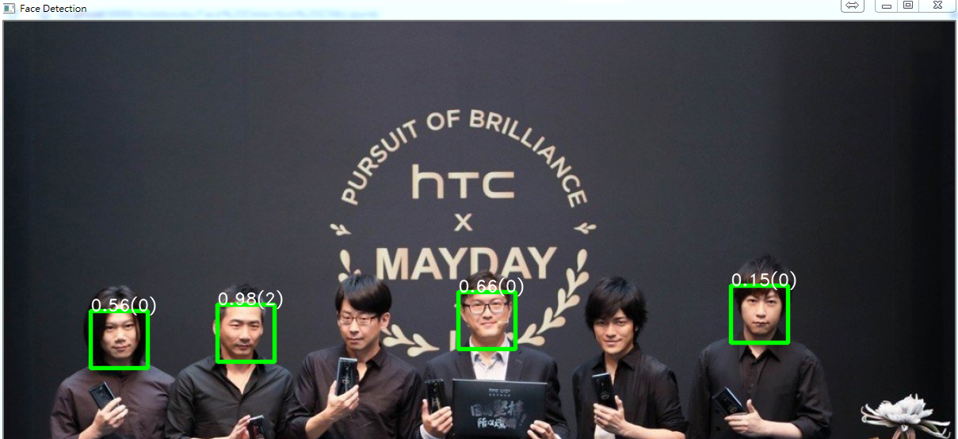
Dlib-多人臉辨識
import dlib
import cv2
img = cv2.imread(‘imges/Mayday.jpg’)
img = imutils.resize(img, width=1200)
detector = dlib.get_frontal_face_detector()
face_rects,scores,idx=detector.run(img,0,0)
for I, d in enumerate(face_rects):
x1 = d.left()
y1 = d.top()
x2 = d.right()
y2 = d.bottom()
text = “%2.2f(%d)” %(scores[i], idx[i])
cv2.rectiangle(img, (x1,y1), (x2,y2), (0, 255, 0), 4, cv2.LINE_AA)
cv2.putText(img, text, (x1,y1), cv2.FONT_HERSHEY_DUPLEX,
0,7, (255,255,255),1,cv2.LINE_AA)
cv2.imshow(“Face Detection”, img)
cv2.waitKey(0)
cv2.destroyAllWindows()

Slide 18
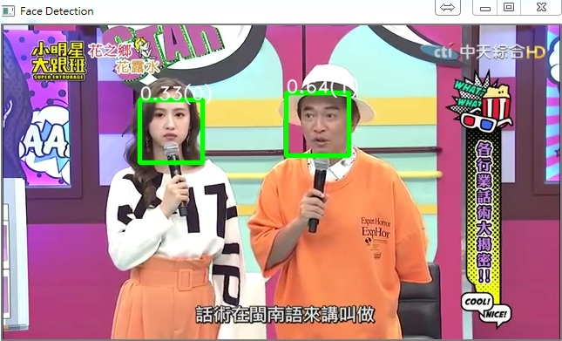
Dlib-影片辨識
Import dlib
Import cv2
Import imutils
Cap = cv2.VideoCapture(‘images/test1.mp4’)
Width = int(cap.get((cv2.CAP_PROP_FRAME_WIDTH))
Height = int(cap.get((cv2.CAP_PROP_FRAME_HEIGHT))
Fourcc = cv2.Videowriter_fourcc(*’XVID’)
Out = cv2.VideoWriter(‘output.avi’, fourcc, 20, 0,(width,height))
Detector = dlib.get_frontal_face_detector()
While(cap.isOpened()):
ret, frame = cap.read()
face.rects,scores,idx = detector.run(frame,0)
for I, d in enumerate(face_rects):
x1 = d.eft()
y1 = d.top()
x2 = d.right()
y2 = d.bottom()
text =‘%2.2f(%d)” % (scores[i],idx[i]))
cv2.rectangle(frame,(x1,y1),(x2,y2),(0,255,0),4,cv2.LINE_AA)
c2.putText(frame, text,(x1 y1),cv2.font_Hershey_duplex,
0,7,(255,255,255),1,cv2.LINE_AA)
out.write(frame)
cv2.imshow(“Face Detection”,frame)
ff cv2.waitKey(1) & 0xFF == ord(‘q’):
cap.release()
out.release()
cv2.desroyAllWindows()

Slide 19
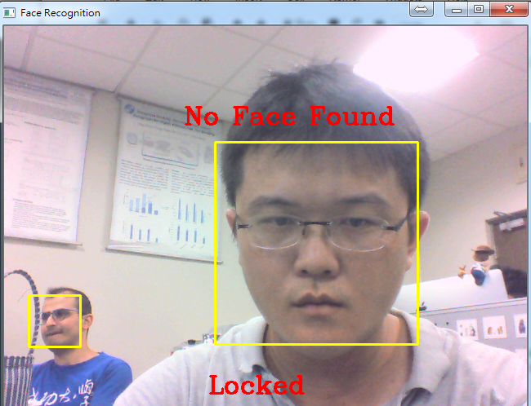
Dlib-即時串流多人臉辨識
import dlib
Import cv2
Import imutils
Cap = cv2.VideoCapture(0)
Detector = dlib.get_frontal_face_detector()
While(cap.isOpened()):
ret, frame = cap.read()
face_rects,scores, idx = detector.run(frame,0)
for i, d in enumerate(face_rects):
x1 = d.left()
y1 = d.top()
x2= d.right()
y2 = d.bottom()
text = “%2.2f(%d)” % (scores[i], idx[i])
cv2.rectangle(frame, (x1,y1), (x2,y2), (0,255,0),4,cv2.LINE_AA)
cv.puttext((frame,text, (x1,y1), cv2.FONT_HERSHEY_DUPLEX,
0,7,(255,255,255),1,cv2.LINE_AA)
cv2.imshow(“Face Detection”,frame)
break
cap.release()
cv2.destroyAllWindows()

Slide 20
Motion Analysis –Yawn Detector and Counting
透過OpenCV做哈欠偵測
計算哈欠次數

Slide 21
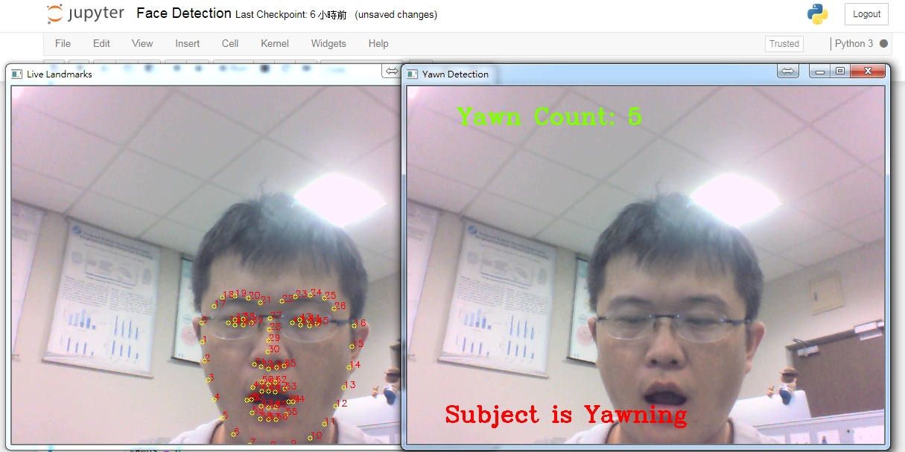

Slide 22
Thanks for your listening

