Slide 1
程柏勳
Intelligent Information Retrieval Lab.
Deep Learning
Implementation
Wow! I Built a Machine
IIR Freshmen Course 2019.07.23

Slide 2
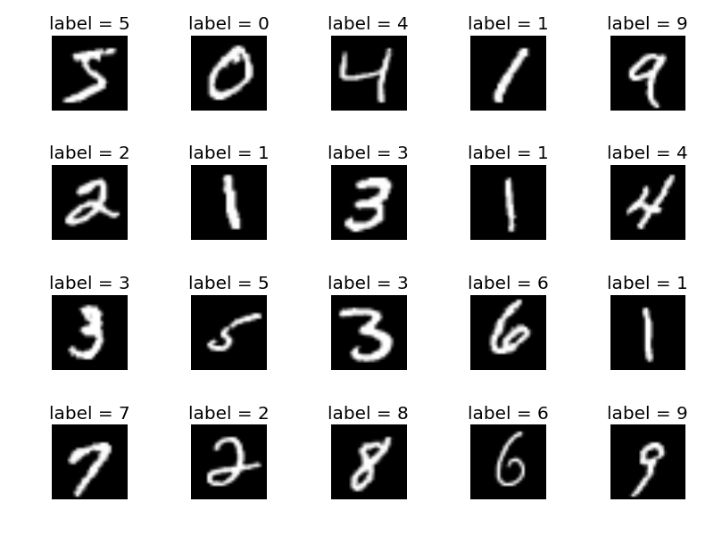
Deep Learning Implementation
COURSE OUTLINE
1
3
CNN in Keras
Tutorial
MLP in Tensorflow
Tutorial
MNIST
Classifier
MLP in Keras Tutorial
RNN in Keras
Tutorial
2
4

Slide 3
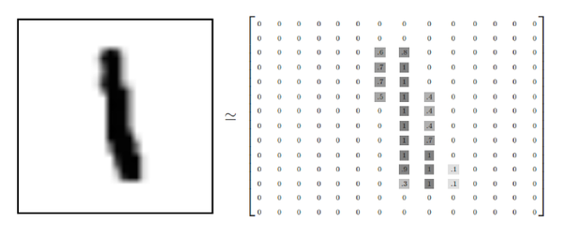

Deep Learning Implementation
MNIST DATASET
A large database of handwritten digits taken from Americans
Contains 60,000 training images and 10,000 testing images
digit “1”
28px * 28px
2D-array
28 x 28
1D-array
784 (28x 28)
National Institute of Standards and Technology
Reference: https://en.wikipedia.org/wiki/MNIST_database

Slide 4

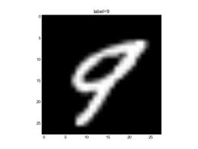
Deep Learning Implementation
HOMEWORK #1
Dimension Reduction with Autoencoder on MNIST
dim. =2
Encoder
Code
Decoder
Input
Output
9
9
* Criteria
Dimension Reduction with Autoencoder
Visualization in a 2-dimensional space
Tool: Keras / Tensorflow
** Bonus: Denoising Autoencoder
9
other digits
Visualization

