Slide 1
Deep Neural network with Keras
黃睦翔

Slide 2
Outline
Dense (Fully connected feed forward network)
Build Model
Sequential
Functional (Model)
RNN
CNN
Conv2D/3D
Variant types
Pooling

Slide 3
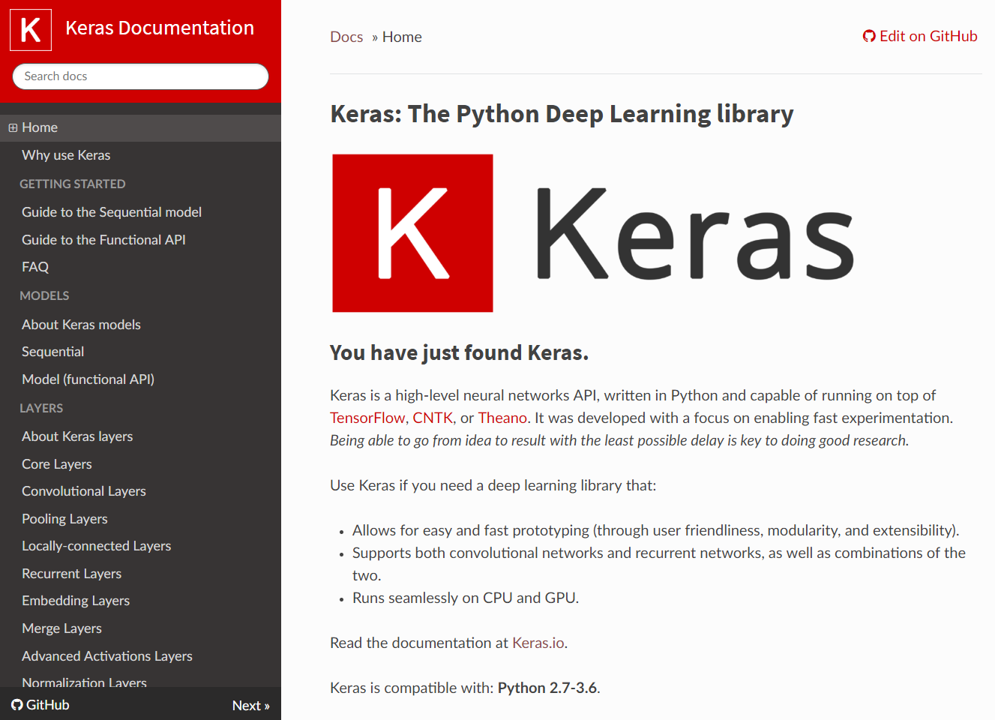
https://keras.io/

Slide 4
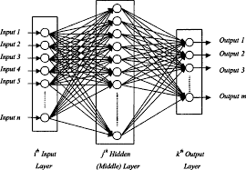
Core layer
Dense
Activation
Dropout
Flatten
Input
Permute
……….

Slide 5
Create Model
Sequential
Easy
But not so flexible
Functional (Model)
Good!

Slide 6
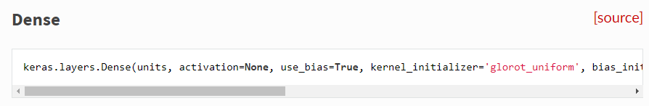
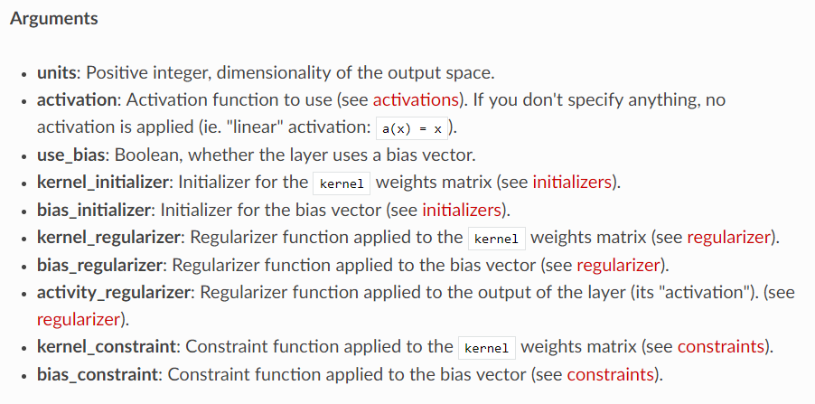
Dense

Slide 7
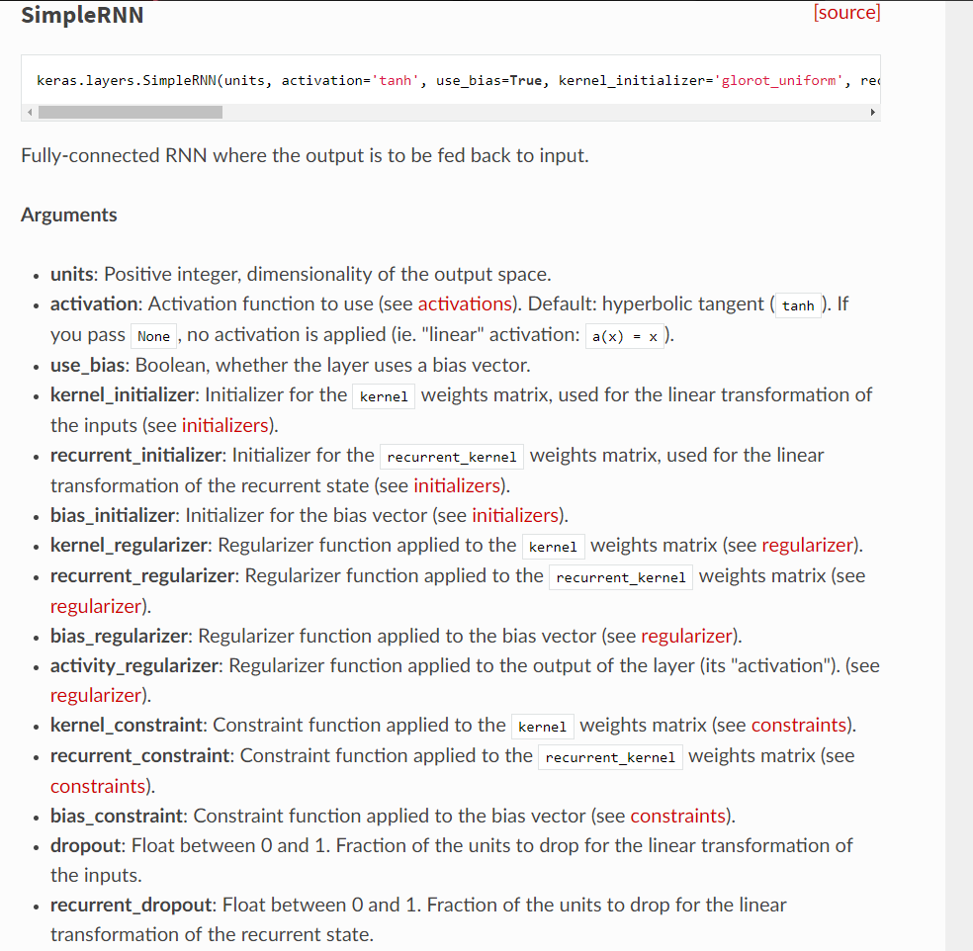
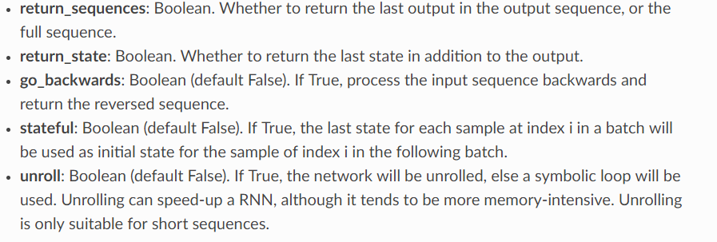
RNN

Slide 8
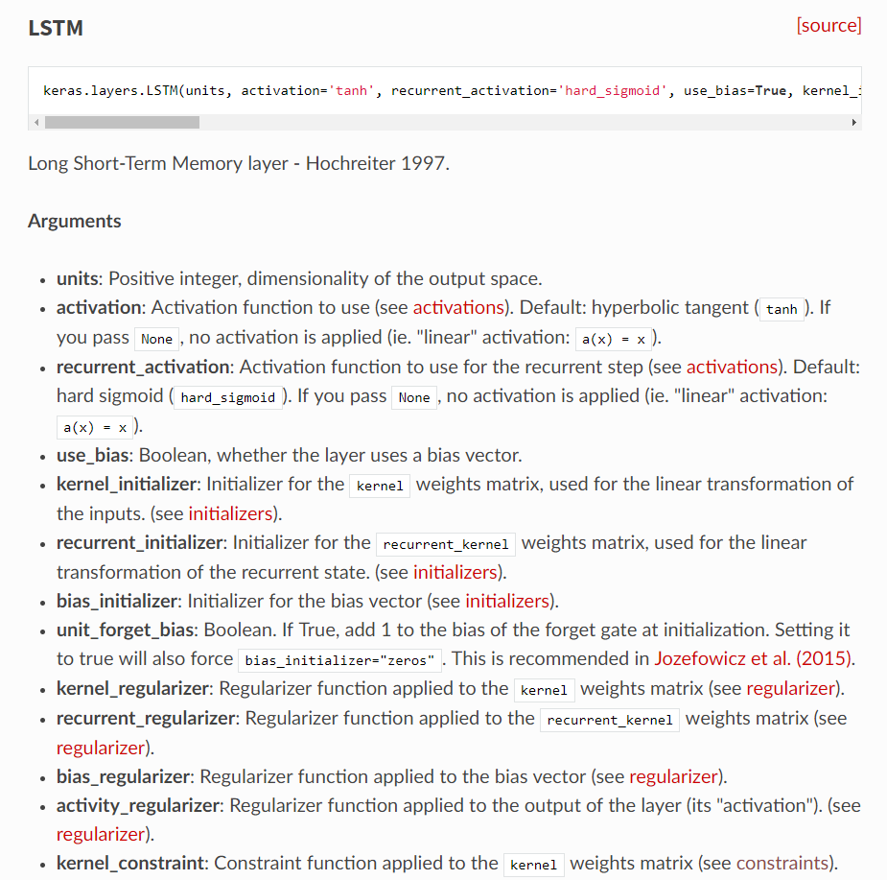
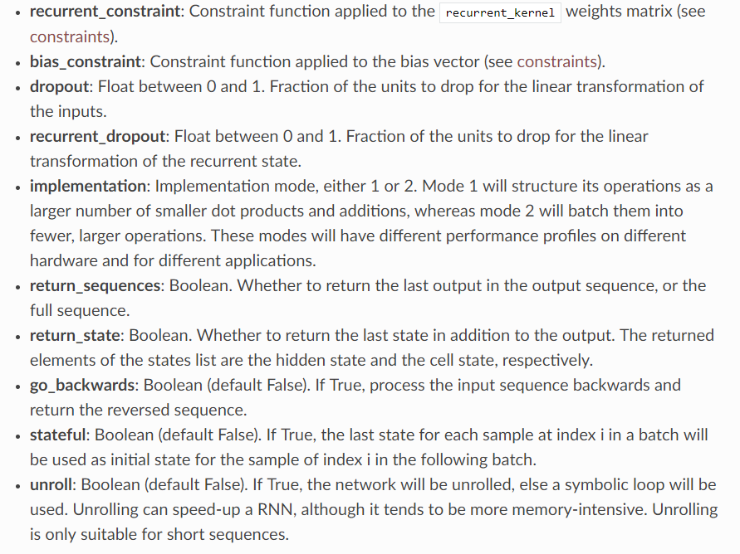

Slide 9
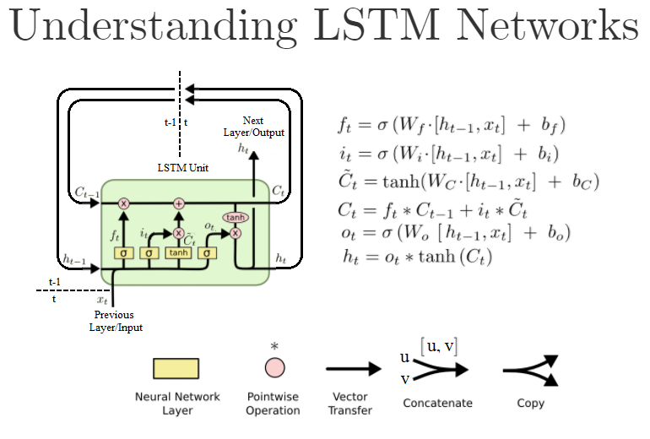
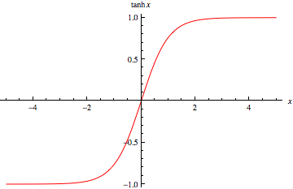

Slide 10
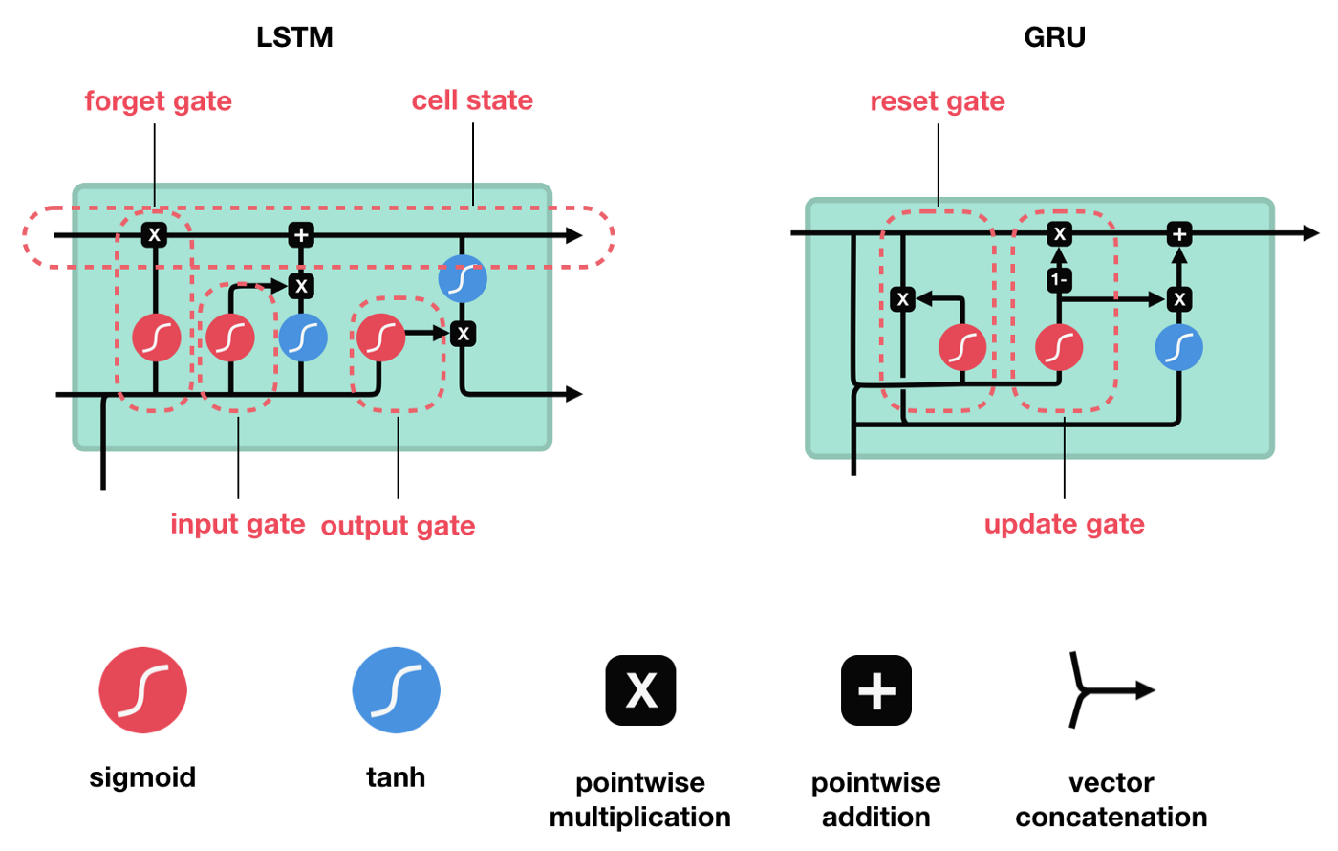

Slide 11
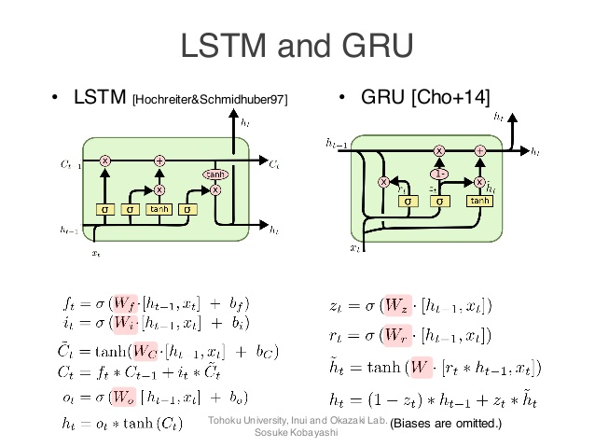

Slide 12
CNN
Conv2D
Typical
Variant
Dilated
Depthwise
Seperable
Dimension control
Pooling
Upsampling2D
Conv2Dtranspose
Conv1D/Conv3D -> Similar

Slide 13
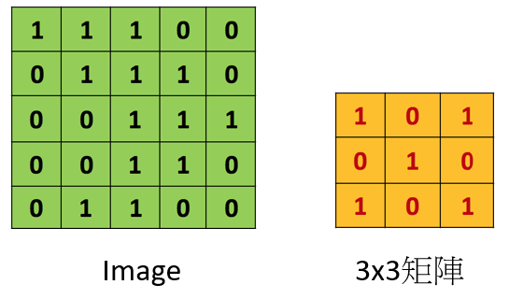
Typical 2D CNN

Slide 15
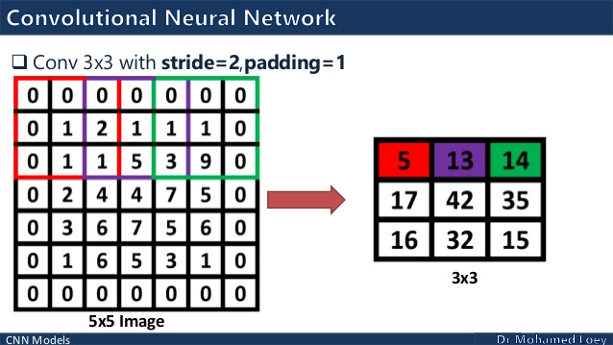

Slide 16
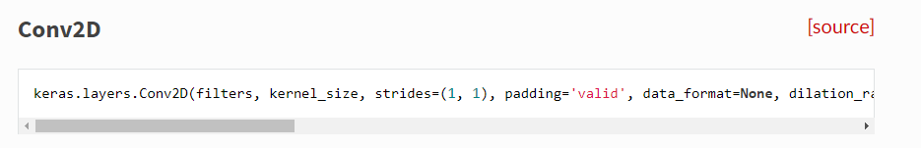
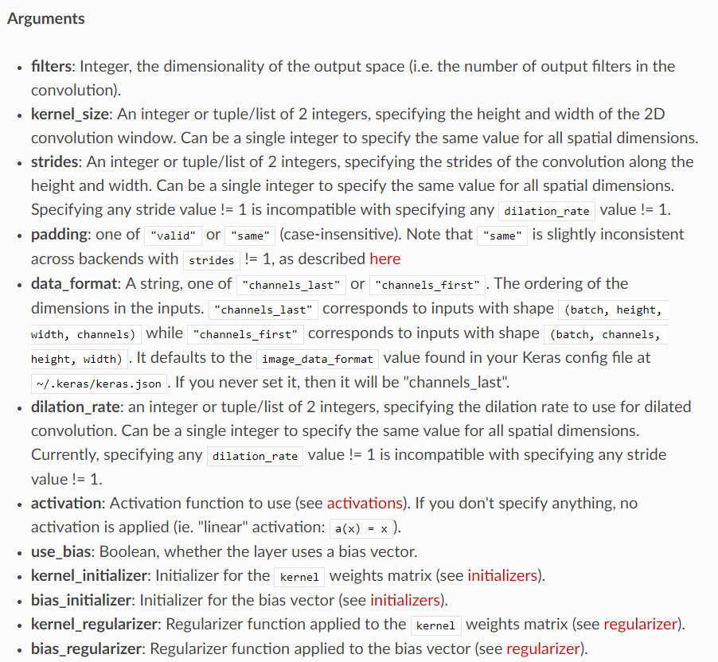
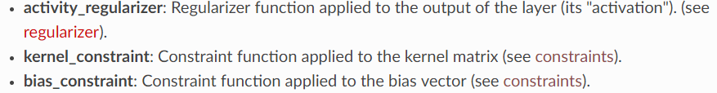

Slide 17
(batch, 128, 128, 32) → Conv2D → (batch, 128, 128, 128)
How many filters we need?

Slide 18
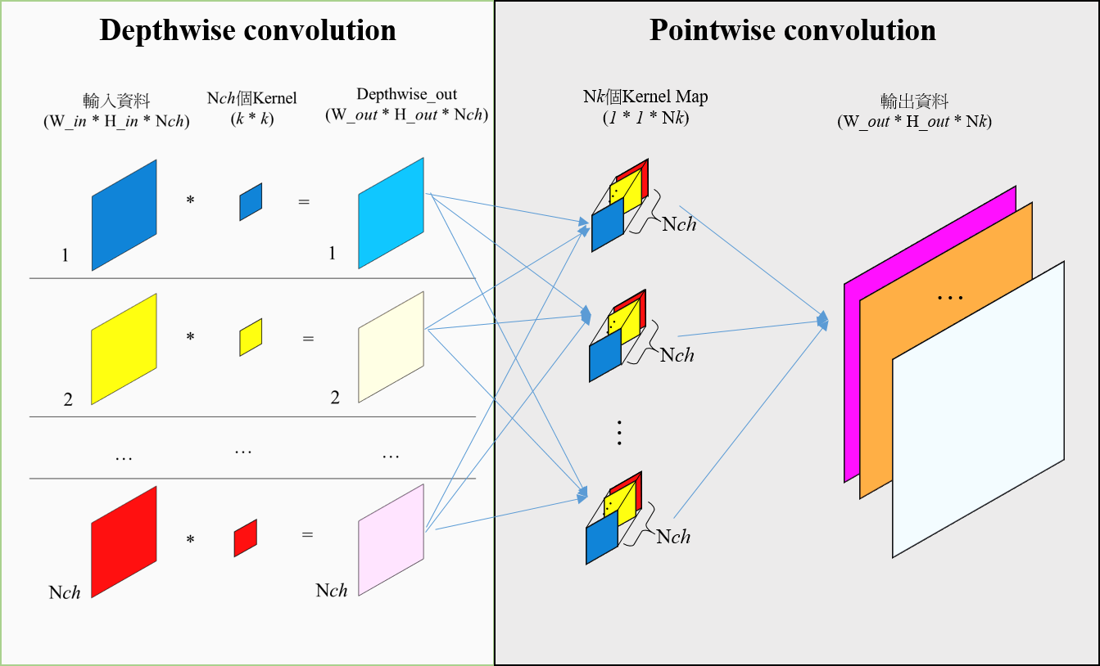

Slide 19
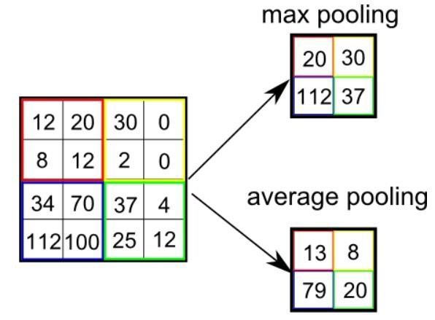
Pooling

Slide 20
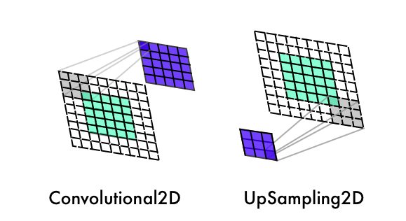
Upsampling2D

Slide 21
Conv2Dtranspose

Slide 22
