Slide 1

SCTP Socket-Transfer and Auto-Handover in Wireless Environment
Project ID: #110640
Name: Gao Chenchen
Supervisor: Xu Changqiao
May, 2012
Page
Notes:
SCTP Socket-Transfer and Auto-Handover in Wireless Environment

Slide 2
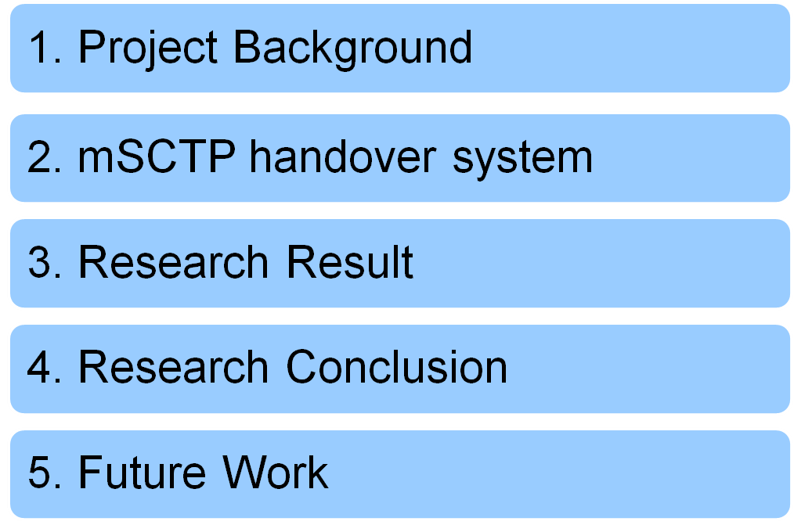
Content
Page

Slide 3
Achievement
Research on SCTP mechanism and DAR extension
Design and implement SCTP socket-transfer demo system
Add auto-handover function to the SCTP demo system
Compare the performance between SCTP and TCP handover
Page
Notes:
SCTP Socket-Transfer and Auto-Handover in Wireless Environment

Slide 4
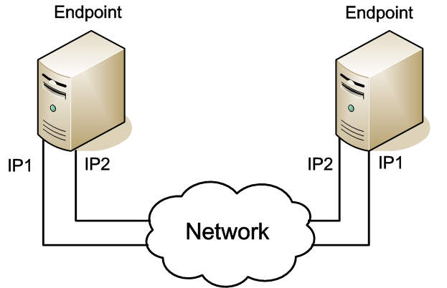
Project Background
Modern Devices
— Equiped with multiple interfaces
Stream Control Transmission Protocol(SCTP)
— Multihoming
Page

Slide 5
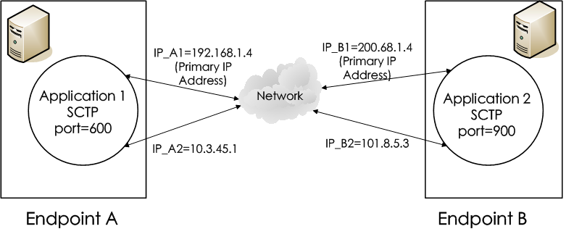
Project Background
Core Technique
— Dynamic Address Reconguration (DAR) extension
Multi-homed SCTP association
Page
Notes:
SCTP Socket-Transfer and Auto-Handover in Wireless Environment

Slide 6
mSCTP handover system
Project Meaning √
— Implement a mechanism for seamless handover
— Provide a foundation for better network service
System advantage √
— Smooth and reliable handover
— No package loss
— Low latency
Page
Notes:
SCTP Socket-Transfer and Auto-Handover in Wireless Environment

Slide 7
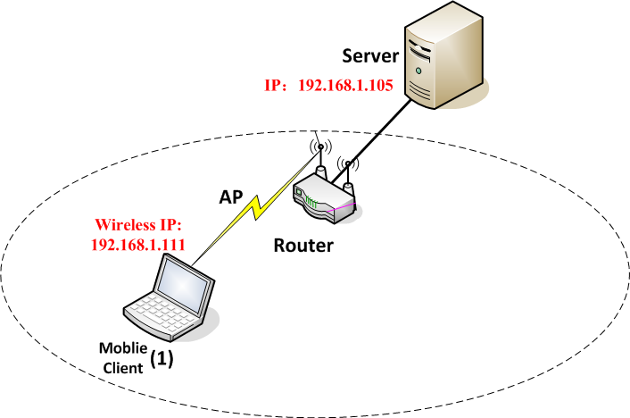


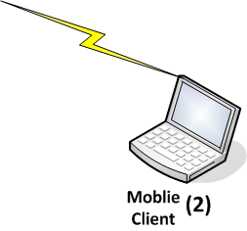

mSCTP handover system- Topology
Wired IP:
192.168.1.100
AR
Page

Slide 8
mSCTP handover system- Function
Start
File_Transfer Thread:
file transfer with wireless IP
Check Link Thread
Yes
Add new IP procedure
No
ChangePrimary Thread:
change primary IP
File still transfer with wireless IP
File Transfer over
File Transfer with wired IP
Page

Slide 9
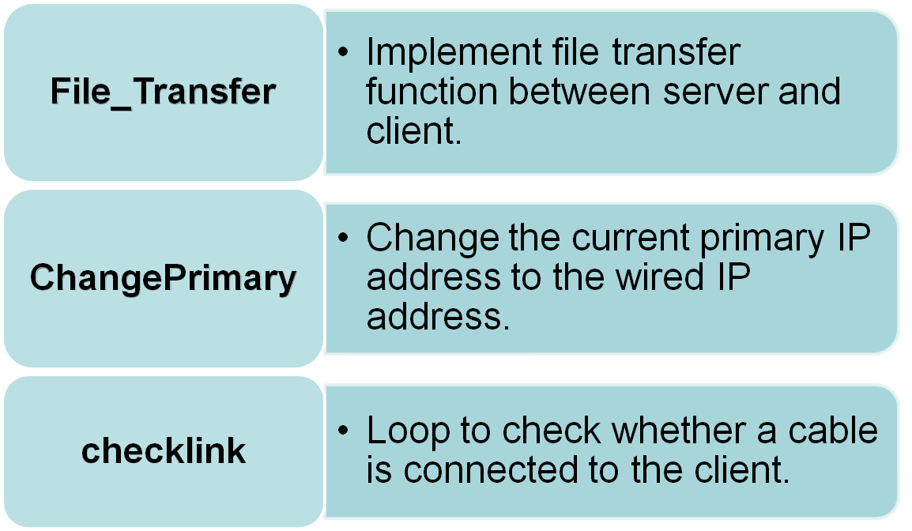
mSCTP handover system- Design
Thread function
Page

Slide 10
mSCTP handover system- Design
Server Side
Client Side
set up and wait for client request
Connect to server and send the requested
file name
Sendmsg
(requested file name)
Receive requested file name
Receive ACK message with assoc id
Send back ACK message with assoc id
Sendmsg
(ACK with assoc id)
Create three threads:
File_Transfer
changePrimary
Checklink
Create three threads:
File_Transfer
changePrimary
Checklink
Page

Slide 11
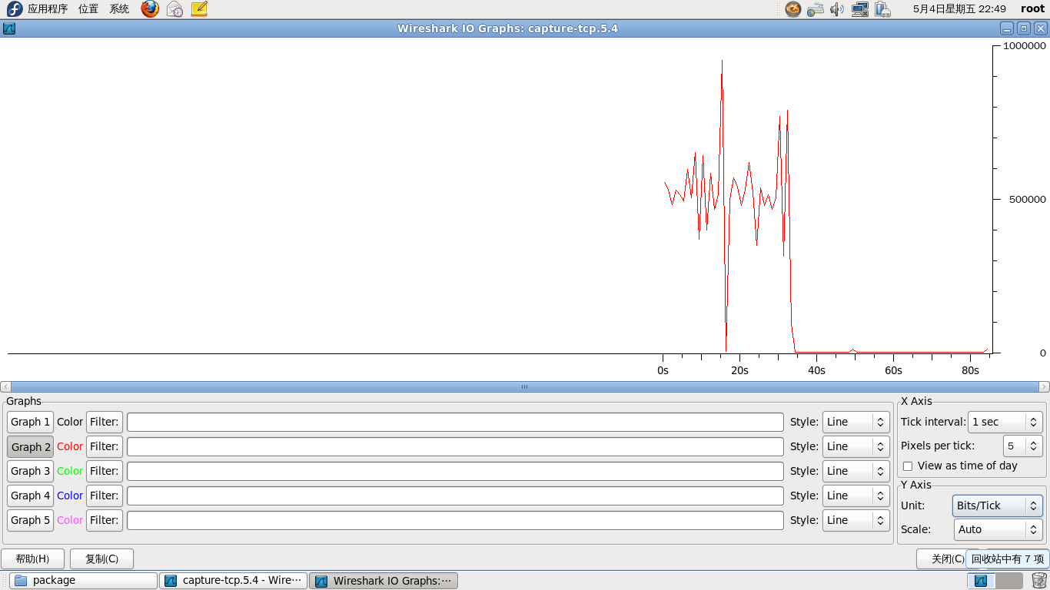


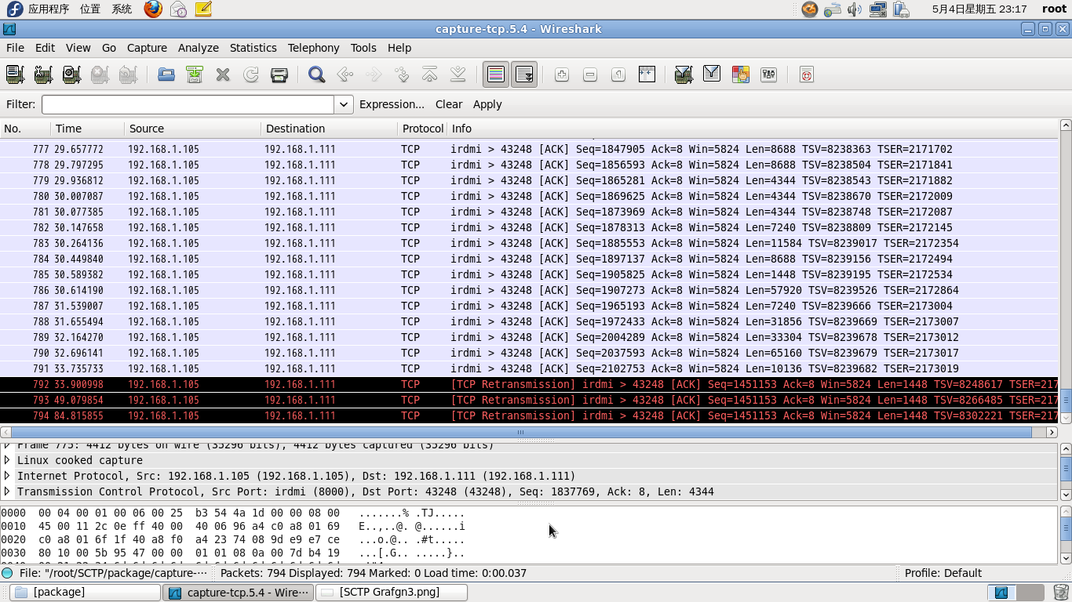
Research Result -TCP handover
Handover result in IO graph & package
Data flow
Bits/s
Time /s
Page

Slide 12
Research Result – Drawbacks of TCP connection
One-to-one style connection
— Can bind only one IP address
— Change IP will kill active process
Without IP changing mechanism
— Need to reconnect with new IP address
— Reconnection has to be done manually
Low data transfer efficiency
— Connection broken block data transfer
— No resume broken transfer function
Page

Slide 13
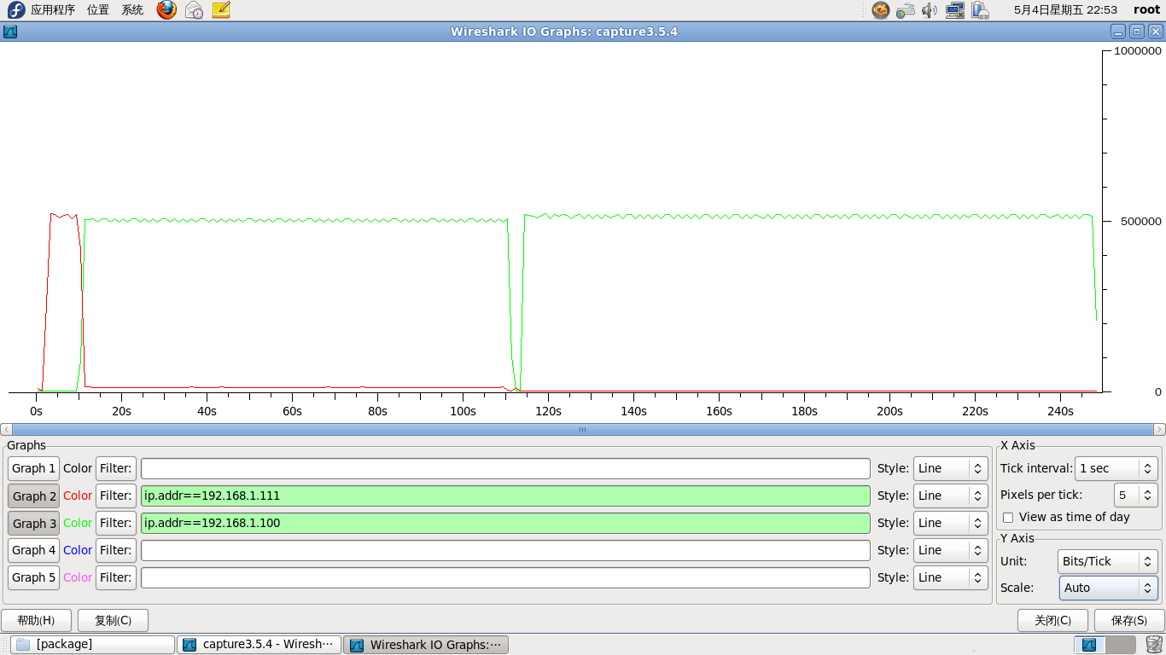
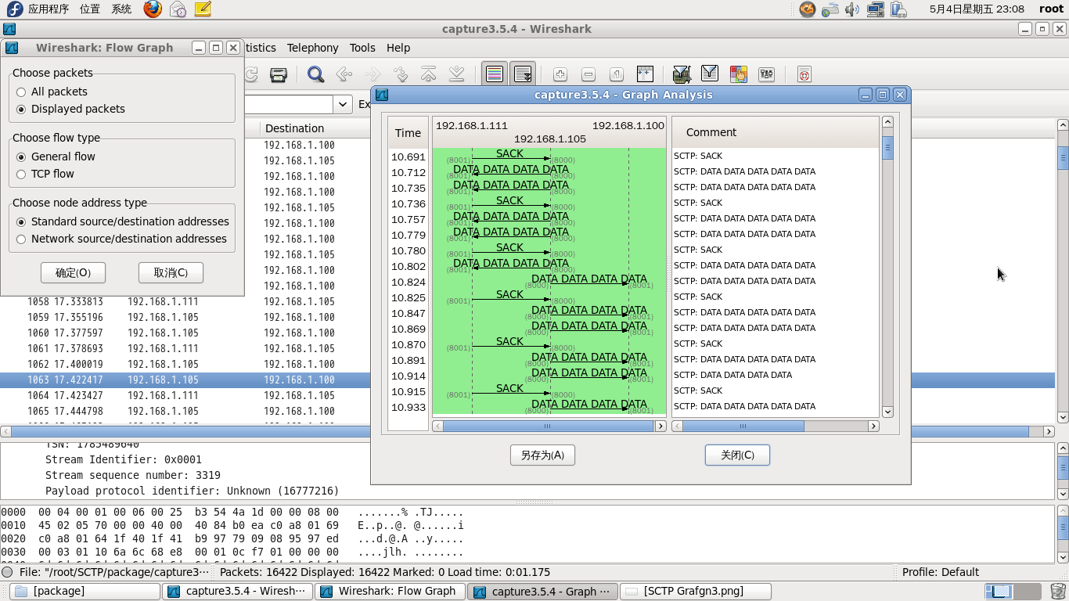




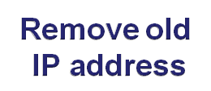
Research Result -mSCTP handover
Handover result in IO graph
Data flow
Bits/s
Time /s
Page
Notes:
SCTP Socket-Transfer and Auto-Handover in Wireless Environment

Slide 14
Research Result – Performance comparison with mSCTP
One-to-Many style connection
— Can bind multiple IP addresses
— Suitable for handover
Dynamic Address Reconfiguration
— Add new IP address to association
— Automatically change primary IP address
High data transfer efficiency
— No suspension and reconnection
— Continuous data transfer
Page
Notes:
SCTP Socket-Transfer and Auto-Handover in Wireless Environment

Slide 15
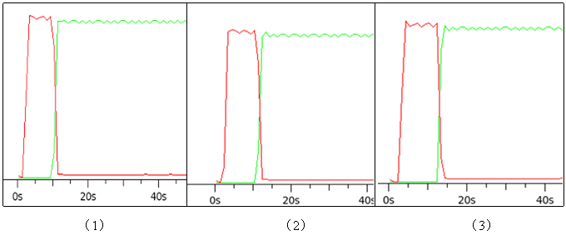
Research Result – mSCTP handover process time
Time spending for above three handover process is:
(1) 3.471341s; (2) 3.876508s; (3) 3.625362s
The average time spending of handover process is:
Average Time = 3.657734s √ Accepted
Page

Slide 16
Research Conclusion
TCP handover ×
— Undependable connection, suspension
— Low efficiency, high delay
— Very bad performance on handover
mSCTP handover √
— Reliable connection, smooth handover
— High efficiency, low latency, no package loss
— Support seamless handover
Page

Slide 17
Future Work
Reduce mSCTP handover process time
— Improve handover efficiency
Develop network selection algorithm
— Overall evaluation about network condition
— Always using best quality network
— Further improve service efficiency
Page

Slide 18

Thank you for listening!
Page

