Slide 1
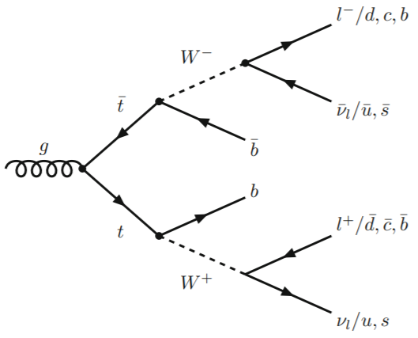
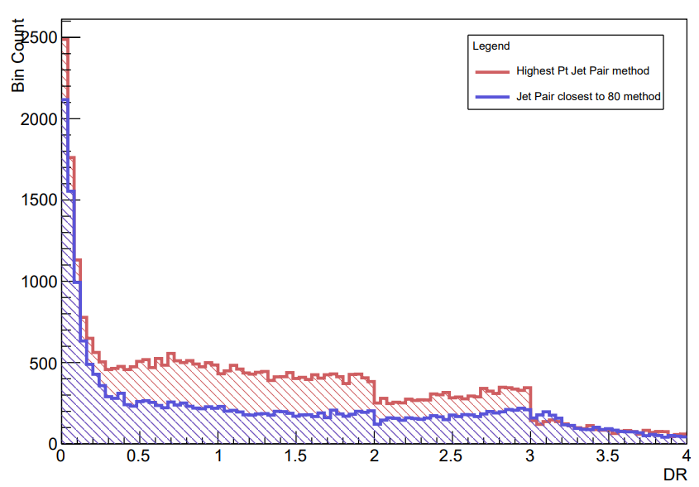
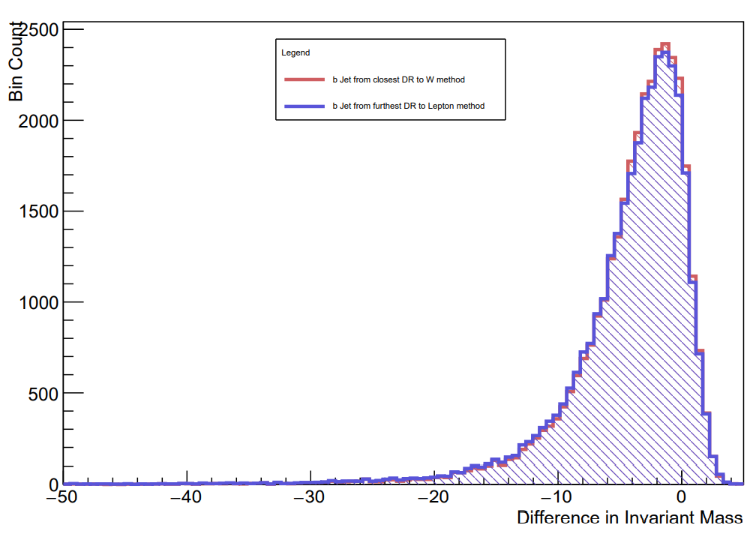
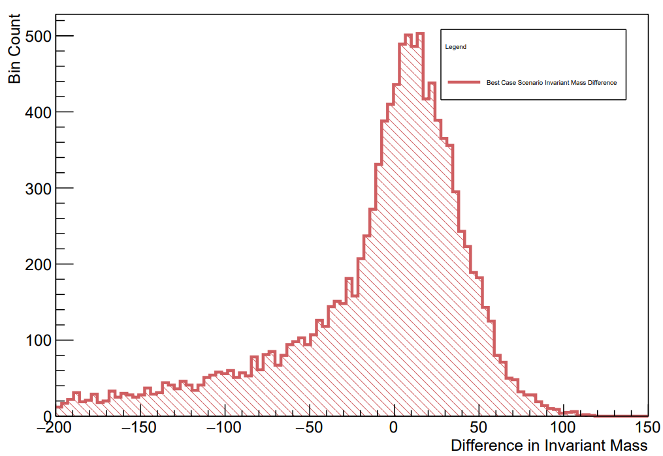
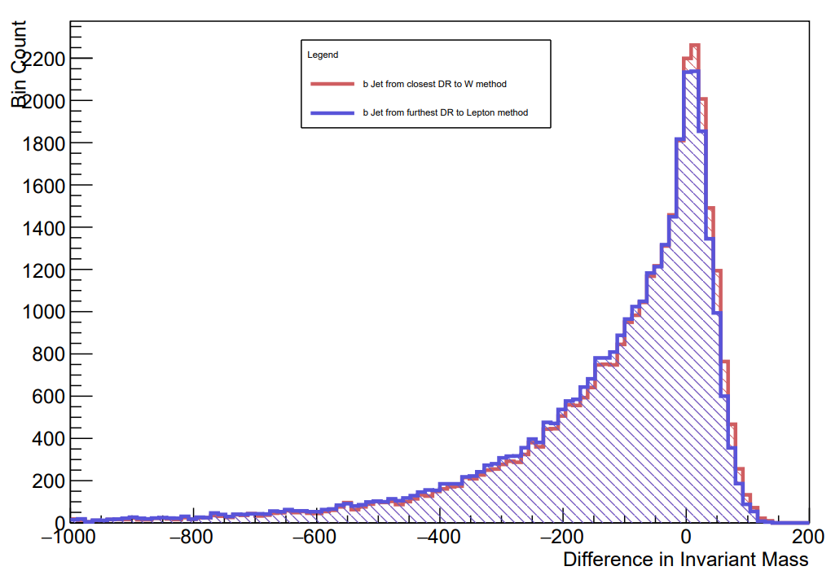
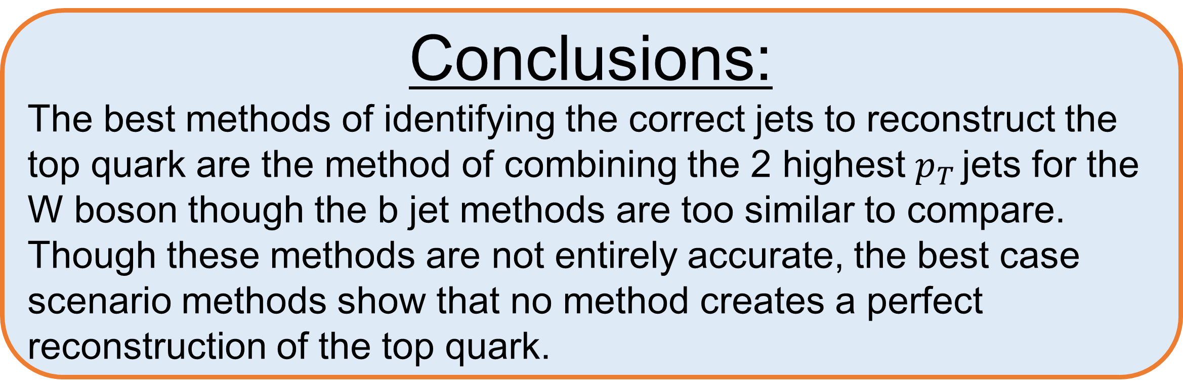


Measuring the mass of the top quark using simulated events at ATLAS
Sophie Hatia Supervisor: Prof. Veronique Boisvert
Abstract:
This project is conducted in C++ within a unix environment and aims to reconstruct the top quark using simulated data of 𝑡𝑡 ̅ decay final state products and compare the reconstructed invariant mass to the true top quark invariant mass for each simulated event. The top quark is the heaviest known elementary particle in the Standard Model and is the only quark to decay before hadronisation occurs, allowing a unique insight into the properties of bare quarks, a crucial area of knowledge for studying the Standard Model and beyond. The mass of the top quark is not predicted by the Standard Model and therefore must be determined experimentally.
Motivations for Studying
The top mass is a very important parameter in the Standard Model
It cannot be calculated by the Standard Model and must be determined experimentally
It is believed that it is the most sensitive probe into the electroweak symmetry breaking so it plays a key role in many extensions of the standard model
It gives rise to many theories that could solve what is known as the “Hierarchy problem” (the large discrepancy between the electroweak and Planck scale)
$t\overline{t}$ Events
The b jet hadronises to a b jet
The W boson can decay in two different ways: two hadronic jets or a lepton and its neutrino
This leads to three decay channels for this decay: Dilepton, semi-leptonic & full hadronic
For this project the semi-leptonic channel is used
[1]
[1] [2]
Reconstructing the W boson
Selecting the right b jet
Two methods to reconstruct W: combine 2 highest $p_{T }$jets or find jet pair with Invariant mass closest to 80 GeV
Both produced very similar means and distributions:
M1: 1.318 ± 0.005354
M2: 1.310 ± 0.007698
Method 1 used all events with >1 non b jet while Method 2 used only events with 2 or 3 non b jets as there are too many combinations past that
There are 2 b jets per event → need to find the right one for the t quark
Two Methods: finding b jet with smallest ∆R to W boson or finding b jet with largest ∆R to lepton
Both produce extremely similar distributions and means:
M1: -4.128 ± 0.02667
M2: -4.327 ± 0.02829
So similar that the two methods are almost equivalently accurate
Method 1 was run over more points so gave a more accurate mean value → it was chosen
Comparing to the true top quark
Best Case Scenarios
The reconstructed W was combined with the b jets chosen by Methods 1 & 2 discussed previously
Both produced very similar distributions
Large peak at 0 GeV implies most reconstructed top quarks were accurate to top quark and mass
Long tail after 0 GeV shows many events produce top quarks with Invariant Masses too high to be accurate
W and b jets were constrained to have a ∆R of 0.4 with their true counterparts
Large peak at 0 GeV shows the right W and b jet were chosen for most events
Negative trail to -200 GeV shows some events create a top quark with a greater mass than the true top mass
Even when using the true information the some events select the wrong jets to combine
No method creates a perfect reconstruction of the top quark
Conclusions:
The best methods of identifying the correct jets to reconstruct the top quark are the method of combining the 2 highest $p_{T }$jets for the W boson though the b jet methods are too similar to compare. Though these methods are not entirely accurate, the best case scenario methods show that no method creates a perfect reconstruction of the top quark.
References:
[1] Kieseler J. In: Introduction to Top Quark Production and Decay in Proton-Proton Collisions. Cham: Springer International Publishing; 2016. p. 7-26. Available from: https://doi.org/10. 1007/978-3-319-40005-1_2.
[2] Lannon K, Margaroli F, Neu C. Measurements of the production, decay and properties of the top quark: A review. European Physical Journal C. 2012;72(8):1-22.

