Slide 1
SSIM
Robustness of the image quality metric
Sophie Schauman
Sedona, Arizona, USA
9 January 2023

Slide 2

ISMRM Workshop Series
Declaration of Financial Interests or Relationships
Speaker Name: Sophie Schauman
I have no financial interests or relationships to disclose with regard to the subject matter of this presentation.

Slide 3
SSIM - Structural Similarity Index Measure
Are we using it correctly?
Are different implementations comparable?
Is it fit for purpose?
Notes:
Importance of L!!!!

Slide 4
Are we using it correctly?
LUMINANCE
LUMINANCE
CONTRAST
STRUCTURE
[1] Zhou Wang, A. C. Bovik, H. R. Sheikh and E. P. Simoncelli, "Image quality assessment: from error visibility to structural similarity," in IEEE Transactions on Image Processing, vol. 13, no. 4, pp. 600-612, April 2004, doi: 10.1109/TIP.2003.819861.
Notes:
Importance of L!!!!

Slide 5
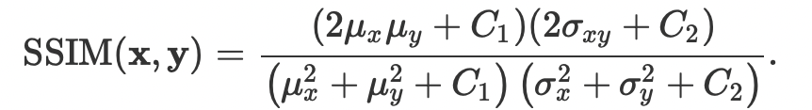
Are we using it correctly?
CROSS-CORRELATION
MEAN
VARIANCE
STABILIZING CONSTANTS
[1] Zhou Wang, A. C. Bovik, H. R. Sheikh and E. P. Simoncelli, "Image quality assessment: from error visibility to structural similarity," in IEEE Transactions on Image Processing, vol. 13, no. 4, pp. 600-612, April 2004, doi: 10.1109/TIP.2003.819861.
Notes:
Importance of L!!!!

Slide 6


Are we using it correctly?
CROSS-CORRELATION
MEAN
VARIANCE
K₁ = 0.01
K₂ = 0.03
L = DYNAMIC RANGE
[1] Zhou Wang, A. C. Bovik, H. R. Sheikh and E. P. Simoncelli, "Image quality assessment: from error visibility to structural similarity," in IEEE Transactions on Image Processing, vol. 13, no. 4, pp. 600-612, April 2004, doi: 10.1109/TIP.2003.819861.
Notes:
Importance of L!!!!

Slide 7
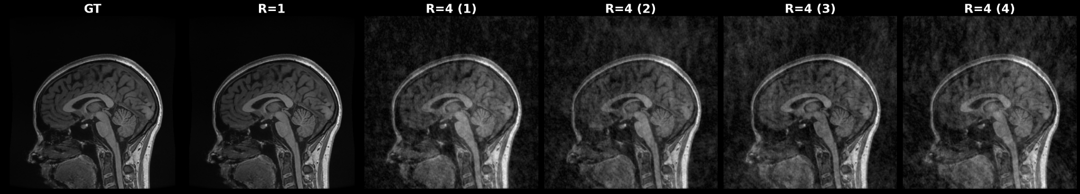
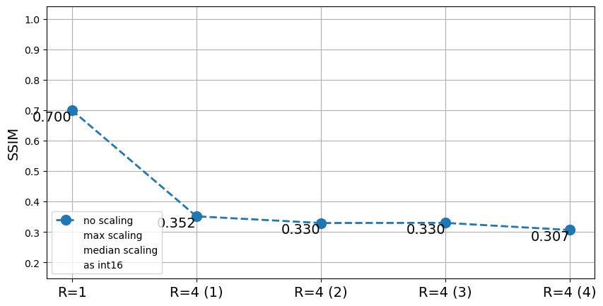
Are we using it correctly?
REFERENCE
“IMPERFECT RECONSTRUCTIONS”
R=1 + Noise R=4 + Noise R=4 + Noise R=4 + Noise R=4 + Noise

Slide 8
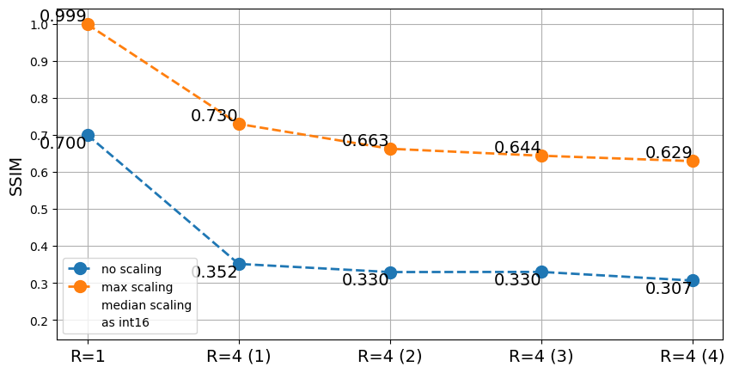
Are we using it correctly?
REFERENCE
“IMPERFECT RECONSTRUCTIONS”
R=1 + Noise R=4 + Noise R=4 + Noise R=4 + Noise R=4 + Noise

Slide 9
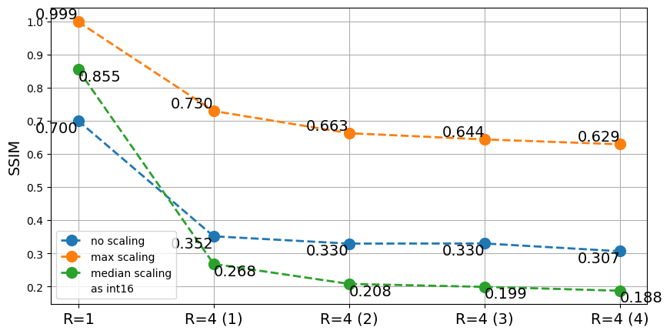
Are we using it correctly?
REFERENCE
“IMPERFECT RECONSTRUCTIONS”
R=1 + Noise R=4 + Noise R=4 + Noise R=4 + Noise R=4 + Noise

Slide 10
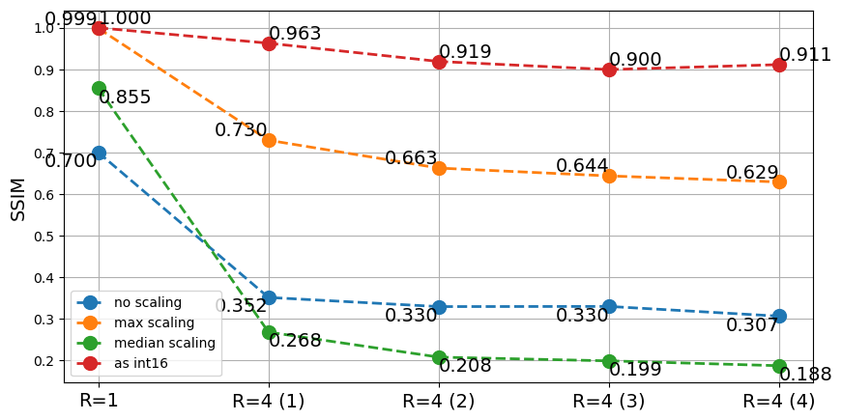
Are we using it correctly?
REFERENCE
“IMPERFECT RECONSTRUCTIONS”
R=1 + Noise R=4 + Noise R=4 + Noise R=4 + Noise R=4 + Noise

Slide 11
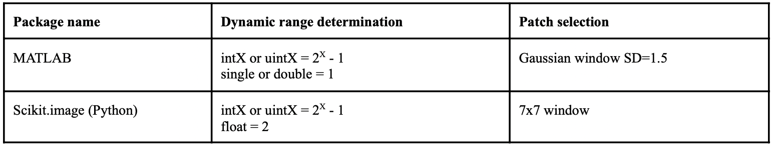
Are different implementations comparable?
(L)
Notes:
Python vs MATLAB

Slide 12
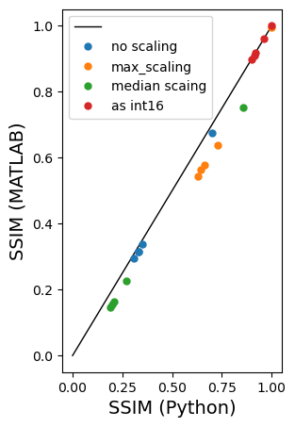
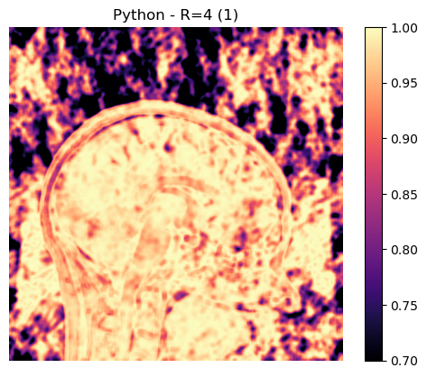

Are different implementations comparable?
SSIM = 0.911
SSIM = 0.908
Notes:
Python vs MATLAB

Slide 13
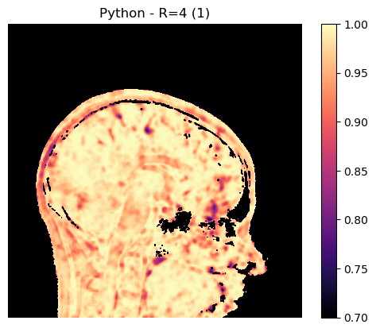

Are different implementations comparable?
SSIM = 0.986
SSIM = 0.986
Notes:
Python vs MATLAB

Slide 14
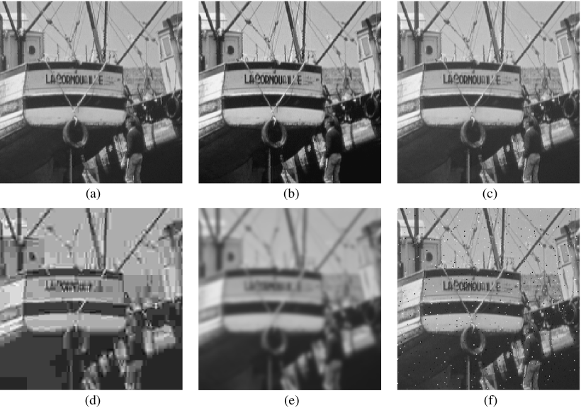
Is it fit for purpose?
Reference
Contrast shift
0.9168
Mean shift
0.9900
Developed and evaluated for non-medical images
Full field of view
Standardized dynamic range
The errors in this kind of data are different to what we encounter in MRI
Undersampling
Ghosting
Deep learning hallucinations
Local noise amplification (g-factor)
JPEG compression
0.6949
Blurring
0.7052
Salt+pepper noise
0.7748
MSE=210
Notes:
Background, resolution, scaling, ground truth

Slide 15
SSIM - Structural Similarity Index Measure
Are we using it correctly? - Data type and scaling
Are different implementations comparable? - No, unless careful
Is it fit for purpose? - Unknown
Notes:
Importance of L!!!!

Slide 16

SSIM - Structural Similarity Index Measure
Experiments for setting a standard
Join me!
https://github.com/SophieSchau/ssim_as_metric
Notes:
Importance of L!!!!

