Slide 1
Intellectual Property Concepts: New Changes in Patent Laws & Practical Reminders for Trademark and Copyright Law Robert Kain and Darren Spielman Kain Spielman, P.A. www.ComplexIP.com® ©Kain Spielman, P.A. 2015 ComplexIP.com® is a Registered Trademark of Kain Spielman, P.A.

Slide 2
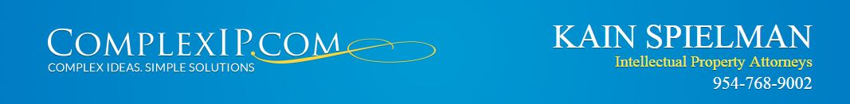
Patents
America Invents Act (AIA) (effective 2011)
The most significant change to U.S. Patent Act in Decades.

Slide 3
First Inventor to File
The First Person/Company to File an application in the USPTO wins, unless the earlier filed application is an invention derived from the later filed company.
Derivation Proceedings
A third party, who had access to your invention, filed a patent application before you filed.
What to do: File a derivation proceeding may invalidate the earlier filed patent as not being the “first to invent.”
Access to your invention may be a contract, an NDA, and employee, consultant or investor.

Slide 4
Change in the Process
Inventor’s Oath or Declaration
Can be late filed
Best Mode (best way to make and use invention)
No longer a basis for invalidity

Slide 5
Reaction to Patent Trolls - New Procedures for Defendants
Inter Parties Proceedings (IPRs): USPTO 2 Party litigation - challenge issued patents and invalidate with prior art
Post Grant Review (PGRs): USPTO 2 Party litigation - challenge issued patents within 9 months of issuance
Supplemental Examination (Reexams) - By Patent Owner or By Third Party
published prior art only, USPTO determines whether substantial new question of patentability (SNQP) (a substantial likelihood that a reasonable examiner would consider an item of information important in determining the patentability).
Third Party Filing - ONE SHOT.

Slide 6
Reaction to Patent Trolls (cont.)
Pre-issuance Proceedings - while patent application is pending
Submit published prior art to USPTO, recommend concise description of relevance
Time to file: within six (6) months of publication or before first Office Action rejection

Slide 7
Computer Software
June 2104 The U.S. Supreme Court issues a decision in the case Alice Corp. Pty. Ltd. v. CLS Bank Int'l, 573 U.S. __, 134 S. Ct. 2347, 2359 (2014).
Is It Possible to Patent after Alice Corp?
Views from the USPTO
Dec. 2014 : USPTO released Interim Guidance on Patent Subject Matter Eligibility

Slide 8
NOT Patent Eligible
Adding the words "apply it" (or an equivalent) with the judicial exception, or mere instructions to implement an abstract idea on a computer;
Example: step A and step B while “using a computer”
Simply appending well-understood, routine and conventional activities
Example “obtain data” or “adjust account”

Slide 9
NOT Patent Eligible (cont)
Adding insignificant extra solution activity to the judicial exception, e.g., mere data gathering in conjunction with a law of nature or abstract idea
Example: displaying the process result to the user
Generally linking the use of the step-wise program algorithm to a particular technological environment or field of use.
Example: “buy the specified commodity”

Slide 10
Patent Eligible
Alice Corp requires computer program claims to have something "significantly more" than the step-wise computer program algorithm.
Improvements to another technology or technical field; (e.g. changing gray scale on displays; opening a mold to make a product (3D printing))
Improvements to the functioning of the computer itself; (e.g. faster RAM)
Applying the judicial exception with, or by use of, a particular machine; (e.g. tracking satellites orbiting the Earth which required GPS transmitters/receivers)

Slide 11
Patent Eligible (cont)
Effecting a transformation or reduction of a particular article to a different state or thing (e.g., making 2 web pages while retaining Web site visitors from being diverted)
Adding a specific limitation other than what is well-understood, routine and conventional in the field, or adding unconventional steps that confine the claim to a particular useful application;
Other meaningful limitations beyond generally linking the use of the judicial exception to a particular technological environment.

Slide 12
Practical Reminders for Trademark and Copyright Law

Slide 13
Copyrights: General Background
Copyrights are regulated under Federal Law(17 U.S.C. § 101 et seq).
A copyright protects original works of authorship including literary works (including books), musical works, dramatic works, choreographic/theater works, pictorial, graphic and sculptural works, motion pictures and other audio visual works, sound recordings and architectural works.
You own the copyright as author or creator of the work copyright immediately upon creation, when the work is fixed in a form to be displayed to others.

Slide 14
Rights of Content Author
Transfer/Assignment/Sale (must be in writing)
Exclusive right of reproduction
Derivative works/Alter Original
Distribution
Display
License
Public Performance

Slide 15
Ownership/Work for hire
If your employee creates the “work” on behalf of the business, he/she is not the owner of the copyright.
Business owns the “work” unless you and that employee have agreed in a written document signed by both of you that employee owns it.
What kind of employee do you have, independent contractor (1099) or full time employee (W-2)?

Slide 16
Copyright Notice
The Copyright symbol “ ©” is not required.
Helpful if you want to litigate
Display the copyright symbol, date of creation, your name.
You don't have to be registered with the U.S. Copyright Office to use the copyright notice.

Slide 17
Does Your Copyright Expire?
Depends upon when it was created, but for Works created after January 1, 1978
Works are protected for the author’s lifetime plus 70 years after the authors death.
For works made for hire:
95 years from the first publication or
120 years from creation (whichever expires first)

Slide 18
Examples:
Computer Programs
Marketing Materials
Manuals
Drawings
Photographs
Webpages

Slide 19
Trademarks
Consumers Rule. Trademarks enable consumers to distinguish goods and services of one person or company from those of another. Consumers recognize trademarks as showing a common source or quality control over goods and services sold under the mark.
What functions as a trademark: anything that distinguishes your goods from the goods of others.

Slide 20
Categories of Trademarks
Arbitrary:
Preferred Trademark Type: It is inherently distinctive and serves entirely as an indication of a source of the product/service
Suggestive
Look to the association in the product or service’s field
Some marks may seem suggestive but are descriptive based on the context (E.g., if others use same term to describe products in the same field)
Descriptive
Only becomes a trademark if it is source indicator
Must establish secondary meaning through use
Secondary meaning = not just what the product is but its source must become primary to the public
Generic
Generic marks have no trademark protection and can start out as generic or even transform to generic over time

Slide 21
Categories of Trademarks
Arbitrary
Suggestive
Descriptive
Generic

Slide 22



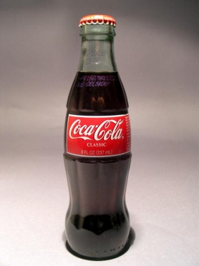


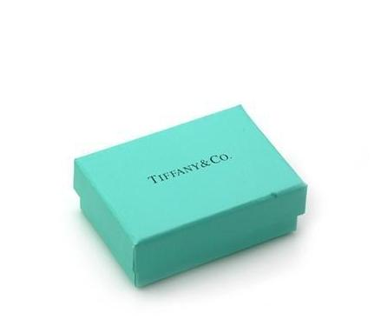
Types of trademarks
Words, phrases designs or logos
Shapes
Sounds
Colors
Service marks

Slide 23
Trademark Registration
Federal trademark registration with the USPTO (U.S. Patent and Trademark Office)
Lanham Act (15 USC § 1051 et seq.)
Nationwide coverage
Florida State Trademark Registration
Handled by the Secretary of State
Simple an fast process
Coverage is for Florida only (or more limiting if you only provide that good or service in a singular geographic area)

Slide 24
Trademark Registration
Nationwide protection from filing date (stronger than common law rights)
Owner has a presumption of validity
Listed on the USPTO database
Constructive use nationwide / constructive notice to others
Incontestable mark after 5 years (limits alleged infringer’s defense that mark is not distinctive)
Ability to bar infringing imports by U.S. Customs & Border Patrol
Protection against counterfeiting
Use of the ® symbol (can use “TM” otherwise)
Lanham Act – federal court jurisdiction and structured, predictable enforcement mechanism
Damages include award of attorney fees and possible treble damages available

Slide 25
Trademark Pitfalls
Failure to do your due diligence before selecting and adopting a new trademark
DO A TRADEMARK SEARCH!
Sunbiz.org (corporate name)
Corporate name registration provides NO protection for the use of the name in commerce
Domain name purchase
Domain name registration provides NO protection for the use of the name in other contexts
Using the cheap alternative for registration

Slide 26
Open Discussion & Questions
For more information you can contact us: Robert Kain, Esq. (Rkain@ComplexIP.com)
Darren Spielman, Esq. (Dspielman@ComplexIP.com)
Kain Spielman, P.A. 900 S.E. 3rd Ave., Suite 205 Ft. Lauderdale, FL 33316 954-768-9002 954-768-0158 (fax) www.ComplexIP.com

