Slide 1


Sponsored Programs Administration Resource & Knowledge Series
AWARD CLOSE-OUT
Presented by:
Justo Torres, Laurianne Torres

Slide 2
General Business
TEAM PROJECTS
August 24th
Contact your mentor if you have questions or need guidance:
Nancy Nisbett Justo Torres
407.882.2223 phone 407-882-1131 phone
nancy.nisbett@ucf.edu justo.torres@ucf.edu
Svetlana Shtrom Laurianne Torres
407-823-5150 phone 407-882-0113 phone
svetlana.shtrom@ucf.edu laurianne.torres@ucf.edu
AWARD CLOSE-OUT

Slide 3
General Business
CERTIFICATE CEREMONY
August 31
AWARD CLOSE-OUT

Slide 4
Exploring Research Administration from Concept to Commercialization
CLOSE-OUT OVERVIEW
OMB A-110
OMB A-133
Reporting Responsibilities
Award Document Cues
Laurianne Torres

Slide 5
CLOSE-OUT OVERVIEW
Close-out Requirements
(as defined by OMB A-110, Section D)
All reports due within 90 days of project end
D.71.(a) says that sponsor may approve extension
All obligations liquidated within 90 days of project end
Sponsor will make prompt payments
Recipient will promptly refund unobligated cash
OMB A-129 governs delinquent debts
Sponsor shall make upward/downward adjustments after close-out docs are received
Recipient shall account for real and personal property
Sponsor may recover unallowable costs after an audit
AWARD CLOSE-OUT

Slide 6
CLOSE-OUT OVERVIEW
Audit Requirements
(as defined by OMB A-133)
Non-federal entities that expend >$500,000 require audit
Required to be performed annually
Must account for all Federal awards received and expended
Maintain internal control over Federal awards
Comply with laws, regulations, provisions
Prepare appropriate financial statements
Follow up and take corrective action
Summary schedule of prior audit findings (C.315(b))
Corrective action plan (C.315(c))
AWARD CLOSE-OUT

Slide 7
CLOSE-OUT OVERVIEW
Reporting Responsibilities
Technical
(PI)
Administrative
(ORC)
Financial
(F&A, ORC)
AWARD CLOSE-OUT

Slide 8
CLOSE-OUT OVERVIEW
Award Document Cues
Consistency is key.
FFP with final invoice to include detailed costs
FFP with residual balances to be returned to sponsor
Federal flow-thru subcontract w/ for-profit flow-downs
Accepting outdated FAR clauses
Poorly-defined SOWs and deliverables
AWARD CLOSE-OUT

Slide 9

THINK ABOUT IT…
True or False?
A No Cost Extension may be requested
to allow time to close-out a project.
AWARD CLOSE-OUT

Slide 10
THINK ABOUT IT…
Recipients of Federal awards shall have
a period of _____ days to closeout an award.
a. 90 calendar days after completion of the award as specified in OMB A-21.
b. 90 business days after completion of the award as specified in OMB A-110.
c. 90 calendar days after completion of the award as specified in OMB A-110.
d. It depends on each institution’s business processes.
AWARD CLOSE-OUT

Slide 11
Exploring Research Administration from Concept to Commercialization
PRE-CLOSEOUT CONSIDERATIONS
No Cost Extensions
Reporting Requirements
Invoice & Payment
Budget & Cost Transfers
Expenditure Review
Obligations
Justo Torres

Slide 12
THINK ABOUT IT…
A No Cost Extension may be requested for the following reasons:
a. To allow for additional time to complete technical or programmatic work.
b. To allow time to complete the closeout process.
c. To allow for the expenditure of remaining balances.
AWARD CLOSE-OUT

Slide 13
PRE-CLOSEOUT CONSIDERATIONS
90 Days before a project ends
Technical Reports and Deliverables
Expenditure and Revenue
Invoicing
Equipment Vesting
Plans for Personnel
Equipment Vesting
To Extend or Not to Extend…
Other Recurring Charges
THINGS TO REVIEW
AWARD CLOSE-OUT

Slide 14
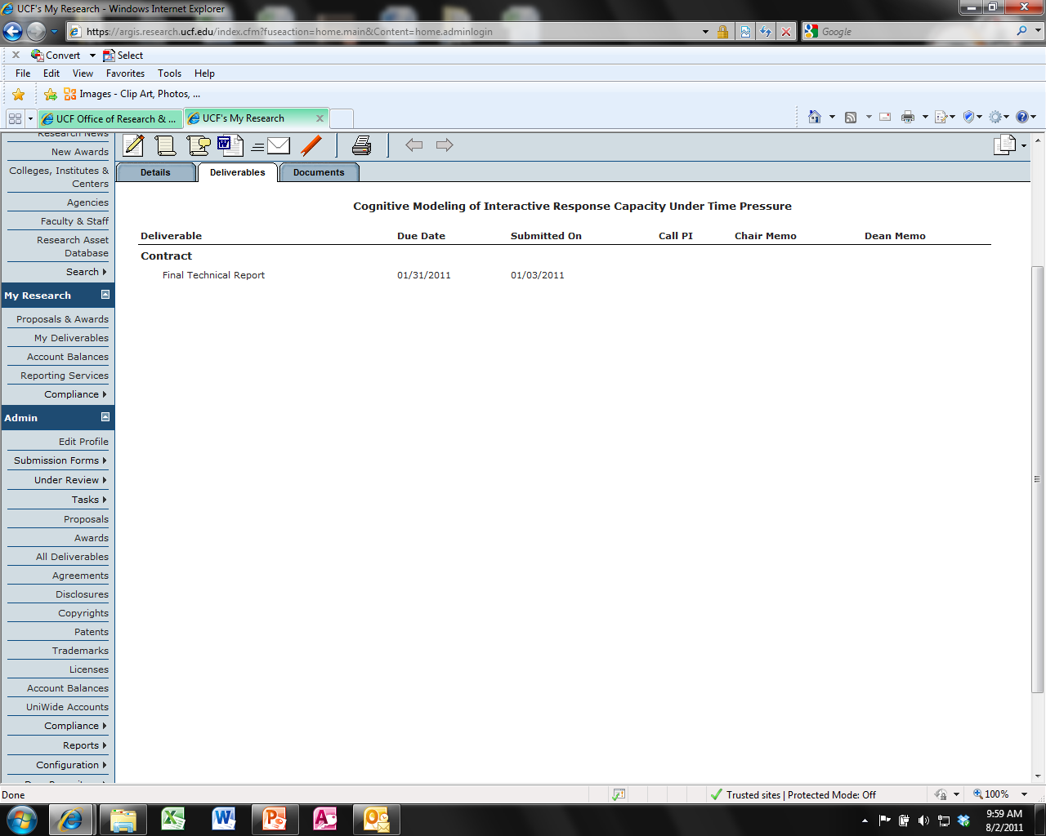
PRE-CLOSEOUT CONSIDERATIONS
Reporting Requirements – What does ARGIS say?
AWARD CLOSE-OUT

Slide 15
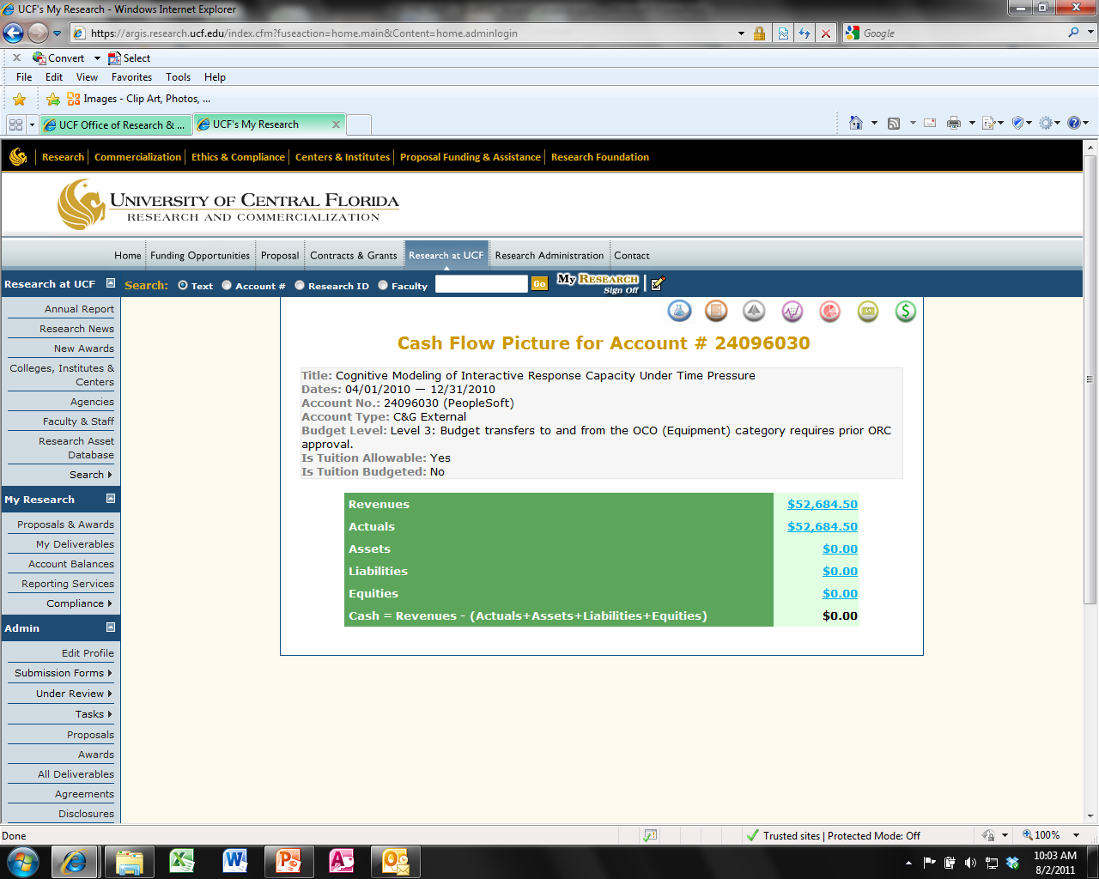
PRE-CLOSEOUT CONSIDERATIONS
Invoice and Payment
AWARD CLOSE-OUT

Slide 16

PRE-CLOSEOUT CONSIDERATIONS
Expenditure Review
Expenditures should be monitored at all times, but…
Corrections or adjustments may be required
Are All Costs Reasonable, Allowable, Allocable, and Appropriate?
Is the Project Over or Under Spent?
Are There any Costs That Do Not Belong?
Do I have More or Less Revenue than Expected?
AWARD CLOSE-OUT

Slide 17
PRE-CLOSEOUT CONSIDERATIONS
Budget Transfers
Moving available budget from one line item to another within one project account.
AWARD CLOSE-OUT

Slide 18
PRE-CLOSEOUT CONSIDERATIONS
Cost Transfers
Moving expenditures off of one project onto another.
Project A
Project B
AWARD CLOSE-OUT

Slide 19



PRE-CLOSEOUT CONSIDERATIONS
Outstanding Obligations
Actually put that plan into effect
Every Time your phone rings, think about the projects that are ending
Speaking of the phone…are the callers asking about the status of their payment?
Cost Share…You were serious about that?
Did I ever get reimbursed for that trip?
Time to Be Done
Develop a Transfer plan for Project personnel
AWARD CLOSE-OUT

Slide 20
PRE-CLOSEOUT CONSIDERATIONS
To extend or Not to extend…
Deliverables missing
Additional data needed
Additional Time needed for final technical report
Subcontractor requesting additional time
REQUEST/NOTIFY NO-COST EXTENSION
Deliverables complete
Subcontractor’s work is complete
Final technical report in process for completion
Balance Remains
PROCEED TO CLOSEOUT
AWARD CLOSE-OUT

Slide 21
PRE-CLOSEOUT CONSIDERATIONS
No Cost Extensions
Check w/ PI if more time is needed to complete project work
If more time is needed, request a NCE from sponsor
(the sooner the better, not once the award has expired!)
NCE should be same form and format as original award
For NSF-funded projects:
Grantees may authorize a one-time extension up to 12 months
Must notify NSF within 10 days of award end date
AWARD CLOSE-OUT

Slide 22
Exploring Research Administration from Concept to Commercialization
CLOSE-OUT PROCESS
Financial
Technical
Administrative
Subcontract Close-Out
Justo Torres

Slide 23
THINK ABOUT IT…
Proper closeout procedures include all of the following, except:
a. Transfer of project personnel, payment or release of all encumbrances, and transfer or return of equipment.
b. Spending of all remaining balances.
c. Completion of all technical, administrative and financial reports due.
d. Inactivation of the project ID in PeopleSoft.
AWARD CLOSE-OUT

Slide 24
THINK ABOUT IT…
True or False?
Only costs that are posted to an account before the
project end date may be considered allowable by an auditor.
AWARD CLOSE-OUT

Slide 25
CLOSE-OUT PROCESS
Financial
Some questions to consider:
Are all costs booked to this project and are they appropriate?
Have all recurring costs been cancelled?
Has all F&A been allocated?
Have all costs been invoiced?
Has all revenue been received?
Was all cost share met?
AWARD CLOSE-OUT

Slide 26

CLOSE-OUT PROCESS
Financial Review and Certification
Ensure that all costs are booked, allowable, allocable, consistent, and reasonable
Ensure that all recurring charges have been cancelled and all obligations paid
Final Invoice
SF 269/272
Contractor’s Release
All Costs are invoiced
Reconcile cash and expenditures
Certification to release sponsor from further financial obligation
Rebates & Incentives
Assign any rebate to sponsor
AWARD CLOSE-OUT

Slide 27
CLOSE-OUT PROCESS
Technical
Some questions to consider:
Disposal of Sensitive Data and/or Equipment
Technology Control Plan
Are all deliverables submitted and accepted
Is the final technical report submitted or in the process of being submitted
AWARD CLOSE-OUT

Slide 28
CLOSE-OUT PROCESS
Technical Review and Certification
Ensures that all technical work has been performed as specified in the award document and is acceptable to the sponsor
Final Report
SF 298
DD 254
Reports all technical accomplishments
Certification that final technical report is submitted
Certification of disposition of classified information
DD 882
Certification of Invention
AWARD CLOSE-OUT

Slide 29
CLOSE-OUT PROCESS
Administrative
Some questions to consider:
Was equipment purchased on the project?
Where is the equipment?
What is the condition and value of the equipment?
Who owns the equipment?
If not UCF, do we want it?
AWARD CLOSE-OUT

Slide 30
CLOSE-OUT PROCESS
Administrative Review and Certification
Ensures that all Government-Furnished Property (GFP) or Contractor-Acquired property is properly managed
Final Inventory
Property Self Assessment
DD 1662/NASA 1018
PeopleSoft query to investigate purchased and tagged equipment
Annual self-assessment of property management
Certification status and vesting of property
AWARD CLOSE-OUT

Slide 31
CLOSE-OUT PROCESS
Subcontract Close-out
When subcontracting, it is our responsibility to require any subcontractors to report in the same manner and fashion as is required of us
Build timetable for subcontractors’ reports that allows for timely submission to the prime
Method of payment should be appropriate to monitor restrictions flowed down from prime
AWARD CLOSE-OUT

Slide 32
Exploring Research Administration from Concept to Commercialization
BALANCE ACCOUNTS
Cost Reimbursable vs. Fixed Price
Refunds
Service Fees
F&A Costs
Laurianne Torres

Slide 33
THINK ABOUT IT…
What happens to a residual balance at project close-out?
AWARD CLOSE-OUT

Slide 34

BALANCE ACCOUNTS vs. REFUND?
Cost Reimbursable
Fixed Price
Methods of Payment
defined in contract
AWARD CLOSE-OUT

Slide 35
BALANCE ACCOUNTS
Fixed-Price contract or grant
Cost-Reimbursable contract or grant
Fixed-Price project with cash deficit
Greater than 20% remaining cash balance (10% if federal) without justification
Service-fee project
Less than 20% cash balance remains (10% if federal)
F&A budget has been maximized
Remaining cash will be used to support research
AWARD CLOSE-OUT

Slide 36
REFUNDS
Should be the exception, not the norm
Only apply to cost-reimbursable contracts or grants when:
Cash has been drawn or invoiced without actual cost basis
Costs have been transferred off the project after being invoiced and paid
Advanced payment has been made, but not utilized
Cost has been deemed unallowable
AWARD CLOSE-OUT

Slide 37
Exploring Research Administration from Concept to Commercialization
WHAT CLOSE-OUT DOESN’T DO
Laurianne Torres

Slide 38
WHAT CLOSE-OUT DOESN’T DO
The close-out of an award does not affect:
Sponsor’s right to disallow/recover costs from later audit
Recipient’s obligation to return any funds due as a result of later refunds, corrections, etc.
Audit requirements
Property management requirements
Record Retention
AWARD CLOSE-OUT

Slide 39
Exploring Research Administration from Concept to Commercialization
AUDIT
OMB A-133
Record Retention
Justo Torres

Slide 40
AUDIT
Who conducts the A-133 audit?
How long does it take?
What projects are audited?
When does the audit take place?
Auditor General of the State of Florida
Process usually takes 5-8 months
All Federally-funded R&D projects active during audit year, sampling 3-5 representative projects (each valued over $300k)
Early as February, but typically July to December
AWARD CLOSE-OUT

Slide 41
THINK ABOUT IT…
Regulations require that documentation of expenditures
be kept for how long?
a. Varies with funding source.
b. 3 years after the end of the award period.
c. 5 years after the end of the award period.
d. 7 years after the end of the award period.
AWARD CLOSE-OUT

Slide 42
AUDIT
Record Retention
Must be retained for a period of 3 years, with some exception:
Litigation requires retention until all matters are resolved
Equipment records retained 3 years after disposition
Unless/until records are transferred to sponsor
AWARD CLOSE-OUT

Slide 43

QUESTIONS or COMMENTS?

Slide 44
THANKS FOR JOINING US!
Please come to the next session:
COMMERCIALIZATION
August 17, 2011
10:00 am to 12:00 pm
Sponsored Programs Administration Resource & Knowledge Series

