Slide 1


Sponsored Programs Administration Resource & Knowledge Series
AWARD MANAGEMENT
PART I
Presented by:
Justo Torres, Laurianne Torres, Terri Vallery

Slide 2
General Business
Can we use the UCF logo in our email signature line?
Jane Doe
Office of Research & Commercialization
12201 Research Parkway, Suite 501
Orlando, FL 32828
407-823-1234 phone
407-823-5678 fax
Go Knights!
Yes, but only if we do it correctly!
Go to http://umark.ucf.edu/images/pdf/Graphic_Standards81507.pdf and see the top of page 8.
AWARD MANAGEMENT – PART I

Slide 3
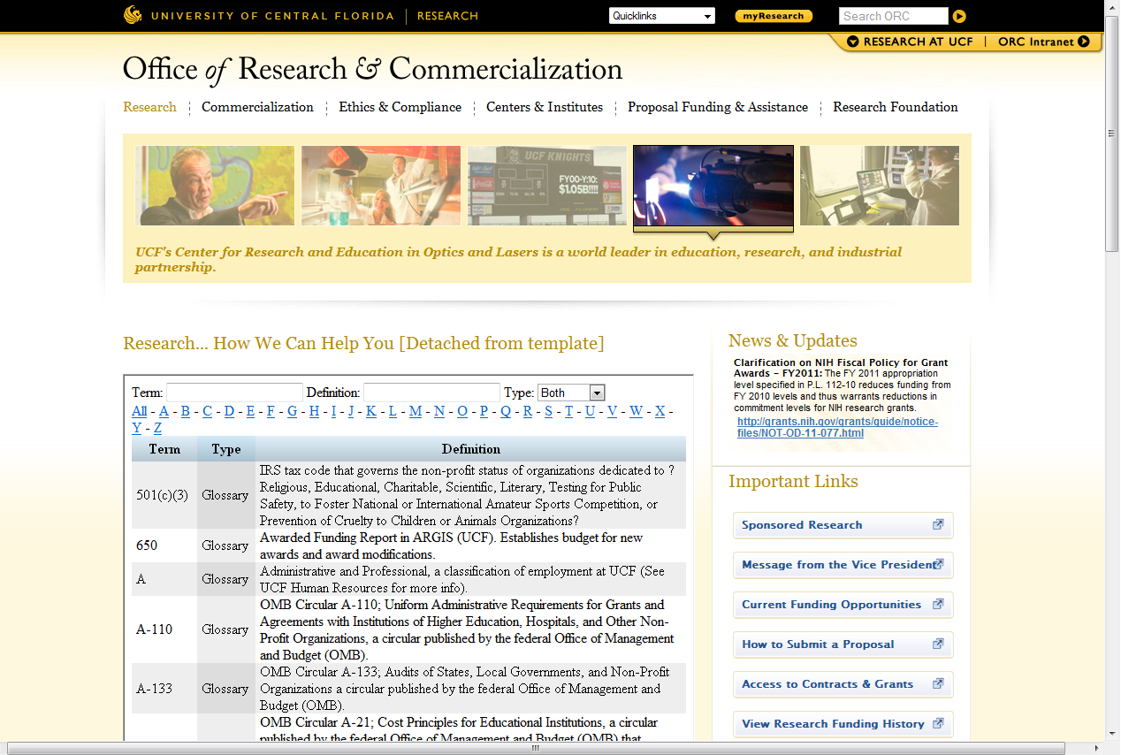
General Business
Glossary of Research Terms coming soon!
http://www.research.ucf.edu/research.glossary.html
AWARD MANAGEMENT – PART I

Slide 4
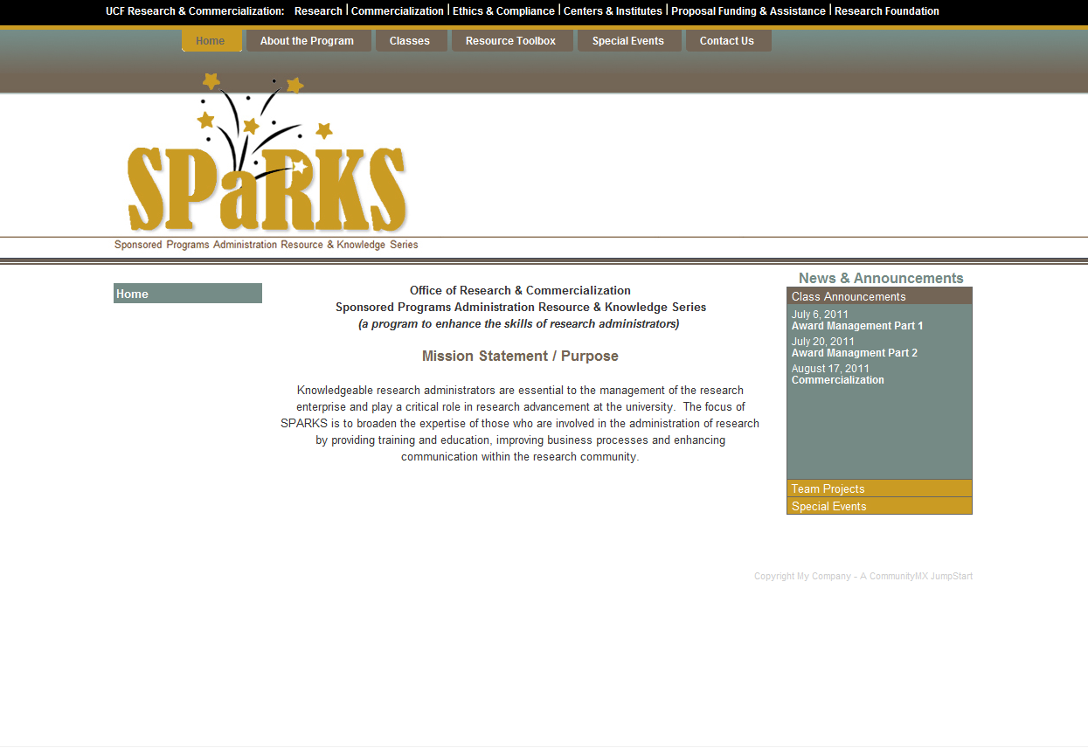
General Business
SPaRKS website now live!
www.sparks.research.ucf.edu
AWARD MANAGEMENT – PART I

Slide 5
General Business
Interested in Certification?
Want to Be a Certified Research Administrator?
http://www.cra-cert.org/
Email Doshie Walker to let her know that you are interested in a CRA REVIEW SESSION!
AWARD MANAGEMENT – PART I

Slide 6
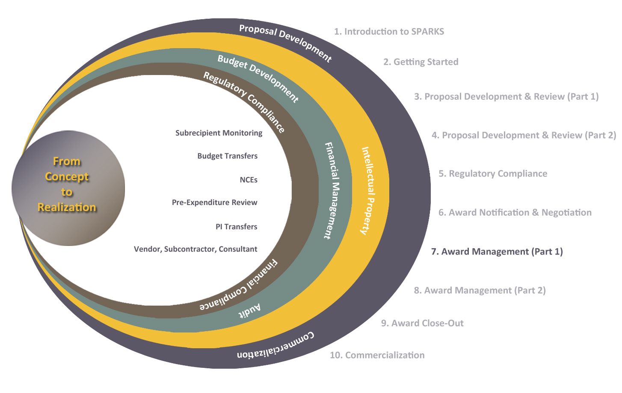
Exploring Research Administration from Concept to Commercialization

Slide 7
Exploring Research Administration from Concept to Commercialization
AWARD ACCEPTANCE
What is considered acceptance?
Laurianne Torres

Slide 8
AWARD ACCEPTANCE
What does “acceptance” mean?
Depending on award type, acceptance means:
Fully-executed two-party agreement
Unilateral award from sponsor
Commencing work or acknowledging receipt of T&Cs
Requires certain documents on file (at a minimum):
SOW
Budget
PTF (prior to account establishment)
AWARD MANAGEMENT – PART I

Slide 9
Exploring Research Administration from Concept to Commercialization
AWARD ESTABLISHMENT
Award Types
Pre-Award Costs & Advance Set-up
Award Actions
Account Types
Setting up Budget
Notifying the PI
Other Considerations
Justo Torres, Terri Vallery

Slide 10

THINK ABOUT IT…
Which of the following describes a fixed-price agreement?
a. Prevents cost overruns.
b. Is usually riskier than a cost-reimbursable agreement.
c. Requires financial reporting to the sponsor.
d. Has a longer project period than a cost-reimbursable agreement.
AWARD NOTIFICATION & NEGOTIATION

Slide 11
AWARD ESTABLISHMENT
Award Types
Fixed
Cost Reimbursable
Time & Materials
AWARD MANAGEMENT – PART I

Slide 12
AWARD ESTABLISHMENT
Pre-Award Costs / Advance Set-up
Typically no more than 90 days prior to start date
At the risk of the recipient
Does not obligate sponsor to fund more than award amount
AWARD MANAGEMENT – PART I

Slide 13
THINK ABOUT IT…
True or False?
With incremental funding,
spending limits can NEVER be exceeded.
AWARD NOTIFICATION & NEGOTIATION

Slide 14
AWARD ESTABLISHMENT
Award Actions
New Award/Competing Award | New research project funded competitively for the first time
Continuation/Non-competing Award | Incremental funding of a previously approved project
Renewal/Competing Continuation | Continuing project funded competitively for a new project period
Supplemental Award | Additional funding provided during a previously-approved budget period (ex. REU supplement to a NSF award)
Modification/Amendment | Budget modification, change in SOW or research plan, change of project personnel or level of effort, administrative changes, termination
AWARD MANAGEMENT – PART I

Slide 15
AWARD ESTABLISHMENT
Education & General (E&G)
Contracts & Grants (C&G)
UCF or RF
Auxiliary
Research Foundation
Account Types
AWARD MANAGEMENT – PART I

Slide 16
AWARD ESTABLISHMENT
Setting up the Budget
PI Spending Authority
University Recovery
Direct Costs
Cost Share
F&A Costs
AWARD MANAGEMENT – PART I

Slide 17
AWARD ESTABLISHMENT
Budget Levels
Level 1 (least restrictive) | All direct costs rolled up into Salary F&A
Level 2 | Salary (with OPS rolled up) Equipment Remaining Direct F&A
Level 3 | Salary Other Personnel Services (OPS) Expenses Equipment F&A
Level 4 (most restrictive) | All direct costs broken out by category F&A
AWARD MANAGEMENT – PART I

Slide 18
AWARD ESTABLISHMENT
Notifying the PI
Spending Authority
Direct Costs
Cost Share
Terms & Conditions related to the technical effort
Reporting Requirements
AWARD MANAGEMENT – PART I

Slide 19
AWARD ESTABLISHMENT
When there are Other Considerations
PTF outlines other issues that may need to be addressed:
Conflict of Interest
Research Misconduct
Human Subjects Protection
Animal Subjects Protection
Hazardous Materials
Responsible Conduct in Research
Export Control
AWARD MANAGEMENT – PART I

Slide 20
Exploring Research Administration from Concept to Commercialization
AWARD MANAGEMENT
Pre-Expenditure Review
Project Deliverables/Reporting
Subrecipients & Subrecipient Monitoring
Budget Transfers
Cost Transfers
No Cost Extensions
Termination
FDP & Expanded Authority
PI Relocation
Justo Torres, Terri Vallery

Slide 21
AWARD MANAGEMENT
Pre-Expenditure Review
Certain research expenditures require ORC review/approval:
Equipment
Travel
All foreign travel
All domestic travel >$2,000
Services > $1,000
AWARD MANAGEMENT – PART I

Slide 22
AWARD MANAGEMENT
Project Reporting / Deliverables
Failure to deliver may lead to non-payment and project termination, leading to revenue deficits and other losses.
Technical
Administrative
Financial
AWARD MANAGEMENT – PART I

Slide 23
AWARD MANAGEMENT
Subrecipients & Subrecipient Monitoring
Prime is responsible for conduct and completion of project
Progress reports & invoices should be reviewed and approved by PI
Issue award funding in increments (e.g., yearly basis) to provide a check/balance opportunity to review progress/performance, discuss issues, review expenditures
F&A is charged on first $25K only (for awards calculated using MTDC); monitor to ensure this is charged correctly
AWARD MANAGEMENT – PART I

Slide 24
AWARD MANAGEMENT
Subrecipients & Subrecipient Monitoring
Some things to consider:
Consider ending subawards early in the final year to assure sub has ample time for their close-out, and UCF also has at least 90 days to close-out
Consider modifying flowed-down award terms and reducing sub close-out period to 45 or 60 days, rather than the standard 90 days
AWARD MANAGEMENT – PART I

Slide 25
THINK ABOUT IT…
An investigator on an NSF grant has permission to rebudget $150,000 in renovation budget into equipment. If the institution’s F&A rate is 54%, how much money will be available for the equipment?
a. $69,000
b. $81,000
c. $97,403
d. $150,000
AWARD NOTIFICATION & NEGOTIATION

Slide 26
AWARD MANAGEMENT
Budget Transfers
Moving available budget from one line item to another within one project account.
AWARD MANAGEMENT – PART I

Slide 27
AWARD MANAGEMENT
Budget Transfers
Adequate budget must be available in the affected categories.
Request must come from PI/other authorized individual on DAL.
Consider any sponsor restrictions
Ex. % of total that may be transferred without sponsor approval
AWARD MANAGEMENT – PART I

Slide 28
AWARD MANAGEMENT
Budget Transfers
Examples of Inappropriate Requests
To reflect spending pattern
To clear a deficit or use remaining funds
For expenditures otherwise unallowable
AWARD MANAGEMENT – PART I

Slide 29
AWARD MANAGEMENT
Budget Transfers
Examples of Appropriate Requests
To adjust for minor changes related to labor costs
Ex. Budget in Salary moved to OPS for additional grad students
To purchase previously unbudgeted piece of equipment (with sponsor approval)
To accommodate approved changes in SOW
AWARD MANAGEMENT – PART I

Slide 30
AWARD MANAGEMENT
Budget Transfers
Typically Budget Transfers:
Will not change the scope of the work
May be the answer to correct an error
Are meant to meet the aims of the grant
AWARD MANAGEMENT – PART I

Slide 31
AWARD MANAGEMENT
Cost Transfers
Moving expenditures off of one project onto another.
Project A
Project B
AWARD MANAGEMENT – PART I

Slide 32
AWARD MANAGEMENT
Cost Transfers
Questions to Consider:
Did the expense benefit the award?
Was the expense incurred during the project or budget period of the award?
Should the expense be allocated between sources?
Is the expense allowable according to sponsor guidelines?
Is there an inordinate amount of cost transfers being placed on or removed from the project?
Are we at the end of the project period?
AWARD MANAGEMENT – PART I

Slide 33
AWARD MANAGEMENT
Cost Transfers
What are auditors looking for?
Length of time between original expense posting and transfer
Processing cost transfer after grant has ended
Transferring from an over spent project to another
Transfers of partial amount
Burden of proof, in case of audit, is on UCF not auditor
AWARD MANAGEMENT – PART I

Slide 34
AWARD MANAGEMENT
Cost Transfers
Examples of Inappropriate Cost Transfer requests:
To clear a deficit
Error made; no other information
To utilize available funding
For convenience
AWARD MANAGEMENT – PART I

Slide 35
AWARD MANAGEMENT
Cost Transfers
Examples of Appropriate Cost Transfer requests:
Error correction
Continuation costs
Cost transfers between tasks of the same sponsored project
Costs benefitting more than one project
Costs transferred in anticipation of a cost overrun
Disallowed costs
Reallocation of salary to reflect actual effort
AWARD MANAGEMENT – PART I

Slide 36
THINK ABOUT IT…
A No Cost Extension may be requested for the following reasons:
a. To allow for additional time to complete technical or programmatic work.
b. To allow for additional time to complete the close-out process.
c. To allow for the expenditure of remaining balances.
d. All of the above.
AWARD NOTIFICATION & NEGOTIATION

Slide 37
AWARD MANAGEMENT
No Cost Extensions
Additional time (not funds) for completion of approved SOW
No Cost Extensions may not:
Be requested for the purpose of using unobligated funds
Propose any new activities
AWARD MANAGEMENT – PART I

Slide 38
AWARD MANAGEMENT
Termination
Mutual vs. Unilateral
Cause vs. Convenience
All work must cease.
Obligations that can be canceled, must be canceled.
Those that can’t, should be honored and reimbursed.
A stop work order (not termination) on a fixed price agreement typically changes the payment methodology to cost-reimbursable.
AWARD MANAGEMENT – PART I

Slide 39
AWARD MANAGEMENT
PI Relocation
Award staying with UCF?
Seek agency approval for change of PI.
Will we subcontract the former PI at their new institution?
Award transferring to PI’s new institution?
Will equipment remain at UCF or transfer as well?
Will UCF be subcontracted?
Has UCF posted, invoiced, and been paid for all final costs?
What amount are we relinquishing?
AWARD MANAGEMENT – PART I

Slide 40
AWARD MANAGEMENT
Federal Demonstration Partnership & Expanded Authority
What is the Federal Demonstration Partnership (FDP)?
A cooperative initiative among 10 Federal agencies and 120 institutional recipients of federal funds working together to streamline research administration processes
4 types of membership:
Research Institution
Emerging Research Institution
Federal Agencies
Affiliate Organization
AWARD MANAGEMENT – PART I

Slide 41
AWARD MANAGEMENT
Federal Demonstration Partnership & Expanded Authority
Work in phases every 4 years (currently in Phase V) working off of a 4-year strategic plan.
Current initiative based mostly on the Faculty Administrative Burden Survey.
Created a standard FDP Subaward for ease in subcontracting among FDP organizations.
AWARD MANAGEMENT – PART I

Slide 42
AWARD MANAGEMENT
Federal Demonstration Partnership & Expanded Authority
Most notable accomplishment = Expanded Authority
Participating Federal agencies have a matrix list of expanded authority permissions
ex. 90-day pre-award, one-year NCEs
AWARD MANAGEMENT – PART I

Slide 43

QUESTIONS or COMMENTS?

Slide 44
THANKS FOR JOINING US!
Please come to the next session:
AWARD MANAGEMENT (PART II)
July 20, 2011
10:00 am to 12:00 pm
Sponsored Programs Administration Resource & Knowledge Series

